Slide 1

MDR & XDR TB AND ANTILEPROTIC DRUGS
DR SAMPRADA TANK (AP)
PHARMACOLOGY DEPARTMENT
SBKS MI & RC

Slide 2
Definitions
1. Drug-sensitive TB: - susceptible to all 5 first line anti-TB drugs (ATDs).
2. Multidrug resistant TB (MDR-TB): - resistant to both R and H with or without resistance to any number of other 1st line drugs.
3. Rifampin resistant TB (RR-TB):-resistant to R but not to H, with or assessed by without resistance to other ATDs. These patients are to be treated as if they have MDR-TB.
4. Mono-resistant TB: - resistant to one 1st line ATD, but not R-resistant.
5. Poly-drug resistant TB (PDR-TB):- resistant to more than one 1st line ATD, except both R and H resistance
6. Extensive drug resistant TB (XDR-TB):- A MDR-TB case whose bacilli are additionally resistant to a FQ and one 2nd line injectable ATD.

Slide 3
Goal of TB treatment
Render patient non-infectious, break the chain of transmission and decrease pool of infection
Decrease TB deaths and related comorbidity by ensuring relapse free cure
Minimize & prevent development and amplification of drug resistance

Slide 4
Grouping* of anti-TB drugs and other consideration
Groups & steps | Medicine | Abbreviation
Group A Include all three medicines | Levofloxacin or Moxifloxacin | Lfx Mfx
 | Bedaquiline | Bdq
 | Linezolid | Lzd
Group B Add one or both medicines | Clofazimine | Cfz
 | Cycloserine or Terizidone | Cs Trd
Group C Add to complete the regimen and when medicines from Group A and B cannot be used | Ethambutol | E
 | Delamanid | Dlm
 | Pyrazinamide | Z
 | Imipenem-cilastatin or Meropenem | Ipm-Cln Mpm
 | Amikacin (OR Streptomycin) | Am (S)
 | Ethionamide or Prothionamide | Eto Pto
 | p-aminosalicylic acid | PAS
Drugs not included in Groups A–C
Kanamycin and Capreomycin:
  Associated with poorer outcomes
  No longer recommended for use in MDR-TB regimens.
Gatifloxacin
  Non availability of quality-assured preparations due to concern about dysglycaemias.
Thioacetazone
  Not available in a quality-assured formulation.
Clavulanic acid
  Only a companion agent to the carbapenems (Imp-Cln and Mpm)
  Not to be counted as an effective TB agent
* Reference: WHO Consolidated Guidelines for TB module 4: Treatment of DR-TB 2020
Annexure 11: evidences on efficacy and safety of the second-line anti-TB drugs

Slide 5
Newer drugs
Bedaquiline
Delamanid
Diarylquinoline that specifically targets mycobacterial ATP synthase, an enzyme which supplies energy to M.tb
Strong bactericidal and sterilizing activities
Extensive tissue distribution, highly bound to plasma proteins and is hepatically metabolized.
Extended half-life of up to 5.5 months
Significantly improves time to culture conversion in MDR-TB patients
First approved drug in the class of nitro-dihydro-imidazo-oxazoles for the treatment of MDR-TB.
Bactericidal drug with 36 hours of half-life
Act with two different mechanisms
  It blocks the synthesis of mycolic acids
  Poison the bacilli with nitric oxide
As per WHO recommendation, the risk-benefit considerations for the use of Bdq in patients aged 6–17 years and Dlm in patients aged 3–5 years are similar to those considered for adults.

Slide 6
Shorter oral Bedaquiline- containing MDR/RR-TB regimen
Transitioning from the current shorter injectable containing MDR/RR-TB regimen to the shorter oral Bedaquiline-containing MDR/RR-TB regimen in patients >5 years of age weighing 15kg or more in a phased manner starting with selected states to gain programmatic experience to guide future expansion within 2021

Slide 7
Eligibility – inclusion criteria
1. DST based inclusion criteria
2. Other inclusion criteria
Rifampicin resistance detected/inferred
MDR/RR-TB with H resistance detected/inferred based on InhA mutation only or based on KatG mutation only (not both)
MDR/RR-TB with FQ resistance not detected
Children, aged 5 years to less than 18 years of age and weighing at least 15 kg, given their special needs, in consultation with the pediatrician
No history of exposure to previous treatment with second-line medicines in the regimen (Bdq, Lfx, Eto or Cfz) for more than 1 month (unless susceptibility to these medicines is confirmed)
No extensive TB disease
No severe extra-pulmonary TB
Women who are not pregnant or lactating.

Slide 8
Regimen and duration
(4-6) Bdq _{(6 m),} Lfx, Cfz, Z, E, H^{h}, Eto
(5) Lfx, Cfz, Z, E
Points to note
From start to end of 4 months: Bdq, Lfx, Cfz, Z, E, H^{h}, Eto
From start of 5 months to end of 6 months(If IP not extended): Bdq, Lfx, Cfz, Z, E
From start of 7 months to end of 9 months: Lfx, Cfz, Z, E
If the IP is extended up to 6 months then all 3 drugs Bdq, H^{h} and Eto are stopped together
Duration
9 – 11 months
Bedaquiline for 6 month
Continuation phase (CP): 5 months
Initial phase (IP): 4 months
IP can be extended up to 6 months
Composition or the duration of the initial or continuation phase cannot be changed

Slide 9
Longer oral M/XDR-TB regimen
Recommended for MDR/RR-TB patients who are Excluded from shorter oral Bedaquiline-containing MDR/RR-TB regimen including for the XDR-TB patient.

Slide 10
Regimen and duration
(18-20) Lfx Bdq _{(6 month or longer)} Lzd# Cfz Cs
#dose of Lzd will be tapered to 300 mg after the initial 6–8 months of treatment
Duration: 18 – 20 months
No separate IP and CP
Bdq will be given for 6 months & extended beyond 6 months as an exception
Pyridoxine to be given to all DR-TB patients as per weight band
For Pre-XDR-TB and XDR-TB patients the duration of longer oral XDR-TB regimen would be for 20 months with appropriate modifications.

Slide 11
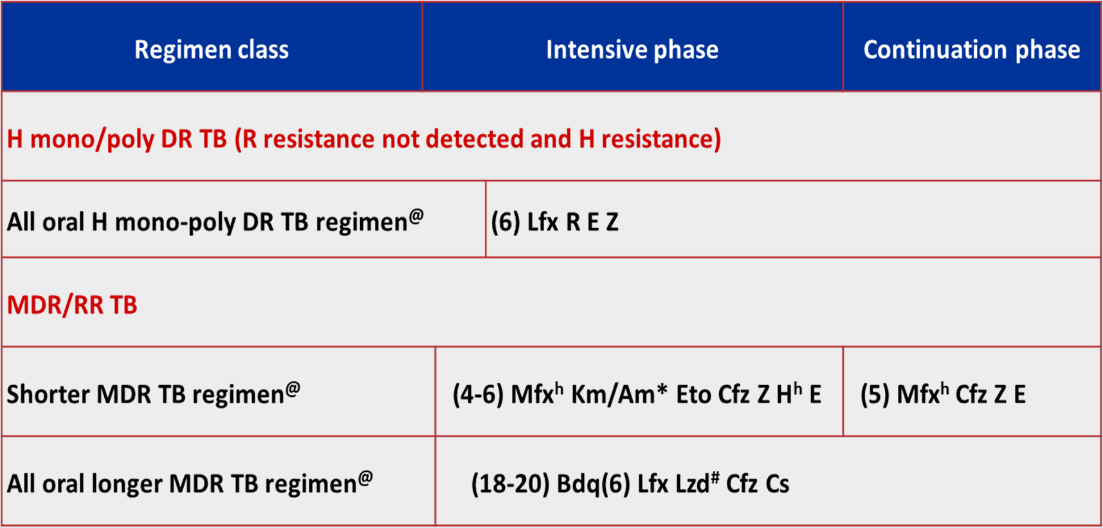
SUMMARY

Slide 12
LEPROSY
Leprosy is a chronic granulomatous infection; primarily affecting skin, mucous membranes and nerves.
It is more prevalent among the lowest socio-economic strata
Causative organism: Mycobacterium leprae
Considered incurable since ages and bears a social stigma.
Availability of effective antileprotic drugs, it is entirely curable now.
Deformities/defects already incurred may not reverse

Slide 13
LEPROSY CLASSIFICATION
WHO reclassified leprosy in 1998 into:
Single lesion paucibacillary leprosy (SL PB): With a solitary cutaneous lesion.
Paucibacillary leprosy (PB): With 2–5 skin lesions.
Both SLPB and PB cases are skin smear negative for M.leprae.
Multibacillary leprosy (MB): With > 6 skin lesions, as well as all smear positive cases.

Slide 14
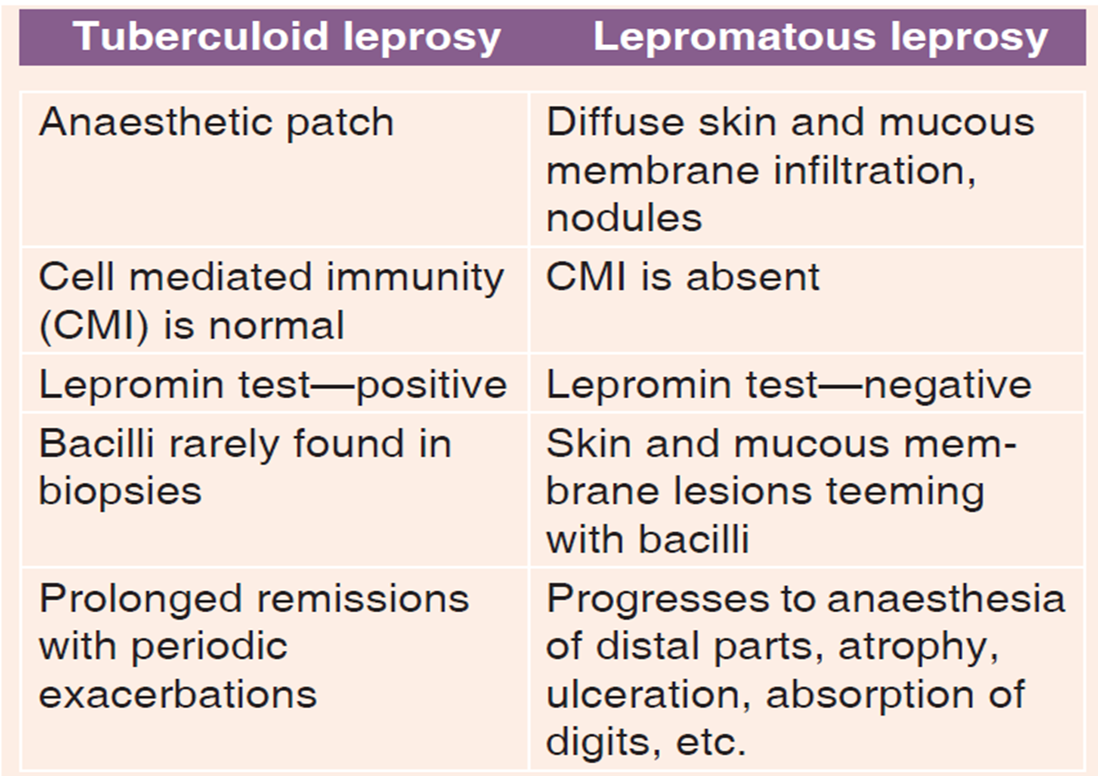
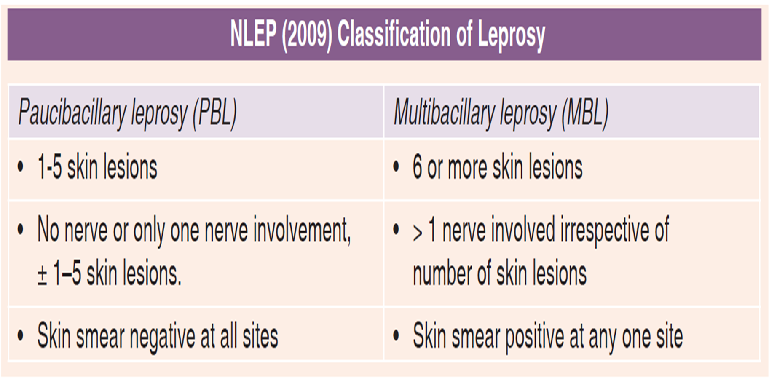

Slide 15
DRUG CLASSIFICATION
Sulfones: Dapsone
Phenazine drivatives: Clofazimine
Antitubercular drugs: Rifampin
Ethionamide
Other Antimicrobials: Ofloxacin
Moxifloxacin
Minocycline
Clarithromycin

Slide 16
DAPSONE
Chemically related to sulfonamides
MOA: inhibition of PABA incorporation into folic acid by folate synthase
The antibacterial action of dapsone is antagonized by PABA
Leprostatic
The mechanism of resistance: Selective propagation of resistant bacilli over time
Dapsone resistant M. Leprae have mutated folate synthase which has lower affinity for dapsone.

Slide 17
PHARMACOKINETICS OF DAPSONE
Completely absorbed after oral administration
Widely distributed in the body, though penetration in CSF is poor
70% plasma protein bound, but more importantly it is concentrated in the skin (especially lepromatous skin), muscle, liver and kidney,
Acetylated as well as glucuronide and sulfate conjugated in liver
Metabolites are excreted in bile and reabsorbed from intestine, so that ultimate excretion occurs mostly in urine.
Plasma T_{½} of dapsone is variable, though often > 24 hrs.
Elimination takes 1–2 weeks or longer

Slide 18
ADRS
Mild haemolytic anaemia- dose-related toxicity—reflects oxidising property
Gastric intolerance—nausea and anorexia
Other A/E: methaemoglobinaemia, headache, paresthesias, mental symptoms, drug fever
Cutaneous reactions: itching, allergic rashes, fixed drug eruption, hypermelanosis, phototoxicity and rarely exfoliative dermatitis.
Hepatitis and agranulocytosis: rare
Sulfone syndrome: develops 4–6 weeks after starting dapsone treatment: consists of fever, malaise, lymph node enlargement, desquamation of skin, jaundice and anaemia.
Its treatment consists of stopping dapsone and instituting corticosteroid therapy along with supportive measures.

Slide 19
DAPSONE
Contraindications:
Severe anaemia (Hb < 7 g/ dl)
G-6-PD deficiency
In those showing hypersensitivity reactions.
Other use:
In combination with pyrimethamine, dapsone can be used for chloroquine-resistant malaria, toxoplasmosis and P. jirovecii infection.

Slide 20
CLOFAZIMINE (CLO)
It is a dye with leprostatic and anti-inflammatory properties.
The mechanisms of antileprotic action of clofazimine are:
  Interference with template function of DNA in M.leprae
  Alteration of membrane stucture and its transport function
  Disruption of mitochondrial electron transport chain.
When used alone, the clinical response to clofazimine is slower than that to dapsone, and resistance develops in 1–3 years.
Dapsone resistant M. leprae respond to clofazimine, but apparently after a lag period of about 2 months.

Slide 21
CLOFAZIMINE (CLO)
Pharmacokinetics:
Orally active (40–70% absorbed)
It accumulates in macrophages and gets deposited as needle shaped crystals in many tissues including subcutaneous fat.
Entry in CSF is poor.
The T_{½}: 70 days
Other uses:
Because of its anti-inflammatory property, it is valuable in lepra reaction.
Occasionally, it is used as a component of combination regimen for extensive drug resistant TB (XDR-TB).

Slide 22
ADRS
Skin:reddish-black discolouration of skin, especially on exposed parts.
Discolouration of hair and body secretions: harmless
Dryness of skin, itching and scaling is often troublesome
Acneform eruptions and phototoxicity
Conjunctival pigmentation may create cosmetic problem.
GI symptoms: Nausea, anorexia, abdominal pain, weight loss and enteritis with intermittent loose stools can occur, particularly when higher doses are used to control lepra reaction
CONTRAINDICATIONS - During early pregnancy & In patients with liver & kidney damage

Slide 23
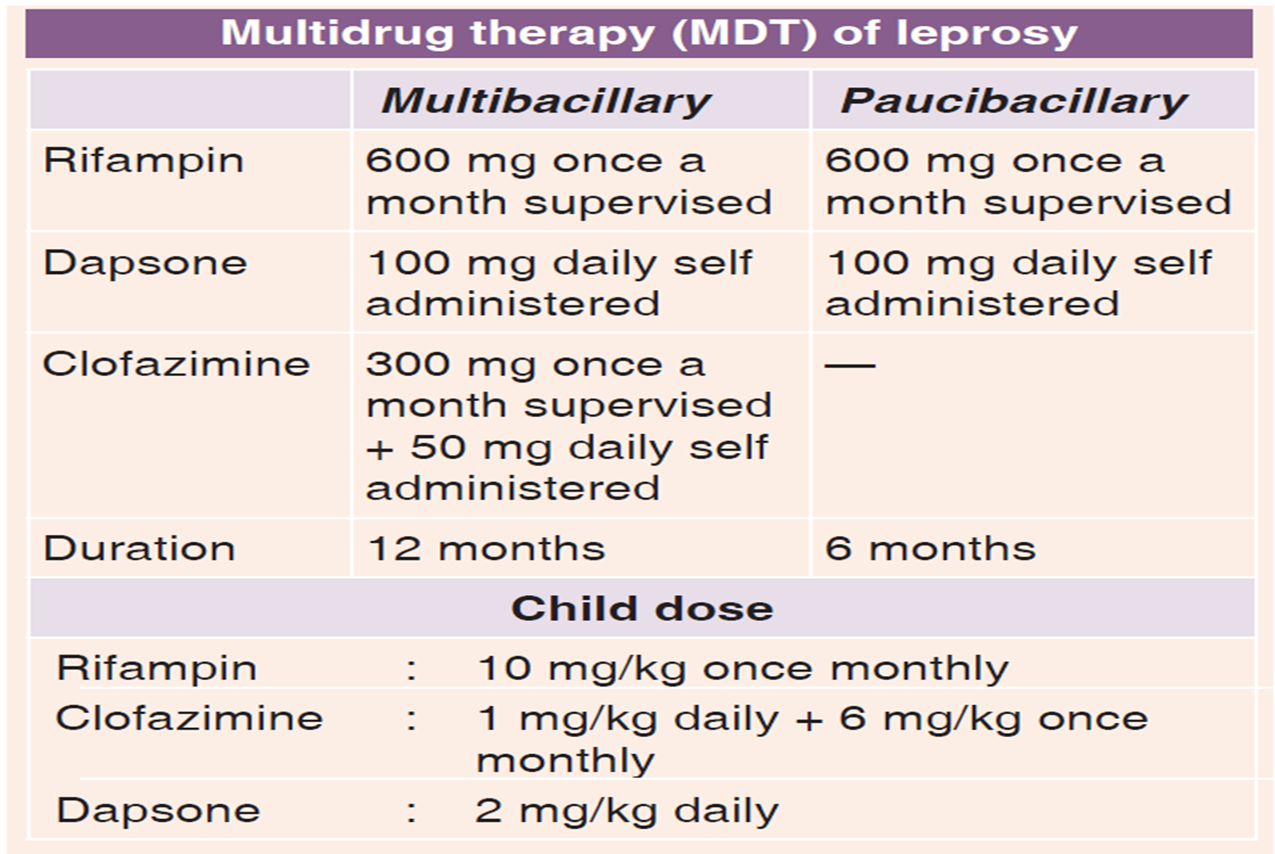

Slide 24
CO-INFECTION
Leprosy and TB coinfection MDT for leprosy is continued, but rifampin is given daily as for treatment of TB.
No association with HIV found
MDT for leprosy can be given safely to HIV +ive patients and to those receiving anti-retroviral therapy.
RELAPSE OF LEPROSY
The same MDT (12 months for MBL and 6 months for PBL) is started on confirmation of relapse.

Slide 25
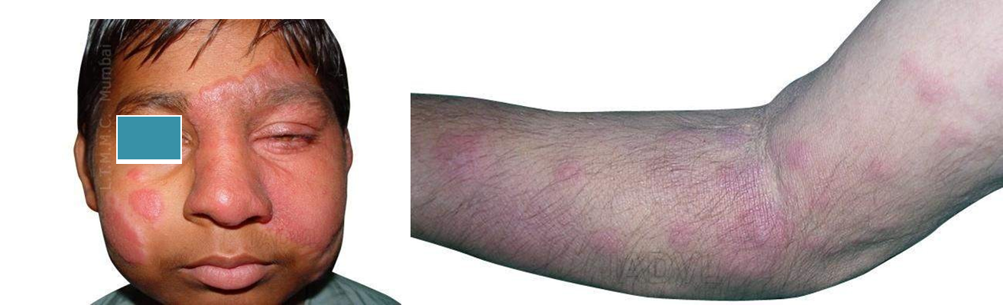
LEPRA REACTIONS
Due to release of Ag from killed bacilli
TYPE I
TYPE II

Slide 26












Type -I Lepra Reaction
TYPE I / REVERSAL REACTIONS
Type IV Hypersensitivity (Delayed hypersensitivity response)
Cutaneous ulcerations,multiple nerve involvement
Treatment : Corticosteroids, Clofazimine

Slide 27



















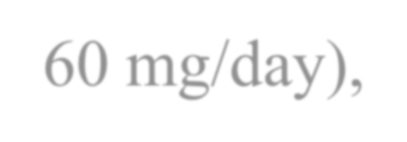

Type -II Lepra Reaction
TYPE II / ERYTHEMA NODOSUM LEPROSUM
Type III Hypersensitivity (Humoral antibody response)
Existing lesions enlarge , become red, inflamed and painful
Treatment : Clofazamine
(200mg OD),corticosteroids(40-60 mg/day), Thalidomide(alternative to steroids)

Slide 28
MCQS
1- TB Bacilli resistant to one 1st line ATD, but not R-resistant known as
A- MDR TB
B- XDR TB
C- Mono drug resistant TB
D- Rifampin resistant TB [RR TB]

Slide 29
2-MOA of Bedaquiline is
A- mycobacterial ATP synthase, an enzyme which supplies energy to M.tb.
B-synthesis of mycolic acids .
C-Poison the bacilli with nitric oxide.
D-All of the above.

Slide 30
3-Duration of MDT of leprosy for multibacillary & paucibacillary respectively
A- 04 & 06 months
B- 06 & 12 months
C- 12 & 08 months
D-12 & 6 months

Slide 31
4-All of the following are antileprotic drugs except
A- rifampicine
B- rifampin
C- clofazimine
D – dapsone

Slide 32
5 – treatment of lepra reactions includes
A- clofazimine
B- corticosteroids
C – A & B
D – none of the above

Slide 33

THANK YOU

