Slide 1
Cell Injury I
Cell Injury and Its Mechanism
Dr. Swapan Goswami
Professor
Department of Pathology
S.B.K.S. MI & RC

Slide 2
Overview
Normal
cell
+ Stress
Adapted
Cell
- Stress
Injury
+Stress
Reversibly
injured cell
- Stress
Apoptosis
Irreversibly
Injured cell
Dead cell
Necrosis
*Kumar Robbins and Cotran Pathologic Basis of Disease, 8th ed
Notes:
Normal cell has relative narrow range of functions and structure
Limited changes in metabolism = homeostasis (increased Glc and TG metabolism in active contracting muscle)
Stress = demands in excess of normal homeostatic changes leads to adaptations
If stress exceeds adaptive response of cell -→ injury
In addition, a variety of agents can directly injure cells (ie CN, , Hg, pH, temp, etc)

Slide 3
DEFINATION
If the limits of adaptive response to a stimulus are exceeded, or in certain instances when the cell is exposed to an injurious agent or stress, a sequence of events follows that is termed cell injury.
*Kumar Robbins and Cotran Pathologic Basis of Disease, 8th ed

Slide 4
CELLULAR RESPONSE TO INJURY DEPENDS ON :-
(A) Duration of injury
(B) Type of injury
(C) Cell’s metabolic state
(D) Cell’s ability to adapt

Slide 5
CELLULAR RESPONSE TO INJURY :-
Adaptations
  Atrophy
  Hypertrophy
  Hyperplasia
  Metaplasia
  Dysplasia
Cell injury
  Reversible
  Irreversible
Intra cellular accumulation & Pathological calcification
Cellular Ageing
*Kumar Robbins and Cotran Pathologic Basis of Disease, 8th ed

Slide 6
CELLULAR CHANGES DURING INJURY
INTRA CELLULAR SYSTEM VULNERABLE TO INJURY :-
Cell membrane
Production of ATP via aerobic respiration
Protein synthesis by ER & Ribosomes
DNA in nucleus

Slide 7
Morphology of cell injury
Swelling (via increased water content)
Fatty change (steatosis)
Intracellular deposits (lipid,protein)
Loss of cellular fine structure (microvilli)
Karyolysis (DNA degradation)
Pyknosis (nuclear shrinkage)
Karyorrhexis (nuclear fragmentation)
Necrosis (dead cells)

Slide 8
Mechanisms of cell injury
3 Principles
1) The cellular response to injury depends on the type, duration and severity of the injury.
2) The consequences of the injury depend on the type, state and adaptability of the cell.
3) Cell injury results from an abnormality in one or more essential cellular components:
    Aerobic respiration (mitochondrial oxidation & ATP production)
    Membrane integrity (cell & organelle membranes)
    Protein synthesis
    Cytoskeletal structure

Slide 9
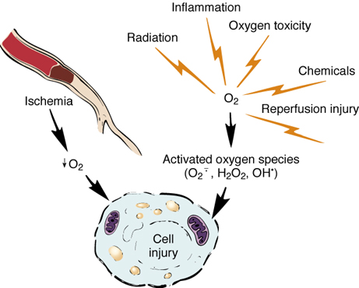
CAUSES OF CELL INJURY
*Kumar Robbins and Cotran Pathologic Basis of Disease, 8th ed

Slide 10
Causes of Cell Injury
  Oxygen Deprivation
  Physical Agents
  Chemical Agents and Drugs
  Infectious Agents
  Immunologic Reactions
  Genetic Derangements
  Nutritional Imbalances

Slide 11
Hypoxia and Ischaemia
Cells of different tissues essentially require oxygen to generate energy and perform metabolic functions.
Deficiency of oxygen or hypoxia results in failure to carry out these activities by the cells.
Hypoxia is the most common cause of cell injury.

Slide 12
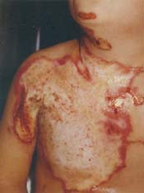
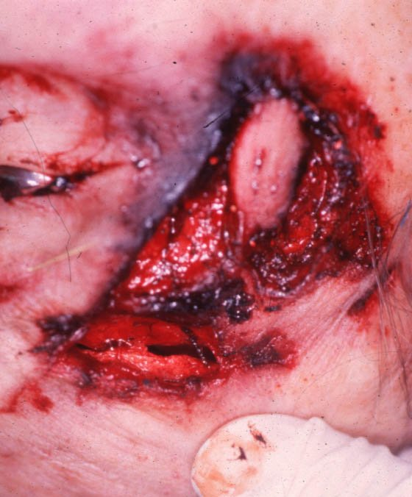
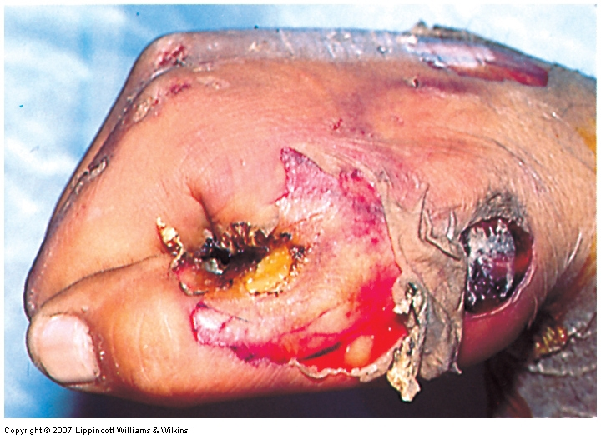
Physical Agents
Mechanical trauma
Extremes of temperature – burns, deep cold
Radiation
Electric shock

Slide 13
Chemical Agents and Drugs
Hypertonic concentration of salt – deranging electrolyte homeostasis
Poisons – arsenic, cyanide, or mercuric salts
Insecticides and Herbicides
Air pollutant – carbon monoxide
Occupational hazard – asbestos
Alcohol and Narcotic drugs
*Kumar Robbins and Cotran Pathologic Basis of Disease, 8th ed

Slide 14
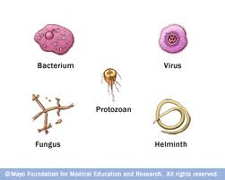
Infectious Agents
Bacteria
Viruses
Parasites
Fungi
Rickettsiae
*Kumar Robbins and Cotran Pathologic Basis of Disease, 8th ed

Slide 15
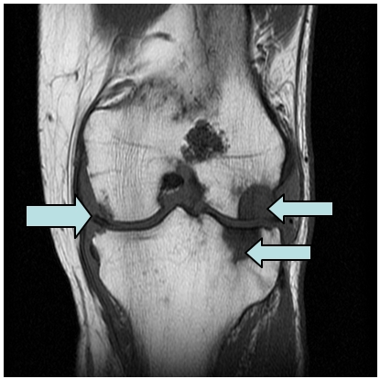
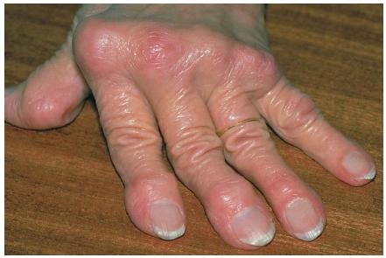
Immunologic Reactions
Anaphylactic reaction to foreign protein or drug
Reactions to endogenous self-antigens – autoimmune diseases
*Kumar Robbins and Cotran Pathologic Basis of Disease, 8th ed

Slide 16
Genetics Derangements
Congenital malformation – Down syndrome
Decreased life of red blood cell – Thalassemia, Sickle cell anemia
Inborn errors of metabolism
*Kumar Robbins and Cotran Pathologic Basis of Disease, 8th ed

Slide 17
Nutritional Imbalances
Protein-calorie deficiencies
Vitamin deficiencies
Anorexia nervosa
Excesses of lipids – Obesity, Atherosclerosis
Metabolic diseases – Diabetes
*Kumar Robbins and Cotran Pathologic Basis of Disease, 8th ed

Slide 18
Mechanisms of Cell Injury
Depletion of ATP
Mitochondrial Damage
Influx of Intracellular Calcium and Loss of Calcium Homeostasis
Accumulation of Oxygen-Derived free radical (Oxidative stress)
Defects in Membrane Permeability

Slide 19
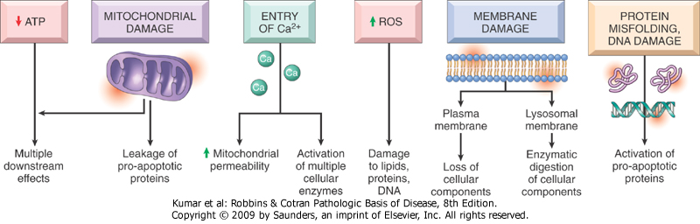
Mechanisms of Cell Injury
*Kumar Robbins and Cotran Pathologic Basis of Disease, 8th ed

Slide 20
Depletion of ATP
Mechanisms of Cell Injury
Causes
  Hypoxia mitochondrial damage
  Ischemia (reduced blood supply and hence oxygen and nutrients)
  Chemical Injury certain toxins(e.g cyanides)

Slide 21
Mechanisms of Cell Injury
ATP is critical for:
  Membrane transport
  Maintenance of ionic gradients ( Na+, K+ Ca2+)
  Protein synthesis
  Cytoskeletal function (microfilaments)

Slide 22
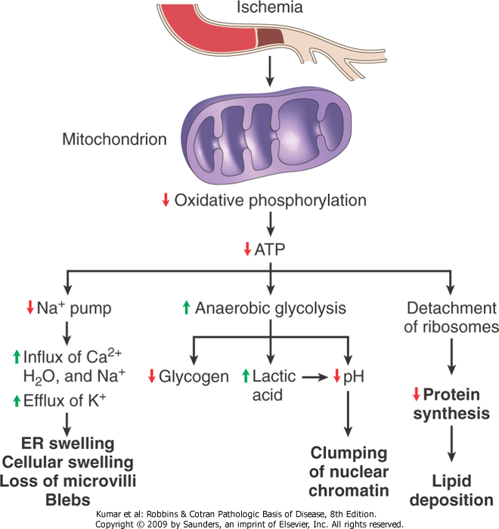
Mechanisms of Cell Injury
*Kumar Robbins and Cotran Pathologic Basis of Disease, 8th ed

Slide 23
Mitochondrial Damage
Mechanisms of Cell Injury
Causes
Hypoxia, Toxins
Cytosolic Ca²⁺
Oxidative stress
Lipid breakdown product

Slide 24
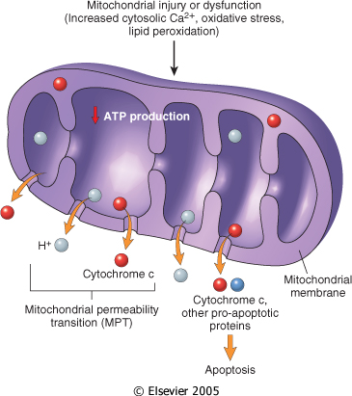
Mechanisms of Cell Injury
*Kumar Robbins and Cotran Pathologic Basis of Disease, 8th ed

Slide 25
CALCIUM INFLUX AND LOSS OF CALCIUM HOMEOSTASIS
Mechanisms of Cell Injury
Ischemia and certain toxins causes an increase in cytosolic calcium concentration initially by releasing calcium from intracellular stores and later from increased calcium influx across the cell membrane.
Increased cytosolic calcium causes cell injury by several mechanisms.

Slide 26
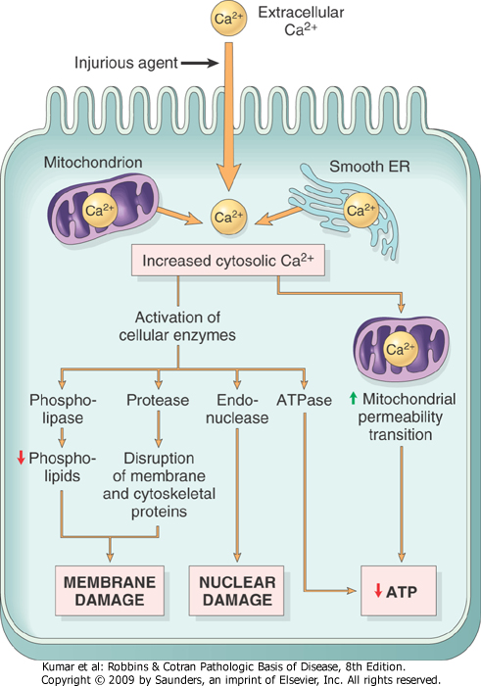
Mechanisms of Cell Injury
*Kumar Robbins and Cotran Pathologic Basis of Disease, 8th ed

Slide 27
Free Radicals
Mechanisms of Cell Injury
Free radicals cause chain reactions
Generated by:
  Absorption of radiant energy
  Oxidation of endogenous constituents
  Oxidation of exogenous compounds

Slide 28
Examples of Free Radical Injury
Mechanisms of Cell Injury
Chemical (e.g., CCl₄, acetaminophen)
Inflammation / Microbial killing
Irradiation (e.g., UV rays → skin cancer)
Oxygen (e.g., exposure to very high oxygen tension on ventilator)
Age-related changes

Slide 29
Mechanism of Free Radical Injury
Mechanisms of Cell Injury
Lipid peroxidation → damage to cellular and organellar membranes
Protein cross-linking and fragmentation due to oxidative modification of amino acids and proteins
DNA damage due to reactions of free radicals with thymine

Slide 30
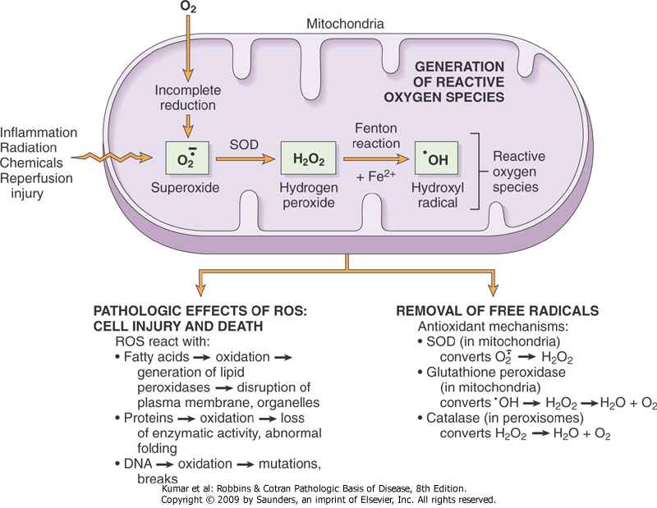
Mechanisms of Cell Injury
*Kumar Robbins and Cotran Pathologic Basis of Disease, 8th ed

Slide 31
Effects of the free radicals on cell injury
Mechanisms of Cell Injury
Lipid peroxidation of Membranes
- Plasma membrane
- Organellar membrane

Slide 32
Mechanisms of Cell Injury
Oxidative modification of proteins
-Oxidation of amino acid side chains
Protein-protein cross-linkages
-Oxidation of the protein backbone
Protein fragmentation

Slide 33
Mechanisms of Cell Injury
Lesions in DNA
Reaction with Thymine
DNA single-stranded break
DNA fragmentation

Slide 34
DEFECTS IN MEMBRANE PERMEABILITY
Mechanisms of Cell Injury
Several biochemical mechanisms contribute to membrane damage these involve:
1) ATP depletion
2) ROS
3) Decrease phospholipid synthesis
4) Increased phospholipase activity 5) Cytoskeletal abnormalities caused by activation of protease as a result of increase cytosolic calcium…..

Slide 35
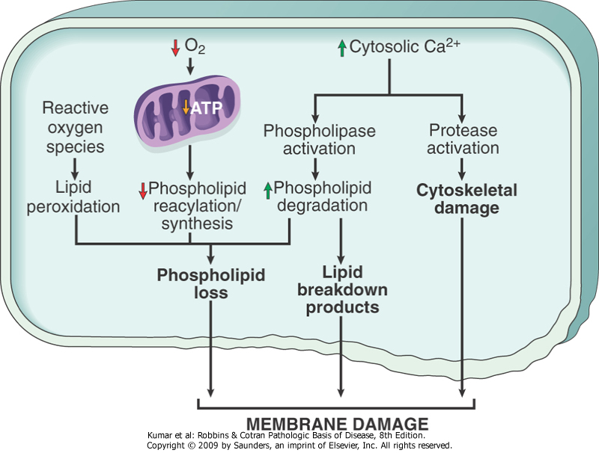
Mechanisms of Cell Injury
*Kumar Robbins and Cotran Pathologic Basis of Disease, 8th ed

Slide 36
Protein Misfolding
Mechanisms of Cell Injury

Slide 37
Mechanisms of Cell Injury
Diseases caused due to protein misfolding
Marfan syndrome
Fibrillin, a scaffolding on which tropoelastin is deposited to form elastic fibers.
Adenomatous polyposis coli
APC loci, 5q21
Adenomatous polyposis in colons (in teens).
100% malignant transformation ( >40ys ).
Notes:
26

Slide 38
MCQs

Slide 39
Mark (✓) the most appropriate answer.
Stimuli causing cellular injury do so by which of the following mechanisms:
  ATP depletion
  Loss of mitochondrial membrane potential
  Oxidative stress
  Loss of membrane permeability
  All of the above

Slide 40
Mark (✓) the most appropriate answer.
Ischemia reduces oxidative phosphorylation in mitochondria, resulting in a decreasein ATP production. Which of the following would NOT follow as a morphologicconsequence?
  Increased anaerobic glycolysis
  Increase in pH and glycogen
  Decrease in protein synthesis
  Influx of Ca++, H2O, and Na++
  Efflux of K+

Slide 41
Mark (✓) the most appropriate answer.
Which of the following would NOT cause mitochondrial damage?
    Increase in cytosolic Ca++
    Oxidative stress
    Retention of cytochrome c
    Breakdown of phospholipids through the phospholipase A2 and sphingomyelin pathwayse
    Lipid breakdown products (e.g. free fatty acids and ceramide)

Slide 42
Mark (✓) the most appropriate answer.
Some energy producing processes produce reactive oxygen species (free radicals)that can cause damage to cells. Which of the following is NOT a mechanism of free radical generation?
  Absorption of radiant energy
  Enzymatic metabolism of exogenous chemicals or drugs
  During creation of ATP via glycolysis
  Free electron donation from transition metals (e.g. copper, iron)
  Reduction-oxidation reactions during normal metabolic processes

Slide 43
Mark (✓) the most appropriate answer.
Stimuli causing cellular injury do so by which of the following mechanisms:
  ATP depletion
  Loss of mitochondrial membrane potential
  Oxidative stress
  Loss of membrane permeability
  All of the above

Slide 44
Mark (✓) the most appropriate answer.
Ischemia reduces oxidative phosphorylation in mitochondria, resulting in a decrease in ATP production. Which of the following would NOT follow as a morphologic consequence?
  Increased anaerobic glycolysis
  Increase in pH and glycogen
  Decrease in protein synthesis
  Influx of Ca++, H2O, and Na++
  Efflux of K+

Slide 45
Mark (✓) the most appropriate answer.
Which of the following would NOT cause mitochondrial damage?
    Increase in cytosolic Ca++
    Oxidative stress
    Retention of cytochrome c
    Breakdown of phospholipids through the phospholipase A2 and sphingomyelin pathwayse
    Lipid breakdown products (e.g. free fatty acids and ceramide)

Slide 46
Mark (✓) the most appropriate answer.
Some energy producing processes produce reactive oxygen species (free radicals)that can cause damage to cells. Which of the following is NOT a mechanism of free radical generation?
  Absorption of radiant energy
  Enzymatic metabolism of exogenous chemicals or drugs
  During creation of ATP via glycolysis
  Free electron donation from transition metals (e.g. copper, iron)
  Reduction-oxidation reactions during normal metabolic processes

Slide 47
THANK YOU

