Slide 1

Dr. Jigna Patel
AMYLOIDOSIS

Slide 2
Competency
At the end of the lecture the student will be able to:
1) Describe the Pathogenesis of amyloidosis
2) Describe the Pathology of Amyloidosis.
Domain: Knows
Level: Knows How
Core: Yes

Slide 3
AMYLOIDOSIS
DEFINITION
Amyloidosis is the term used for a group
of diseases characterised by extracellular
deposition of fibrillar proteinaceous
substance called amyloid having common
morphological appearance, staining
properties and Physical structure but with
variable protein composition.

Slide 4
With light microscopy and Haematoxylin Eosin stains Amyloid appears as amorphous, eosinophilic, hyaline, extracellular substance that, with progressive accumulation, encroaches on , and produces pressure atrophy of adjacent cells.

Slide 5
AMYLOIDOSIS
GROSSLY
On the cut surface of an organ containing amyloid which stained brown with iodine and turned violet on addition of dilute sulfuric acid.

Slide 6
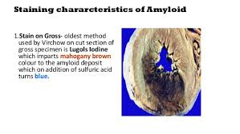

Slide 7
AMYLOIDOSIS
H & E STAINING
By H & E staining under light microscopy, amyloid appears as extracellular, homogeneous, structureless and eosinophilic hyaline material; it stains positive with congo red staining and shows apple-green birefringence on polarising microscopy.

Slide 8
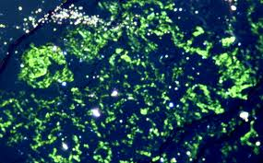
AMYLOIDOSIS
POLARISING MICROSCOPY
APPLE-GREEN BIREFRINGENCE

Slide 9
AMYLOIDOSIS
PHYSICAL AND CHEMICAL
NATURE OF AMYLOID
All the forms of amyloid are similar in appearance, but they are chemically heterogeneous.
Based on these analysis, amyloid is composed of 2 main types of complex proteins:
Fibril proteins - 95%
Non-fibrillar - 5%
(mainly P-component)

Slide 10
AMYLOIDOSIS
FIBRIL PROTEINS
By electron microscopy,
Amyloid consists of meshwork of fibril proteins. The fibrils are delicate, randomly dispersed, non-branching, each measuring 7.5-10 nm in diameter and having indefinite length.

Slide 11
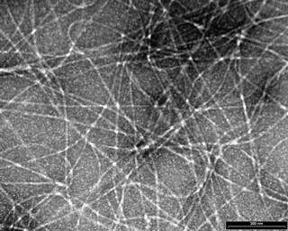
AMYLOIDOSIS
E M FIBRIL PROTEINS
AMYLOID
FIBRILS

Slide 12
AMYLOIDOSIS
Each fibril is further composed of double helix of two pleated sheets in the form of twin filaments separated by a clear space.
By X-ray crystallography and infra-red spectroscopy, the fibrils are shown to have cross-β-pleated sheet configuration which produces 1000 A⁰ periodicity that gives characteristic staining properties of amyloid with congo red and birefringence under polarising microscopy. Based on these amyloid is also referred to as β-fibrillosis.

Slide 13
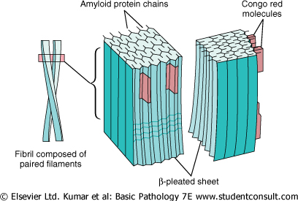
AMYLOIDOSIS

Slide 14
AMYLOIDOSIS
Amyloid fibril proteins can be categorised as under:
AL (amyloid light chain) protein
AA (amyloid associated) protein
Other proteins

Slide 15
AMYLOIDOSIS
AL PROTEIN
Derived from immunoglobulin light chain
Seen in association with plasma cell dyscrasias
Included in primary systemic amyloidosis

Slide 16
AMYLOIDOSIS
AA PROTEIN
Derived from larger precursor protein in the serum called SAA (serum amyloid associated protein)
SAA is an acute phase reactant protein synthesised in liver, its level being high in chronic inflammatory and traumatic conditions.
Included in secondary amyloidosis

Slide 17
AMYLOIDOSIS
OTHER PROTEINS
Transthyretin (TTR) – familial amyloid polyneuropathies
Aβ₂ - microglobulin (Aβ₂M) – seen in long term cases of haemodialysis
β-amyloid protein – seen in cerebral plaques as well as cerebral vessels in Alzheimer’s disease.
Immunoglobulin heavy chain amyloid – derived from truncated heavy chain of immunoglobulin

Slide 18
AMYLOIDOSIS
Amyloid from hormone precursor proteins – pro-calcitonin, islet amyloid polypeptide, pro-insulin, prolactin, lactoferrin
Amyloid of prion protein – derived from precursor prion protein which is plasma membrane glycoprotein, prion protein are proteinaceous infectious particles lacking in RNA or DNA.
Miscellaneous heredofamilial forms of amyloid – derived from apolipoprotein I, gelsolin, lysozyme, cystatin C

Slide 19
AMYLOIDOSIS
NON-FIBRILLAR COMPONENTS
Amyloid P-component
- synthesised in liver
- derived from circulating serum amyloid
p- component which is a glycoprotein
resembling the normal serum α₁ glycoprotein
and is PAS – positive
- by E M, it has pentagonal profile or doughnut
shape with external diameter of 9 nm and
internal diameter of 4 nm.

Slide 20
AMYLOIDOSIS
NON-FIBRILLAR COMPONENTS
2. Apolipoprotein-E
- regulator of lipoprotein metabolism
- apoE4 increases the risk of Alzheimer precursor protein deposition in Alzheimer’s disease
3. Sulfated glycosaminoglycans
- constituents of matrix proteins
4. α₁ anti-chymotrypsin – seen in cases of AA deposits
5. Protein X – present in cases of prionoses

Slide 21
AMYLOIDOSIS
PATHOGENESIS
Proteins that form amyloid fall into two
general categories:
Normal proteins that have an inherent tendency to fold improperly, associate and form fibrils
Mutant proteins that are prone to misfolding and subsequent aggregation

Slide 22
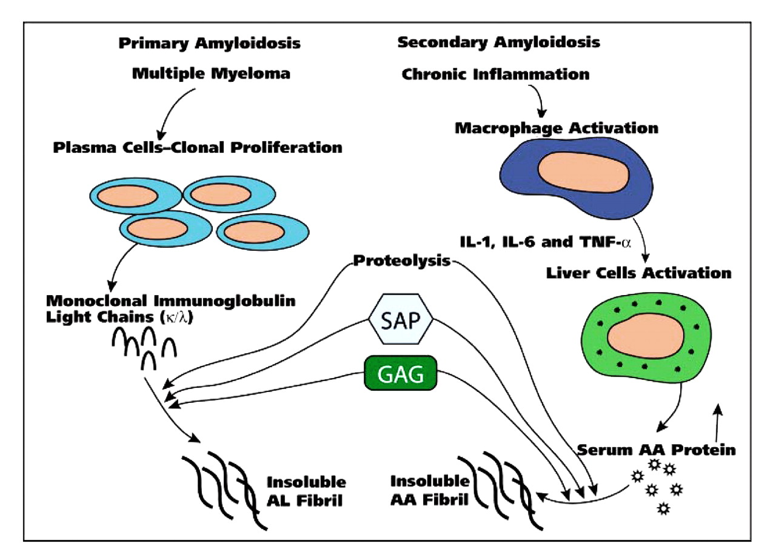
AMYLOIDOSIS
PATHOGENESIS

Slide 23
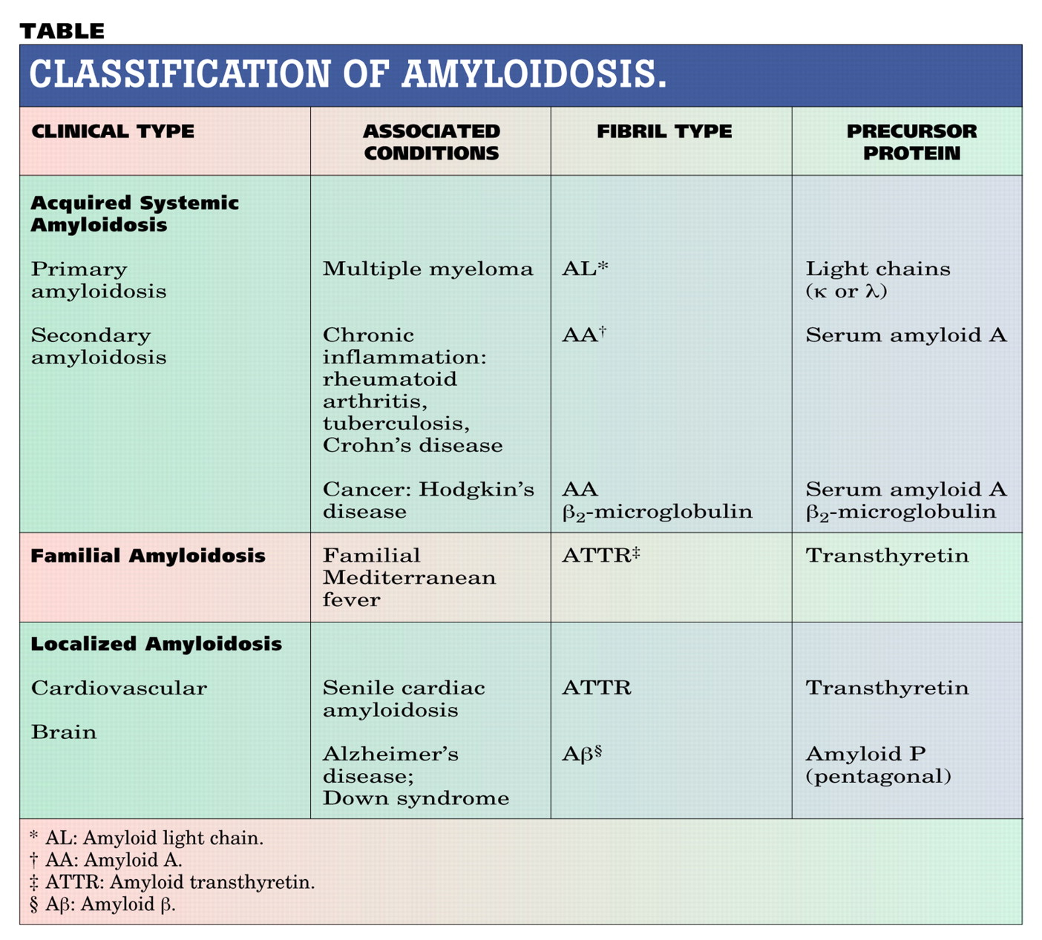
AMYLOIDOSIS

Slide 24
AMYLOIDOSIS
STAINING CHARACTERISTICS
OF AMYLOID
Stain | Appearance
H & E | pink, hyaline, homogeneous
Methyl violet/Crystal violet | Metachromasia: rose-pink
Congo red | Light microscopy: pink red
 | polarising light: apple-green birefringence
Thioflavin-T/Thioflavin-S | Ultraviolet light: fluorescence
Immunohistochemistry | Immunoreactivity: Positive
Non-specific stains:
Standard toluidine blue | Orthochromatic blue, polarising ME: dark red
Alcian blue | Blue-green
PAS | pink

Slide 25
AMYLOIDOSIS
DIAGNOSIS
BIOPSY EXAMINATION:
- biopsy of affected organ
- FNA of abdominal subcutaneous fat
followed by congo red staining and
polarising ME for confirmation
IN VIVO CONGO RED TEST
OTHER TESTS:
  - protein electrophoresis
  - immunoelectrophoresis of urine and serum
  - bone marrow aspiration

Slide 26
AMYLOIDOSIS
MORPHOLOGIC FEATURES OF
AMYLOIDOSIS OF ORGANS
Grossly, enlarged, pale and rubbery
On c/s firm, waxy and translucent parenchyma which takes positive staining with the iodine test.
Microscopically, deposits of amyloid found in extracellular location(initially in the wall of small blood vessels), later the deposits are in large amounts causing macroscopic changes and effects of pressure atrophy.

Slide 27
AMYLOIDOSIS OF KIDNEY

Slide 28
AMYLOIDOSIS
AMYLOIDOSIS OF KIDNEY
Most common
Found in most cases of secondary amyloidosis
Can cause proteinuria and nephrotic syndrome

Slide 29
AMYLOIDOSIS
GROSSLY
May be normal sized, enlarged or terminally contracted due to ischaemic effect of narrowing of vascular lumina
On c/s pale, waxy and translucent

Slide 30
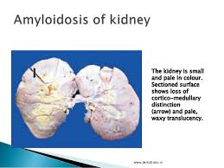

Slide 31
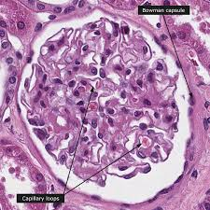

Slide 32
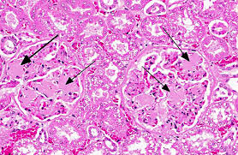

Slide 33
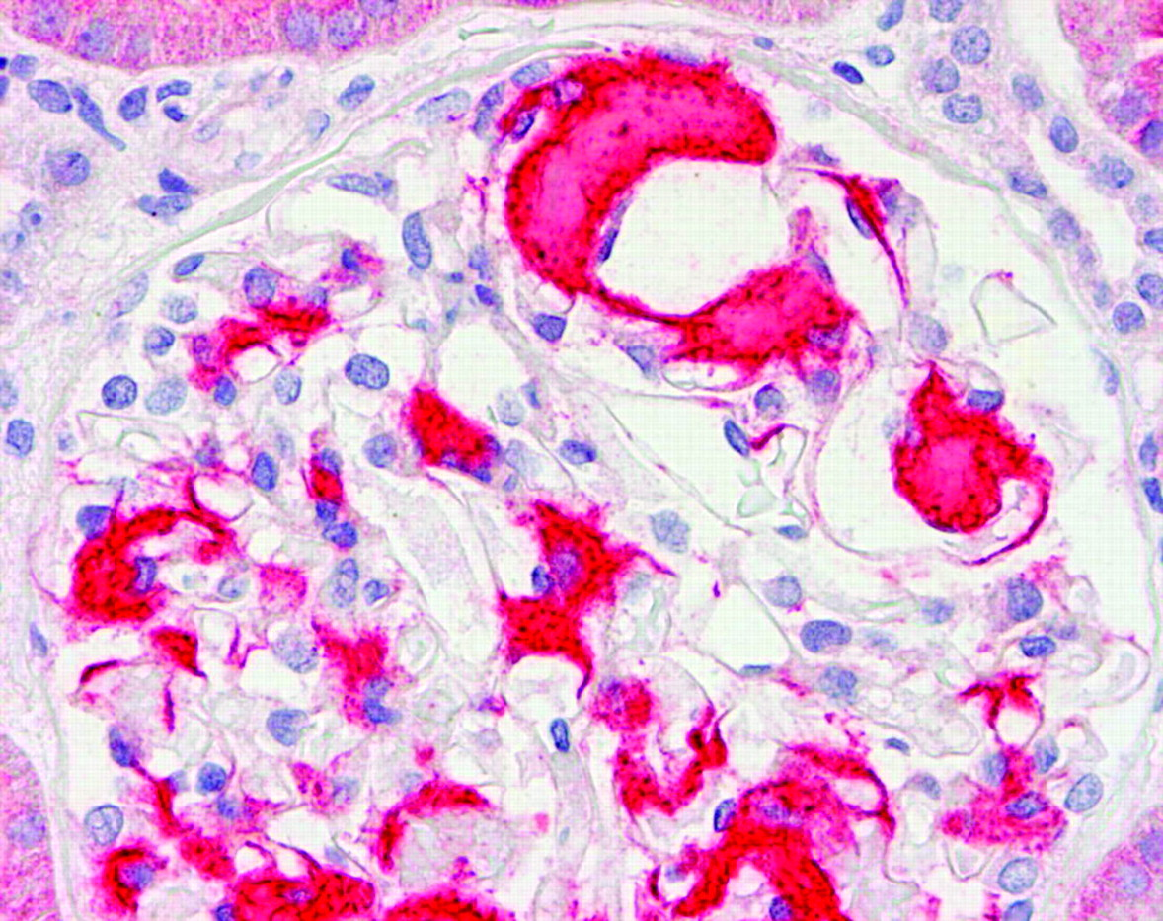
AMYLOIDOSIS
MICROSCOPICALLY
Glomerular
deposit
Amyloid deposition occurs in the glomeruli
It may involve peritubular interstitial tissue and the wall of arterioles

Slide 34
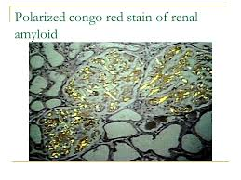

Slide 35
AMYLOIDOSIS OF SPLEEN

Slide 36
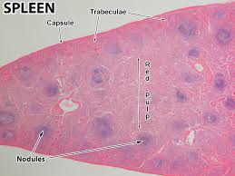

Slide 37
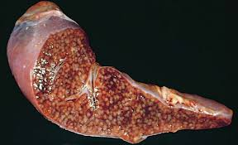

Slide 38
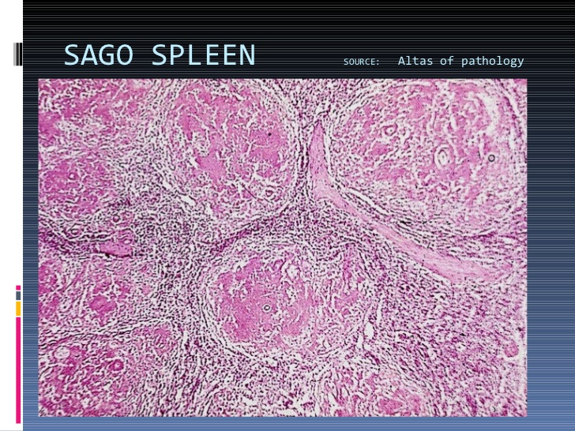

Slide 39
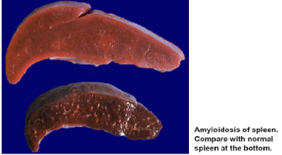

Slide 40
AMYLOIDOSIS
AMYLOIDOSIS OF SPLEEN
Two patterns:
1. SAGO SPLEEN:
gross- splenomegaly is not marked
c/s – translucent pale and waxy
nodules resembling sago grains
ME- deposits in the wall of arterioles
of the white pulp and may replace the
follicles.

Slide 41
AMYLOIDOSIS
AMYLOIDOSIS OF SPLEEN
2. LARDACEOUS SPLEEN:
gross- splenomegaly moderate to
marked
c/s –map like areas of amyloid ME- deposits involves the wall of
splenic sinus, small arteries and in the
connective tissue of red pulp.

Slide 42
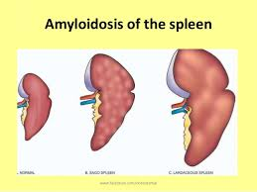

Slide 43
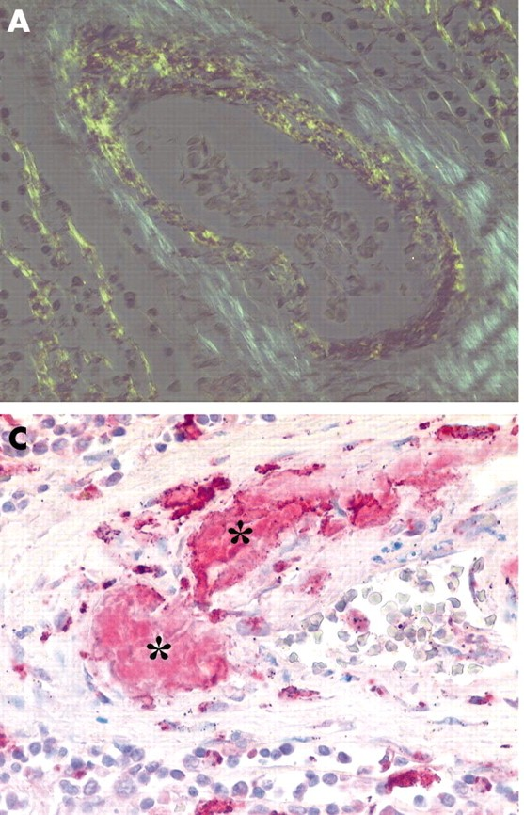
AMYLOIDOSIS
(A) Green birefringent vascular amyloid deposits were found in Congo red stained specimens
Amyloid deposits

Slide 44
AMYLOIDOSIS OF LIVER

Slide 45
AMYLOIDOSIS
AMYLOIDOSIS OF LIVER
Grossly, often enlarged, pale, waxy, firm.
Microscopically, amyloid appears in the space of disse
Later, as deposits increases → compress cord of hepatocytes → liver cells are shrunken, atrophic and replaced by amyloid.

Slide 46
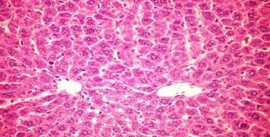

Slide 47
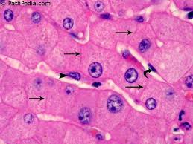

Slide 48
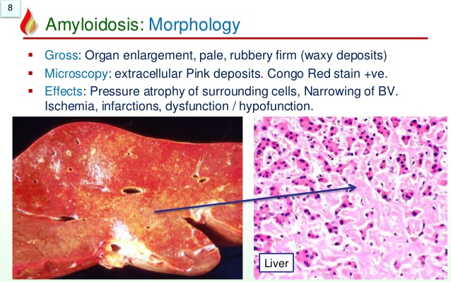

Slide 49
AMYLOIDOSIS
OTHER ORGANS
Heart, pituitary, thyroid, adrenals, skin, lymphnodes, respiratory tract, peripheral and autonomic nerves.

Slide 50
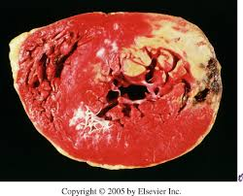

Slide 51
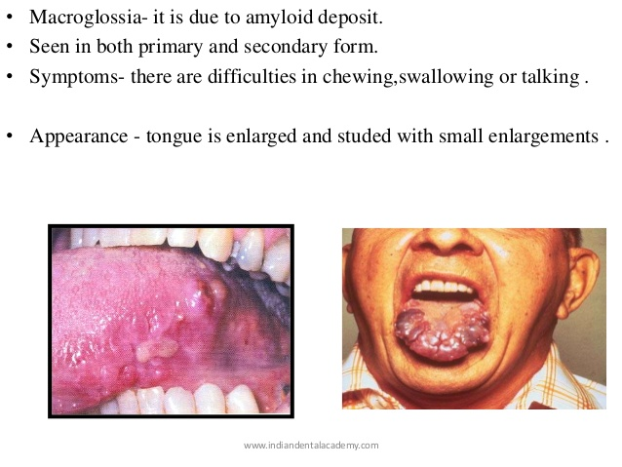

Slide 52
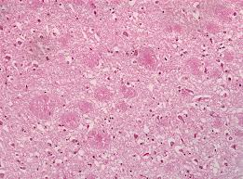

Slide 53
AMYLOIDOSIS
PROGNOSIS
Prognosis is generally poor
Primary amyloidosis, if left untreated, is rapidly progressive and fatal. Therapy is directed at reducing the clonal marrow plasma cells.
Secondary amyloidosis, control of inflammation is the main treatment.
Renal failure and cardiac arrhythmias- most common cause of death in systemic amyloidosis.

Slide 54
MCQ-1
Green birefringence by polarizing microscopy is seen in:
A) Collagenoses.
B) Lysosomal storage diseases.
C) Amyloidosis.
D) Sarcoidosis.

Slide 55
MCQ-2
The second component of amyloid is known as :
A) B component.
B) E component.
C) L component.
D) P component.

Slide 56
MCQ-3
In Alzheimers disease the amyloid protein is:
A) Transthyretin.
B) B2 amyloid protein.
C) B2 Microglobulin.
D) Calcitonin.

Slide 57
MCQ-4
Dyes used to detect amyloid are all except:
A) Congo Red.
B) Thioflavin
C) Crystal violet
D) Eosin.

Slide 58
MCQ-5
In Liver amyloid first appears in:
A) Sinusoids.
B) Parenchymal cells.
C) Blood vessels.
D) Space of Disse.

Slide 59
MCQ Keys
1- C
2- D
3- B
4- D
5- D

Slide 60

AMYLOIDOSIS

