Slide 1
Edema
Dr. Devanshi Gosai
Associate Professor, SBKSMIRC.

Slide 2
Approximately 60% of lean body weight is water, two thirds of which is intracellular.
Most of the remaining water is found in extracellular compartments in the form of interstitial fluid; only 5% of the body’s water is in blood plasma.
Edema is an accumulation of interstitial fluid within tissues.

Slide 3
Extravascular fluid can also collect in body cavities and such accumulations are often referred to collectively as effusions.
Examples include effusions in
  The pleural cavity (hydrothorax),
  The pericardial cavity (hydropericardium), or
  The peritoneal cavity (hydroperitoneum, or ascites).

Slide 4
Anasarca is severe, generalized edema marked by profound swelling of subcutaneous tissues and accumulation of fluid in body cavities.
The mechanisms of inflammatory edema are largely related to increased vascular permeability and the non-inflammatory causes are described in the following discussion.

Slide 5
Edema may be caused by:
• Increased hydrostatic pressure (e.g., heart failure)
• Increased vascular permeability (e.g., inflammation)
• Decreased colloid osmotic pressure resulting from reduced plasma albumin
• Decreased synthesis (e.g., liver disease, protein malnutrition)
• Increased loss (e.g., nephrotic syndrome)
• Lymphatic obstruction (e.g., inflammation or neoplasia)
• Sodium retention (e.g., renal failure)

Slide 6
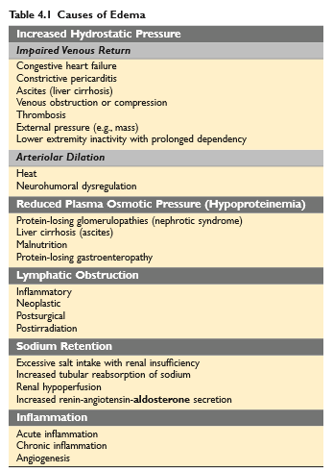

Slide 7
Fluid movement between the vascular and interstitial spaces is governed mainly by two opposing forces—
  the vascular hydrostatic pressure and
  the colloid osmotic pressure produced by plasma proteins.
Normally, the outflow of fluid produced by hydrostatic pressure at the arteriolar end of the microcirculation is nearly balanced by inflow at the venular end owing to slightly elevated osmotic pressure; hence there is only a small net outflow of fluid into the interstitial space, which is drained by lymphatic vessels.

Slide 8
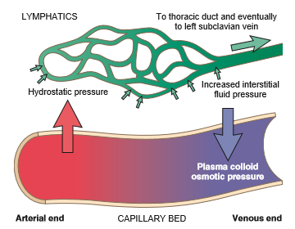
Either increased hydrostatic pressure or diminished colloid osmotic pressure causes increased movement of water into the interstitium.

Slide 9
The edema fluid that accumulates in the setting of increased hydrostatic pressure or reduced intravascular colloid typically is a protein-poor transudate;
by contrast, because of increased vascular permeability, inflammatory edema fluid is a protein-rich exudate with a high specific gravity.

Slide 10
Increased Hydrostatic Pressure
Increases in hydrostatic pressure are mainly caused by disorders that impair venous return.
Local increases in intravascular pressure caused, for example, by deep venous thrombosis in the lower extremity can cause edema restricted to the distal portion of the affected leg.

Slide 11
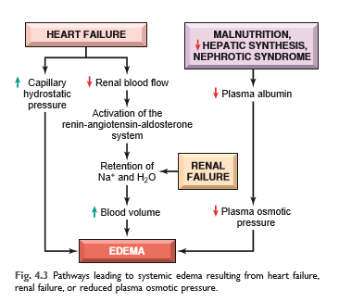
Generalized increases in venous pressure, with resultant systemic edema, occur most commonly in congestive heart failure.

Slide 12
The figure illustrates the interlocking mechanisms that underlie generalized edema resulting from cardiac, renal, and hepatic failure.
The reduced cardiac output leads to systemic venous congestion and resultant increase in capillary hydrostatic pressure. At the same time reduction in cardiac output results in hypo-perfusion of the kidneys, triggering the renin-angiotensin-aldosterone axis and inducing sodium and water retention.

Slide 13
In patients with normal heart function, this adaptation increases cardiac filling and cardiac output, thereby improving renal perfusion.
However, the failing heart often cannot increase its cardiac output in response to the compensatory increases in blood volume. Instead, a vicious cycle of fluid retention, increased venous hydrostatic pressures, and worsening edema ensues.
Unless cardiac output is restored or renal water retention is reduced (e.g., by salt restriction or treatment with diuretics or aldosterone antagonists), this downward spiral continues.

Slide 14
Reduced Plasma Osmotic Pressure
Reduction of plasma albumin concentrations leads to decreased colloid osmotic pressure of the blood and loss of fluid from the circulation.
Under normal circumstances, albumin accounts for almost half of the total plasma protein. Therefore, conditions in which albumin is either lost from the circulation or synthesized in inadequate amounts are common causes of reduced plasma osmotic pressure.

Slide 15
Nephrotic syndrome is the most important cause of albumin loss from the blood. In diseases that are characterized by nephrotic syndrome, the glomerular capillaries become leaky, leading to the loss of albumin (and other plasma proteins) in the urine and the development of generalized edema.
Reduced albumin synthesis occurs in the setting of severe liver disease (e.g., cirrhosis) and protein malnutrition.

Slide 16
Regardless of cause, low albumin levels lead in a stepwise fashion to edema, reduced intravascular volume, renal hypoperfusion, and secondary hyperaldosteronism.
Unfortunately, increased salt and water retention by the kidney not only fails to correct the plasma volume deficit but also exacerbates the edema, because the primary defect—low serum protein—persists.

Slide 17
Lymphatic Obstruction
Edema may result from lymphatic obstruction that compromises resorption of fluid from interstitial spaces.
Impaired drainage and consequent lymphedema results from a localized obstruction caused by an inflammatory or neoplastic condition.
For example, the parasitic infection filariasis can cause massive edema of the lower extremity and external genitalia (so-called “elephantiasis”) by producing inguinal lymphatic and lymph node fibrosis.

Slide 18
Lymphedema may occur as a complication of therapy. One relatively common setting for this clinical entity is in women with breast cancer who undergo axillary lymph node resection and/or irradiation, both of which can disrupt and obstruct lymphatic drainage, resulting in severe lymphedema of the arm.

Slide 19
Sodium & Water Retention
Excessive retention of salt (and its obligate associated water) can lead to edema by increasing hydrostatic pressure (because of expansion of the intravascular volume) and reducing plasma osmotic pressure.
Excessive salt and water retention are seen in a wide variety of diseases that compromise renal function, including post-streptococcal glomerulonephritis and acute renal failure.

Slide 20
MORPHOLOGY:
Edema is easily recognized on gross inspection; microscopic examination shows clearing and separation of the extracellular matrix (ECM) elements. Although any tissue can be involved, edema most commonly is encountered in subcutaneous tissues, lungs, and brain.
Subcutaneous edema can be diffuse but usually accumulates preferentially in parts of the body positioned the greatest distance below the heart, where hydrostatic pressures are highest.

Slide 21
Thus, edema typically is most pronounced in the legs with standing and the sacrum with recumbency, a relationship termed dependent edema.
Finger pressure over edematous subcutaneous tissue displaces the interstitial fluid, leaving a finger-shaped depression; this appearance is called pitting edema.

Slide 22
Edema resulting from renal dysfunction or nephrotic syndrome often manifests first in loose connective tissues (e.g., the eyelids, causing periorbital edema).
With pulmonary edema, the lungs often are two to three times their normal weight, and sectioning shows frothy, sometimes blood-tinged fluid consisting of a mixture of air, edema fluid, and extravasated red cells.

Slide 23
Brain edema can be localized (e.g., because of abscess or tumor) or generalized, depending on the nature and extent of the pathologic process or injury. With generalized edema, the sulci are narrowed as the gyri swell and become flattened against the skull.

Slide 24
Clinical Features:
The effects of edema vary, ranging from merely annoying to rapidly fatal. Subcutaneous edema is important to recognize primarily because it signals potential underlying cardiac or renal disease.
Pulmonary edema is a common clinical problem. It is seen most frequently in the setting of left ventricular failure, but also may occur in renal failure, acute respiratory distress syndrome, and inflammatory and infectious disorders of the lung.
It can cause death by interfering with normal ventilatory function; besides impeding oxygen diffusion, alveolar edema fluid also creates a favorable environment for infections.

Slide 25
Brain edema is life threatening; if the swelling is severe, the brain can herniate (extrude) through the foramen magnum. With increased intracranial pressure, the brain stem vascular supply can be compressed, leading to death due to injury to the medullary centers controlling respiration and other vital functions.

Slide 26
MCQs

Slide 27
The essential difference between plasma and interstitial fluid compartment is:
Glucose is higher in the former
Urea is higher in the former
Protein content is higher in the former
Potassium is higher in the former

Slide 28
2. Osmotic pressure exerted by the chemical constituents of the body fluids has the following features except:
Crystalloid osmotic pressure comprises minor portion of total osmotic pressure
Oncotic pressure constitutes minor portion of total osmotic pressure
Oncotic pressure of plasma is higher
Oncotic pressure of interstitial fluid is lower

Slide 29
3.For causation of edema by decreased osmotic pressure, the following factor is most important:
Fall in albumin as well as globulin
Fall in globulin level
Fall in albumin level
Fall in fibrinogen level

Slide 30
4. Transudate differs from exudate in having the following except:
No inflammatory cells
Low glucose content
Low protein content
Low specific gravity

Slide 31
5. The following type of oedema is characteristically dependent oedema:
Nephrotic oedema
Nephritic oedema
Pulmonary oedema
Cardiac oedema

