Slide 1
CLINICAL ASPECTS OF NEOPLASIA
DR. KUNTAL PATEL
PROFESSOR
PATHOLOGY
S.B.K.S. M.I. & R.C.

Slide 2
HOST RESPONSE AGAINST TUMOUR
(TUMOUR IMMUNOLOGY)

Slide 3
It has long been known that body’s immune system can recognise tumour cells as ‘non-self’ and they attempt to destroy them and limit the spread of cancer. The following observations provide basis for this concept:
Certain cancers evoke significant lymphocytic infiltrate composed of immunocompetent cells and such tumours have somewhat better prognosis e.g. medullary carcinoma breast (as compared with infiltrating ductal carcinoma), seminoma testis (as compared with other germ cell tumours of testis).
Rarely, a cancer may spontaneously regress partially or completely, probably under the influence of host defense mechanism. For example, rare spontaneous disappearance of malignant melanoma temporarily from the primary site which may then reappear as metastasis.

Slide 4
3. It is highly unusual to have primary and secondary tumours in the spleen due to its ability to destroy the growth and proliferation of tumour cells.
4. Existence of immune surveillance is substantiated by increased frequency of cancers in immunodeficient host
e.g. in AIDS patients, or development of post-transplant lymphoproliferative disease.

Slide 5
In an attempt to support the above observations and to understand the underlying host defense mechanisms, experimental animal studies involving tumour transplants were carried out.
1. Tumour antigens
2. Antitumour immune responses
3 Immunotherapy.

Slide 6
1. TUMOUR ANTIGENS
Previously categorised into following two types:
i) Tumour-specific antigens (TSAs) located on tumour cells and are unique or specific antigens for particular tumour and not shared by normal cells.
ii) Tumour associated antigens (TAAs) are present on tumour cells as well as on some normal cells from where the tumour originated.

Slide 7
presently distinction of tumour antigens is based on their recognition by the host immune cells, i.e. CD8+ T cells (CTL), and by the molecular structure of the tumour antigens.

Slide 8
Various groups of tumour antigens
Oncoproteins from mutated oncogenes
Protein products of tumour suppressor genes
Overexpressed cellular proteins
Abnormally expressed cellular proteins
Tumour antigens from viral oncoproteins
Tumour antigens from randomly mutated genes
Cell specific differentiation antigens
Oncofoetal antigens
Abnormal cell surface molecules

Slide 9
2. ANTI-TUMOUR IMMUNE RESPONSES
1. Cell-mediated mechanism
Specifically sensitised cytotoxic T lymphocytes (CTL)
Natural killer (NK) cells are lymphocytes which after activation by IL-2, destroy tumour cells without sensitisation, either directly or by antibody-dependent cellular cytotoxicity (ADCC).
Macrophages
2. Humoral mechanism
3. Immune regulatory mechanisms

Slide 10
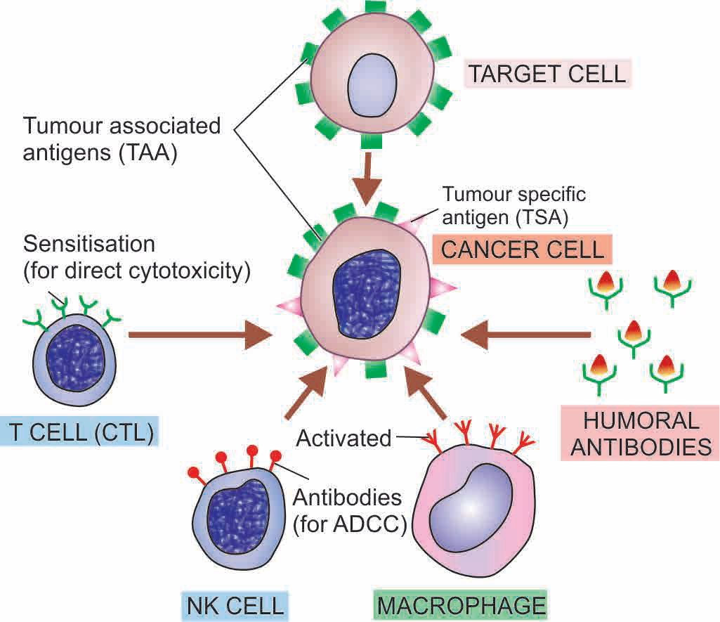
Schematic illustration of immune responses in cancer.
(CTL = cytotoxic T-lymphocyte; NK cell = natural killer cell; ADCC = antibody-dependent cellular cytotoxicity).

Slide 11
3. CANCER IMMUNOTHERAPY
It is a generally-accepted hypothesis that the best defense against human diseases is our own immune system.
Since there is no magic bullet against cancer, immunotherapy has been used as treatment against cancer in combination with other therapies (surgery, radiatation, chemotherapy).

Slide 12
Non-specific stimulation of the host immune response was initially attempted with BCG, Corynebacterium parvum and levamisole, but except slight effect in acute lymphoid leukaemia, it failed to have any significant influence in any other tumour.
Specific stimulation of the immune system was attempted next by immunising the host with irradiated tumour cells butfailed to yield desired results because if the patient’s tumour within the body failed to stimulate effective immunity, the implanted cells of the same tumour are unlikely to do so.

Slide 13
iii) Current status of immunotherapy is focused on following three main approaches:
Cellular immunotherapy consists of infusion of tumourspecific cytotoxic T cells which will increase the population of tumour-infiltrating lymphocytes (TIL). The patient’s peripheral blood lymphocytes are cultured with interleukin-2 which generates lymphokine-activated killer cells having potent antitumour effect.
Cytokine therapy is used to build up specific and non-specific host defenses. These include: interleukin-2, interferon-a and -g, tumour necrosis factor-a, and granulocyte-monocyte colony stimulating factor (GM-CSF).
Monoclonal antibody therapy is undergoing trial against CD20 molecule of B cells in certain B cell leukaemias and lymphomas.

Slide 14
EFFECT OF TUMOUR ON HOST

Slide 15
A. LOCAL EFFECTS
Both benign and malignant tumours cause local effects on the host due to their size or location. Malignant tumours due to rapid and invasive growth potential have more serious effects.
Some of the local effects of tumours are as under:
Compression
Mechanical obstruction
Tissue destruction
Infarction, ulceration, haemorrhage

Slide 16
B. SYSTEMIC MANIFESTATIONS
Generalized effects of cancer include cancer cachexia, fever, tumour lysis syndrome and paraneoplastic syndromes

Slide 17
Paraneoplastic syndromes
(PNS)
Paraneoplastic syndromes (PNS) are a group of conditions developing in patients with advanced cancer which are neither explained by direct and distant spread of the tumour, nor by the usual hormone elaboration by the tissue of origin of the tumour.
About 10 to 15% of the patients with advanced cancer develop one or more of the syndromes included in the PNS.
Rarely, PNS may be the earliest manifestation of a latent cancer.

Slide 18
Endocrine syndrome
Elaboration of hormones or hormone-like substances by cancer cells of non-endocrine origin is called as ectopic hormone production.
Some examples are :
Hypercalcaemia Symptomatic hypercalcaemia unrelated to hyperparathyroidism is the most common syndrome in PNS. It occurs from elaboration of parathormone- like substance by tumours such as squamous cell carcinoma of the lung, carcinoma kidney, breast and adult T cell leukaemia lymphoma.
Cushing’s syndrome About 10% patients of small cell carcinoma of the lung elaborate ACTH or ACTH-like substance producing Cushing’s syndrome. In addition, cases with pancreatic carcinoma and neurogenic tumours may be associated with Cushing’s syndrome.

Slide 19
c) Polycythaemia Secretion of erythropoietin by certain tumours such as renal cell carcinoma, hepatocellular carcinoma and cerebellar haemangioma may cause polycythaemia.
d) Hypoglycaemia Elaboration of insulin-like substance by fibrosarcomas, islet cell tumours of pancreas and mesothelioma may cause hypoglycaemia.

Slide 20
ii) Neuromyopathic syndromes
About 5% of cancers are associated with progressive destruction of neurons throughout the nervous system without evidence of metastasis in the brain and spinal cord.
This is probably mediated by immunologic mechanisms. The changes in the neurons may affect the muscles as well.
The changes are: peripheral neuropathy, cortical cerebellar degeneration, myasthenia gravis syndrome, polymyositis.

Slide 21
iii) Effects on osseous, joints and soft tissue e.g.
hypertrophic pulmonary osteoarthropathy and clubbing of fingers in cases of bronchogenic carcinoma, by unknown mechanism but is probably due to increased blood flow to the limb.

Slide 22
iv) Haematologic and vascular syndrome
e.g.
venous thrombosis (Trousseau’s phenomenon), non-bacterial thrombotic endocarditis, disseminated intravascular coagulation (DIC), leukemoid reaction and normocytic normochromic anaemia occurring in advanced cancers.
Autoimmune haemolytic anaemia may be associated with B-cell malignancies.

Slide 23
v) Gastrointestinal syndromes
Malabsorption of various dietary components as well as hypoalbuminaemia may be associated with a variety of cancers which do not directly involve small bowel.
vi) Renal syndromes Renal vein thrombosis or systemic amyloidosis may produce nephrotic syndrome in patients with cancer.

Slide 24
vii) Cutaneous syndromes
Acanthosis nigricans characterised by the appearance of black warty lesions in the axillae and the groins may appear in the course of adenocarcinoma of gastrointestinal tract.
Other cutaneous lesions in PNS include seborrheic dermatitis in advanced malignant tumours and exfoliative dermatitis in lymphomas and Hodgkin’s disease.
viii) Amyloidosis
Primary amyloid deposits may occur in multiple myeloma whereas renal cell carcinoma and other solid tumours may be associated with secondary systemic amyloidosis.

Slide 25
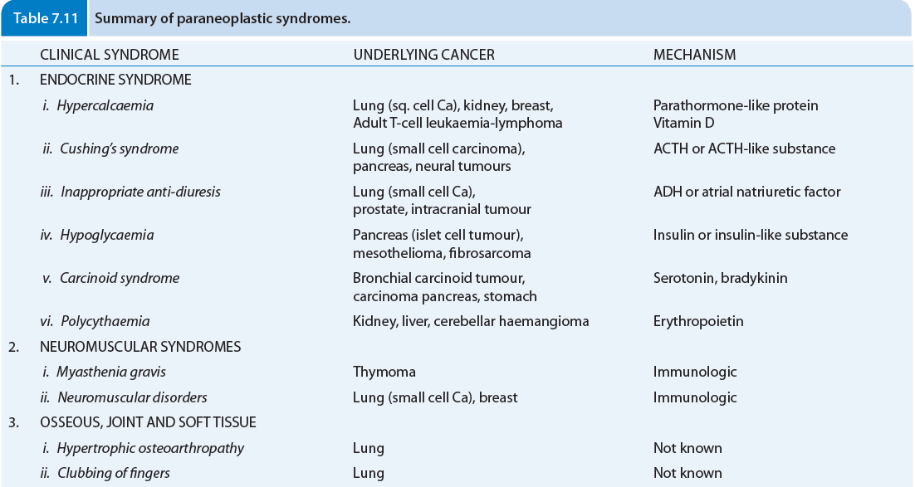

Slide 26
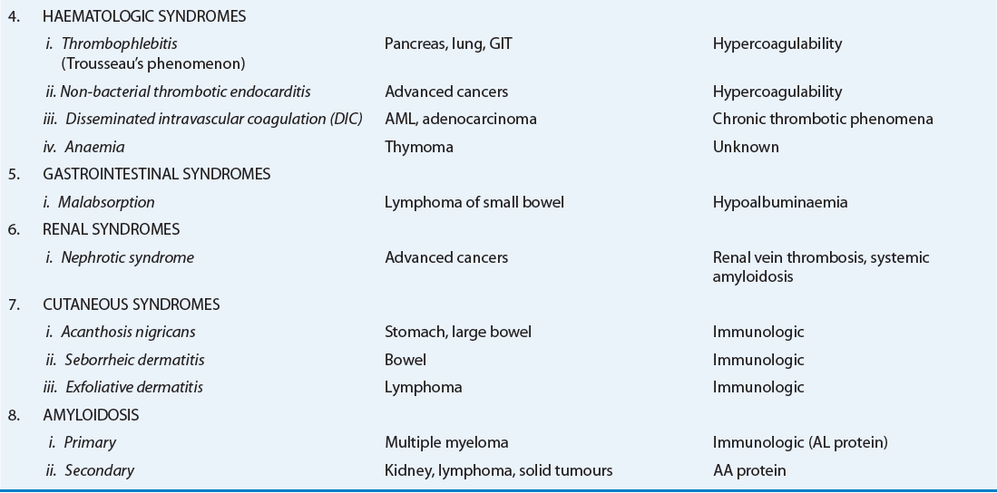

Slide 27
MCQ

Slide 28
1. The local effects of tumours are as under:
Compression
Mechanical obstruction
Infarction, ulceration, haemorrhage
All of the above

Slide 29
2. Presently distinction of tumour antigens is based on their recognition by the host immune cells, i.e.
CD8+ T cells (CTL)
Platelets
Mast cells
Endothelial cells

Slide 30
3. Natural killer (NK) cells are lymphocytes which after activation by
Il-3
IL-2
IL-5
IL-6

Slide 31
4. Following skin lesion is not the PNS
Acanthosis nigricans
seborrheic dermatitis
exfoliative dermatitis
Lichen planus

Slide 32
5. Haematologic and vascular para neoplastic syndrome is,
venous thrombosis (Trousseau’s phenomenon)and leukemoid reaction
non-bacterial thrombotic endocarditis,
disseminated intravascular coagulation (DIC),
All of above

Slide 33
ANSWER KEY

Slide 34
MCQ NUMBER | CORRECT ANSWER
1 | D
2 | A
3 | B
4 | D
5 | A

Slide 35
☺ THANK YOU ☺

