Slide 1




Slide 2
OUTLINE
Definition and classification
Brief anatomy and pathophysiology of the chest
Recognize the types and mechanisms of life threatening thoracic injuries
Initial assessment and mx of various thoracic injuries
Secondary mx of thoracic injuries and some unique challenges they can impose

Slide 3
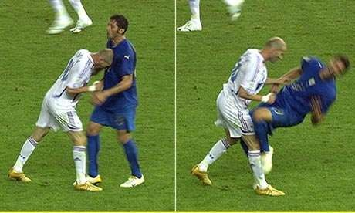
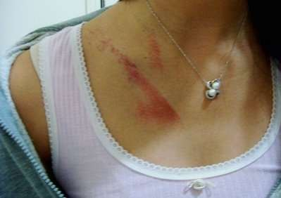
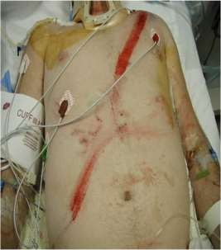
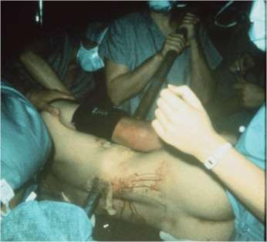
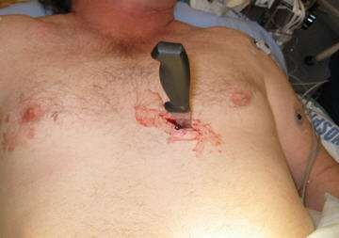
CHEST TRAUMA

Slide 4

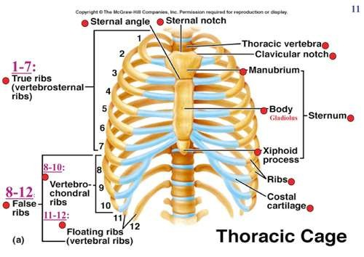
Anatomy of the chest
Thoracic Inlet..
Connects thoracic cavity to the root of the Neck.

Slide 5
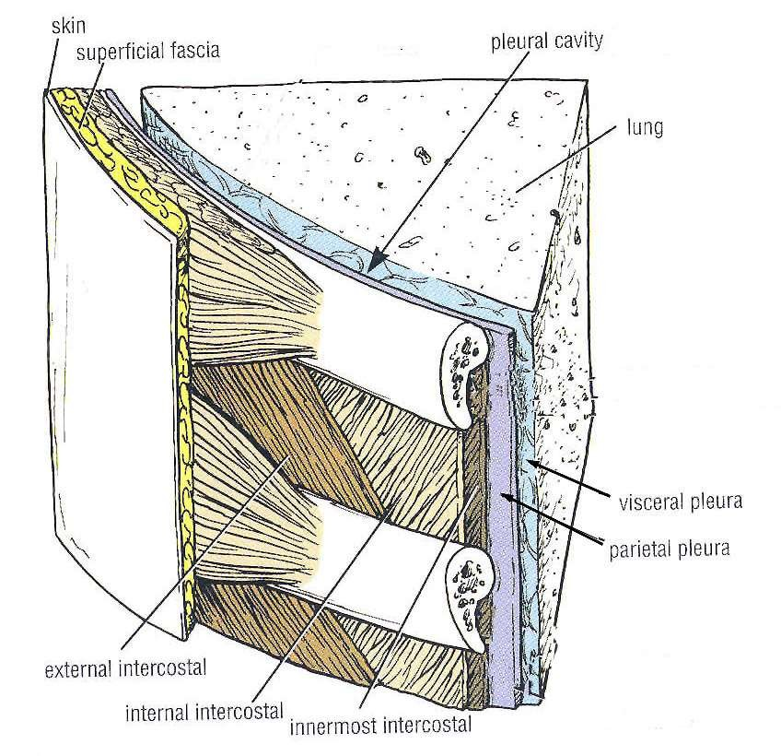
Thoracic Wall

Slide 6

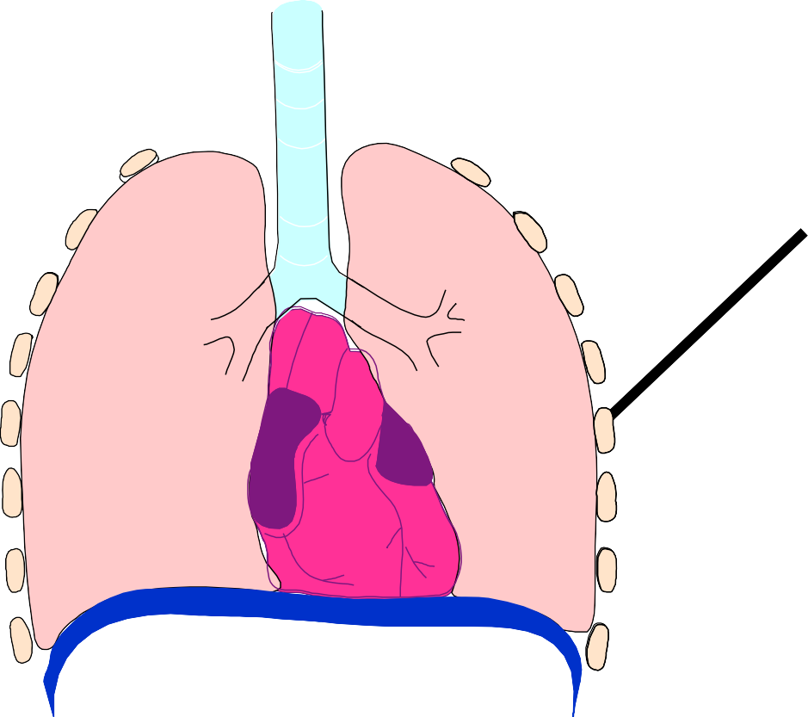









Anatomy of the chest
Two Lungs (right and left)
Heart Diaphragm

Slide 7


BLUNT
CHEST TRAUMA
PENETRATING

Slide 8
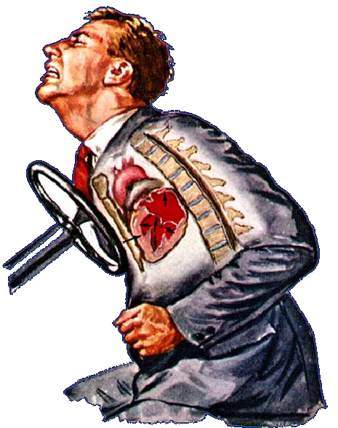
BLUNT TRAUMA TO THE CHEST
Acceleration/Deceler ation Injury
  MVA
  Falls > 3m
  Sports
Compression ( AP & transverse )
Blast Injuries

Slide 9
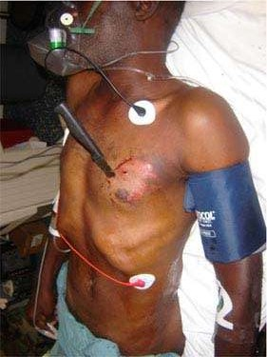
PENETRATING CHEST TRAUMA
High velocity
  Gun shot
  Missile fragments
Low velocity
  Stab injury

Slide 10
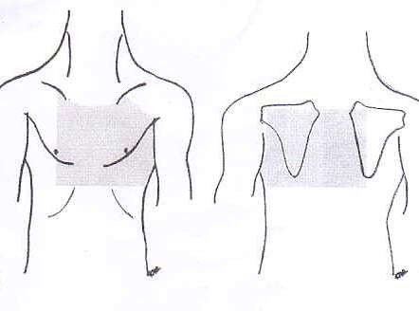
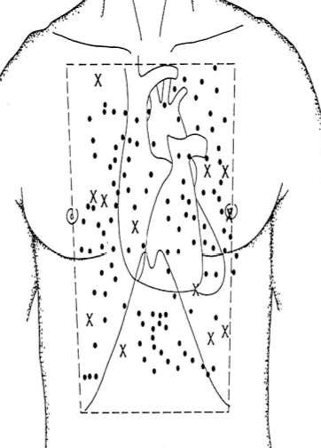
Danger box

Slide 11
Epidemiology
A third of RTA’s have significant chest trauma
Approx. 80% is blunt chest trauma
20 - 25% overall mortality
Majority of the deaths are preventable
< 10% of BCT require surgical intervention as opposed to 15 - 30% in PCT

Slide 12
CLINICAL PRESENTATION
VARIED
 Polytraumatized with other injury components i.e. abdominal hemorrhage
MECHANISM OF INJURY
HIGH INDEX OF SUSPICION FOR SINISTER BADNESS BENEATH THE SURFACE

Slide 13

Initial Management – Primary Survey (ATLS protocol)
Airway/spinal stabilization
Trachea, bronchial disruption
Breathing
Chest wall integrity, pneumothorax, flail
Pulmonary contusions, 0₂ diffusion block
Circulation
Tamponade, hemothorax, tension pneumothorax
Cardiac, great vessel injury

Slide 14
“TREAT LIFE THREATENING INJURIES AS THEY ARE IDENTIFIED”

Slide 15
IMMEDIATE LIFE THREATENING THORACIC INJURIES
Cardiac disruption/tamp onade
Tracheal disruption
Contained Aortic transection
Tension pneumothorax
Massive hemothorax
Open pneumothorax

Slide 16
Crucial 1° Survey Differential Dx: Cardiac Tamponade vs Tension Pneumothorax
Clinical Sign | Cardiac Tamponade | Tension Pneumothorax
Blood Pressure | Low (PEA) | Low
Cardiac Tones | Muffled | Normal
Breath Sounds | Normal | Absent - collapsed side
Neck Veins | Distended (flat in hypovolemia) | Flat
Respirations | ± Normal | Tachypnea
Treatment | Needle/drain pericardium | Needle/tube chest




Slide 17
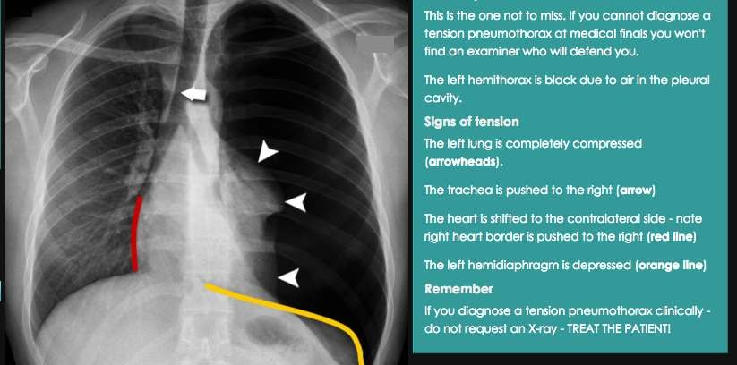
TENSION PNEUMOTHORAX

Slide 18
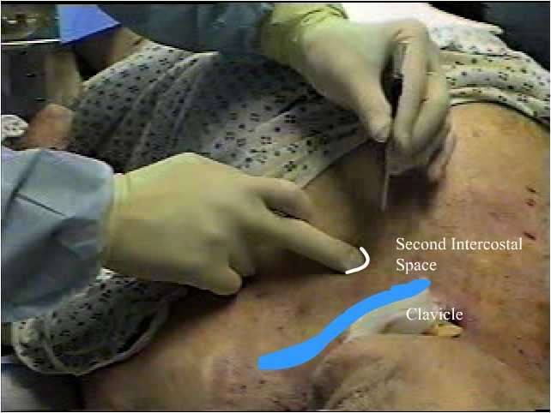
Needle Decompression
www.health-nurses- doctors.blogspot.com
3/16/2017

Slide 19
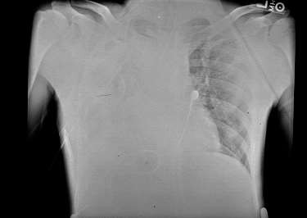
MASSIVE HEMOTHORAX

Slide 20
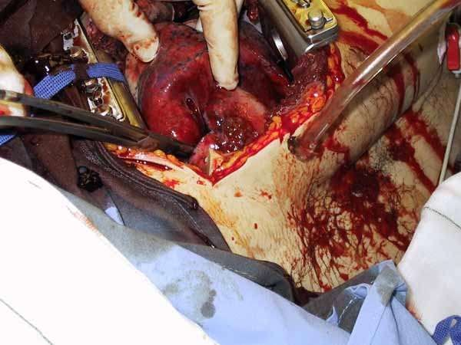
Application of Pulmonary Hilar Cross Clamp

Slide 21
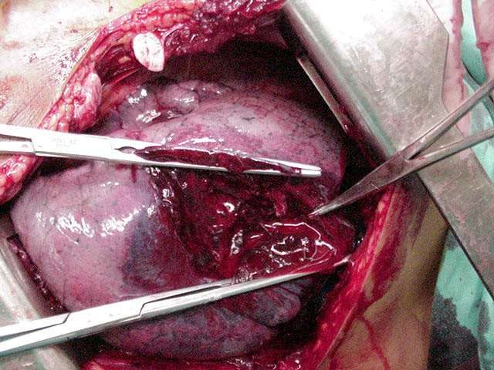
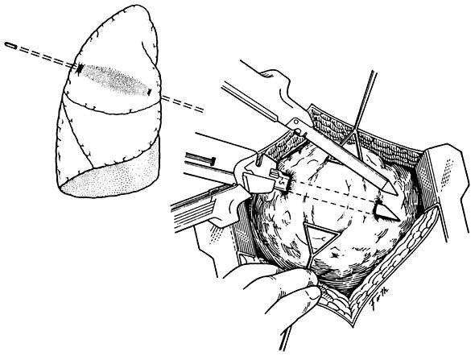
Pulmonary Tractotomy
Lung-Sparing Surgery After Penetrating Trauma Using Tractotomy, Partial Lobectomy, and Pneumonorrhaphy
George C. Velmahos, MD, PhD; Craig Baker, MD; Demetrios Demetriades, MD, PhD; Jeremy Goodman; James A. Murray, MD; Juan A. Asensio, MD
Arch Surg. 1999;134:186-189.

Slide 22
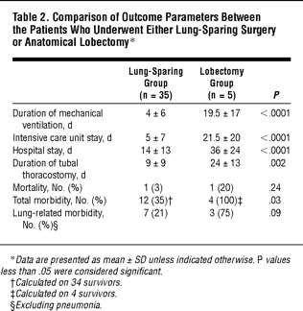
Pulmonary Tractotomy

Slide 23
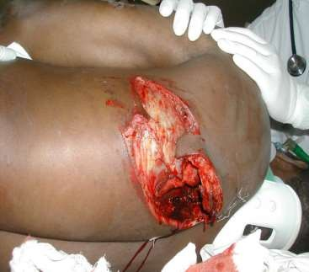
OPEN PNEUMOTHORAX
“Sucking” chest wound
Respiratory distress
Preferential path of air
when hole ≥ ⅔ diameter of trachea
Cover 3 sides
EMERGENCY ICC INSERTION

Slide 24
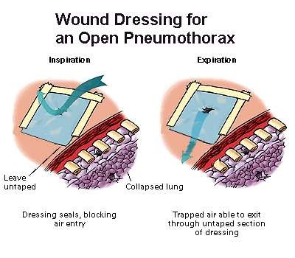
Occlusive Dressing

Slide 25
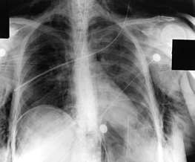
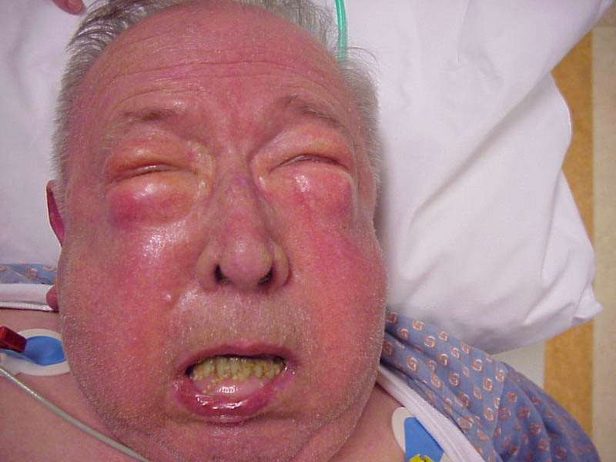
TRACHAEL DISRUPTION

Slide 26

TRACHAEL DISRUPTION
Blunt or penetrating trauma
Intra/extra thoracic location (supraglotic, glotic, subglotic
PRESENTATION
  Massive, sometimes uncontrollable air leak
  Stridor, acute respiratory distress, voice change
  Neck, upper chest subcutaneous emphysema – often massive and disfiguring
Acutely manage with bronchoscopy, deep intubation (beyond injury) and sometimes tracheostomy

Slide 27
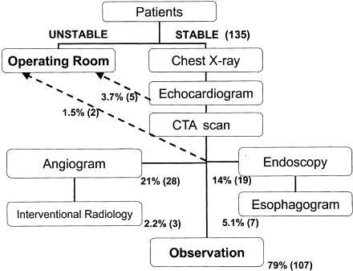
Management Algorithm for Penetrating Mediastinal Trauma

Slide 28
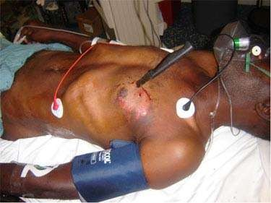
CARDIAC TRAUMA

Slide 29
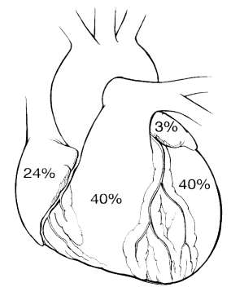
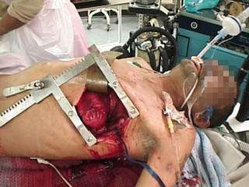
Distribution of Penetrating Cardiac Trauma

Slide 30
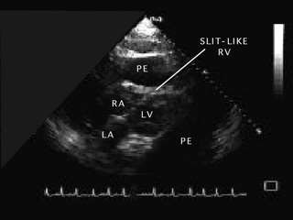
PERICARDIAL TAMPONADE

Slide 31
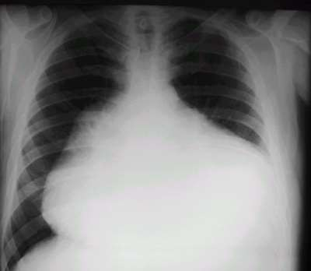

Slide 32
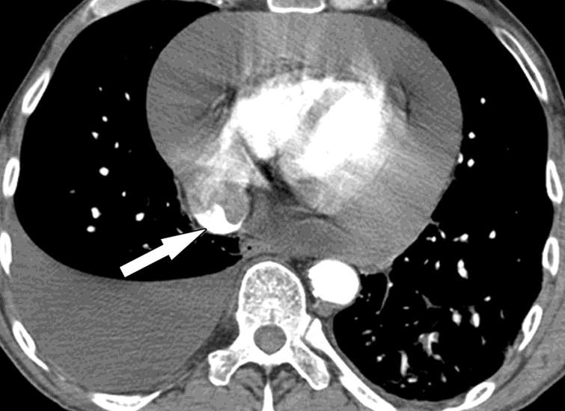
CT AXIAL VIEW

Slide 33
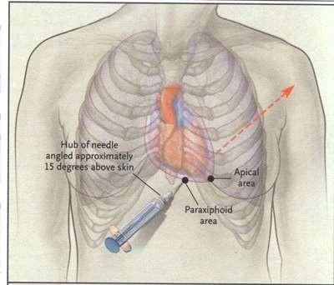
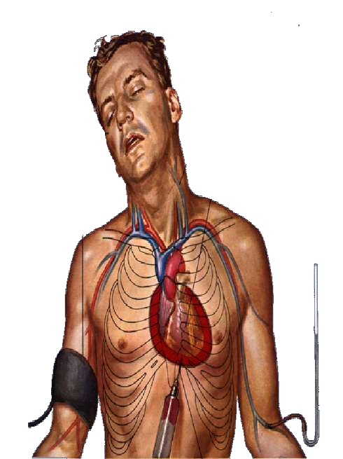
PERICARDIOCENTE SIS

Slide 34
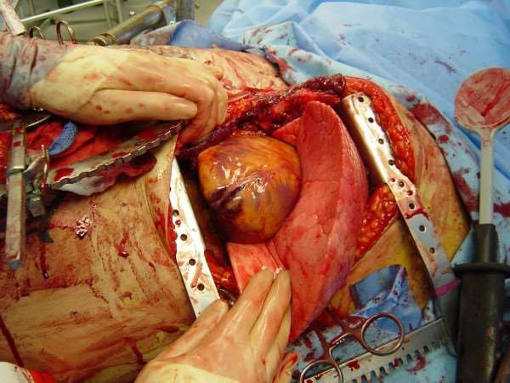
ED Thoracotomy (EDT)

Slide 35
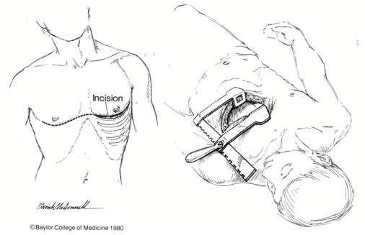
LEFT ANTERIOR THORACOTOMY

Slide 36
Rationale for EDT
Resus agonal pt with PCT
Evacuation of pericardial tamponade
Control intra-thoracic hemorrhage
  X-clamp to DTA
  X-clamp the hilum of the lung
Perform open CPR
Repair cardiac injuries
Asensio JA, et.al. An evidence-based critical appraisal of emergency department thoracotomy, Evidence- Based Surgery 2003: 1(1) 11-21.

Slide 37
FORMIDABLE UNDERTAKING
· Uncontrolled set up
Iatrogenic injury from sharps
Transmission of communicable diseases
 HIV, HEPATITIS
DISTRACTING e.g requires significant resources

Slide 38
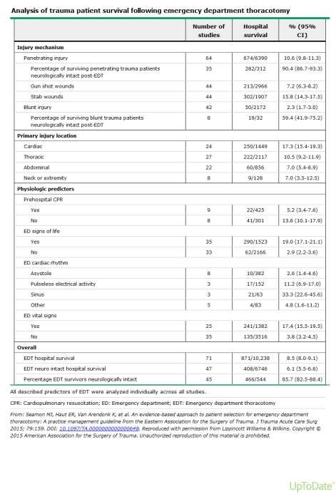


Slide 39
Eastern Association For the Surgery of Trauma Guidelines (EAST)
Patient manifest signs of life in the field or the hospital
Patient has PCT and is hemodynamically unstable despite appropriate fluid resuscitation OR has required CPR for < 15 mins
A thoracic or trauma surgeon is available within 45 mins

Slide 40
SIGNS OF LIFE
Spontaneous breathing
Palpable carotid pulse
Measurable BP
Electrical cardiac activity
Pupillary light response
Spontaneous extremity movement

Slide 41
Contra-indications for EDT
NO PULSE OR BP IN THE FIELD
ASYSTOLE AND NO PERICARDIAL TAMPONADE
CPR > 15mins
MASSIVE NON SURVIVABLE INJURIES
NO THORACIC OR TRAUMA SURGEON WITHIN
45 mins

Slide 42
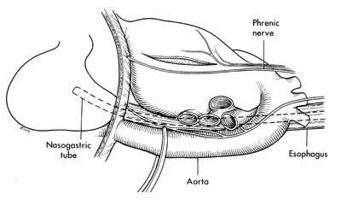
Application of Aortic Cross Clamp

Slide 43
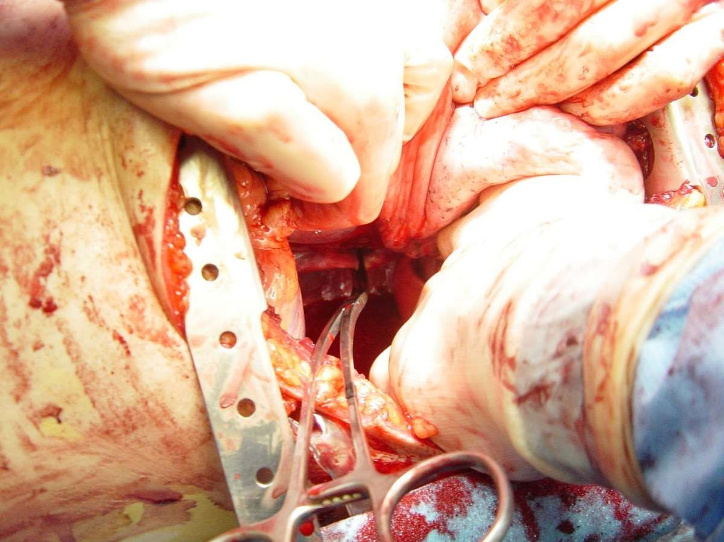
Esophagus
Aorta
Spine
Diaphragm

Slide 44
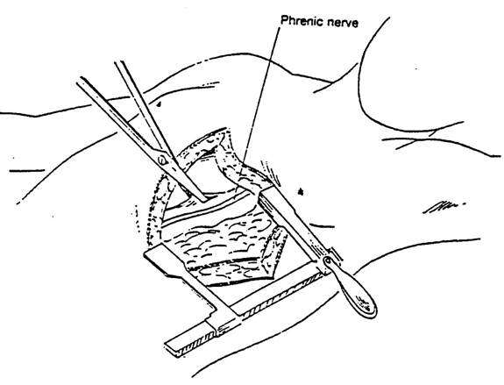

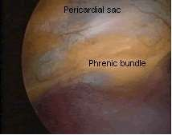
Vertical Pericardial Incision
A

Slide 45
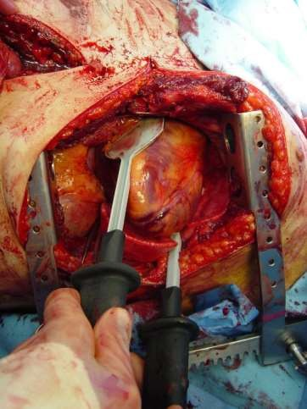
Internal Paddles for Direct Cardioversion

Slide 46
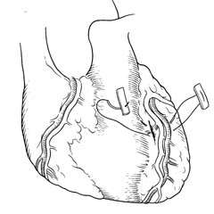
Laceration Adjacent to Coronary Artery

Slide 47
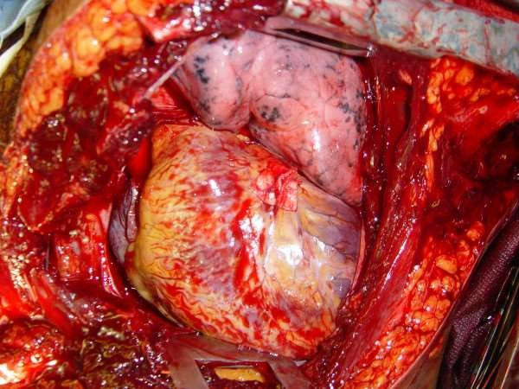
Laceration Adjacent to Coronary Artery

Slide 48
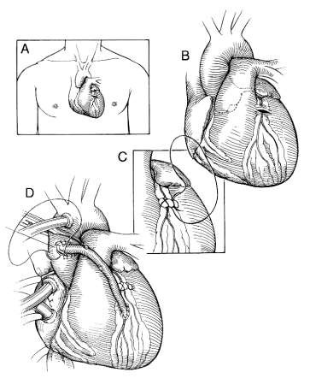
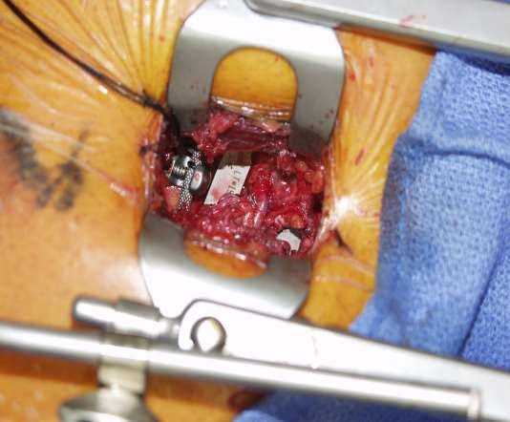
Coronary Artery Laceration

Slide 49
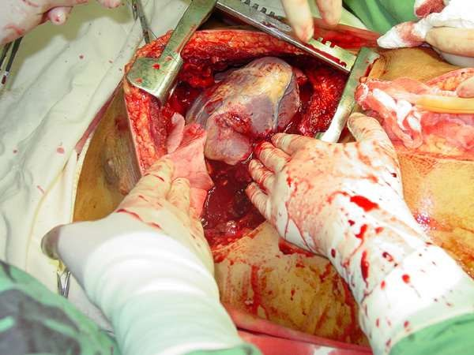
Ventricular Laceration

Slide 50
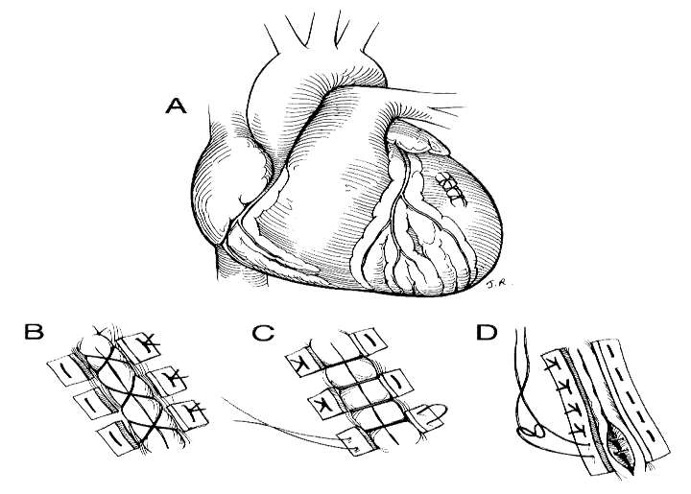
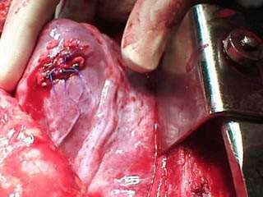
Ventricular Lacerations and Repairs

Slide 51
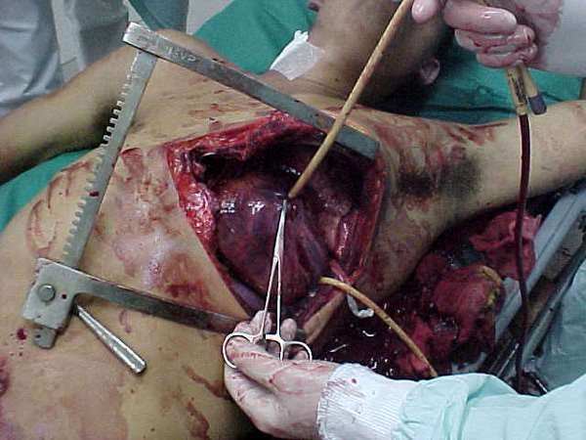
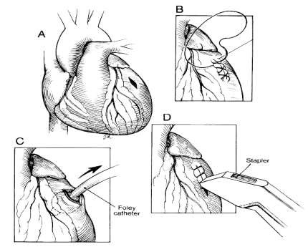
Ventricular Lacerations and Repairs

Slide 52
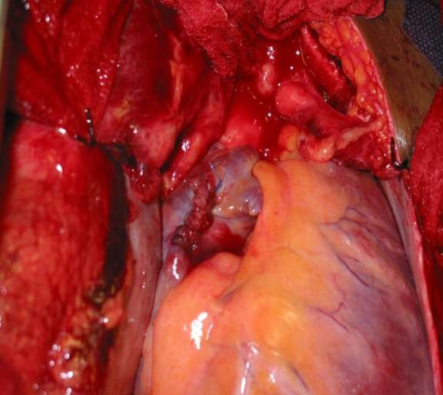

Atrial Lacerations and Repairs

Slide 53

Immediate Life Threatening Thoracic Injuries: Aortic Disruption
Occurs commonly @ Ligamentum arteriosum
≅ ⅓ fatality on site due to free rupture
Exsanguination
Rapid acceleration- deceleration ( i.e.
MVA, falls from height
> 3m)

Slide 54

Contained Injuries to the Aorta
Widened mediastinum
Obliteration of aortic knob
Right deviation of trachea
Depression of LMS bronchus
Pleural/apical cap
Left hemothorax (can be bilateral)
Fractures of 1st and/or 2nd ribs

Slide 55


Contained Injuries to the Aorta

Slide 56
Contained Injuries to the Aorta
Not a source of multiple hypotensive episodes in survivors - look for other injuries
Salvageable tear when
hematoma contained
~⅓ die per 24 hours without treatment
Widened mediastinum very unreliable sign on portable x-ray
· TEE, helical contrast CT
scan, MRI, aortogram
· TEVAR
· Address after life threatening injuries stabilized

Slide 57
POST TRAUMATIC PNEUMOTHORAX
≥ 15% OF THE THORAX
Intercostal tube drain
Eighty percent of chest trauma including PCT managed by ICC

Slide 58
Rib Fractures
Isolated or multiple
Segmental > 3 ribs
1st to 3rd rib involvement underlying intrathoracic visceral involvement
 Uncommon

Slide 59
· Significant morbidity and even mortality
Poor pain control
Underlying lung disease
Elderly
Atelectasis ➔ Pneumonia➔Respiratory failure
Thromboembolism

Slide 60

Flail chest
3 or more adjacent ribs # @ 2 or more places
Cautious fluid resus.
Analgesia
EVOLVING PULMONARY CONTUSIONS

Slide 61
SURGICAL FIXATION vs
CONSERVATIVE MX
PAIN CONTROL
⬇⬇⬇ VENTILATORY REQUIREMENTS
SHORTER ICU & HOSPITAL STAY
IMPROVED POST-OP RESP FUNCTION

Slide 62
STERNAL FRACTURES
· Significant impacting force
MVA with steering wheel impact or
seat belt injury
UNDERLYING CARDIAC CONTUSION
 CXR, e-FAST, ECG and serial troponin

Slide 63



Slide 64


Blunt Cardiac Injuries

Slide 65

Cardiac Contusions
Acute injury pattern (ant STEMI I, aVL, V₂-V₄, ↓II,III, aVF), LBBB
Watch for & treat PVC’s aggressively (K⁺, temp)
Rx acute myocardial infarction, inotropes
Cardiac Echo to assess wall motion, valves

Slide 66
TUBE THORACOSTOMY
Almost 90% of chest trauma
Maintain or regain respiratory and hemodynamic stability
Within 48h of trauma
  Tension pneumothorax
  Traumatic symptomatic pneumothorax
  Worsening occult pneumohemothorax

Slide 67

Triangle Of Safety

Slide 68
Contra- Indications
Absolute…. Need for emergency Thoracotomy
Relative
  Bleeding Diathesis
  Anti-coagulation
  Adhesions
  Loculations
  Pulmonary bullae
68

Slide 69
Complications of Chest Tube
· Hemorrhage
Infection
Trauma to the Liver, Spleen, Diaphragm, Aorta, Heart.
Minor complications
Subcut hematoma, Cough, Dyspnea.
Improper placement

Slide 70

INSERTION OF A CLOSED THORACOSTOMY TUBE

Slide 71
Summary
Life ending thoracic injuries are common
Survival depends on proper and immediate diagnosis and appropriate management
ED thoracotomy can save lives but expected survivorship is <10%
Don’t forget ABC’s of trauma and damage control principles

