Slide 1
AUTOLOGOUS BLOOD TRANSFUSION
Dr. Vidhi Jain
Assistant Professor
SBKS MI & RC

Slide 2
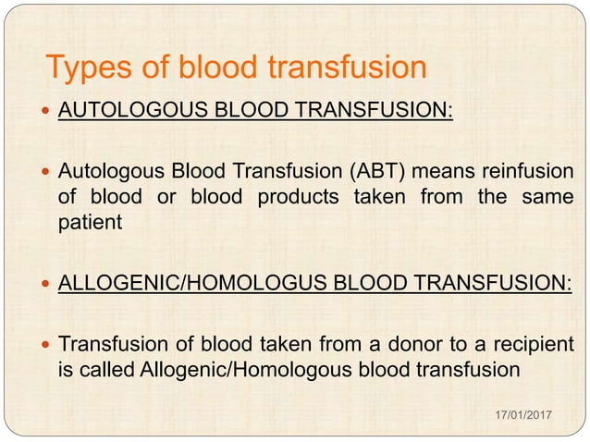

Slide 3
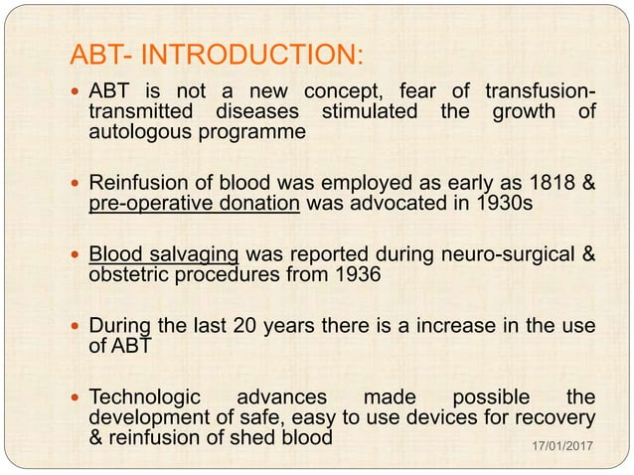

Slide 4
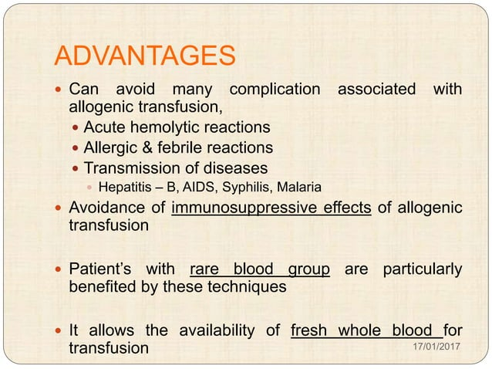

Slide 5
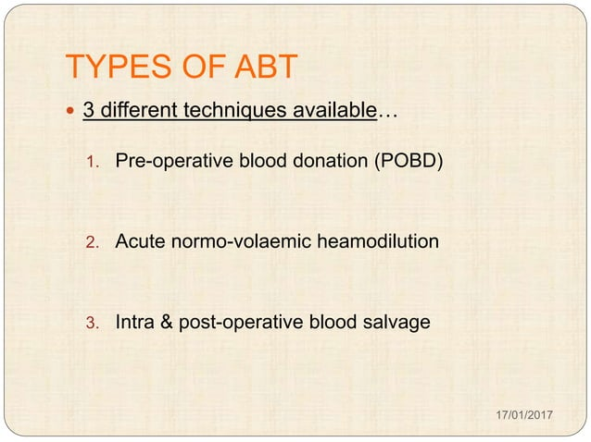

Slide 6
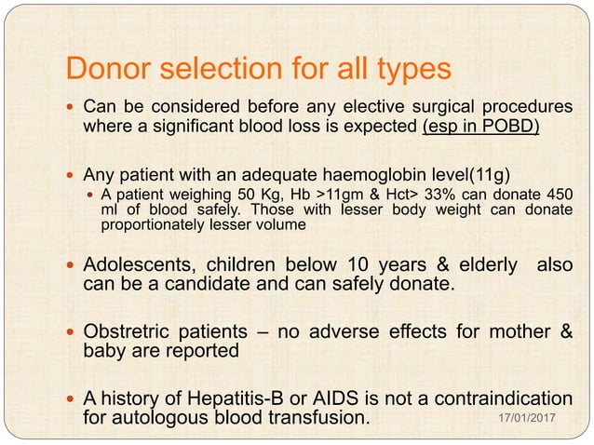

Slide 7
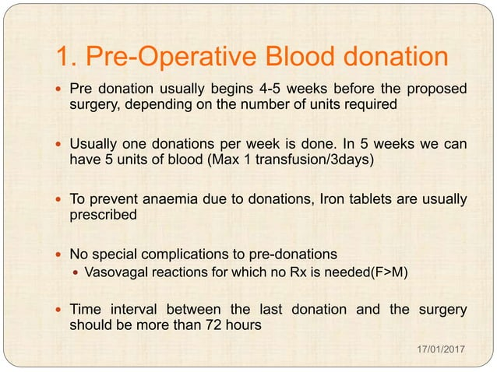

Slide 8
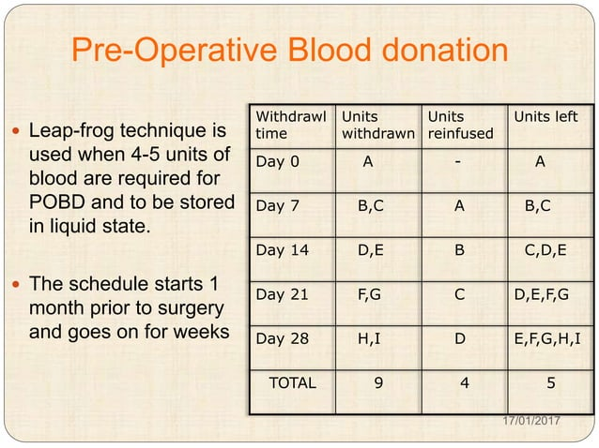

Slide 9
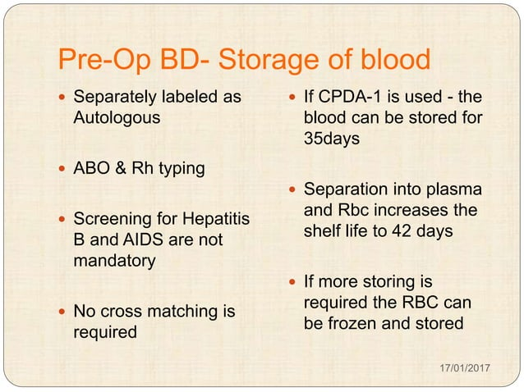

Slide 10
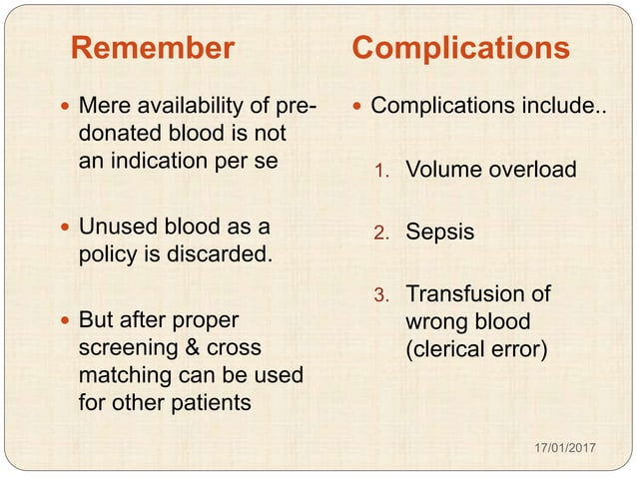

Slide 11
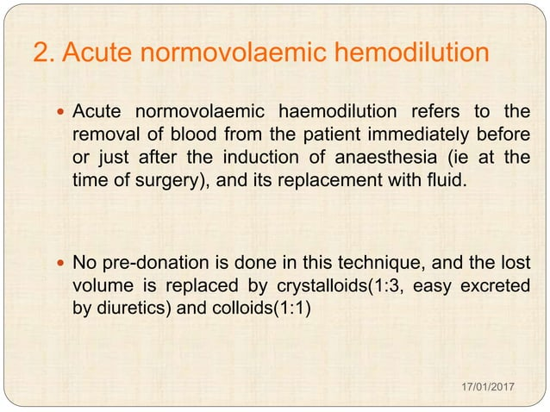

Slide 12
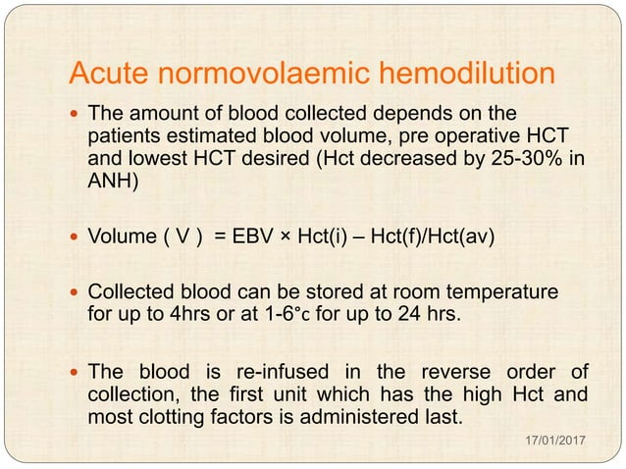

Slide 13
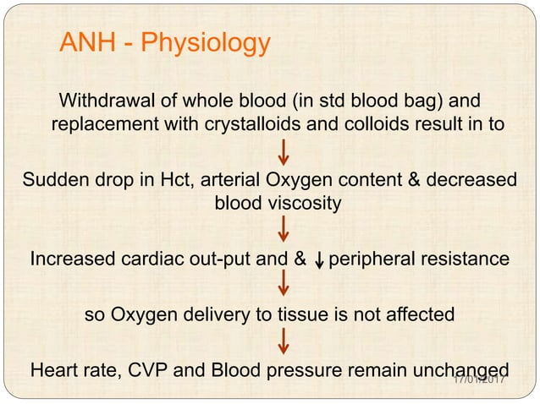

Slide 14
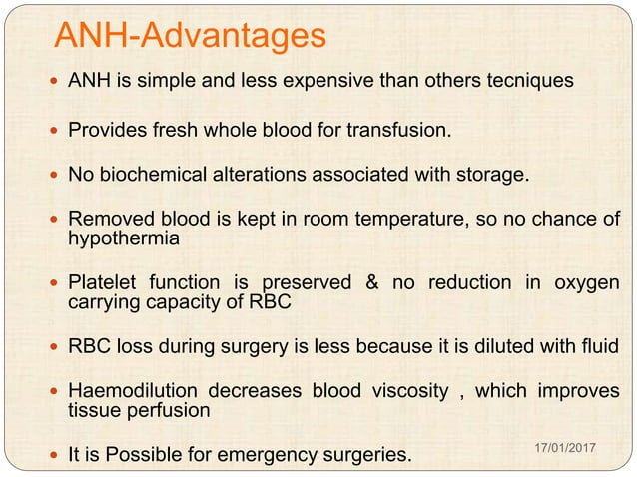

Slide 15
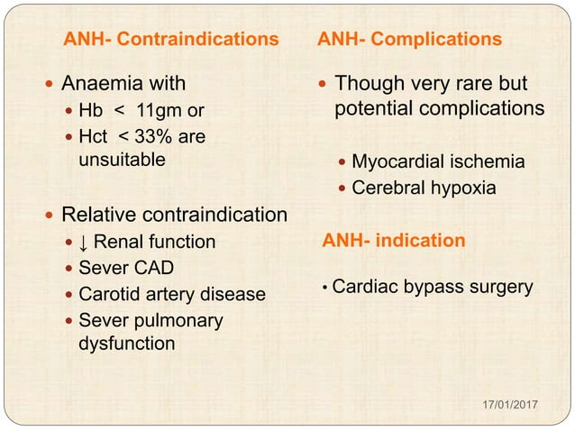

Slide 16
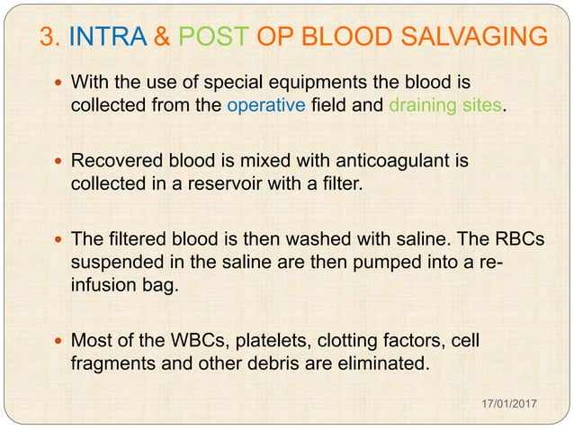

Slide 17
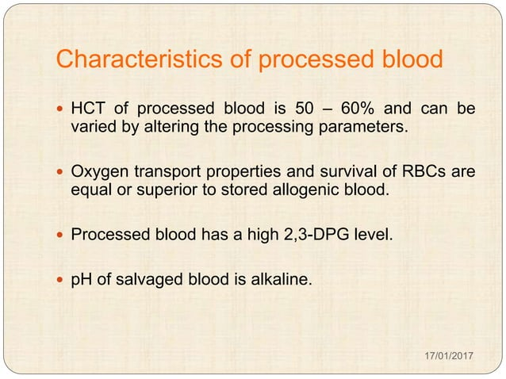

Slide 18
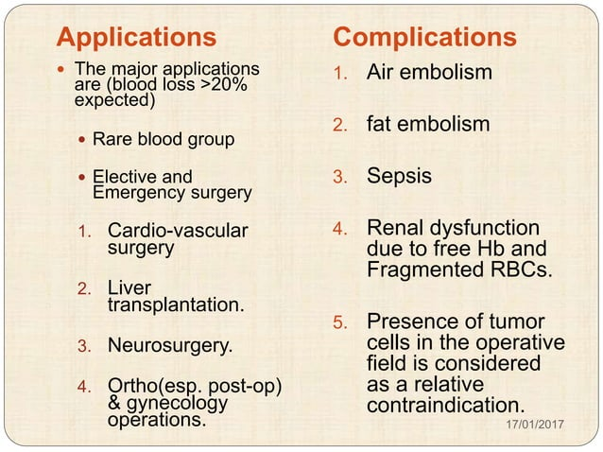

Slide 19
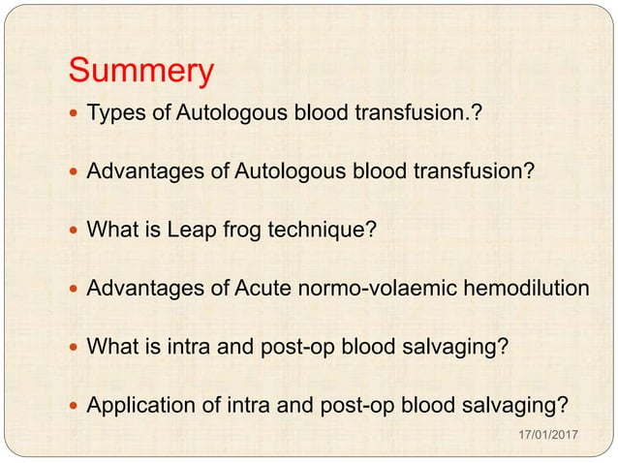

Slide 20
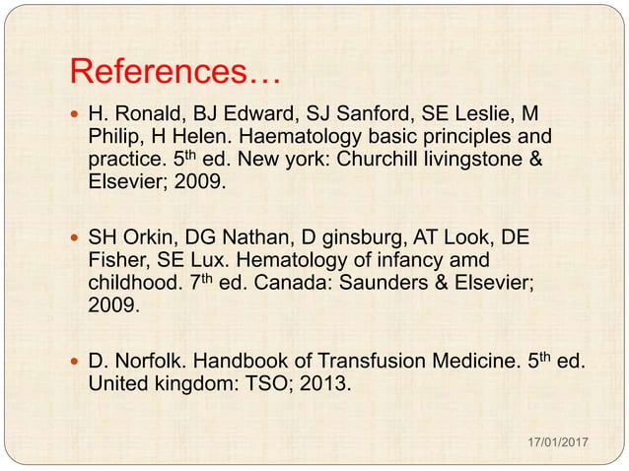

Slide 21
MCQs

Slide 22
Which fluid should be used to dilute RBCs?
  0.9% Normal Saline
  Lactated Ringer Solution
  5% Dextrose and water
  Immune globulin

Slide 23
2. Followings are criteria for Autologous Blood Donation. EXCEPT:
a. Hb<11gm/dL
b. Hct >33%
c. weight 50kg
d. Hepatitis B positive

Slide 24
3. In Acute Normovolumic Hemodilution collected blood can be stored at room temperature upto _____ hrs.
a. 6hrs
b. 8hrs
c. 4hrs
d. 2hrs

Slide 25
4. If CPDA-1 anticoagulant solution is used, shelf-life of Red cell is ________.
a. 35 days
b. 42 days
c. 21 days
d. 28 days

Slide 26
The most effective component for treating a patient with fibrinogen deficiency is:
a. Fresh Frozen Plasma
b. Fresh Whole Blood
c. Platelet Concentrates
d. Cryoprecipitates

Slide 27
Answers
1-A
2-A
3-C
4-A
5-D

Slide 28


