Slide 1
MINIMAL INVASIVE SURGERY
Prepared by: Dareevan Mahdi
Suprvisor:
Dr. Sardar Hasan
University of Duhok College of Medicine

Slide 2
OBJECTIVES
Definition.
Principle of laparoscopic surgery.
Types of minimal invasive surgery.
Advantages and disadvantages.
Preoperative evaluation.
Contraindications.
Operative problems.
Post operative care.
Surgical principles.
Robotic surgery.

Slide 3
DEFENITION:
Minimal access surgery is a product of modern technology and surgical innovation that aims to accomplish surgical therapeutic goals with minimal somatic and psychological trauma.
This type of surgery has reduced wound access trauma, as well as being less disfiguring than conventional techniques.
It can offer cost-effectiveness to both health services and employers by shortening operating times, shortening hospital stays, improving operative precision compared to open surgery in some (but not all) cases and allowing faster recuperation.

Slide 4
PRINCIPLES OF MINIMAL ACCESS SURGERY
The core principles of minimal access surgery can be summarized by the acronym (I-VITROS)
I: Insufflate.
V: Visualise.
I: Identify.
T: Triangulate.
R: Retract.
O: Operate.
S: Seal/haemostasis.

Slide 5
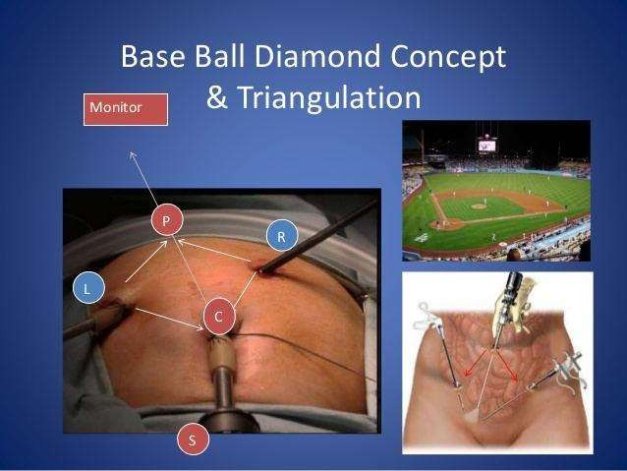

Slide 6
Types of Minimal Invasive Surgery
Minimal access techniques can be categorised as follows:
Laparoscopy.
Thoracoscopy.
Endoluminal endoscopy.
Perivisceral endoscopy.
Arthroscopy.
Combined approach.
NOTES.

Slide 7
Advantages of minimal access surgery
Decrease in wound size.
Reduction in wound infection , dehiscence , bleeding, herniation and nerve entrapment.
Decrease in wound pain.
Improved mobility.
Decreased wound trauma.
Decreased heat loss.
Improved visualization.

Slide 8
Disadvantages of minimal access surgery
Reliance on remote vision and operating.
Loss of tactile feedback.
Dependence on hand eye coordination.
Difficulty with haemostasis.
Reliance on new techniques.
Extraction of large specimens.

Slide 9
Preoperative Evaluation
Preparation of the patient and careful preoperative management is essential to minimize the morbidity.
History.
Examination.
Prophylaxis against thromboembolism.
Urinary catheter and nasogastric tube.
Informed consent.

Slide 10
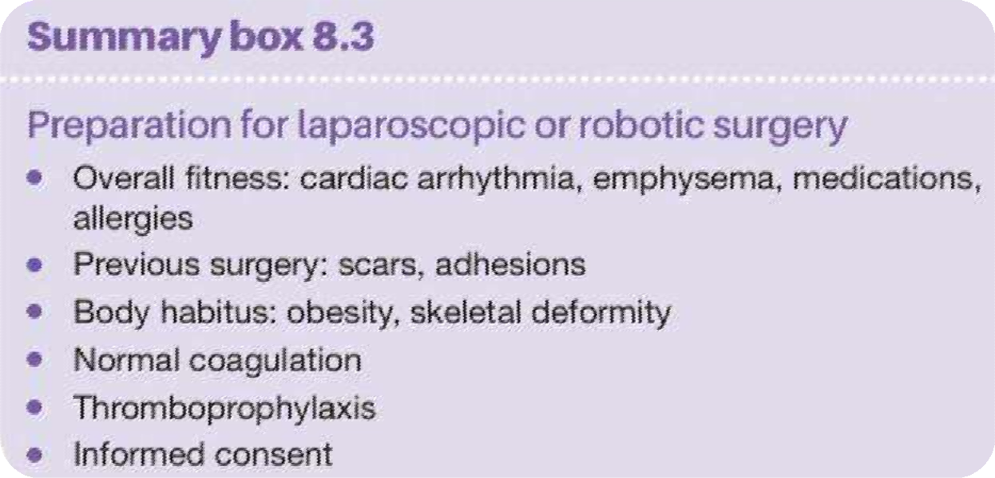


Slide 11
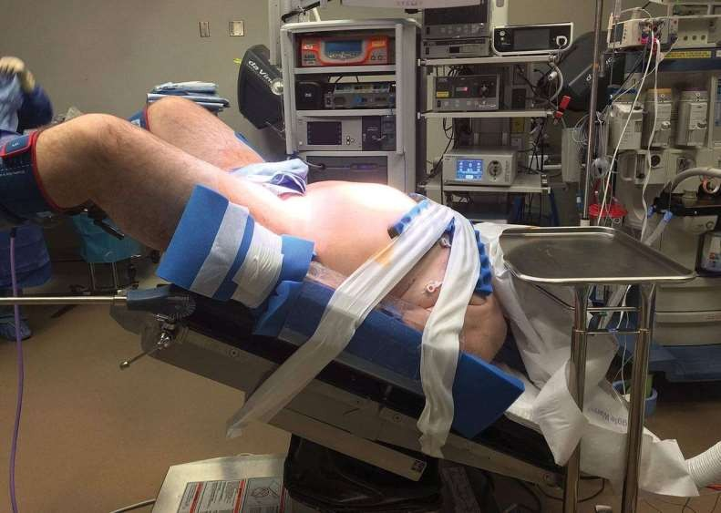

Slide 12
Contraindications-relative
Previous abdominal surgeries.
Morbid Obesity.
Peritonitis.
Bleeding disorders.
Compromised cardiac status.
3rd trimester pregnancy.
Portal hypertention.

Slide 13
Operative Problems
Intraoperative perforation of a viscus.
Bleeding:
1-bleeding from a major vesssel.
2-bleeding from organs encountred during surgery.
3-bleeding from trocar site.
Blood clots.
Septecemia and infection.

Slide 14
Post Operative Complications
Dull upper abdominal pain.
Nausea.
Shoulder tip pain.

Slide 15
Post Operative Care
Analgesia.
Oral fluids.
Oral feeding.
Urinary catheter.
Drains.

Slide 16
Discharge From The Hospital
patient discharge is based on clinical indicators .
One of the core drivers for the application of minimally invasive surgery is an earlier recovery and therefore discharge from hospital. For the common laparoscopic procedure , most surgeons discharge a significant proportion of their laparoscopic patients on the day of surgery, but some are kept in overnight and discharged the following morning.
Patients should not be discharged until they are seen to be comfortable, have passed urine and are eating and drinking satisfactorily.
They should be told that if they develop abdominal pain or other severe symptoms they should return to the hospital.

Slide 17
Patient can get out of bed as soon as they have recovered from the anaesthetic and they should be encouraged to do so.
Such movements are remarkably pain free when compared with the mobility achieved after an open operation.
Similarly, patients can cough actively and clear bronchial secretions, and this helps to diminish the incidence of chest infections.

Slide 18
Surgical Principles
Meticulous care in the creation of a pneumoperitoneum.
Controlled dissection of adhesions.
Adequate exposure of operative field.
Avoidance and control of bleeding.
Avoidance of organ injury.
Avoidance of diathermy damage.
Vigilance in the postoperative period.

Slide 19
Basic Laparoscopic Instruments
Laparoscope.
Light source and fiberoptics.
Trocars.
Devices for dissection and grasping.
Devices for haemostasis.
Surgical staplers.
Tissue removal devices.

Slide 20
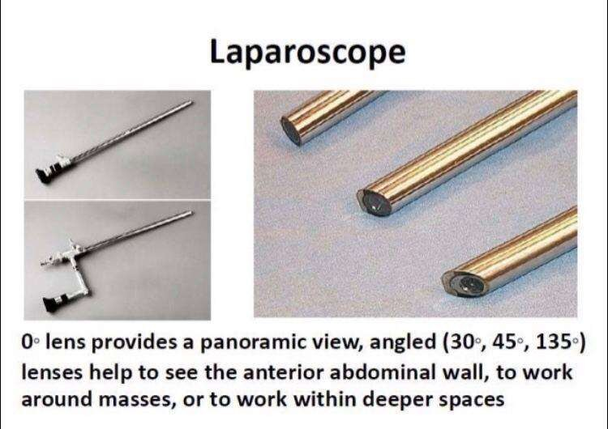

Slide 21
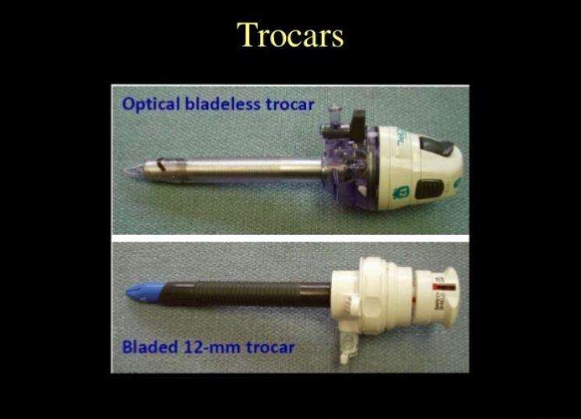

Slide 22
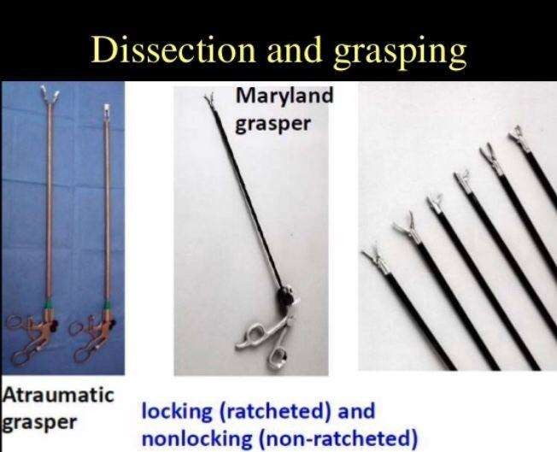

Slide 23
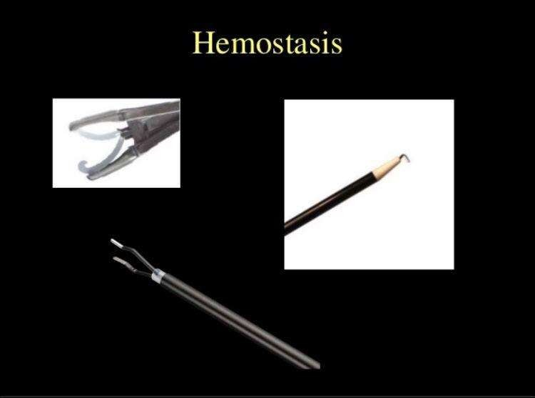

Slide 24
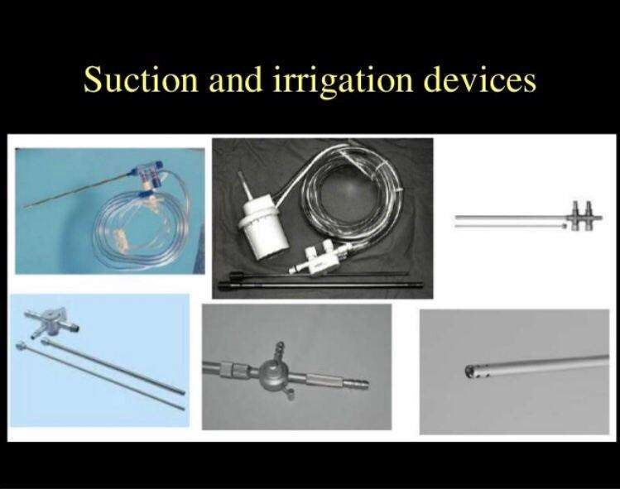

Slide 25
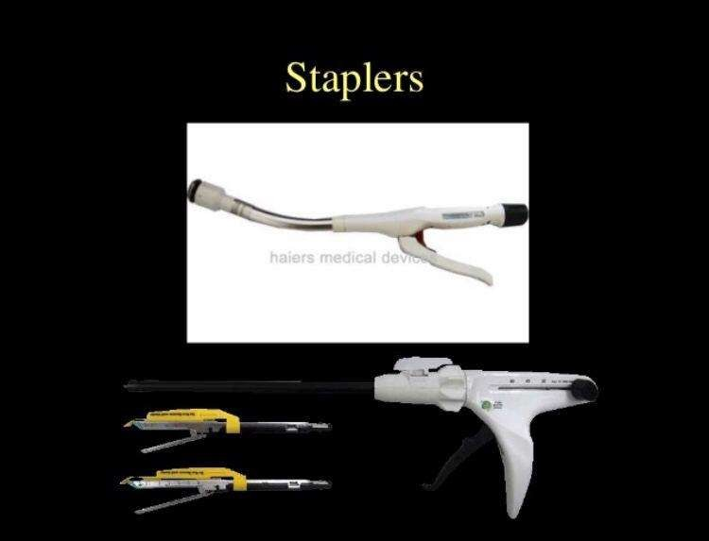

Slide 26
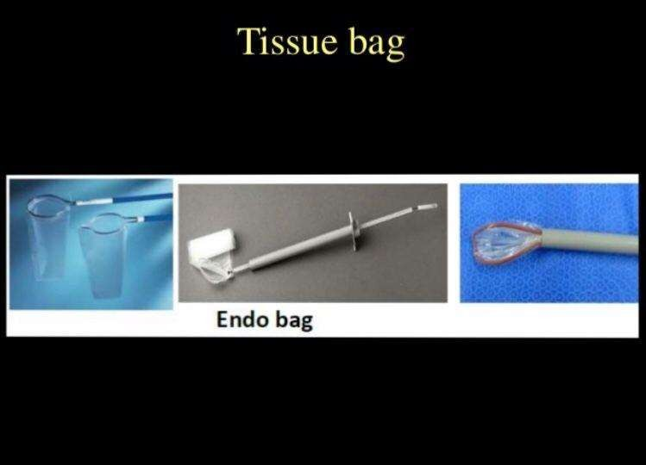

Slide 27
Creating A Pneumoperitoneum
There are two method for creation of pneumopertoneum:
1-closed method.
2-open method ( modifeid Hasson approach).
In some cases combination approach maybe employed.

Slide 28
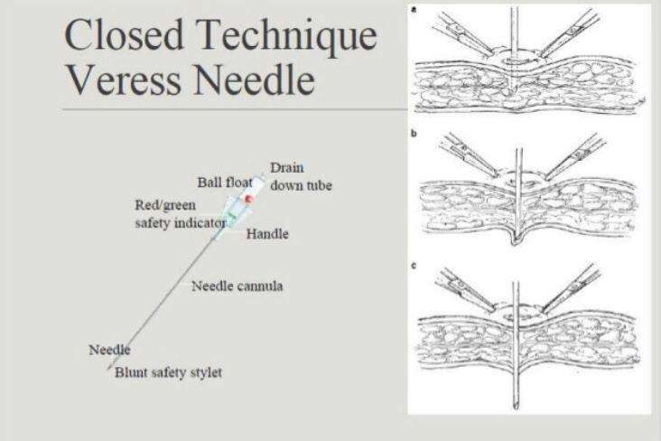

Slide 29
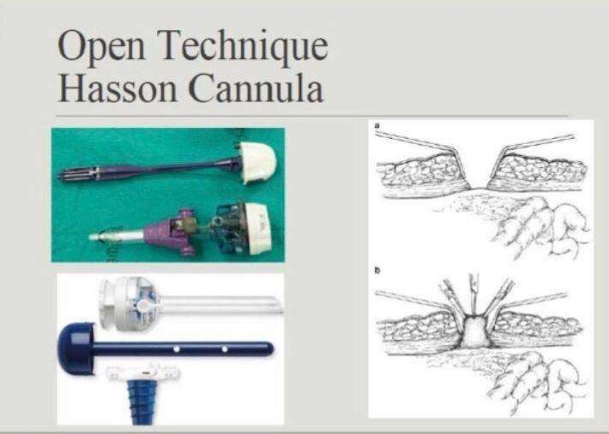

Slide 30
Robotic surgery
Computer enhanced surgical devices.
Steadier image.
Fewer members.
Teleoperated system.
Image guided system.

Slide 31
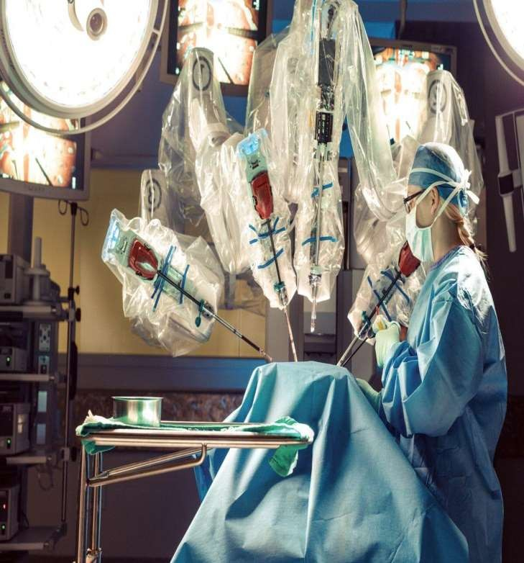

Slide 32
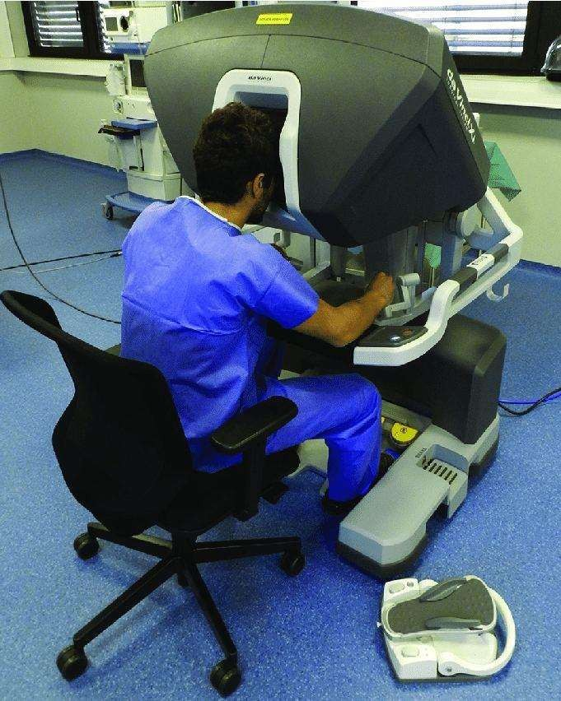

Slide 33
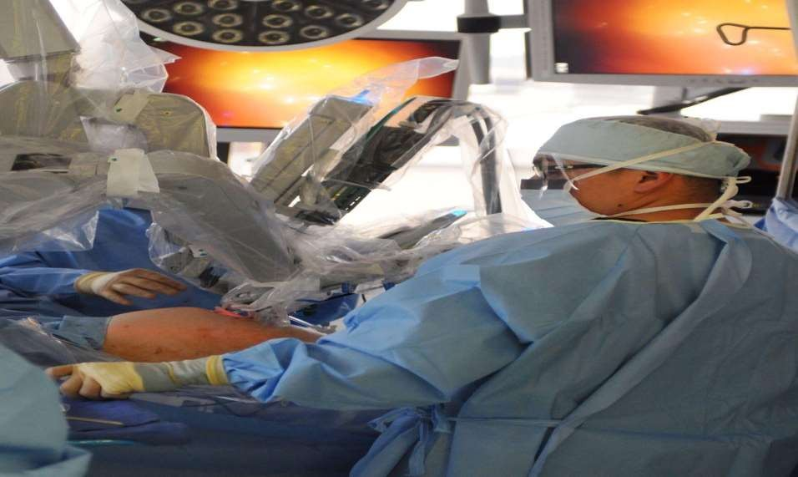

Slide 34
References
Schwartz Principles of surgery. 10th ed.
Bailey and loves. Short practice of surgery. 27th ed.
SRBS manual of surgery. 4th ed.

Slide 35
Thank you

