Slide 1
THYROID MALIGNANCIES
Dr. Pratik Shaparia

Slide 2
THYROID MALIGNANCIES
 | PAPILLARY | FOLLICULAR | ANPLASTIC | MEDULLARY | LYMPHOMA
ETIOLOGY | Irradiation of thyroid under 5 yrs age Ret/PTC3 oncogene for aggressive,ret/PTC1 for less agressive | Persistent thyroid stimulation in endemic area by TSH,irradiation |  | Sporadic,familial 10-20%,MEN 2-A(PHEO,PTH),MEN 2-B(mucosal neuroma,marfanoid habitus | Mostly lymphocytic(hashimoto) thyroiditis,or as part of generalized malignant lymphoma
AGE | young | 20-30 | elderly | no | -
SEX | female | female | female | no | -

Slide 3
 | PAPILLARY | FOLLICULAR | ANAPLASTIC | MEDULLARY | LYMPHOMA
GOITRE | Suspiciously firm,irregular,may be indistingushible from benign,may be impalpable with palpable lymphnodes,pain often reffered to ear,histroy may 5 yrs long | Suspiciously firm and irregular | Hard ,irrregular ,infilterating
LYMPHATIC | yes | yes | yes | In 50-60% | yes
BLOOD BORNE MET |  |  | yes | yes

Slide 4
 | PAPILLARY | FOLLICULAR | ANAPLASTIC | MEDULLARY | LYMPHOMA
BLOOD INVEST. | TSH maybe raised,elevation of anti thyroid antibodies | “
FNAC | Choice inv. | “” | Choice inv, |  | Yes but difficult to diffrientiate from hashimoto
BIOPSY | only if obviously unresecteble | “” | ,isthumusectomy if tracheal compression and biopsy |  | Tru-cut or open,isthmusectomy if tracheal compression
OTHERS | Frozen section to decide level of nodal dissection,CT,MRI OR ULTRASOUND done to know local and nodal extent | “

Slide 5
 | PAPILLARY | FOLLICULAR | ANAPLASTIC | MEDULLARY | LYMPHOMA
HISTOLOGY | A mixture of papillary and colloid filled follicles,in some follicular structures predominate,papillary projections,pale empty nudlei(orphan annie eyed nuclei),seldom encapsulated,multiple foci may occur | Invasion of capsule and vascular spaces,macroscopically encapsulated | undiffrentiated | Parafollicular C- cells tumor,resembles carcinoid tumor,cell-balls and amyloid stroma
TREATMENT
PROGNOSIS

Slide 6
figuresthy.malg.pic.1.pngthy.malg.pic.2 anaplastic.png

Slide 7
TREATMENT OF MALIGNANCY
DIFFRENTIATED(PAPILLARY,FOLLICULAR)
When preop diagnosis has been made
1.HIGH RISK PATINETS e.g.larger than 2 cm tumor,locally aggressive or metastatic disease
total thyroidectomy+
excision of involved structures e.g.trachea,oesophagus,larynx or RLN+
lymphnode dissection+
radio active ablation+
long term TSH suppresion
Notes:
Metastsis are treated with large doses of radioiodine and pt.should be rendered hypothyroid by prior surgery or radioiodine.indications for scannin affter operation-locally recurrent,metastsis,high risk patient,unresectable disease and rising thyroglobulin level.scan should be done after 10 days of radioiodine dose.s.thyrogloblin level and careful palpation should be used to decide repeat dosing.T3(40 to 60 mcg/day) should be used instead of T4(100 to 200 mcg/day) for thyroid suppression who required radioiodine as it is short acting

Slide 8
2.LOW RISK PATIENTS-controversies for best approach
Conservative approach
lobectomy+TSH suppresion if
tumor < 2 cm
Confined to one lobe
Centres low in expirience as 30% risk of hypoparathyroidism,RCN injury
total thyroidectomy if
bilateral disease
Clear indication of post op radioiodine
Preop diagnosis of high risk cancer

Slide 9
Radical approach
all patients
total thyroidecotmy+
Central compartment node dissection+
Radioiodine+
TSH suppresion
2.When diagnosis made after diagnostic lobectomy
TSH suppersion and F/U
completion thyroidectomy if new swelling appears or thyroglobulin level rises

Slide 10
ANAPLASTIC CA.
compete resection if confined to thyroid or strap muscles followed by radiotherpy
Isthumusectomy if tracheal compression
MEDULLARY CA.
Total thyroidectomy with bilateral and central node dissection
Prophylactic thyroidectomy in infants in familial disease
LYMPHOMA
irradiation

Slide 11
thyroiditis
thyroiditis.docx

Slide 12
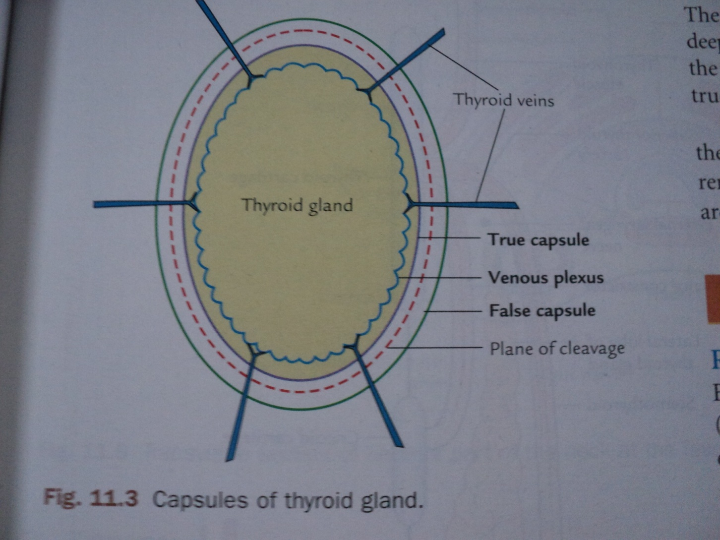

Slide 13
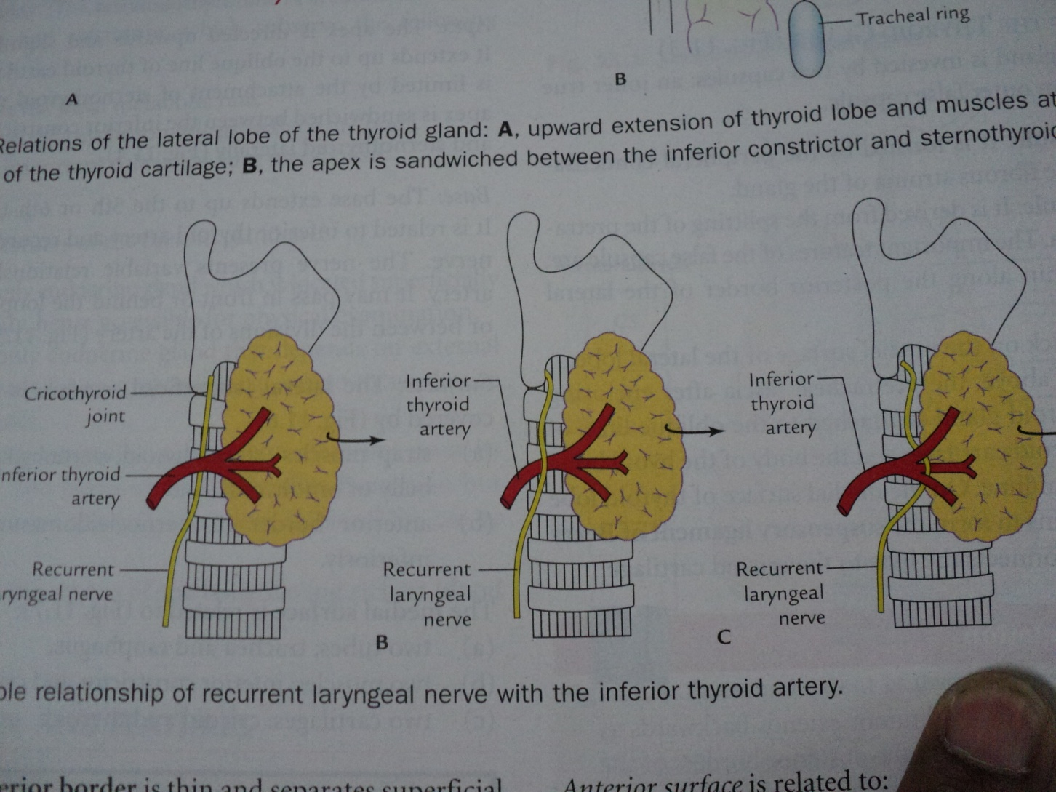

Slide 14
Author/year | Study design | level | Results | outcome
Journal of the American College of Surgeons Volume 209, Issue 2, August 2009, Pages 170–179.e2 Haejin In, MD, MBA^{a, ,} , Elizabeth N. Pearce, MD, MSc^{b}, Arthur K. Wong, MBA, MScª, James F. Burgess, PhD^{c}, David B. McAneny, MD, FACSª, Jennifer E. Rosen, MD, FACSª | We performed a cost-effectiveness analysis comparing these different strategies. Treatment efficacy and complication data were derived from a literature review. Costs were examined from a health-care system perspective using actual Medicare reimbursement rates to an urban university hospital. Outcomes were measured in quality-adjusted life-years (QALY). Costs and effectiveness were converted to present values; all key variables were subjected to sensitivity analysis. | Level 4 | TT was the most cost-effective strategy, resulting in a gain of 1.32 QALYs compared with RAI (at an additional cost of $9,594) and an incremental cost-effectiveness ratio of $7,240/QALY. RAI was the least costly option at $23,600 but also provided the least QALY (25.08 QALY). Once the cost of TT exceeds $19,300, the incremental cost-effectiveness ratio of lifelong ATM and TT reverse and lifelong ATM becomes the more cost-effective strategy at $15,000/QALY. | This is the first formal cost-effectiveness study in the US of the optimal treatment for patients with Graves disease who fail to achieve euthyroidism after 18 months of ATM. Our findings demonstrate that TT is more cost effective than RAI or lifelong ATM in these patients; this continues until the cost of TT becomes > $19,300.

Slide 15


