Slide 1
HEPATIC FAILURE
Dr.Deepali Shukla

Slide 2
Definition:
Liver failure is the inability of the liver to perform its normal synthetic and metabolic function as part of normal physiology.
Two forms are recognized. Acute and Chronic.
Hepatic failre is most severe clinical consequences of liver disease as the end point of progressive liver damage.
Either insidious destruction of hepatocytes
Repetative discrete waves of parenchymal damage.

Slide 3
Less commonly hepatic failure is the result of sudden and massive destruction of hepatic tissue.
Whatever the sequences, 80% to 90% of hepatic function must be lost before hepatic failure ensues.

Slide 4
Hepatic failure fall mainly in two major categories.
1.Acute liver failure also known as Fulminant hepatic failue
Fulminant hepatitis
Subacute liver failure
Hyperacute liver failure
2.Chronic liver failure

Slide 5
ACUTE HEPATIC FAILURE
Acute hepatic failure is defined as the rapid development of hepatocellular dysfunction, specially coagulopathy and mental status challenges in a patient without known prior liver disease.
Acute liver failure denotes clinical hepatic insufficiency that progress from onset of symptoms to hepatic encephalopathy within 2 to 3 weeks.
It is a medical emergency that requires hospitalization.
It is more common in woman than in men.

Slide 6
Etiology:
Acute viral hepatitis( A –E )
Chemical agents
Mushroom poisoning
Drugs
Vascular causes

Slide 7
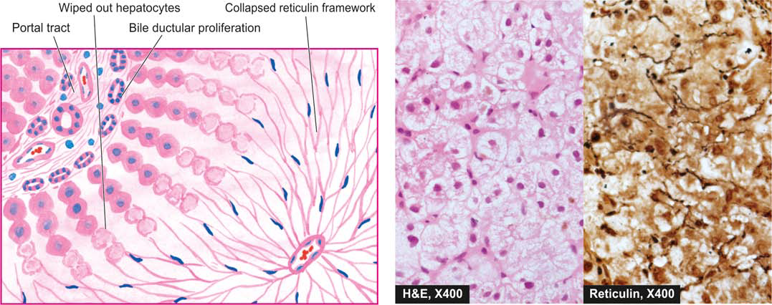

Slide 8
Viral hepatitis:
Hepatitis A and B accounts for most of the cases.
Atypical causes of viral hepatitis and fulminant hepatic failure includes cytomegalovirus, herpes simplex virus, Epstein barr virus.
Drug induced hepatotoxicity:
Acetaminophen is the main drug for hepatotoxicity.
Some kind of antibiotic, anaesthetic agents, salicylates are also associated with hepatotoxicity.

Slide 9
Toxin related hepatotoxicity:
Amina phalloides
Mushroom
Cyanobacteria

Slide 10
Ischemic hepatitis/ Liver injury caused by insufficient blood
Shock liver flow
Budd chiari syndrome Occlusion of hepatic veins that drain
liver
Portal vein thrombosis Blockage or narrowing of the portal vein

Slide 11
Metabolic causes:
Alpha 1 antitrypsin
Fructose intolerance
Galactosemia
Reye syndrome

Slide 12
Morphology:
The histologic correlate of acute liver failure is Massive hepatic necrosis.

Slide 13
Chronic liver failure:
Chronic liver failure occurs in context of cirrhosis.
Chronic liver disease is the most common route of hepatic failure and is the end point of relentless chronic liver damage ending in cirrhosis.
Etiology of Chronic liver failure:
Hepatitis B and C
Long term alcohol consumption
Cirrhosis
Hemochromatosis
Malnutrition

Slide 14
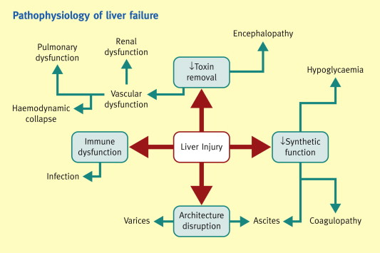

Slide 15
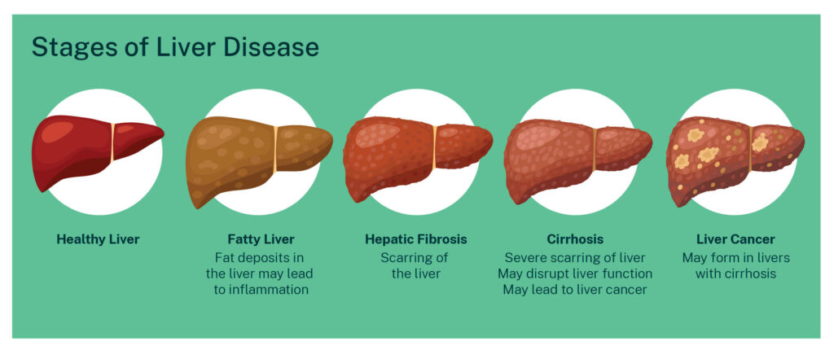

Slide 16
Clinical features:
Jaundice and cholestasis
Hypoalbuminemia
Hypoglycemia
Gynecomastia
Weight loss
Muscle wasting

Slide 17

Palmar erythema

Slide 18
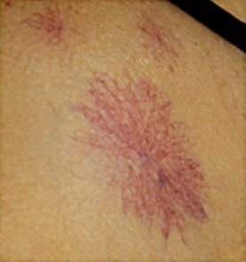
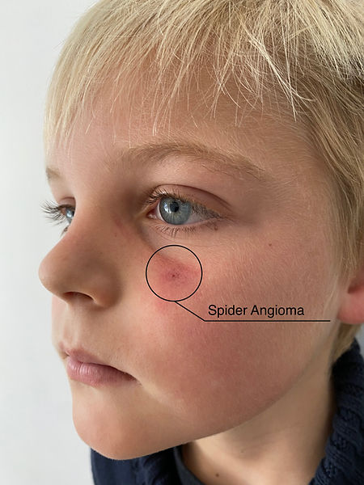
Spider angioma

Slide 19
Complication of hepatic failure:
Jaundice
Hepatic encephalopathy
Hyperkinetic circulation
Hepatorenal syndrome
Hepatopulmonary syndrome
Coagulation defect
Ascites and edema
Endocrine changes

Slide 20
Jaundice:
Jaundice usually reflect the severity of liver cell damage since it occurs due to failure of liver cells to metabolite bilirubin.
In acute liver failure jaundice nearly parallels the extend of liver cell damage
In chronic liver failure jaundice usually appears late.

Slide 21
Hepatic encephalopathy:
Hepatic encephalopathy also known as portosystemic encephalopathy is the occurance of confusion, altered level of consciousness and coma as a result of liver failure.
In advanced stages it is also called hepatic coma . It may ultimately lead to death.

Slide 22
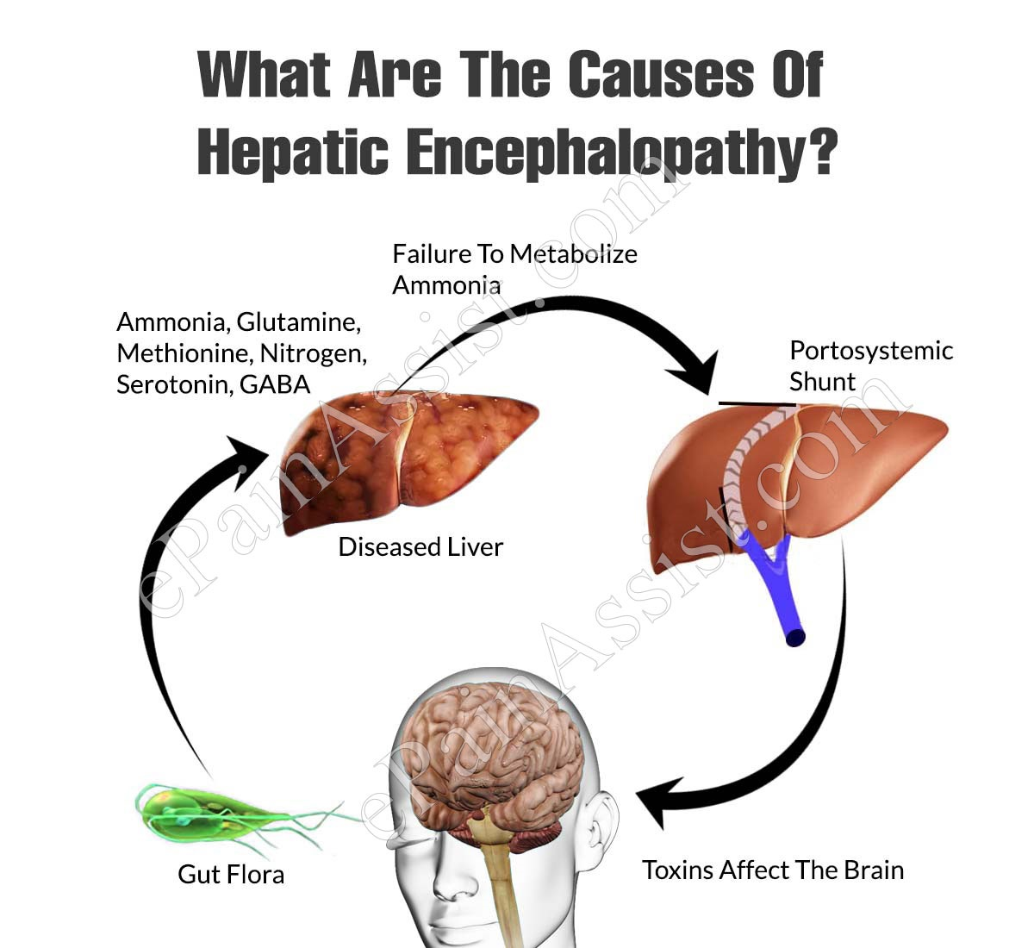

Slide 23
Signs and symptoms:
Disturbed consciousness
Personality changes
Intellectual deterioration
Flapping tremors
Coma
death

Slide 24
The genesis of cns manifestation in liver disease is by toxin products not metabolized by liver.
Ammonia is main for this pathogenesis.
Toxic substances produced by intestinal bacteria reach upto systemic circulation and progress to hepatic coma.

Slide 25
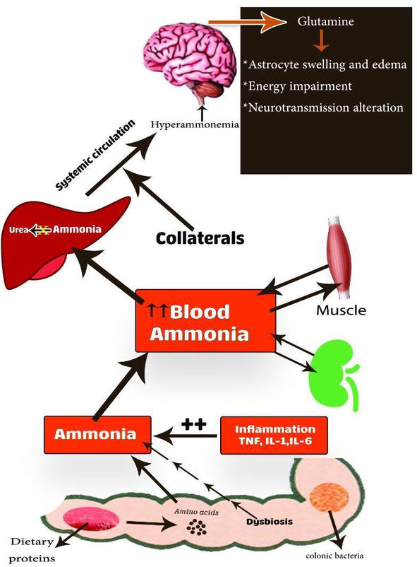

Slide 26
Hyperkinetic circulation
Peripheral vasodilatation
Increased splanchnic blood flow
Increased cardiac output
Impaired renal cortical perfusion

Slide 27
Hepatorenal syndrome:
Effective reduction in renal blood flow as a consequence of systemic vasodilatation and pooling of blood in portal circulation.
Acute renal failure is usually associated with oliguria and uremia but with good tubular fuction.

Slide 28
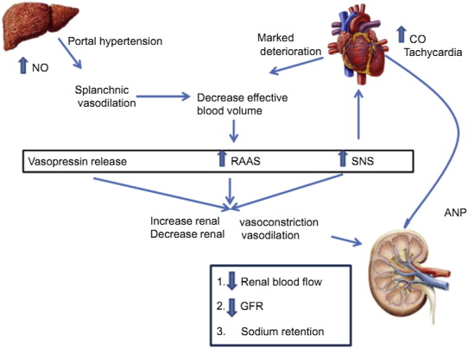

Slide 29
Hepatopulmonary syndrome:
Pulmonary vasodilatation and intra pulmonary arterio venous shunting
Ventilation perfusion inequality
Impaired pulmonary function

Slide 30
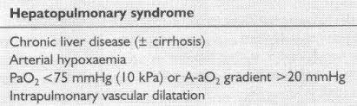

Slide 31
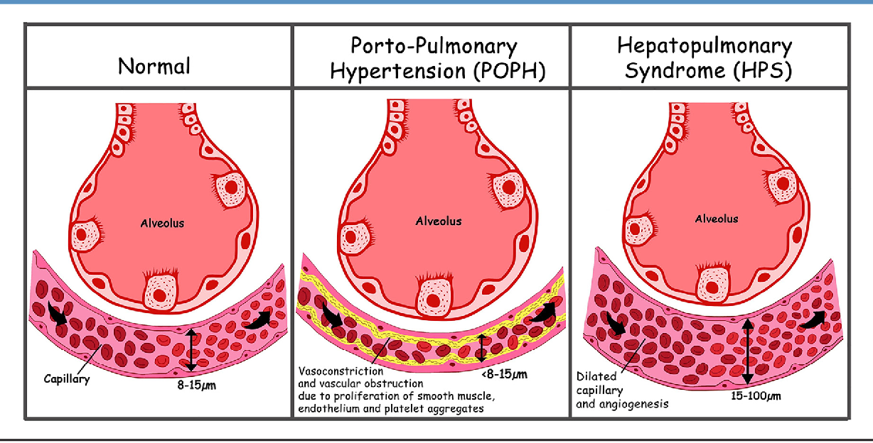

Slide 32
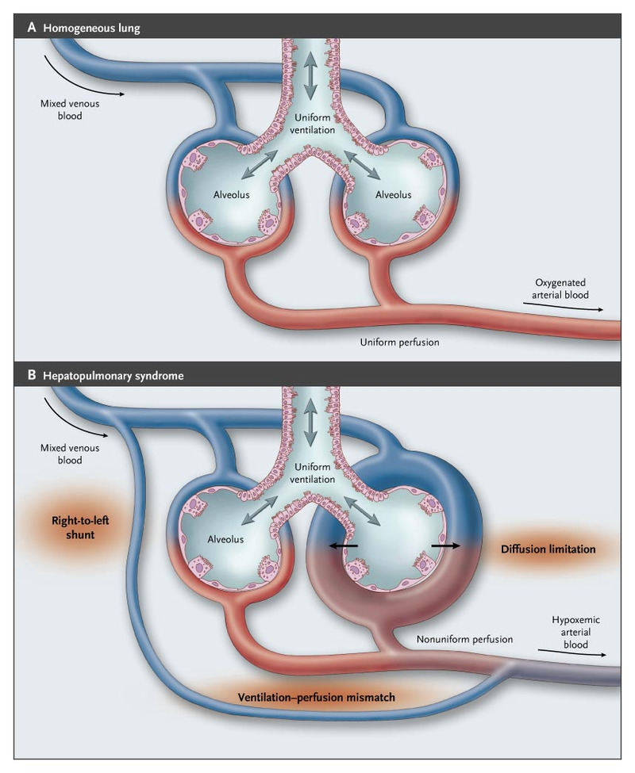

Slide 33
Coagulation defect:
Impaired synthesis of coagulation factors result in coagulation disorders.
DIC, thrombocytopenia, fibrin degradation products in blood.

Slide 34
Ascites and oedema:
Decreased synthesis of albumin by liver
Decreased oncotic pressure, increased hydrostatic pressure
Ascites and edema

Slide 35
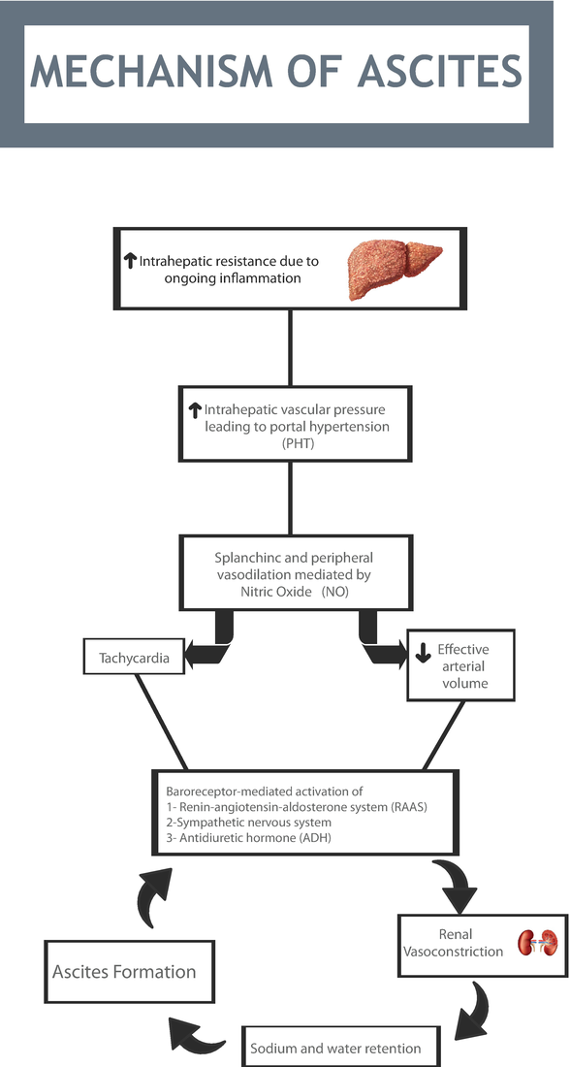

Slide 36
Endocrinal change:
Gynecomastia
Hypogonadism
Underlying mechanism appears to be changed end organ
sensitiveness to sex hormones in cirrhosis.

Slide 37
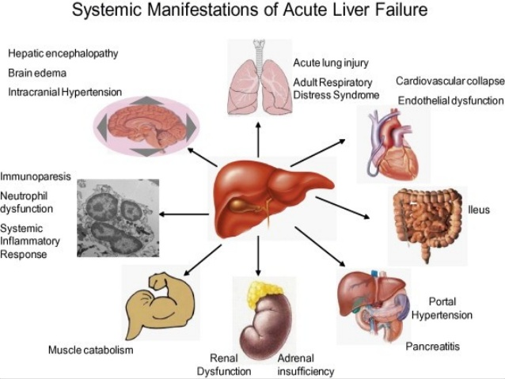

Slide 38
THANK YOU…

