Slide 1
ANATOMY OF LUNGS
DR ARTI D. SHAH (HOD AND PROFESSOR)
DEPARTMENT OF RESPIRATORY MEDICINE
24/1/24

Slide 2
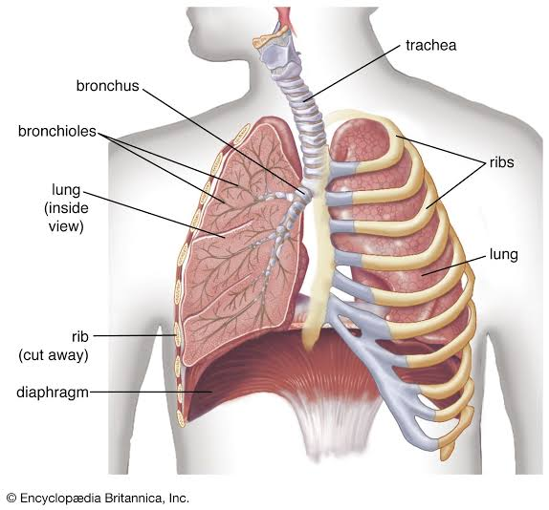
LUNGS INTRODUCTION
Lungs are pair of respiratory organs situated in THORACIC CAVITY
Each lung invaginates the corresponding PLEURAL CAVITY
The right and left lung are seprated by MEDIASTENUM
They are spongy in texture and BROWN or BLACK in color
Right lung is 700 gm and 50to 100 gm heavier than left lung
There are 10 BRONCHOPULMONARY SEGMENTS in each lung

Slide 3
FEATURES
Each lung is CONICAL in shape and it has
APEX –at upper end
BASE – resting on diaphragm
THREE BORDERS- (1) ANTERIOR
(2) POSTERIOR
(3) INFERIOR
TWO SURFACE (1)COSTAL
(2) MEDIAL

Slide 4
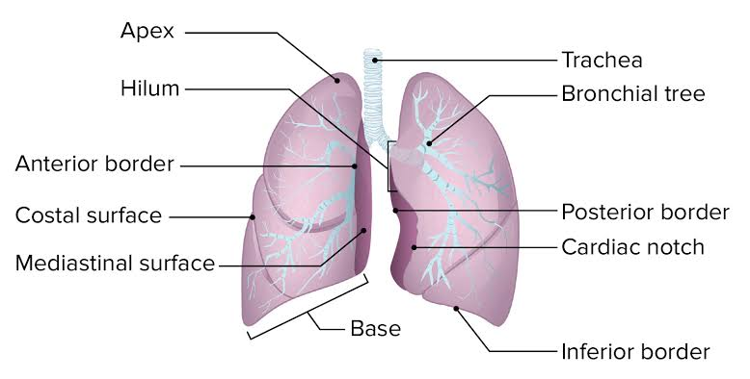

Slide 5
APEX
Short and lies above the level of ANTERIOR END of FIRST RIB
It reaches nearly 2.5 cm above the MEDIAL 1/3 of clavicle just medial to the SUPRACLVICULAR FOSSA

Slide 6
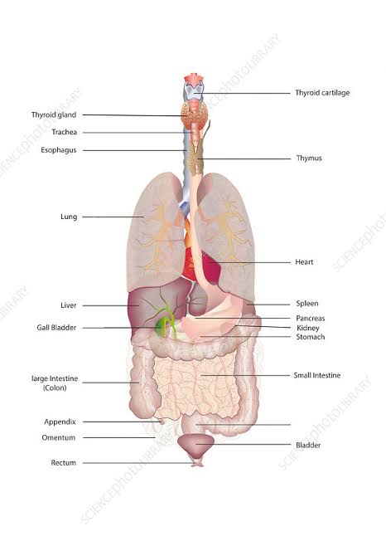
BASE
It is SEMILUNAR and CONCAVE
Rest on diaphram which seprates Right lung fromRight Lobe of liver
And left lung from Left lobe of liver and fundus of stomach and spleen

Slide 7
ANTERIOR BORDER
It is very thin and shorter than the posterior border
On the right side it is vertical
On left side it has CARDIAC NOTCH at the level of 4 th COSTAL CARTILAGE

Slide 8
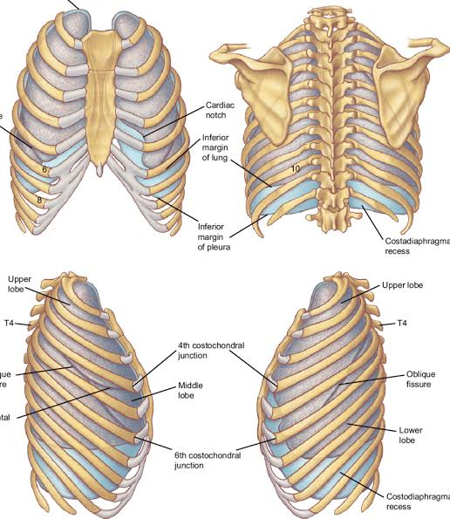
POSTERIOR BORDER
Thick and ill defined
Corresponds to medial margins of head of ribs
Extend from level of 7 TH CERVICAL SPINE to 10 TH THORACIC SPINE

Slide 9
INFERIOR BORDER
Seprates BASE from the COSTAL and MEDIAL surface

Slide 10
COSTAL SURFACE
LARGE and CONVEX
It is in contact with COSTAL PLEURA and overlying THORACIC WALL

Slide 11
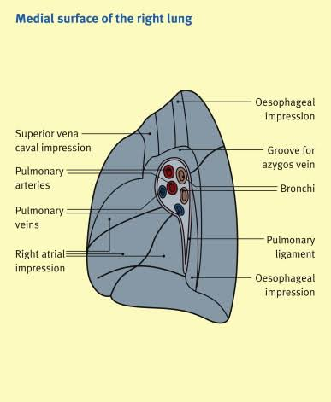
MEDIAL SURFACE
Divided into POSTERIOR or VERTIBRAL PART
ANTERIOR OR MEDIASTINAL PART
Vertibral part- vertibral bodies, intervertibral disc ,posterior intercostal vessels and splenic nerves
Mediastinal part- mediastinal septum ,cardiac impression ,hilum

Slide 12
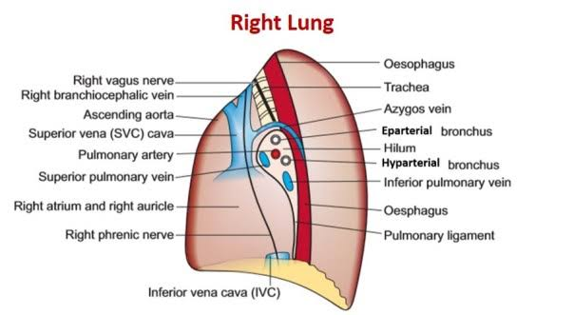
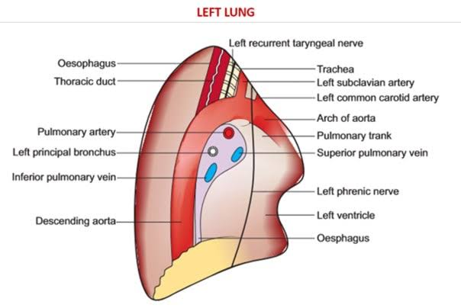
LUNG IMPRESSION

Slide 13
FISSURES AND LOBES
Right lung has
3 LOBES –UPPER
- MIDDLE
- LOWER 2 FISSURES-OBLIQUE
-HORIZONTAL
Left lung has
2 LOBES – UPPER
- LOWER
DIVIDED by OBLIQUE FISSURE

Slide 14
OBLIQUE FISSURE cuts into the whole thickness of the lung exept HILUM
It passes obliquely DOWNWARD and FORWARD crossing posterior border about 6 cm below apex and the inferior border about 5 cm from median plane
In RIGHT lung the HORIZONTAL FISSURE passes from anterior border upto OBLIQUE FISSURE and seperates wedge shaped MIDDLE LOBE from UPPER LOBE
LINGULA – tongue shaped projection of left lung below the CARDIAC NOTCH

Slide 15
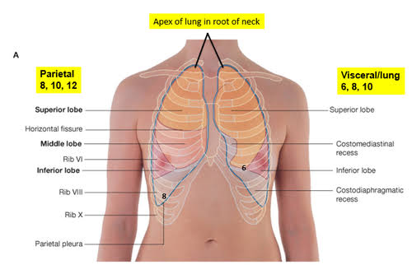
SURFACE MARKING
Oblique fissure can be drawn by joining -2 cm lateral to 3rd THORACIC SPINE , point on 5 th rib in MIDAXILLARY LINE , point on 6 th costal cartilage 75 cm from median plane
Horizontal fissure is drawn by line joining – point on ANTERIOR BORDER of right lung at level of 4 th costal cartilage, second point on 5 th rib in MIDAXILLARY LINE

Slide 16
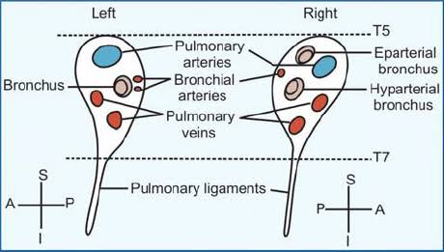
ROOT OF LUNG
It is SHORT ,BROAD PEDICLE which connects the MEDIAL SURFACE of the lung to the MEDIASTINUM
Roots of the lungs lie at the level of 5th ,6 th , 7 th thoracic vertebrae

Slide 17
ARRANGEMENTS
Right side
Epartial bronchus
Pulmonary artery
Inferior pulmonary vein
Left side
Pulmonary artery
Bronchus
Inferior pulmonary vein

Slide 18
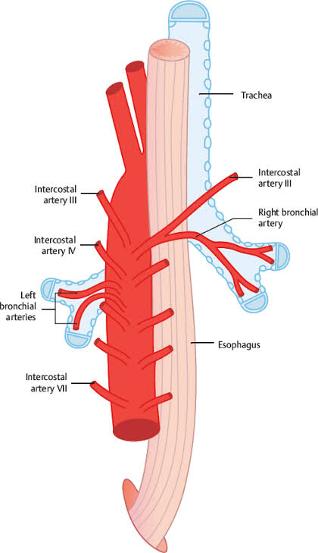
ARTERIAL SUPPLY
BRONCHIAL ARTERY supply nutrition to bronchial tree and pulmonary tissue
RIGHT SIDE –arise from third RIGHT POSTERIOR INTERCOSTAL ARTERY
LEFT SIDE – arise from DECENDING THORACIC AORTA
Deoxygenated blood is brought to the lungs by 2 PULMONARY ARTERIES and oxygenated blood is returned to the heart by 4 pulmonary veins

Slide 19
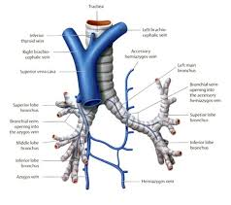
VENOUS SUPPLY
Venous blood from the 1 st and 2 nd division of the bronchi is carried by BRONCHIAL VEIN
RIGHT BRONCHIAL VEIN drains into AZYGOUS VEIN
LEFT BRONCHIAL VEIN drains into HEMIAZYGOUS VEIN

Slide 20
LYMPHATIC DRAINAGE
  PULMONARY LYMPH NODES – at angle of BIFURCATION of branching lobar bronchi
BRONCHOPULMONARY HILAR LYMPH NODES – in hilum of lung
TRACHIOBRONCIAL LYMPH NODES – above and below bifurcation of trachea
APPLIED – BRONCHOPULMONARY HILAR LYMPH NODES isimportant for metastasis

Slide 21
NERVE SUPPLY
Parasympathetic – from vagus –bronchospasm
vasodilation
increase mucus
secretion
Sympathetic – from T2 to T5 spinal segments
-bronchodilation
vasoconstriction
decrease mucus secretion

Slide 22
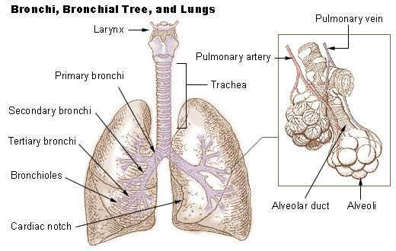
BRONCHIAL TREE
Trachea divided at level of the lower border of 4 th THORACIC VERTEBRA into two PRIMARY BRONCHUS , SECONDARY BRONCHI
TERTIARY BRONCHI
Right primary bronchus is 2.5 cm long it is shorter ,wider and more in line with the trachea than left principal bronchus

Slide 23
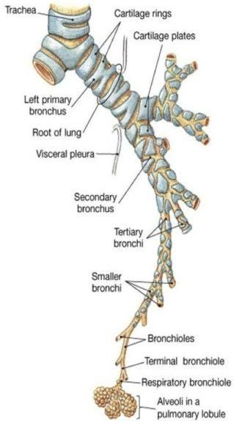
Left principal bronchus is 5 cm ,it is LONGER NARROWER and more OBLIQUE than the right bronchus
SECONDARY LOBAR BRONCHII one for each lobe of lung
Right side -3 LOBAR BRONCHI
Left side – 2 LOBAR BRONCHI
Each lobar bronchus divides into TERTIARY or SEGMENTAL BRONCHII ,one for each BRONCHOPULMONARY SEGMENT
RIGHT SIDE -10
LEFT SIDE -10
SEGMENTAL BRONCHI divide repetedly to form very small branches called TERMINAL BRONCHIOLES

Slide 24
CARINA –is hook shaped process projecting backward from lower margin of lowest trachial ring . It helps to divide trachea into two primary bronchi
It is most sensitive area ,so when patient is made to lie on his /her left side secretion from right bronchial tree flows towards carena due to gravity .it stimulate cough impulse and sputum out = POSTURAL DRAINAGE

Slide 25
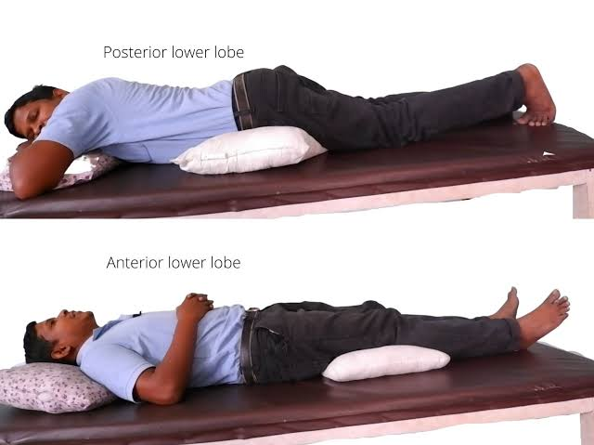

Slide 26
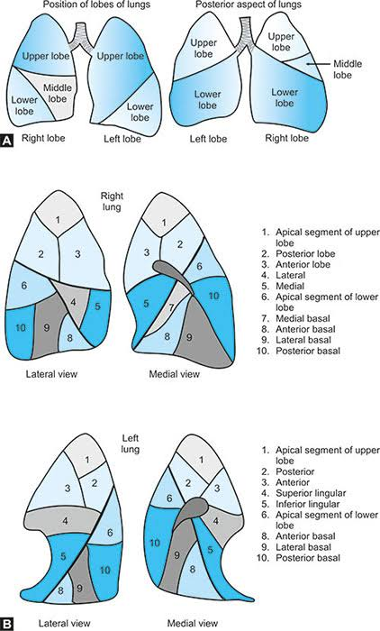
BRONCHOPULMONARY SEGMENTS

Slide 27
BRONCHOPULMONARY SEGMENTS has lead to development of CONSERVATIVE LUNG SURGERY and SEGMENTAL RESECTION
Since BP segments is an independent functional unit – localised chronic disease such as TB , BRONCHIACTESIS and BENIGN NEOPLASM – one segment is removed leaving other segments intact

Slide 28
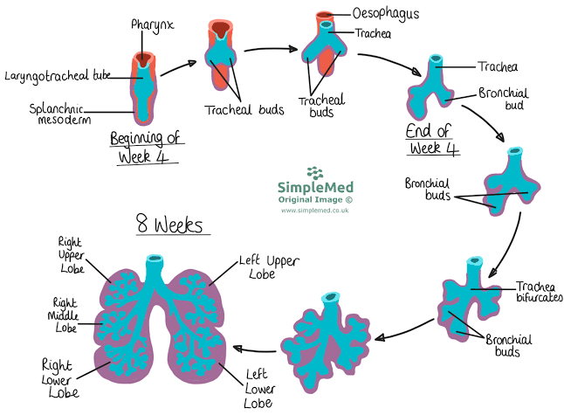
DEVELOPMENT OF RESPIRATORY SYSTEMS

Slide 29
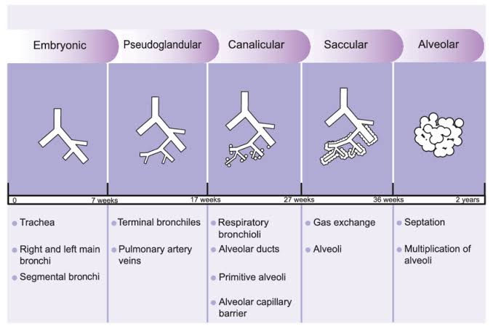

Slide 30
CONGENITAL ANOMALIES
TRACHEO-OESOPHAGIAL FISTULA
TRACHIAL STENOSIS
AZYGOUS LOBE OF LUNG around VENA AZYGOUS- this is due to additional respiratory bud which develops independently of the main respiratory system
HYALINE MEMBRANE DISEASE- this is due to deficiency of pulmonary surfactant
AGENESIS OF LUNG

Slide 31
REFERENCE
VISHRAM SINGH ‘S TEXTBOOK OF ANATOMY [2 nd edition]
GRAY S ATLAS OF ANATOMY [2 nd EDITION ]
B D CHAURASIA ‘S HUMAN [9 th EDITION]

Slide 32
