Slide 1
COPD- CHRONIC OBSTRUCTIVE PULMONARY
DISEASE
DR. Jasmin Jasani
PATHOLOGY

Slide 2
Chronic obstructive pulmonary disease (COPD) or chronic obstructive airway disease (COAD) are commonly used clinical terms for a group of pathological conditions in which there is chronic, partial or complete, obstruction to the airflow at any level from trachea to the smallest airways resulting in functional disability of the lungs i.e. these are diffuse lung diseases.

Slide 3
The following entities are included in COPD:
I. Chronic bronchitis
II. Emphysema
III. Bronchial asthma
IV. Bronchiectasis
V. Small airways disease (bronchiolitis)

Slide 4
1. CHRONIC BRONCHITIS
Chronic bronchitis is a common condition defined clinically as persistent cough with expectoration on most days for at least three months of the year for two or more consecutive years.

Slide 5
ETIOPATHOGENESIS
Smoking The most commonly identified factor implicated in causation of chronic bronchitis and in emphysema is heavy smoking. Heavy cigarette smokers have 4 to 10 times higher proneness to develop chronic bronchitis. Prolonged cigarette smoking appears to act on the lungs in a number of ways:
i) It impairs ciliary movement.
ii) It inhibits the function of alveolar macrophages.
iii) It leads to hypertrophy and hyperplasia of mucus-secreting
glands.
iv) It causes considerable obstruction of small airways.
v) It stimulates the vagus and causes bronchoconstriction.

Slide 6
2. Atmospheric pollution The incidence of chronic bronchitis is higher in industrialised urban areas where air is polluted. Some of the atmospheric pollutants which increase the risk of developing chronic bronchitis are sulfur dioxide, nitrogen dioxide, particulate dust and toxic fumes.
3. Occupation Workers engaged in certain occupations such as in cotton mills (byssinosis), plastic factories etc. are exposed to various organic or inorganic dusts which contribute to disabling chronic bronchitis in such individuals.
4. Infection Bacterial, viral and mycoplasmal infections
5. Familial and genetic factors

Slide 7
MORPHOLOGIC FEATURES
Grossly, the bronchial wall is thickened, hyperaemic and oedematous. Lumina of the bronchi and bronchioles may contain mucus plugs and purulent exudate.
Microscopically, just as there is clinical definition, there is histologic definition of chronic bronchitis by increased Reid index.

Slide 8
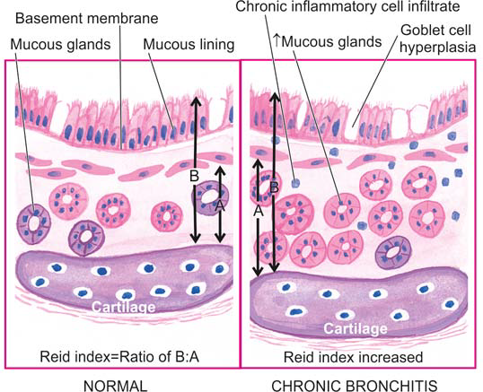
Reid index is the ratio between thickness of the submucosal mucus glands (i.e. hypertrophy and hyperplasia) in the cartilage-containing large airways to that of the total bronchial wall

Slide 9
EMPHYSEMA
The WHO has defined pulmonary emphysema as combination of permanent dilatation of air spaces distal to the terminal bronchioles and the destruction of the walls of dilated air spaces.
Thus, emphysema is defined morphologically, while chronic bronchitis is defined clinically.

Slide 10
Classification of ‘true emphysema’ and ‘overinflation’.
A. TRUE EMPHYSEMA
1. Centriacinar (centrilobular) emphysema
2. Panacinar (panlobular) emphysema
3. Paraseptal (distal acinar) emphysema
4. Irregular (para-cicatricial) emphysema
5. Mixed (unclassifi ed) emphysema
B. OVERINFLATION
1. Compensatory overinfl ation (compensatory emphysema)
2. Senile hyperinfl ation (ageing lung, senile emphysema)
3. Obstructive overinfl ation (infantile lobar emphysema)
4. Unilateral translucent lung (unilateral emphysema)
5. Interstitial emphysema (surgical emphysema)

Slide 11
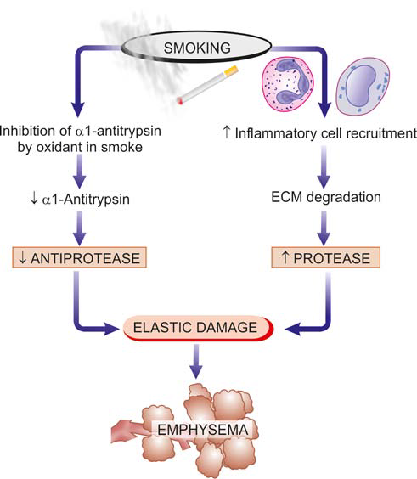
Pathogenesis of alveolar wall destruction in emphysema by protease-antiprotease mechanism.

Slide 12
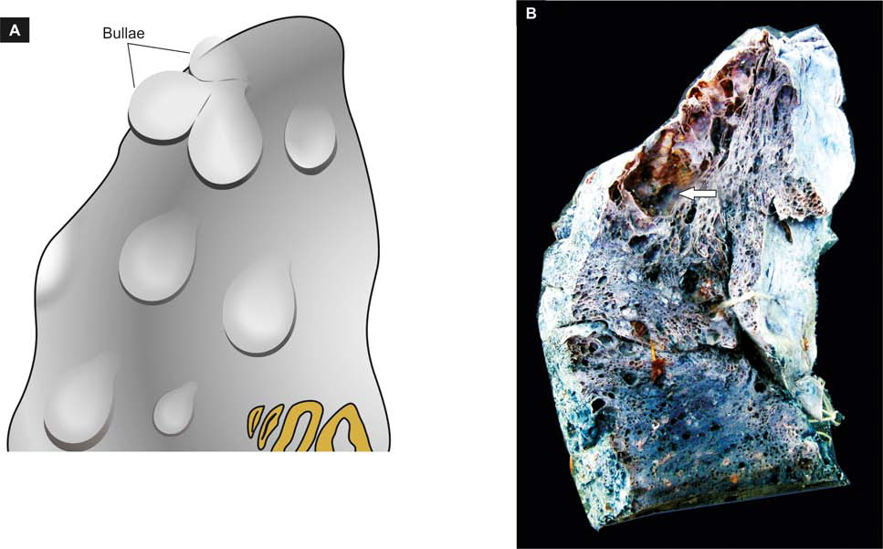
Bullous emphysema. A, Diagrammatic view as seen on the external surface of the lung. B, Sectioned lung showing air-fi lled sacs.

Slide 13
Grossly, the lungs are voluminous, pale with little blood. The edges of the lungs are rounded.
The bullae are air-filled cyst-like or bubble-like structures, larger than 1 cm in diameter.
They are formed by the rupture of adjacent air spaces while blebs are the result of rupture of alveoli directly into the subpleural interstitial tissue and are the common cause of spontaneous pneumothorax

Slide 14
Microscopically, depending upon the type of emphysema, there is dilatation of air spaces and destruction of septal walls of part of acinus involved i.e. respiratory bron chioles, alveolar ducts and alveolar sacs.

Slide 15
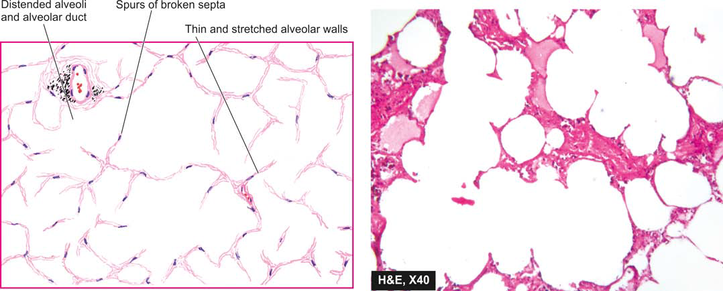
Panacinar (Panlobular) emphysema showing involvement of the entire lobules and whole of acinus.

Slide 16
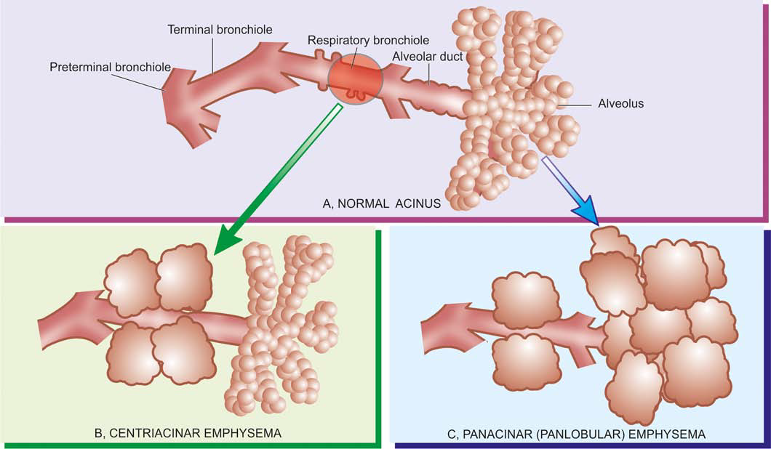
The anatomic regions of involvement in an acinus in major forms of emphysema

Slide 17
BRONCHIAL ASTHMA
Asthma is a disease of airways that is characterised by increased responsiveness of the tracheobronchial tree to a variety of stimuli resulting in widespread spasmodic narrowing of the air passages which may be relieved spontaneously or by therapy.
Asthma is an episodic disease manifested clinically by paroxysms of dyspnoea, cough and wheezing.
However, a severe and unremitting form of the disease termed status asthmaticus may prove fatal.

Slide 18
It occurs at all ages but nearly 50% of cases develop it before the age of 10 years. In adults, both sexes are affected equally but in children there is 2:1 male-female ratio

Slide 19
ETIOPATHOGENESIS AND TYPES
Based on the stimuli initiating bronchial asthma, two broad etiologic types are traditionally described: extrinsic (allergic, atopic) and intrinsic (idiosyncratic, non-atopic) asthma. A third type is a mixed

Slide 20
1. Extrinsic (atopic, allergic) asthma
This is the most common type of asthma.
It usually begins in childhood or in early adult life.
personal and/or family history positive
Hyper sensitivity to various extrinsic antigenic substances or ‘allergens’ is usually present in these cases.
Most of these allergens cause illeffects by inhalation e.g. house dust, pollens, animal danders,moulds etc.
Occupational asthma stimulated by fumes, gases and organic and chemical dusts is a variant of extrinsic asthma.

Slide 21
2. Intrinsic (idiosyncratic, non-atopic) asthma
This type of asthma develops later in adult life with negative personal or family history of allergy, negative skin test and normal serum levels of IgE.
3. Mixed type
Many patients do not clearly fit into either of the above two categories and have mixed features of both.

Slide 22
MORPHOLOGIC FEATURES
The pathologic changes are similar in both major types of asthma.
Grossly, the lungs are overdistended due to over-infl ation.
Microscopically, the following changes are observed
1. The mucus plugs contain normal or degenerated respiratory epithelium forming twisted strips called Curschmann’s spirals.
2. The sputum usually contains numerous eosinophils and diamond-shaped crystals derived from eosinophils called Charcot-Leyden crystals.

Slide 23
3. The bronchial wall shows thickened basement membrane of the bronchial epithelium, submucosal oedema and inflammatory infiltrate consisting of lymphocytes and plasma cells with prominence of eosinophils.

Slide 24
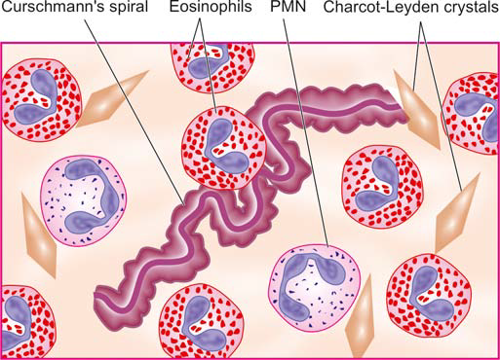
Diagrammatic appearance of Curschmann’s spiral and Charcot-Leyden crystals found in mucus plugs in patients with bronchial asthma.

Slide 25
CLINICAL FEATURES
Asthmatic patients suffer from episodes of acute exacerbations interspersed with symptom free periods.
Characteristic clinical features are paroxysms of dyspnoea, cough and wheezing. Most attacks typically last for a few minutes to hours.
When attacks occur continuously, it may result in more serious condition called status asthmaticus.

Slide 26
BRONCHIECTASIS
Bronchiectasis is defined as abnormal and irreversible dilatation of the bronchi and bronchioles (greater than 2 mm in diameter) developing secondary to inflammatory weakening of the bronchial walls.
The most characteristic clinical manifestation of bronchiectasis is persistent cough with expectoration of copious amounts of foul-smelling, purulent sputum.

Slide 27
ETIOPATHOGENESI
The origin of inflammatory destructive process of bronchial walls is nearly always a result of two basic mechanisms:
1. Endobronchial obstruction by foreign body, neoplastic growth or enlarged lymph nodes
2. Infection

Slide 28
MORPHOLOGIC FEATURES
The disease characteristically affects distal bronchi and bronchioles beyond the segmental bronchi.
Grossly, the lungs may be involved diffusely or segmentally.
Bilateral involvement of lower lobes occurs most frequently.

Slide 29
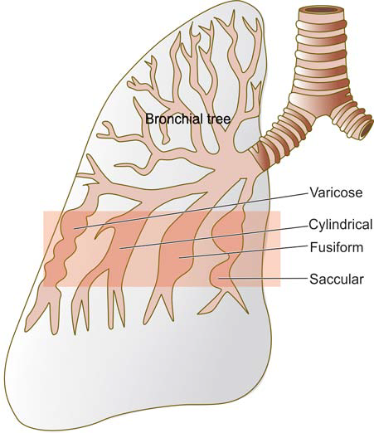
Types of bronchial dilatations in bronchiectasis.

Slide 30
Cut surface of the affected lobes, generally the lower zones, shows characteristic honey-combed appearance.
The bronchi are extensively dilated nearly to the pleura, their walls are thickened and the lumina are filled with mucus or muco-pus.

Slide 31
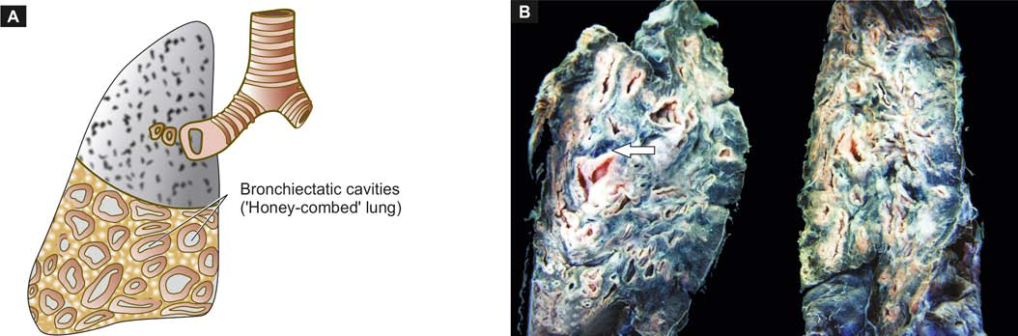
Bronchiectasis of the lung. Sectioned surface shows honey-combed appearance of the lung

Slide 32
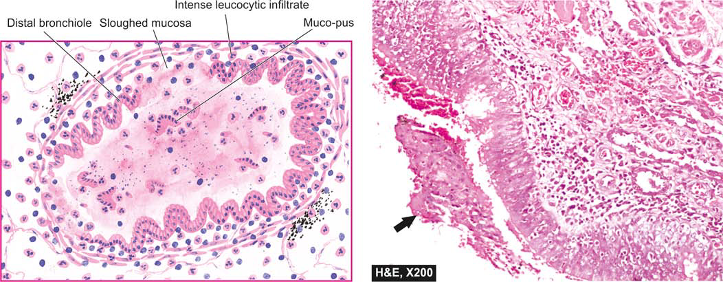
Microscopic appearance of a dilated distal bronchiole in bronchiectasis. The bronchial wall is thickened and infiltrated by acute and chronic inflammatory cells. The mucosa is sloughed off at places with exudate of muco-pus in the lumen (arrow).

Slide 33
CLINICAL FEATURES
The clinical manifestations of bronchiectasis typically consist of chronic cough with foulsmelling sputum production, haemoptysis and recurrent pneumonia.

Slide 34
☺ THANK YOU ☺

Slide 37
MCQ

Slide 38
1.
REID INDEX USED AS CRITERIA OF QUANTITATION IN CHRONIC BRONCHITIS IS THE RATIO OF THICKNESS OF:
BRONCHIAL MUCOSA TO THAT OF BRONCHIAL WALL
SUBMUCOSAL GLANDS TO THAT OF BRONCHIAL WALL
BRONCHIAL CARTILAGE TO THAT OF THE BRONCHIAL WALL
INFLAMMATORY INFILTRATE TO THAT OF THE WALL

Slide 39
2.
EMPHYSEMA PATHOGENESIS IS
EXCESSIVE LIPASE
DEFICIENCY OF LIPASE
EXCESSIVE ALPHA 1 ANTITRYPSIN
DEFICIENCY OF ALPHA 1 ANTITRYPSIN

Slide 40
3.
CLASSICAL FEATURES OF ASTHMA ARE
Curschmann’s spirals.
Charcot-Leyden crystals.
Numerous eosinophils
All of the above

Slide 41
4.
THE EXTEND OF DAMAGE TO PULMONARY PARENCHYMA IS SEVEREST IN FOLLOWING TYPE OF EMPHYSEMA:
CENTRIACINAR
PANACINAR
DISTAL ACINAR
IRREGULAR

Slide 42
5.
BRONCHIACTASIS COMMONLY DEVELOPS IN THE FOLLOWING MICROANATOMICAL ZONE OF BRONCHEAL TREE:
ACINI BEYOND RESPIRATORY BRONCHEOLE
ACINI BEYOND TERMINAL BRONCHEOLE
TERMINAL BRONCHEOLE <2mm DIAMETER
BRONCHEOLE >2mm DIAMETER

Slide 43
ANSWERS

Slide 44
1-B
2-D
3-D
4-B
5-D

