Slide 1
MEDIASTINUM
DR.BHAVESH PATEL (PROFESSOR)
DEPT. OF RESPIRATORY MEDICINE
21/2/24

Slide 2
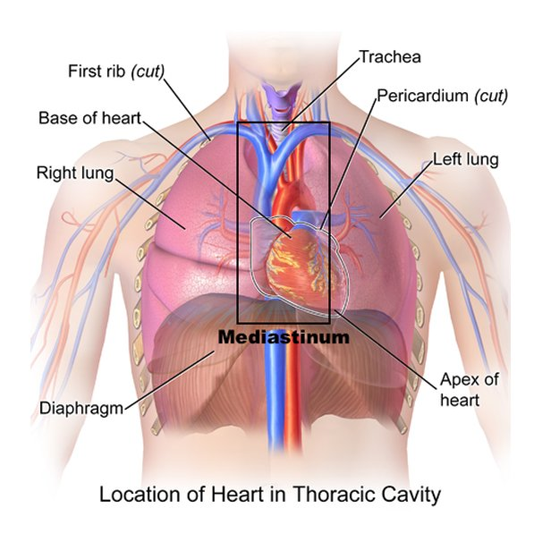
Mediastinum is the middle space left in the thoracic cavity in between the lungs.

Slide 3
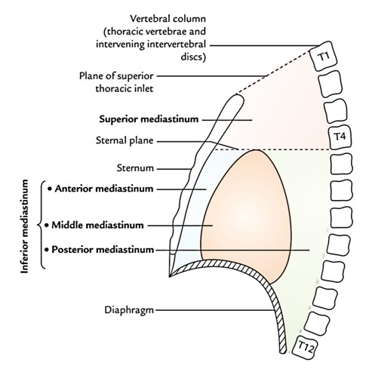
Boundaries
Anteriorly: Sternum
Posteriorly : Vertebral column
Superiorly : Thoracic inlet
Inferiorly : Diaphragm
On each side: Mediastinal
pleura.

Slide 4
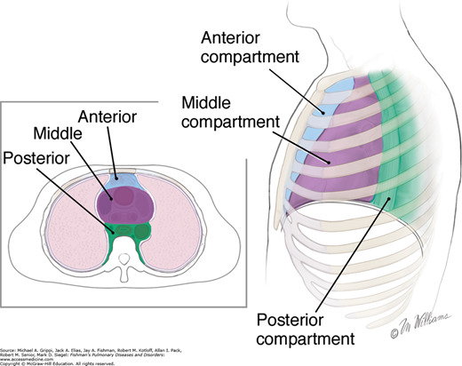
Division of Mediastinum
Superior mediastinum
Inferior mediastinum
-anterior mediastinum
-middle mediastinum
-posterior mediastinum

Slide 5
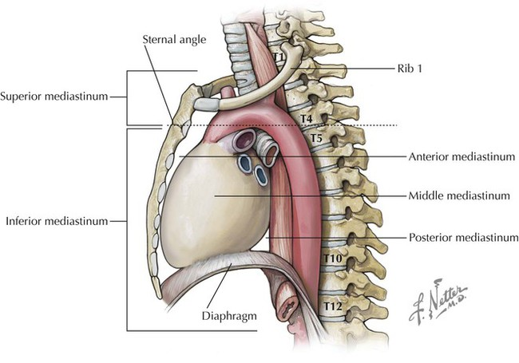
Superior Mediastinum
Anteriorly : Manubrium sterni
Posteriorly: Upper four thoracic vertebrae
Superiorly: Plane of the thoracic inlet
Inferiorly: An imaginary plane passing through the sternal angle in front, and the lower border of the body of the fourth thoracic vertebra behind
On each side: Mediastinal pleura

Slide 6
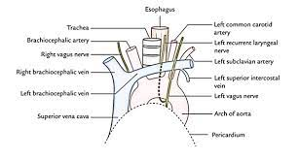
Contents of Superior Mediastinum
TRACHEA AND OESOPHAGUS
MUSCLES- Sternohyoid
Sternothyroid
Lower end of Longus Colli
ARTERIES-Arch of Aorta
Brachiocephalic Artery
Left Common Carotid Artery
Left Subclavian Artery
VEINS-Right and Left Brachiocephalic vein
Upper Half of Superior Vena Cava
Left Superior Intercoastal Vein

Slide 7
NERVES-Vagus
Phrenic
Cardiac nerves on both sides
Left recurrent laryngeal nerve
THYMUS AND THORACIC DUCT
LYMPH NODES-Paratracheal
Brachiocephalic
Tracheobronchial

Slide 8
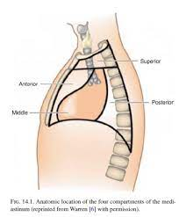
Anterior Mediastinum
Anterior mediastinum is a very narrow space in front of the pericardium, overlapped by the thin anterior borders of both lungs
Boundaries
Anteriorly: Body of sternum
Posteriorly : Pericardium
Superiorly: Imaginary plane separating the superior mediastinum from the inferior mediastinum.
Inferiorly: Superior surface of diaphragm.
On each side: Mediastinal pleura.

Slide 9
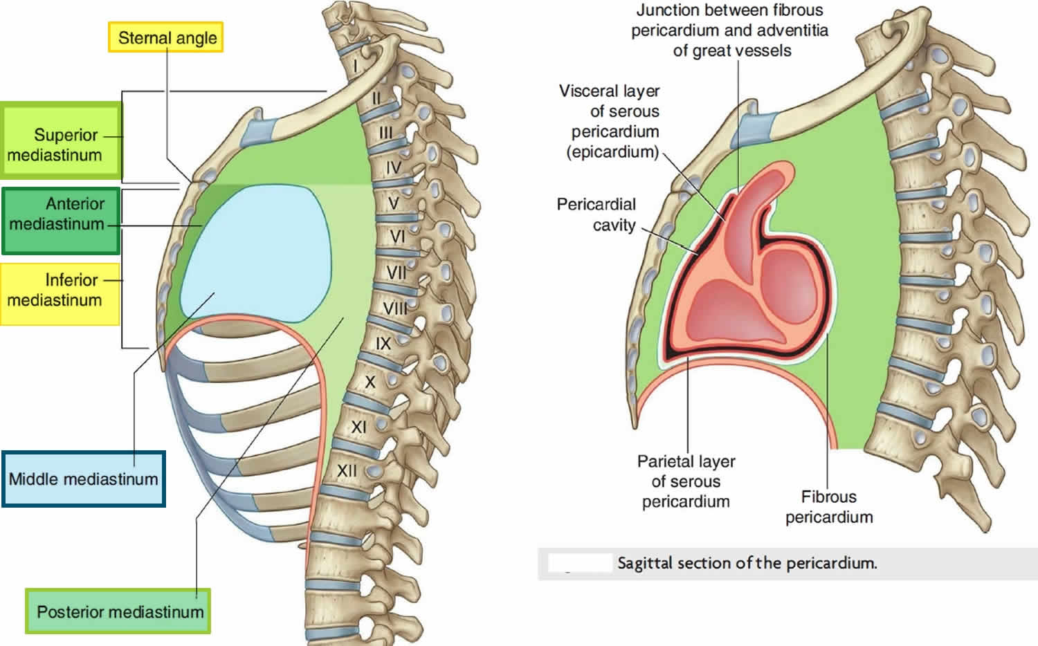
Contents of Anterior Mediastinum
Sternopericardial ligaments
Lymph nodes with lymphatics.
Small mediastinal branches of the internal thoracic artery.
The lowest part of the thymus.
Areolar tissue

Slide 10
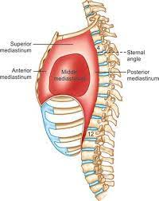
Middle mediastinum
Middle mediastinum is occupied by the pericardium and its contents, along with the phrenic nerves and the pericardiophrenic vessels
Boundaries
Anteriorly : Stenopericardial ligaments.
Posteriorly: Esophagus, descending thoracic aorta, azygos vein
On each side: Mediastinal pleura

Slide 11
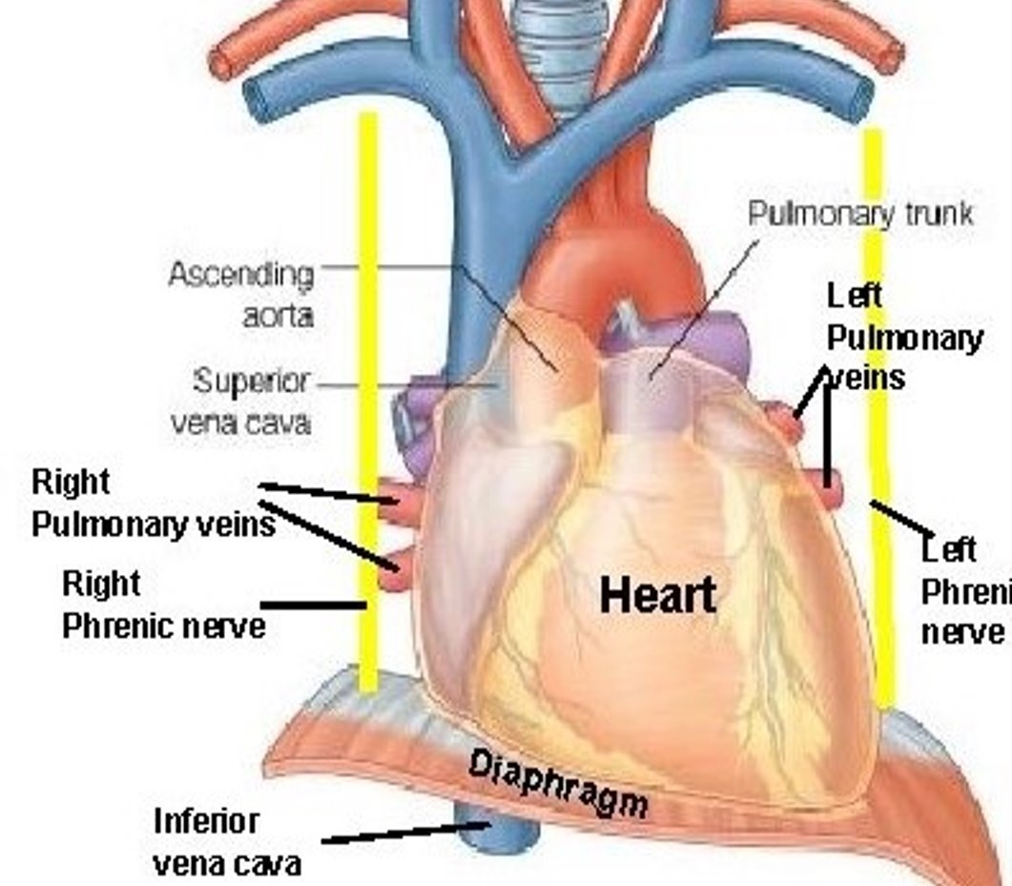
Contents of Middle mediastinum
HEART ENCLOSED IN PERICARDIUM
ARTERIES-ASCENDING AORTA
    PULMONARY TRUNK
    TWO PULMONARY ARTERIES
VEINS-LOWER HALF OF SUPERIOR VENA CAVA
  TERMINAL PART OF AZYGOUS VEIN
  RIGHT AND LEFT PULMONARY VEINS
NERVES-PHRENIC
  DEEP CARDIAC PLEXUS
LYMPH NODES-TRACHEOBRONCHIAL NODES
TUBES-BIFURCATION OF TRACHEA
  RIGHT AND LEFT PRICIPAL BRONCHI

Slide 12
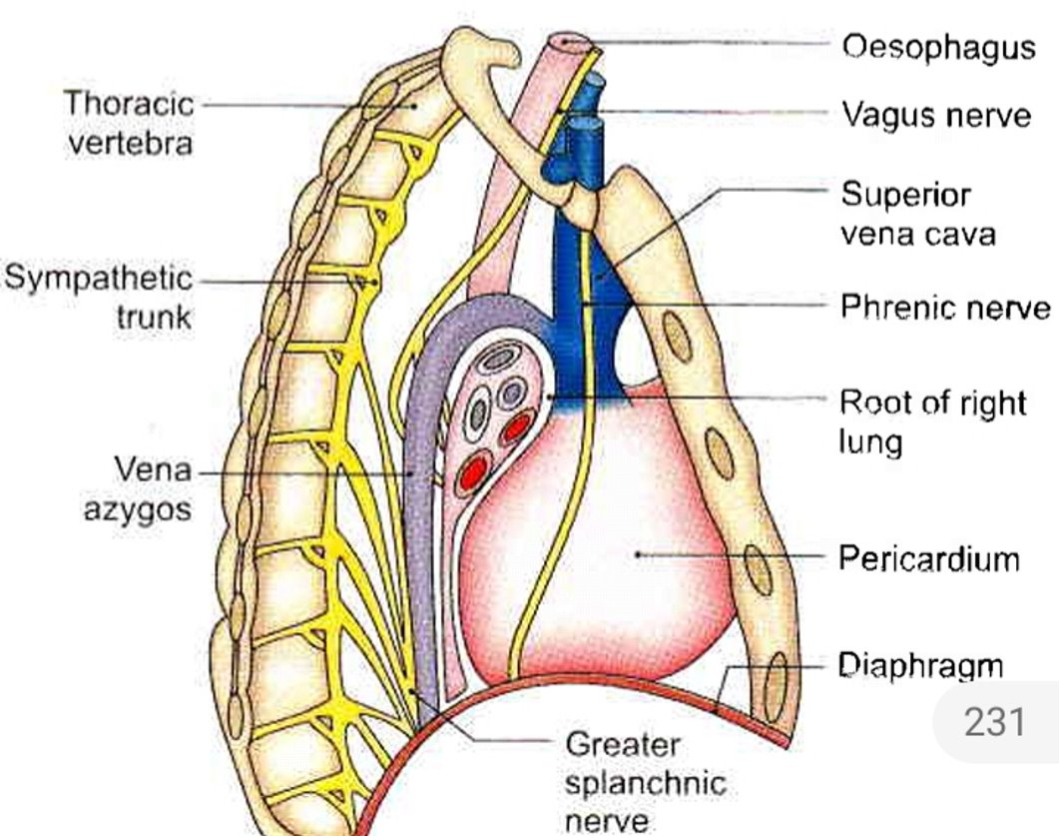
Posterior Mediastinum
Boundaries
Anteriorly: (i) Pericardium, (ii) bifurcation of trachea, (iii) pulmonary vessels, and (iv) posterior part of the upper surface of the diaphragm.
Posteriorly; Lower eight thoracic vertebrae and intervening discs.
On each side: Mediastinal pleura

Slide 13
Contents of posterior mediastinum
OESOPHAGUS
ARTERIES-DESCENDING THORACIC AORTA AND ITS BRANCHES
VEINS-AZYGOUS VEIN
  Hemiazygous vein
  Accessory Hemiazygous Vein
NERVES-VAGI
  Splanchnic Nerve arising from lower 8 thoracis ganglia of sympathetic chain
LYMPH NODES AND LYMPHATICS-POSTERIOR MEDIASTINAL LYMPH NODES LYING ALONGSIDE OF AORTA
    Thoracic Duct

Slide 14
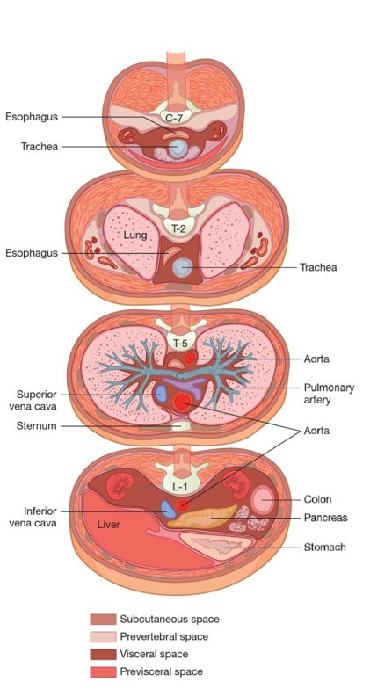
Pneumomediastinum
Pneumomediastinum (mediastinal emphysema) is an uncommon condition characterized by the accumulation of air or gas in the mediastinum
In the neck, the deep layer of the deep cervical fascia ensheaths the trachea and esophagus as they descend into the mediastinum.
The trachea and esophagus are thus enclosed in this visceral space; therefore, air or infection can readily travel from the mediastinum to the neck or retroperitoneum

Slide 15
After alveolar rupture, air enters the perivascular interstitium and dissects proximally within the bronchovascular sheath toward the mediastinum
Mediastinal air can decompress by extension into the cervical, subcutaneous, and retroperitoneal spaces.
A pneumomediastinum that ruptures into the free pleural space results in a pneumothorax.

Slide 16
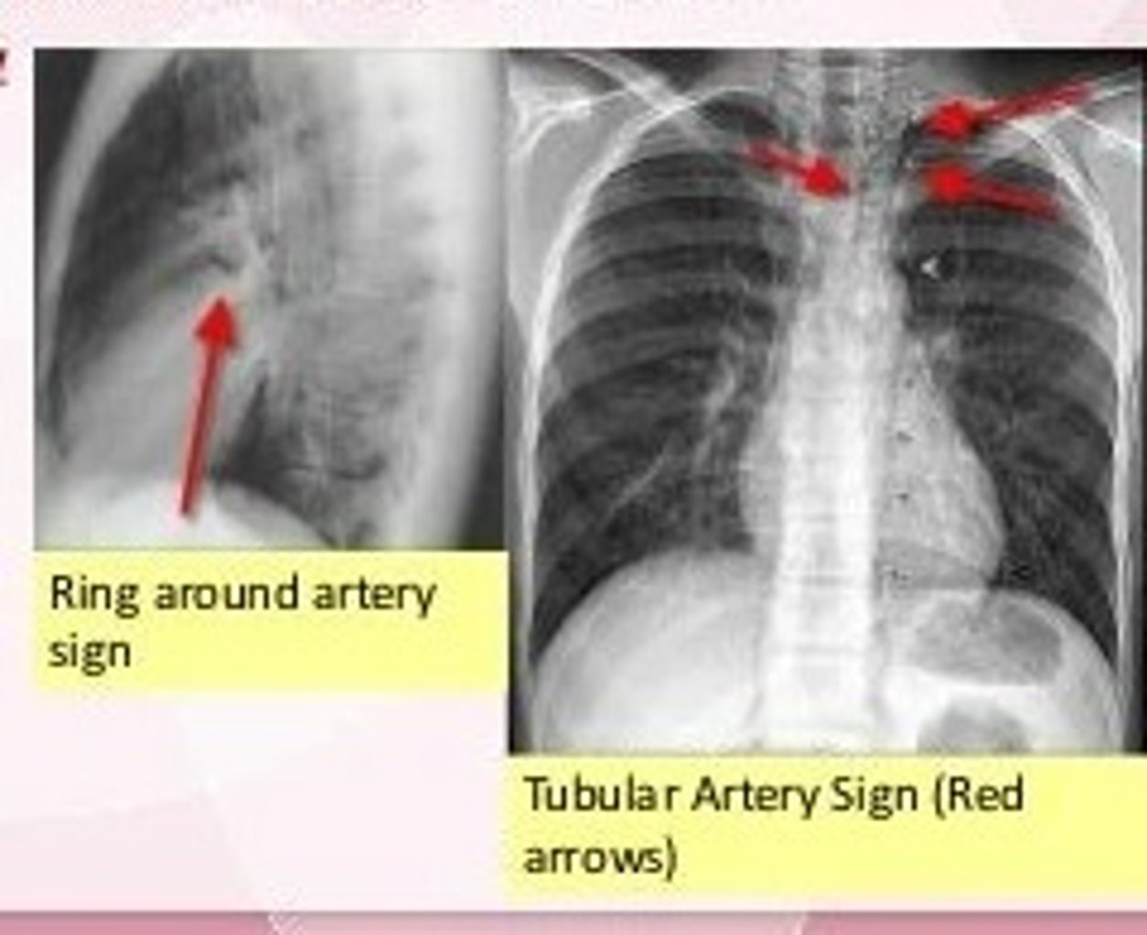

Slide 17
Spontaneous Pneumomediastinum
Idiopathic spontaneous pneumomediastinum is a rare self-limited condition that most commonly affects young adult men
There is characteristic crepitation synchronous with the heartbeat heard in these patients (Hamman sign).
The majority of patients with spontaneous pneumomediastinum have predisposing factors that cause increase in airway pressure, which leads to alveolar rupture.

Slide 18
Caused from
straining against a closed glottis (i.e., the Valsalva maneuver) as during vomiting, coughing, or exercising.
sudden and/or severe increases in lung volume, as occur during marijuana smoking, inhaling of cocaine, or during a seizure.
Localized airway obstruction from
-tumor
-foreign bodies
- Asthma
-parenchymal lung disease can also cause alveolar rupture.

Slide 19
Presents with
substernal pain, often pleuritic, which may radiate to the neck or back.
Dyspnea
Dysphagia
Odynophagia
Dysphonia- Air in the subcutaneous tissues of the neck produces a characteristic change in voice quality, a higher-pitched nasal tone
Examination often reveals palpable subcutaneous emphysema in the neck
Auscultation of the chest may reveal a crunching or clicking sound heard over the pericardium, synchronous with the heartbeat (Hamman sign)
Computed tomography (CT) is more sensitive in detecting air than are plain radiographs. Air may be evident deep in the neck as well as in the subcutaneous tissue

Slide 20
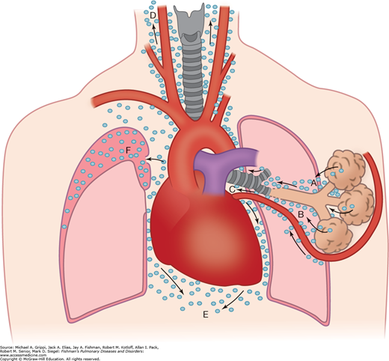
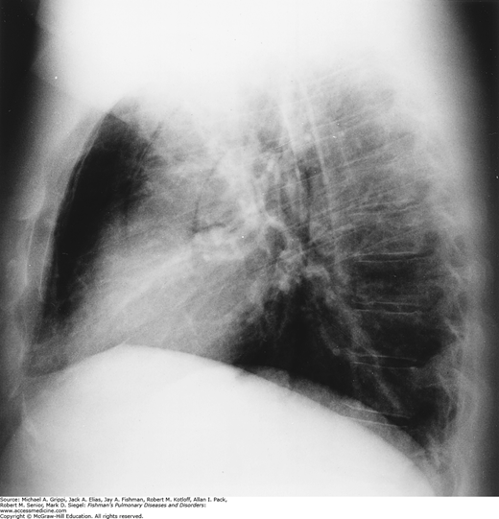
Possible routes of air following alveolar disruption. Air from the alveolus (A), enters perivascular interstitium (B), dissecting proximally within bronchovascular sheath toward mediastinum (C), as mediastinal pressure rises, decompression occurs in cervical (D), subcutaneous, and retroperitoneal (E), soft tissue spaces. A pneumothorax is possible if the pleura (F) is ruptured.

Slide 21
MEDIASTINAL SYNDROME
Compression of mediastinal structures by any tumor gives rise to a group of symptoms known as mediastinal syndrome
Obstruction of SVC-Engorgement of veins in upper half of body
Pressure over the TRACHEA- Dyspnoea and cough
Pressure on LEFT RECURRENT LARYNGEAL NERVE-Dysphonia
Pressure on INTERCOSTAL NERVES-Intercostal Neuralgia
Pressure on VERTEBRAL COLUMNS -Erosion of vertebral bodies

Slide 22
Acute Mediastinitis
Acute mediastinitis is a life-threatening disorder that causes severe morbidity in the afflicted patient.
All three mediastinal compartments can be affected
- The anterior compartment most commonly after sternotomy for cardiac surgery
- The middle compartment usually from esophageal perforation
- The posterior compartment from direct extension from the neck, lung, or spine

Slide 23
Mediastinitis from Esophageal Perforation
Instrumental perforation of the esophagus now accounts for almost one-half of all esophageal perforations.
Perforation is more common after
rigid esophagoscopy
dilation of a stricture
pneumatic dilation for achalasia, but it also occurs after variceal sclerosis
esophageal tube placement (nasogastric, Sengstaken–Blakemore, and salivary bypass tubes)
simple flexible esophagoscopy

Slide 24
Patients usually present with
-abrupt onset of severe substernal chest pain, which is pleuritic after forceful vomiting or retching.
-Dyspnea is common even in the absence of pneumothorax
-Shock develops quickly and the patient usually appears gravely ill.

Slide 25
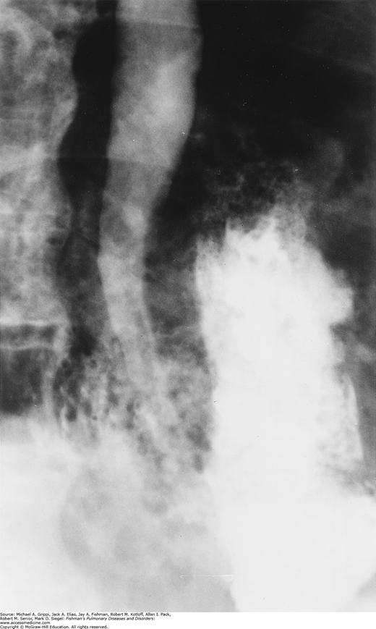
Examination reveals
tachypnea
tachycardia
fever
hypotension
splinting of the chest and abdomen
cervical emphysema
Radiographic findings
cervical or mediastinal emphysema
Pneumothorax
pleural effusion
contrast esophagogram (usually with water-soluble contrast) should be performed immediately when the diagnosis is suspected, but chances false-negative rate are10%
Next best step is chest CT

Slide 26
Treatment involves
surgical debridement of necrotic tissue
secure closure of the perforation
correction of any distal obstruction and wide drainage, usually performed through a left thoracotomy
Recent reports suggest favorable results in appropriately selected patients’ management with covered esophageal stents and image-directed drainage.

Slide 27
Appropriate broad-spectrum antibiotics with anaerobic coverage and the maintenance of proper nutrition are also integral components of the management plan.
Esophagectomy is occasionally required in the presence of a perforated, nondilatable stricture, a destroyed esophagus in which direct repair is not possible, or cancer

Slide 28
Descending Necrotizing Mediastinitis
Extension of the cervical infection down the layers of the deep cervical fascia into the mediastinum leads to this syndrome of descending necrotizing mediastinitis.
Downward spread is aided by gravity, negative intrapleural pressure, and lytic dissolution of fascia and fat.

Slide 29
Type 1, infection above the carina
Type IIA, infection to the level of the lower anterior mediastinum
Type IIB, infection involving the lower anterior and posterior mediastinum.
Patients present with
odynophagia
neck swelling
neck pain
dyspnea
chest pain

Slide 30
Signs include
fever
swelling and redness of the oropharynx
About 2/3 of patients have comorbidities that are associated with immunosuppression or chronic illnesses.
Common causes include
tooth abscesses
Pharyngitis
peritonsillar abscess
Epiglottis
perforation of the pharynx

Slide 31
CT with intravenous contrast should be performed on all severe neck infections and suspected cases of descending necrotizing mediastinitis to identify radiologic signs of mediastinitis that may not be clinically apparent
Streptococcus species are the most common aerobic organisms and Bacteroides species are the most common anaerobic organisms
Antibiotics should be started upon clinical suspicion of this diagnosis. All patients require cervical incision, exploration, drainage, and treatment of the underlying condition.

Slide 32
Many patients also require transthoracic drainage by thoracotomy, videothoracoscopy, transmediastinal, and subxyphoid
Tracheostomy is often required due to the severity of upper airway swelling.

Slide 33
Mediastinal Granuloma
Granulomatous mediastinitis is a disease of the mediastinal lymph nodes usually resulting from infection by Histoplasma capsulatum and occasionally from tuberculosis, other fungi, and sarcoidosis
Coalescence of caseous mediastinal lymph nodes can result in a single large mass that incites a considerable fibrotic response, which can result in encapsulation and produce a mediastinal granuloma.

Slide 34
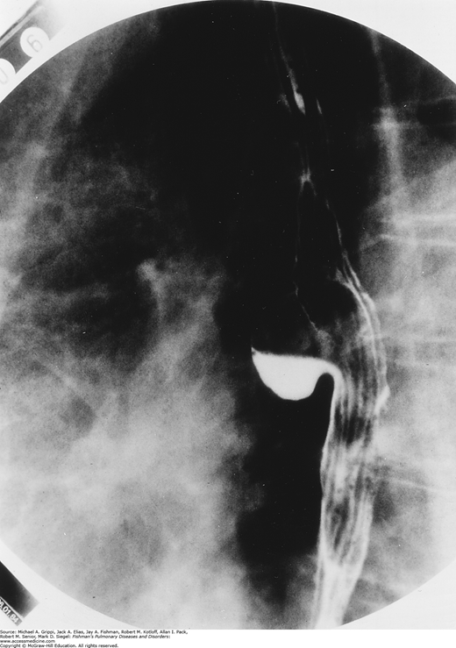
The right paratracheal area is the most common site for development of an encapsulated mass.
When calcification is absent and the patient presents with what appears to be mediastinal adenopathy, a tissue diagnosis is required to exclude malignancy.

Slide 35

The presence of calcified lymph node masses within the bronchi is referred to as broncholithiasis.
Erosion into the airway, if it occurs, does so over a prolonged period of time and may remain clinically silent, only to be noted if a bronchoscopy is performed for some other indication

Slide 36
May present as
Cough
Obstruction
Bleeding
Rarely, if ever, should broncholiths be removed bronchoscopically, the exception being the occasional “stone” that is completely free within the bronchus.
Most symptomatic broncholiths should be removed at thoracotomy, where the pulmonary artery may be managed.
Fistulas occurring between the trachea and esophagus or esophagus and mediastinum as a result of granulomatous lymphadenitis should be closed and reinforced with viable tissue

Slide 37
Objective​ | Type of Study​ | Methods​ | Results​ | Conclusion​
Spontaneous mediastinum emphysema is uncommon and is associated with raised alveolar pressure | Retrospective Cohort | Between 1980-2001 114 patients with mediastinal emphysema were hospitalized in Wolfson Medical Centre. In 22 patients emphysema occurred without an obvious preceding event and was classified as spontaneous. All patients were kept under observation​ | All patients recovered and were followed for at least one month. There were no complications and no recurrences​ | Spontaneous mediastinal emphysema is usually benign condition which can be treated expectantly. Recurrences are rare​

Slide 38
References
BD Chaurasia
Fishman's pulmonary diseases and disorders

Slide 39


