Slide 1
ISCHAEMIC HEART DISEASE (IHD)
DR TRUPTI R JANSARI

Slide 2
Ischaemic heart disease (IHD) is defined as acute or chronic form of cardiac disability arising from imbalance between the myocardial supply and demand for oxygenated blood.
Since narrowing or obstruction of the coronary arterial system is the most common cause of myocardial anoxia, the alternate term ‘coronary artery disease (CAD)’ is used synonymously with IHD.
IHD or CAD is the leading cause of death in most developed countries (about one-third of all deaths) and somewhat low incidence is observed in the developing countries. Men develop IHD earlier than women and death rates are also slightly higher for men than for women until the menopause.

Slide 3
the etiology of IHD under three broad headings:
i) coronary atherosclerosis;
ii) superadded changes in coronary atherosclerosis; and
iii) non-atherosclerotic causes.

Slide 4
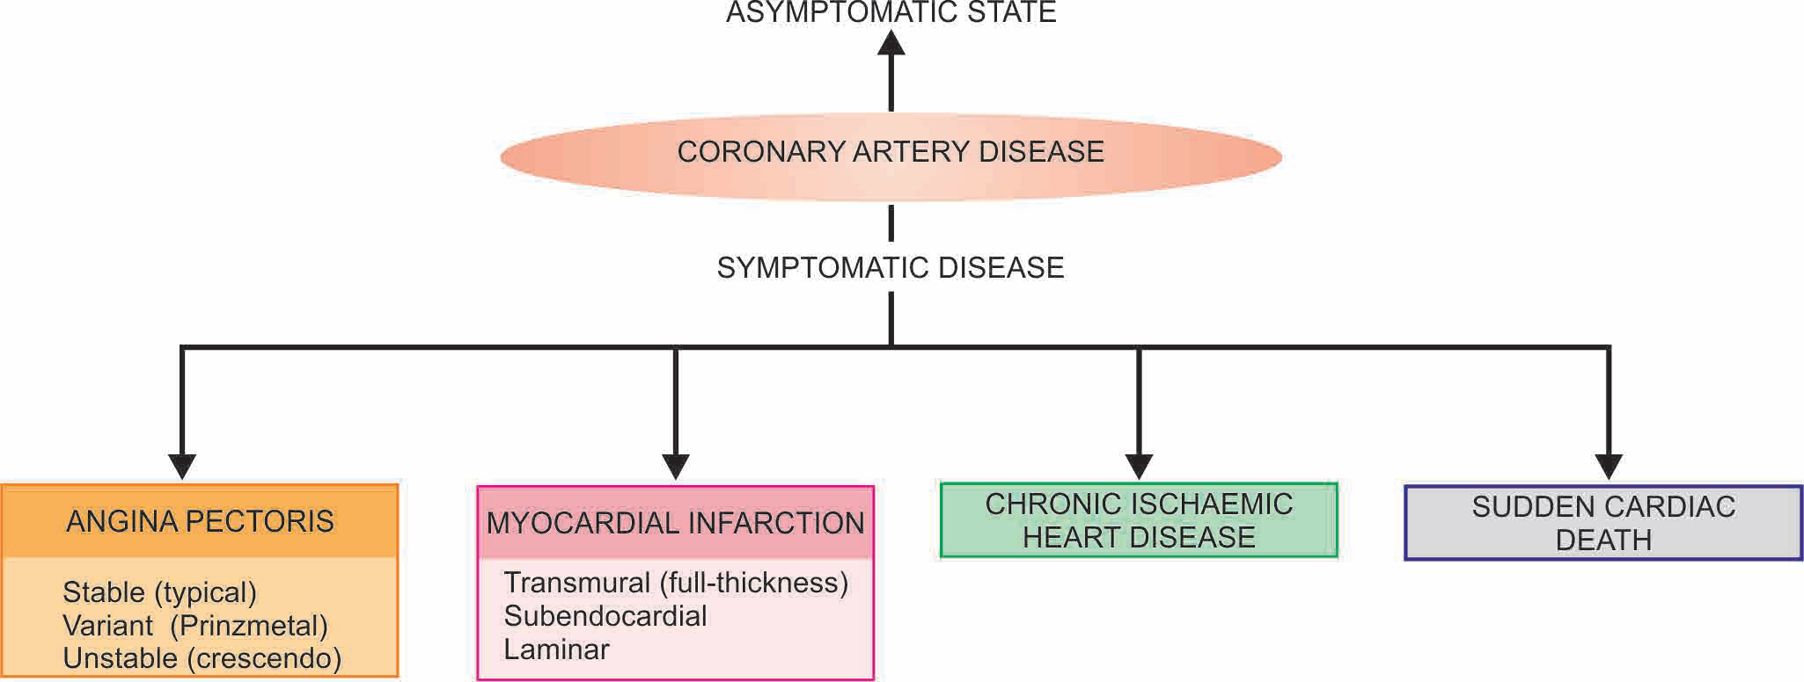
SPECTRUM OF CORONARY ISCHAEMIC MANIFESTATIONS.

Slide 5
ACUTE MYOCARDIAL INFARCTION
Acute myocardial infarction (MI) is the most important and feared consequence of coronary artery disease.
Many patients may die within the first few hours of the onset, while remainder suffer from effects of impaired cardiac function.
A significant factor that may prevent or diminish the myocardial damage is the development of collateral circulation through anastomotic channels over a period of time. A regular and well-planned exercise programme encourages good collateral circulation and improved cardiac performance.

Slide 6
INCIDENCE
higher in the elderly.
About 5% of heart attacks occur in young people under the age of 40 years,
Males throughout their life are at a significantly higher
risk of developing acute MI as compared to females.
Women during reproductive period have remarkably low incidence of acute MI, probably due to the protective influence of oestrogen.
The use of oral contraceptives is associated with high risk of developing acute MI.
After menopause, this gender difference gradually declines but the incidence of disease among women never reaches that among men of the same age.

Slide 7
ETIOPATHOGENESIS
Myocardial ischaemia
Myocardial ischaemia is brought about by one or more of the following mechanisms:
i) Diminished coronary blood flow e.g. in coronary artery disease, shock.
ii) Increased myocardial demand e.g. in exercise, emotions.
iii) Hypertrophy of the heart without simultaneous increase of coronary blood flow e.g. in hypertension, valvular heart disease.

Slide 8
2. Role of platelets Rupture of an atherosclerotic plaque exposes the subendothelial collagen to platelets which undergo aggregation, activation and release reaction. These events contribute to the build-up of the platelet mass that may give rise to emboli or initiate thrombosis.
3. Acute plaque rupture In general, slowly-developing coronary ischaemia from stenosing coronary aherosclerosis of high-grade may not cause acute MI but continue to produce episodes of angina pectoris.
Superimposed coronary thrombosis due to disruption of plaque is seen in about half the cases of acute MI.
Intramural haemorrhage is found in about one-third cases of acute MI. Plaque haemorrhage and thrombosis may occur together in some cases.

Slide 9
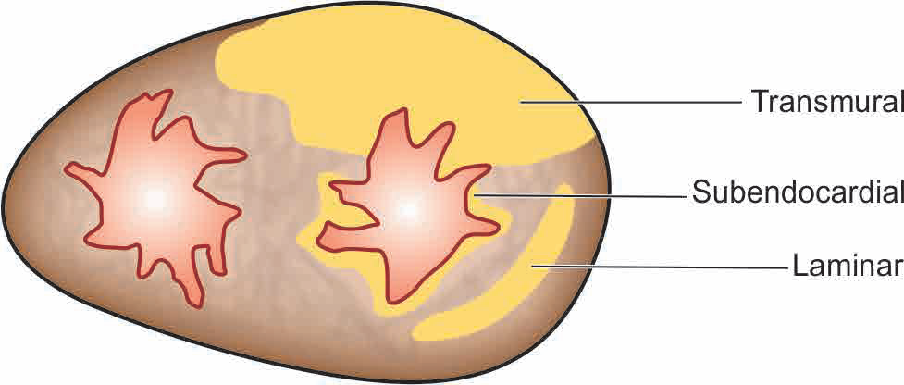
4. Non-atherosclerotic causes About 10% cases of acute MI are caused by non-atherosclerotic factors such as coronary vasospasm, arteritis, coronary ostial stenosis, embolism, thrombotic diseases, trauma and outside compression as already described.
5. Transmural versus subendocardial infarcts

Slide 10
TYPES OF INFARCTS
Infarcts have been classified in a number of ways by the physicians and the pathologists:
1. According to the anatomic region of the left ventricle involved, they are called anterior, posterior (inferior), lateral, septal and circumferential, and their combinations
like anterolateral, posterolateral (or inferolateral) and anteroseptal.
2. According to the degree of thickness of the ventricular wall involved, infarcts are of two types :
i) Full-thickness or transmural, when they involve the entire thickness of the ventricular wall.
ii) Subendocardial or laminar, when they occupy the inner subendocardial half of the myocardium.
3. According to the age of infarcts, they are of two types:
i) Newly-formed infarcts called as acute, recent or fresh.
ii) Advanced infarcts called as old, healed or organised.

Slide 11
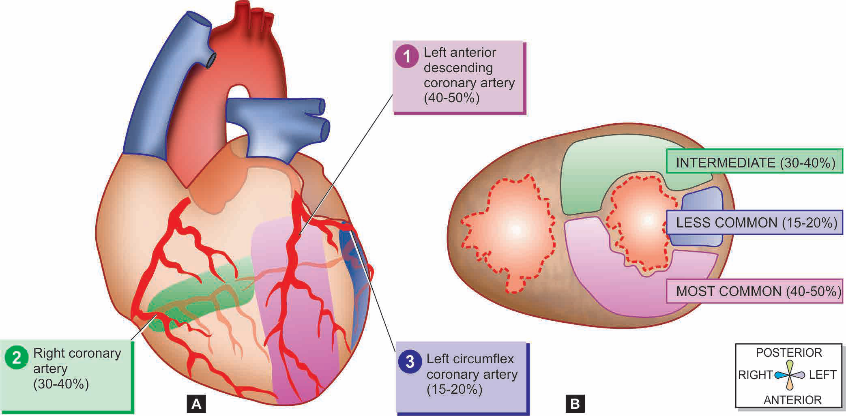
Common locations and the regions of involvement in myocardial infarction. The figure shows region of myocardium affected by stenosis of three respective coronary trunks in descending order shown as: 1) left anterior descending coronary, 2) right coronary and 3) left circumflex coronary artery. A, As viewed from anterior surface. B, As viewed on transverse section at the apex of the heart.

Slide 12
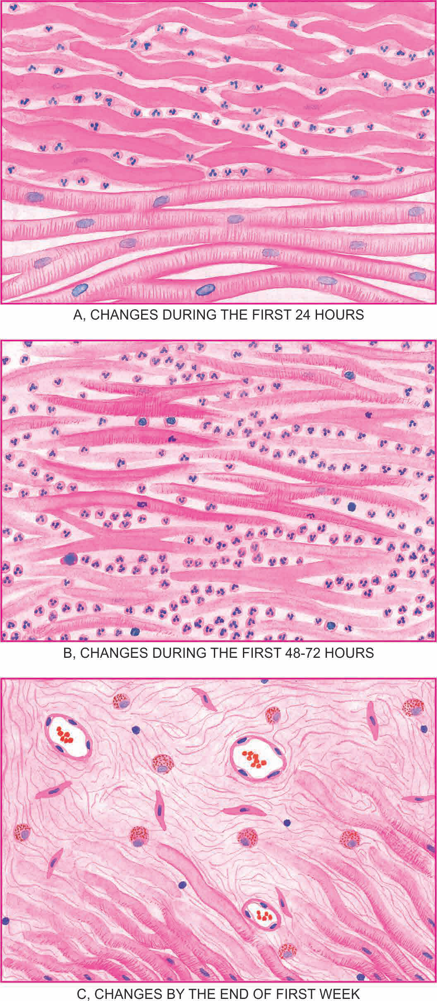
During first 24 hours, coagulative necrosis progresses further as evidenced by shrunken eosinophilic cytoplasm and pyknosis of the nuclei. The neutrophilic infiltrate at the margins of the infarct is slight.
During first 48 to 72 hours, coagulative necrosis is complete with loss of nuclei. The neutrophilic infiltrate is well developed and extends centrally into the interstitium.
In 3-7 days, neutrophils are necrosed and gradually disappear. The process of resorption of necrosed muscle fibres by macrophages begins. Simultaneously, there is onset of proliferation of capillaries and fibroblasts from the margins of the infarct

Slide 13
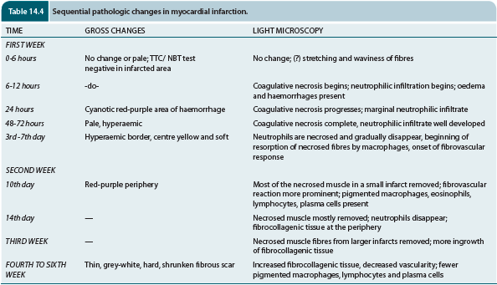

Slide 14
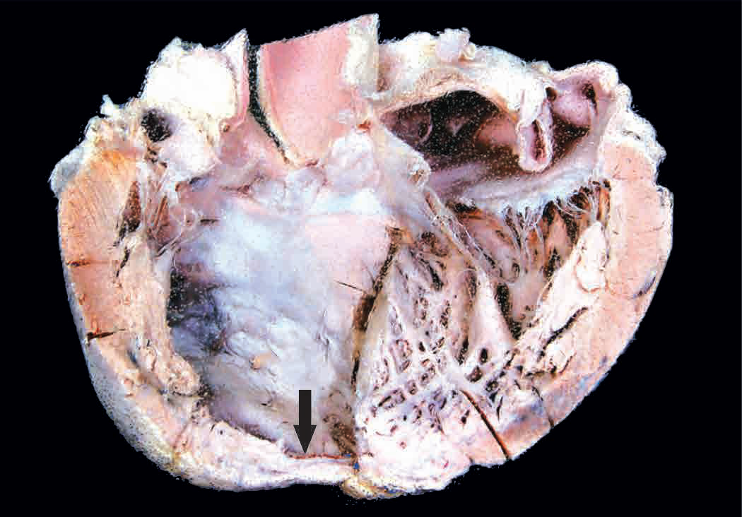
Myocardial infarction, healed. Opened up left heart shows grey white thinning of myocardium at the apex (arrow) due to healed fibrous scarring.

Slide 15
DIAGNOSIS
3 types of features—
clinical features,
ECG changes, and
serum enzyme determinations

Slide 16
1. Clinical features
i) Pain: Usually sudden, severe, crushing and prolonged, substernal or precordial in location, unrelieved by rest or nitroglycerin, often radiating to one or both the arms, neck and back.
ii) Indigestion:
iii) Apprehension: The patient is often terrified, restless and apprehensive due to great fear of death.
iv) Shock:
v) Oliguria:
vi) Low grade fever:
vii) Acute pulmonary oedema:

Slide 17
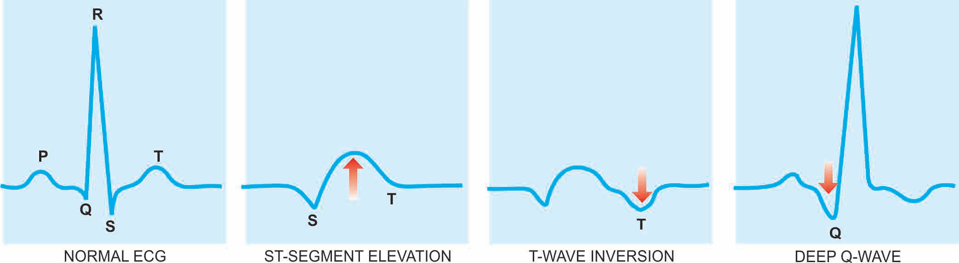
2. ECG changes

Slide 18
3. Serum cardiac markers
Certain proteins and enzymes are released into the blood from necrotic heart muscle after acute MI.
i) Creatine phosphokinase (CK) and CK-MB CK has three
forms—
a) CK-MM derived from skeletal muscle;
b) CK-BB derived from brain and lungs; and
c) CK-MB, mainly from cardiac muscles and insignificant amount from extracardiac tissue.

Slide 19
ii) Lactate dehydrogenase (LDH)
iii) Cardiac-specific troponins (cTn):
a) cardiac troponin T (cTnT); and
b) cardiac troponin I (cTnI).
iv) Myoglobin

Slide 20
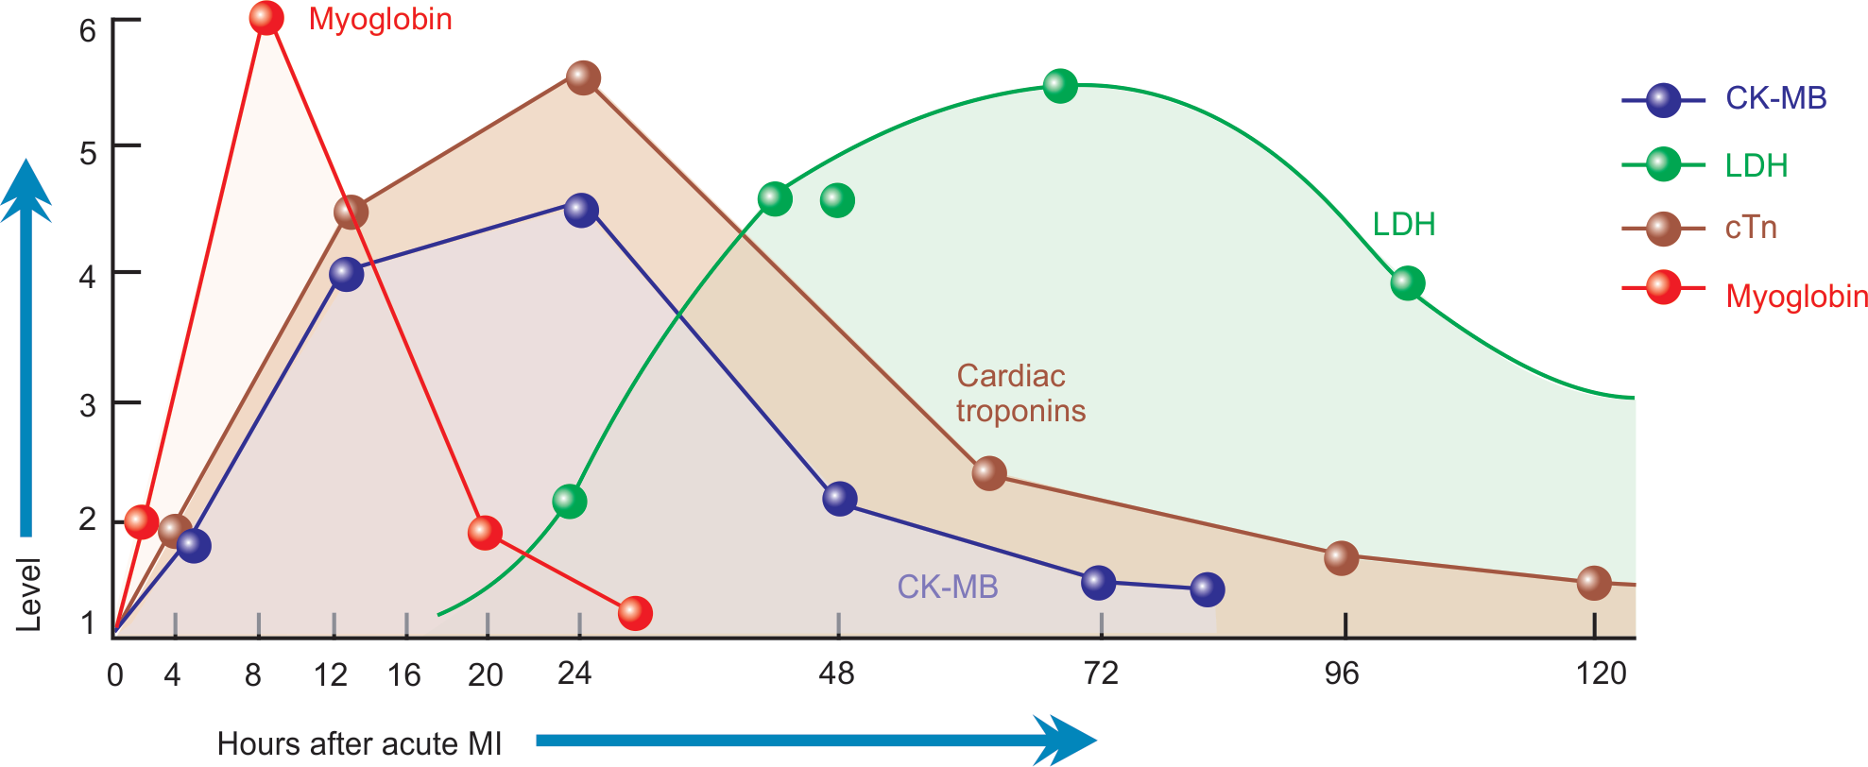
Time course of serum cardiac markers for the diagnosis of acute MI.

Slide 21
COMPLICATIONS
Arrhythmias
Congestive heart failure
Cardiogenic shock
Mural thrombosis and thromboembolism
Rupture
Cardiac aneurysm
Pericarditis
Postmyocardial infarction syndrome

Slide 22
SUMMARY
Ischaemic heart disease (IHD) is acute or chronic cardiac disability arising from imbalance between the myocardial supply and demand for oxygenated blood.
Atherosclerotic coronary artery disease (CAD) is the most common cause of IHD, most commonly of LAD, others are RCA and CXA.
Acute coronary syndromes include a triad of acute myocardial infarction, unstable angina and sudden cardiac death .
Angina pectoris results from transient myocardial ischaemia and is characterised by paroxysmal pain in the substernal or precordial region.
Acute myocardial infarction (MI) is the most important and feared consequence of coronary artery disease.

Slide 23
Early thrombolyitc therapy within 30 minutes of occurrence may help in restoration of blood supply. The gross and microscopic
changes in the myocardial infarction, most often in the left ventricle, vary according to the age of the infarct.
The diagnosis of acute MI is made by clinical features, ECG changes, and serum enzyme determinations.
Chronic ischaemic heart disease is focal or diffuse fibrosis in the myocardium characteristically found in elderly patients of progressive IHD.
Sudden death by myocardial ischaemia is almost always by fatal arrhythmias, chiefly ventricular asystole or fibrillation

Slide 24
MCQs

Slide 25
MCQ
1. Which of the following is less likely to be a manifestations of ischemic heart disease
Myocardial infarction
Chronic ischemic heart disease
Sudden cardiac death
Myocarditis
Angina pectoris

Slide 26
2. Myocardial ischaemia is brought about by
i) Diminished coronary blood flow
ii) Increased myocardial demand
iii) Hypertrophy of the heart without simultaneous increase of coronary blood flow
vi) All of the above

Slide 27
MCQ
3. Causes of imbalance between myocardial oxygen supply and demand include:
i.) Atherosclerotic coronary artery disease
ii.) Coronary artery spasm
iii.) Dilated cardiomyopathy
iv.) all of the above

Slide 28
4. All of the following are classical ECG Changes of IHD except
ST Elevation
T – wave inversion
Deep Q wave
T – wave elevation

Slide 29
5. The earliest marker to raise following MI is
CK – MB
TROPONIN
MYOGLOBIN
NONE OF THE ABOVE

Slide 30
ANSWERS
1 - iv
2 - iv
3 - iv
4 - iv
5 - iii

