Slide 1
FEVER
DR. BHAVESH PATEL(PROFESSOR)
DEPARTMENT OF RESPIRATORY MEDICINE
23/3/24

Slide 2
DEFINITION:
It is an elevation of body temperature above the normal circadian variation as a result of the change in the thermoregulatory centre, located in the hypothalamus.
Normal : 37°C to 37.6°C (98.6°F to 99.6 °F)
Febrile : Above 37.8°C (100°F)
Hyperpyrexia : >41°C (>106°F)
Hypothermia : < 35°C (< 95°F)

Slide 3
NORMAL BODY TEMPERATURE & PHYSIOLOGICAL VARIATION:
Normal Oral Temperature varies between 37.0°C (98.6°F)at 6.00 AM to 37.6°C (99.6°F) at 6.00 PM.
The normal diurnal variation is 1°F. The normal body temperature is more towards the evening because of increased BMR and increased skeletal muscle activity.
Body temperatures have seasonal variation as well, with low levels during summer and higher levels during winter.
Rectal temperature is 0.6°C (1°F) higher than oral temperature which is 0.6°C (1°F) higher than axillary temperature.

Slide 4
Baseline temperatures are also affected by:-
Age (lower by 0.02°C for every 10-year increase in age)
Demographics (African-American women have temperatures 0.052°C higher than white men)
Comorbid conditions (cancer is associated with 0.02°C higher temperatures; hypothyroidism is linked to temperatures lower by 0.01°C).
In a menstruating woman, the early morning temperature is subnormal in the two weeks preceding ovulation. At the time of ovulation, the temperature rises by about 0.6°C (1°F), and persists till menstruation occurs (due to thermogenic property of progesterone).

Slide 5
MECHANISM OF FEVER DEVELOPMENT:
Hypo-thalamic set point raised
Neurons in the vasomotor center are activated and vasoconstriction commences
Shunting of blood away from the periphery to the internal organs essentially decreases heat loss from the skin, and the person feels cold.
The processes of heat conservation (vasoconstriction) and heat production (shivering and increased non-shivering thermogenesis) continue until the temperature of the blood bathing the hypothalamic neurons matches the new "thermostat setting."
Shivering- increases heat production from the muscles
Non-shivering heat production from the liver
State of Heat Balance
Mechanisms of heat conservation
Behavioural adjustments (e.g., putting on more clothing or bedding)

Slide 6
MECHANISM OF FEVER RESOLUTION:
Mechanisms of heat loss
Sweating
State of Heat Balance
Loss of heat by sweating and vasodilation continues until the blood temperature at the hypothalamic level matches the now lowered setting. (Normal body temperature)
Hypo-thalamic set point reset
In response to either a reduction in the concentration of pyrogens or the use of antipyretics.
Behavioral changes (e.g., removal of clothing)
Vasodilation commences.

Slide 7
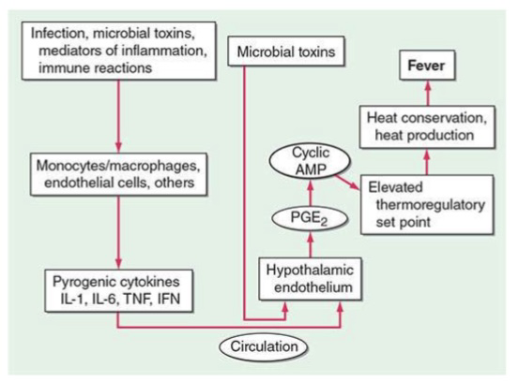
PATHOGENESIS OF FEVER:

Slide 8
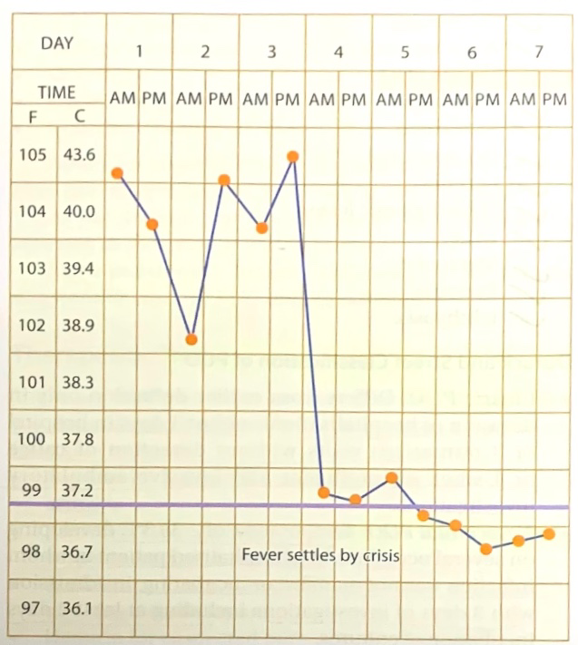
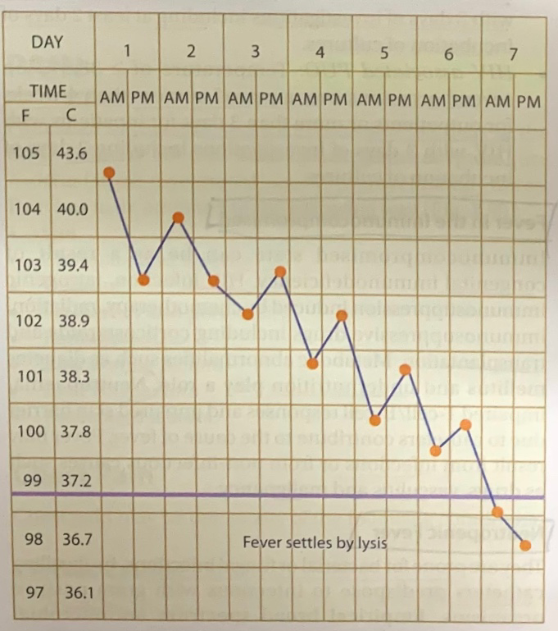
Fever can subside in the following ways:-
Crisis : Elevated temperature settles down to the baseline immediately after starting treatment. It may be accompanied by diaphoresis, diarrhoea or diuresis, e.g. Pneumonia.
Lysis : Elevated temperature settles down to the baseline in a step ladder fashion, after starting treatment, e.g. Typhoid fever.

Slide 9
ASSOCIATED SIGNS & SYMPTOMS:
Chill is a sensation of cold that occurs in most fevers.
Rigor is a profound chill with piloerection (goose flesh) associated with teeth chattering and severe shivering.
Chills or rigors occur when the thermostat, situated in the hypothalamus, is suddenly reset to a higher temperature due to presence of pyrogens.
The body temperature then tends to rise to the newly reset level in the thermostat by conserving heat in the body by cutaneous vasoconstriction and involuntary contraction of skeletal muscles, experienced as chills or rigors.
Chills or rigors may be commonly seen with bacterial, rickettsial, protozoal, influenzal infections.

Slide 10
With every 1°F rise of temperature, above 100°F, the PR increases by 10, the RR by 4, and BMR by 7. Oxygen consumption increases by 13%.
Fever with Relative Bradycardia
﻿﻿﻿Typhoid fever
﻿﻿﻿Meningitis
﻿﻿﻿Viral fever (Influenza)
﻿﻿﻿Brucellosis
﻿﻿﻿Leptospirosis
﻿﻿﻿Drug induced fever

Slide 11
Fever with Exanthems
﻿﻿﻿Rash appearing on 1st day of fever -Chicken pox.
﻿﻿﻿Rash appearing on 4th day of fever -Measles
﻿﻿﻿Rash appearing on 7th day of fever- Typhoid
Febrile Convulsions
It occurs in infants and children less than 5 years old.
Convulsions are common at temperatures more than
40°C. It may not be a sign of cerebral disease.

Slide 12
CAUSES OF FEVER:
Disease categories having cardinal sign as fever can be grouped as:-
Infectious diseases
Autoimmune and noninfectious inflammatory disorders
Cancer
Medication related (e.g., vaccines, drug fever)
Endocrine disorders (e.g., hyperthyroidism)
Intrinsic hypothalamic malfunction

Slide 13
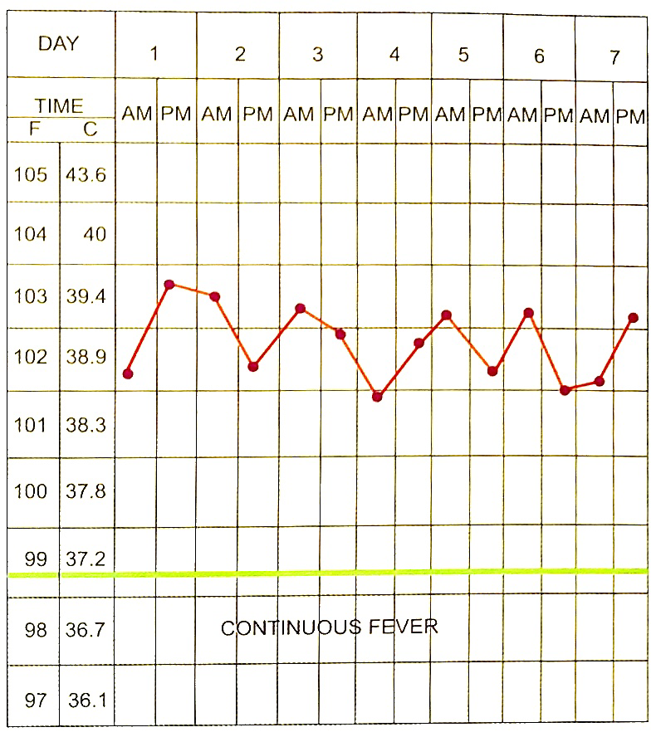
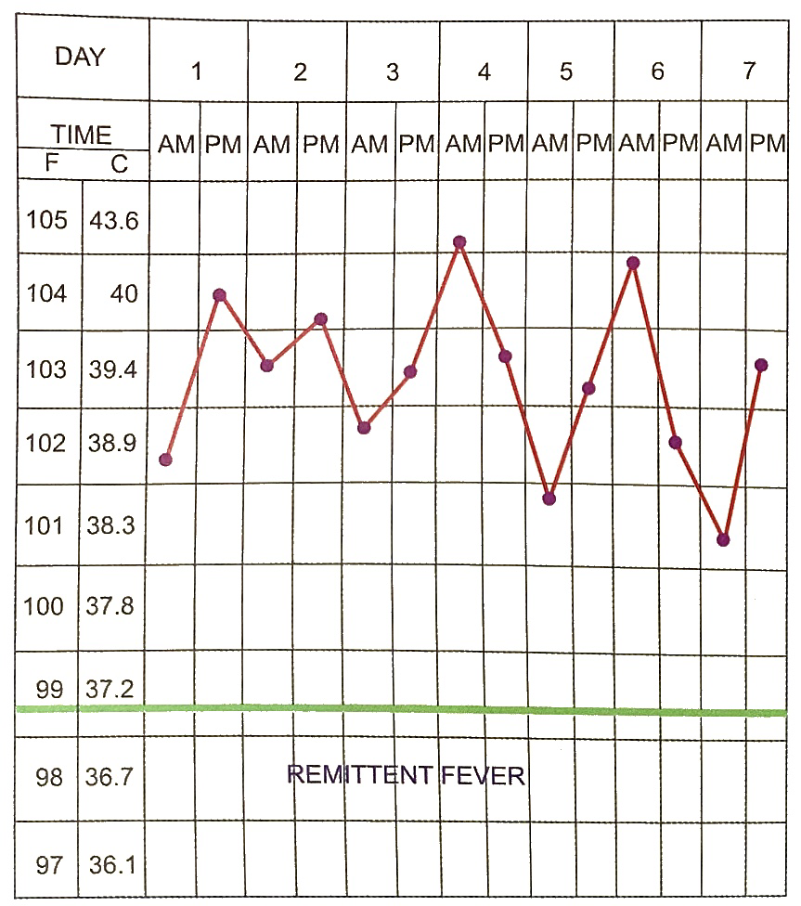
PATTERNS OF FEVER:
CONTINUOUS FEVER:
The temperature remains elevated above normal without touching the baseline and the fluctuation does not exceed 0.6°C (1 F) (diurnal variation)
E.g. lobar pneumonia, infective endocarditis, enteric fever.
REMITTENT FEVER :
The temperature fluctuation exceeds 0.6°C (1°F), but without touching the baseline.

Slide 14
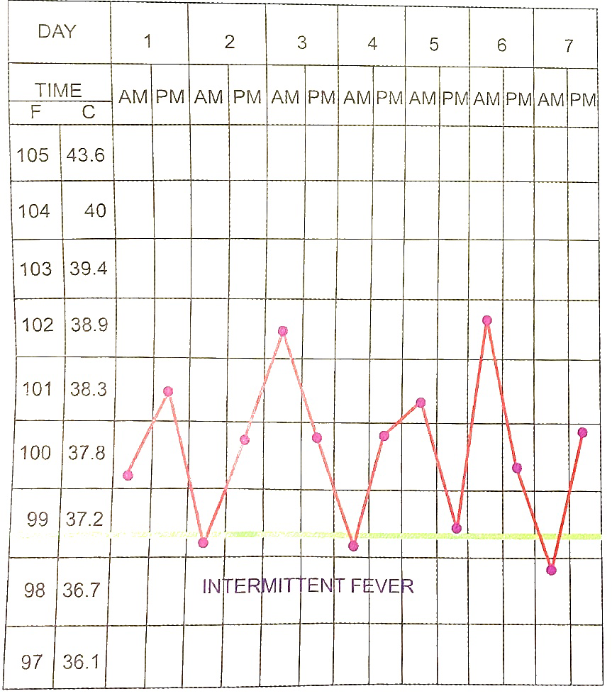
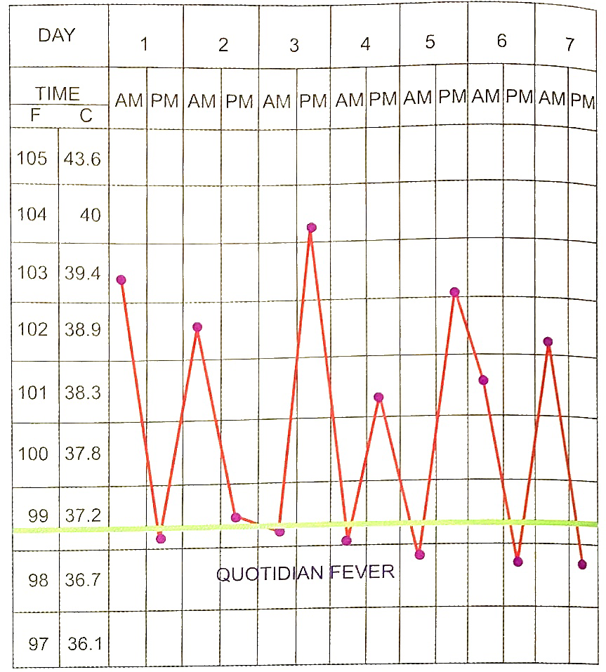
INTERMITTENT FEVER:
The elevated temperature touches the baseline in between.
In hectic or septic type of intermittent fever, the diurnal variation is extremely large, as occurs in septicemia.
Quotidian fever is a hectic fever occurring daily. Occurs in mixed malarial infections.

Slide 15
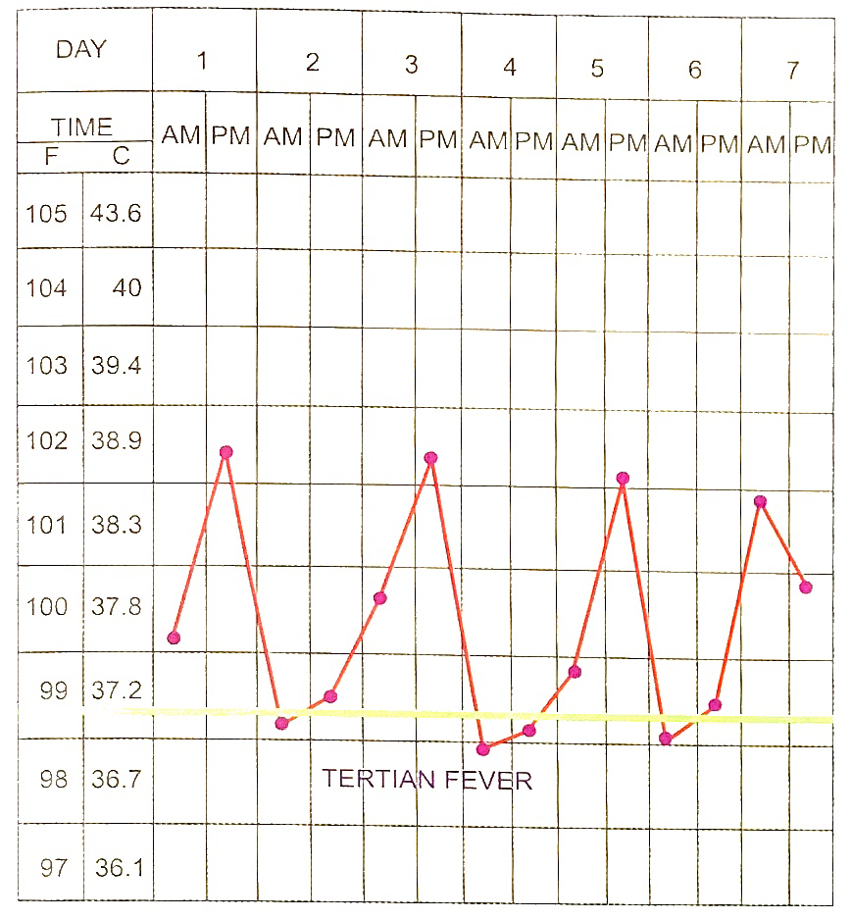
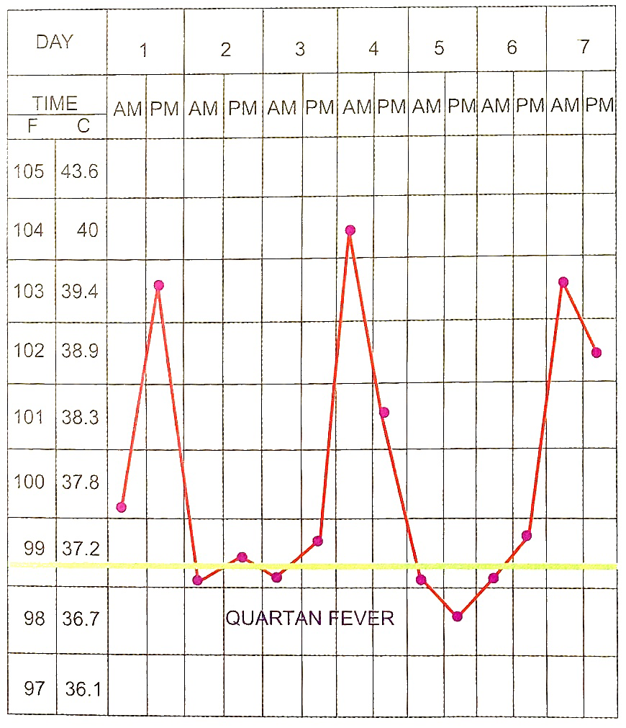
RELAPSING FEVER:
Febrile episodes are separated by normal temperature for more than one day, e.g. Borrelia infection, rat bite fever.
﻿﻿﻿Tertian fever - occurs on the first and third day, e.g. Pl. vivax, ovale, falciparum.
﻿﻿﻿Quartan fever - occurs on first and fourth day, e.g. PI. malariae.

Slide 16
﻿﻿﻿PEL-EBSTEIN FEVER- A type of fever lasting for 3-10 days followed by an afebrile period of 3-10 days, e.g. Hodgkins and other lymphomas.
﻿﻿﻿SADDLE BACK FEVER- Initially fever lasts for 2-3 days followed by a remission lasting for 2 days and the fever reappears and continues for 2-3 days, e.g. Dengue fever.
Borrelia infection and rat bite fever: Both are associated with several days of fever followed by several days of afebrile period and then the cycle repeats.
CYCLIC NEUTROPENIA- Cyclic neutropenia accompanied with fever occurs every 21 days.

Slide 17
DRUG FEVER:
﻿﻿﻿It is prolonged fever and may belong to any febrile pattern.
﻿﻿﻿It begins 1-3 weeks after the start of the drugs and persists 2-3 days after the drug is withdrawn.
﻿﻿﻿There is relative bradycardia and hypotension.
﻿﻿﻿Pruritus, skin rash and arthralgia may occur.
Eosinophilia may be present.
Important commonly used drugs producing fever are-
Exception- Digoxin does not cause drug fever.
Anti-TB drugs
Sulphonamide
Procainamide
Penicillins
Iodides
Propylthiouracil
Methyldopa
Anticonvulsants

Slide 18
HYPERPYREXIA:
It is an elevation of body core temperature, above 41°C (106°F), due to inadequate dissipation of heat. It is a medical emergency, since they are prone for sudden cardiorespiratory arrest.
Causes of Hyperpyrexia:-
﻿﻿﻿Pontine haemorrhage
﻿﻿﻿Rheumatic fever
﻿﻿﻿Meningococcal meningitis
﻿﻿﻿Septicemia
﻿﻿﻿Cerebral malaria.
Treatment- It is treated with parenteral anti-pyretics to set the elevated thermostat set point to a lower level. Physical cooling aids in reducing the body temperature. Chlorpromazine is sometimes helpful in reducing the body temperature.

Slide 19
HYPERTHERMIA:
Hyperthermia is characterised by an unchanged setting of the thermoregulatory centre with an uncontrolled increase in body temperature that exceeds body's ability to lose heat.
The setting of the hypothalamic thermoregulatory centre is unchanged. Exogenous heat exposure and endogenous heat production are two mechanisms by which hyperthermia can result in dangerously high internal temperatures.
Hyperthermia is often diagnosed on the basis of the events immediately preceding the elevation of core temperature-e.g., heat exposure or treatment with drugs that interfere with thermoregulation.
In patients with heat stroke syndromes and in those taking drugs that block sweating, the skin is hot but dry, whereas in fever, the skin can be cold as a consequence of vasoconstriction.
Antipyretics do not reduce the elevated temperature in hyperthermia, whereas in fever and even in hyperpyrexia adequate doses of either aspirin or acetaminophen usually result in some decrease in body temperature.

Slide 20
It can be caused by:
Heat stroke
2. ﻿﻿﻿Malignant hyperthermia:
It is an inherent abnormality of skeletal muscle cell sarcoplasmic reticulum which is unable to store calcium ion.
There is an increase in the intracellular myoplasmic calcium, leading to activation of myosin ATPase, which converts ATP to ADP + PO + heat thereby producing hyperthermia.
Hyperthermia is triggered by use of inhalation anaesthetics (Halothane, Cyclopropane) and muscle relaxants (Succinylcholine) in susceptible individuals.
3. Neuroleptic malignant syndrome :
It is characterised by muscular rigidity, ﻿﻿﻿autonomic dysregulation and hyperthermia.
Neuroleptic drugs like haloperidol, phenothiazines trigger the onset of symptoms.

Slide 21
Treatment of the above mentioned hyperthermia is by withdrawal of the offending agents. Antipyretics are of no use as the thermostat is not reset to higher level.
Physical cooling helps. Central muscle relaxant (Dantrolene sodium) is helpful in the last two conditions. Bromocriptine is helpful in treatment of neuroleptic malignant syndrome.
4. Thyrotoxicosis
5. Pheochromocytoma
﻿﻿﻿6. Hypothalamic fever
﻿﻿﻿7. Seratonin syndrome:
It is seen with selective serotonin uptake inhibitors - monoamine oxidase inhibitors and other seratonergic medications.
It consists of hyperthermia, diarrhoea, tremor and myoclonus.
8. Central nervous system damage:
- It is common in cerebral haemorrhage, status epilepticus, and hypothalamic injury.

Slide 22
PYREXIA OF UNKNOWN ORIGIN
It is defined by Petersdorf and Beeson as a persistent temperature of more than 101.2°F (38.4°C) lasting for more than 3 weeks, and defying one week of evaluation.
It may be classified as Low grade and High grade PUO.
Causes of Low grade PUO:
(i) Exercise
(ii) Heavy meals
(in) Essential hyperthermia
(iv) Psychogenic
(v) Excitement
(vi) Premenstrual
Causes of High grade PUO:
(i) Factitious / Fabricated
(ii) Occupational
(iii) Icthyosis
(iv) Eczema
(v) Hypothalamic lesion
(vi) Drug induced
(vii) Metabolic
(viii) Periodic

Slide 23
DURACK AND STREET CLASSIFICATION OF PUO:
Classic PUO:
Differs from earlier definition only in duration of hospitalization-either 3 days in hospital or 3 outpatient visits without detection of cause or 1 week of intelligent and invasive ambulatory investigations.
﻿﻿﻿Nosocomial PUO:
Temperature of ≥ 38.3°C developing on several occasions in a hospitalized patient in whom infection was not manifest or incubating on admission with 3 days of investigations including at least 2 days incubation of cultures.
﻿﻿﻿Neutropenic PUO:
Temperature of ≥ 38.3°C on several occasions in a patient whose neutrophil count is less than 500/ microlitre or is expected to fall in 1 to 2 days with 3 days of investigations including at least 2 days of incubation of cultures.
﻿﻿﻿HIV associated PUO:
Temperature of > 38.3°C on several occasions over a period of more than 4 weeks for outpatients or more than 3 days for inpatients with HIV, with 3 days of investigations including 2 days of incubation of cultures.

Slide 24
Most PUOs are due to:
﻿﻿﻿Occult tuberculosis
﻿﻿﻿Occult pus
﻿﻿﻿Occult malignancies
﻿﻿﻿Collagen vascular diseases.
Extra-pulmonary tuberculosis remains the leading diagnosable cause of PUO among infections.
As the duration of fever increases the likelihood of infection as the cause of PUO is remote.
90% of PUOs are diagnosed by proper evaluation. The rest recover under a watchful non-interference.
Malignancies associated with PUO:
Hodgkin's disease
NHL
Leukemia (Preleukemia and aleukemia)
Hepatoma
Renal cell carcinoma
Ca colon

Slide 25
IMPORTANT INVESTIGATIONS:
1. ESR-platelet correlation:
If ESR > 100 mm/hr with thrombocytosis, think of
﻿﻿﻿Tuberculosis
﻿﻿﻿Malignancy
﻿﻿﻿Connective tissue disease
ESR > 100 mm/ hr without thrombocytosis, think of
viral infections
2. Elevated alkaline phosphatase
﻿﻿﻿﻿﻿﻿Miliary tuberculosis
Biliary tract infections
﻿﻿﻿Alcoholic hepatitis
﻿﻿﻿Primary and secondaries of liver
﻿﻿﻿Hypernephroma
lymphoma
﻿﻿﻿CMV infection

Slide 26
﻿﻿﻿3. Blood culture
4. ﻿﻿﻿Serological tests (4 fold rise significant). Useful in:
﻿﻿﻿Enteric fever
﻿﻿﻿Hepatitis
﻿﻿﻿CMV infection
﻿﻿﻿Tularemia
5. Imaging techniques
﻿﻿﻿Plain X-ray chest: In all patients with PUO, when initial X-rav chest is normal, a second X-ray must be taken after 3 weeks to rule out miliary tuberculosis (time taken for radiological opacity to appear): Mottling of < 0.5 mm is not detectable in X-ray.
Secondary syphilis
﻿﻿﻿Brucellosis
﻿﻿﻿Q-fever
﻿﻿﻿Amoebiasis
﻿﻿﻿HIV

Slide 27
﻿﻿﻿Contrast films
IVP in renal abscesses, tumours
Barium meal in intrinsic bowel disease
Oral cholecystogram andCholangiography
﻿﻿﻿Ultrasound: Excellent imaging is procured in thin individuals and poor imaging in obese indi-viduals. SOL in hepatobiliary tree of more than 1 cm and endocarditic vegetation of more than 2 mm can be detected.
﻿﻿﻿CT scan: It gives excellent imaging in obese patients also. SOL in liver of more than 1 cm and CNS lesion of more than 2 mm can be detected.
MRI: It gives best resolution of tissue planes of differing intensity. It has an advantage over CT scan when studying bone, brain, pelvis, spinal cord and thoracic large vessels. MRI is contraindicated when metal clips are present. (MRI and CT scans are useless in diagnosing meningitis)

Slide 28
Radionuclide scans: 99m Tc-Sulphur colloid is used for scanning liver and spleen. 111 Indium labelled leucocytes are used for detection of intra-abdominal abscess.
﻿﻿﻿6. CSF study
﻿﻿﻿7. Bone marrow study

Slide 29
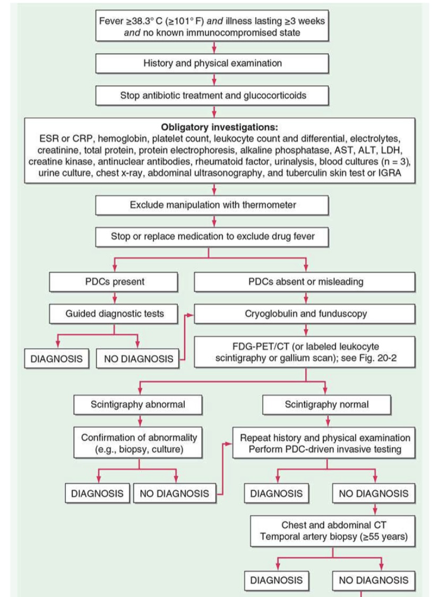
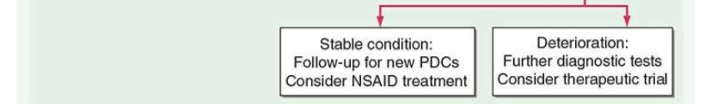

Slide 30
TREATMENT OF FEVER:
Treatment of fever and its symptoms with routine antipyretics does no harm and does not slow the resolution of common viral and bacterial infections.
However, in bacterial infections, the withholding of antipyretic therapy can be helpful in evaluating the effectiveness of a particular antibiotic, especially in the absence of positive cultures of the infecting organism, and the routine use of antipyretics can mask an inadequately treated bacterial infection.
The objectives in treating fever are first to reduce the elevated hypothalamic set point and second to facilitate heat loss.
Oral aspirin and NSAIDs effectively reduce fever but can adversely affect platelets and the gastrointestinal tract. Therefore, acetaminophen is preferred as an antipyretic.
In children, acetaminophen or oral ibuprofen must be used because aspirin increases the risk of Reye's syndrome.
If the patient cannot take oral antipyretics, parenteral preparations of NSAIDs and rectal suppositories of various antipyretics can be used.

Slide 31
In cases of PUO, therapeutic trials are best avoided whenever possible. If instituted, the drug should be specific for that certain condition.
Examples include:
﻿﻿Aspirin in a possible case of juvenile rheumatoid arthritis
﻿﻿Antitubercular agents continued for 3 to 4 weeks in suspected occult tuberculosis
﻿﻿Antibiotics in a patient with suspected endocarditis awaiting culture report
﻿﻿Heparin for suspected pulmonary embolism
﻿﻿Corticosteroids for suspected giant-cell arteritis
﻿﻿Antitubercular or steroid therapy in a suspected case of granulomatous hepatitis.

Slide 32
EVIDENCE BASED STUDY
Background: Tuberculosis (TB), especially extrapulmonary tuberculosis (EPTB), is an important cause of fever of unknown origin (FUO) in TB-burdened areas.
Methods: We retrospectively analysed EPTB patients who were referred with FUO at 3 university-affiliated hospitals over 8 years (2010-2017). The subjects were assigned to groups of early diagnosis and delayed diagnosis within 3 days of an initial comprehensive evaluation from the referral. Clinical and laboratory variables were compared between the groups.

Slide 33
Results: A total of 95 patients with febrile EPTB were included. Localizing symptoms and/or signs suggestive of anatomy were identified in 62.1% of the patients.
Concurrent lung involvement by TB was presented by 49.5% (47/95) of the patients, and only 23.4% of them showed typical findings of pulmonary TB on simple chest X-ray. Most of the patients showed abnormal lesions on cross-sectional CT (98.9%) and MRI (100%).
The clinical variables and blood test results of patients were not significantly different between the two groups. The less typical imaging finding of EPTB on CT (38.5% vs. 79.0%) and MRI (37.5% vs. 79.0%) in the delayed diagnosis group was a risk factor for delayed diagnosis.
Conclusion: Febrile EPTB referred as FUO showed nonspecific clinical manifestations. The active application of cross-sectional imaging tests according to clinical clues or randomly in the absence of local manifestations, combined with invasive diagnostic approaches even for atypical presentations may lead to an earlier diagnosis of febrile EPTB.

Slide 34
REFERENCES
MANUAL OF PRACTICAL MEDICINE –ALAGAPPAN
HARRISON’S PRINCIPLES OF INTERNAL MEDICINE- 21ST EDITION
Kim JH, Kim ES, Jun KI, Jung HG, Bang JH, Choe PG, Park WB, Song KH, Kim HB, Kim NJ, Oh MD, Park SW. Delayed diagnosis of extrapulmonary tuberculosis presenting as fever of unknown origin in an intermediate-burden country. BMC Infect Dis. 2018 Aug 28;18(1):426. doi: 10.1186/s12879-018-3349-5. PMID: 30153813; PMCID: PMC6114835.

Slide 35
THANK YOU

