Slide 1
Spinal Tuberculosis
Dr. Bhavesh Patel (Professor)
Department of Respiratory Medicine
20/4/24

Slide 2
Introduction
Also known as Pott’s Spine or Tuberculous Spondylitis
Bones and Joints are the Fourth Commonest site of TB
Constitutes – 10% of Extra Pulmonary TB
Weight bearing joints are the most commonly affected
Spine – 40%
Hips- 13%
Knees -10%
Spine is the commonest site of bone and joint TB
Upper Thoracic Spine – In Children
Lower Thoracic Spine and Upper Lumbar followed by middle thoracic and cervical– In adults

Slide 3
Predisposing Factors
Malnutrition
Poor Sanitation
Over Crowding
Close contact with TB Patients
Multiple pregnancy
Immunodeficiency States
Diabetes Mellitus
Chronic renal disease

Slide 4
Pathology
TB spine is always secondary
Reactivation of hematogenous foci or spread from paravertebral lymph nodes
Hematogenous spread via paravertebral venous plexus of bateson.
Response will be either Proliferative or Exudative
Proliferative- Granuloma with fibrosis
Exudative – Non reactive, wide caseation necrosis, in immunocompromised

Slide 5
Types
PARADISCAL- commonest, contiguous area of two adjacent vertebrae along with intervertebral disc is affected
CENTRAL- Body of single vertebrae, nearby disc may be normal
ANTERIOR- Anterior part of the body
POSTERIOR- Posterior complex ( Pedicle, Lamina, spinous process or transverse process) affected

Slide 6
After Effects
PARADISCAL: Granulomatous inflammation, erosion of margins of the vertebrae, compromise of nutrition of IV disc, Disc degeneration, Destruction
CENTRAL- weakening of trabeculae, collapse of vertebrae
ANTERIOR- Infection spread up or down under anterior longitudinal ligament
POSTERIOR- Bony destruction can compress the cord

Slide 7
COLD ABSCESS
Pus and trabecular debris of diseased vertebrae
Not associated with usual signs of inflammation-COLD ABSCESS
NOTE: Pus can track in any direction
BACKWARDS: Compress cord
ANTERIORLY: Pre vertebral abscess
SIDES: para vertebral abscess
ALONG MUSCULOFASCIAL PLANES: Ex- Psoas Abcess

Slide 8
Healing
Occurs by fibrosis
In the spine bony ankylosis follows more often
Lytic areas are replaced by new bone and adjacent vertebrae undergo fusion

Slide 9
Clinical Features
Presentation varies from non specific backache to catastrophic paraplegia
Complaints:
pain
Stiffness
Cold abscess( if evident externally)
paraplegia
deformity
Constitutional Symptoms

Slide 10
Pain
Backache: Common Presenting complaint
Initially diffuse & late localized
Radicular Pain
Depending on root:
  Pain in arm- Cervical root
  Girdle Pain – Dorsal roots
  Groin Pain – Lumbar roots

Slide 11
Cold Abscess
CERVICAL- Retropharyngeal/ At post border of Sternomastoid in post triangle of the neck/ at axilla
THORACIC- Mediastinal/ anterior chest wall along the spinal nerves
LUMBAR- Pre vertebral swelling/ Psoas abscess/ abscess presenting at groin
STIFFNESS- Early symptom
Paravertebral muscles undergo spasm
Paraplegia
Deformity- In children
Constitutional Symptoms- Fever, Weight loss

Slide 12
Examination
Should have a high index of suspicious
AIMS: Look for findings of TB Spine
Localise site of lesion
Detect complications: Cold abscess/ Paraplegia
GAIT: Short steps
ATTITUDE & DEFORMITY
PARAVERTEBRAL SWELLING
TENDERNESS ON THE AFFECTED SPINE
REDUCED MOBILITY
DEFORMITY: Gibbus

Slide 13
Neurological Examination
AIMS: Detect any compression
Level of Compression
Severity of compression
LIMBS: Upper or lower based on site
Motor, sensory, reflexes, bowel and bladder functions

Slide 14
General Examination
Physical Examination
Systemic Illness: DM, Hypertension

Slide 15
Investigations
Radiology(X Ray)-
Specify the level
2 views- AP & Lateral
Chest X Ray
X Ray Abdomen
KUB- If psoas abscess is suspected

Slide 16
Findings
Reduction in Disc Space- Early sign
Compare with normal
Lateral X Ray is better
Importance: Secondaries to bone usually preserve the disc
2. Destruction of vertebral body – erosion and wedging
3. Deformity – depend on the number of the vertebrae affected .

Slide 17
COLD ABSCESS
PARAVERTEBRAL ABSCESS – a soft tissue shadow corresponding to affected vertebrae
Widened mediastinum
Retropharyngeal abscess
Psoas abscess

Slide 18
OTHER FINDINGS -
RAREFACTION – above and below affected vertebrae
OBLIQUE XRAY – may show posterior complex involvement
SIGNS OF HEALING – adjacent vertebrae undergo fusion .

Slide 19
OTHERS -
CT SCAN : accurate confirmations
MRI : to assess neural status
MYELOGRAPHY : suspected spinal tumor syndrome
BIOPSY : CT guided needle or open biopsy .

Slide 20
GENERAL INVESTIGATIONS -
ESR raised
Hb Decreased, Lymphocytosis
MANTOUX – erythema more than 10 mm
Smear – AFB Staining, Culture (LJ Media), CBNAAT
ELISA : ANTI TB ANTIBODY
XRAY- Reduced disc space, blurred paradiscal margins, loss of trabecular pattern,increased prevertebral soft tissue shadow, sublimation/dislocation, decreased lordosis/kyphosis

Slide 21
CT Scan findings
Pattern of bony destruction
Calcification in abscess
Posterior Spinal TB (Missed on x-ray)
Abscess in dorsal spine- Bird nest appearance

Slide 22
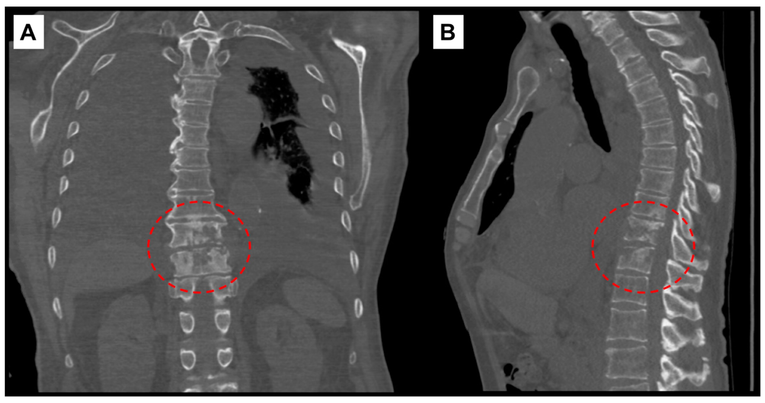
Computed-tomography scan of chest showing T10–T11 discitis and osteomyelitis. (A) Coronal view with red, interrupted circle highlighting destructive changes to vertebral bodies. (B) Sagittal view.

Slide 23
MRI
Skip lesions
Spinal cord involvement
Spinal arachnoiditis
USG – To find out primary in abdomen guided aspiration
Radionucleotide scan t99m- >=5 mm can be detected, abscess show cold spot due to decreased uptake

Slide 24
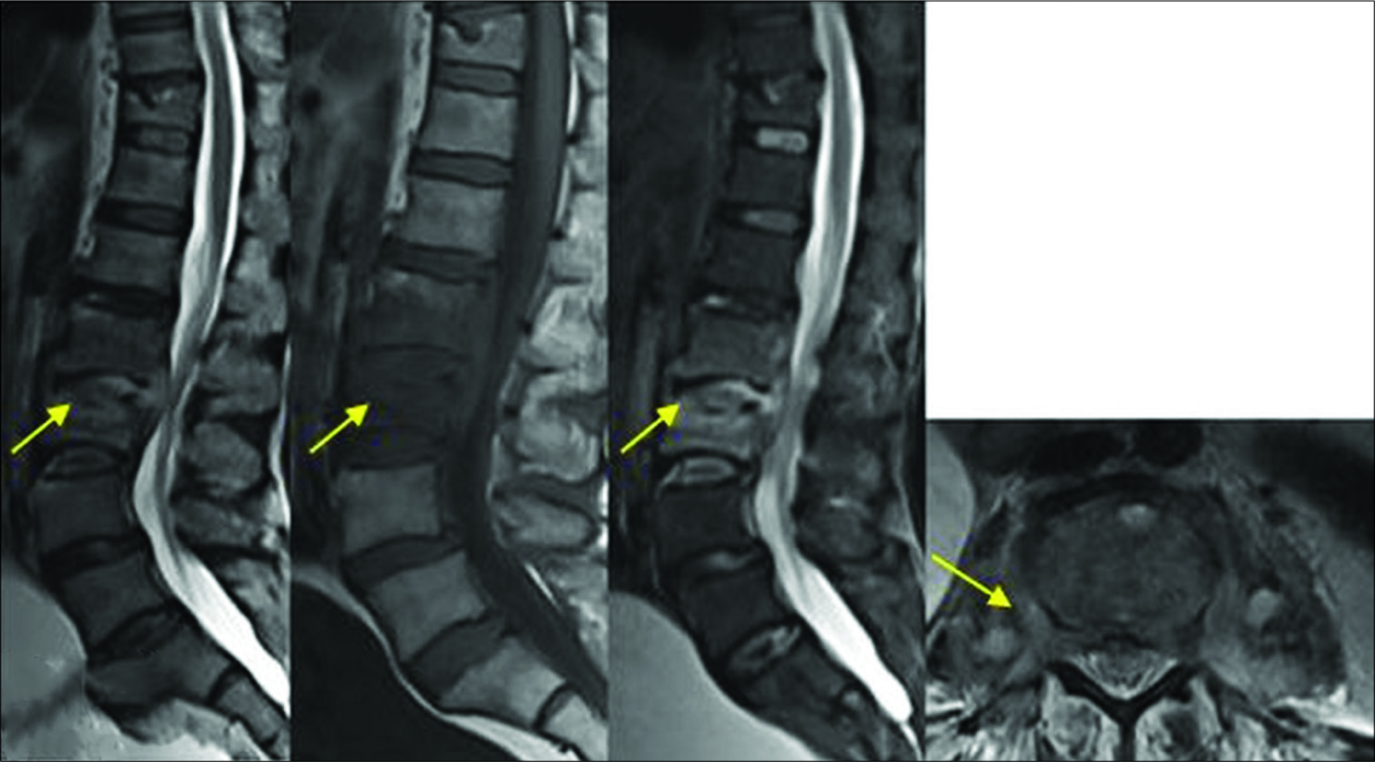
Multiplanar T2,T1 and T2Fat sat MR images depict presence of disc involvement, intraosseous and paravertebral small collections with thick abscess wall. Features sugggesting Pyogenic etiology with score of 1.

Slide 25
DIFFERENTIAL DIAGNOSIS -
BACKACHE -
Traumatic
Prolapsed Disc
Secondaries or myeloma
Ankylosing Spondylitis

Slide 26
Treatment
Patient should be given a high protein diet and good atmosphere
TB Drugs
Rest of the spine : Children body cast, collar if cervical
Mobilization: Advised to avoid sports for two years

Slide 27
Treatment of Cold abscess
Smaller ones subside with TB Therapy
In superficial abscesses:
Aspiration: Using thick needle
Evacuation
Psoas Abscess; Extraperitoneally via kidney incision

Slide 28
MRCB Controlled Trials
Bed rest not necessary
Streptomycin not necessary
Pop jackets provide no benefits
Debridement is not a good opration
Complication- Cold Abscess
Neurological Complications: Paraplegia

Slide 29
Pott’s Paraplegia
2% Incidence
Common in dorsal spine
Causes:
Inflammatory Oedema
Extradural pus and granulation tissue- common
Sequestra
Internal Gibbus
Infarction of spinal cord
Extradural Granuloma

Slide 30
Types
Early onset (During active phase of infection following cold compression)
Late onset (Over after many years due to persistent mechanism)
Clinical Features:-Night Cries
Patient walk carefully to avoid sudden jerks which can exacerbate pain- Aldeman’s Gait
Gradual onset
Clonus- Ankle or Patellar -Prominent

Slide 31
Paralysis: Stages
Muscle weakness: Spasticity and Incordination
Paraplegia in extention
Paraplegia in flexion
Complete Flaccid Paralysis

Slide 32
Grades: Goel (1967)
Basis is extent of motor involvement
Clinician detects the deformity
Symptomatic but manages to walk
Unable to walk, Paraplegia in extention, Partial sensory loss
Unable to walk, Paraplegia in extention, near complete sensory loss, sphincter disturbances

Slide 33
Treatment
Drugs | 2HRZE/10RHE All patients require close monitoring for development or progression of neurological deficit in the first 4 weeks of treatment. Some patients require surgical intervention.
Duration | Total treatment duration: 12 months (extendable to 18 months on a case-bycase basis
Referal | Optimum management of spinal TB requires the involvement of multiple specialists including a spinal orthopaedic surgeon, microbiologist/infectious diseases specialist and spinal radiologist, as well as physiotherapists and orthotists. All presumptive spinal TB cases should be referred and managed in specialist centres
Follow up | Patients without neurological deficit should be advised to return to the clinic immediately if new symptoms develop, and all ambulant patients should be assessed weekly for neurological signs. Patients with neurological deficit require staging and grading of their deficit. These patients should be assessed weekly with neural charting to detect neural recovery or deterioration. Repeat X-rays of the spine are suggested every 3 months following initiation of treatment to assess for radiological healing. Repeat MRI scans are suggested at 6, 9, 12 and 18 months following initiation of treatment to assess healing. At the end of treatment, all patients require follow up every 6 months for at least 2 years, and should be told to return to the clinic promptly if they develop new symptoms in the interim.

Slide 34
Treatment
Conservative- ATT, Rest to spine, Neurological examination
Surgical:
Indication: Paraplegia in conservative treatment
Sudden onset severe paraplegia
Severe Paraplegia: In flexion, motor/Sensory loss> 6 months or complete moor loss one month despite conservative treatment
Paraplegia with uncontrolled spasticity

Slide 35
Relative indications
Reactive paraplegia
Paraplegia in old age
Painful paraplegia
Complications: UTI/Stones

Slide 36
Procedures
Costo Transverectomy
Anterolateral decompression
Radical Debridement and Arthrodesis (Honkong Operation)
Laminectomy

Slide 37
Prognosis
Age: Children has better prognosis
Duration of Paraplegia: Long standing has bad prognosis
Severity: Motor alone has good prognosis
Onset of paraplegia: Acute onset has better
Sudden Progress: Bad prognosis

Slide 38
TITLE: Spinal tuberculosis current concepts
Objective | Type of Study | Methods | Results | Conclusions
A review of literature on the epidemiology, diagnosis, and management of spinal tuberculosis (TB). | Retrospective study | A systematic computerized literature search was performed using Cochrane Database of Systematic Reviews, EMBASE, and PubMed. Studies published over the past 10 years were analyzed. The searches were performed using Medical Subject Headings terms, and the subheadings used were “spinal tuberculosis,” “diagnosis,” “epidemiology,” “etiology,” “management,” “surgery,” and “therapy | Tissue diagnosis remains the only foolproof investigation to confirmdiagnosis. Magnetic resonance imaging and GeneXpert help in early detection and treatment of spinal TB. Uncomplicated spinal TB has good response to appropriately dosed multimodal ambulant chemotherapy. Surgery is warranted only in cases of neurological complications, incapacitating deformity, and instability. | The incidence of atypical clinicoradiological presentations of spinal TB is on the rise. Improper dosing, inadequate duration of treatment, and inappropriate selection of candidates for chemotherapy has not only resulted in the resurgence of TB but also led to the most dreadful consequence of multidrug resistant strains. In addition, global migration phenomenon has resulted in worldwide spread of spinal TB. The current consensus is to diagnose and treat spinal TB early, prevent complications, promote early mobilization, and restore the patient to his or her earlier functional status.

Slide 39
REFERENCES
Sharma Mohan textbook of tuberculosis and nontuberculous mycobacterial diseases
Index TB Guidelines

Slide 40
THANK YOU

