Slide 1
PULMONARY FUNCTION TEST
DR. ARTI D SHAH (HOD AND PROFESSOR)
DEPT. OF RESPIRATORY MEDICINE
25/5/24

Slide 2
COMPLETE PULMONARY SURVEY
TESTS OF MECHANICAL FUNCTION
TESTS OF GAS EXCHANGE
A. SPIROMETRY
- Volumes & Capacities
- Flow volume loops
- Flow rates (insp & exp)
- Bronchodilator reversibility
B. STATIC LUNG VOLUMES
C. RESPIRATORY MECHANICS
- Respiratory Muscle Strength
- Elastic recoil of lungs & chest wall
- Respiratory resistances
- Bronchial provocation
A. ABG (ARTERIAL BLOOD GAS ANALYSIS)
B. DLCO (DIFFUSING CAPACITY OF LUNGS FOR CO – transfer factor)

Slide 3
USES:
Objective evidence of the lung function.
﻿﻿﻿To identify or exclude a respiratory cause of breathlessness.
﻿﻿﻿Preoperative evaluation by quantifying the lung function in patients undergoing pulmonary resection.
﻿﻿﻿Assessment of the course of a disease over time (COPD).
﻿﻿﻿Monitoring the effectiveness of the therapy.
﻿﻿﻿Help in differentiating the type of respiratory failure.
﻿﻿﻿Detect airway hyper-responsiveness.
﻿﻿﻿Evaluation of the disability.

Slide 4
VOLUME DISPLACEMENT SPIROMETER:
These record the amount of air exhaled or inhaled within a certain time.
Patient breathes into mouthpiece → air moves into cylinder → plastic bell, rubber/ plastic diaphragm → moves a pen which traces a curve on moving paper graph.
Common types of volume spirometers- Water seal spirometer
- ﻿﻿﻿Dry rolling seal spirometer
﻿﻿﻿ - Bellows spirometer
﻿﻿﻿The tracing is mechanically produced during the subject's expiratory manoeuvre.
﻿﻿﻿A leak test and a three litre syringe calibration check are easy to perform.

Slide 5
FLOW SENSING SPIROMETER:
A.K.A pneumotachometer is a device that measures gas flow.
These measure how fast the air flows in or out as the volume of air inhaled or exhaled is increased.
These spirometers produce a signal proportional to gas flow→ integrated to measure volume in addition to flow.
Common types of flow spirometer- ﻿﻿﻿Rotating vanes (turbines)
﻿﻿ -Pressure differential flow sensing spirometer
﻿ - Hot wire anemometers
﻿﻿ - Pilot tube flow sensing spirometer
﻿﻿﻿Usually lighter and more portable than volume spirometers.
﻿﻿﻿Disposable, single use flow sensors eliminate the risk of cross contamination.
﻿﻿﻿Harder to calibrate than volume spirometers.
﻿﻿﻿Less accurate in determining volumes since volume must be derived from the flow signal.

Slide 6
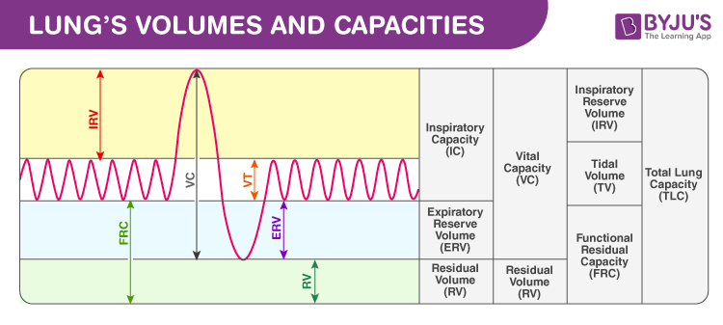
LUNG VOLUMES & CAPACITIES:

Slide 7
Tidal volume(500ml)- the total amount of air moves into and out of the airways with each inspiration and expiration during normal quiet breathing.
Inspiratory reserve volume (IRV)[3,000 mL]:-
Amount of air in excess of tidal inspiration that can be inhaled with maximum effort.
﻿﻿Expiratory reserve volume (ERV)[1,200 mL]:- Amount of air in excess of tidal expiration that can be exhaled with maximum effort.
Residual volume (RV)[1,300 mL]:- Amount of air remaining in the lungs after maximum expiration; keeps alveoli inflated between breaths and mixes with fresh air on next inspiration.

Slide 8
Inspiratory capacity (IC)[3,500 mL] (TV + IRV):- Maximum amount of air that can be inhaled after a normal tidal expiration.
Vital capacity (VC)[4,700 mL] (TV + IRV + ERV):- Amount of air that can be exhaled with maximum effort after maximum inspiration ; used to assess strength of thoracic muscles as well as pulmonary function.
Functional residual capacity (FRC)[2,500 mL] (RV + ERV): Amount of air remaining in the lungs after a normal tidal expiration
Total lung capacity (TLC)[6,000 mL] (RV + VC) or (RV + TV + IRV + ERV):- Maximum amount of air the lungs can contain .

Slide 9
SPIROMETRIC VALUES:
Forced vital capacity (FVC) - the total volume of air that can be exhaled during a maximal forced expiration effort.
Forced expiratory volume in one second(FEV1) - the volume of air exhaled in the first second under force after a maximal inhalation.
FEV1/ FVC ratio -The percentage of the FVC expired in one second.
FEV6- Forced expiratory volume in six seconds.
FEF25-75% -Forced expiratory flow over the middle one half of the FVC; the average flow from the point at which 25 percent of the FVC has been exhaled to the point at which 75 percent of the FVC has been exhaled.
MVV- Maximal voluntary ventilation.

Slide 10
INDICATIONS FOR SPIROMETRY:
DIAGNOSTIC
To evaluate symptoms, signs or abnormal lab tests
MONITORING
To describe the course of diseases that affect lung function.
﻿﻿To monitor people exposed to injurious agents.
EVALUATION OF DISABILITY
PUBLIC HEALTH
Epidemiological surveys
To assess patients as part of a rehabilitation
programme
To assess risks as part of an insurance evaluation
To measure the effect of disease on pulmonary function
To screen individuals at risk of having pulmonary disease
To assess pre-operative risk
﻿To assess prognosis
To assess health status before beginning strenuous physical activity programmes
﻿﻿To monitor for adverse reactions to drugs with known pulmonary toxicity.
﻿﻿To assess individuals for legal reasons
Derivation of reference equations
Clinical research

Slide 11
RELATIVE CONTRAINDICATIONS:
Acute disorders affecting test performance (e.g., vomiting, nausea, vertigo, orofacial injury)
﻿﻿Hemoptysis of unknown origin (FVC maneuver may aggravate underlying condition.)
﻿﻿Pneumothorax
﻿﻿Recent abdominal or thoracic surgery
﻿﻿Recent eye surgery (increases in intraocular pressure)
﻿﻿Recent myocardial infarction (within 1 month) or unstable angina.
﻿﻿Thoracic aneurysms (risk of rupture d/t increased thoracic pressure)

Slide 12
COMPLICATIONS OF SPIROMETRY:
Pneumothorax
﻿﻿﻿Increased intracranial pressure
﻿﻿﻿Syncope, dizziness, light headedness
﻿﻿﻿Chest pain
﻿﻿﻿Paroxysmal coughing
﻿﻿﻿Contraction of nosocomial infections
﻿﻿﻿Oxygen desaturation due to interruption of oxygen therapy
﻿﻿﻿Bronchospasm

Slide 13
METHOD OF SPIROMETRY:
FVC manoeuvre is effort dependent, it can give wrong results if the effort is inadequate. Therefore, proper counselling and motivation of patient is important.
Subjects should avoid following activities:
Smoking within at least 1 h of testing
Consuming alcohol within 4 h of testing
Eating a large meal within 2 h of testing
﻿﻿Performing vigorous exercise within 30 min of testing
﻿﻿Wearing clothing that substantially restricts full chest and abdominal expansion

Slide 14
To diagnose an airway disorder, following bronchodilators must be omitted for the period indicated:
Short-acting bronchodilators – within the previous 6 hours.
Long-acting bronchodilators – within the previous 12 hours.
Slow release theophyllines – within the previous 24 hours.
If the spirometry is done to determine a response to therapy → do not to withhold the bronchodilators.

Slide 15
TEST PREPARATION:
The equipment should be calibrated
﻿Dentures should normally be left in place; only removed if they are loose fitting.
﻿﻿Testing may be performed either in the sitting or standing position. Sitting is preferable to avoid falling due to syncope.
However, standing position is preferred for obese.
﻿﻿The patient's age, height and weight are recorded. For patients with a deformity of the thoracic cage, such as kyphoscoliosis, the arm span from fingertip to fingertip can be used as an estimate of height.
Explain to the patient, what the test will analyze and the importance of his involvement for best results.

Slide 16
TEST TECHNIQUE:
The technician instructs the patient on how the breathing manoeuvre is to be carried out.
Nostrils should be closed with a nose clip.
Hold mouthpiece with teeth and seal lips tightly around it. Keep the mouthpiece over the tongue, so that it does not obstruct the mouthpiece.
Blow out all the air as rapidly, forcibly and completely as possible (approx 6s). Encourage the patient by saying "keep blowing", "do not stop", etc.
After complete exhalation ask the patient to take rapid maximum inhalation.

Slide 17
Repeat test for minimum three times and take best value for interpretation.
At least three tests of acceptable efforts are performed to ensure reproducibility of results.
When both acceptability and repeatability criteria are met, the test can be concluded.
Up to 8 manoeuvres should be performed until the criteria are met or the patient is unable to continue.
Spirometry should be recorded again 15– 30 minutes after administration of a SABA e.g. 200– 400 mcg of salbutamol, to check for bronchodilator reversibility.
Post-bronchodilator change in FEV1 by 12% and 200 ml is considered as good bronchodilator reversibility (BDR).

Slide 18
ACCEPTABILITY CRITERIA
REPEATABILITY CRITERIA
Free from artefacts (such as cough or glottis closure early in expiration)
﻿﻿Free from leaks
﻿﻿Good starts
Extrapolation back from the peak flow produces a theoretical start time from which the measurement should be timed. This new time zero should occur within 5% of the FVC or within 150 ml.
Acceptable exhalation: Adults- at least 6 s of exhalation and a plateau in the volume curve. Children <1-, at least 3 seconds of exhalation and a plateau in the volume curve.
Three acceptable manoeuvres (meeting above criteria)
﻿﻿The two largest FVC measurements within 150 ml of each other
﻿﻿The two largest FEV1 measurements within 150 ml of each other.

Slide 19
COMMON PROBLEMS:
Sub-maximal effort
﻿﻿Leaks between the lips and mouthpiece
﻿﻿Incomplete inspiration or expiration
﻿﻿Hesitation at the start of the expiration
﻿﻿Cough (within the first second of expiration)
﻿﻿Glottic closure
﻿﻿Obstruction of the mouthpiece by the tongue
﻿﻿Vocalisation during the forced manoeuvre.
﻿﻿Poor posture.

Slide 20
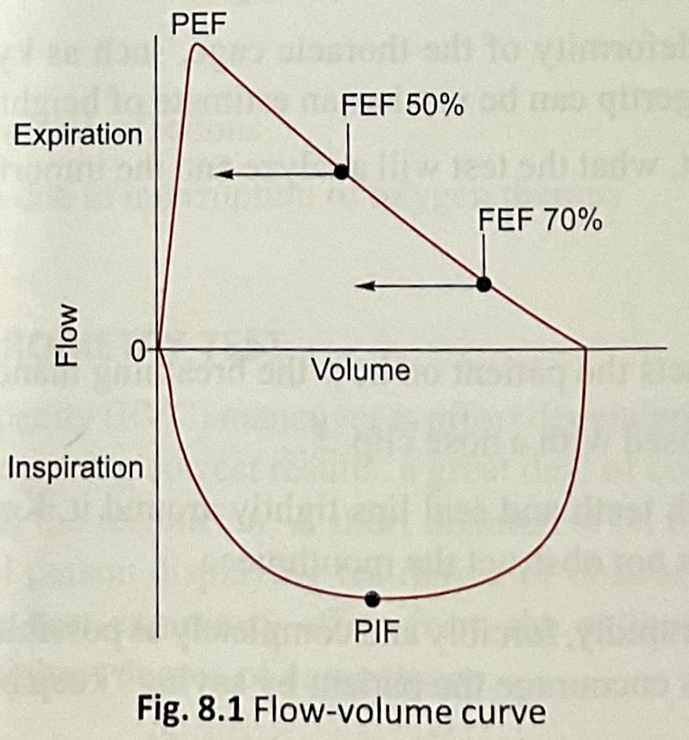
INTERPRETATION OF FLOW-VOLUME CURVE:
Flow is plotted against volume to display a continuous loop from inspiration to expiration.
A normal flow volume loop has a rapid peak expiratory flow rate which then falls down to meet the volume axis (slope of the curve).
The inspiratory portion of the loop is a deep curve plotted on the negative portion of the flow axis.
Inspiratory flow volume curve are effort dependent over the entire vital capacity range.
The overall shape of the flow volume loop is important in interpreting spirometric results.

Slide 21
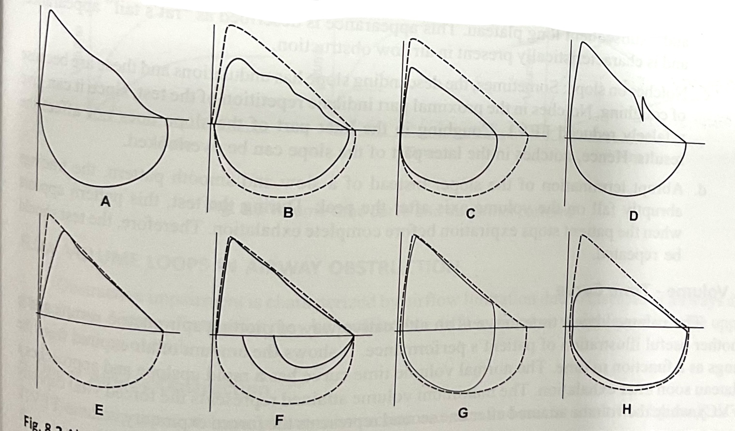
A- normal
B- submaximal effort
C- not at TLC
D- Coughing
E- start not rapid
F- submaximal inspiration
G- stop prematurely
H-tongue occlusion

Slide 22
ABNORMAL PATTERNS IN PEAK:
﻿﻿﻿Blunt peak (sand mound): Inadequate effort.
﻿﻿﻿Notch: Indicates either a cough or hesitant start.
﻿﻿﻿Delayed peak: Indicates defective start.
﻿﻿﻿Flat peak: Reduced flow rate along with expiratory plateau indicates upper airway obstruction. PEFR values will be disproportionately less in comparison to FEV1 in such situations.

Slide 23
ABNORMAL PATTERNS IN SLOPE:
﻿﻿﻿Steep curve: In restrictive lung diseases such as ILD → Upward concavity reduced.
﻿﻿﻿Rat's tail appearance: In airway obstruction→ sharp peak→ rapidly declines due to airway collapse→ shift of upward concavity proximally→ subsequent long plateau.
﻿﻿﻿Notches on slope: Undulations because of coughing. Notches in the proximal part→ gives a falsely reduced FEV1 → require repetition. Coughing in the later part→ does not affect the results.
﻿﻿﻿Abrupt termination of the slope: when the patient stops expiration before complete exhalation → test should be repeated.

Slide 24
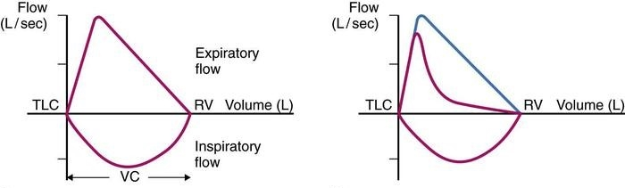
OBSTRUCTIVE ABNORMALITIES:
Characterized by airflow limitation d/t diseases of airways and parenchyma.
Airway obstruction may be localized/diffuse, fixed/ variable and involve upper/ lower airway or both.
NORMAL
OBSTRUCTION
RESTRICTION

Slide 25
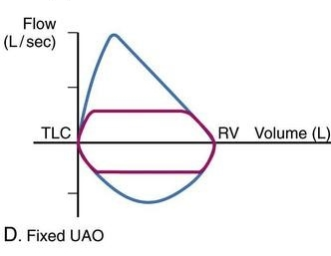
UPPER AIRWAY OBSTRUCTION:
Fixed upper airway obstruction- Airway diameter at the site of obstruction does not vary during inspiration or expiration.
There is constant flow resistance during both phases of respiratory cycle.
Caused by circumferential lesions of upper airways:
Endotracheal neoplasms
Postintubation cicatricial stenosis of trachea
Encircling goiter

Slide 26
b. Variable upper airway obstruction - Diameter of the airway at the site of the obstruction varies during the respiratory cycle.
The lesion causing the obstruction is localised and may be mobile or floppy or even unchanging with respiratory movement.
Physiological effects of variable upper airway obstruction are determined by the site of the lesion.
Extrathoracic
Intrathoracic

Slide 27
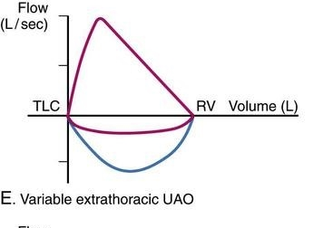
Extrathoracic-
Site of the lesion is in airways more than 2 cm above manubrium sterni.
The extrathoracic airway has a negative intraluminal pressure relative to the atmospheric pressure during inspiration.
Airway diameter decreases during inspiration → worsening of obstruction
While during expiration→ obstruction improves due to dilatation of airway.
Causes:
Unilateral or bilateral vocal cord palsy
Burn injury
Trauma and adhesions of vocal cord due to endotracheal intubation
Obstructive sleep apnea

Slide 28
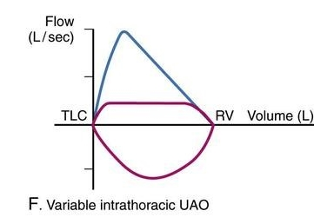
﻿﻿Intrathoracic-
Site of obstruction is in the lower trachea and main bronchi.
The airway diameter decreases during expiration and increases during inspiration.
Consequently the obstruction gets worse during expiration.
Causes-
Tumours of lower trachea
Polychondritis of trachea
Tracheomalacia

Slide 29
LOWER AIRWAY OBSTRUCTION:
Lower airway obstruction characteristically produces an obstructive ventilator defect with expiratory airflow limitation.
1. Larger airway obstruction
Airways > 2 mm (first 9 generations) contribute to about 80% of airway resistance.
Their obstruction produces a characteristic obstructive ventilator defect with decreased PEFR, FEV1 and FEV1/FVC%.
Flow volume loop: descending limb of expiratory curve becomes concave upwards. The loss of linearity correlates with severity of obstruction.

Slide 30
2. Smaller airway obstruction
Airways < 2 mm, contribute to about 20% of airway resistance.
Values of PEFR, FEV1 ratio, MVV and airway conductance remain almost normal.
﻿﻿﻿Increase in RV and relative to the TLC with increase in ratio of RV and TLC.
﻿﻿﻿Fall in frequency dependent lung compliance >25% at a respiratory rate of >60/ minutes.
﻿﻿﻿Decreased FEF 25%-75%
﻿﻿﻿HRCT : mosaic attenuation with expiratory air trapping
Causes of small airway obstruction
Chronic bronchitis
Asymptomatic cigarette smoking
Asthmatic in remission
Bronchiolitis obliterans
Exposure to noxious fumes
Left ventricular failure

Slide 31
COMBINED AIRWAY OBSTRUCTION:
Airway resistance (Raw) is increased.
﻿﻿﻿Specific airway conductance is decreased.
﻿﻿﻿FEV1 and FEV1/FVC% are decreased.
﻿﻿﻿Peak expiratory flows, FEF 25%-75% are decreased.
﻿﻿﻿Lung volume measurements show features of hyperinflation with elevation of RV, FRC and TLC.
VC and FVC may be normal
Causes:
chronic bronchitis
bronchial asthma
cystic fibrosis.

Slide 32
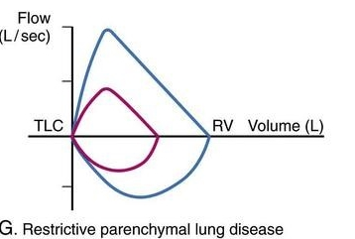
RESTRICTIVE ABNORMALITIES:
In usual restrictive abnormalities → there is reduction of the flow rates along with reduction of FVC → FV loop is seen as a ‘’normal shaped, miniature graph’’.
A characteristic pattern in ILDs → preservation of flow rates →FV loop seen as a ‘’narrow but tall’ graph.
Restrictive abnormality occurs due to:
• Chest wall diseases (skeletal and neuromuscular disorders)
• Pleural diseases
• Parenchymal diseases
• Interstitial lung diseases (ILD)

Slide 33
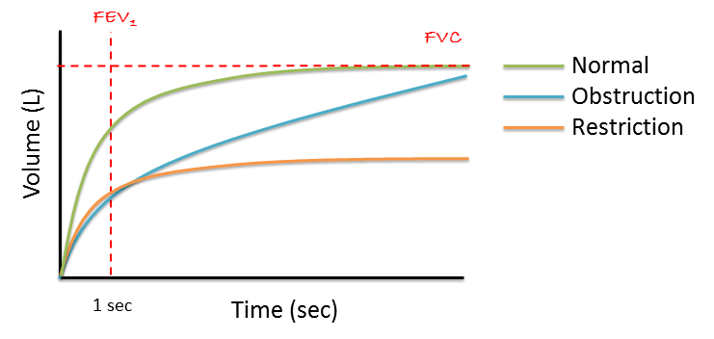
INTERPRETATION OF VOLUME- TIME CURVE:

Slide 34
It shows the amount of air expired from the lungs as a function to time.
The normal volume time curve has a rapid upslope f/b plateau soon after exhalation.
Maximum volume attained represents the FVC.
Volume attained after one second represents FEV1.
Steep ascent: Restrictive defects. The duration of expiration is reduced.
﻿﻿﻿Shallow ascent: In airflow obstruction due to a low flow rate. The duration of expiration is prolonged.
﻿﻿﻿Ledges on the slope: Because of coughing, the ascending slope shows small ledges. If these appear in the first second, the test should be repeated. Cough in the later part does not affect the result.

Slide 35
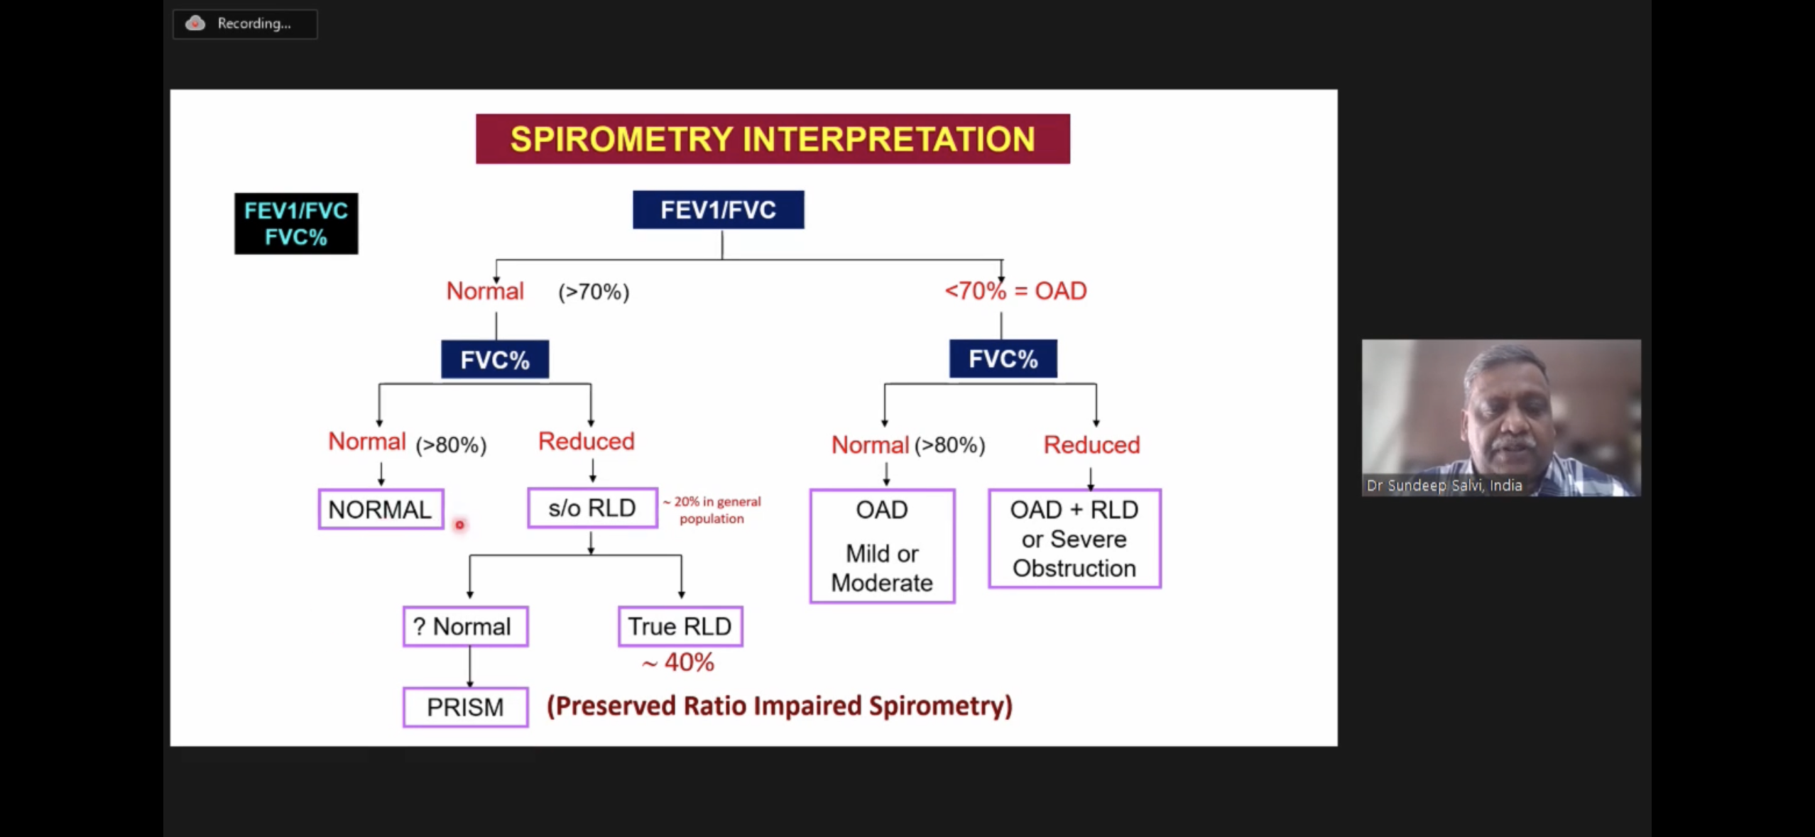

Slide 36
CLASSIFICATION OF DISEASE SEVERITY BASED ON PFT:
OBSTRUCTIVE ABNORMALITIES:
When FEV1/FVC ratio is below the normal range, the severity of the abnormality may be graded based on % predicted FEV1.
SEVERITY OF ASTHMA ACCORDING TO FEV1
MILD | FEV1>80% OF PREDICTED
MODERATE | FEV1 80-60%OF PREDICTED
SEVERE | FEV1<60%OF PREDICTED

Slide 37
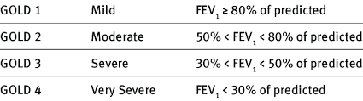
CLASSIFICATION OF COPD BASED ON SEVERITY

Slide 38
RESTRICTIVE ABNORMALITY:
This is interpreted on the basis of TLC.
Reduction in FVC without a reduction in FEV1 /FVC ratio as restrictive abnormality.
SEVERITY OF RESTRICTION
MILD | FVC<LLN but >70
MODERATE | FVC 50-69
SEVERE | FVC35-49
VERY SEVERE | FVC<35

Slide 39
IMPAIREMENT OR DISABILITY:
The American Medical Association provides guidelines for the classification of respiratory impairment based upon the results of spirometry or maximal oxygen consumption.
Severe impairment (AMA class 4 with estimated 50-100% impairment) is defined as any one of the following:
﻿﻿Dyspnea after walking < 100 meters on level gound
﻿﻿FVC <50% predicted
﻿﻿FEV1 <40% predicted
﻿﻿DLCO <40% predicted
﻿﻿VO2 max <15 ml/kg/min
The Social Security Administration defines total respiratory disability using either height corrected FEV or a DLCO <30% predicted.

Slide 40
BRONCHODILATOR REVERSIBILITY TEST
The reversibility of airflow obstruction is demonstrated by repeating spirometry after treatment with a dose of inhaled beta-agonist (salbutamol 400 mcg) by MDI
PREPARATION:
Tests should be performed when patients are clinically stable and free from respiratory infection.
Patients should not have taken inhaled short-acting bronchodilators in the previous six hours, long-acting bronchodilator in the previous 12 hours, or sustained release theophylline in the previous 24 hours.

Slide 41
SPIROMETRY:
FEVI should be measured before a bronchodilator is given.
Bronchodilator should be given by MDI through a spacer device or by nebulizer.
FEV1 should be measured again 10-15 minutes after a short-acting bronchodilator is given/ 30-45 minutes after the combination (SABA + Anticholinergic).
RESULTS:
An increase in FEV1 that is both greater than 200 ml and 12% above the pre-bronchodilator FEV1 is considered significant.
% Improvement =100 X FEV1 (post-bronchodilator) - FEV1 (baseline)
FEV1 (baseline)

Slide 42
INTERPRETATION:
Reversibility is a characteristic feature of asthma.
A significant improvement in spirometry may suggest the diagnosis of asthma even if the original measurements were within the normal range.
However, in chronic asthma there may be partial reversibility of airflow obstruction.
The airflow obstruction in COPD is largely irreversible.
However, a small but significant improvement in FEV1 can be shown in many COPD patients.

Slide 43
BRONCHIAL PROVOCATION TESTING
Identifies and characterises airway hyper-responsiveness.
Bronchial hyper-responsiveness (BHR) refers to an exaggerated response to a bronchoconstrictor and is reflected by an increased sensitivity to the stimulus.
The bronchoconstrictive stimuli used are pharmacological agents (histamine, methacholine), physical stimuli (non-isotonic aerosols, cold dry air exercise) and specific sensitizing agents (allergens, occupational sensitisers).
Indications for bronchial provocation testing:
﻿﻿To diagnose BHR.
﻿﻿To document severity of BHR
﻿﻿To follow changes in BHR after therapeutic intervention or aggravation of symptoms
﻿﻿To exclude asthma in patients with chronic cough.
﻿﻿To determine who is at risk in the workplace or during recreational activities.
﻿﻿To establish a control or baseline prior to environmental or occupational exposure.

Slide 44
Absolute Contraindications | Relative Contraindications
Severe airflow limitation (FEV1 < 50% predicted or < 1.0 L). | Moderate airflow limitation (FEV1 < 60% predicted or < 1.5 L).
Heart attack or stroke in last 3 months. | Inability to perform acceptable-quality spirometry.
Uncontrolled hypertension, systolic BP > 200, or diastolic BP > 100 mm Hg. | Pregnancy Nursing mothers
Known aortic aneurysm | Current use of cholinesterase inhibitor medication (for myasthenia gravis)
INTERPRETATION:
Spirometry performed before and after the bronchoconstrictor stimulus is most commonly used to quantify response.
A positive test is characterised by a specific dose or level of stimulant at a defined fall in FEV1, usually 20% (PD20).

Slide 45
PEAK FLOW METER TESTING
The peak flow meter records peak expiratory flow rate (PEFR) which correlates with FEV1 in measurements of airflow obstruction and carrying out reversibility tests.
These are mechanical devices having springs and diaphragms.
This displacement of spring/ diaphragm is proportional to the peak flow and calibrated scale is printed on it.
TECHNIQUE:
﻿﻿Stand or sit up straight
﻿﻿Inhale maximally
﻿﻿Get a good seal around the mouthpiece.
﻿﻿Blow out as hard and as fast as possible
﻿﻿Continue to exhale for 1-2 seconds

Slide 46
Three measurements should be obtained → highest of the three is reported.
PIF is approximately 2/3 of PEFR.
The major contribution to the peak flow is from the large central airways.
Asthma and other diseases affecting smaller airways may not be detected.
USES:
1. Assessment of acute asthma:
﻿﻿Less than 75% (children <60%) of the patient’s best→ moderate attack.
﻿﻿Less than 50% (children <40%) of the patient’s best→ severe attack.
PEFR <100 L/min or inability to perform a peak flow test → severe attack.
Helps to assess the response to treatment during an acute attack.
A failure to improve should indicate the need for ongoing treatment and hospital admission.

Slide 47
2. Monitoring of chronic asthma
Twice daily peak flow for the routine monitoring of asthma.
Large fluctuation in peak flow indicates poor asthma control.
Diurnal variability: morning peak flow < afternoon or evening peak flows.
Variability >20% → persistent asthma. Variability >30% → severe disease.
3. Diagnosis of asthma
﻿﻿If spirometry is not available, a peak flow response to bronchodilator (>20% improvement) in a patient with good technique indicates reversible airways obstruction.
﻿﻿Symptoms of asthma with normal spirometry: home peak flow monitoring→ Diurnal variability of >15% strongly suggests asthma.
﻿﻿In occupational asthma: Characteristic improvements and deterioration in peak flow values related to time at work and off work over a period of at least 2 weeks can clinch the diagnosis.

Slide 48
EVIDENCE BASED STUDY:
TITLE: Spirometric Evaluation of Pulmonary Function Tests in Bronchial Asthma Patients
METHOD: The present study was undertaken to assess the pulmonary function status of bronchial asthma patients.
The results are based on a sample of 403 asthma patients and 347 healthy subjects (control group) in the age range of 20-70+ years.
To study pulmonary functions of asthmatic patients, spirometric evaluation of FEV1, FVC, FEV1/FVC, have been recorded on each subject.

Slide 49
The data have been subjected to statistical analysis viz. mean, standard deviation, standard error of mean and test of significance.
RESULT: All the pulmonary parameters in asthmatic patients showed significantly less observed values than the normal predicted values.
The difference in the mean values of all the lung function parameters of bronchial asthma patients are lower as compared to normal healthy subjects with statistically significant differences in almost all the age groups.

Slide 50
REFERENCES:
BEDSIDE RESPIRATORY MEDICINE- HAZARIKA

Slide 51
THANK YOU

