Slide 1
COUGH
& HAEMOPTYSIS
DR. CHIRAG CHAKRAVARTI (ASST. PROFESSOR)
DEPARTMENT OF RESPIRATORY MEDICINE
24/6/24

Slide 2
COUGH:
It is the reflex act of forceful expiration against a closed glottis that helps in clearing excessive secretions and foreign material from airways.it is an important defence mechanism of body

Slide 3
MECHANISM OF COUGH :
It is brought about by contraction of respiratory muscles against the closed glottis with a resultant increase in intrathoracic pressure followed by opening of the glottis with forced expiration at very high air flow rate in the upper airways.

Slide 4
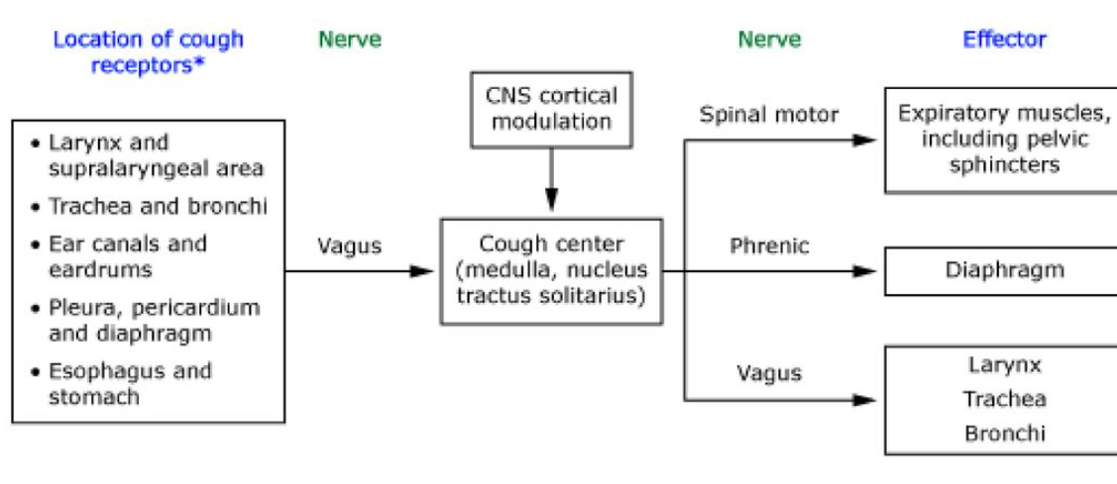
COUGH REFLEX ARC

Slide 5
CLASSIFICATION OF COUGH:
ACUTE | COUGH LASTING LESS THAN 3 WEEKS
SUB-ACUTE | COUGH LASTING FOR 3 TO 8 WEEKS
CHRONIC | COUGH LASTING MORE THAN 8 WEEKS

Slide 6
ACUTE COUGH:
URTI(VIRAL,BACTERIAL)
ALLERGIES
ACUTE EXACERBATION OF COPD ,ASTHMA
FOREIGN BODY ASPIRATION
PULMONARY EMBOLISM
PNEUMOTHORAX

Slide 7
SUB-ACUTE COUGH:
1.Post infectious Bacterial Sinusitis
2.Asthma

Slide 8
CHRONIC COUGH:
Tuberculosis
Bronchial asthma
Post nasal drip (nose and sinus conditions)
Gastroesophogeal reflux disease
Smoker's cough
Chronic obstructive
Pulmonary disease
Left ventricular heart failure
Lung cancer

Slide 9
COUGH WITH DIFFERENT CHARACTERSTICS:
Dry cough: Pleural disorders, interstitial lung disease, mediastinal lesions.
Productive cough: Suppurative lung disease, chronic bronchitis, pulmonary TB.
Short cough: It is seen in upper respiratory tract infections (common cold).
Brassy cough: Cough with metallic sound produced by compression of the trachea by intrathoracic space occupying lesions.
Bovine cough: Cough with loss of its explosive nature, e.g. tumours pressing on recurrent laryngeal nerve.
Drug Induced Cough: ACE Inhibitors(bradykinin accumulation),adenosine,calcium channel blockers,fentanyl,latanoprost,beta blockers(bronchospasm)

Slide 10
whooping cough-Bordetella Pertusis
Barking cough: It is found in epiglottal involvement as well as in hysterical and nervous individuals.
Croupy cough-laryngo tracvheobronchitis
Nocturnal cough: It is present in the following conditions:
Chronic bronchitis
Left sided failure
Bronchial asthma
Aspiration
Tropical eosinophilia
Postnasal drip

Slide 11
DIURNAL AND POSTURAL VARIATION IN COUGH
Night time cough-congestive cardiac failure,bronchial asthma,pharyngitis
Cough In supine position-congestive cardiac failure
Aggrevated with posture-Bronchiectasis,lung abcess
Early morning cough-Bronchial Asthma
Cough during eating-Tracheo-esophageal fistula,vocal cord paralysis,laryngitis

Slide 12
Complications of cough
Chest pain(myalgia)
Pneumothorax
Urinary incontinence
Hernia
Sub conjuctival haemorrhage
Cough syncope (Post-tussive syncope): It is due to raised intrathoracic pressure, which reduces venous return to the heart, thereby diminishing cardiac output, resulting in cerebral hypoperfusion and syncope

Slide 13
Sputum
It is a mixture of tracheobronchial secretion, cellular debris, micro-organisms and saliva. The character of sputum is determined by its amount, colour, consistency and smell.
Saliva contains squamous cells.
Sputum contains epithelial cells.
If sputum contains epithelial cells and eosinophils then suspect.
Bronchial asthma
Allergic bronchopulmonary aspergillosis (ABPA).

Slide 14
AMOUNT:
Bronchorrhoea: When the quantity of sputum production is >100 mL/day.
Copious sputum production is seen in conditions like:
1. Bronchiectasis
2. Lung abscess
3. Empyema rupturing into the bronchus
4. Necrotising pneumonia
5. Alveolar cell carcinoma.
Copious sputum production upon changes in posture is seen in bronchiectasis and lung abscess. This postural relationship to cough is due to irritation of the healthy bronchial mucosa.
Large amount of colourless sputum is present in alveolar cell carcinoma.

Slide 15
Colour of the Sputum
Green or yellow colored thick sputum indicates bacterial infections. The green color to sputum is imparted by the enzyme myeloperoxidase (verdoperoxidase)
Black colored sputum is present in coal worker's pneumoconiosis,aspergillosis
Rusty sputum is present in pneumococcal pneumonia
Red currant jelly sputum is seen in Klebsiella pneumonia
Pink frothy sputum is present in pulmonary edema
Blood-stained sputum is present in tuberculosis
Anchovy sauce sputum is present in ruptured amoebic liver abscess.

Slide 16
CONSISTENCY:
Serous: It is clear, watery and frothy. It is seen in broncho-alveolar carcinoma. It may be pink, as occurs in pulmonary oedema,broncho alveolar carcinoma
Mucoid: It is clear, greyish white or black in colour and frothy. It may be seen in conditions like chronic bronchitis and chronic asthma.
Mucopurulent or purulent: Yellowish or greenish brown in colour, seen in bacterial infection(pneumonia,LRTI)
Purulent: lung abscess, empyema

Slide 17
Bronchial asthma: Macroscopically the sputum is worm like, which are remnants of casts of bronchus.
Microscopically, the sputum consists of:
a. Eosinophils
b. Desquamated epithelium
c. Cruschmann spirals (whorled mucous plugs)
d. Charcot-Leyden crystals (crystalloid debris of eosinophil membrane)
e. Creola bodies (exfoliated cells due to disruption of mucosal integrity).

Slide 18
Odour of Sputum
Offensive and foetid:
a. Lung abscess
b. Bronchiectasis
c. Anaerobic bacterial infection.

Slide 19
Investigations for the evaluation of cough
Staining techniques-gram stain, ZN stain,special stains
Blood investigations-CBC,CRP,Pro-calcitonin
Imaging techniques-xray, hrct thorax
PFT
Bronchoscopy
Sputum cytology
Psychological assesment

Slide 20
HAEMOPTYSIS:
It is Defined As expectoration of Blood OR Blood tinged sputum from Lower Respiratory Tract
Most cases of hemoptysis results from disruption of Branches of Bronchial arterial tree

Slide 21
Causes of Haemoptysis
Infection
a. Tuberculosis
b. Lung abscess
c. Bronchiectasis
d. Pneumonia
e. Fungal infection (aspergillosis,nocardiosis,blastomycosis)
Neoplasm
Bronchogenic carcinoma
Bronchial adenoma
Metastatic tumour to lung.

Slide 22
Cardiovascular Disorders
Mitral stenosis
Pulmonary hypertension
Aortic aneurysm
Arteriovenous malformation
Pulmonary embolism.
Congenital
Bronchial cyst
Sequestration of lung
- Intralobar
- Extralobar.

Slide 23
Collagen Vascular Disorder
Vasculitis
Wegener's granulomatosis
Goodpasture's syndrome.
Traumatic
1.Non-iatrogenic
Blunt injury
Inhalation of toxic gases or acid aspiration.
2.latrogenic
Diagnostic-Biopsy procedure
Drug induced-Anticoagulants like warfarin,Anti platelets like aspirin and clopidogrel,Recreational drugs like cocaine

Slide 24
Miscellaneous
Bleeding disorders.
Haemoptysis is uncommon in:
• Metastatic lesions of the lung except in secondaries due to choriocarcinoma and renal cell carcinoma.
Viral infection

Slide 25
Severity of Haemoptysis
Mild-<100 mL blood loss per day
Moderate-100 to 150 mL blood loss per day
Severe-Up to 200 mL blood loss per day
Massive-> 500 mL blood loss per day (or) rate of blood loss > 150 mL/hr (or) 100 mL blood loss per day for more than 3 days.
If there is > 500 mL blood loss per day, aggressive intervention (rigid bronchoscopy or surgery) is advo-cated. If the blood loss is sub-massive, after subsidence of haemoptysis, fibreoptic bronchoscopy is indicated.

Slide 26
Types of Haemoptysis
Frank haemoptysis: It is the expectoration of blood only.Massive and fatal blood loss may occur. Frank haemoptysis daily suggests bronchogenic carcinoma.
Blood stained hemoptysis is found in bronchial infection,suppurative pneumonia
Frothy pink sputum is seen in pulmonary odema due to left ventricular failure
Rusty sputum (degradation products of hemoglobin mixed with sputum) found in Pneumococcal pneumonia and Klebsiella pneumonia
Endemic haemoptysis: Present in infection with Para-gonimus westermani (lung fluke).mostly seen in people residing in Himalayan belt

Slide 27
Difference between Hemoptysis and hematemesis
Absence of nausea and vomiting
After the episode sputum is always blood tinged
Sputum is frothy,bright red to pink in colour
Alkaline pH and mixed with macrophages and neutrophils rather than acidic PH and food particles as seen in Hematemesis

Slide 28
Causes of haemoptysis in TB
Active Tuberculosis-Tuberculous vasculitis,Rupture of Rasmussen's aneurysm,Drug induced - Rifampicin, Pyrazinamide (interferes with PT, APTT, INR)
Old TB- Calcification - calcified blood vessels ruptures,Fungal ball (aspergillosis),Post TB bronchiectasis,Scar carcinoma

Slide 29
Causes of death in haemoptysis
Aspiration
Asphyxation

Slide 30
Supportive Management
Bed rest
Posture where bleeding site should be lower
Sedation and mild anxiolytics
Cough suppressant
Antibiotics
Blood replacement
Oxygen therapy

Slide 31
Definitive Management
Double lumen ET tube intubation
Active and localized bleeding - cold saline, adrenaline, condom pressure tamponade
Non-localized bleeding - fogarty catheter
Bronchography - bleeding site identified and sealed with gel foams, polyvinyl alcohol and coils
Final option - open surgery

Slide 32
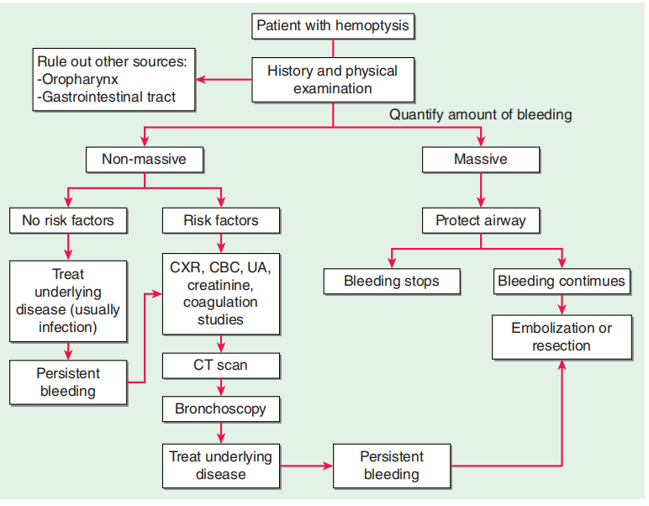
APPROACH FOR HAEMOPTYSIS

Slide 33
Daily cough frequency in tuberculosis and association with household infection.
BACKGROUND: Cough is the key symptom of pulmonary TB (PTB) and is associated with transmission. No tool for measuring the subjective impact of cough in PTB has been previously validated. We sought to measure patient reported cough in PTB and investigate any relationship to objectively quantified daily cough frequency
METHODS: The validity of the Leicester Cough Questionnaire (LCQ) was assessed in sequential patients newly diagnosed with PTB at a UK hospital. Resulting LCQ scores were compared to non-cough clinical variables, and to 24-h, ambulatory, objective cough frequency measured using the Leicester Cough Monitor.

Slide 34
.RESULTS: The LCQ in 30 patients with PTB was acceptable to users and had high internal reliability (Cronbach's α = 0.93), concurrent validity (correlation with visual analogue scale for cough severity, Spearman's ρ = ???0.69) and responsiveness (substantial median increase score after 2 weeks of TB treatment: 5.1 points, IQR 1.8???9.7; P = 0.003). There was only moderate correlation between patient-reported cough and objectively-measured 24-h cough frequency in PTB (ρ = ???0.48, P = 0.008)..
CONCLUSION: The LCQ is valid for use in PTB, with applications that include monitoring treatment of the disease. However, there was a mismatch between objective and subjective assessment of cough, which has important implications for delayed diagnosis and transmissibility.

Slide 35
REFERENCES
BEDSIDE RESPIRATORY MEDICINE -2ND EDITION-BASANTA HAZARIKA
HARRISONS PRINCIPLE OF INTERNAL MEDICINE-21ST EDITION
MANUAL OF PRACTICAL MEDICINE-R ALAGAPPAN-6TH EDITION.
https://www.ncbi.nlm.nih.gov/pmc/articles/PMC3171924/

Slide 36


