Slide 1
PNEUMOTHORAX
DR. ARTI D. SHAH (HOD AND PROFFESSOR)
DEPARTMENT OF PULMONARY MEDICINE
25/7/24

Slide 2
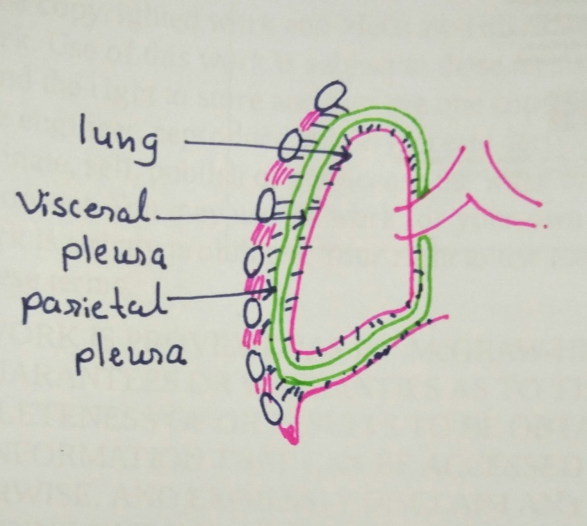
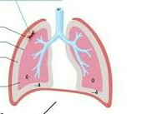
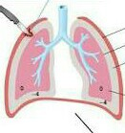
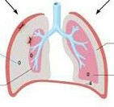
Definition
Abnormal presence of air in pleural cavity, separating visceral pleura from parietal pleura, with subsequent collapse of adjacent lung is known as pneumothorax.

Slide 3
Classification of pneumothorax
Pneumothorax
spontaneous
traumatic
Primary spontaneous
Secondary spontaneous
Non-Iatrogenic
iatrogenic
Accidental
Artificial

Slide 4
Pathophysiology
pressure within the pleural space is negative with respect to the alveolar pressure during the entire respiratory cycle.
Despite this, air does not enter the pleural space from the alveoli.
Reason : the partial pressure of all gases in the venous blood averages only 706 mm Hg, so driving the net movement of alveolar air (760 mm Hg at sea level during end-inspiration) into the capillaries and not into the pleural space, which would require a pleural pressure lower than 706 mm Hg to pull the air in.
Under normal circumstances, most individuals do not generate a net negative inspiratory force of –54 mm Hg.

Slide 5
Presence of air in the pleural cavity is thought to occur by one of three events:
Communication between the pleura and the alveolus
Communication between the atmosphere and the pleural space
The presence of a gas-producing organism within the pleura
The greater the amount of air that enters the pleural cavity, the more the lung collapses.
If unabated, enough air may enter the pleural space to cause a shift of the mediastinum and eventually lead to hemodynamic compromise
A condition referred to as tension pneumothorax.

Slide 6
physiologic consequences of a pneumothorax
decrease in the vital capacity of the lung.
decrease in the PaO2 due to low ventilation–perfusion(V/Q) ratios, anatomic shunts, and, occasionally, alveolar hypoventilation.
Total lung capacity, functional residual capacity, and diffusing capacity are also reduced.

Slide 7
ANATOMICAL TYPES OF PNEUMOTHORAX
Closed pneumothorax-the pleural cavity pressure is less than atmospheric pressure. the amount of air entering the pleural cavity does not increase.
Open pneumothorax-the pleural cavity presssure is equal to atmospheric pressure. so air circulates freely.
Tension pneumothorax-the pleural cavity pressure is more than atmospheric pressure. air accumulates in the pleural cavity

Slide 8
Primary spontaneous pneumothorax
From rupture of subpleural emphysematous blebs located in apices of lung
Pathogenesis – airway inflammation
Respiratory bronchiolitis
More in cigarette smokers – due to airway inflammation by smoking
Abnormal regions of visceral pleura – leakage of air occurs through this area
During days when there are broad swings in atmospheric pressure
Upon exposure to loud music
Taller & thinner individuals
Familial tendencies – individual with HLA haplotype A₂, B₄₀ more likely

Slide 9
Inheritated disease associated with pneumothorax –
Marfan’s syndrome,
Homocystinuria,
Ehler-danlos syndrome,
Alfa1 antitrypsin deficiency
Birt-Hogg-Dube syndrome –
  Increased incidence of spontaneous pneumothorax, benign skin tumors, and renal tumors.
  Autosomal dominant
  Chromosome – 17p11.2
  Mutation in folliculin (FLCN) gene
Bronchial abnormalities – in non-smoker patients with spontaneous pneumothorax
include – disproportionate bronchial anatomy ,
accessory bronchus, and
missing bronchus
Notes:
Put in two slides

Slide 10
Clinical manifestations
Peak Age-early 20s
Rarely Occurs After Age 40
Chest pain – acute, localized to side of pneumothorax, typically pleuritic
Dyspnea
Generalized malaise
Horner’s syndrome
– rare complication of spontaneous pneumothorax
- due to traction on sympathetic ganglion produced by shift of mediastinum
Cough, hemoptysis, orthopnea - uncommon
Notes:
PSP – symptoms abate over 24 hrs
SSP – more severe symptoms

Slide 11
Changes on physical examination
Moderate tachycardia
Chest on examination – larger on affected side & move less during respiration
Tactile fremitus absent
Percussion note – Hyper resonant
Breath sounds – reduced or absent on affected side
Hamman sign may be detected –
crunching or clicking noises synchronous with heartbeat but influenced by respiration & body position.
Tension pneumothorax – severe tachycardia, hypotension, cyanosis, tracheal deviation
Notes:
Hamman sign also in pneumomediastinum

Slide 12
Arterial blood gas analysis
PSP - <25% lung affected – mild hypoxemia
>25% lung affected – severe hypoxemia
SSP – life threatening hypoxemia and hypercapnea
ECG Changes
Left pneumothorax – rightward shift of frontal QRS axis
diminution of precordial R-wave
decrease in QRS amplitude
precordial T wave inversion
Right pneumothorax – prominent R-wave in lead V2 with loss of Swave
reversible reduced QRS voltage

Slide 13
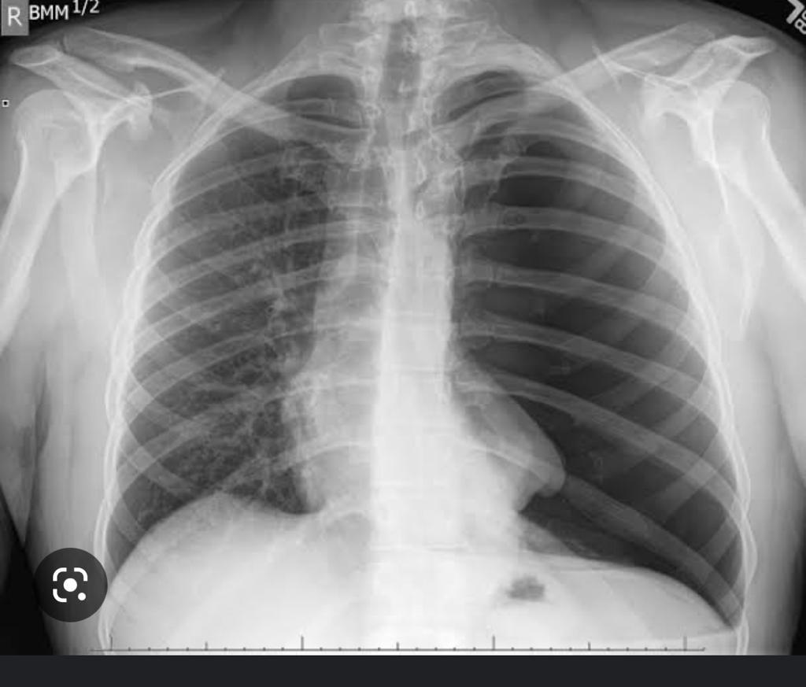
Diagnosis
Clinical history
Examination
Chest radiography Radiograph- Visceral Pleural Line-faint But Sharply Defined Line Seperating The Lung Parenchyma From Remainder Of Thoracic Cavity Which Is Clear And Devoid Of Lung Markings
Ultrasonography
CT scan

Slide 14
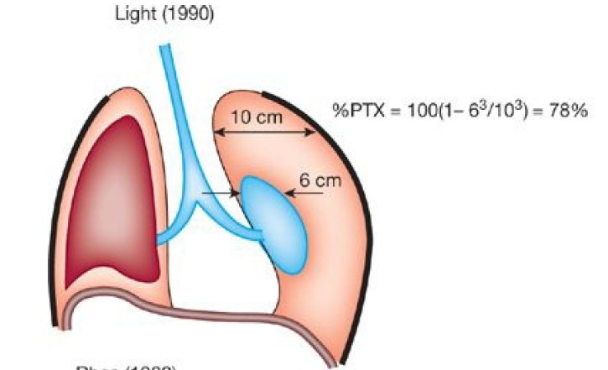
Quantitation
Light’s index
% pneumothorax = 100 (1-(diameter lung)³ /(diameter hemithorax)³

Slide 15
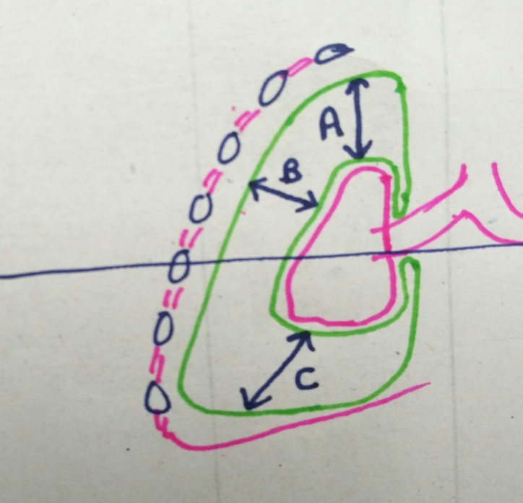
Collins method
% pneumothorax = 4.2+ [4.7 – (A+B+C)]
Distance between apex of partially collapsed lung & apex of thoracic cavity(A), and midpoint of upper (B) & lower (C) halves of collapsed lung & lateral chest wall were measured in centimeters.

Slide 16
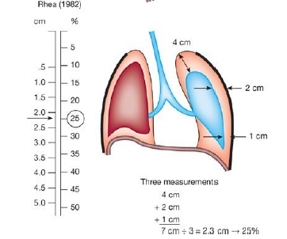
Rhea method
10% pneumothorax for every cm of intrapleural distance.

Slide 17
British Thoracic Society’s (BTS) guidelines for management of spontaneous pneumothorax
Small – rim of air between pleura & chest wall <1 cm
Moderate - rim of air between pleura & chest wall 1 – 2 cm
Large - rim of air between pleura & chest wall >2 cm
American Collage of Chest Physicians
Small – apex to cupola distance <3 cm
Large - apex to cupola distance >3 cm

Slide 18
Reccurence rates for PSP
Less in men than in women
Less in individuals who stopped smoking than who continued smoking
Most recurrence within first year

Slide 19
Treatment
Observation
Supplemental oxygen
Aspiration
Tube Thoracostomy
Medical thoracoscopy
Video assisted thoracoscopic surgery
Open thoracotomy

Slide 20
Observation
Rate of spontaneous absorption is slow
1.25% of volume absorbed every 24 hrs
15% of hemithorax take 12 days to be completely reabsorbed.
Supplemental Oxygen
Accelerate rate of pleural air absorption
Rate increase fourfold when high-flow supplemental oxygen through facemask.

Slide 21
Aspiration
2nd intercostal space midclavicular line 16 gauge needle with internal polyethylene catheter inserted.
Alternate site selected if loculated pneumothorax or adhesions present.
A Three Way Stopcock And 60 Ml Syringe Are Then Attached To The Catheter. Air Is Manually Withdrawn Until No More Can Be Aspirated.
If no resistance felt after aspirating 4L
Assumed that no expansion occurred
Tube thoracostomy
Can be done as outpatient
If hospitalized, net hospitalization stay 1.8 days
Complication-life Threatening Haemorrhage

Slide 22
Tube Thoracostomy
Positioned in uppermost part of pleural space where residual air accumulates
Hospitalization stay 3-6 days
Chest tube should remain in place for 24 hrs after lung expands &air leak ceases.
Because if removed high chances of recurrence
If lung not re-expanded or bronchopleural fistula persists after 3 to 4 days
Thoracotomy or thoracoscopy
If The Chest Tubes Are Removed Too Soon After The Lung Reexpands And The Air Leak Ceases There Is High Liklihood Of An Early Recurrence

Slide 23
Tube Thoracostomy with instillation of a sclerosing agent
To diminish recurrence rates by injecting various agents into pleural space
To create an intense inflammatory reaction that would obliterate pleural space, to create pleurodesis
Agents –quinacrine, talc slurry, olive oil, tetracycline
Causes chronic debilitating pain
Minimize use of corticosteroids & anti-inflammatory agents in whom pleurodesis is to be attempted
Drawback Of Talc- Ards
Recommended Agent-tetracycline Derivatives(very Painful)

Slide 24
AUTOLOGOUS BLOOD PATCH FOR PERSISTENT AIR LEAK
50 To 100 Ml Of Blood Is Drawn From A Vein And Then Promptly Injected Without Anticoagulation Through The Chest Tube Into The Pleural Space.
The Chest Tube Is Elevated About 60cm To Prevent The Blood From Being Drained
It Is Possible That The Blood Patch Technique Might Also Decrease The Incidence Of Recurrence

Slide 25
Medical Thoracoscopy
Under local anesthesia with conscious sedation
Less expensive
Video-assisted thoracoscopic surgery (VATS)
Under general anaesthesia with double-lumen endotracheal intubation which allows single lung ventilation & collapse of lung on operated side
Objective 1) to treat bullous disease responsible for pneumothorax
  2) to create pleurodesis

Slide 26
Open Thoracotomy
Only after thoracoscopy failed
Some surgeon prefer axillary mini thoracotomy.
Because time is short &
good cosmetic result &
less expensive
Effective in controlling pneumothorax & diminishing recurrence rate

Slide 27
Secondary spontaneous pneumothorax
Obstructive lung disease
COPD
Asthma
Interstitial lung disease
Idiopathic pulmonary fibrosis
Nonspecific interstitial pneumonitis
Langerhans cell histiocytosis
Lymphangioleiomyomatosis
Sarcoidosis
Radiation pneumonitis /fibrosis
Infection
P. jiroveci pneumonia
Tuberculosis
Acute bacterial pneumonia(staphylococcus)

Slide 28
Malignancy
Primary lung cancer
Pulmonary metastasis (especially sarcoma)
Complications of chemotherapy
Connective tissue disease
Rheumatoid arthritis
Ankylosing spondylitis
Marfan syndrome
Ehlers-danlos syndrome
Polymyositis/ Dermatomyositis
Scleroderma
Others
Catamenial pneumothorax
Pulmonary infarction
Pulmonary alveolar proteinosis
Von Recklinghausen disease
Wegener granulomatosis

Slide 29
More serious
Decrease pulmonary function of patient with already compromised pulmonary function
Physical examination less helpful
Distinguished feature of spontaneous pneumothorax from large, thin walled, air containing bulla
Pneumothorax – pleural line convex towards lateral chest wall
Large bulla – concave towards lateral chest wall
Recurrence rates higher than those for primary spontaneous pneumothorax

Slide 30
CLINICAL MANIFESTATIONS
Dyspnoea-which Frequently Seems Out Of Proportion To Size Of Pneumothorax
Chest Pain On The Side Of Pneumothorax
Physical Examination-less Helpful Than It Is In Primary Spontaneous Pneumothorax

Slide 31
DIAGNOSIS
Chest Xray- Visceral Pleural Line
It Is Important To Distinguish Spontaneous Pneumothorax From A Large Thin Walled Air Containing Bulla
Ct Scan Should Be Obtained Because The Two Conditions Are Easily Differentiated in it.
It Is Important To Make The Distinction Because Only Pneumothorax Should Be Treated With Tube Thoracostomy.

Slide 32
TREATMENT
Nearly Every Patient With Secondary Spontaneous Pneumothorax Should Initially Be Hospitalised And Managed By Tube Thoracostomy
Aspiration Is Not Recommended.
In Primary Spontaneous Pneumothorax-lung Usually Expands And Air Leak Ceases Within 3 Days
Secondary Spontaneous Pneumothorax Due To Copd The Mean Time For Lung Expand Is 5 Days

Slide 33
Catamenial pneumothorax
In conjunction with menstruation, recurrent, unusual
Chest pain & dyspnea within 24 to 48 hrs of onset of menstrual flow
More likely if mental or physical stress present
Mechanism- 1) diaphragmatic defect- air gained access to peritoneal cavity during menstruation enter pleural cavity through this defect
2) Pleural or diaphragmatic endometriosis
Medical treatment aimed at treating endometriosis by suppressing ectopic endometrium by administering gonadotropin releasing hormone antagonist
Surgical –Thoracoscopy with closure of diaphragmatic defect

Slide 34
Traumatic pneumothorax
Iatrogenic Pneumothorax
Causes – Transthoracic needle aspiration (Most common)
Subclavian needle stick
Thoracocentesis
Transbronchial biopsy
Pleural biopsy
Positive pressure ventilation
Supraclavicular needle stick
Nerve block
Incidence high in ICU patients
Frequency Of Pneumothorax Is Increased If Patient had Aspiration Pneumonia, Copd Or Treatment With Positive End Expiratory Pressure.

Slide 35
CLINICAL DIAGNOSIS
Depends Both On Patient’s Condition And On Initiating Procedure.
If Pneumothorax Occurs As A Complication Of Mechanical Ventilation The Patient Is Likely To Demonstrate A Sudden Clinical Deterioration.
DIAGNOSIS
Iatrogenic Pneumothorax Should Be Suspected In Patients Who Became More Short Of Breath After A Medical Or Surgical Procedure
Signs And Symptoms Are Similar To Those Of Primary And Secondary Pneumothorax And The Diagnosis Is Confirmed By Chest Xray

Slide 36
TREATMENT
The Treatment Of Iatrogenic Pneumothorax Differs From That Of Spontaneous Pneumothorax In That Recurrence Is Not Likely And Therefore One Need Not Try To Create A Pleurodesis.
When A Pneumothorax Occurs During Positive Pressure Ventilation Tube Thoracostomy Should Be Performed Immediately In Most Cases To Prevent The Development Of Tension Pneumothorax
The Chest Tube Should Be Left In Place For Atleast 48hrs After The Air Leak Stops If The Patient Continues To Receive Mechanical Ventilation
In General If The Patient Has No Symptoms Or Just Mild Symptoms And The Pneumothorax Occupies Less Than 40% Of Hemithorax The Patient Can Be Managed With Observation
The Administration Of Supplemental Oxygen Will Incraese The Rate At Which Air Is Absorbed From Pleural Space.

Slide 37
Non-iatrogenic pneumothorax
Result from either penetrating or non-penetrating chest trauma
Penetrating
– wound allows air to enter pleural space directly through chest wall,
- visceral pleura also frequently penetrated, allowing air to enter pleural space from alveoli
Non-penetrated
– ribs may become fractured or dislocated & visceral pleura may be lacerated
- With sudden chest compression, alveolar pressure increase causing alveolar rupture
Treatment – tube thoracostomy

Slide 38
Tension pneumothorax
Medical emergency
When intrapleural pressure greater than atmospheric throughout expiration & often during inspiration also.
One way valve develops
More common after Traumatic pneumothorax, with mechanical ventilation & cardiopulmonary resuscitation
Severe dyspnea, marked tachycardia & cyanosis
Physical examination:
Hypotension, distended neck veins, tracheal deviation, subcutaneous emphysema,unilateral chest hyperinflation
Require immediate chest drainage
Treatment – high concentration oxygen
Large bore needle inserted in second anterior ICS
Notes:
Less crowded

Slide 39
Bronchopleural fistula
Communication between pleural space & bronchial tree.
An Alveolar Pleural Fistula Is A Communication Between Pulmonary Parenchyma Distal To Segmental Bronchus And The Pleural Space.
Prolonged air leak
most air leak seal within 24 to 48 hrs after tube thoracoscopy
only 3-5% have persisting air leaks
Bpf Occur Almost Exclusively After Pneumonectomy Lobectomy Or Segmentectomy And Almost Always Require Reoperation Or Some Type Of Surgical Intervention

Slide 40
CLASSIFICATION OF AIR LEAKS
(1)Continuous Leak- Largest And Most Uncommon And Is Present Throughout Entire Respiratory Cycle. Usually Seen Only In Patients Who Is Using A Ventialtor Or Who Has A Bpf
(2) Inspiratory Air Leak-present Only During Inspiration. Seen In Patients Who Is Using Ventilator And Has A Sizeable Alveolar Pleural Fistula Or Small Bpf
(3)expiratory Air Leak- Present Only During Expiration. Commonly Seen After Pulmonary Surgery And Its Presence Suggests An Alveolar Pleural Fistula
(4)forced Expiratory Leak- Smallest Air Leak. Present Only When Patient Performs A Forced Expiartion Or Coughs
As Leaks Begin To Heal Or Resolve They Usually Go From An E Leak To An Fe Leak.

Slide 41
Management – VATS – preferred procedure
Increased risk in patient with COPD & CF
Not candidate for surgical intervention
fistula may be localized by bronchoscopic balloon catheter occlusion and subsequently injected with a variety of substances to promote sealing of the air leak like Fibrin glue, liquid bioadhesive (isobutyl 2-cyanocrylate), sterile gelatin sponge

Slide 42
Reexpansion pulmonary edema
Rare but lethal
Due to rapid reexpansion of collapsed lung after tube thoracostomy
Due to increased permeability of pulmonary capillaries that are damaged by mechanical stress due to free radicals
Hypoxemia, tachypnea, tachycardia, hypotension
X-ray : patchy or diffuse alveolar infilterates
Treatment : supportive,
in severe – mechanical ventilation
Best strategy - prevention

Slide 43
ICD INSERTION
4 Methods
Tube Thoracostomy With Guidewire And Dilators.
Tube Thoracostomy With A Trocar
Operative Tube Thoracostomy
Tube Thoracoscopy Through A Single Port Thoracoscope

Slide 44
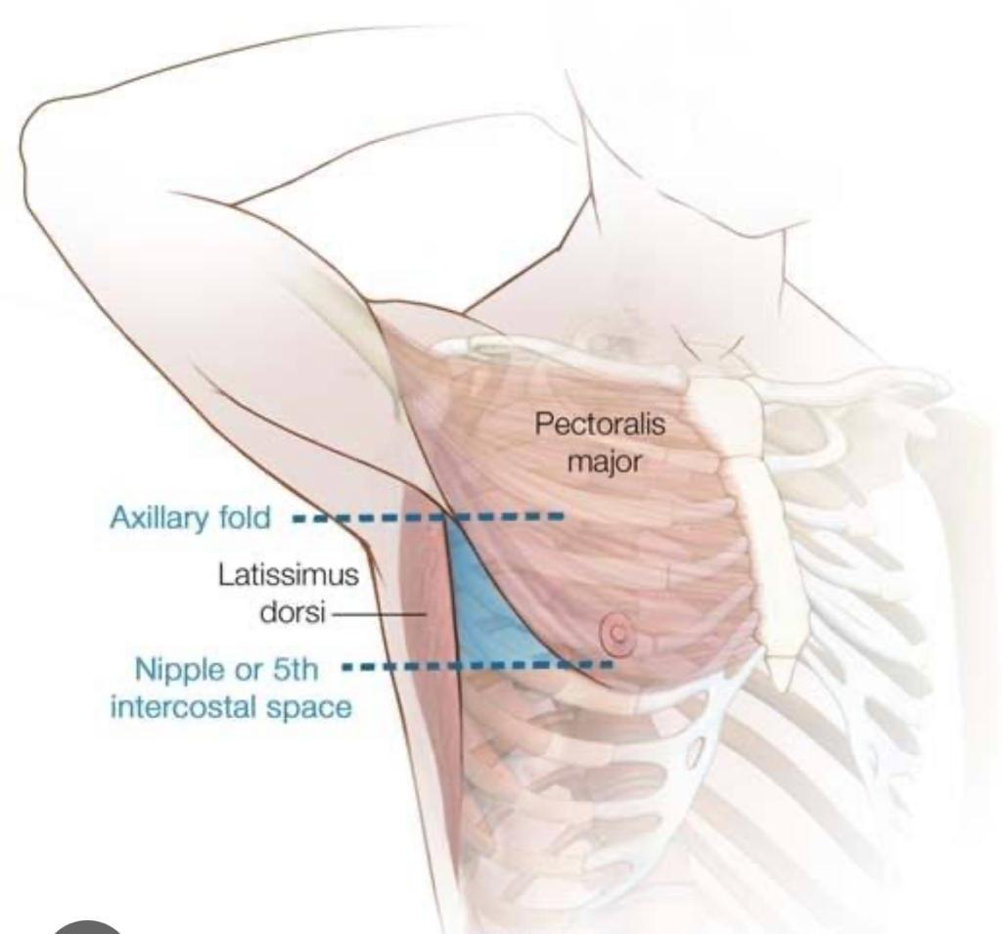
TRIANGLE OF SAFETY
Lateral Edge Of Latissimus Dorsi
Lateral Border Of Pectoralis Major
Superior To Horizontal Level Of 5th Ics

Slide 45
GUIDEWIRE TUBE THORACOSTOMY
Easiest Way
Skin Periosteum And Parietal Pleura Are Anaesthetised
An Incision Is Made In The Skin That Is Ample To Permit Passage Of The Chest Tube Of Desired Size.
18 Gauge Needle Attached To A Syringe Is Introduced Into The Pleural Space.
Fluid Or Air Is Aspirated To Confirm The Intrapleural Position
The Syringe Is Removed And The J Wire Is Threaded Through The Needle In The Desired Direction Into The Pleural Space
With Guidewire In Place The Tract Is Enlarged By Advancing Progressively Larger Dilators Over The Wire Guide
Finally The Chest Tube Containing The Inserter Is Threaded Over The Guide Wire
Once The Tube Is In Place The Insertor And The Guidewire Are Withdrawn
The Tube Is Then Clamped Until It Is Attached To The Chest Drainage System
The Tube Is Anchored In Place By Means Of A Long Suture Through The Skin And Around The Tube.

Slide 46
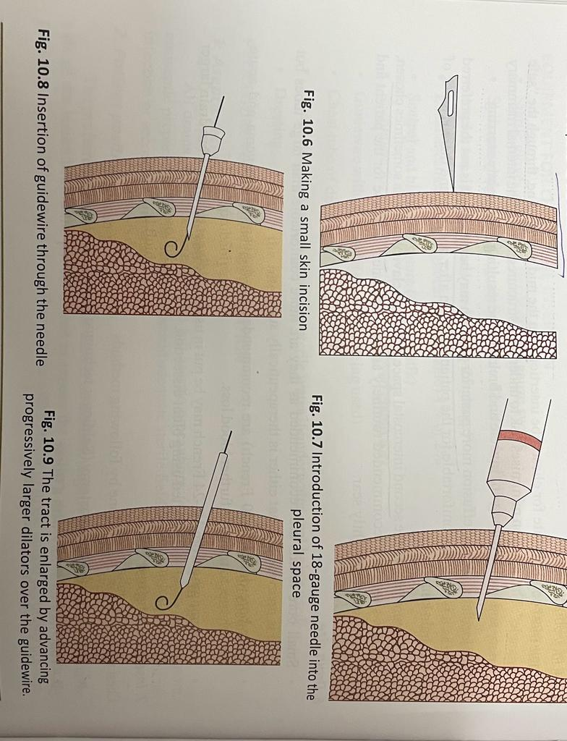
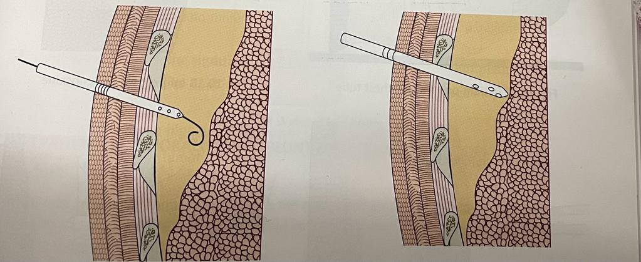

Slide 47
TROCAR TUBE THORACOSTOMY
Initially Requires 2-4 Cm Incision Parallel To Superior Border Of The Rib Through The Skin And Subcutaneous Tissues After Local Anasethsia Is Obtained.
The Trocar Can Then Be Inserted Between The Ribs Into The Pleural Cavity
Because Significant Force Is Required To Insert The Trocar The Hand Not Applying The Force Should Be Placed Next To Patient’s Chest Wall To Control The Depth Of Penetration
Once The Trocar Is In The Pleural Space, The Stylet Is Removed. When The Stylet Is Removed, The Operator Should Immediately Cover The Trocar With The Thumb To Prevent A Pneumothorax
The Chest Tube With Its Distal End Clamped, Is Quickly Inserted Into The Pleural Space. The Trocar Is Removed By Sliding It Back Over The Tube.
The Chest Tube Must Remain Clamped Until It Is Attached To An Underwater Seal To Prevent Air From Entering The Pleural Space
The Drain Should Be Secured With Suture After Insertion To Prevent It From Falling Out.

Slide 48
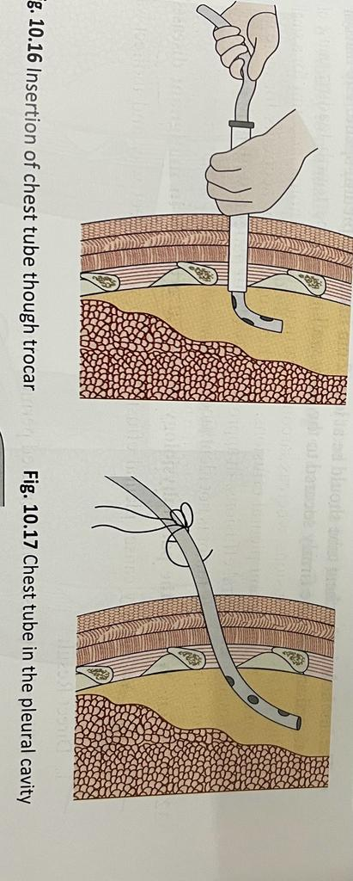
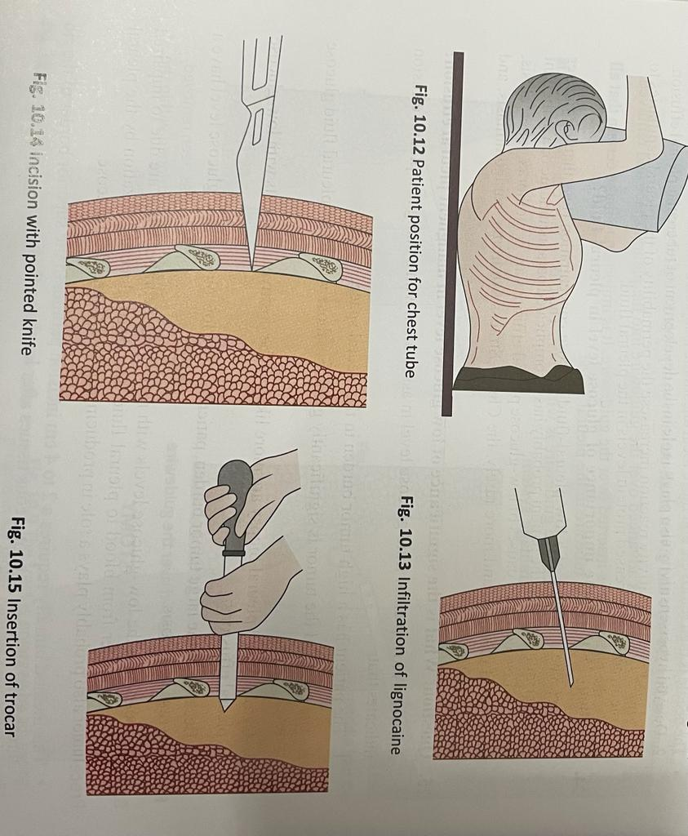

Slide 49
OPERATIVE TUBE THORACOSTOMY
In This Method An Incision Is Made In The Chest Wall After Proper Aseptic Precautions And Local Anesthesia. The Skin Incision Should Be Enough To Allow Introduction Of The Index Finger In To The Pleural Cavity.
Intercostal Tissues Are Dissected Bluntly Using Artery Forceps, Allowing Access To The Pleural Space. A Finger Placed Through The Incision Site Seeks Pleural Adhesions That Might Misdirect The Tube Towards The Lung, Apex Or Base. If Adhesions Are Found, The Probing Finger Can Gently Break Them Down.
The Large-bore Chest Tube (20 To 36 French) Is Then Clamped Using A Forceps, Placed Through The Site, And Released From The Clamp As It Is Directed In To Its Appropriate Position Inside The Chest.
The Last Hole In The Chest Tube Should Be At Least 2 Cm Inside The Pleural Space. The Incision Is Closed And The Tube Firmly Secured To The Chest Wall.

Slide 50
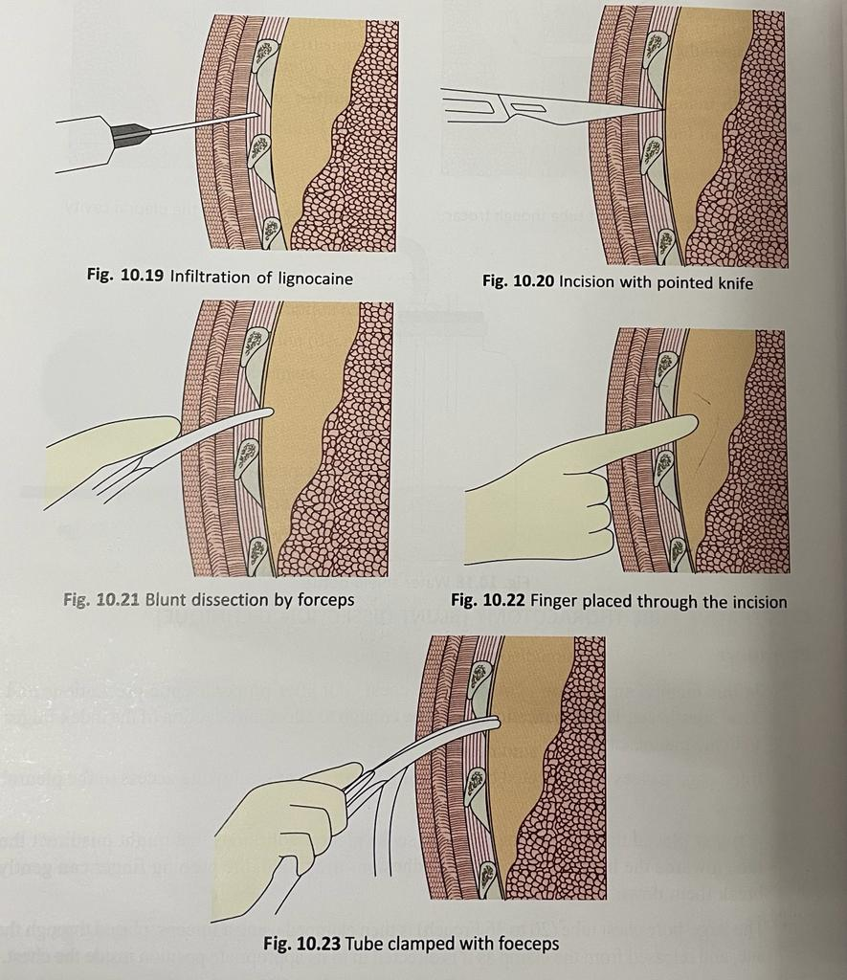

Slide 51
VERIFICATION OF CHEST TUBE PLACEMENT
After The Chest Tube Has Been Inserted And Connected To A Drainage System, A Chest Radiograph Should Be Obtained To Verify The Correctness Of Its Position.
Ideally, Both A Posteroanterior (Pa) And A Lateral View Should Be Obtained Because Certain Ectopic Locations May Not Be Apparent On The Pa View Alone.
A Ct Scan Should Be Obtained When The Chest Tube Does Not Drain Adequately And The Chest Radiograph Is Noncontributory .
With Ct, The Tube Can Be Visualized Over Its Entire Course With Accurate Location Of Its Tip

Slide 52
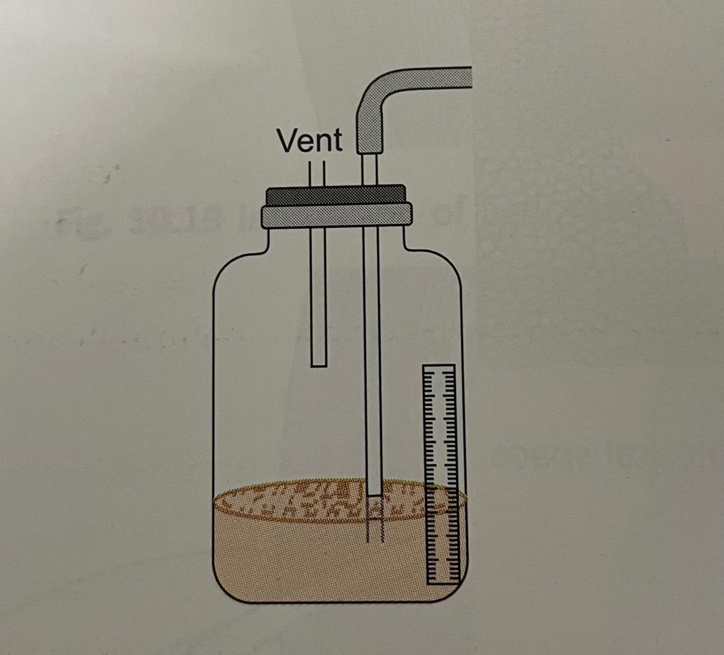
PLEURAL DRAINAGE SYSTEMS
ONE BOTTLE COLLECTION SYSTEM
In one bottle system, the bottle serves as both a collection container and a water seal. The chest tube is connected to a rigid tube inserted through a stopper into a sterile bottle. Saline solution is instilled into the bottle so that the tip of the rigid tube is approximately 3 cm below the surface of the saline solution.

Slide 53
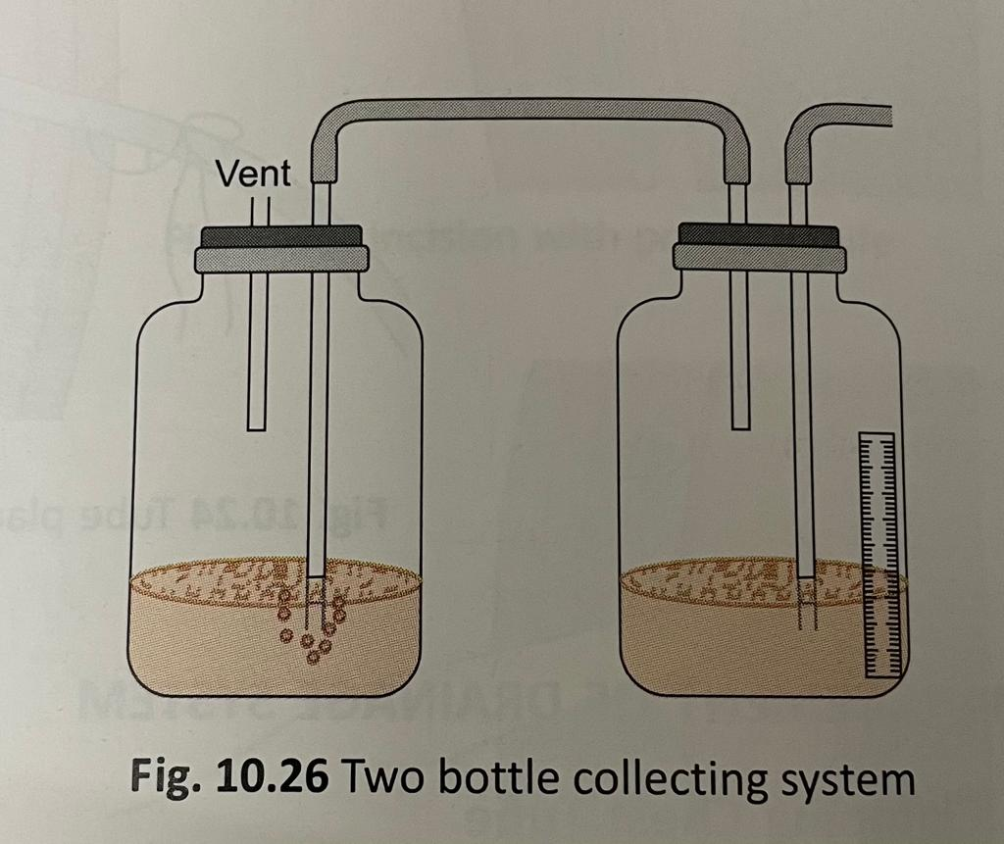
TWO BOTTLE COLLECTION SYSTEM
Two bottle system is preferred to the one-bottle system when the amount of fluid draining from the pleural space is more. In this system, the bottle adjacent to the patient acts as a collection bottle for the drainage, and the second bottle provides the water seal.

Slide 54
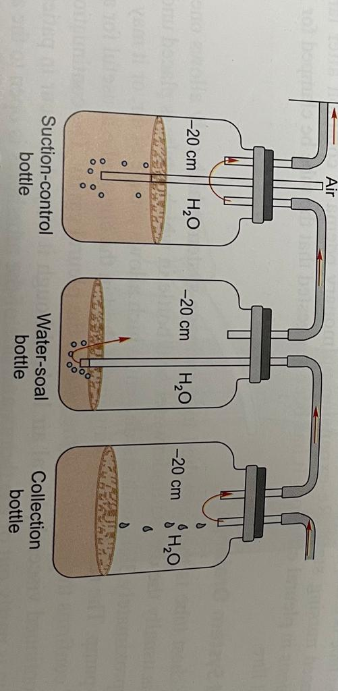
THREE BOTTLE COLLECTION SYSTEM
In this system there are three bottles, suction controlling bottle, water shield bottle and collection bottle. It is usually designed to apply negative pressure to the pleural space to facilitate reexpansion of the underlying lung or to expedite the removal of air or fluid from the pleural space.

Slide 55
Criteria To Remove Chest Tube
Lung Fully Expanded
No Air Leaks Or Bpf
Pleural Fluid Drain <50ml In 3 Consecutive Days
Change Of Color To Normal
Complications Of Intercostal Tube
Misposition Of Chest Tube
Bleeding And Hemothorax
Perforation Of Visceral Organs
Pleural Infection
Subcutaneous Emphysema
Reexpansion Pulmonary Edema

Slide 56
EVIDENCE BASED STUDY
Background: Conventional treatment (i.e. chest tube insertion and chemical pleurodesis) still remains standard for patients with secondary spontaneous pneumothorax because the risk of surgical bullectomy is deemed high in this subset. However, it has been suggested that surgical treatment using thoracoscopy may expedite postoperative recovery and, thus, may reduce hospital stay.
Materials and methods: Retrospective review of 61 patients with secondary spontaneous pneumothorax, who underwent conventional treatment (n=39) or video-assisted thoracoscopic surgery (VATS) (n=22) between January 2007 and December 2009, was performed. Talc was used for chemical pleurodesis in both groups.

Slide 57
Results: Hospital stay of conventional treatment group and VATS group was 14.2±14.2 days (4~58 days) and 10.6±5.8 days (5~32 days), respectively, with statistically significant difference (p=0.033). Recurrence rate of conventional treatment group was also significantly higher (12/39, 30%) compared to VATS group (1/22, 4.5%) (p=0.016).
Conclusion: In selected patients with secondary spontaneous pneumothorax with continuous air leak or inadequate lung expansion, thoracoscopic surgery with chemical pleurodesis using talc results in shorter hospital stay and lower recurrence rate compared to conventional approach.

Slide 58
REFERENCE
Pleural disease by richard light
Bedside respiratory medicine by hazarika

Slide 59
Thank u

