Slide 1
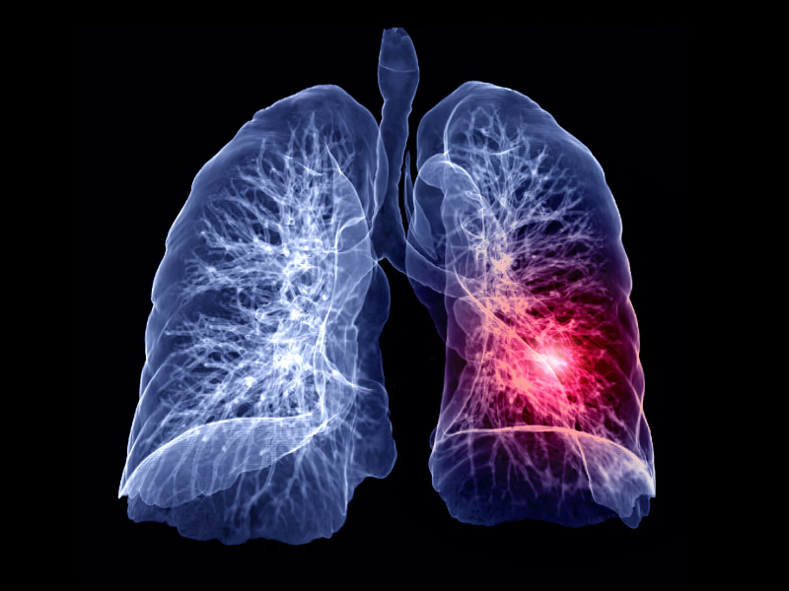
PULMONARY THROMBOEMBOLISM
BY-
DR. BHAVESH PATEL (PROFESSOR)
DEPT OF RESPIRATORY MEDICINE
20/8/24

Slide 2
INTRODUCTION
Pulmonary thromboembolic disease refers to the condition in which blood clot(s) (thrombus or multiple thrombi) migrate from the systemic circulation to the pulmonary vasculature.
Most of these thrombi arise from the deep veins of the lower and upper extremities (deep venous thrombosis [DVT]).
clinically, DVT and pulmonary embolism (PE) can be considered a continuum of the same disease, collectively referred to as venous thromboembolism.

Slide 3
Source of Emboli
• Thrombus originates in lower extremities in 85 - 90% cases.
• Thrombus often begins at a site where blood flow is turbulent, such as at a venous bifurcation, or behind a venous valve.
• Most thrombi originate in the deep veins of the calf and propagate proximally to the popliteal and femoral veins.
• Other sources of emboli are pelvic vein, upper extremity, or may be associated with thoracic outlet obstruction or effort thrombosis (Paget von Schroetter syndrome)

Slide 4
• Air embolism is usually iatrogenic and typically enters the blood stream accidentally through a central venous catheter.
• Fat embolism and amniotic fluid embolism are other causes of pulmonary embolism
• Pulmonary embolism in sickle cell disease is caused by "clumping" of abnormal red blood cells in the setting of hypoxia and stress, and can cause both acute respiratory distress as well as a more progressive disease with secondary pulmonary hypertension.

Slide 5
Predisposing Factors
• Virchow identified three main factors contributing to the formation of venous thrombosis
(Virchow's triad): venous stasis, hypercoagulability, and injury to the venous wall (endothelium).
Inherited Conditions
• Antithrombin III deficiency
• Factor V Leiden mutation

Slide 6
2. Acquired Risk Factors:
• Surgery, Trauma
• Major medical risk factors include NYHA class III and IV congestive heart failure,
COPD,
sepsis
other inflammatory disorders,
advanced age,
stroke,
critical illness,
prolonged bed rest

Slide 7
Any prolonged period of immobilization such as
paralysis,
bed rest
prolonged air travel.
Economy class syndrome
• Pregnancy, OCP
• Obesity BMI > 29kg/m2
• Metabolic syndrome
• Cancer
• Hematological abnormalities

Slide 8
Pathophysiology
• Once detached from their point of origin, emboli travel via the systemic venous system, through the right chambers of the heart, and eventually reach the pulmonary arterial system
• The physiologic effects and clinical consequences vary widely, ranging from asymptomatic disease to hemodynamic collapse and death.
Major factors that determine the outcome include:
• (1) size and location of emboli;
• (2) coexisting cardiopulmonary diseases;
• (3) secondary humoral mediator release and vascular hypoxic responses;
• (4) the rate of resolution of emboli.

Slide 9
Hemodynamic Consequences
• The normal pulmonary arterial system is a low-pressure system capable of accommodating only moderate increase in pressure with substantial increase in blood flow
• With Pulmonary vascular Obstruction less than 20 % there is mild hemodynamic abnormality.
•When the degree of pulmonary vascular obstruction exceeds 30 to 40 percent, moderate increases in right ventricular pressure occur
but cardiac output is maintained through an increase in heart rate and myocardial contractility.

Slide 10
• Compensatory mechanisms begin to fail when the degree of pulmonary artery obstruction exceeds 50 to 60 percent.
Cardiac output begins to fall and right atrial pressure increases dramatically.
• In patients without prior cardiopulmonary disease, the maximal mean pulmonary artery pressure capable of being generated by the right ventricle appears to be 40 mmg (PASP of approximately 70 mmHg).

Slide 11
GAS EXCHANGE ABNORMALITIES
• Hypoxemia is the most common immediate physiologic consequence of pulmonary embolism.
• Obstruction of the pulmonary vasculature re-directs the blood flow to other parts of the pulmonary vascular bed.
This results in an increase in intra-pulmonary shunting, ventilation-perfusion (V/Q) inequality, and decreases in the mixed venous 02 level, thereby magnifying the effect of the normal venous admixture.
• Further shunting and alveolar dead space increases due to alveolar hemorrhage, and atelactasis

Slide 12
• Hypocapnia in PTE is due to hypoxia-induced intrapulmonary reflex vagal stimulation, with resulting hyperventilation.
• Finally, hypoxemia may lead to an increase in sympathetic tone, which in turn causes systemic vasoconstriction
• One uncommon consequence of pulmonary embolism is pulmonary infarction.
• Infarction is uncommon because the pulmonary parenchyma has three potential sources of oxygen: the pulmonary arteries, bronchial arteries, and airways.
• Two of these three sources apparently must be compromised before infarction develops.

Slide 13
Clinical features
• The most common presenting symptom of acute embolism is
the sudden onset of dyspnea.
• Other symptoms include
chest pain,
cough,
leg swelling or pain,
hemoptysis.
• The most common physical finding is unexplained tachypnea.
• Less frequent findings include inspiratory crepitations, tachycardia, and loud S2.
• Fever may develop some hours after the event.

Slide 14
Investigations
• Increased Total Leukocyte Count but never more than20,000cells/cumm
• Hypoxemia with hypocapnia
• ECG - The electrocardiogram is nonspecific
• Findings in acute PE are generally nonspecific and include T- wave changes, ST-segment abnormalities, and left- or right-axis deviation.

Slide 15
D-dimer testing has proven to be highly sensitive but not specific.
Increased levels are present in nearly all patients with venous thromboembolism, but also occur in a wide range of other circumstances
advancing age
Pregnancy
Trauma
Infections
the postoperative period
inflammatory states
malignancy.
Therefore, the role of D-dimer testing is limited to one of venous thromboembolism exclusion

Slide 16
Chest X ray
• Most patients with pulmonary embolism have abnormal but nonspecific chest radiographic findings.
• Common radiographic findings include atelectasis, pleural effusion, pulmonary infiltrates, and mild elevation of a hemidiaphragm.
• Classic findings of pulmonary infarction-such as Hampton's hump or decreased vascularity (Westermark's sign)-are suggestive but infrequent.
• A normal chest radiograph in a patient with otherwise unexplained acute dyspnea or hypoxemia is strongly suggestive of embolism.

Slide 17
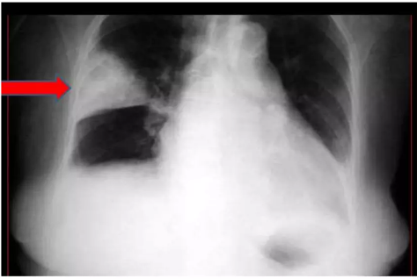
Hampton hump refers to a dom-shaped, pleurally-based opacification in the lung.
•

Slide 18
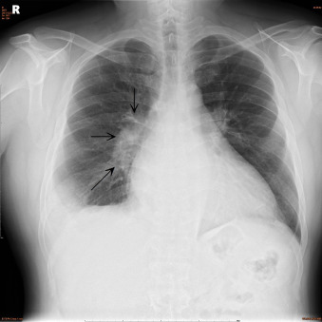
Pala sign is a prominent pulmonary artery that can be caused either by pulmonary hypertension that develops or by distension of the vessel by a large pulmonary embolus.

Slide 19
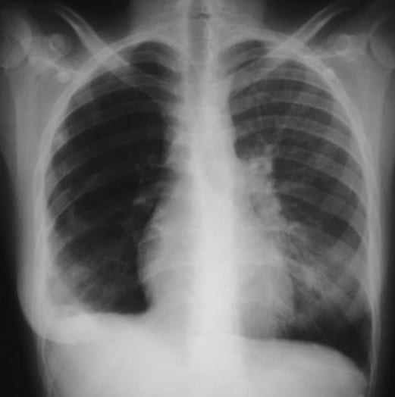
• Westermark's sign - peripheral oligemia

Slide 20
Role of CT Pulmonary Angiogram- MDCT with Li contrast
• CT is considered confirmatory in excluding embolism in patients with a low or intermediate likelihood of disease and confirming embolism in patients with intermediate or high probability of disease.
• When discordance exists between the clinical assessment and CT findings, additional studies should be performed.
• It is possible this recommendation will change as studies are published.

Slide 21
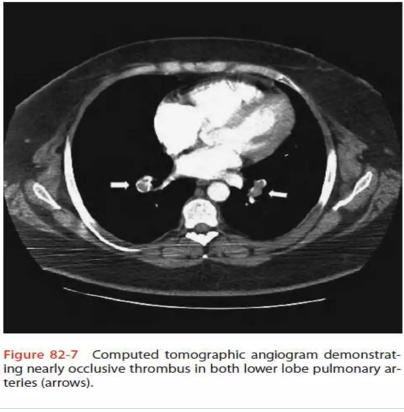

Slide 22
Ventilation-Perfusion Scanning
• A negative study rules out the diagnosis of pulmonary embolism with the same degree of certainty as a negative pulmonary angiogram and with a higher degree of certainty than can be achieved by a negative CT scan.
• VQ scans are divided into 4 criteria high probability scan, intermediate probability scan, low probability scan, and normal scan.
• The positive predictive value of a "high probability" scan (one characterized by multiple, segmental-sized, mismatched defects) approximates 88 percent.

Slide 23
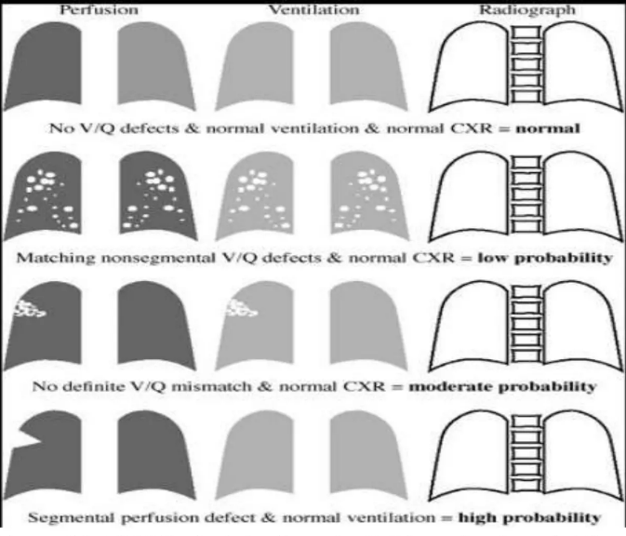
MODIFIED PIOPED CRITERIA FOR DIAGNOSIS OF PULMONARY EMBOLISM DETERMINE THE PROBABILITY OF PULMONARY EMBOLI FOLLOWING A VQ SCAN

Slide 24
Echocardiogram
• Presence of unexplained right ventricular volume or pressure overload should suggest the possibility of embolism and lead to confirmatory testing.
• Trans Esophageal Echocardiography has better sensitivity and specificity especially in cases of proximal embolus, reaching up to 90%. Compared to 50% in transthoracic echo.

Slide 25
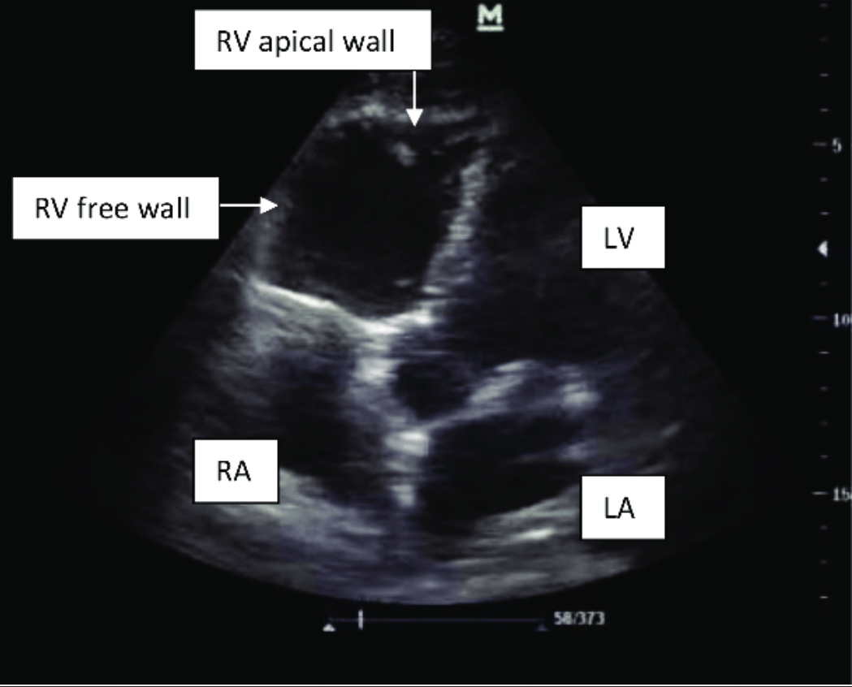
McConnell sign: akinesis of the free wall of the right ventricle with sparing of the apical segment seen in acute pulmonary embolism causing right ventricle systolic dysfunction.

Slide 26
Duplex ultrasonography, which refers to the combination of Doppler venous flow detection and real-time B-mode imaging is the investigation of choice for diagnosing Venous Thrombosis of Limb.
• MR Angiography is being evaluated as diagnosing modality in PIOPEDI (Prospective Investigation of Pulmonary Embolism DiagnosisIII )study.

Slide 27
Pulmonary Angiogram- Gold Standard
• Pulmonary angiography remains the accepted "gold standard" for PE diagnosis.
• Only two angiographic findings are diagnostic of acute embolism: the filling defect and abrupt cutoff of a vessel.
• Catheter is inserted in the right heart and dye is injected into pulmonary trunk. Filling is observed under fluoroscopy.
• Limitations of Pulmonary Angiogram
• It requires expertise in study performance and interpretation;
• it is invasive.
• High mortality due to procedure itself.

Slide 28
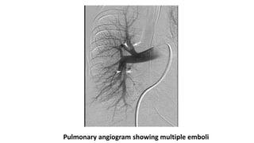

Slide 29
Clinical Assessment & Scoring
• Three scoring system has been developed and validated to use.
• 1 Wells score
• 2 Geneva Score
• 3 Modified Geneva score

Slide 30
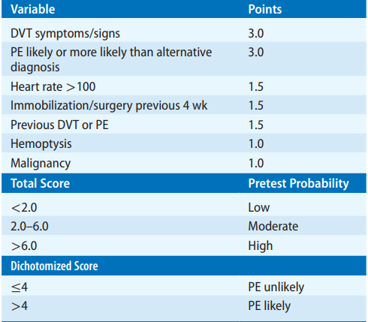
WELL’S CLINICAL PREDICTION SCORE

Slide 31
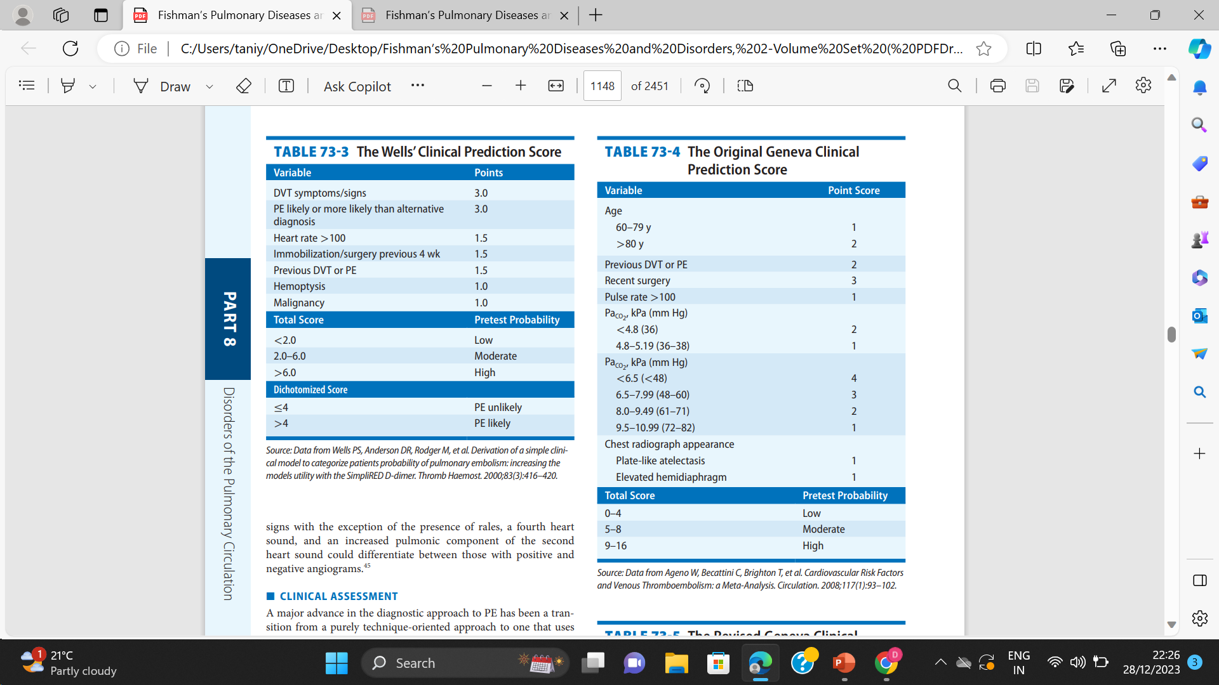
ORIGINAL GENEVA CLINICAL PREDICTION SCORE

Slide 32
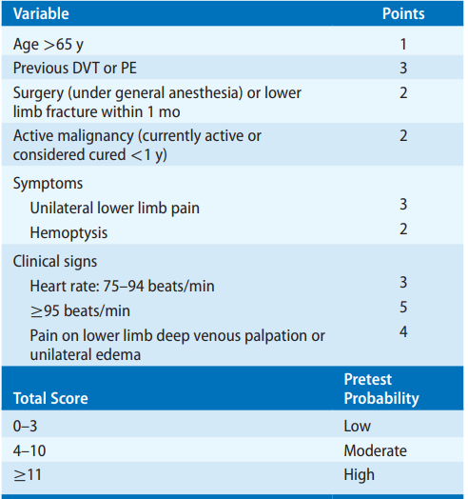
REVISED GENEVA CLINICAL PREDICTION SCORE

Slide 33
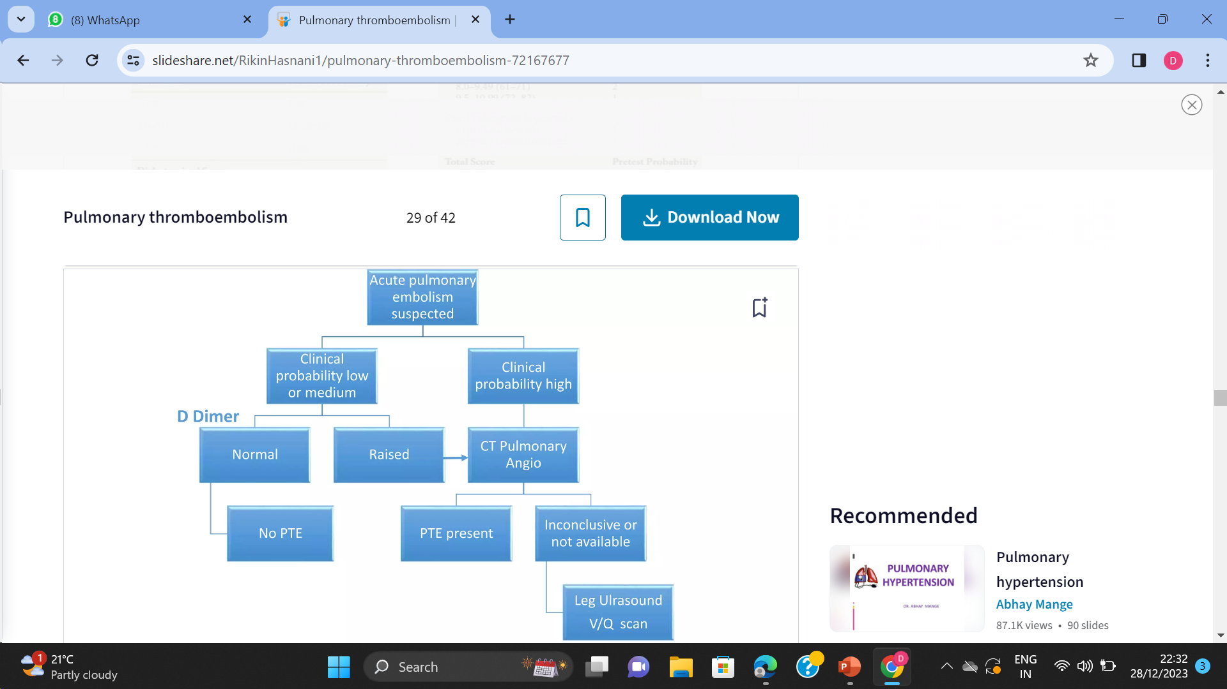

Slide 34
A ventilation/perfusion (V/Q) scan based approach
• It is used in settings such as pregnancy, contrast allergy, or renal insufficiency.
• A negative V/Q scan is capable of excluding the diagnosis regardless of the clinical assessment
• A high probability scan is capable of confirming the diagnosis in patients with a high clinical suspicion.
• All other circumstances require additional testing.

Slide 35
Classification of Acute pulmonary Embolism
• Massive PTE
• Sub massive PTE
• Small to moderate PTE

Slide 36
TREATMENT
I. Heparin
• Unfractionated heparin (UFH)
given as initial IV bolus of 80 units of heparin/kg followed by a continuous infusion initiated at 18 units/kg/hr.
• The heparin drip is adjusted to maintain aPTT ratio of 2.0 - 3.5
• UFH is given S/C in a dose of 333U stat followed by 250U S/C 12th hourly

Slide 37
• LMWH has replaced UFH in treatment of PTE however UFH should be used in
• renal insufficiency
• Extremes of bodyweight,
• hypertensive crisis
• and circumstances in which a rapid adjustment of anticoagulation is needed, such as
• women in the late stage of pregnancy who may need Caesarian sections,
• patients with recent surgery or recent history of bleeding, and
• hemodynamically unstable patients with VTE who may need surgical procedures such as emergency embolectomy.

Slide 38
II. Novel Agents
• 1.Fondaparinux
• 2. Direct thrombin inhibitors - bivalirudin, lepirudin, argatroban.
• Ill Thrombolytic Therapy
• Thrombolytic agents available
streptokinase,
recombinant tissue plasminogen activator (rt PA),
and urokinase.

Slide 39
• Thrombolysis is indicated in following conditions where it is considered lifesaving; that is, in patients
• with pulmonary embolism who present with hemodynamic compromise,
• patients who develop hemodynamic compromise during conventional therapy with heparin,
• patients with embolism associated with intracavitary right heart thrombi

Slide 40
INTERVENTIONAL RADIOLODIC TECHNIQUES
Interventional thrombus fragmentation represents a potential alternative to systemic thrombolysis or surgical embolectomy
• A wide variety of fragmentation and embolectomy devices designed to either fragment and/or remove fresh embolic material have been tested in patients with pulmonary embolism.
• In general, the devices use either pressured saline or a rotating impeller to fragment central thrombi. The fragments are either aspirated through a separate port on the catheter or allowed to migrate distally.
• Most of the devices appear to be effective, safe, and potentially lifesaving in the presence of central, acute clots.

Slide 41
Pulmonary Embolectomy
• It is indicated in patients with
persistent hypotension,
Shock
cardiac arrest
who either failed thrombolysis or
have contraindications to thrombolytics.

Slide 42
Long term anticoagulation therapy
• Warfarin is drug of choice
• It is given in a dose to maintain INR between 2-3
• It should be given for duration of 6 to 12 months and additional prophylactic short course should be considered when predisposing factor is encountered.
• In case of 2nd episode of VTE and inherited disorder lifelong prophylactic therapy should be considered.

Slide 43
VENA CAVAL FILTER
indicated in patients who either have a contraindication to anticoagulation or develop recurrent VTE while on adequate anticoagulation
• IVC filters has proved to have potentially life saving benefits.
However, long-term studies suggest that IVC filters, although capable of preventing short-term embolic recurrence, they are associated with a long term increase in the incidence of venous thromboembolism.
• To prevent long term side effects of IVC filters, retrievable filters are developed.
• Four different retrievable vena caval filters have received approval by the FDA (Gunther tulip filter, ALN filter, Recovery filter, OptEase filter).

Slide 44
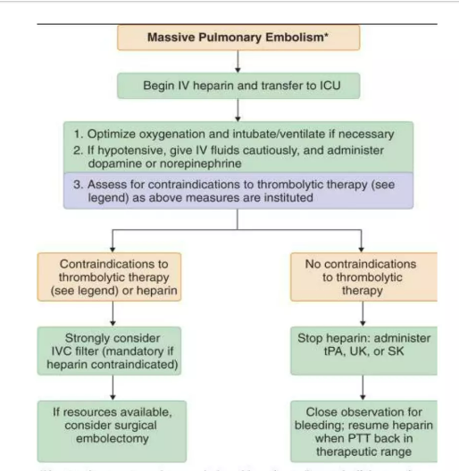

Slide 45
Pulmonary embolism in menopausal hormone therapy: a population-based register study
Objective: Oral but not transdermal menopausal hormone therapy (MHT) increases the risk of venous thromboembolism. There is no evidence regarding the risk of the serious complication pulmonary embolism (PE). The aim was to investigate the risk of PE in women using MHT depending on administration route, type of progestin and treatment duration.
Method: The population-based case-control study covered 17,71,253 women aged 40-69 years, during 2006-2015. Diagnoses of PE (n = 13,974) and drug dispensations were received from national validated registers.

Slide 46
Results: Current MHT users had a higher risk of PE than non-users (odds ratio [OR] 1.15, 95% confidence interval [CI]. First ever users had the highest risk (OR 2.07). Transdermal administration was not associated with increased risk of PE. The OR was slightly but non-significantly higher with estrogen combined with medroxyprogesterone acetate than with norethisterone acetate.
Discussion: The risk of PE was significantly increased in users of oral but not transdermal MHT, with the highest risk in first ever users of oral estrogen combined with medroxyprogesterone acetate. The risk was considerably lower in women with recurrent treatment, probably because of the healthy user effect.
Conclusion: PE was most common close to initiation of oral treatment. Transdermal MHT did not increase the risk of PE.

Slide 47


