Slide 1
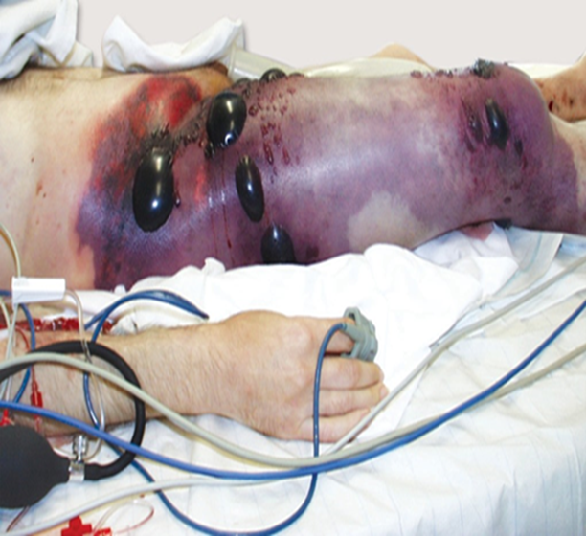
Gas Gangrene
Dr Tanuja Javadekar
PROFESSOR and head
DEPARTMENT OF MICROBIOLOGY

Slide 2
INTRODUCTION
Anaerobic bacteria do not have cytochrome system for oxygen metabolism - unable to neutralize toxic oxygen metabolites.
They either cannot grow in presence of oxygen (obligate anaerobes) or do not utilize oxygen but tolerate its presence (aerotolerant anaerobes).

Slide 3
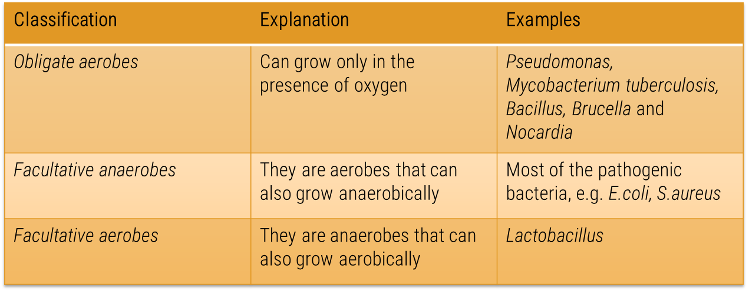
Oxygen

Slide 4
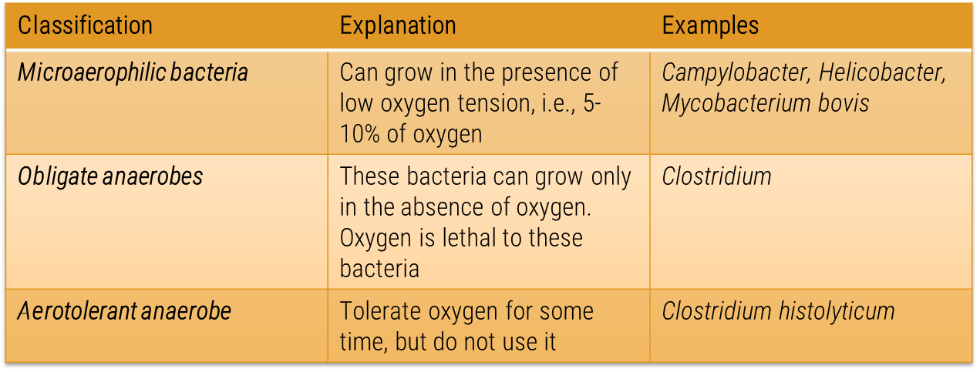
Oxygen

Slide 5
Clinical Presentations of Anaerobic Infections
Infections adjacent to mucosal surfaces that bear anaerobic flora
Predisposing factors - ischemia, tumor, penetrating trauma, foreign body, or perforated viscus
Spreading gangrene involving skin, subcutaneous tissue, fascia, and muscle
Foul smelling putrid pus
Abscess formation
Septic thrombophlebitis
Toxemia and fever not marked
Failure to respond to antibiotics that do not have significant anaerobic activity
Organisms are seen under Gram stain, but fail to grow in routine aerobic culture

Slide 6
CLOSTRIDIAL INFECTIONS
Clostridia - gram-positive bacilli, bulging spores
Saprophytes - in soil, fresh water, marine water, decaying vegetation, animal matter and sewage - play a major role in recycling of organic matter.
Few members may cause a variety of infections in humans such as:
  C. perfringens: Causes gas gangrene, an edematous myonecrosis like condition
  C. tetani: Causes tetanus
  C. botulinum: Produces a powerful neurotoxin called botulinum toxin that causes botulism
  C. difficile: Causes pseudomembranous colitis in hospitalized patients.

Slide 7
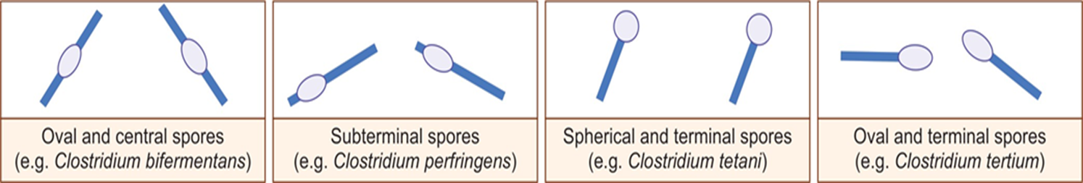
Types of spores of various Clostridia species

Slide 8
CLOSTRIDIUM PERFRINGENS INFECTIONS
(CLOSTRIDIUM WELCHII)
Capsulated, non-motile, gram-positive bacillus
Bears subterminal bulging spores - does not produce spores in tissues or in culture media (especially the gas gangrene strains)
Invasive as well as toxigenic.

Slide 9
Clinical Manifestations
Clostridial Wound Infection
Clostridial Enteric Infection
Gas gangrene

Slide 10
Clostridial Wound Infection
MacLennan has classified them as follows:
  Simple wound contamination
  Anaerobic cellulitis
  Anaerobic myositis (gas gangrene)

Slide 11
Gas Gangrene - Definition
Defined as a rapidly spreading, edematous myonecrosis, occurring in association with severely crushed wounds contaminated with pathogenic clostridia - C. perfringens.
Previously, the disease was called malignant edema or clostridial myonecrosis.
Established agents: C. perfringens (most common, 60% of the total cases) and C. novyi and C. septicum (20–40%)
Probable agents: They are less commonly implicated, e.g. C. histolyticum, C. sporogenes,C. bifermentans & C. tertium.

Slide 12
Gas Gangrene - Pathogenesis
The development of gas gangrene requires:
  Anaerobic environment: Crushing injuries of muscles such as road traffic accidents(causing laceration of large or medium size arteries), open fractures of long bones or foreign bodies(bullet injuries)- lead to interruption in the blood supply and tissue ischemia.
  Anoxic muscles start utilizing pyruvate anaerobically to produce lactic acid.
  Contamination of wound with clostridial spores( during war or RTA)
  Spontaneous non-traumatic gas gangrene - via hematogenous seeding of normal muscle with bowel clostridia as people with GI pathologies(colonic malignancy)

Slide 13
Virulence factors mediating Gas Gangrene
Toxin produced by C.perfringens
C.perfringens proliferate locally ------elaborate exotoxins-----alpha toxin & Ф toxin .
Alpha toxin----- Phospholipase C & Sphingomyelinase activities.
----- Activate platelet Adhesion molecules GpIIb/IIIa.
----- Neutrophil receptor CD11b/CD18.
----- Formation of aggregates of platelets and neutrophils in the blood vessels
causing occlusion.
----- Suppresses myocardial contractility leading to reduction in cardiac output
& result in profound hypotension.
Ф Toxin ----- marked vasodilation by activating medicators

Slide 14
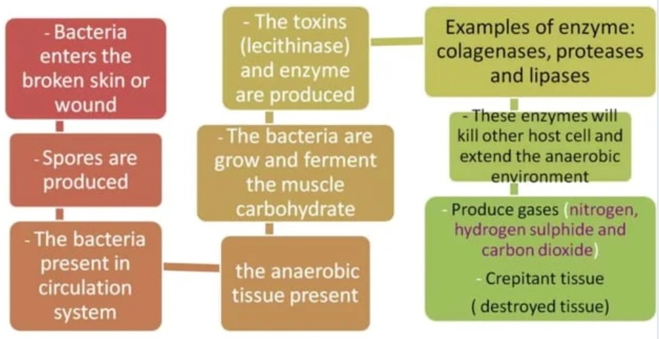
Pathogenesis

Slide 15
Gas Gangrene - Clinical Manifestations
The incubation period is variable.
Depend on : Nature of Injury , amount of wound contamination & type of clostridial species involved.
  10–48 hours for C. perfringens
  2–3 days for C. septicum
  5–6 days for C. novyi.

Slide 16

Gas Gangrene - Clinical Manifestations
Sudden onset of excruciating pain at the affected site
Rapid development of a foul-smelling thin serosanguineous discharge
Gas bubbles (crepitus) in the muscle planes.
Brawny edema and induration
Such gangrenous tissues later may become liquefied and sloughed off
Shock and organ failure develop later
Associated with higher mortality rate (50%).

Slide 17
Gas Gangrene - Laboratory diagnosis
Based on clinical diagnosis of gas gangrene – Tx should start as early as possible.
Laboratory diagnosis role play : (1) Confirmation of the clinical diagnosis. (2) Species identification.
Specimen: Necrotic tissues, muscle fragments and exudates from deeper parts of the wound(infection appears to be more active).
Blood culture may be positive for C.perfriengens and C. septicum.
Swab rubbed over the wound surface or soaked in exudates are not satisfactory.
Specimens should be put into Robertson’s cooked meat browth and transported immediately to the laboratory.

Slide 18
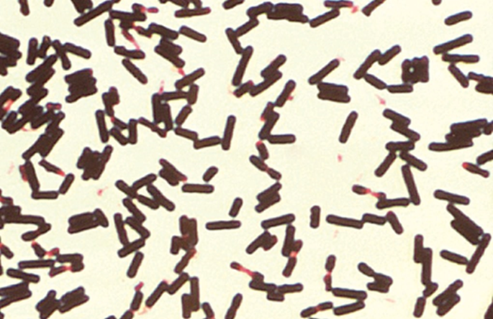
Direct Microscopy
Gram stained smear of Clostridium perfringens : Absence of neutrophils in the infected tissue ---clue about clostridia present.
Thick ,stubby ,boxcar-shaped ,gram positive bacilli without spore – suggestive of clostridium perfingens.
Spore bearing gram positive bacilli suggest other clostridia species.
Citron bodies – boat or leaf shaped pleomorphic irregularly stain bacilli with spore – C. septicum.

Slide 19
The Gram stain is an important rapid tool for anaerobic bacteriology. Not only does it reveal the types and relative numbers of microorganisms and host cells present, it also serves as a quality control measure for the adequacy of anaerobic techniques.
A positive Gram stain with a negative culture may indicate:
(1) poor transport methods,
(2) excessive exposure to air during specimen processing,
(3) failure of the system (jar, pouch, or chamber) to achieve an anaerobic atmosphere,
(4) inadequate types of media or old media,
(5) killing of microorganisms by antimicrobial therapy.

Slide 20
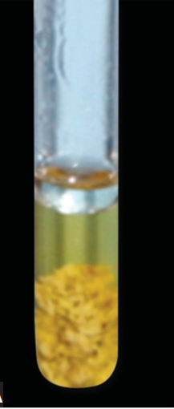
Culture
Robertson’s cooked meat (RCM) broth:
Most commonly used anaerobic media.
Contains chopped meat particles (beef heart) - provide glutathione and unsaturated fatty acids - take up oxygen and create lower redox potential - permit the growth of obligate anaerobes
  Incubation: Anaerobically (by GasPak or Anoxomat, etc.)

Slide 21
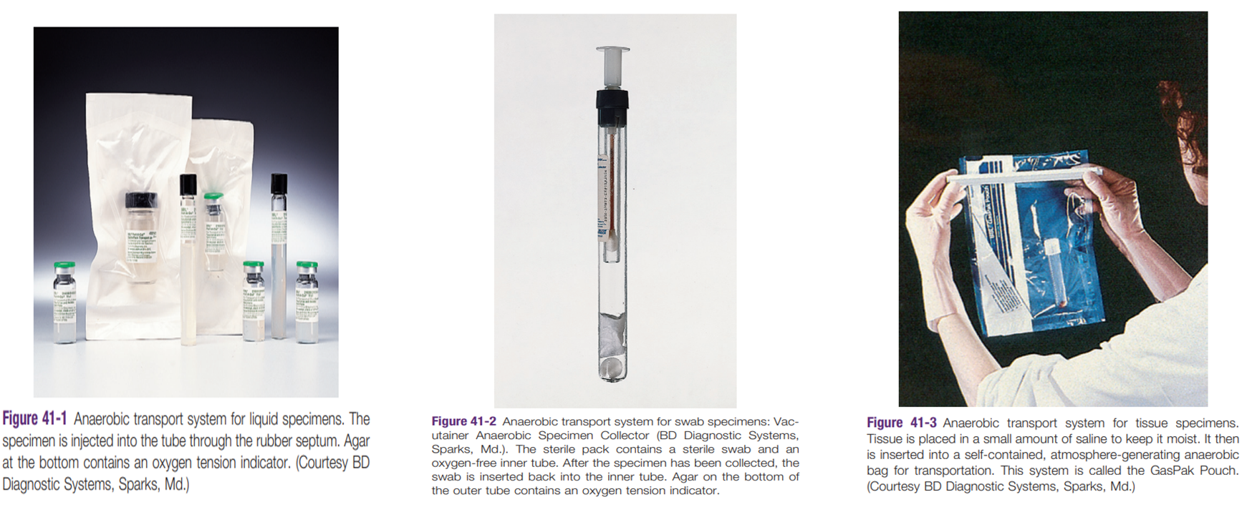
Transport system for anaerobic organisms

Slide 22
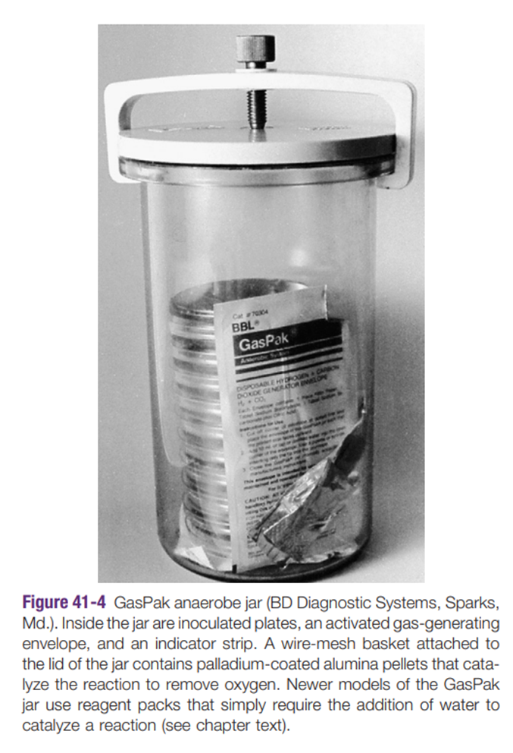
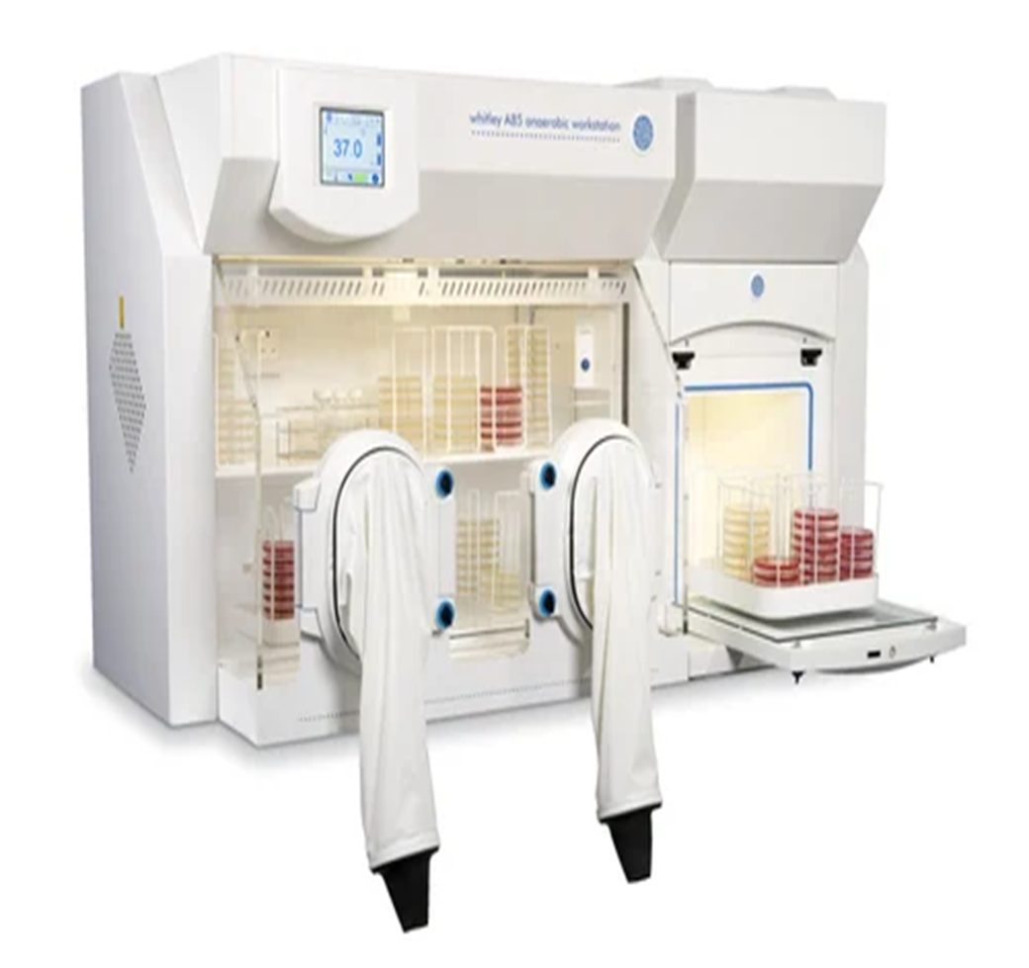

Slide 23
Identification of C. perfringens
  Culture Plate : Incubated anaerobically at 37°C for 2 days.
  Target hemolysis (double zone hemolysis)
  On Blood agar : C.perfrigens prodeuce an inner narrow zone of complet
  hemolysis(due to Фtoxin) & surrounded by wider zone of
  incomplete hemolysis (due to alpha toxin).

Slide 24
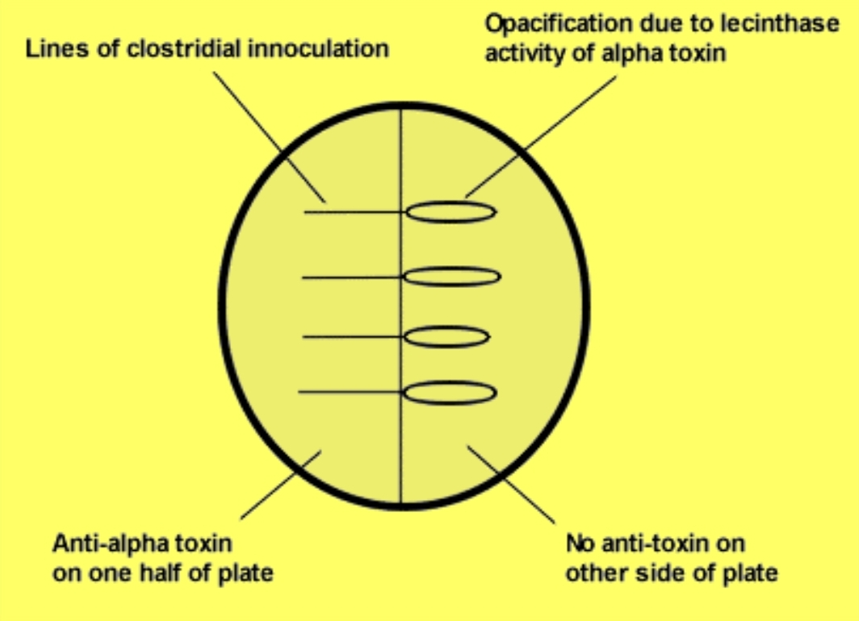
Nagler’s reaction
  Nagler’s reaction: Opalescence surrounding the streak line on egg yolk agar
  Due to lecithinase activity of alpha toxin
  Test also positive for C.bifermentoans,C.sordellii

Slide 25
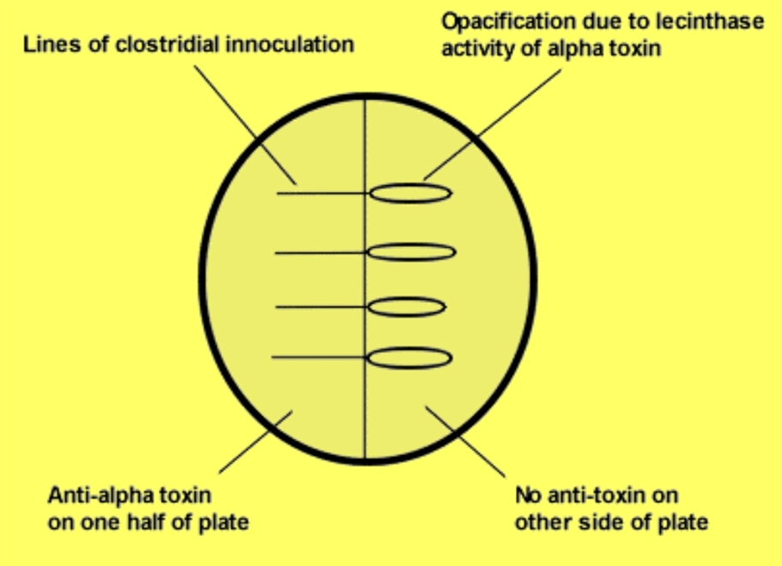
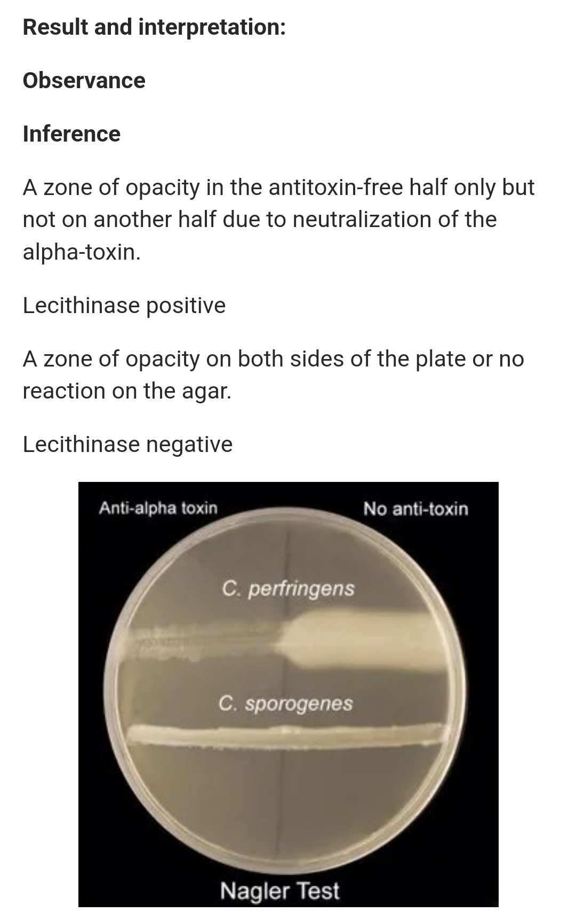

Slide 26
Reverse CAMP test
  C.perfringens is streaked over the center of blood agar plate and streptococcus
  agalactice is streaked perpendicular to it.
  Presence of enhanced zone of hemolysis pointing towards C.perfringens indicate test positive.
  Reverse CAMP test: Positive
  Heat tolerance test: Positive – can grow when RCM broth is inoculated at 45 C for 4-6 hours.
  In litmus milk: Produces stormy clot reaction– due to fermentation of lactose producing acid and vigorous gas.

Slide 27
Gas Gangrene - Laboratory diagnosis
A. Target hemolysis of C. perfringens-zone of incomplete hemolysis (blue arrow) and zone of complete hemolysis (black arrow); B. Nagler’s reaction; C. Reverse CAMP test.

Slide 28
Gas Gangrene – Treatment
Early surgical debridement - most crucial step in the management of gas gangrene.
All devitalized tissues should be widely resected so as to remove conditions that produce anaerobic environment.
Closure of wounds – delayed for 5–6 days until the sites are free from infection.
Antibiotics: Combination of penicillin and clindamycin is recommended for 10–14 days
Hyperbaric oxygen: It may kill the obligate anaerobic clostridia - C. perfringens; however, it has no effect on aerotolerant clostridia (C. septicum)
Passive immunization with anti-α-toxin antiserum.

Slide 29
Q1
All of the following statements regarding Clostridium perfringens are correct EXCEPT:
(A) It produces an enterotoxin.
(B) It produces a double zone of β-hemolysis when grown on blood agar.
(C) Some strains are aerotolerant.
(D) It is the most common cause of antibiotic-associated diarrhea.
(E) It can cause intravascular hemolysis

Slide 30
Q2
Nagler reaction detects
a. Corynebacterium diphtheriae
b. Clostridium tetani
c. Clostridium perfringens
d. Clostridium botulinum

Slide 31
Q3
Principle toxin responsible for gas gangrene is:
a. Alpha toxin
b. Theta toxin
C. Beta toxin
d. Delta toxin

Slide 32
Q4
Characteristic of anaerobic bacteria is:
a. Foul smelling discharge
b. Fail to grow in aerobic media
C. Gas in tissue
d. All of the above

Slide 33
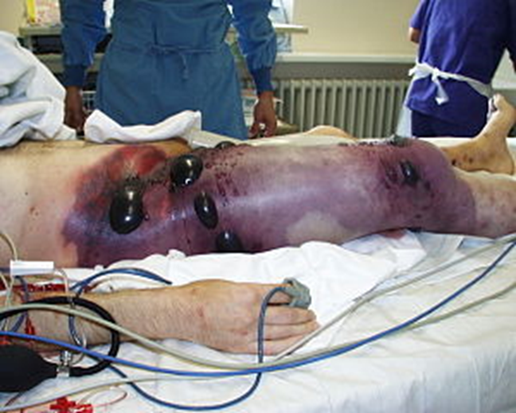
Q5
The photograph of leg of a victim of road traffic accident is shown in picture.
Name the most probable clinical condition.
Name the clinical sample/s and precaution to be taken while collecting the sample.

