Slide 1
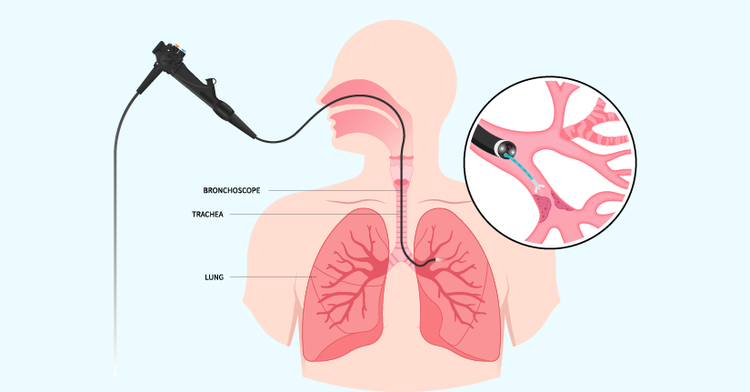
BRONCHOSCOPY - 1
FLEXIBLE BRONCHOSCOPY
TRANSBRONCHIAL LUNG BIOPSY
TRANSBRONCHIAL NEEDLE ASPIRATION
DR. CHIRAG CHAKRAVARTI (ASST. PROFESSOR)
(DEPARTMENT OF RESPIRATORY MEDICINE)
(SBKS & MIRC)
17/9/24

Slide 2
FLEXIBLE BRONCHOSCOPY
Key Points:
﻿﻿Bronchoscopy is a specialized optical device used for diagnostic and therapeutic procedures in the lung.
﻿Two types of bronchoscopy-flexible and rigid, the flexible bronchoscope is employed in more than 95% of all bronchoscopic procedures.
﻿﻿Flexible bronchoscopic procedures are performed with the patient under light sedation and with application of topical anesthesia.
﻿﻿The standard adult flexible bronchoscope has the outer diameters ranging from 5.3 mm to 6.0 mm, working channels is at least 2.0 mm and total length of 605 mm.
﻿﻿For therapeutic flexible bronchoscope the outer diameter is 6.0 mm and working channels is 2.8 mm.
﻿﻿The most common indication for flexible bronchoscope is to diagnose the cause of an abnormality seen on a chest radiograph. Those abnormalities include infiltrates of any size or location, atelectasis, or mass lesion.
﻿﻿Absolute contraindications of bronchoscopy are uncooperative patient and patient with SPO, at room air below 92%.
﻿﻿The incidence of complications is about 2% and mortality from the procedure is less than 0.02%.

Slide 3
FLEXIBLE BRONCHOSCOPY
INTRODUCTION
Bronchoscopy is a specialized optical device and can be used for diagnostic and therapeutic procedures in the lung with the help of the bronchoscope. It is regarded as one of the most frequently performed procedures used by the pulmonologist. Bronchoscopy, whether fiberoptic or rigid, is an invasive procedure for visualization of the upper and lower respiratory tract, for the diagnosis and management of a spectrum of inflammatory, infectious, and malignant diseases of the airway and lungs.

Slide 4
FLEXIBLE BRONCHOSCOPY
FLEXIBLE BRONCHOSCOPY
Flexible bronchoscopy is an invasive procedure that is utilized to visualize the nasal passages, pharynx, larynx, vocal cords, and tracheo-bronchial tree. It is utilized for both the diagnosis and treatment of lung disorders. The procedure may be performed in an endoscopy suite, the operating room, the emergency department, a radiology suite, or at the bedside in the ICU. The flexible bronchoscope is employed in more than 95% of all bronchoscopic procedures.
The major advantages of the flexible bronchoscope include :
The ability to insert it nasally, orally, or through a tracheostomy stoma, and to visualize apical segments of upper lobes as well as segmental and subsegmental bronchi in all lobes.
In contrast to rigid bronchoscopy, which requires a dedicated room or an operating room, almost all flexible bronchoscopies can be safely performed in an outpatient setting, or by the patient's bedside.
Ability to perform flexible bronchoscopic procedures with the patient under light sedation and with application of topical anesthesia.

Slide 5
FLEXIBLE BRONCHOSCOPY
EQUIPMENT FOR FLEXIBLE BRONCHOSCOPE
Bronchoscopic devices: The appropriate bronchoscope size is determined by the bronchoscopist, based on the patient age and types of intervention.
For small airways, a pediatric bronchoscope having a 2.8 mm outer diameter and 1.2 mm working channel is suitable.
For adult bronchoscope the outer diameters ranging from 5.3 mm to 6.0 mm and working channels of at least 2.0 mm.
In therapeutic flexible bronchoscope an outer diameter of 6.0 mm and working channels of 2.8 mm is suitable for various procedures.

Slide 6
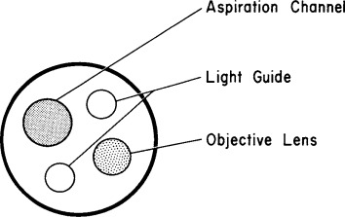
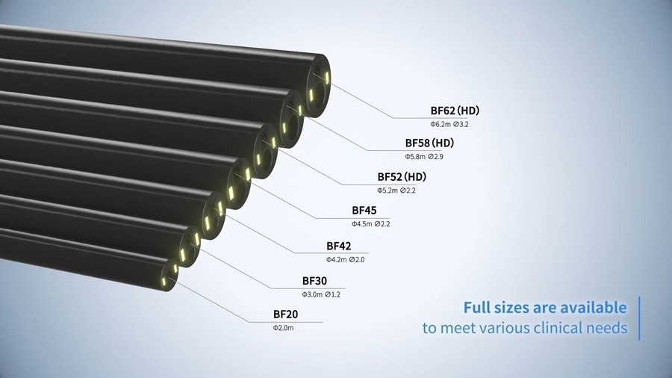
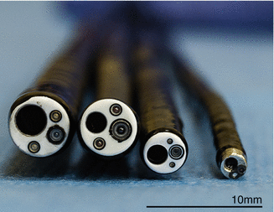

Slide 7
FLEXIBLE BRONCHOSCOPY
﻿﻿﻿2) Bronchoscopic light source and any related video or photographic equipment.
﻿3) Cytology brushes, flexible forceps, transbronchial aspiration needles, retrieval baskets (Compatibility of the external diameter of all scope accessories with the internal diameter of the bronchoscope should be verified before the procedure).
4) Specimen collection devices, fixatives, and as determined by institutional policies.
5) Syringes for medication delivery, normal saline lavage, and needle aspiration.
﻿6) Laryngoscope, endotracheal tubes in various sizes, thoracostomy set/tray and laryngeal mask airway.
7) ﻿Sterile gauze for intermittently clearing tip of bronchoscope during procedure.
﻿8) Water-soluble lubricant or lubricating jelly to apply in the nose and bronchoscope.
﻿9) Monitoring devices: Pulse oximeter, electrocardiographic monitoring equipment, sphygmomanometer and whole-body radiation badge for personnel if fluoroscopy is used

Slide 8
FLEXIBLE BRONCHOSCOPY
9. Procedure room equipment:
﻿﻿Oxygen and related delivery equipment.
﻿﻿Medical vacuum systems (wall or portable) and related suction supplies for scope or mouth.
﻿﻿Adequate ventilation and other measures to prevent transmission of tuberculosis.
﻿﻿Protease enzymatic agent (e.g., protozyme) or detergent for cleaning and removal of blood and protein before disinfection or sterilization.
﻿﻿High-level disinfection or sterilization agent: 2% alkaline glutaraldehyde (e.g., Cidex, Metracide, Sonacide, Glutarex) or ethylene oxide for sterilization of bronchoscope.

Slide 9
FLEXIBLE BRONCHOSCOPY
Medications: Following medicines should be available in the procedure room.
﻿﻿Topical anesthetic (lidocaine 1%, 2%, 4%)
﻿﻿Anticholinergic agent to reduce secretions and minimize vaso-vagal reflexes (atropine, glycopyrrolate
﻿﻿Sedative agent 30-45 min prior to the procedure (e.g., midazolam, morphine, hydroxyzine) and intravenous sedative immediately prior to and/or during the procedure (midazolam, propofol, diazepam, fentanyl)
﻿﻿Sterile nonbacteriostatic 0.9% NaCI solution for bronchial washings or lavage.
﻿﻿Vasoconstrictor for bleeding control (dilute epinephrine, usually 1:10,000).
﻿﻿Inhaled B agonist (salbutamol)
﻿﻿Water-soluble lubricant, or combined lubricant/anesthetic (viscous lidocaine)

Slide 10
FLEXIBLE BRONCHOSCOPY
MONITORING
Patient monitoring should be done at regular intervals before and after bronchoscopy. The
following should be monitored continuously, until the patient returns to his pre sedation level of :
﻿Level of consciousness, medications administered, dosage, route, and time of delivery.
﻿Blood pressure, breath sounds, heart rate, rhythm, and changes in cardiac status.
﻿SPo2 monitoring, broncoscopy should not be done when SPO2 is at room air below 92%.
﻿Chest radiograph one hour after transbronchial biopsy to exclude pneumothorax.

Slide 11
FLEXIBLE BRONCHOSCOPY
INDICATIONS
Diagnostic indications:
Currently, the major indications for diagnostic bronchoscopy include lung mass, nodule, suspected cancer, lung infiltrates, or suspected opportunistic lung infection. The increasing number of organ transplant recipients and immunocompromised patients who develop pulmonary complications has led an increased number of diagnostic bronchoscopies. However, the wide clinical application of HRCT scanning and VATS for lung biopsy has resulted in a decreased number of diagnostic bronchoscopies in patients with diffuse interstitial lung diseases.

Slide 12
FLEXIBLE BRONCHOSCOPY
Diagnostic indications for bronchoscopy :
Investigation of symptoms | Investigation of suspected neoplasm
Hemoptysis | Unexplained paralysis of vocal cords or hemidiaphragm
Persistant cough | Localized monophonic wheeze
Recurrent infection | Suspicious sputum cytology
Stridor | Unexplained pleural effusion
 | Mediastinal tissue diagnosis and staging
 | Assess for lung resection
 | Staging of lung carcinoma
Assessment of recurrent infection | Assessment of diffuse lung disease
Identification of organisms by BAL , TBLB . | Interstitial lung disease
Evaluate the airway abnormality in persistant infection ( obstruction ) | Drug induced lung disorders

Slide 13
FLEXIBLE BRONCHOSCOPY
B. Therapeutic bronchoscopy
Therapeutic bronchoscopy is traditionally performed for malignant disease. However there is some benign condition where therapeutic bronchoscopy is indicated for example emphysema and bronchial asthma.
Indications for therapeutic bronchoscopy
Pulmonary toilet
Removal of foreign body
Removal of Endobronchial tissue by brachytherapy , laser , photodynamic therapy, cryotherapy and electrosurgery
Stent placement
Drainage of abscess
Shield of persistent air leak in pneumothorax
Intralesional injection
Intubation
Airway maintenance in hemoptysis
Bronchial thermoplasty

Slide 14
FLEXIBLE BRONCHOSCOPY
PROCEDURE
﻿﻿﻿The patient should fast for at least 4 hr prior to the procedure.
﻿﻿﻿The oropharynx is anesthetized with 4% xylocaine or nebulize with 4% xylocain for 15 to 20 minutes with jet nebulizer and the nasal passage with 2% lidocaine.
﻿﻿﻿Venous access should always be secured before the procedure.
﻿﻿﻿Oxygen saturation should be checked before the procedure, if required oxygen should be administered via a single nasal cannula.
﻿﻿﻿The patient should be placed in supine position.
﻿﻿﻿Generally bronchoscopy is performed without sedation, but some patients may require conscious sedation.
﻿﻿﻿In the nasal approach, the bronchoscope is lubricated with 2% lidocaine gel and passed through the nares under direct vision. It is then inserted in to the nasopharynx until the epiglottis is visualized.

Slide 15
FLEXIBLE BRONCHOSCOPY
8. The movement of the vocal cords is assessed, and they are then anesthetized using 2 ml 1% lidocaine, and the vocal cords are examined for abduction and adduction and for any pathology.
9.﻿ After examination of vocal cords the bronchoscope is advanced through the widest part of the glottis and taking care not to touch vocal cords.
10. When bronchoscope is in the trachea further 2 ml of 1% lidocaine is administered in the trachea, carina and right and left main bronchi.
11. Then advancing the bronchoscope first in right bronchus then left. The airways are carefully inspected down to the subsegmental level for the presence of endobronchial lesions or mucosal abnormalities.

Slide 16
FLEXIBLE BRONCHOSCOPY
(Contraindications)
Absolute Contraindications | Relative contraindications
Uncooperative patient | Malignant arrhythmia
Hypoxia patient (SpO2) | Unstable Angina
 | Bleeding diathesis
Factors associated with increased risk of complications
Unconscious patient
Recent unstable angina
Moderate hypoxemia or hypercarbia
Pulmonary hypertension immunosuppression
Superior Vena cava obstruction

Slide 17
FLEXIBLE BRONCHOSCOPY
COMPLICATIONS
The adverse effects of flexible bronchoscopy may be due to the sedation, the local anesthesia or may be due to procedure. The overall incidence of complications is about 2% and mortality from the procedure is less than 0.02%
Complications of flexible bronchoscopy
Sedative use in procedure | Lignocaine related
Respiratory depression | Bradycardia
Cardiovascular effects (hypotension ) | Seizures
 | Bronchospasm
 | Laryngeal spasm
Procedure related complication
Bronchospasm
Laryngospasm
Hypoxemia
Cardiac arrhythmia

Slide 18
TRANSBRONCHIAL LUNG BIOPSY
PREREQUISITES
﻿Establish the indication of TBLB
﻿Informed consent should be obtained from the patient after details of the procedure, goals and risks are explained.
Ask the patient about the presence of familial or acquired hemorrhagic diathesis.
﻿Check all coagulation profiles, serum creatinine before the procedure.
5. Procedure should be abandoned if there is:
﻿Haemoglobin <10 gm%
﻿Platelet count <50,000
﻿Serum creatinine > 3 mg/dl
﻿Serum urea level of >30 mg/dI
﻿SPO2 <90%
6. ﻿Routine pulmonary function testing and ABG before TBLB are generally not necessary
7. Special imaging procedures such as HRCT are helpful in identifying the abnormal area to be biopsied.

Slide 19
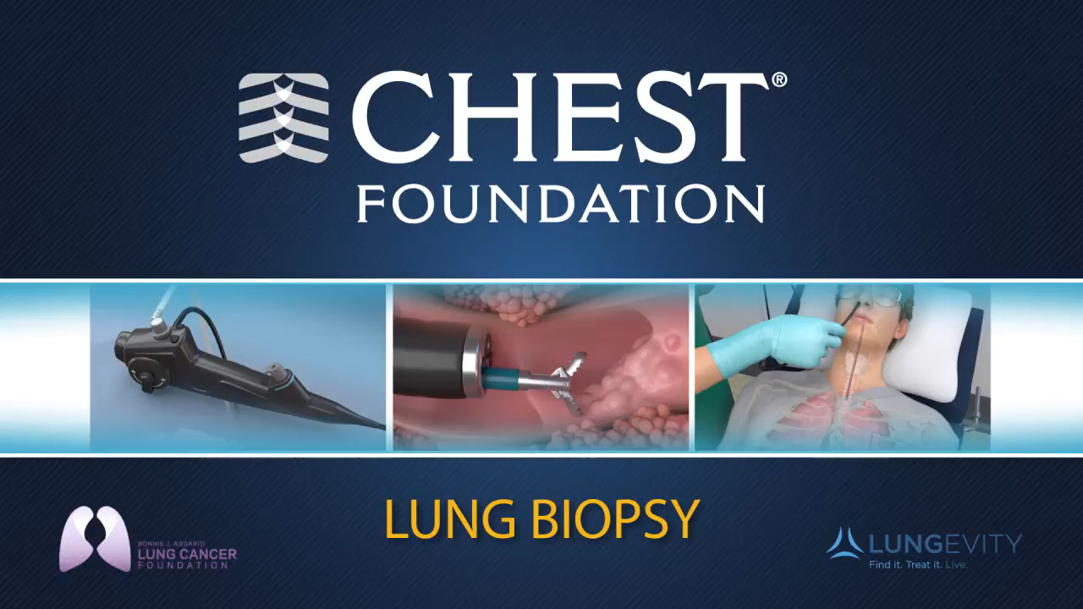

Slide 20
TRANSBRONCHIAL LUNG BIOPSY
PROCEDURE
﻿﻿﻿The preparation of the patients, premedications and sedation for TBLB is similar to that for routine bronchoscopy.
﻿﻿﻿Cough suppression is especially important during TBLB and administration of optimal sedation and cough syrup may be necessary.
﻿﻿﻿Bronchoscopy examination is performed in the usual manner and both bronchial trees are thoroughly examined prior to TBLB.
﻿﻿﻿The scope is then maintained in this wedged position while biopsy forceps is advanced through the working channel of the scope.

Slide 21
TRANSBRONCHIAL LUNG BIOPSY
5. When the distal end of the forceps exits the distal end of the scope, the forceps is further advanced distally until its tip is beyond bronchoscopic visualization.
6. If fluoroscopy is available the fluoroscopic image is projected on the monitor. When the lesion is localized the biopsy forceps is opened 5 to 6 mm proximal to the area to be biopsied and advanced to the lesion and then closed.
7. When forceps is in closed position ask the patient if any pain is experienced. If the patient indicates pain, the forceps is opened and withdrawn proximally without taking biopsy and then attempted in another area.
8. After taking biopsy the biopsy forceps is withdrawn gradually and the scope is maintained in the wedged position.
9. If bleeding occurs during the procedure, to minimize bleeding the scope is maintained in the wedged position with slow instillation of 10 to 15 ml of iced saline.
10. ﻿After the TBLB is completed and there is no bleeding, the scope is withdrawn proximally and the patient is asked to cough gently to see if this induces bleeding or not.
11. Chest radiograph should be done after one hour in every patient after completion of the procedure, and instructions should be given to the patient to contact physician if new symptoms develop.

Slide 22
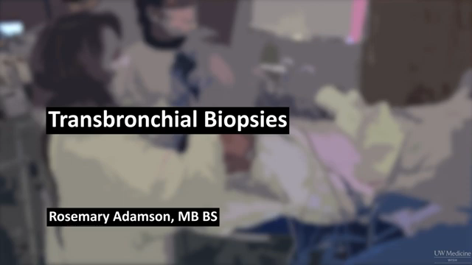
TRANSBRONCHIAL LUNG BIOPSY

Slide 23
TRANSBRONCHIAL NEEDLE ASPIRATION
Transbronchial needle aspiration is a minimally invasive procedure that provides a nonsurgical means to diagnose and stage bronchogenic carcinoma by sampling the mediastinal lymph nodes.
In TBNA a fine needle is inserted through the wall of the airway into a lymph node in order to obtain a specimen for cytological, histological or microbiological analysis. The procedure can be performed with or without the use of ultrasound guidance.

Slide 24
TRANSBRONCHIAL NEEDLE ASPIRATION
INDICATIONS
Indication of TBNA is diagnosis and staging of malignancy involving in mediastinal lymph nodes, submucosal, endobronchial, and parenchymal masses. Diagnostic information may also be obtained in the same locations for many benign conditions, including sarcoidosis, tuberculosis and fungal disease.
1. Mediastinal and/or hilar lymphadenopathy
﻿To establish the diagnosis
﻿For staging of known or suspected bronchogenic carcinoma
2. Endobronchial lesions
• Especially in case of necrotic tumor, hemorrhagic tumor or to predict the line of surgical resection.
﻿Extrinsic compression of the airway by peribronchial process.
﻿Submucosal disease.
﻿Peripheral nodules/masses.
﻿Follow-up of small-cell tumors, lymphoma.
﻿Diagnosis and/or drainage of mediastinal cysts and/or mediastinal abscesses.

Slide 25
TRANSBRONCHIAL NEEDLE ASPIRATION
EQUIPMENT
All needle systems for transbronchial aspiration consist of:
﻿A retractable sharp beveled flexible needle
﻿A flexible catheter
﻿A proximal control device to manipulate the needle, the stylet, or both, and a side port through which suction can be applied
For lesions located outside the airway wall, the needle should be at least 10 mm in length.
The 20 to 22-gauge needles are usually used to obtain cytology specimens. Due to the nature of the procedure, the catheter used should be flexible enough to be maneuverable into more peripheral locations and should be stiff enough to exert force to penetrate the thick proximal bronchial wall.
A metal stylet provides the necessary stiffness to the flexible catheter. A needle, 15 mm in length and 21- gauge in diameter is necessary for the aspiration of a mediastinal abscess or cyst.

Slide 26
TRANSBRONCHIAL NEEDLE ASPIRATION
PROCEDURE
﻿﻿﻿Before doing the procedure, routine coagulation profile, ECG, chest radiograph and preferable computed tomography (CT scan on the chest should be ready. Chest radiograph and computed tomography (CT) scans of the chest should be thoroughly reviewed to locate nodules, masses and mediastinal lymph node involvement before TBNA. This should help to select the proper site for needle puncture.
﻿﻿﻿After proper checking of needle and catheter, the device is then introduced in to the working channel of the bronchoscope and smoothly threaded until the metal hub at the distal end of the catheter is observed to protrude beyond the distal end of the flexible bronchoscope and is in the field of view.
﻿﻿﻿To prevent damage to the working channel of the flexible bronchoscope by the needle, the flexible bronchoscope should be kept as straight as possible, with its distal tip in the neutral position during catheter insertion. The bevelled end of the needle must be secured within the metal hub during its passage through the working channel.
The needle is advanced and locked in place only after the metal hub is visible beyond the tip of the flexible bronchoscope. The catheter can then be retracted keeping the tip of the needle distal to that of the flexible bronchoscope.

Slide 27
TRANSBRONCHIAL NEEDLE ASPIRATION
5. With the puncture site identified, the scope with needle tip protruding is advanced to the target and the tip of the bronchoscope flexed toward the puncture point.
6. When the bronchoscope is fixed at the patient's nose or mouth, the operator advance the catheter with a quick thrusting motion allowing the needle to penetrate the intercartilaginous space.
7. The following techniques may be used to insert the needle through the airway wall :
a.) Jabbing method
The needle is thrust through the intercartilaginous space with a quick, firm jab to the catheter, while the scope is fixed at the nose or mouth;
b.) Hub against the wall method
With the needle in the retracted position, the distal end of the catheter can be placed directly in contact with the target and held firmly while the needle is pushed out of the catheter for its spontaneous penetration through the tracheobronchial wall.

Slide 28
TRANSBRONCHIAL NEEDLE ASPIRATION
c.) Piggyback method
Once the needle is advanced and locked in position, the catheter is fixed against the proximal end of the insertion port, using the index finger in a single port scope or the little finger in a dual port scope, to prevent recoil when resistance is met; the bronchoscope and catheter are then pushed forward as a single unit, until the entire needle penetrates the tracheobronchial wall.
d.) Cough method
While applying the jabbing or piggyback technique, the patient is asked to give a hard cough for the spontaneous penetration of the needle.
All of these techniques can be used alone or in combination for successful penetration of the needle through the tracheobronchial wall.
8. With the needle inserted, suction is applied at the proximal sideport using a 50 ml syringe.
Aspiration of blood indicates inadvertent penetration of a major intrathoracic vessel, suction is released, the needle is retracted, and a new site is selected for aspiration.

Slide 29
TRANSBRONCHIAL NEEDLE ASPIRATION
9.When there is no blood in the aspirate, the catheter is agitated to and fro, with continuous
suction, in an attempt to shear off cells from the mass or lymph node.
a. Sampling of peripheral lesions is best performed by placing the metal hub of the needle
against the lesion, under fluoroscopic guidance, before pushing the needle into the lesion.
b. For lesions more difficult to reach, the needle may be advanced in a major airway and then guided into the lesion under fluoroscopy.
c. Sampling of endobronchial lesions may be performed by embedding the needle in the lesion, to the metal hub, parallel to the airway wall, and agitating to and fro repeatedly, with continuous suction.
10. The needle is withdrawn from the target site after releasing suction. The tip of the bronchoscope is straightened and the needle assembly is pulled out of the bronchoscope in a single, smooth motion.

Slide 30
TRANSBRONCHIAL NEEDLE ASPIRATION
11. ﻿The specimen for cytology is prepared by using air from a 50 ml syringe to 'blow' the specimen on to the slide before smearing it using another slide and immediately placing it in 95% alcohol. The specimen is then flushed from the needle using 3 ml of saline and sent to the cytology lab for processing.
COMPLICATIONS
﻿ Most important complication following TBNA is related to damage to the working channel of the bronchoscope.
﻿ Post procedure fever.
﻿ Pneumothorax occurs with TBNA of peripheral lesion.
﻿ Haemomediastinum
5. Oozing of a minimal amount of blood from the puncture site. Oozing represents dilated blood vessels in the tracheobronchial wall rather than invasion of a major vascular structure.

Slide 31
RETROSPECTIVE COHORT STUDY
ABSTRACT
Introduction: Making the diagnosis of HP is challenging due to a lack of consensus criteria and variability of both pathologic and radiographic findings. The purpose of this retrospective study was to determine the diagnostic utility of the combination of BAL lymphocyte count and TBBX in patients with HP.
Methods: We conducted a retrospective cohort study of all patients with a MDD diagnosis of HP at a single center.
Results: 155 patients were included in the study. 49% of patients who underwent BAL had a lymphocyte count > 20, 42% had a lymphocyte count > 30, and 34% had lymphocyte count > 40%. The median BAL lymphocyte count was higher in inflammatory HP compared to fibrotic HP. The addition of TBBX to BAL significantly increased the diagnostic yield regardless of the BAL lymphocyte cutoff used. The yield of bronchoscopy with TBBX and BAL when a lymphocyte count > 40% was used as a cutoff was 52%.

Slide 32
RETROSPECTIVE COHORT STUDY
Conclusions: Our study suggests that the combination of TBBX with BAL significantly increases the likelihood that the procedure will provide adequate additional information to allow a confident MDD diagnosis of HP and may reduce the need for SLB in the diagnostic workup of HP.

Slide 33
THANK YOU

