Slide 1
OPPORTUNISTIC INTESTINAL COCCIDIANPARASITIC INFECTIONS
Dr Sucheta Lakhani
Professor
Department of Microbiology

Slide 2
Case
A 32-year old man with known HIV infection is brought to the hospital with diarrhea.he has had between 15 and 25 watery stools a day for the past 2 weeks. He has had a low grade fever and felt very fatigued but denies vomiting. He has not passed any blood in his stool. He says that he has lost 8 pounds in this time frame. His last CD4 cell count was150cells/mm3.On examination, his temperature is 98.9F.pulse is 110 beats/minute, blood pressure is 95/75mm Hg, and respiratory rate is 24breaths/minute. In general, He appers cachectic . His eyes are dry and sunken. His mucous membranes are moist. His cardiovascular examination is notable for tachycardia .Modified acid-fast stained stool sample reveals multiple red and pink, round oocysts.
What is the most likely cause of diarrhea?
How is the infection most commonly Acquired?

Slide 3
OPPORTUNISTIC INTESTINAL COCCIDIAN
PARASITIC INFECTIONS
Cryptosporidium, Cyclospora, and Cystoisospora are the intestinal coccidian parasites - cause opportunistic infections in HIV infected patients producing profuse watery diarrhea.
Diagnosed by detection of acid fast oocysts in stool microscopy

Slide 4
OPPORTUNISTIC INTESTINAL COCCIDIAN
PARASITIC INFECTIONS
Cryptosporidium species infecting man – classified as two separate species, C. parvum (mammals, including humans) and C. hominis (primarily humans).
Cyclospora cayetanensis - recently described coccidian parasite, as human intestinal pathogen.
Isospora belli - recently renamed as Cystoisospora belli - only species that infects man.

Slide 5
MORPHOLOGY
The life cycle of coccidian parasites passes through various stages - oocyst, trophozoite, schizont (meront), merozoite, and zygote.

Slide 6
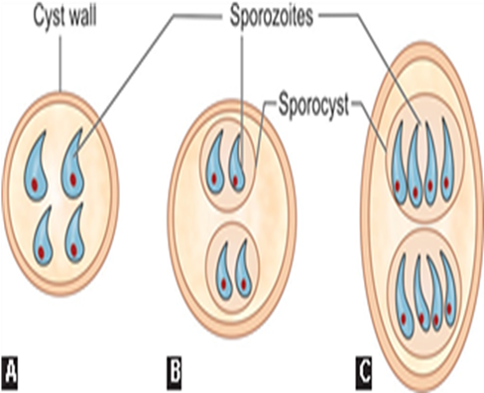
Oocyst
Oocyst is the infective form to man as well as the diagnostic form excreted in the feces.
It is round to oval,surrouned by a cyst wall and bears sporozites.
The oocysts are acid fast in nature but do not satin by iodine.
They are extremely resistance to routine chlorination, heat and other disinfection.

Slide 7
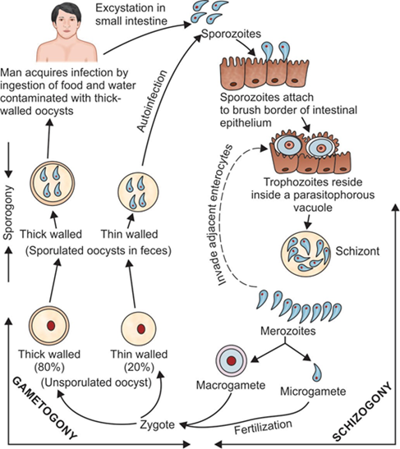
LIFE CYCLE
Infective stage: Sporulated oocyst (both thick- walled and thin-walled)
Transmission: Ingestion
autoinfection

Slide 8
The life cycle of cyclospora and cystoisospra are similar to cryptosporidium but with following difference.
Autoinfection is not observed.
The oocyst released in the human feces are unsporulated.
The sporulation of oocyst takes place in the soil(environment) whereas in cryptosporidium ,the sporulation of oocyst takes place in the human intestine.

Slide 9
Why cryptosporidiosis occur more frequently than cyclosporiasis and cystoisosporiasis?
Low infective dose of cryptosporidium(10-100 oocysts can initiate the infection)
Small size of the oocyst(4-6µm)
Oocysts are resistance to the available drugs and disinfectants including chlorination.
Large animal and human reservoir.
Zoonotic contact.

Slide 10
CLINICAL FEATURES
Immunocompetent Hosts:
Majority of infections - asymptomatic.
Some individuals develop symptoms - average incubation period of about 1 week.
Watery non-bloody diarrhea - common presentation.
Abdominal pain, nausea, anorexia, fever, and/or weight loss may be present
Self-limiting - subsides within 1–2 weeks

Slide 11
CLINICAL FEATURES
Immunocompromised Hosts (e.g. AIDS):
Chronic, persistent profuse diarrhea (1–25 L/day).
Severe weight loss, wasting and abdominal pain .
Extraintestinal manifestations - biliary tract infection (sclerosing cholangitis), respiratory tract infection, and pancreatitis
Disease is more severe in patients with AIDS when CD4+ T cell counts become <100/μL

Slide 12
CLINICAL FEATURES
Immunocompromised Hosts (e.g. AIDS) (Cont..):
Other immunocompromised conditions – severe combined immunodeficiency syndrome, hematological malignancies and solid organ transplant recipient
Disease - more severe in Cryptosporidium than Cyclospora and Cystoisospora - attributed to autoinfection seen in the former—a key factor for maintaining the infection, resulting in chronic persistent diarrhea.

Slide 13
LABORATORY DIAGNOSIS
Direct Microscopy (Stool Examination)
Sample collection: Three stool samples should be collected. Rarely (in HIV positive patients), sputum, bronchial wash, duodenal or jejunal aspirate can be collected
Direct wet mount: Highly refractile, double-walled oocyst
Concentration technique: If the oocyst load is less, then various techniques are used to concentrate the stool sample
Acid-fast staining: Oocysts are acid-fast to 0.5–1% sulfuric acid or acid alcohol and appear as red color oocysts against blue back ground
Kinyoun’s method (cold acid-fast staining) is the method of choice.

Slide 14
LABORATORY DIAGNOSIS
Direct fluorescent antibody staining: Available for cryptosporidiosis - oocysts can be detected by using fluorescent labeled monoclonal antibody directed against cyst wall antigens.
Autofluorescence: Oocysts of Cyclospora fluoresce when viewed under ultraviolet epifluorescence microscopy.
Phase contrast microscopy

Slide 15
Oocyst
The oocysts of intestinal coccidian parasites are highly refractile,
double-walled, and acid-fast.
. Cryptosporidium: The oocyst is round, measures 4–6 μm in size, and contains four sporozoites.
. Cyclospora: The oocyst is round, measures 8–10 μm size, and contains two sporocysts, each comprising two sporozoites.
The oocysts are variably acid-fast.Oocysts also exhibit autofluorescence
. Cystoisospora: The oocyst is oval and larger, measuring 20–33 μm length; contains two sporocysts, each comprising four sporozoites.

Slide 16
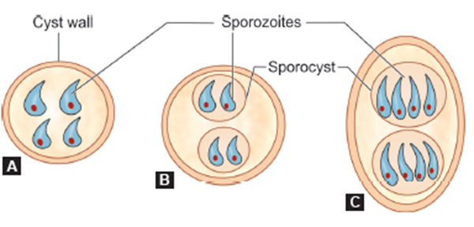

Oocyst

Slide 17
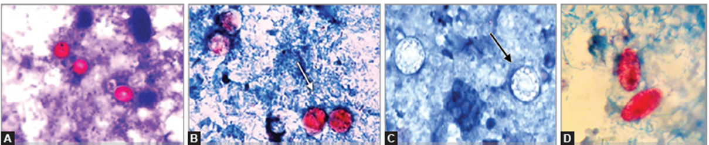
Oocyst
Acid-fast staining of stool specimen demonstrating oocysts of:
A. Cryptosporidium parvum (acid-fast, round, 4–6 μm);
B. Cyclospora cayetanensis (acid-fast, round, 8–10 μm);
C. Cyclospora cayetanensis (non-acid-fast, round, 8–10 μm);
D. Cystoisospora belli (acid fast, oval, 20–33 μm).

Slide 18
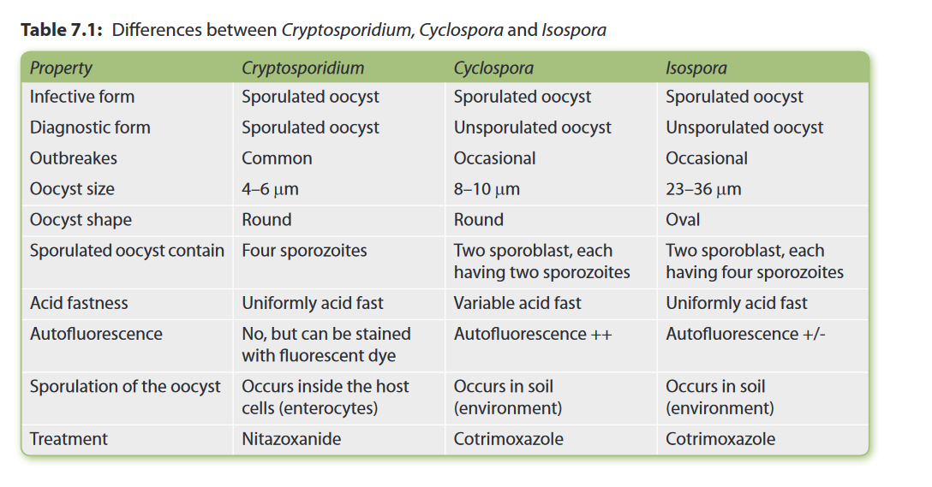

Slide 19
Antigen Detection from Stool
ELISA
ICT
Antibody Detection :
ELISA are available detecting antibodies in patient’s serum against oocyst antigens of Cryptosporidium or Cyclospora.
Useful for sero-epidemiological purpose, not for routine diagnosis.

Slide 20
Molecular Diagnosis
PCR or real-time PCR can be performed to detect specific genes from both clinical and environmental samples targeting genes such as 18S rRNA or small subunit rRNA.
BioFire FilmArray

Slide 21
Other Methods
Low CD4-T lymphocyte count (especially in HIV positive patient)
Fecal leukocyte marker—lactoferrin is increased in 75% of cases indicating increase pus cells in feces.

Slide 22
Treatment of Intestinal coccidian parasitic infections
Mild cases
Self-limiting, requires fluid replacement like ORS.
Lactose-free glutamine supplemented diet is preferred for cryptosporidiosis.
Severe cases
Cryptosporidiosis: Nitazoxanide is given to adults (for 3 days - not effective in HIV-infected patients. Paromomycin - alternate
Cyclosporiasis and cystoisosporiasis: Cotrimoxazole (for 7-10 days). Patients who cannot tolerate cotrimoxazole may be treated with ciprofloxacin or nitazoxanide.

Slide 23
Prevention
Requires minimizing exposure to infectious oocysts in human or animal feces.
Proper hand washing, use of submicron water filters, use of appropriate disinfectants/sterilant to kill the oocysts (such as hydrogen peroxide, steam sterilization), improved personal hygiene are some of the efforts to prevent transmission.

Slide 24
1.
A 33 year old women has chronic diarrhea . A fecal sample is obtained. Microscopic identification of which of the following stages of the organism would provide the strongest evidence for cryptosporidiosis?
A. Cyst
B. Oocyst
C. Egg
D. Sporocysts
F. Merozoites

Slide 25
2.
Chronic, debilitating cryptosporidiosis is most likely to affect which of the following individual?
A. Dairy farmers
B. Individuals with AIDS
C . Infants placed in day care centres
D. Hikers who drink from steams and lackes.

Slide 26
3.
Which of the following correct regarding cryptosporidium?
A. The infective stage is sporulated thick walled oocysts.
B. The parasite resides in the large intestine.
C. The life cycle takes place in two hosts
D. It commonly causes chronic diarrhea in immunecompetent persons.

Slide 27
4.
Sporulated oocyst of Isospora belli contains:
(a) One sporocyst and two sporozoites
(b) One sporocyst and four sporozoites
(c) Two sporocysts and four sporozoites
(d) Two sporocysts and eight sporozoites

Slide 28
5.
Which statement is false about Cryptosporidium parvum?
(a) Developmental stages of the parasite occur inside a parasitophorous vacuole
(b) High infective dose
(c) Large number of animal reservoir
(d) It causes diarrhea in AIDS patients.

Slide 29
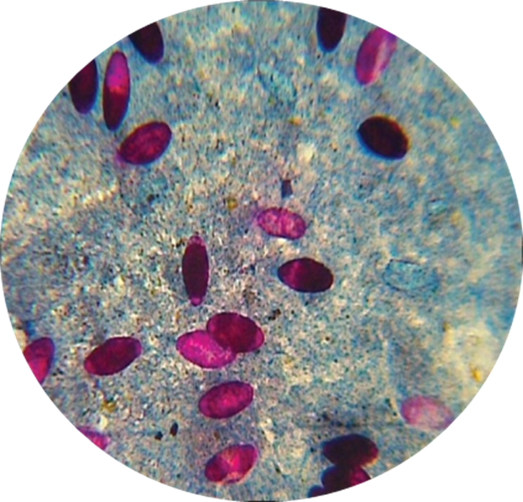
OSPE
Identify the staining technique.
Describe the morphology as per shown in image.
Acid-fast oocysts of Cystoisospora belli

Slide 30
Modification of acid-fast staining
Cold method (Kinyoun’s Method)- Intermittent heating not required
Acid alcohol – decolorizer
Malachite green – counterstain
Concentration of sulphuric acid (more content of mycolic acid in the cell wall, more acid fastness, more % of sulphuric acid needed)

Slide 31
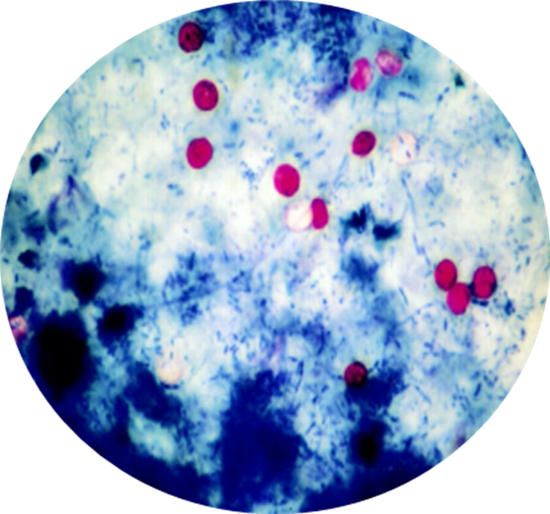
OSPE
Identify the staining technique.
Describe the morphology as per shown in image.
Acid-fast oocysts of Cryptosporidium spp.

