Slide 1
BACTERIAL MENINGITIS
DR HIMANI PANDYA

Slide 2
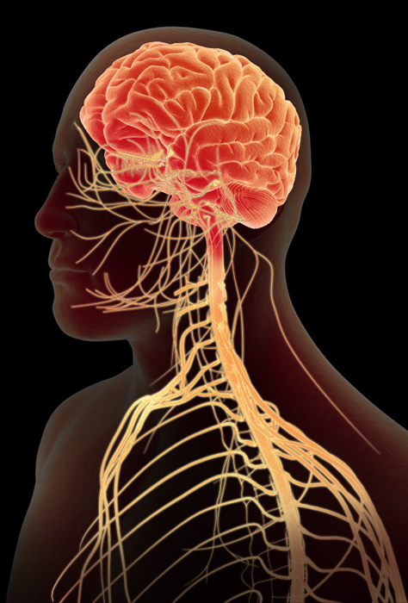
INFECTIONS OF THE CENTRAL NERVOUS SYSTEM
1. Meningitis: Inflammation of the meninges
Acute:
  Pyogenic—bacterial origin
  Aseptic—viral origin
Chronic: Tubercular or fungal
2. Encephalitis: An inflammation of brain tissue; generally of viral etiology
3. Meningoencephalitis: Inflammation affecting both the meninges and the brain tissue, as is caused by free-living amoebae
4. Focal infections in the brain—brain abscess and subdural empyema
This Photo by Unknown Author is licensed under CC BY-SA-NC

Slide 3
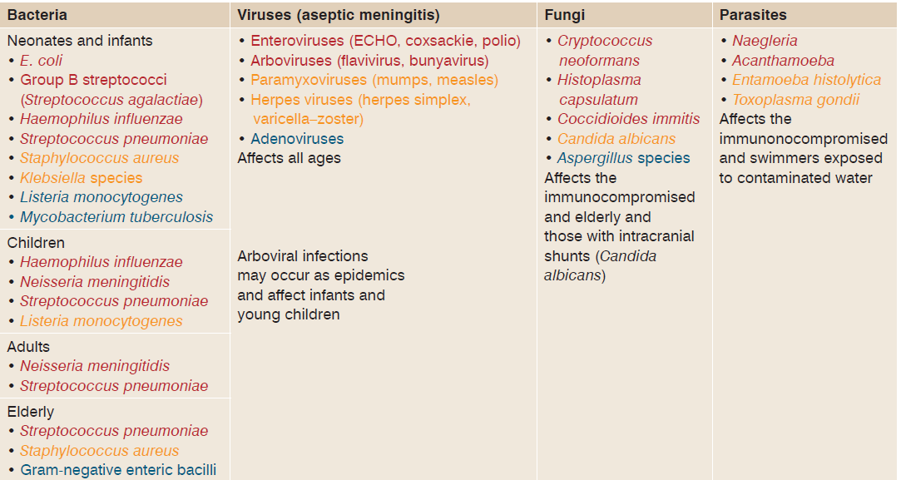
Table 23.1 Microorganisms that cause meningitis

Slide 4
ETIOLOGY
Etiologically, meningitis may be of the following types:
Pyogenic meningitis of bacterial origin caused by pyogenic organisms
Tuberculous (caused by Mycobacterium tuberculosis)
Fungal (caused by Cryptococcus)
Aseptic meningitis (caused by viruses)

Slide 5
Meningitis is a life-threatening infection of the leptomeninges (arachnoid and pia mater) surrounding the brain and spinal cord, with involvement of the subarachnoid space. The disease can be Caused by several pathogens including bacteria, viruses, fungi or parasites.
Highest global burden is seen with bacterial meningitis.

Slide 6
ACUTE BACTERIAL MENINGITIS
Acute bacterial meningitis (also called as pyogenic meningitis), is an acute purulent infection within the subarachnoid space. It is
Characterized by elevated polymorphonuclear cells in CSF.
Agents implicated in pyogenic meningitis - vary according to the age.
Overall: Streptococcus pneumoniae - most common. Other agents include meningococcus, Streptococcus agalactiae, Listeria and Haemophilus influenzae.
Neonates: Streptococcus agalactiae, gram-negative bacilli - Escherichia coli and Klebsiella, and Listeria monocytogenes.
Elderly (>60 years): Streptococcus agalactiae and Listeria monocytogenes.

Slide 7
Transmitted from person-to-person through droplets of respiratory secretions from cases or nasopharyngeal carriers.
Close and prolonged contact—kissing, sneezing or coughing on someone - with an infected person facilitate the spread of the disease.
ROUTES OF TRANSMISSION
Hematogenous spread- Most common- through choroid plexus
Direct spread from an infected site- Otitis media, Mastoiditis, Sinusitis etc.
Anatomical defect in central nervous system (CNS)- Trauma, Result of any surgery, Congenital

Slide 8
Predisposing factors
Age: Neonates have the highest prevalence- immature immune system, increase in permeability of BBB, Congenital infection(S. agalactae, Listeria).
Vaccination: H.influenza, N. meningitidis, S. pnuemoniae
Primary site: Respiratory site- Alcoholism, Diabetes, Immunosupression etc
Presence of CSF shunts: entry of Staphylococcus, Pseudomonas, Acinetobacter
Breach in BBB

Slide 9
CLINICAL MANIFESTATIONS
Average incubation period - 4 days, range 2 and 10 days.
Important symptoms - fever, vomiting, intense headache, altered consciousness and occasionally photophobia.
Signs of meningism (meningeal irritation):
  Nuchal rigidity (“stiff neck”)- Pathognomic sign of meningeal irritation
  Kernig’s sign- stiffness of hamstrings, inability to straighten the leg when the hip is flexed to 90 degrees
  Brudzinski’s sign: neck is passively flexed, spontaneous flexion of hips and knees.

Slide 10
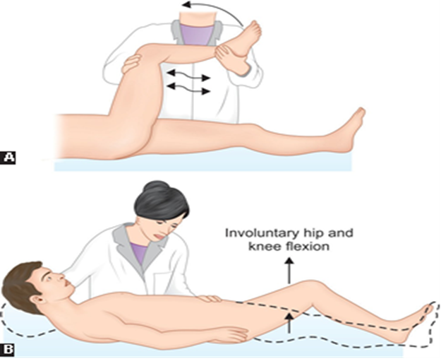
A- KERNIG SIGN, B IS BRUDZINKI SIGN

Slide 11
LABORATORY DIAGNOSIS

Slide 12
CASE 1:
A 5 yrs old child was brought to emergency department with the history of seizures, with high grade fever. on examination he had altered sensorium and neck rigidity with positive kernig’s sign
A lumbar puncture was performed
CSF was sent to the laboratory for various investigations
Gram’s stain: GPC- Lanceolate shape diplococci with pus cells
Culture: alpha haemolytic colonies on BA, optochin sensitive, draughtman’s colony
What is your provisional diagnosis? and what is the most likely etiological agents?
What are the other investigations done from CSF?
Explain the pathogenesis and Laboratory diagnosis of the above disease

Slide 13
CASE 2:
A 5 yrs old girl going to the Day care centre, suddenly develops high grade fever with Headache, Stiff neck and double vision. The vaccination status was unknown.
CSF samples were collected
CSF examination showed GNC intracellular Diplococci were seen in Gram’s staining
1. What is your Provisional diagnosis?
2. Write the laboratory diagnosis of the above condition

Slide 14
LABORATORY DIAGNOSIS
Specimen
CSF
Blood (culture; especially in neonates)
Automated rapid culture methods
Serology (for viral serology)
Urine (for antigen detection)
Fig. 23.2 Algorithm of the approach to the diagnosis of meningitis

Slide 15
CSF COLLECTION AND TRANSPORT
CSF - most ideal specimen for pyogenic meningitis. The cerebrospinal fluid (CSF) is contained in the brain ventricles and the cranial and spinal subarachnoid spaces. The mean CSF volume is 150 ml, with 25 ml in the ventricles and 125 ml in subarachnoid spaces
Blood culture - another useful specimen for culture.
CSF collection 30 MIN: CONSENT
Lumbar puncture under strict aseptic conditions at L3-L4 interspace.
It is divided into three sterile containers; one each for cell count, biochemical analysis and bacteriological examination
CSF transport: Should be examined immediately
When the bacteriological examination (culture) is required - CSF should never be refrigerated - if a delay is expected - kept in an incubator at 37°C.
For molecular diagnosis - CSF can be kept inside the freezer.

Slide 16
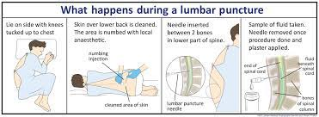

Slide 17
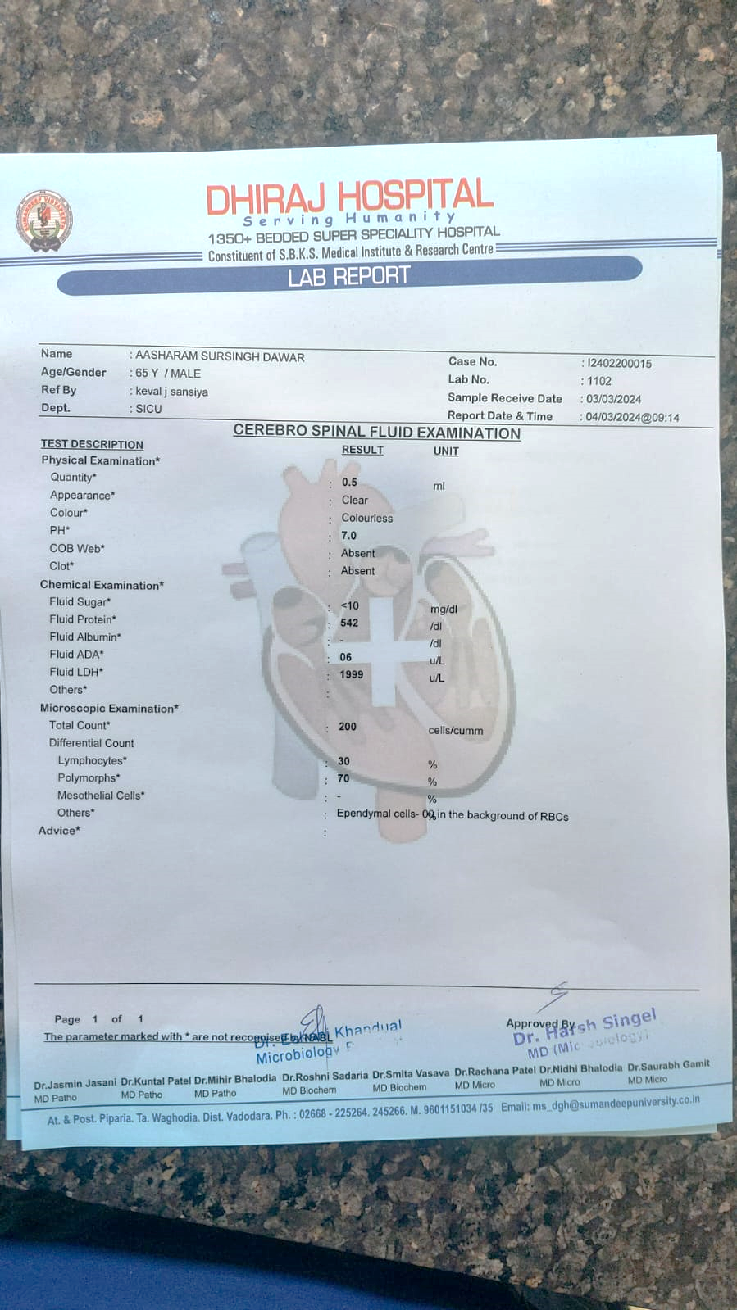

Slide 18
Characteristics | Normal individual | Pyogenic meningitis | Tuberculous meningitis | Viral meningitis
CSF pressure (mm of water) | Normal (50–150) | Highly elevated (>180) | Moderately elevated | Slightly elevated/normal
Total leukocyte count (per mm3) | 0–5 | 100–10,000 | 10–500 | 25–500
Predominant cell type | Lymphocytes | Neutrophils | Lymphocytes | Lymphocytes
Glucose (mg%) | 40–70 | <40 mg/dL (decreased to absent) | 20–40 mg/dL (slightly decreased) | Normal
Total proteins (mg%) | 15–45 | >45 mg/dL (usually >250; markedly increased) | 100–500 mg/dL (moderate to markedly increased) | 20–80 mg/dL (normal or slightly elevated)

Slide 19
Appearance in CSF gram stain | Suggestive of
Gram-positive cocci in pair, capsulated, flame or lanceolate-shaped Gram-positive diplococci, flame or lanceolate-shaped with clear halo (capsulated) | Streptococcus pneumoniae
Gram-negative diplococci, capsulated, with adjacent sides flattened (lens or half-moon shaped) | Neisseria meningitidis
Pleomorphic gram-negative coccobacilli, capsulated | Haemophilus influenzae
Gram-negative bacilli, arranged singly | Escherichia coli or others
Gram-positive cocci in short chain | Streptococcus agalactiae
Gram-positive short bacilli | Listeria monocytogenes

Slide 20
SEROLOGY
From CSF: After centrifugation – supernatant - used for antigen detection. Latex agglutination test - performed using latex beads coated with anti-capsular antibodies
From urine: Useful for pneumococcal meningitis. Immunochromatographic test (ICT) - detect the C-polysaccharide antigen of S. pneumoniae in urine

Slide 21
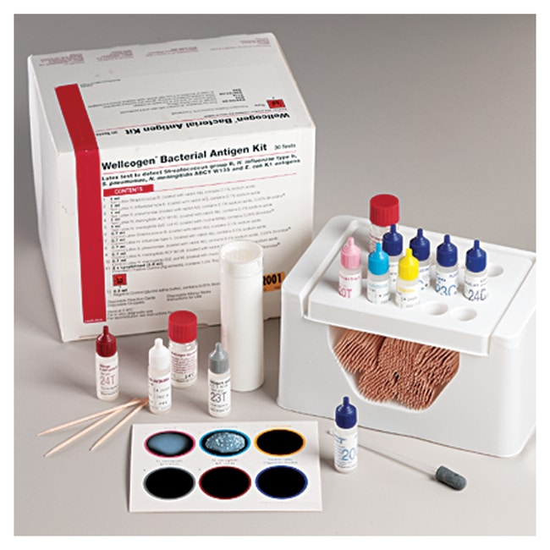
Detection of antigen from
Streptococcus group B,
Haemophilus influenzae type b,
Streptococcus pneumoniae
Neisseria meningitidis (meningococcus) groups A, B, C, Y or W135
Escherichia coli K1 present in cerebrospinal fluid (CSF) as a consequence of infection.

Slide 22
CULTURE
Ideal media for bacteriological culture of CSF are enriched media like chocolate agar and blood agar, and differential media like MacConkey agar
Enriching: As the bacterial load is very low - part of the CSF - inoculated into enriched media - blood culture bottles at the bed side (preferred) or brain heart infusion (BHI) broth in the laboratory
Blood culture can be collected in conventional blood culture bottles - BHI broth/agar or preferably in automated blood cultures (e.g. BacT/ALERT)
Culture plates (blood agar and chocolate agar) are incubated at 37°C, preferably in candle jar (provides 5% CO2) for 48 hours

Slide 23
Streptococcus pneumoniae- Lanceolate Culture: It produces α-hemolytic colonies on blood agar, described as draughtsman-shaped or carrom coin appearance Biochemical identification: It shows bile soluble, ferments inulin and sensitive to optochin
Neisseria meningitidis- Gram stain from CSF Supernatant: serology(Important in partially treated patient) It produces non- hemolytic colonies on blood agar, which on smear shows gram-negative diplococci Blood culture: Meningococcemia: early cases Selective media: Thayer martin with vancomycin, Colistin and Nystatin Biochemical identification: Meningococci are catalase and oxidase positive. They ferment glucose and maltose but not sucrose Serogrouping: Slide agglutination serogrouping (SASG) test is done to identify the serogroups of meningococci isolates by using appropriate antisera

Slide 24
Pneumococcal Meningitis
Streptococcus pneumoniae (or pneumococcus) - leading cause of meningitis in adults (>20 years of age),
Also the most common agent of pneumonia.
Present as commensals in human nasopharynx - spread locally to cause otitis media or pneumonia – bloodstream to distant sites - invasive pneumococcal disease - bacteremia and meningitis

Slide 25
Pneumococcal Meningitis (Cont..)
Principle virulence factors – capsular polysaccharide, C-carbohydrate antigen, pneumolysin and autolysin.
Risk factors: Underlying pneumococcal pneumonia (most important) or otitis media, alcoholism, diabetes, splenectomy, complement deficiency, hypogammaglobulinemia, and head trauma

Slide 26
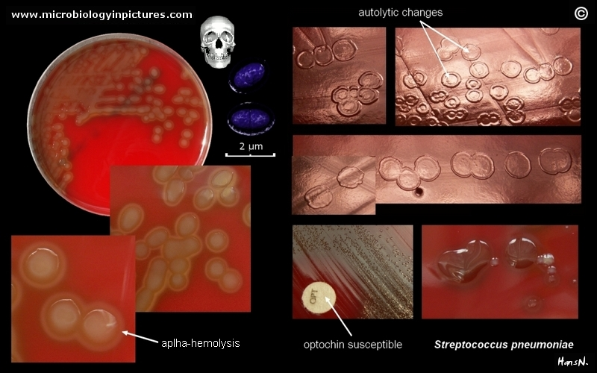
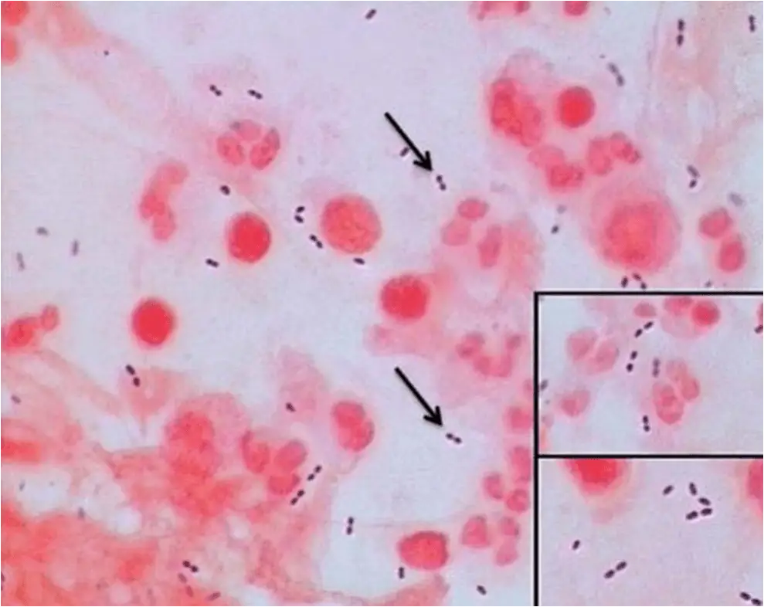
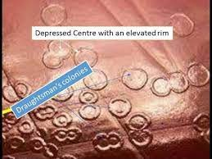

Slide 27
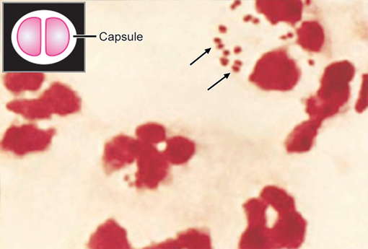
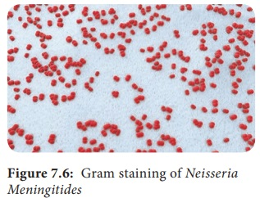
Meningococcal Meningitis
Caused by Neisseria meningitidis
(or meningococcus) – Intracellular capsulated gram-negative diplococci with adjacent sides flattened
(lens-shaped/half-moon shaped) The characteristic :
skin rash (purpura)
of meningococcal
septicemia, caused by Neisseria meningitidis

Slide 28
Haemophilus influenzae Culture: Blood agar with S. aureus streak line shows satellitism. Biochemical identification: Disk test for X and V factor requirement shows growth surrounding combined XV disk
Streptococcus agalactiae Culture: It produces β-hemolytic colonies on blood agar, which on smear shows gram-positive cocci in short chain Biochemical identification: It shows CAMP test positive and resistance to bacitracin Serogrouping with group specific antisera shows Lancefield group B

Slide 29
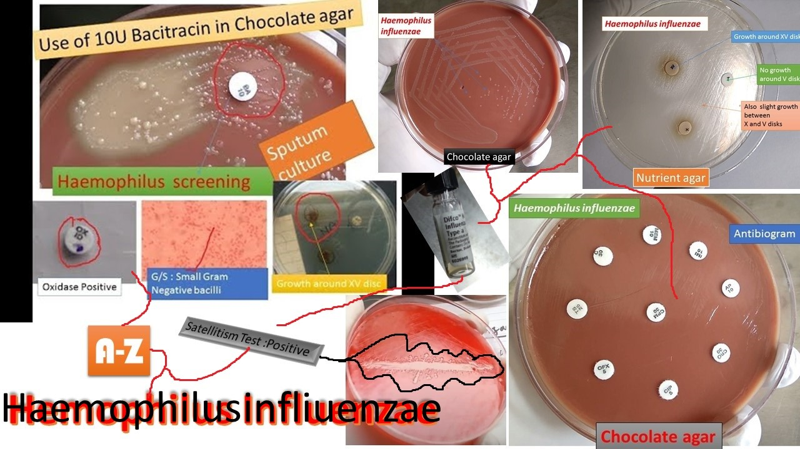

Slide 30
Gram-negative bacilli meningitis Escherichia coli and Klebsiella produce lactose-fermenting colonies on MacConkey agar; identified by ICUT tests Non-fermenters: Pseudomonas is oxidase positive, whereas Acinetobacter is oxidase negative. They produce non-lactose fermenting colonies; identified by ICUT tests
Listeria monocytogenes Motility: It shows tumbling type of motility at 25°C but nonmotile at 37°C (called differential motility, which is due to temperature dependent flagella expression) Culture: It grows on blood agar (β-hemolytic colonies), and chocolate agar. Note: Selective media such as PALC AM agar (containing mixture of antibiotics) may be useful for isolation of Listeria from specimens such as food and environmental samples.

Slide 31
Antimicrobial susceptibility test: done to initiate definitive antimicrobial therapy.
Sensitivity: CSF and blood cultures - take >48 hours for identification – Sensitivity drops rapidly - prior antimicrobial therapy or delay in processing
Rapid diagnostic tests: antigen detection or molecular test - considered to determine the bacterial etiology of pyogenic meningitis

Slide 32
Listeriosis
Caused by Listeria monocytogenes - food-borne pathogen that can cause serious infections, particularly in neonates, pregnant women and elderly people.
Also a ubiquitous saprophyte, known to cause epizootic disease in birds and animals

Slide 33
Human Infection
Mode of transmission: through contaminated food, vertical transmission.
Age: Extremes of age (neonate and old age)
Use of proton pump inhibitors increases risk
Other risk factors: Pregnant women & immunocompromised individuals

Slide 34
Human Infection (Cont..)
Survive refrigeration (4°C)- Commonly found in stored foods especially aged soft cheeses, packaged meats, milk and cold salads
Listeriosis is most often sporadic, although outbreaks do occur

Slide 35
Pathogenesis
Intracellular survival: After entry into the intestinal epithelium - survives inside the host cell – lysis of phagosome by forming pores (mediated by listeriolysin O) - host cell actin polymerization - helps the bacterium to reach near the cell membrane.
Migrates to the adjacent epithelial cells/ macrophages by direct cell-to-cell spread - by listeriopods.

Slide 36
Clinical Manifestations
Depends on the age of the patient and other risk factors
Common serotypes 1/2a,1/2b & 4
Neonatal listeriosis: early-onset and late-onset neonatal disease
In pregnant women:
  Fetal complications - abortion, preterm delivery - early onset disease
  Maternal complications - flu-like symptoms, bacteremia and rarely meningitis

Slide 37
Clinical Manifestations (Cont..)
Adults:
Bacteremia and meningitis
Risk factors - immunosuppression (steroid therapy, HIV, diabetes, malignancy)
Gastroenteritis following consumption of contaminated milk, meat and salads.

Slide 38
Differences between early- and late-onset neonatal listeriosis
Early onset neonatal disease | Late onset neonatal disease
Occurs <5 days of birth (Mean age-1.5 days) | Occurs >5 days of birth (Mean age-14.2 days)
Acquired from- maternal genital flora | Acquired from- environment
Associated with- Obstetrical complications - premature delivery & low birth weight | Not associated
Most common - neonatal sepsis | Most common - neonatal meningitis
Granulomatosis infantiseptica- miliary micro abscesses and granulomas, most often in the skin, liver, and spleen | Not seen
Mortality rate >30% | Mortality rate <10%
Does not cause nosocomial outbreaks | Nosocomial outbreaks are seen

Slide 39
Treatment of Listeriosis
Meningitis: Ampicillin - drug of choice, given for 2–3 weeks in combination with gentamicin for synergistic effect
Cotrimoxazole is given for patients with penicillin allergy
In febrile gastroenteritis - Amoxicillin is recommended in immunocompromised, elderly or pregnant patients.

Slide 40
Staphylococcal meningitis
S. aureus and coagulase-negative staphylococci – cause meningitis following invasive neurosurgical procedures, particularly ventricular shunting

