Slide 1
TB IN CKD PATIENTS
BY-
DR. CHIRAG CHAKRAVARTI (ASST. PROFESSOR)
DEPT OF RESPIRATORY MEDICINE
22/10/24

Slide 2
INTRODUCTION
TB is more common in patients with chronic kidney disease (CKD), especially when associated with anatomic abnormalities or immunosuppression.
Because of the immunosuppressive effect of uraemia, use of corticosteroids and immunosuppressive drugs during renal transplantation [RT], these patients are at a high risk of developing TB
Genitourinary TB occurs in about 5% of active TB cases. It is almost always secondary to a symptomatic or asymptomatic primary lesion in the lung.
﻿﻿Renal involvement may also occur as a complication of miliary (septicemic) TB.

Slide 3
PATHOGENESIS
IN UREMIA:
﻿﻿Granulocyte functions like chemotaxis ,adherence and phagocytosis are defective
﻿﻿Decreased Interleukin 2 production by activated T Helper cells.
﻿﻿A defect in the costimulatory function of antigen-presenting cells.
Persistent inflammatory state of monocytes, which is caused by the uremia per se, as well as by the dialysis treatment.

Slide 4
IN HEMODIALYSIS
• Conventional cellulose membrane causes alternate complement pathway leading to changes in granulocyte cell adhesion molecules CD11b ,CD18 and L – selectin which correlates with leucopenia.
IN POST - KIDNEY TRANSPLANTATION
• Immunosuppression with tacrolimus or mycophenylate mofetil is associated with the development of TB earlier in the post-transplant period and in younger patients predisposing to infection as cell mediated and humoral immunity got affected.

Slide 5
OTHER FACTORS WHICH CONTRIBUTE TO DECREASED IMMUNITY
Malnutrition
Vit D deficiency
hyperparathyroidism

Slide 6
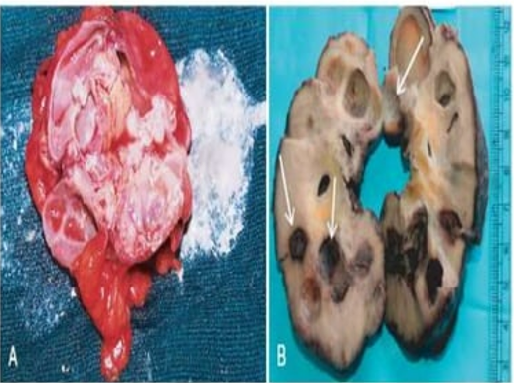
A. cut section of kidney shows areas of cavitation and caseation necrosis (white chalky material)
B. cavitating lesions are caused by TB in cut section of kidney (arrows)

Slide 7
CLINICAL FEATURES
MAIN C/O- (mimicking symptoms of uremia)
Fever
Loss of apetite
loss of weight
LESS FREQUENT C/O- (classic symptoms of tb)
Cough
hemoptysis

Slide 8
Clinical Presentation of TB during Maintenance Hemodialysis
Males > females.
﻿Majority develop TB before or within short period from the beginning of Maintainance hemodialysis, a time when effect of uremia on immune status is still pronounced.
﻿﻿Constitutional symptoms of TB seen.
Headache, chills and shortness of breath were less common.
﻿﻿Pyrexia of unknown origin presented in some pts.
﻿﻿ pleural effusion may also be presented.

Slide 9
﻿﻿Lung is the most common site of involvement in patients on Maintainance hemodialysis.
﻿﻿Lymph Node involvement has been found to be most common extra pulmonary site of TB on MHD.
﻿﻿Other extra pulmonary involvement (granulomatous infiltrates) include :
Abdomen and Urinary tract
Meninges
Bone and Joints
﻿﻿Disseminated / Miliary TB ranged between 10 to 15 %﻿﻿
Tuberculosis Peritonitis has been seen in patients on Capd- continuous ambulatory peritoneal dialysis.

Slide 10
Clinical Presentation of Tuberculosis following Renal Transplantation-
﻿﻿usually young pts.
﻿﻿Males > females
﻿﻿Constitutional Symptoms are more often seen
Lung is most common site
followed by abdomen , pericardium, thalamus, bone and joints.
﻿﻿Miliary TB has also been reported
﻿﻿Pyrexia of unknown origin presentation is associated more commonly
﻿﻿Neurological TB more common after transplantation.

Slide 11
DIAGNOSIS
Chest x ray
finding of an AFB smear positive
positive culture of M. tuberculosis
typical histopathologic findings.
due to the frequent extrapulmonary presentation and nonspecific symptomatology, a high index of suspicion is required, coupled with a need for invasive procedures, including liver, bone, lymph node, and peritoneal biopsies

Slide 12
All patients with CKD- considered at risk for tuberculosis
should have a history of prior TB or
TB contact sought,
any history of prior TB treatment checked (including drugs taken and treatment duration),
an appropriate clinical examination,

Slide 13
a chest x-ray
Any patient with CKD with an abnormal chest x-ray consistent with past TB,
or previous history of extrapulmonary TB who has previously received adequate treatment should be monitored regularly
The decision on chemoprophylaxis regimen should be made if thought necessary

Slide 14
Diagnosis of Latent TB Infection
based on information gathered from the medical history, physical examination, chest radiograph, sputum examinations.
All patients with CKD, on haemodialysis or CAPD and prior to renal transplantation should have a chest x-ray and abnormalities investigated.
Chemoprophylaxis could be offered to those with LTBI before transplantation, precluding the need for post-transplant prophylaxis.

Slide 15
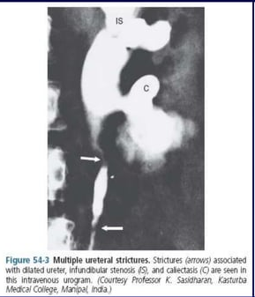
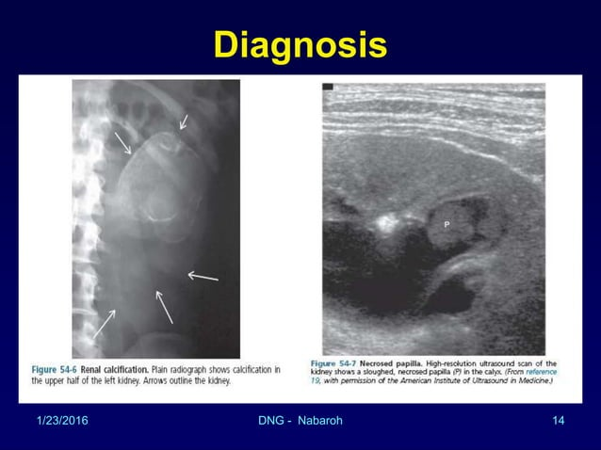

Slide 16
MANAGEMENT
The pharmacological properties of antituberculosis drugs determine how their levels are likely to be influenced by renal failure, clearance during dialysis and also their interaction with immunosuppressive drugs used in patients undergoing renal transplantation.
﻿﻿Treatment duration - 6 months for most cases of fully sensitive disease
exception of TB involving the CNS when treatment should be for 12-18 months.

Slide 17
ISONIAZID
﻿Isoniazid- metabolised by the liver and excreted by the kidneys.
However , recent studies show isoniazid is dialysable in only very small amounts and most clearance occurs from hepatic metabolism
isoniazid in renal failure - half-life of isoniazid is increased by about 45% in slow acetylators, this does not lead to significant adverse events necessitating dosage reduction, and therapeutic drug monitoring.

Slide 18
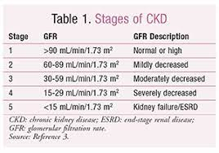
﻿﻿Furthermore administering isoniazid in reduced doses may lead to reduced potency and risk the development of resistance.
﻿﻿Stage 1-3 of CKD - Isoniazid 300 mg
Stage 4-5 of CKD - Isoniazid 300 mg
Renal Transplant Recipients 15 mg/kg max 900 mg 3X/week

Slide 19
RIFAMPICIN
Rifampicin- metabolised by the liver.
Urinary excretion accounts for very little of its elimination from the body- about 10% of a given dose being found unchanged in the urine.
Rifampicin does not appear in significant amounts in dialysate
﻿side effects for rifampicin do not occur with increased frequency in CKD or on dialysis
dose of rifampicin need not be altered in renal impairment and that drug levels need not be monitored (450 - 600 mg / day).

Slide 20
PYRAZINAMIDE
Pyrazinamide is metabolised in the liver.
Only 3-4% is renally excreted in unaltered.
however, in renal failure, its elimination was found with much higher levels detectable for up to 48 hours after administration.
due to its effect on uric acid retention, this may lead to hyperuricaemia and gout.

Slide 21
﻿﻿Pyrazinamide and its metabolites are significantly eliminated from the body by haemodialysis, 45% appearing in the dialysate.
﻿﻿Due to possible delayed elimination of the drug and its metabolite, the dosage interval should be altered in stages 4 and 5 CKD and in patients on haemodialysis
﻿﻿20 -35 mg/kg per dose three timer per week

Slide 22
ETHAMBUTOL
Around 80% of Ethambutol is excreted unchanged by the kidneys
﻿﻿In patients with renal failure, excretion of Ethambutol was significantly reduced following the usual dose of 15 mg/kg.
﻿﻿It is renally excreted and ocular toxicity is largely dose-dependent.
Ethambutol has been detected in dialysate.

Slide 23
there is improved efficacy when administered in high doses less often than in a daily lower dose.
Serum monitoring should be done and trough levels should be less than 1.0 mg/ml at 24 h post-dose without dialysis.
Recommendation: 15-25 mg/kg per dose three times per week

Slide 24
AMINOGLYCOSIDES
﻿﻿Streptomycin, Kanamycin, Amikacin and Capreomycin: around 80% are excreted unchanged in the urine without undergoing significant metabolism.
﻿﻿Streptomycin causes significant vestibular toxicity but less nephrotoxicity compared with the other aminoglycosides.
A/w ﻿increase in elimination time with increasing age and declining renal function.
﻿﻿Streptomycin, Kanamycin, Amikacin and Capreomycin: approximately 40% are removed by haemodialysis when these drugs are given just before haemodialysis.
12-15 mg/kg/dose 2 or 3 times/week for all of these drugs. Drug levels should be monitored.

Slide 25
Streptomycin:
The dosing interval should be increased rather than the dose decreased as the drugs exhibit concentration dependent bactericidal effect and lower doses may reduce drug efficacy
preferable to give Streptomycin twice or thrice weekly without action decreasing the usual dose.
15 mg/kg (max 1 g daily).
Dose is reduced in <50 kg and >40 years to max 500 to 750 mg daily.
Peak plasma concentrations of Streptomycin should be between 15 and 40 mg/ml and trough concentrations <3-5 mg/ml or <1 mg/ml in CKD or those >50 years.

Slide 26
Second-Line Drugs Used in The Management of Resistant Disease
Fluoroquinolones -
﻿﻿Ofloxacin and Ciprofloxacin are dependent on renal clearance and doses should be reduced accordingly.
﻿﻿Other Fluoroquinolones undergo some degree of renal clearance which varies from drug to drug.
Levofloxacin undergoes greater renal clearance than Moxifloxacin.
﻿﻿Fluoroquinolones decrease the metabolism of Cyclosporin A and displace it from the bound form, thus increasing its toxicity

Slide 27
Cycloserine
﻿Up to 70% of Cycloserine is excreted by the kidney and 56% removed by haemodialysis.
﻿﻿Given that dose-related neurological and psychiatric side effects of Cycloserine are reported dose adjustment in renal failure is recommended.
﻿﻿it is recommended - increasing the dose interval suggesting 250 mg once daily or preferably 500 mg 3 times/week.
﻿﻿Again, it should be given after haemodialysis to avoid under-dosing and monitored for neurotoxicity.

Slide 28
Para-amino salicylic acid (PAS)-
﻿﻿A modest amount of PAS (6.3%) is cleared by haemodialysis but its metabolite, acetyl-PAS, is substantially removed.
﻿8-12 g/day in two or three divided doses twice weekly should be adequate.
Ethionamide/ prothionamide –
﻿Ethionamide and Prothionamide are not cleared by the kidneys nor are they removed by haemodialysis, so no adjustment to dosing is needed ﻿﻿
15 to 20 mg/kg/day (maximum 1g; usually 500 to 750 mg in single daily dose or two divided dose.

Slide 29
Clofazimine-
Clofazimine accumulates in CKD and causes skin and hair discolouration, photosensitivity and ocular problems.
The normal dose is 100-300 mg daily and this should be reduced to three times weekly in patients with CKD and those on dialysis.

Slide 30
Linezolid ﻿﻿-
A higher incidence of blood disorders and optic neuropathy has been reported if Linezolid is used for longer than 28 days, making its use in the management of TB difficult.
Linezolid is a reversible non-selective monoamine oxidase (MAO) inhibitor and patients should avoid eating tyramine-rich foods such as cheese and products containing yeast. Causes hypertensive crisis.
﻿﻿The normal dose is 600 mg every 12 h.

Slide 31
Patients with CKD not on dialysis
﻿﻿Isoniazid (H), Rifampicin (R) can be used in normal doses in renal impairment.
﻿﻿Pyridoxine supplementation should be given with Isoniazid to prevent the development of peripheral neuropathy.
﻿﻿For patients with stages 4 and 5 CKD, dosing intervals should be increased to three times weekly for Ethambutol, Pyrazinamide and the Aminoglycosides.
Ethambutol and the Aminoglycosides have the disadvantage of renal clearance, thus need for drug monitoring.

Slide 32
Patients with ESRD on Hemodialysis
﻿﻿﻿Both Rifampicin and Isoniazid may be given in their usual daily Doses
﻿﻿﻿Haemodialysis removes a significant amount of Pyrazinamide and the primary metabolite of Pyrazinamide, pyrazinoic acid, accumulates in patients with renal failure.
Variable doses of 25-30 mg/kg three times weekly have been Recommended.
Pyrazinamide should be administered immediately after haemodialysis.
﻿﻿﻿Ethambutol can be given at a dose of 15-25 mg/kg three times weekly after haemodialysis to avoid premature drug removal.

Slide 33
Renal Transplantation Patients ﻿﻿
Rifampicin interacts with immunosuppressive regimens, increasing the chance of graft rejection, and doses of mycophenolate mofetil, tacrolimus and cyclosporine will need adjustment.
﻿﻿Corticosteroid doses should be doubled in patients receiving Rifampicin.
﻿Azathioprine sometimes causes hepatotoxicity, which has to be differentiated from the hepatotoxicity due to antituberculosis drugs.

Slide 34
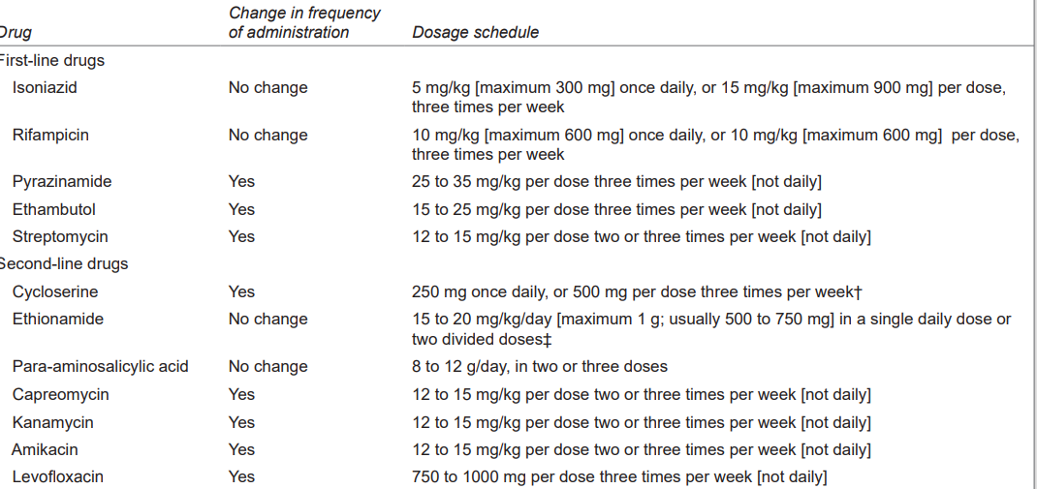

Slide 35
Evidence based study on Successful management of pulmonary tuberculosis in renal allograft recipients in a single center
Background and purpose:
Pulmonary infections, especially tuberculosis, are responsible for significant mortality and morbidity among renal transplant recipients in developing countries. Conventional diagnostic modalities are associated with a low yield, delaying specific therapy.

Slide 36
Methods:
All patients transplanted within a 1.5-year period were prospectively followed-up for one year. Patients were on a cyclosporine-based triple immunosuppressive regimen. None received isoniazid prophylaxis, and those transplanted in the last seven months of the study period received daily cotrimoxazole. Patients exhibiting unequivocal evidence of pulmonary infections underwent further evaluation. Search for offending organisms was made by sputum examination and bronchoalveolar lavage (BAL).

Slide 37
Results:
Thirty-nine infection episodes were recorded in 34 patients. M. tuberculosis was isolated during 10 episodes, pyogenic bacteria and Pneumocystis carinii in 6 each, candida in 4, aspergillus in 3, cytomegalovirus (CMV) in 3, and nocardia and mucor in one episode each.
More than one organism was isolated during five episodes. Bacterial pneumonia and tuberculosis were diagnosed in another seven and two patients, respectively, on the basis of a therapeutic response to specific chemotherapy.

Slide 38
Over two thirds of the organisms were identified by examination of BAL fluid. BAL was useful in the diagnosis of tuberculosis and P. carinii pneumonia but was relatively insensitive for CMV and bacterial infections.
An increased frequency of acute rejection and higher serum creatinine were factors that predisposed to infections. All patients with pulmonary tuberculosis made a full recovery.

Slide 39
Conclusion:
Tuberculosis and P. carinii are the most common nonpyogenic infections in the first year after transplantation in developing countries. An aggressive search for tubercle bacilli should be made using bronchoscopy and examination of BAL fluid in patients not responding to a short trial of antibiotics.
A four-drug regime without rifampicin given for 18 months is effective for pulmonary tuberculosis in patients on cyclosporine. We recommend routine prophylactic use of one single-strength tablet of cotrimoxazole daily for at least six months after transplantation.

Slide 40


