Slide 1
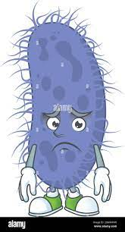

Enteric fever: Salmonella and Non Salmonella
Dr. Monika Mavani (R2)
SBKS MI & RC
Department of Microbiology

Slide 2
Enteric fever is a potentially fatal multisystem illness caused by:
Salmonella Typhi (typhoid fever)
Salmonella Paratyphi A, B and C (paratyphoid fever)
Salmonella is antigenically complex. There are several classifications:
CLINICAL CLASSIFICATION
Typhoidal Salmonella
Includes S. Typhi and S. Paratyphi
Restricted to human hosts
Cause enteric fever
Non-Typhoidal salmonella
Can colonize intestine of a broad range of animals.
Can also infect humans, causing food borne gastroenteritis and septicemia

Slide 3
ANTIGENIC CLASSIFICATION
(KAUFFMANN-WHITE SCHEME)
Serogroup |  | Serotype name
New | Old
2 | A | S. Paratyphi A
4 | B | S. Paratyphi B
 |  | S. Typhimurium
7 | C1 | S. Paratyphi C
 |  | S. Choleraeusis
9 | D1 | S. Typhi
 |  | S. Enteritidis

Slide 4
MOLECULAR CLASSIFICATION
Salmonella enterica
enterica
salamae
arizonae
diarizonae
houtenae
indica
Salmonella bongori
Taxonomically, the correct nomenclature of members of salmonellae is as follow example: Salmonella species enterica subspecies enterica serotype Typhi.

Slide 5
ANTIGENIC STRUCTURE
Salmonellae possess three important antigens on their cell wall:
Somatic antigen (O)
Flagellar antigen (H)
Surface envelope antigen (Vi)- in some species
Vi antigen
Is a surface polysaccharide envelope or capsular antigen covering O antigen.
Few serotypes S.Typhi, S.Paratyphi C, S.Dublin and some strains of Citrobacter freundii.
Poorly immunogenic
Complete absence of Vi antibody in a proven case of typhoid fever indicates poor prognosis.

Slide 6
Somatic (O) antigen | Flagellar (H) antigen
Part of cell wall polysaccharide | Made up of protein flagellin
Widal test- O antigen of S.Typhi is used | Widal test- H antigens of S.Typhi, S.Paratyphi A and B are used.
Less immunogenic | More immunogenic
Appears early, disappears early, indicates recent infection | Appears late, disappears late, indicates convalescent stage
Compact, granular, chalky clumps Agglutination takes place slowly (55⁰C) | Large, loose, fluffy clumps Agglutination takes place rapidly (37⁰C)

Slide 7
PATHOPHYSIOLOGY
Ingested contaminated food and water
Ingested bacilli invade small intestinal mucosa
Taken up by macrophage and transported to regional lymph node
S. Typhi multiply in the intestinal lymphoid tissue
Interacts with enterocytes and Peyer’s patches during 1-3 weeks of incubation period (Diarrhoea)

Slide 8
End of incubation period, bacilli enter bloodstream (Bacteraemia phase) Onset of typhoid fever
Bacteria invade the gallbladder, biliary system and lymphatic tissue of bowel and multiply in high number (Secondary bacteraemia)
Then pass into the intestinal tract

Slide 9
CLINICAL FEATURES
Incubation period is typically about 10-14 days.
STAGE 1ST WEEK
Slowly temperature rise for 4-5 days (stepladder pattern)
Abdominal pain and myalgia
Headache
Constipation
Malaise
Relative bradycardia
Arthralgia
Anorexia
END OF 1ST WEEK
Rose spots may appear on upper abdomen and on back
Cough
Hepatosplenomegaly
Abdominal distention with tenderness
Diarrhea

Slide 10
STAGE 3 (3RD WEEK)
Febrile becomes toxic and anorexic
Significant weight loss
Typhoid state (apathy, confusion and psychosis)
High risk (5-10%) haemorrhage and perforation may cause death
END OF 2ND WEEK
Delirium, complications, coma, cerebellar ataxia, meningitis and death (if untreated)

Slide 11
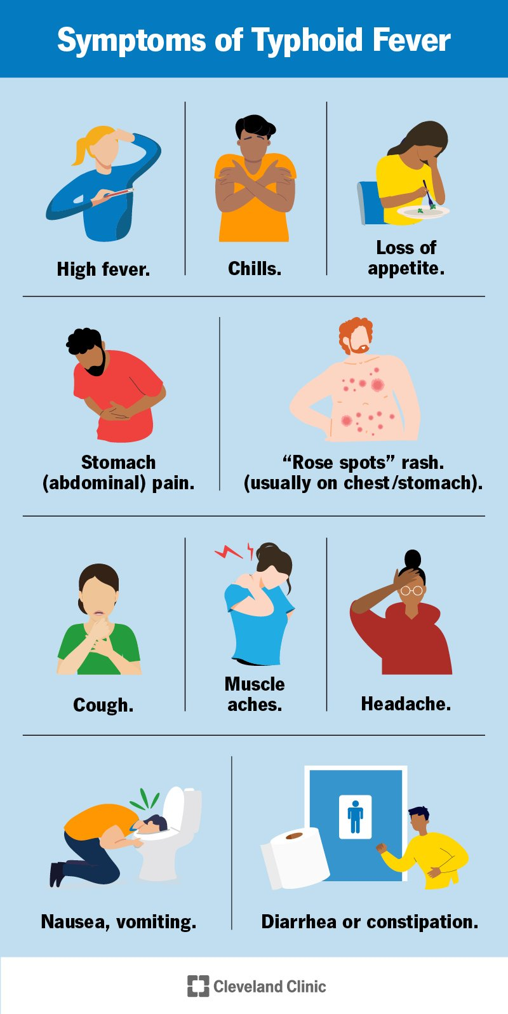
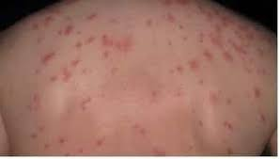
ROSE SPOTS ON BACK
PARATYPHOID FEVER
Course tends to be shorter and milder than that of typhoid fever and the onset is often more abrupt with acute enteritis.
Rash may be more abundant with less intestinal complications.

Slide 12
COMPLICATIONS
BOWEL
Perforation
Hemorrhage
SEPTICAEMIC FOCI
Bone and joint infection
Meningitis
Cholecystitis
TOXIC PHENOMENA
Myocarditis
Nephritis
CHRONIC CARRIAGE
Persistent gallbladder carriage

Slide 13
LABORATORY DIAGNOSIS
Time of specimen to be collected:
First week: Blood culture, bone marrow or duodenal aspirate culture
Second/Third week: Serum for serology
Third/Fourth week: Urine and Stool culture
Culture and Identification:
Blood culture is the ideal method for diagnosis in first week of fever.
Blood culture bottles are incubated at 37°C.
Salmonellae are non fastidious, growth occurs within 24 hours. From positively flagged blood culture broth, subcultures are made on to blood agar and MacConkey agar.

Slide 14
Blood agar: Nonhemolytic moist colonies.
MacConkey agar: Colonies are round, translucent, pale and non-lactose fermenting.
Enrichment broth such as Selenite F broth, tetrathionate broth and gram-negative broth are used.
DCA (deoxycholate citrate agar): Produces non-lactose fermenting pale colonies with black centre.
XLD agar (xylose lysine deoxycholate): Produces red colonies with black center.
Wilson Blair’s brilliant green bismuth sulphite medium: useful for the isolation of S. Typhi from heavily contaminated specimens.
S. Typhi produces characteristic jet black colored colonies with a metallic sheen due to production of H₂S.

Slide 15
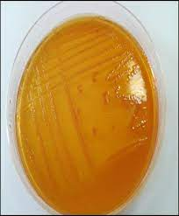
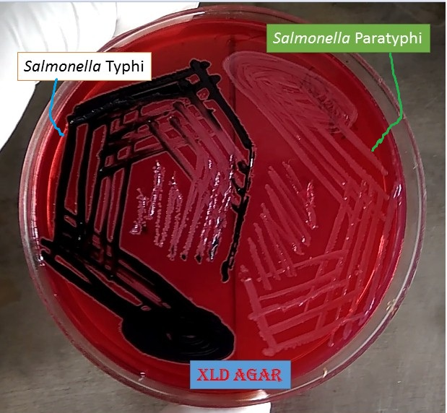
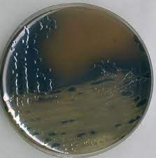
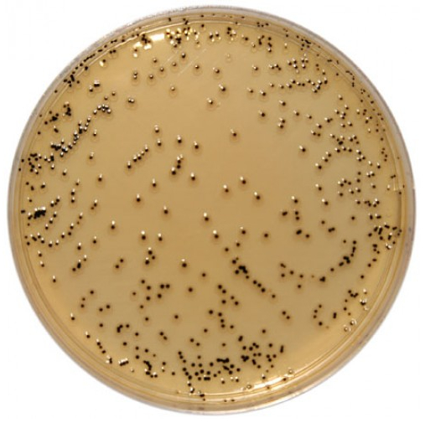
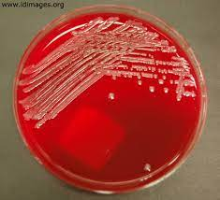
XLD agar
Wilson Blair
MacConkey Agar
DCA
Blood Agar

Slide 16
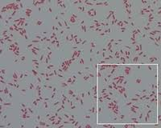
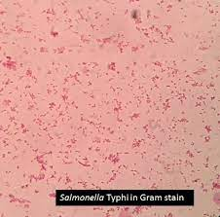
Gram-stained smear made from colonies reveals gram negative, non-sporing and non–capsulated bacilli.
They are motile with peritrichous flagella.

Slide 17
Identification:
It is either by automated identification systems or by conventional biochemical tests.
Catalase positive and oxidase negative.
Indole test-negative, citrate test-negative, urease test-negative.
TSI (triple sugar iron test)- Alkaline/acid, Gas present except for S. Typhi.
Abundant H₂S present except for:
S. Para typhi A: H₂S not produced.
S. Typhi: Speck of H₂S present at the junction of slant and butt.

Slide 18
Slide Agglutination Test:
Identification of Salmonella at genus level can be confirmed by slide agglutination using polyvalent O antisera. Then, the serotypes can be identified by using type specific O antisera.
Antimicrobial Susceptibility Testing (AST):
AST is performed by disk diffusion method or by automated MIC detection method.
Demonstration of Serum Antibodies:
Widal Test-
It is an agglutination test where H and O antibodies against S. Typhi and S. Paratyphi A and B are detected and measured in the patient’s sera by using O and H antigens.

Slide 19
Antigens used: Four antigens are used
1. O antigens of S. Typhi (TO)
2. H antigens of S. Typhi (TH)
3. H antigens of S. Paratyphi A (AH)
4. H antigens of S. Paratyphi B (BH)
Patient’s serum is serially diluted in normal saline in test tubes from 1 in 10 to 1 in 640 dilutions.
Results: O agglutination appears as compact granular chalky clumps with clear supernatant fluid.
H agglutination appears as large loose fluffy cotton woolly clumps, with clear supernatant fluid.
If agglutination does not occur, button formation occurs due to deposition of antigens and the supernatant fluid remains hazy.

Slide 20
Interpretation of Widal test
Widal test result | Suggestive of
Rise of TO and TH antibody | Enteric fever due to S. Typhi
Rise of TO and AH antibody | Enteric fever due S. Paratyphi A
Rise of TO and BH antibody | Enteric fever due S. Paratyphi B
Rise of only TO antibody | Recent infection : Due to S. Typhi or S. Paratyphi A or S. Paratyphi B
Rise of only TH antibody | Convalescent stage/anamnestic response
Rise of all TH, AH, BH antibodies | Post TAB vaccination

Slide 21
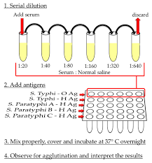
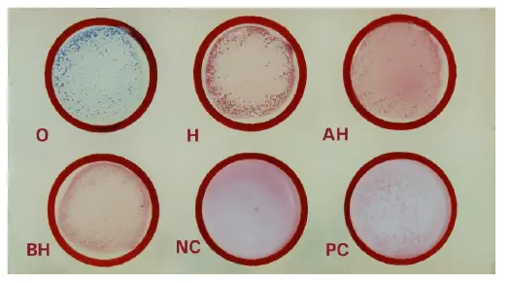

Slide 22
Other antibody tests are:
Typhidot test
IDLTubex test
IgM dip stick test
Dot blot assay
Demonstration of Serum Antigens:
Present in blood in early course and in urine in late phase.
Methods like ELISA are used for detection of antigens.
Molecular methods:
PCR based methods by targeting genes like flagellin gene, Iro B and fliC gene.

Slide 23
TREATMENT
Ceftriaxone is the drug of choice for empirical treatment: 1-2g/day for 10-14 days.
Azithromycin and fluoroquinolones can also be used as an alternative drug for empirical therapy.
Treatment of carriers: Ampicillin or amoxicillin plus probenecid for 6 weeks.
Prophylaxis:
Control of Reservoirs
Sanitation Measures
Vaccine

Slide 24
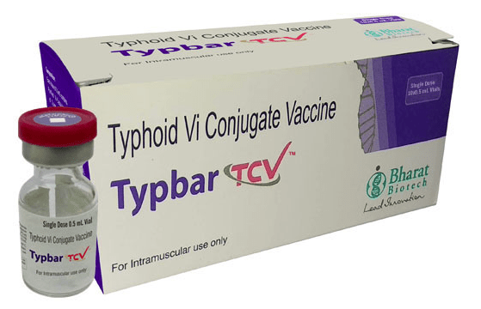
Vaccine:
Vi antigen capsular polysaccharide (Vi-CPS) vaccine
Vi-rEPA
Typhoral (oral live attenuated S. Typhi Ty21a vaccine)

Slide 25
Non-typhoidal Salmonellae
Infections of NTS are caused by-
S. Typhimurium and S. Enteritidis
S. Newport
S. Javiana
S. Heidelberg
S. Choleraesuis
S. Dublin
NTS can be acquired from multiple animal reservoirs.
NTS is most commonly associated with animal food products, especially eggs, poultry, undercooked ground meat and dairy products.

Slide 26
CLINICAL MANIFESTATIONS
GASTROENTERITIS:
S. Typhimurium is the most common species.
Nausea, vomiting, watery diarrhea, fever and onset of abdominal cramps 6–48 hours after the ingestion of contaminated food.
Usually self limiting.
BACTEREMIA:
Most commonly caused by S. Choleraesuis (source-pig) and S. Dublin (source—cattle).
8% of people with NTS gastroenteritis develop into bacteremia leading to endovascular infection and to metastatic localized infection.

Slide 27
ENDOVASCULAR INFECTIONS:
Endocarditis
Arteritis
METASTATIC LOCALIZED INFECTION:
Hepatic or splenic abscess
NTS meningitis
Lobar pneumonia and lung abscess
Pyelonephritis and cystitis
Genital tract infections
Salmonella osteomyelitis
Reactive arthritis (Reiter’s syndrome) seen in persons with HLA-B27 histocompatibility antigen.

Slide 28
TREATMENT
In uncomplicated NTS, it is conservative with fluid replacement.
Ciprofloxacin is given for preemptive treatment or severe gastroenteritis.
Ceftriaxone is indicated for bacteremia and invasive infections.
MDR strains of NTS are resistant to more than 5 drugs-ampicillin, chloramphenicol, streptomycin, sulfonamides and tetracyclines.

Slide 29
Questions:
Q1. Infective does of S. Typhi :
One bacillus
10³ –10⁶ bacilli
10⁸ –10¹⁰ bacilli
1–10 bacilli

Slide 30
Questions:
Q2. In a patient with typhoid, diagnosis after 15 days of onset of fever is best done by:
Blood culture
Stool culture
Urine culture
Widal test

Slide 31
Questions:
Q3. Flagellar antigen of Salmonella is:
Vi antigen
H antigen
O antigen
Capsular antigen

Slide 32
References
Essentials of Medical Microbiology by Apurba Sastry, 3e
Koneman’s Color Atlas and Textbook of Diagnostic Microbiology

Slide 33
Thank you

