Slide 1
COGNITION, ATTENTION CONCENTRATION, MEMORY , JUGDEMENT , INSIGHT
-Dr Lakhan Kataria
Professor and Head
Dept of Psychiatry

Slide 2
What is cognition?
All the ways of using one’s store of knowledge in order to plan something in the imagination, usually in the hope of solving a problem.
Mental process of knowing and becoming aware; function is closely associated with judgment.
It encompasses all aspects of intellectual functions and processes such as: perception, attention, thought, intelligence, the formation of knowledge, memory and working memory, judgment and evaluation, reasoning and computation, problem solving and decision making, comprehension and production of language. Imagination is also a cognitive process, it is considered as such because it involves thinking about possibilities. Cognitive processes use existing knowledge and discover new knowledge.

Slide 3
Scales of assessing Cognition
Mostly involve cognitive testing and provide objective, quantifiable data. However, scores vary by educational level in subjects.
1.Mini-Mental State Examination (MMSE)
30-point cognitive test developed in the mid-1970s
Bedside assessment of a broad array of cognitive function,including orientation, attention, memory, construction, and language.
Administered in less than 10 minutes.
The MMSE has been extensively studied and shows excellent reliability when raters refer to consistent scoring rules.

Slide 4
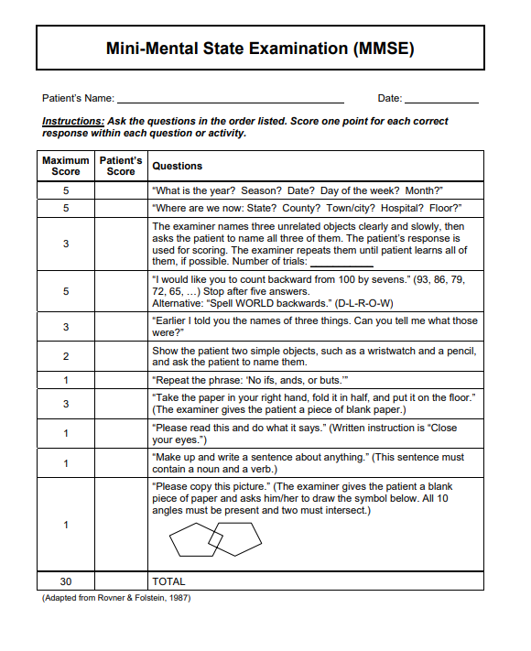

Slide 5
2. Neuropsychiatric Inventory
Developed to assess a wide range of behavioral symptoms that are often seen in Alzheimer's disease and other dementing disorders
The current version rates 12 areas: delusions, hallucinations, dysphoria, anxiety, agitation/aggression, euphoria, disinhibition, irritability/lability, apathy, aberrant motor behavior, nocturnal disturbances, appetite and eating. The standard NPI is
An interview with a caregiver or other informant that can be performed by a clinician or trained lay interviewer
requires 15 to 20 minutes to complete.
3.Scored General Intelligence Test (SGIT)
One of the few tests that attempts to measure general intelligence.
Can be administered by the clinician during the psychiatric interview.
A decline in general intelligence will be seen in cognitive disorders, and the SGIT can alert the clinician to begin a workup for disease states that interfere with cognition

Slide 6
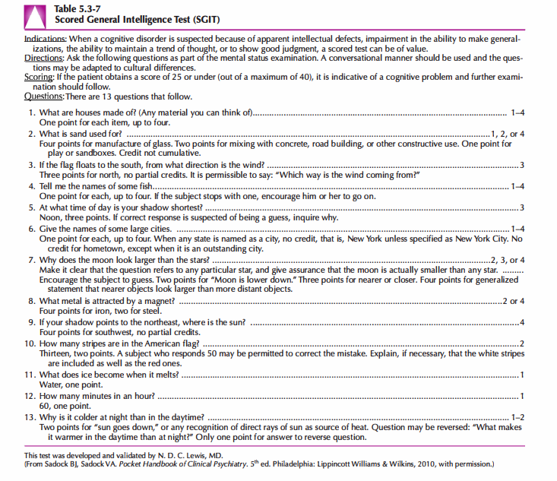

Slide 7
4. Montreal Cognitive Assessment
The Montreal Cognitive Assessment (MoCA) is a widely used screening assessment for detecting cognitive impairment,mainly for mild cognitive impairement (MCI) and Alzhiemers Disease.
This test consists of 30 points and takes part in 10 minutes from the individual. The Montreal test is performed in seven steps.
The sensitivity and specificity of the MoCA for detecting MCI were 90% and 87%.
MoCA scores range between 0 and 30.A score of 26 or over is considered to be normal.

Slide 8
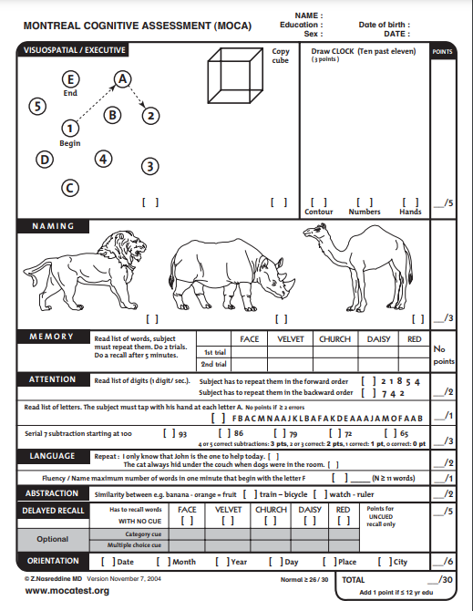

Slide 9
5.The P.G.I Battery of Brain Dysfunction
It is collection of various tests that are used to quantify cognitive dysfunction, impairment, decline, or deficits in clinical settings.
It tests intelligence (both performance and verbal), memory, perceptual acuity, and transference from one hemisphere to another.
It also helps assess the extent of decline or loss in the cognitive area because of illness, accident, injury.
This battery includes five tests :
Bhatia’s Short Scale,
Verbal Adult Intelligence Scale,
PGI Memory Scale,
Bender Visual Motor Gestalt Test and,
Nahor Benson Test of Perceptual Acuity.

Slide 10
6.Addenbrooke's Cognitive Examination-III(ACE III)
The ACE encompassed tests of five cognitive domains: attention/orientation, memory, language, verbal fluency, and visuospatial skills.
It is scored out of 100 a score of 88 and above is considered normal; below 83 is abnormal; and between 83 and 87 is inconclusive.

Slide 11
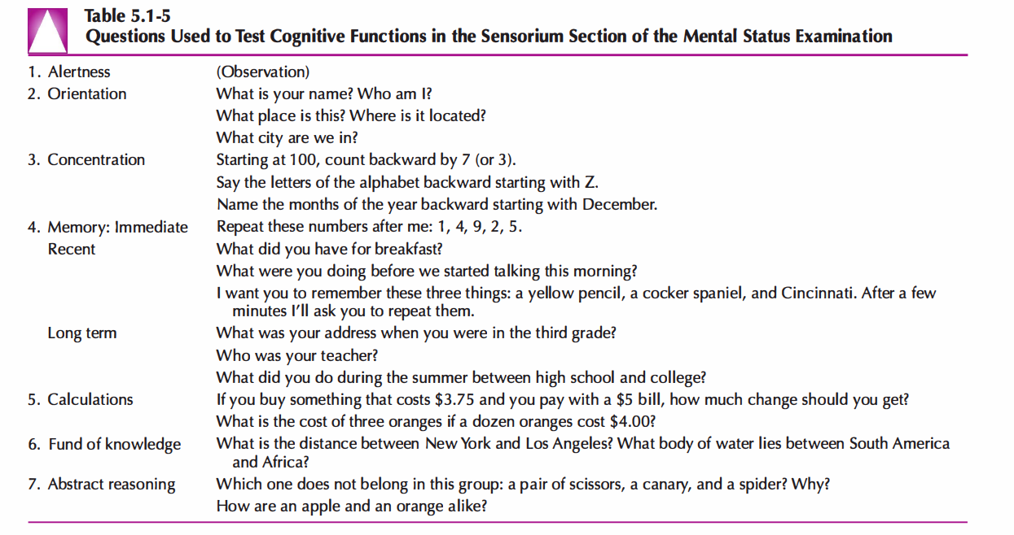

Slide 12
Consciousness
Consciousness refers first to the inner awareness of experience as opposed to the categorizing of events as they occur.
It denotes a knowledge of a conscious self.
UNCONSCIOUSNESS
’unconsciousness means something that is not an inner existence does not occur as an experience;
it is something which has not reached any knowledge of itself.

Slide 13
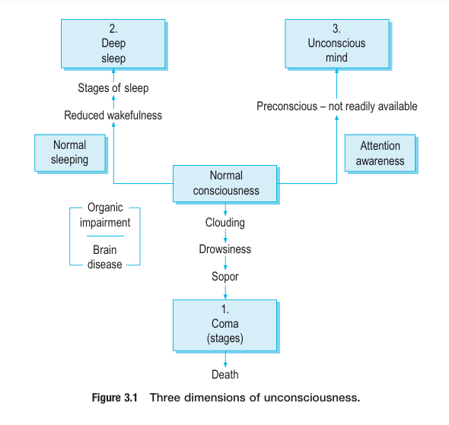
Three Dimensions of unsconsciousness

Slide 14
3 Dimensions of consciousness
Vigilance(Wakefulness)-Drowsiness(sleep):
Vigilance is deliberately remaining alert when otherwise one might be drowsy or asleep.
Lucidity-clouding:
Lucidity is complete clarity of thought as against compromised consciousness and awareness.
Consciousness of self:
Ability to experience self and an awareness of self that is both immediate and complex.

Slide 15
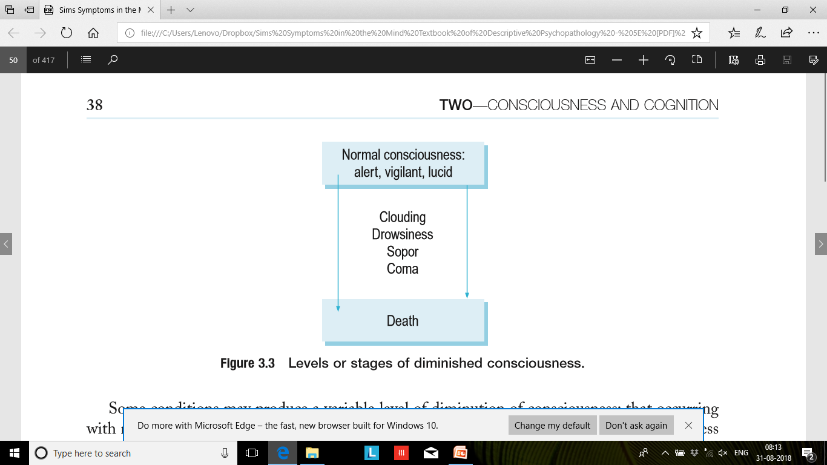
DISTURBED STATE OF CONSCIOUSNESS
Some people also experience heightened consciousness wherein there is a subjective sense of richer perception, increased alertness and a greater capacity for intellectual activity, memory and understanding.
Usually associated with hallucinogens like LSD and CNS stimulants like amphetamine. A similar state of awareness may occur occasionally in early psychotic illness, especially Mania or less often in Schizophrenia.
Stages of Diminished consciousness

Slide 16
QUANTITATIVE LOWERING OF CONSCIOUSNESS
Clouding of consciousness:
Mild impairment of consciousness with deterioration in thinking, attention, perception and memory and usually drowsiness and reduced awareness of environment.
Occurring in acute organic conditions, drug and alcohol intoxication, head injury, meningeal irritation caused by infection.
With lowering of consciousness the patient is psychologically benumbed and there is a general lowering of consciousness without hallucinations, illusion, delusions and restlessness.
The patient is apathetic, generally slowed down, unable to express themselves clearly and may be perseverate. there is no accepted term for this state is best designated as “TORPOR”.
If the history of the illness is not clear,the general defect in intelligence, in the absence of hallucinations, may be mistakenly diagnosed as severe Dementia, but after some weeks there is a remarkable partial recovery and the patient is left with a mild organic deficit.

Slide 17
Drowsiness:Is a persistent state, this is the next level of progressive impairment of consciousness.
The state wherein a person is awake and is in the process of drifting into sleep without a sensory stimulation.
In which person is slow in actions, slurred in speech, sluggish in intention and sleepy on subjective description and Reflexes are reduced in intensity.
Can be seen in over dosage with drugs that have CNS depressant effect(for example Tricyclic antidepressants), toxic state, injury, tumours etc.
COMA:Unconscious state with no response to stimuli. However in lighter states with strong stimuli they may be momentarily rousable.
In later stages they may be said to be brain dead.

Slide 18
QUALITATIVE CHANGES OF CONSCIOUSNESS
Delerium:
LIPOWSKI(1990) defines delirium as a “ a transient organic mental syndrome of acute onset, characterized by Global impairment of cognitive functions, a reduced level of consciousness, attentional abnormalities, increased or decreased psychomotor activity and a disordered sleep-wake cycle.”
Fluctuation of Consciousness :Person becomes more disoriented, disturbed in mood and distracted perpetually with illusions and hallucinations during evenings and better lucidity in mornings.
Drugs like mescaline shows variations in consciousness and fluctuations of time sense.
CONFUSION:Is a Subjective symptoms and objective signs indicating loss of capacity for clear and coherent thought. There is disturbed thought processes.
Brain damages in chronic organic states, also seen in non organic disturbance like functional psychoses and in association with powerful emotion in neurotic disorders.

Slide 19
TWILIGHT STATE:A twilight state is a defined as “interruption of the continuity of consciousness”.
It is characterized by:
1) Abrupt onset and end
2)Variable duration which may go from a few hour duration up to several weeks
3)Occurrence of unexpected violent acts or emotional outbursts during otherwise normal, quiet behaviour
Can occur in epilepsy, alcoholism, brain trauma and general paresis, and also occur with dissociative states.
Mania a potu ( Pathological intoxication):Type of twilight state associated with alcoholism. defined by Keller as “an extraordinarily severe response to alcohol, especially to small amounts, marked by apparently senseless violent behaviour, usually followed by exhaustion ,sleep and amnesia for the episode”.
Coid(1979) describes four components of pathological intoxication:
Condition follows the consumption of a variable quantity of alcohol
Senseless, violent behaviour then ensues
Followed by prolonged sleep
Total or partial amnesia for the disturbed behaviour that occurs.
(Different from delirium tremens which is severe alcohol withdrawal symptoms such a shaking, confusion and hallucinations)

Slide 20
AUTOMATISM:It implies action taking place in the absence of consciousness.
Involuntary behaviour without our control, which may be inappropriate and out of character for the person.
There may be no recollection or only partial and confused memory of the action.
Dream like(ONEIROID) STATE:Patient is disoriented, confused and experiences elaborate hallucinations, usually visual.
There is impairment of consciousness and marked emotional change, which may be terror or enjoyment of the hallucinatory experiences.
Appear to be living in a dream world and so called Occupational delirium for example, bus conductor may ask other patients for their bus fares.
STUPOR: Reduction in or absence of relational functions. i.e. action and speech.
Syndrome in which mutism and akinesis occur (inability to initiate speech or action in a patient who appears awake and even alert).
The patient may look ahead or his eyes may wander, but he appears to take nothing in.
Complete absence in clear consciousness of any voluntary movements
Symptoms of akinesis and mutism in a conscious patient also occur with schizophrenia, with affective psychoses and in dissociative states.

Slide 21
ORIENTATION
Orientation is the capacity of an individual to accurately gauge time, space and person in his current setting.
This enables him to make sense of, and be at home in, his environment.
This is virtually the same faculty as intellectual grasp, in that various perceptual cues are used, and with correct sense of time and place the person is able to come to appropriate conclusions from his context.
Orientation in space is disturbed later in the disease process than time.
Disorientation in time and loss of intellectual grasp (situational disorientation) usually occur first in a progressive illness; disorientation in place usually occurs later and, in person, last of all.

Slide 22
Delusions that Mimic Disorientation: Delusions of misorientation have the features of a delusion: a person on the ward may believe himself to be in prison, and a visiting relative may be considered to be an interrogator from the Gestapo.
Dissociation and Disorientation: Hysterical dissociation may mimic with apparent disorientation. A patient is described in the next chapter who lived in Birmingham, United Kingdom, but who found himself after a hysterical fugue in Montreal. Although apparently disorientated, he actually showed an abnor mality of memory as part of a dissociative state.

Slide 23
ATTENTION AND CONCENTRATION
Attention is the patient's ability to attend to a specific stimulus without being distracted by extraneous internal or environmental stimuli.
Attention is the active or passive focusing of consciousness on an experience such as sensory inputs, motor programmes, memories or internal representations.
Inattention and distractibility can significantly impair a patient's performance on the more demanding tasks of new learning, calculating, and verbal abstraction.
Voluntary attention occurs when the subject focuses his attention on an internal or external event; involuntary when the event attracts the subject’s attention without his conscious effort.
In Passive attention, the subject responds to, for example, a loud noise, whereas in active attention, an individual’s prior expectations and goals determine in a top-down fashion what is attended to
The term "vigilance," however, has been used interchangeably with both "sustained attention" (focusing on one stimulus over an extended period of time) and also with the more common concept of "watchfulness" or "alert ness.“
Vigilance in the sense of alertness refers to a more basic arousal process in which the awake patient can respond to any stimulus appearing in the env
This aspect of attention is usually referred to as concentration.

Slide 24
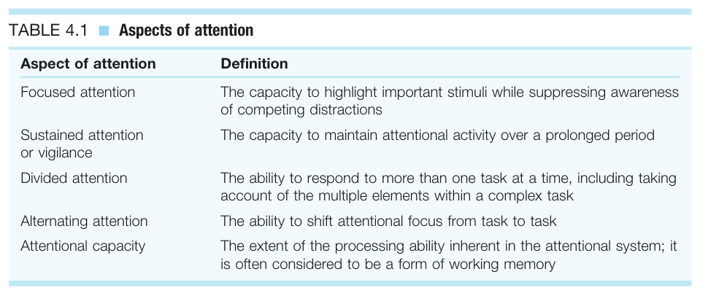

Slide 25
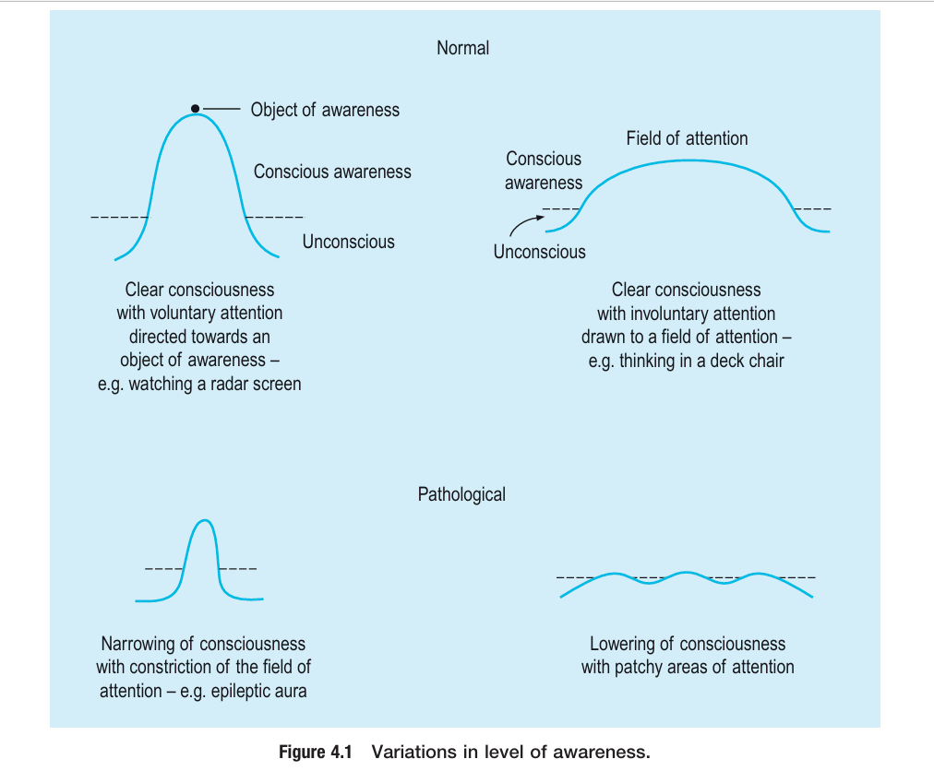

Slide 26
The concept of inattention (distractibility) is applied to two distinct clinical situations.
The first is when the patient is clinically inattentive or is unable to sustain sufficient attention to succeed in the simple tests of attention discussed subsequently.
The second situation is when the patient has specific unilateral inattention (neglect) to stimuli on the side of the body opposite a brain lesion.

Slide 27
ALTERATION OF THE DEGREE OF ATTENTION
Attention is decreased in normal people in sleep, dreams, hypnotic states, fatigue and boredom.
It may be pathologically decreased in organic states, usually with lowering of consciousness, for instance with head injury, acute toxic confusional states such as drug- and alcohol-induced conditions, epilepsy, raised intracranial pressure and brainstem lesions.
In psychogenic states, attention may be altered, for example diminished in hysterical dissociation.
Narrowing of attention is also prominent in depressive illness, in which the morbid mood state results in attention being limited to a restricted number of themes – mostly unhappy.
A severe deficit of attention is a prominent feature in the hyperkinetic disorders in childhood but which also occur in adult.
Observation of the child’s behavior by adults such as parents or teachers concentrates on three aspects: inattention, impulsiveness and hyperactivity.
This is a feature of mania and hypomania and also occurs in organic states. These features combine to show the symptoms of distractibility, which is prominent in mania and some organic states.

Slide 28
PSYCHOSIS AND ATTENTION
Narrowing of attention entails the ability of the subject to focus on a small part of the field of awareness and occurs in conditions in which involuntary attention is directed elsewhere – by hallucinations, by delusions or by strong emotion.
After an unprofitable conversation with a patient with schizophrenia in which she repeatedly ignored questions, she said, ‘I wish you would not interrupt when I am being given my instructions’.
Schizophrenia is associated with significant impairment in the control of selection, the ability to identify and attend to task-relevant inputs, whereas there may not be impairment of the implementation of selection – the processes that determine the processing of relevant informational inputs that in mood disorders, including bipolar mood disorders, during the acute phase as well as in the euthymic state there are demonstrable impairments in sustained attention and working memory.
Depressed mood is often associated with a preoccupation with gloomy thoughts to such an extent that concentration and attention are impaired. This suggests that attention, whether active or passive, is lured by negatively valued features of the individual’s inner or external world.
acute anxiety often results in diminished attention.

Slide 29
EVALUATION
Digit Repetition
The patient's basic level of attention can be readily assessed by using the Digit Repetition Test.
Adequate performance on this task ensures that the patient is able to attend to a verbal stimulus and to sustain attention for the period of time required to repeat the digits.
In patients with a significant language disorder (aphasia), this task and the "A" Random Letter Test for sustained attention, which follows, cannot be validly applied to assess attention.
DIRECTIONS: Tell the patient: "I am going to say some simple numbers. Listen carefully and when I am finished, say the numbers after me." Present the digits in a normal tone of voice at a rate of one digit per second.
Take care not to group digits either in pairs (e.g., 2-6, 5-9) or in sequences that could serve as an aid to repetition (e.g., in telephone number form, 376 8439).
Numbers should be presented randomly without natural sequences (e.g., not 2-4-6-8). Begin with a two-number sequence, and continue until the patient fails to repeat all the numbers correctly.

Slide 30
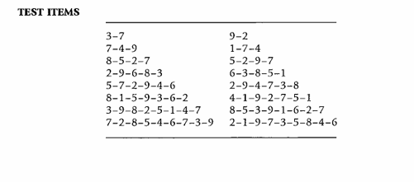
SCORING: The patient of average intelligence can accurately repeat five to seven digits without difficulty. In a nonretarded patient without obvious aphasia, inability to repeat more than five digits indicates defective attention. Specific age-related norms for this task are readily available.1O,22,23

Slide 31
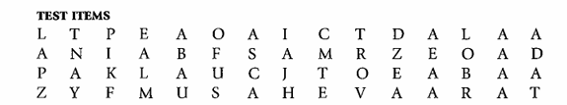
Sustained Attention
Tell the patient: "1 am going to read you a long series of letters. Whenever you hear the letter 'A,' indicate by tapping the desk." Read the following letter list in a normal tone at a rate of one letter per second.
SCORING: The average person should complete the task without error (x = 0.2); a sample of randomly selected brain-damaged patients made an average of 10 errors.
Examples of common organic errors are (1) failure to indicate when the target letter has been presented
(2) indication made when a nontarget letter has been presented; and
(3) failure to stop tapping with the presentation of subsequent nontarget letters (perseveration error).
Another attention test that has been traditionally included in mental status examinations is the Serial Sevens Subtraction Test (e.g., counting back ward from 100 by 7s: 100, 93, 86, ... ). Results of studies of performance by normal people suggest that errors on this test may be influenced by intellectual capability, education, calculating ability, or socioeconomic status, rather than indicating a pathologic process.
Excellent performance indicates ad equate attention or mental control, but failure may reflect any of a number of problems, inattention being but one. In general, this test has proved of limited validity.

Slide 32
Unilateral Inattention
Unilateral inattention (suppression or extinction) should be tested during the routine sensory examination by using double (bilateral) simultaneous stimulation.
DIRECTIONS: Double simultaneous stimulation is tested in all major sensory modalities.
In tactile testing, corresponding points on both sides of the body are touched simultaneously with equal intensity. Visual testing is done by having the patient face the examiner and fix his or her gaze at a point on the examiner's face. The examiner then wiggles a finger in right and left peiripheral fields. Auditory testing is carried out by having the examiner stand behind the patient and provide a stimulus of equal intensity to each ear.
Before undertaking bilateral simultaneous stimulation, the examiner must ensure that basic sensation for each modality is intact bilaterally.
If one side is inferior on unilateral testing, defects found during simultaneous testing would not necessarily reflect inattention.

Slide 33
Extinction is present when the patient suppresses the stimuli from one side of the body. Extinction may occur in all modalities (polymodal neglect) or may be restricted to a single modality.
When extinction is elicited, the degree of inattention can be assessed by increasing the magnitude of the stimulus on the inattentive side.
When the double simultaneous stimulation includes one proximal and one distal stimulus, the distal stimulus tends to be neglected or extinguished.
This is particularly true when the proximal stimulus is the face and the distal one the hand.
Normal adults under 65 often extinguish the hand stimulus on the first trial but usually begin to identify both stimuli after several trials.
Patients with organic brain syndromes rarely recognize the hand stimulus even after as many as 10 trials.
This test (Face-Hand Test is a very useful simple test for organic disease. Some normal elderly individuals will also extinguish the hand stimulus; therefore, the test must be interpreted with caution in patients over 65.

Slide 34
The basic anatomic structures responsible for maintaining an alert state are the brain stem reticular activating system and the diffuse thalamic projection system
Concentration while studying frequently requires conscious voluntary effort that is cortical in origin. The limbic system is also an integral part of the attention process; limbic input adds emotional importance to the object of attention.
Damage to the ascending activating system itself usually causes alterations in the level of consciousness. In such patients, alterations in attention are directly related to the more basic deficit in alertness.
Probably the most common cause of decreased attention and vigilance in a hospital population is delirium.
This dysfunction, in which all cells in the central nervous system are affected, is usually caused by metabolic disturbance, drug intoxication, postsurgical states, or systemic infection.
Another common cause of inattention is extensive bilateral cortical damage of any etiology (e.g., atrophy, multiple infarcts, encephalitis, or head trauma). In patients with advanced Alzheimer's dementia, for example, new stimuli in the vicinity may quickly draw their attention and they then become "stimulus bound." The cortical role in focusing and maintaining attention is very well demonstrated in these patients.
Patients with bilateral lesions of the frontal lobes or the limbic system (e.g., Korsakoff's syndrome) have a type of inattention that is characterized by indifference and perseveration. Clinically, they are apathetic toward their surroundings and are not particularly interested in test items per se.

Slide 35
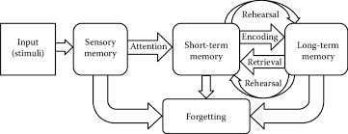
MEMORY
The encoding, storage and retrieval of what was learned earlier.
Atkinson Shiffrin Theory of Memory

Slide 36
Summary of characteristics of stages of memory
 | Sensory Register | Short-Term Memory | Long-Term Memory
Approximate Duration | For Vision: upto 1 sec For Hearing: upto 5 secs | Upto 30 secs, but it varies depending on number of factors | Days, Months, Years or of a lifetime.
Capacity | Relatively large- upto at atleast 16 items, but probably much more. | Relatively small- upto at atleast 7 items or chunks under most condition. | Very large- no known limit.
Transfer Processes | Attention and recognition Items attended to and recognized move to short-term memory. | Rehearsal: Items appropriately rehearsed move to long-term memory.
Type of Information Stored | Copy of Input. | Sounds, Visual images, words and sentences. | Primarily meaningful sentences, life events and concepts; some images; semantic and episodic memory
Major reason information is lost | Decay of Trace | Displacement of old information by incoming information | Faulty organization or Inappropriate retrieval strategy ; Interferance.

Slide 37
Hippocampal region: regarded as most crucial site for memory, a more functional view of neural memory study must also incorporate amygdala which integrates different sensory modalities and input from associated structures that receive input from sensory specific cortical areas and multimodal association.
Afferent and efferent pathways to and from the neocortex converge on Para hippocampal gyrus, providing both hippocampus and amygdala with interconnections to ongoing cortical activity.

Slide 38
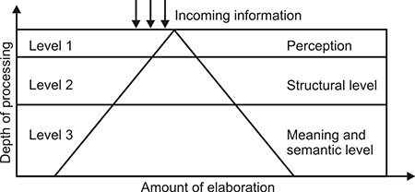
THE LEVELS-OF-PROCESSING THEORY
Given by Craik & Lockhart
According to it, incoming information can be worked on at different levels of analysis. Deeper the analysis, better the memory.
It has 3 levels;-
1.PERCEPTION-immediate awareness of the environment
2.STRUCTURE-what the input sounds or looks like, a deeper analysis
3.MEANING- meaning of the input is analysed. Deepest level.
Later added- ELABORATION: degree to which the information is processed, tied to, or integrated with existing memories.
Best memory-when processing is to the meaning level and elaboration is also the most.
Notes:
2.eg-checking of spelling errors.
3.eg-ideas on the paper.

Slide 39
Long term Memory
Declarative Memory(Explicit) Procedural Memory(Implicit)
(Motor/Cognitive skills,
conditioning)
Semantic Memory Episodic Memory
(Facts) (Events)
Prospective Memory
(Future Planning)

Slide 40
Declarative memory is phylogenetically more recent than non declarative memory.
In addition, declarative memories are available to conscious recollection.
The flexibility of declarative memory permits the retrieved information to be available to multiple response systems.
Non declarative memory is inaccessible to awareness and is expressed only by engaging specific processing systems
SEMANTIC MEMORY- the word ‘semantic’ means meaning.
It consists of knowledge of what words means, how the words are related to one another and the rules for using them in communication and thinking.
It is the kind of memory that makes our use of language possible.
It is very stable and there is little forgetting.
Information is stored in a highly organized way in logical hierarchies from general categories to specific ones.
Or as cluster of words with related meanings.

Slide 41
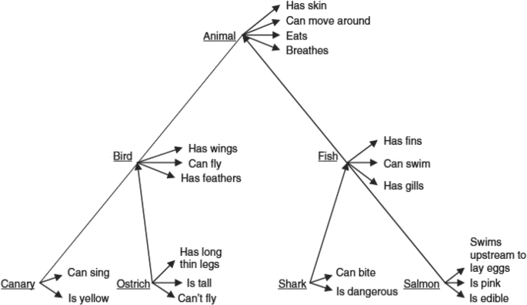
This is an example of how semantic memory works in an organized form from general category to specific ones.

Slide 42
Procedural Memory
Refers to sensory perceptual, motor skill learning, other cognitively acquired operations like Conditioning and Priming.
It is not considered to be directly accessible to conscious collection, retrievable as specific facts or stored with respect to specific time or place.
Therefore it is IMPLICIT and available only by engaging in specific behaviours or cognitive operations and so it is memory without record.

Slide 43
LONG TERM POTENTIATION
The phenomenon of long-term potentiation (LTP) is a mechanism for LTM.
LTP is observed when a postsynaptic neuron is persistently depolarized after a high-frequency burst of presynaptic neural firing. LTP is a persistent strengthening of synapses based on recent patterns of activity that produce a long-lasting increase in signal transmission between two neurons
LTP has a number of properties that make it suitable as a physiological substrate of memory-
established quickly
lasts for a long time
associative i.e. it depends on the co-occurence of presynaptic and postsynaptic activity.
occurs only at potentiated synapses and not all.
prominently seen in Hippocampus.
Notes:
a change within a cell, during which the cell undergoes a shift in electric charge distribution, resulting in less negative charge inside the cell compared to the outside: depolarisation

Slide 44
FORGETTING-Interferences & Motivated forgetting
INTERFERENCES-It is of two types.
1.Retroactive Interference- memory interference from activities that came after the event, one is trying to remember
2.Proactive Interference-It is due to events that came before the to be remembered information.
Motivated Forgetting:
Concept given by Sigmund Freud. He quotes “The forgetting in all cases is proved to be founded on a motive of displeasure”
Based on the concept of REPRESSION. It is the exclusion of distressing memories, thoughts or feelings from the conscious mind.
Some emotionally toned information is made unavailable for conscious thought. To dredge up the unconscious, repressed memories, psychoanalysts use : FREE ASSOCIATION i.e. saying whatever comes to the mind as in this process, retrieval cues for the repressed memories are generated.
Hypnosis and truth serums are some other methods for the same.

Slide 45
AMNESIA
BIOLOGICAL PSYCHOLOGICAL
1) Transient global amnesia 1) Childhood Amnesia
2) Substance induced amnesia 2) Dream Amnesia
3) Diseases of Brain 3) Defensive Amnesia

Slide 46
AMNESIA
Profound loss of memory either due to loss of what has been stored or the ability to form new memories.
It can be –Biological or Psychological.
PSYCHOLOGICAL AMNESIA:
1.CHILDHOOD AMNESIA- 3 theories of why we do not remember early childhood memory(approx. 3 yrs of age)
i)According to Freud-Due to repression. We are unable to retrieve our childhood memories because they are associated with forbidden, guilt arousing sexual and aggressive urges and might provoke guilt or anxiety.
Concept given by Sigmund Freud. He quotes “The forgetting in all cases is proved to be founded on a motive of displeasure”
Based on the concept of REPRESSION. It is the exclusion of distressing memories, thoughts or feelings from the conscious mind.
Some emotionally toned information is made unavailable for conscious thought. To dredge up the unconscious, repressed memories, psychoanalysts use : FREE ASSOCIATION i.e. saying whatever comes to the mind as in this process, retrieval cues for the repressed memories are generated.
Hypnosis and truth serums are some other methods for the same.

Slide 47
2)DREAM AMNESIA-Three interpretations on why we forget most of our dreams.
i)Freud-Dreams are the expression of forbidden sexual or aggressive urges and can produce strong guilt or anxiety.
ii)Due to differences in the symbol systems used in dreaming and waking, that are different and therefore we have difficulty in retrieval.
iii)State Dependance-The dreaming brain is in a different state than the awake brain.
3)DEFENSIVE AMNESIA- Relatively rare, people may forget their names, where they are from and important details of their past lives.
Considered to be a way of protecting oneself from the guilt and anxiety from intense, intolerable situation or conflicts.
Extreme form of repression.
Suddenly amnesiac regains details of his earlier life maybe after weeks to years. But information during the episode itself is not retrievable. This is known as a Memory Gap.

Slide 48
BIOLOGICAL AMNESIA
1)TRANSIENT GLOBAL AMNESIA-Profound memory problem with no loss of consciousness
Cause not known but maybe due to changes in pattern of CBF (Cerebral blood flow)
Sudden without any obvious cause.
Typically lasts for few hours or days before memory becomes normal again.
GLOBAL because so much what has been stored is forgotten and no new memories are formed while the attack is in progress.
2 types- RETROGRADE(forgetting events one was exposed to in the past) & ANTEROGRADE (inablility to encode and store new information)
Retrograde deficits often have a temporal gradient, following a principle known as Ribot's law; deficits are most severe for information that was most recently learned.

Slide 49
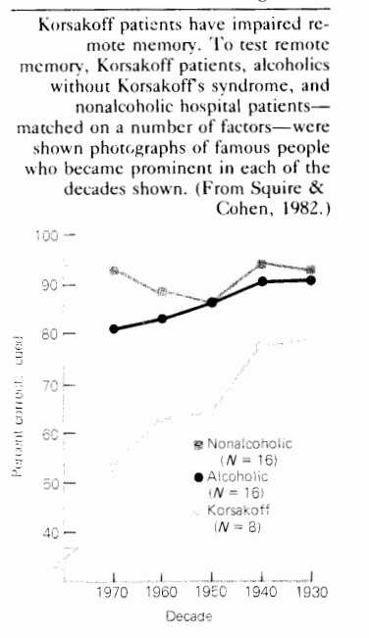
2)SUBSTANCE INDUCED AMNESIA
Marijuana has a limited impact on memory and hardly results in amnesia.
- ALCOHOL Can result in memory gaps after binge drinking.
It is an example of state dependent memory
Chronic drinking can results in KORSAKOFF SYNDROME in which anterograde amnesia is a prominent feature. But can also have loss of remote memories.

Slide 50
3)DISEASES OF THE BRAIN-Common diseases that can result in amnesia are syphilis, tumors, strokes, MS, senile dementia & primary degenerative dementia.
PRIMARY DEGENERATIVE DEMENTIA
Begins in the middle age. Eg. Alzheimers disease.
Goes from relatively mild anterograde amnesia to a profound anterograde and retrograde amnesia-both recent and remote past are largely gone.
SENILE DEMETIA(senile meaning old age)-deficits in many intellectual abilities like memory, attention, judgement, abstract thought, personality changes like excessive dependence and irritablility are common.
Delusion and a general disorientation occur as the disease progresses.
Amnesia is largely ANTEROGRADE and therefore they have trouble learning new things.
Most commonly due to brain arteriosclerosis.
It is different from typical forgetfulness of old age which is also anterograde in nature, but normal old people are able to compensate by reminder cues, writing down what is to be written and organizing lives into routines.

Slide 51
Disturbances in Memory
DÉJÀ VU AND RELATED PHENOMENA (IDENTIFYING PARAMNESIA)
Déjà vu is not primarily a memory disorder but a disturbance in which the associated feeling of familiarity that normally occurs with previously experienced events occurs with a novel event, that is, when the event is experienced for the first time.
In jamais vu, an experience that the patient knows he has experienced before is not associated with the appropriate feeling of familiar ity. The patient may also have the feeling that some important memory is about to be recalled, although it does not actually arrive.

Slide 52
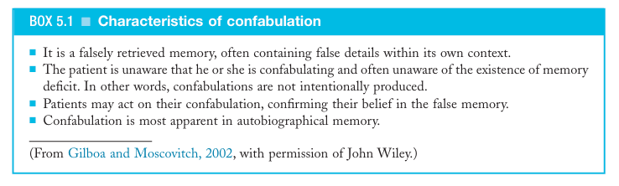
CONFABULATION
This is a falsification of memory occurring in clear consciousness in association with an organically derived amnesia
The term is used to describe mild distortions of an actual memory, such as intrusions, elaborations, paraphrasing or high false alarm rates on tests of anterograde amnesia. It can also refer to bizarre descriptions of false realities

Slide 53
Such memory disturbance may occur with organic deterioration following alcohol abuse and also in the ‘organic amnesic syndrome, not induced by alcohol and other psychoactive substances, in which there is severe memory impairment, especially for recent memory; evidence for disorder of the brain; and absence of a defect in immediate recall, a disturbance of attention and consciousness, and global intellectual impairment.
Suggestibility is a prominent feature of the confabulating patient -to be dependent on clouding of consciousness, weakened judgement and the interplay of fantasy; it may, in fact, closely resemble daydreams
Fantastic confabulation with persecutory content has been described by Roth and Myers This is a falsification of memory occurring in clear consciousness.
Typically, the patient believes others are stealing his money or trying to defraud him.
Memory falsifications of various types occur in schizophrenia, depressive illness, dissocial personality disorder and obsessional states. The more definite, fantastic and gap-filling features of organic confabulations are always associated with memory defect.

Slide 54
MEMORY DISTURBANCE AND ELECTROCONVULSIVE THERAPY
There is always some memory disturbance immediately after electroconvulsive therapy (ECT).
This includes impaired learning ability, defective retrieval and apparent loss of memory stores.
Memories of events immediately preceding the treatments (retrograde amnesia) are most likely to be permanently lost, and more recent personal (autobiographical) memories are more vulnerable to loss than older ones
memory loss that follows ECT is minimal and can be detected for only a few hours after treatment. Unilateral placement of electrodes accelerates postictal recovery and shortens the duration of amnesia
MEMORY IMPAIRMENT IN SCHIZOPHRENIA
There are deficits in long-term memory, including evidence of impaired retrieval in both recall and recognition. There is also evidence of impaired short-term memory, demonstrated by deficit of forward digit span. Furthermore, there is evidence of impairment of working memory and semantic memory, but procedural or implicit memory is intact. The memory deficit has been shown to be associated with severity and chronicity of illness, and with negative symptoms and formal thought disorder
TEMPORAL LOBE DISORDER
It is useful to summarize at this stage the psychopathological phenomena of temporal lobe dys function: disturbance of memory, perception and affect. Disorder of memory includes the hip pocampal defects of diminished storage and accelerated forgetting

Slide 55
Affective Disorder of Memory
It is thought that mood disorder, such as depression, reduces the amount of cognitive processing resources available for a given task, and in the memory domain this is manifest as deficits in the elaboration, organization, encoding and retrieval of material into and out of memory
This mood-congruent memory effect is similar but distinct from state-dependent memory, which refers to the memory bias for material that is learned in a particular mood and is more easily retrieved if the individual is in that same mood during retrieval

Slide 56
SELECTIVE FORGETTING:
Rates of forgetting are influenced by the personal meaningfulness of the information, the conceptual style of the individual, the degree of processing and elaboration of the information and age. It is likely that normal forgetting is determined by disuse or interference by more recently learned or more vivid material and underpinned by physiological or metabolic processes (Lezak et al., 2004). Additionally, there are two forms of interference; proactive and retroactive. In proactive interference, newly learned material interferes with the recall of previously learned material. In retroactive interference, previously learned material interferes with the recall of newly learned material
The process of repression or selective forgetting, however, suggests that forgetting is not simply down to errors in the filing and retrieval mechanism. Forgetting is subject to the influence of affect: which sensations are registered, what is retained and for how long and what information is available for recall.
Directed forgetting is the term for the process by which we actively use executive control proc esses within the prefrontal cortex to forget items that we do not wish to recall. It is obvious from the foregoing that forgetting is an important and normative process.

Slide 57
FALSIFICATION OF MEMORY:
Falsification of memory occurs to some extent because of the interplay of memory with affect.
pseudologia fantastica – fluent plausible lying – the untruthful statements are often grandiose and extreme. Questions are answered with fluency, and the story appears to be believed implicitly by the pseudologic himself.
grandiose delusions and memory disturbance of general paresis may result in falsification and distortion of events remembered. Similarly, confabulation as in the Korsakov state is associated with falsification.
Inaccuracy of recall is sometimes called paramnesia. As well as occurring in the normal state and in personality disorders, it is a prominent feature of affective disturbances.
PSYCHOGENIC DISTURBANCE OF MEMORY:
Cryptamnesia is the experience of not remembering that one is remembering! A person makes a witty remark, or writes a haunting melody, without realizing that he is quoting (plagiarizing) rather than producing something original. The process is seen when words or phrases come into popular usage for a few months or years by some process of mass spread, in which people using the expression believe they are introducing a new idea.

Slide 58
Dissociative (Hysterical) Fugue:
The symptoms pertaining to dissociative (conversion) disorders (hysteria) in the International Classification of Diseases are of two types:
conversion and dissociation.
In dissociation, there is a narrowing of the field of consciousness, with subsequent amnesia for the episode.
In many ways, dissociative symptoms represent a layman’s impression of ‘madness’.
In dissociative (hysterical) fugue states, there is narrowing of consciousness, wandering away from normal surroundings and subsequent amnesia.
The person appears to be in good contact with his environment and usually behaves appropriately, maintaining basic self-care, although he sometimes displays disinhibition
There is quite often loss of identity or assumption of another, false identity.
The duration of the episode can be very variable, from a few hours to several weeks, and the subject may travel considerable distances

Slide 59
Ganser State:
described four criminals who showed the following symptoms.
■ Vorbeigehen (‘to pass by’) or approximate answers, described by Ganser thus: ‘In the choice of answers the patient appears to deliberately pass over the indicated correct answer and to select a false one, which any child could recognize as such’.
■ Clouding of consciousness with disorientation.
■ ‘Hysterical’ stigmata.
■ Recent history of head injury, typhus or severe emotional stress.
■ ‘Hallucinations’, auditory and visual (from his description, they are more like pseudohallucinations).
■ Amnesia for the period during which the above symptoms were manifest
Ganser syndrome is either part of a depressive illness or a transient disturbance in the left hemisphere’s lexical or semantic knowledge. Cutting argues that the knowledge deficit demonstrable in Ganser syndrome is not hysterical on any account but a manifestation of a particular kind of cognitive impairment.

Slide 60
Evaluation
The accurate assessment of memory requires that any question asked by the examiner be verifiable from a source other than the patient.
Valid memory testing presumes that the patient is reasonably attentive, can relate to and cooperate with the examiner, and has no defect that impairs language comprehension or expression.
Immediate Recall (Short-Term Memory) :usually tested by digit repetition
This section assesses the patient's ability to actively learn new material (to acquire new memories). Adequate performance requires the integrity of the total memory system: recognition and registration of the initial sensory input, retention and storage of the information, and recall or retrieval of the stored information.
Four Unrelated Words DIRECTIONS: Tell the patient, "1 am going to tell you four words that I would like you to remember. In a few minutes, I will ask you to recall these words." To ensure that the patient has heard, understood, and initially retained the four words, have him or her repeat the words after their presentation.
when a patient must be given four or five trials to repeat the words accurately, this usually forecasts a significant memory problem. To eliminate possible mental rehearsal, interference should be used between presentation and recall of the words.
The normal patient under age 60 should accurately recall three or four of the words after a 10-minute delay.
Normal persons over age 80 retain an average of only two of four words over 5 minutes, with a substantial variance. After being reminded of the correct words, these individuals will improve their performance after 10 and 30 minutes. Patients with dementia, on the other hand, tend not to improve on subsequent trials.

Slide 61
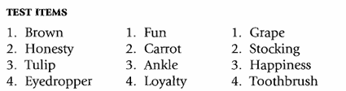
Verbal Story for Immediate Recall DIRECTIONS: Tell the patient, "I am going to read you a short paragraph. Listen carefully, because when I finish reading, I want you to tell me every thing that I told you.“
After reading the story, say "Now tell me everything that you can remember of the story. Start at the beginning of the story and tell me all that happened." The separate items in the story are indicated by slash (f) marks. As the patient retells the story, indicate the number of items recalled. In patients with good immediate recall, it may be useful to ask for another recall after 30 minutes. This is a sensitive method of assessing short-term verbal recall.
Visual Memory (Hidden Objects)
Psychotropic drugs, beta blockers (e.g., propranolol), anticonvulsants, prednisone, and any number of other medications and toxins (e.g., alcohol and street drugs) have been implicated
The patient's emotional state can also significantly affect new-learning ability.
In significant depression, the decrease in motivation and learning probably involves more than purely psychologic mechanisms.

Slide 62
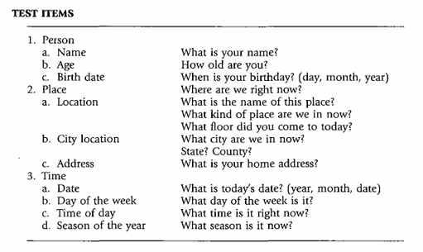
Orientation (Recent Memory) :Orientation to place and time are actually measures of recent memory, as they test the patient's ability to learn these continually changing facts. If a patient is not fully oriented, this alone suggests a significant recent memory deficit.
DIRECTIONS: The patient should be asked the following questions in sequence. Questions may be paraphrased when necessary to ensure clarity. If the patient fails these items, tell the patient the correct answers and have him or her repeat them; several minutes later, have the patient recall the answers. Failure at this level verifies poor new learning ability and predicts deficient performance on any subsequent memory tasks.
Performance correlates with education level; normal college graduates, if they do not know the exact date or day, usually miss by only 1 day, whereas normal people without a high school education may miss by 2 or even 3 days.

Slide 63
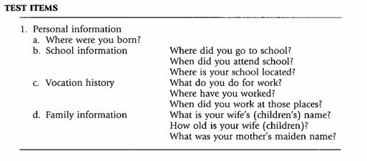
Remote Memory :Remote memory tests such as those included here evaluate the patient's ability to recall personal and historic events. As previously emphasized, personal events must be verifiable by a reliable source other than the patient, performance on the recall of historic information must be interpreted in light of the patient's premorbid intelligence, education, and social experience.
Personal information items are completed with approximately equal accuracy by both normal patients and patients with mild, nonspecific brain damage. Although impaired performance is pathologic, this test does not efficiently differentiate among groups

Slide 64
THINKING-EVALUATION
Proverb Interpretation:
Interpreting proverbs accurately requires an intact fund of general information, the ability to apply this knowledge to unfamiliar situations, and the ability to think in the abstract.
DIRECTIONS: The following proverbs are presented in ascending order of difficulty. Tell the patient, "I am going to read you a saying that you may or may not have heard before.”
Continue only until the patient fails on two successive proverbs. If the patient's response to the first proverb is concrete (non abstract), or if he or she is unable to interpret it, the examiner should supply the correct answer and explain that this is the expected type of response.
TEST ITEMS 1. Don't cry over spilled milk. 2. Rome wasn't built in a day. 3. A drowning man will clutch at a straw. 4. A golden hammer can break down an iron door. 5. The hot coal bums; the cold one blackens.
SCORING: The primary scoring criterion for proverb interpretation is the degree of abstraction demonstrated by the patient in explaining the proverb. It is helpful to rate the quality of the patient's response to each proverb.
Concrete responses are pathologic in all but the retarded or illiterate patient.
Often, uneducated patients will initially give a concrete response but can give abstract interpretations when specifically asked if there is another way of explaining the proverb. Such cued responses should be scored as semi abstract responses

Slide 65
Disturbance in abstract thinking are seen in Schizophrenia, Dementia, past head injury.
Functional Thinking- This type of thinking is characterized by the some degrees of abstraction relating only towards the functional aspects of an object or event.
For e.g. Q: What is a knife; A: An instrument that cuts fruits. Found in Schizophrenia, MR.
Concrete thinking- This refers to the thinking characterized by actual things or events and immediate experience rather than by abstraction.
The person cannot get the abstract meaning of a situation or problem and deals with the event in a superficial way. For e.g. Q: What is the similarity between a table and a chair? A: Both are of wood. Found in Schizophrenia, young children
Over abstraction- This refers to a pattern of thinking characterized by excessive manifestation of a concept beyond the point of relevance. The problem at hand looses its value and remain unsolved. For e.g. The similarity between a table and chair can be answered as: Number of electrons of an atom of a molecule in wood of chair and table are equal. Found in: Schizophrenia, people with philosophical preoccupations.

Slide 66
INTELLIGENCE
Intelligence: Capacity for learning and ability to recall, to integrate constructively, and to apply what one has learned; the capacity to understand and to think rationally.
Comprehension- Understanding and reacting intelligently in a problematic situation.
Conditions having poor comprehension are inattentive states, Dementia. General information- This refers to a person’s knowledge of general information or general knowledge giving due concession to one’s socio-economic status, education and current mental status.
Conditions with poor general information are mental retardation, Dementia.
Vocabulary- This refers to the amount of words the patient uses in his day-to-day dealings. Poor vocabulary is seen in mental retardation, Autism and Dementia.

Slide 67
INSIGHT
Insight is rated on a 6-point scale from one to six.
Grade-1 Complete denial of illness.
Grade-2 Slight awareness of being sick and needing help, but denying at the same time.
Grade-3 Awareness of being sick, but it is attributed to external or physical factors.
Grade-4 Awareness of being sick, due to something unknown in self.
Grade-5 Intellectual insight- awareness of being ill and that the symptoms/ failures in social adjustment are due to own particular irrational feelings/ thoughts; yet doesn’t apply this knowledge to the current/ future experiences.
Grade-6 True emotional insight- it is different from intellectual insight in that the awareness leads to significant basic changes in the future behavior.
Assessment of insight: Insight is most usefully inquired about and reported as a series of health beliefs. Usually a series of questions are asked to assess insight. Do you believe that the experiences that you are having, are symptoms? Do you believe that these symptoms are attributable to illness? Do you believe that the illness is psychiatric? Do you believe that psychiatric treatment might benefit you? Will you be willing to accept advice from a doctor regarding your treatment

Slide 68
thankyou

