Slide 1
Management of Schizophrenia
By: Dr. Lakhan kataria
Professor and Head
Dept. of Psychiatry

Slide 2
Scheme of Presentation
Initial evaluation and management plan for schizophrenia
Recommended therapeutic dose ranges for Antipsychotics
Antipsychotic depot preparations available in India
Management in the acute phase, continuation treatment phase,
maintenance phase.
Antipsychotics and their side effect profile
Treatment resistant schizophrenia
Non-pharmacologial treatment of schizophrenia

Slide 3
Initial evaluation and management plan for schizophrenia
Patient with Psychotic features
Consider differential diagnoses like
• Organic Mental Conditions
• Acute and transient psychotic disorder
• Persistent Delusional disorder
• Schizoaffective disorder
• Severe depression with psychotic symptoms
• Mania with psychotic symptoms
• Drug induced psychosis
Establish the diagnosis of schizophrenia

Slide 4
Assessment
• Severity of illness
• Risk of harm to self and others
• Comorbid substance use/dependence
• Level of functioning
• Detailed Physical examination
• Record- blood pressure, weight and wherever indicated body mass index and waist circumference
• Mental Status Examination
• Investigations- haemogram, liver function test, renal function test, fasting blood glucose level, electrocardiogram (focus on QTc)
• Treatment history- response to previous medication trials, compliance, side effects, etc.
• Patient’s and caregivers beliefs about the cause of illness and beliefs about the treatment
• Assessment for social support, stigma, coping
• Assessment of caregiver burden, coping and distress
Decide about treatment setting-
• Consider inpatient care in case of suicidality, severe agitation and violence, malnutrition, catatonia, patient unable to care for self to the extent that she/he requires constant supervision or support, comorbid general medical conditions making management difficult at the outpatient setting
• Liaison with other specialists depending on the need of the patient

Slide 5
Pharmacological Management
Choose an antipsychotic based on
-Past treatment response,
Past history of side effects
Cost,
Comorbidity, Patient/family preference,
Preferred ROA, Availability,
Current metabolic profile,
Past history of Compliance,
Treatment resistance
Electroconvulsive therapy
• Catatonia,
affective symptoms,
rapid control of symptoms,
suicidality,
past response to ECT, augmentation etc.
Non-Pharmacological Management
• Psychoeducation
• Psychosocial intervention

Slide 6
Factors that influence selection of Antipsychotics
Past treatment response
Cost of treatment, affordability
Psychiatric comorbidity
Medical comorbidity
Side effects
Patient or family preference
Preferred route of administration
Concomitant medications
Non‑adherence
Treatment resistance

Slide 7
Recommended therapeutic dose ranges for Antipsychotics
First Generation Antipsychotics
(FGAs)
Usual daily dose Maximum daily dose
(mg/dl)
Chlorpromazine 300‑800 800
Haloperidol 5‑20 20
Penfluridol 20‑60 mg/week 250 mg/week
Perphenazine 12‑64 64
Pimozide 4‑10 10
Thioridazine 300‑800 800
Trifluoperazine 15‑30 30
Zuclopenthixol 10‑50 50

Slide 8
Second Generation Antipsychotics (SGAs) Usual daily dose Maximum daily dose
(mg/dl)
Amisulpride 50‑800 1200
Aripiprazole 10‑30 30
Asenapine 10‑20 20
Blonanserin 2‑8 24
Clozapine 150‑600 900
Iloperidone 12‑24 24
Olanzapine 10‑30 30
Paliperidone 3‑12 12
Quetiapine 300‑800 800
Risperidone 2‑8 16
Ziprasidone 80‑200 200
Zotepine 75‑300 300
Notes:
Atypical antipsychotics: have the clinical profile of equal positive symptom antipsychotic actions, but low extrapyramidal symptoms and less hyperprolactinemia compared to conventional antipsychotics.
Thus, they are “atypical” from what is expected from a classical, conventional, first-generation antipsychotic.
The “atypicality” of atypical antipsychotics has often been attributed to the coupling of D2 antagonism with serotonin 5HT2A antagonism.

Slide 9
Titration
Quetiapine
- Usual Dosage Range
400–800 mg/day in 1 (quetiapine XR) or 2 (quetiapine) doses for schizophrenia
400–800 mg/day in 1 (quetiapine XR) or 2 (quetiapine) doses for bipolar mania
300 mg once daily for bipolar depression
How to Dose
- (According to manufacturer for quetiapine in schizophrenia): initial 25 mg/day twice a day; increase by 25–50 mg twice a day

Slide 10
each day until desired efficacy is reached; maximum approved dose 800 mg/day
• In practice, can start adults with schizophrenia under age 65 with same doses as recommended for acute bipolar mania
• (According to manufacturer for quetiapine in acute bipolar mania): initiate in twice daily doses, totaling 100 mg/day on day 1, increasing to 400 mg/day on day 4 in increments of up to 100 mg/day; further dosage adjustments up to 800 mg/day by day 6 should be in increments of no greater than 200 mg/day
• Bipolar depression for quetiapine and quetiapine XR: once daily at bedtime; titrate as needed to reach 300 mg/day by day 4
• Quetiapine XR in schizophrenia and acute mania: initial 300 mg once daily, preferably in the evening; can increase by 300 mg/day each day until desired efficacy is reached; maximum approved dose 800 mg/day

Slide 11
RISPERIDONE
- How to Dose
In adults with psychosis in non emergent settings, initial dosage recommendation is 1 mg/day orally in 2 divided doses
Increase each day by 1 mg/day orally until desired efficacy is reached
Maximum generally 16 mg/day orally
Typically maximum effect is seen at 4–8 mg/day orally

Slide 12
Olanzapine
Initial 5–10 mg once daily orally; increase by 5 mg/day once a week until desired efficacy is reached; maximum approved dose is 20 mg/day
For intramuscular formulation, recommended initial dose 10 mg; second injection of 5–10 mg may be administered 2 hours after first injection; maximum daily dose of olanzapine is 20 mg, with no more than 3 injections per 24 hours
For olanzapine-fluoxetine combination, recommended initial dose 6 mg/25 mg once daily in evening; increase dose based on efficacy and tolerability; maximum generally 18 mg/75 mg

Slide 13
Aripiprazole
Schizophrenia, mania: initial approved recommendation is 10–15 mg/day; maximum approved dose 30 mg/day
Depression (adjunct): initial dose 2–5 mg/ day; can increase by 5 mg/day at intervals of no less than 1 week; maximum dose 15 mg/day
Autism: initial dose 2 mg/day; can increase by 5 mg/day at intervals of no less than 1 week; maximum dose 15 mg/day
Tourette’s disorder (patients weighing less than 50 kg): initial dose 2 mg/day; after 2 days increase to 5 mg/day; after 1 additional week can increase to 10 mg/ day if needed
Tourette’s disorder (patients weighing more than 50 kg): initial dose 2 mg/day; after 2 days increase to 5 mg/day; after 5 additional days can increase to 10 mg/day; can increase by 5 mg/day at intervals of no less than 1 week; maximum dose 20 mg/day
Agitation: 9.75 mg/1.3 ml; maximum 30 mg/day
Depot: must initiate oral aripiprazole fi rst; after tolerability is established can administer initial injection along with an overlapping 14-day (Maintena) or 21-day (Aristada) dosing of oral aripiprazole; initial and maintenance doses are described under dosing tips below
Oral solution: solution doses can be substituted for tablet doses on a mg-per-mg basis up to 25 mg; patients receiving 30-mg tablet should receive 25-mg solution.

Slide 14
Clozapine
How to Dose
Initial 25 mg at night; increase by 25–50 mg/day every 48–72 hours as tolerated
Obtain trough plasma level on 200 mg at bedtime
Threshold for response is 350 ng/mL
Levels greater than 700 ng/mL are often not well tolerated
No evidence to support dosing that results in plasma levels greater than 1,000 ng/mL
Doses greater than 500 mg per day may require a split dose

Slide 15
Art of switching (Cross titration)
To switch from one antipsychotic to another, has proven to be problematic for many patients.
Switching antipsychotics actually requires skill to convert patients from one agent to another.
Otherwise, patients can develop agitation, activation, insomnia, rebound psychosis, and withdrawal effects, especially anticholinergic rebound, if it is done too quickly , especially if one tries to precipitously stop one antipsychotic and start the other at full dose
It must be done occasionally under urgent circumstances when there is no time to more carefully transit from one drug to another.
Full doses can be given to patients who are not taking any antipsychotic at the time when one is started, but in a switch scenario, some form of transition is usually necessary in order for the clinical situation to stay stable or improve, and the best results are usually obtained by cross-titration over several days to weeks.
This creates concomitant administration of two antipsychotics for a while as one goes up and the other goes down in dose, and this is acceptable and in fact desirable polypharmacy until transition is complete.

Slide 16
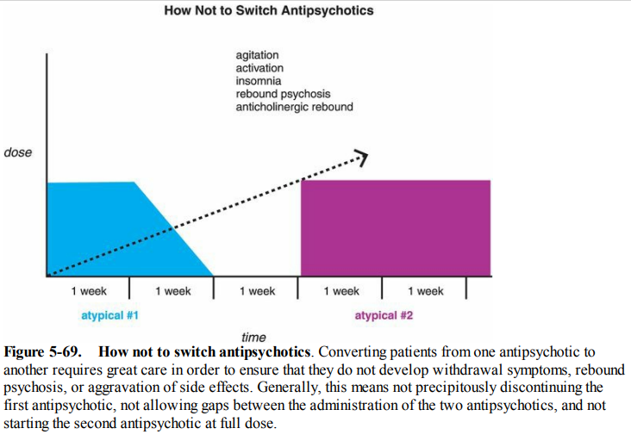

Slide 17
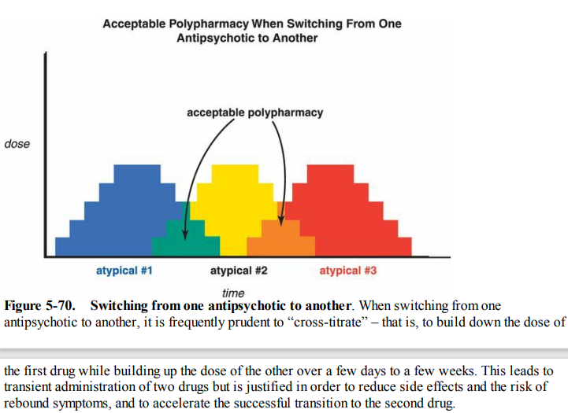

Slide 18
Sometimes the transition between two similar agents can take a long time; it is important to complete the transition and not get caught in cross-titration as shown in Figure 5-71.
Sometimes as the dose of the second drug goes up and the dose of the first drug comes down, the patient begins to do better, and the clinician just stops without completing the transition to a full dose of the second agent and complete discontinuation of the first.
This is not generally recommended, since a full trial on the second agent is the goal, and long-term polypharmacy of two agents is not well studied and can be quite expensive.
If the second agent is not satisfactory, it is generally preferable to try a third (Figure 5-70) rather than use two agents together indefinitely in what can be unacceptable polypharmacy (Figure 5-71).

Slide 19
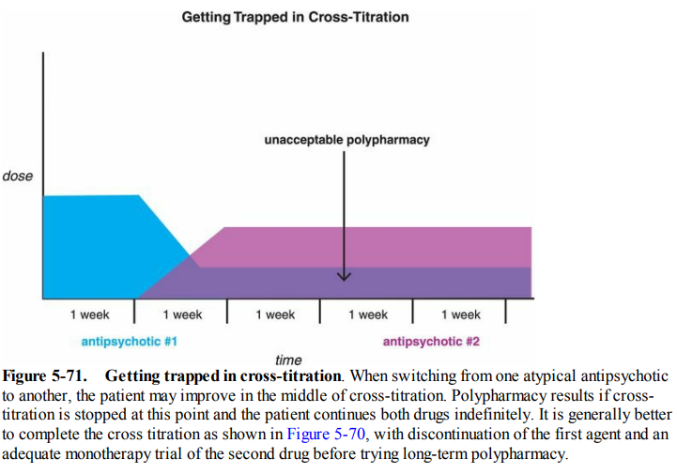

Slide 20
Switching between two agents that have similar pharmacology is generally easiest, fastest, and has the fewest complications, namely a pine to a pine, or a done to a done, over as little as a week's time (Figure 5-72).
However, problems can occur if the switch is too fast from a pine to a done (Figure 5- 73).
The binding characteristics of pines and dones are different, the most striking difference being that the pines in general have more anticholinergic and antihistaminic actions (Figure 5-39), and more α1 antagonist actions (Figure 5-40), and thus are more sedating than the dones, which have less potent binding at these sites.
Notes:
Done: risperidone
Pine: olanzapine

Slide 21
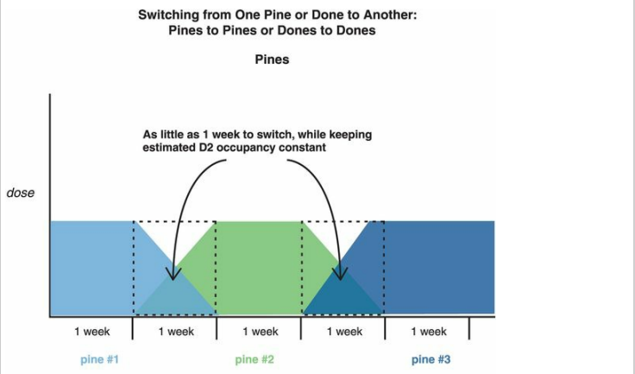

Slide 22
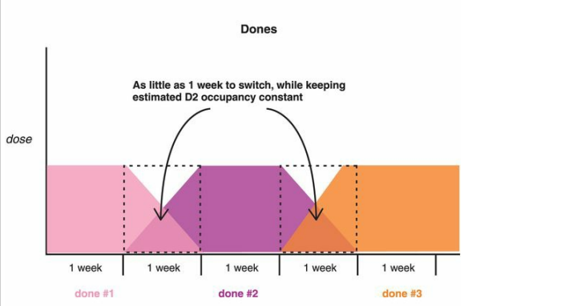

Slide 23
Switching from one pine or done to another.
(A) When switching from one “pine” (clozapine, olanzapine, quetiapine, asenapine) to another, it is prudent to make the switch in as little as 1 week, while keeping estimated D2 receptor occupancy constant.
(B) Likewise, when switching from one “done” (risperidone, paliperidone, ziprasidone, iloperidone, lurasidone) to another, it is prudent to make the switch in as little as 1 week, while keeping estimated D2 receptor occupancy constant.

Slide 24
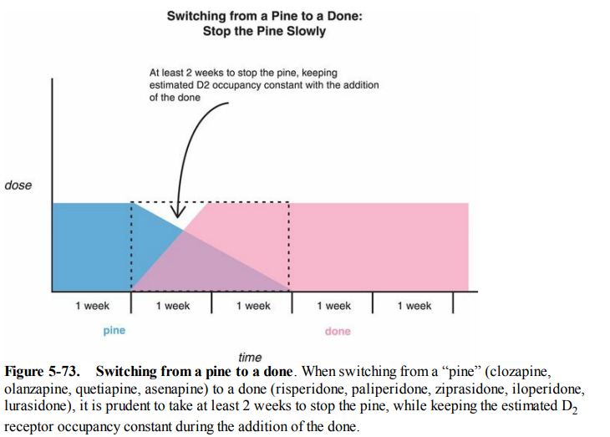

Slide 25
Therefore, when switching from a pine to a done, it is generally a good idea to stop the pine slowly – over at least 2 weeks – to allow the patient to readapt to the withdrawal of blocking cholinergic, histaminic, and α1 receptors, which makes the transition more tolerable without anticholinergic rebound, agitation, and insomnia (Figure 5-73).
When stopping the specific pine i.e clozapine, it should always be stopped very slowly, over 4 weeks or more if possible, to minimize the chances of rebound psychosis as well as anticholinergic rebound (Figure 5-74).

Slide 26
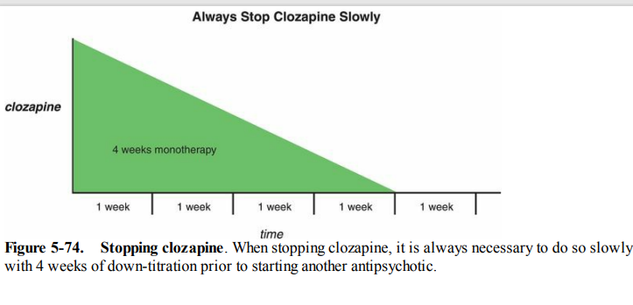

Slide 27
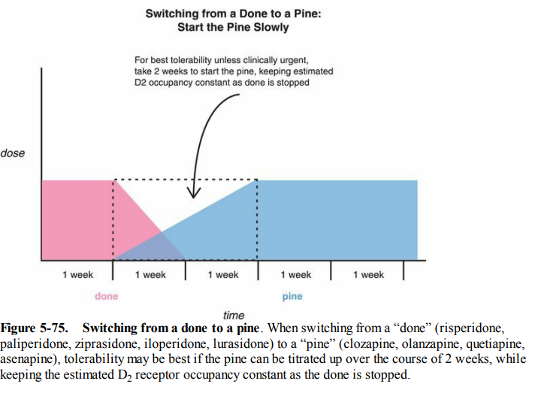

Slide 28
Switching to and from aripiprazole is a special case, in part because it has different pharmacologic properties, and in part because it has higher potency for the D2 receptor than many other drugs, meaning that its administration causes essentially immediate withdrawal of the first drug from D2 receptors.
These principles are likely to be applicable to the new “pip and a rip” (namely, brexpiprazole and cariprazine), as they both have similar binding characteristics and D2 potencies, and are D2 partial agonists, but there is little experience as yet with switching to or from either brexpiprazole or cariprazine.

Slide 29
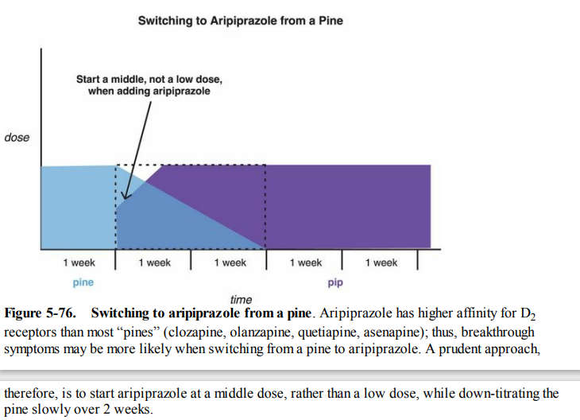

Slide 30
Specifically, when switching to aripiprazole from a pine, it can be a good idea in many patients to start a middle, and not a low, dose when adding aripiprazole, building the aripiprazole dose up rapidly over 3–7 days while taking 2 weeks to taper the pine (Figure 5-76).
The recommendation for fast up-titration of aripiprazole arises from the fact that it essentially replaces the first drug at the D2 receptor immediately, and it can be helpful therefore to get aripiprazole to its therapeutic dose rapidly.
The slower down-titration of the pine allows readaptation of cholinergic and histaminergic receptors to minimize withdrawal, and the taper also allows slower offset of any sedating actions while the full dose of aripiprazole is being established (Figure 5-76).
When switching to aripiprazole from a done (Figure 5-77), it can also be helpful to start a middle, not a low, dose of the aripiprazole, and build it up rapidly over 3–7 days, but it is possible to taper the done over 1 week, since the dones are less likely to be associated with anticholinergic and antihistaminic withdrawal symptoms.

Slide 31
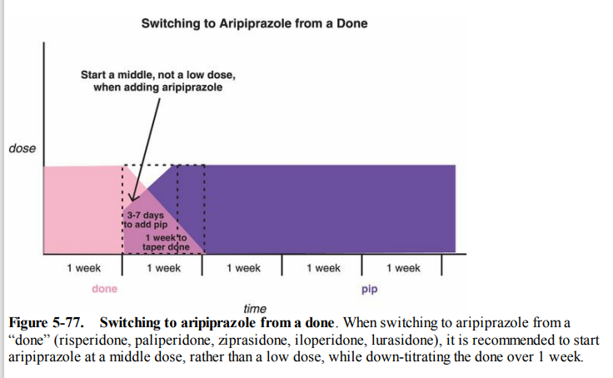

Slide 32
Switching from aripiprazole In the other direction, when stopping aripiprazole and switching to a pine, consider immediately stopping the aripiprazole, which has not only high potency for D2 receptors but a very long half-life (more than 2 days), while starting a middle, and not a low, dose of the pine, tapered up over 2 weeks (Figure 5-78). When switching from aripiprazole to a done, also consider immediately stopping the aripiprazole, and starting a middle, and not a low, dose of the done, tapered up over 1 week (Figure 5-79)

Slide 33
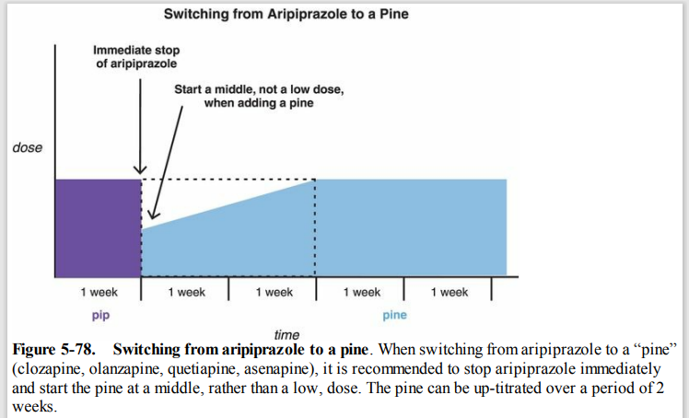

Slide 34
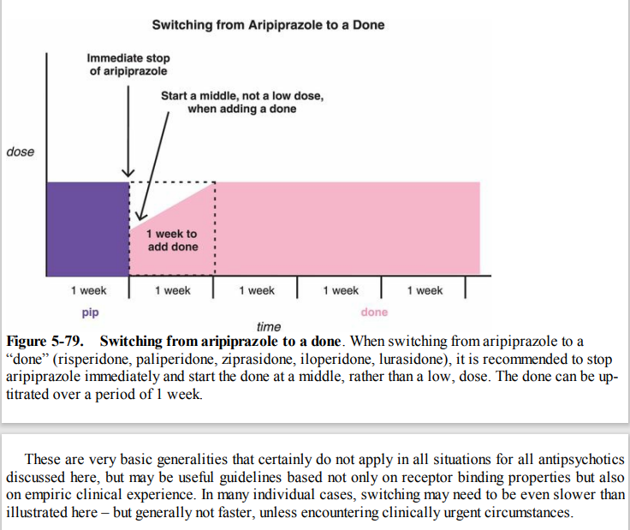

Slide 35
With regular dosing of depot medication, plasma levels rise for at least 6–12 weeks after initiation, even without a change in dose (see section on ‘Depot antipsychotics – pharmacokinetics’ in this chapter). Dose increases during this time are therefore difficult to evaluate. The preferred method is to establish efficacy and tolerability of oral medication at a particular dose and then give the equivalent dose of that drug in LAI form. Where this is not possible, the target dose of LAI for an individual should be that established to be optimal in clinical trials

Slide 36
Dose equivalent
Chlorpromazine 100 mg/day
Haloperidol 2 mg/day
Trifluoperazine 5 mg/day
Amisulpride 400 mg/day
Aripiprazole 15 mg/day
Olanzapine 10 mg/day
Risperidone 4 mg/day

Slide 37
Antipsychotic depot preparations available in
India
Name of antipsychotic Usual 2‑4 weekly dose in mg
Zuclopenthixol decanoate 200
Paliperidone palmitate 234 initially f/b 117 monthly
Fluphenazine decanoate 12.5‑50
Haloperidol decanoate 50
Risperidone depot 25‑50
Olanzapine pamoate 210‑405

Slide 38
Evaluation of patient with non-response to antipsychotic medications
Patient given an adequate
antipsychotic trial (adequate dose for
At least 6 weeks duration)
Adequate Response
• Continue with the same
dose of antipsychotic
medication and keep on
monitoring the side effects
Non-response to treatment
Evaluation
• Re-evaluate the diagnosis
• Medication compliance
True Non-response
• Change the antipsychotic medication
Pseudo Non-response due to poor compliance
• Evaluate the causes, address same and ensure compliance
• In case of poor compliance due to intolerable
side effects –consider change of antipsychotic

Slide 39
Failure of 2 adequate trials of
antipsychotic, one of which is SGA
- Consider Clozapine
Adequate Response
• Continue with the same dose of
antipsychotic medication and keep on monitoring side effects.
Inadequate Response to clozapine
• Consider combining clozapine with ECT
or another antipsychotic medication
• More intensive psychosocial intervention

Slide 40
Possible indications of use of ECT in patients of schizophrenia
• Catatonic symptoms
• Affective symptoms
• Need for rapid control of symptoms
• Presence of suicidal behaviour which puts the life of the patient at risk
• Presence of severe agitation or violence which puts the life of others at risk
• Refusal to eat which puts the life of patient at risk
• History of good response in the past
• Patients not responding to adequate trial of an antipsychotic medication
• Augmentation of partial response to antipsychotic medication
• Clozapine resistant schizophrenia
• Not able to tolerate antipsychotic medications

Slide 41
Basic components of Psychoeducation
Assessing the knowledge of the patient and caregivers about etiology, treatment and prognosis
• Introducing the diagnosis of schizophrenia into discussion
Discussing about various symptom dimensions
Providing information about aetiology
Providing information about treatment in terms of available options, their efficacy, side effects, duration of use
Discussing about importance of medication and treatment compliance
Providing information about possible course and long term outcome

Slide 42
Discussing about problems of substance abuse, marriage and other issues
Discussing about Communication patterns, problem solving, disability benefits
Discussing about relapse and how to identify the early signs of relapse
Dealing with day today stress
Improving insight into illness
Handling expressed emotions and improving communication
Enhancing adaptive coping to deal with persistent/residual symptoms

Slide 43
Factors associated with poor medication compliance
Demographic risk factors
Younger age, male gender, unemployment, lower socioeconomic status
Patient related factors
- Knowledge about illness and treatment, perceived need for
treatment (insight), motivation, beliefs about treatment risks and benefits,
past experiences/“transference”, past history of adherence, self‑stigma
Social risk factors
Living independently, poor social support, poor financial support
Notes:
Transference: Redirecting or projecting someone else’s feelings on to therapist

Slide 44
Clinical risk factors
- Poorer premorbid functioning, earlier age of onset, prior history of non‑adherence
Symptom‑related risk factors
Lack of insight, paranoia, grandiose delusions, conceptual disorganization, impaired cognition, substance abuse, comorbidities, depression, refractoriness, spontaneous remissions
Treatment‑related risk factors
Medication side effects,
poor treatment alliance,
complex dosing,
negative experience of medication,
route of administration, length of treatment, cost of treatment, number of medications
Service‑related risk factors
High cost of medication, poor accessibility of treatment services
Notes:
Premorbid functioning: Individual’s social, interpersonal, academic, occupational functioning prior to onset of psychotic symptoms
It is a predictor of treatment outcome
Adherence

Slide 45
Family/caregivers‑related risk factors
Lack of supervision,
negative attitudes towards treatment,
lack of knowledge about medicines,
nature of relationship with patient,
perceived need for treatment, beliefs about benefits and risks with continued treatment, involvement in treatment, stigma, financial constraints, support from other sources
Clinician/provider related factors
Therapeutic alliance, frequency and nature of contact with clinicians, expected duration of treatment,
duration of past treatment,
accessibility to clinicians and services, reimbursement,
psychoeducation and psychosocial treatment,
complexity of administration

Slide 46
Management in the acute phase
Comprehensive assessment (psychiatric/medical/psychosocial)
Deciding on goals of treatment
Patients
Eliminate/reduce symptoms of schizophrenia and improve the level of functioning Promote safety, reduce risk of harm, reduce stress
Caregivers
Minimize caregiver distress
Offer help to enable them to cope with the illness in their relative
Both
Develop a therapeutic alliance and provide opportunities for patients and caregivers to actively engage in treatment
Offer basic information and support tailored to needs of patients and caregivers
Choice of treatment setting

Slide 47
Antipsychotic treatment
Choice of drug
Dose
Route of administration
Duration of treatment
Determining response or non‑response
Combining antipsychotics
Use of adjunctive medications when indicated (antidepressant, mood stabilizer, bzd)
Use of ECT when indicated
Psychosocial interventions‑ relatively basic and mainly for the purpose of fulfilling the goals of treatment listed above
Planning for further treatment.

Slide 48
Management in the continuation treatment phase
Determining Goals:
Consolidation of remission, continued reduction in symptoms and prevention of early relapse.
Reduction in stress on patient and family by continued engagement, support and enhancing adaptation to life after discharge from hospital.
Further assessment
Antipsychotic treatment (continue same treatment for next 6-12 months)
Psychosocial interventions
Monitoring for response, side effects and treatment adherence

Slide 49
Management in the maintenance phase
• Determining goals:
Maintain/ improve functioning
Improve quality of life, facilate personal recovery.
Psychotic exacerbation need to be effectively treated
Adverse effects: noted and managed.
• Re‑evaluating/modifying the treatment plan
• Assessments and monitoring
• Antipsychotic treatment ( A balance between the need to reduce side effects and need to prevent relapse)
• Psychosocial interventions
• Monitoring for response, side effects and treatment adherence
• Early intervention for relapses
Notes:
Stable patients who do not have positive symptoms may be candidates for reduction in doses. Doses need to be reduced gradually at the rate of about 20% every 6 months till a minimum effective dose is reached.

Slide 50
Duration of treatment for receiving maintenance treatment:
It depends on a number of factors and will need to be individualized.
The suggested guidelines are as follows:
• First-episode patients: 1-2 years of maintenance treatment
• Patients with several episodes or exacerbations: 5 years or longer after the last episode
• Patients with history of aggression or suicide attempts: for longer period or lifelong.

Slide 51
Indications for life long/long term use of antipsychotic medications
History of multiple relapses while on treatment
History of relapses when the medications are tapered off
History of 2 episodes in last 5 years
History of suicidal attempts
Presence of residual psychotic symptoms
Family history of psychosis with poor outcome
Comorbid substance dependence.

Slide 52
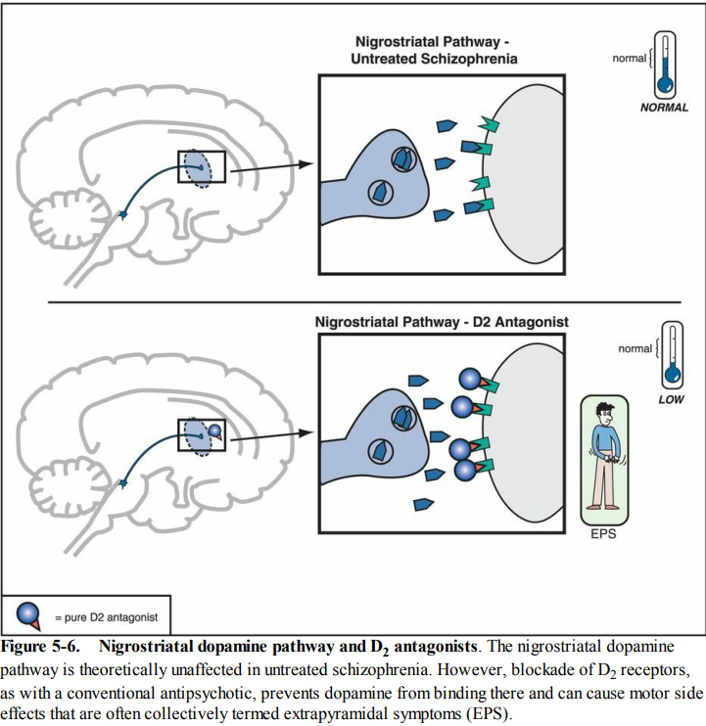
Targeting Nigrostriatal Dopamine D2 receptors:
Causes Motor side effects like
Akathisia
DIP
Dystonia
Tardive dyskinesia (chronic blockade of D2 receptor)
Notes:
Nigrostriatal pathway: Projects from substantia nigra to striatum of basal ganglia.

Slide 53
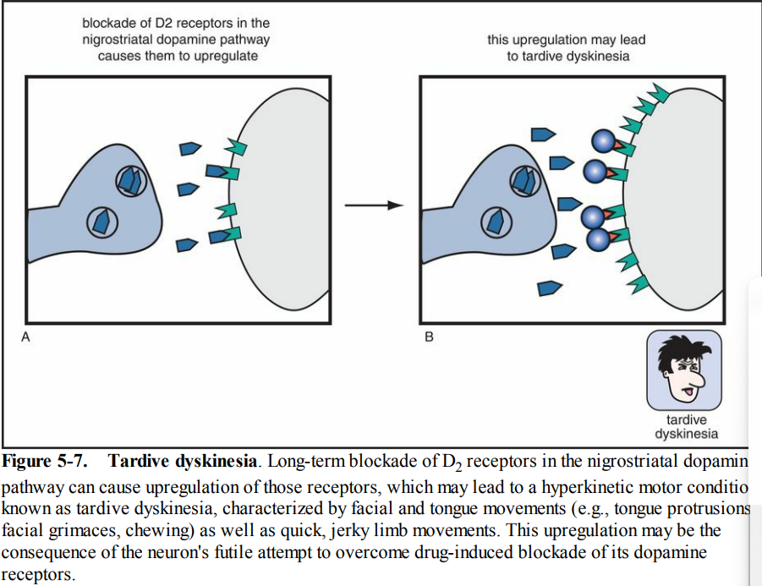

Slide 54
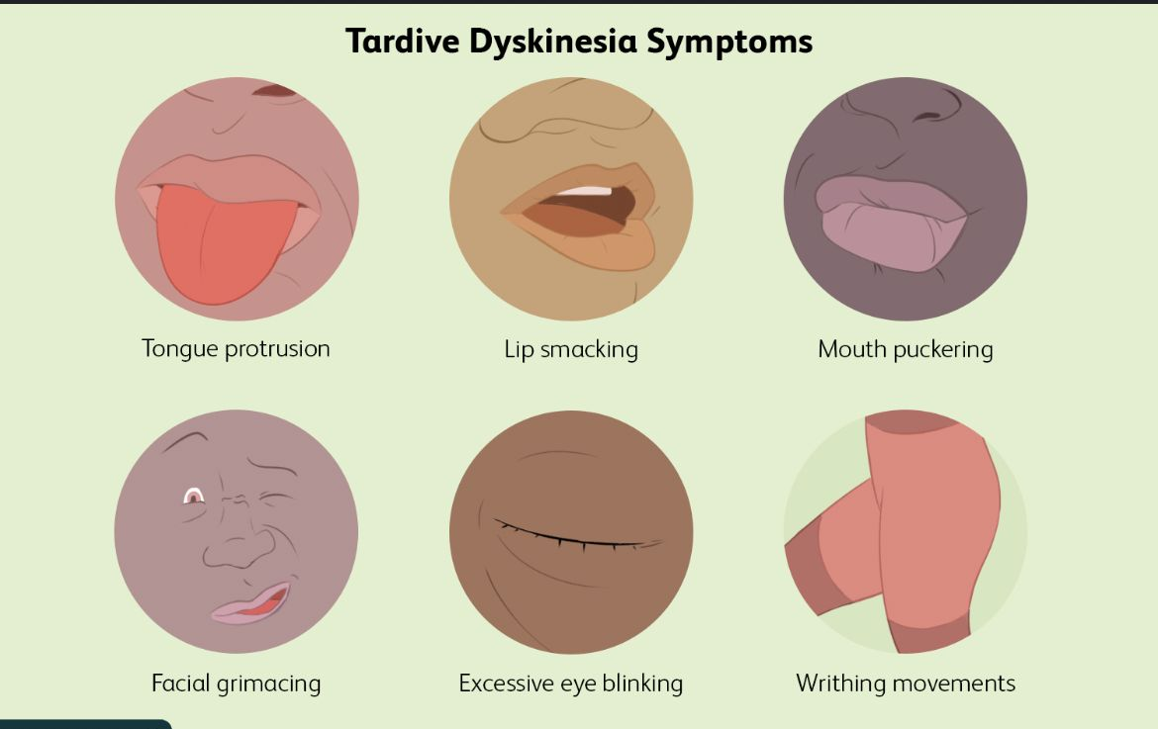

Slide 55
Most common Extrapyramidal symptoms
 | Dystonia (uncontrolled muscular spasm) | Pseudoparkinsonism (bradykinesia, tremor, etc.) | Akathisia (restlessness) | Tardive dyskinesia (abnormal movements)
Signs and symptoms | Muscle spasm in any part of the body, e.g.: ■ eyes rolling upwards (oculogyric crisis) ■ head and neck twisted to the side (torticollis) - The patient may be unable to swallow or speak clearly. In extreme cases, the back may arch or the jaw dislocate | ■ Tremor and/or rigidity ■ Bradykinesia (decreased facial expression, flat monotone voice, slow body movements, inability to initiate movement) ■ Bradyphrenia (slowed thinking) ■ Salivation Pseudoparkinsonism can be mistaken for depression or the negative symptoms of schizophrenia | A subjectively unpleasant state of inner restlessness where there is a strong desire or compulsion to move, e.g.: ■ foot stamping when seated ■ constantly crossing/uncrossing legs ■ rocking from foot to foot ■ constantly pacing up and down | A wide variety of movements can occur such as: ■ lip smacking or chewing ■ tongue protrusion (fly catching) ■ Choreiform hand movements (pill rolling or piano playing) ■ pelvic thrusting - Severe orofacial movements can lead to difficulty speaking, eating or breathing. - Movements are worse when under stress
Notes:
Akathisia can be mistaken for psychotic agitation and has been linked with suicidal ideation 3 and aggression towards others

Slide 56
 | Dystonia (uncontrolled muscular spasm) | Pseudoparkinsonism (bradykinesia, tremor, etc.) | Akathisia (restlessness) | Tardive dyskinesia (abnormal movements)
Rating scales | No specific scale Small component of general EPS scales | Simpson–Angus EPS Rating Scale | Barnes Akathisia Scale | Abnormal Involuntary Movement Scale (AIMS)
Prevalence (with older drugs) | Approximately 10%, but more common: ■ in young males ■ in the neuroleptic‐naïve ■ with high‐potency drugs (e.g. haloperidol) Dystonic reactions are rare in the elderly | Approximately 20%but more common in: ■ elderly females ■ those with pre‐existing neurological damage (head injury, stroke, etc.) | Wide variation but approximately 25% for acute akathisia with FGAs; - Lower with SGAs In decreasing order: aripiprazole, risperidone, olanzapine, quetiapine and clozapine | 5% of patients per year of antipsychotic exposure. More common in: ■ elderly females ■ those with affective illness ■ those who have had acute EPS early in treatment TD may be associated with neurocognitive deficits

Slide 57
 | Dystonia (uncontrolled muscular spasm) | Pseudoparkinsonism (bradykinesia, tremor, etc.) | Akathisia (restlessness) | Tardive dyskinesia (abnormal movements)
Time taken to develop | Acute dystonia can occur within hours of starting antipsychotics (minutes if the IM or IV route is used) - TD occurs after months to years of antipsychotic treatment | Days to weeks after antipsychotic drugs are started or the dose is increased | - Occurs: within hours to weeks of starting antipsychotics or increasing the dose . - Chronic akathisia: Akathisia that has persisted for several months or so. - Tardive akathisia tends to occur later in treatment and may be exacerbated or provoked by antipsychotic dose reduction or withdrawal | Months to years Approximately 50% of cases are reversible.

Slide 58
 | Dystonia (uncontrolled muscular spasm) | Pseudoparkinsonism (bradykinesia, tremor, etc.) | Akathisia (restlessness) | Tardive dyskinesia (abnormal movements)
Treatment | Anticholinergic drugs given orally, IM or IV depending on the severity of symptoms ■ Patient may be unable to swallow ■ Response to IV: within 5 minutes ■ Response to IM: takes around 20 mins ■ May respond to ECT ■Botulinum toxin may be effective ■ rTMS may be helpful | Several options are available depending on the clinical circumstances: ■ Reduce the antipsychotic dose ■ Prescribe an anticholinergic. The majority of patients do not require long‐term anticholinergic agents. Use should be reviewed at least every 3 months. Do not prescribe at night | ■ Reduce the antipsychotic dose ■ Change to an antipsychotic drug with lower propensity for akathisia ■ A reduction in symptoms may be seen with: propranolol 30–80 mg/day; clonazepam (low dose) ■ 5‐HT 2 antagonists cyproheptadine, mirtazapine, trazodone, mianserin, diphenhydramine | ■ Stop anticholinergic if prescribed ■ Reduce dose of antipsychotic medication ■ Change to an antipsychotic with lower propensity for TD ■ Clozapine is the most likely to be associated with resolution of symptoms. Quetiapine may also be useful in this regard ■ Both valbenazine and deutetrabenazine as add‐on treatments (VMAT 2 inhibitors) ■ There is also some evidence for tetrabenazine and Ginkgo biloba as add on treatment
Notes:
■ Where symptoms do not respond to simpler measures, including switching to an antipsychotic with a low propensity for EPS, botulinum toxin may be effective
- Change to an antipsychotic with lower propensity for pseudoparkinsonism (see section on ‘Relative adverse effects – a rough guide’)
Gingko biloba: belongs to class ginkgoopside
- Herbal supplent found in over the counter or unapproved homeopathic products for various health conditions such as: cognitive, neurodegeneration, cvs, reproductive health d/o.

Slide 59
Weight gain
Suggested mechanisms include:
5‐HT2C antagonism,
H1 antagonism,
D2 antagonism, and
increased serum leptin (leading to leptin desensitisation).

Slide 60
Antipsychotic‐induced weight gain
Drug Risk/extent of weight gain
- Clozapine High
Olanzapine
Chlorpromazine Moderate
Iloperidone
Sertindole
Quetiapine
Risperidone
Paliperidone

Slide 61
Amisulpride Low
Asenapine
Brexpiprazole
Aripiprazole
Cariprazine
Haloperidol
Lurasidone
Sulpiride
Trifluoperazine
Ziprasidone

Slide 62
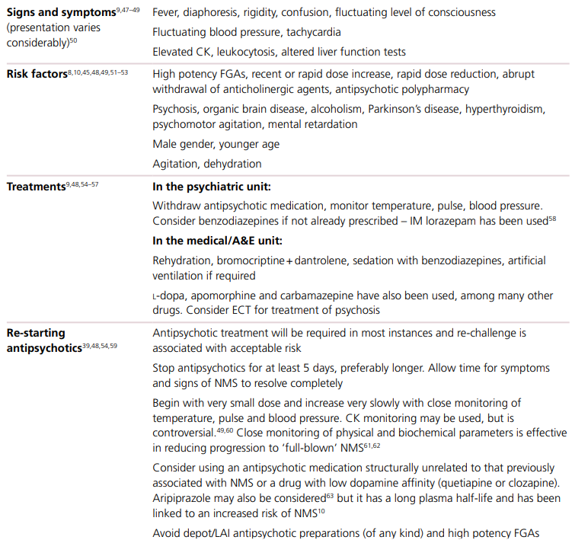
Neuroleptic Malignant Syndrome

Slide 63
QTc Prolongation
Many psychotropic drugs are associated with ECG changes and some are linked to serious ventricular arrhythmia and sudden cardiac death.
Specifically, some antipsychotics block cardiac potassium channels and are linked to prolongation of the cardiac QT interval, a risk factor for the ventricular arrhythmia torsades de pointes.
The cardiac QT interval is a useful, but imprecise indicator of risk of torsades de pointes and of increased cardiac mortality.
The QT interval broadly reflects the duration of cardiac repolarisation.
There is some controversy over the exact association between QTc and risk of arrhythmia.
Very limited evidence: that risk is exponentially related to the extent of prolongation beyond normal limits (440ms for men, 470ms for women), although there are well‐known exceptions that appear to disprove this theory.
Symptoms: Dizziness, fainting spells, seizures

Slide 64
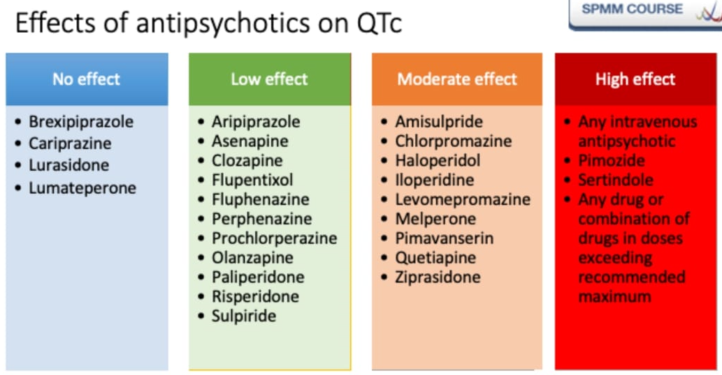

Slide 65
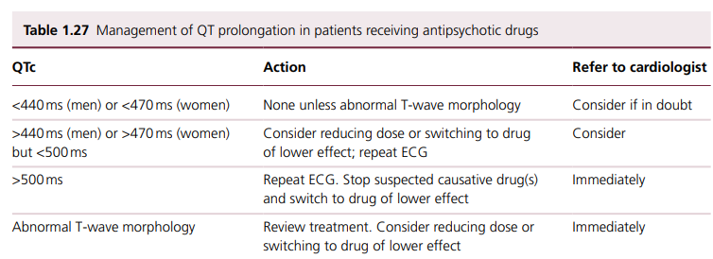

Slide 66
Dyslipidemia
Majority of patients with schizophrenia have several of these risk factors and can be considered at ‘high risk’ of developing cardiovascular disease.
Dyslipidaemia is an risk factor for cardiovascular disease along with obesity, hypertension, smoking, diabetes and sedentary lifestyle.
FGA: Phenothiazines are known to be associated
with increases in triglycerides and low‐density lipoprotein (LDL) cholesterol and
decreases in high‐density lipoprotein (HDL) cholesterol, but the magnitude of these effects is poorly quantified.
Haloperidol seems to have minimal effect on lipid profiles

Slide 67
SGA (Second generation antipsychotic)
Olanzapine: greatest propensity to increase lipids,
Quetiapine and Risperidone: moderate propensity
Aripiprazole, lurasidone and ziprasidone: minimal adverse effect on blood lipids
Olanzapine has been shown to increase triglyceride levels by 40% over the short (12weeks) and medium (16months) term.
Levels may continue to rise for up to a year
Patients treated with olanzapine and risperidone gained a similar amount of weight, but in olanzapine patients serum triglyceride levels increased by four times as much (80mg/dL) as in risperidone patients (20mg/dL)

Slide 68
Clozapine
Mean triglyceride levels have been shown to double and cholesterol levels to increase by at least 10% after 5 years treatment with clozapine.
Patients treated with clozapine have triglyceride levels that are almost double those of patients who are treated with FGA drugs.
Cholesterol levels are also increased.
Particular care should be taken before prescribing clozapine or olanzapine for patients who are obese, diabetic or known to have pre‐existing hyperlipidaemia.

Slide 69
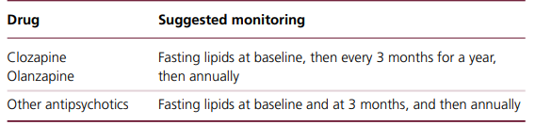
Monitoring lipid concentrations in patients on antipsychotic drugs

Slide 70
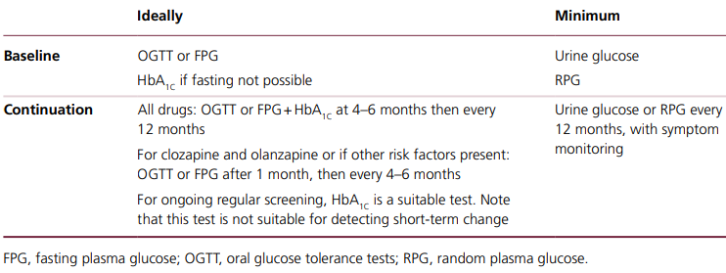
Recommended monitoring for diabetes in patients receiving antipsychotic drugs

Slide 71
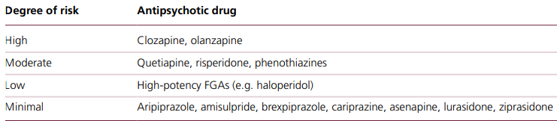
Antipsychotics – risk of diabetes and impaired glucose tolerance

Slide 72
Hyperprolactinaemia
Dopamine inhibits prolactin release and so dopamine antagonists can be expected to increase prolactin plasma levels.
The degree of prolactin elevation is probably dose‐ related.
Persistent elevation of plasma prolactin is associated with suppression of the hypothalamic–pituitary–gonadal axis.
Symptoms : sexual dysfunction(but note that other pharmacological activities also give rise to sexual dysfunction), menstrual disturbances(amenorrhea), Gynecomastia, galactorrhea, interfere with fertility particularly in women and may include delusions of pregnancy.
Long‐term adverse consequences : reductions in bone mineral density, a possible increase in the risk of breast cancer

Slide 73
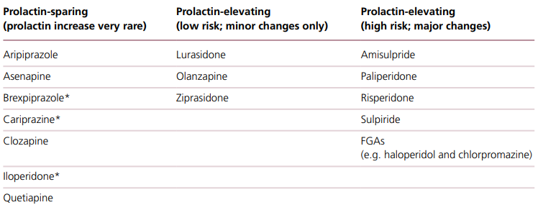
Effects of antipsychotic medication on prolactin concentration

Slide 74
Contraindications for antipsychotics which have a high propensity for causing hyperprolactinemia
■ Patients under 25 years of age (i.e. before peak bone mass)
■ Patients with osteoporosis.
■ Patients with a history of hormone‐dependent breast cancer
■ Young women.

Slide 75
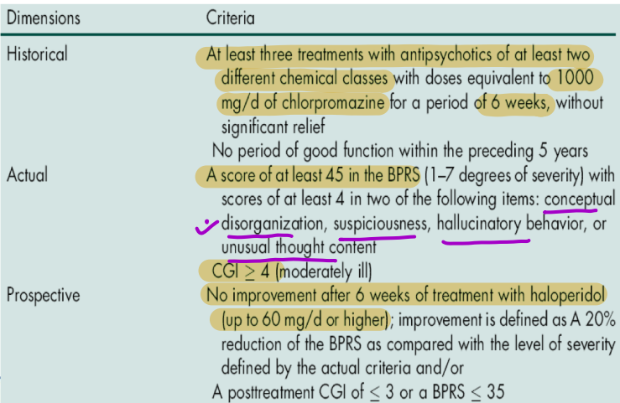
Treatment Resistant Schizophrenia
- Kane’s criteria for TRS
Notes:
CGI: Clinical global impairment.
BPRS: Brief psychiatric rating scale (Somatic concern, anxiety, emotional withdrawal, conceptual disorganization, guilt feelings, tension, mannerisms and posturing, hostility, suspiciousness, hallucinatory behaviour, motor retardation, uncooperativeness, unusual thought content, blunted affect, excitement, disorientation) score upto 7.

Slide 76
Modified Kane’s criteria
Atleast 2 drug trials of 4-6 weeks, at 400-600mg Chlorpromazine equivalents.
>5 yrs with no period of good social or occupational functioning.
Persistent psychosis: Total BPRS > 45 and score of > or equal to 4 on 2 out of 4 positive item scores

Slide 77
APA Guidelines
Patient who has not responded to 2 or 3 treatments using atypical antipsychotics for a duration of at least 4 to 6 weeks : can be considered as TRS and is eligible for treatment with clozapine.
NICE Guidelines
Failure of adequate trial of 2 antipsychotics which includes at atleast one second generation drug other than clozapine.
Notes:
APA: American psychiatric association

Slide 78
Ultra resistant schizophrenia
Atleast 8 weeks treatment with clozapine,
plasma level > or = 350 ng/ml and
<20% fall in BPRS scores
No stable period of functioning over 5 years
- Score > or = 4 on 2 out of 4 of positive symptoms of BPRS
- Total BPRS > or = 45 and CGI > or = 4
- GAF of 40 or less (global assessment of functioning)
Notes:
GAF= global assessment of functioning: used to rate how serious a mental illness may be.

Slide 79
Evaluation of TRS
Exclude pseudoresistance causes
Ensure adequacy of 2 previous trials
Optimize current dosage and treat side effects
Consider depot trial if compliance is not assured
If second generation antipsychotic not previously used

Slide 80
Try Olanzapine, Risperidone, Quetiapine for 6-8 weeks
If no response start Clozapine + Psychosocial treatment
If no response reinstate best prior medication
ECT

Slide 81
What if clozapine also fails?
Augmentation with:
Antipsychotics like risperidone, olanzapine, quetiapine, sulprides.
Somatic treatments
Psychosocial treatments
Following agents can be used as augmenting agents to clozapine:
Lamotrigine
Lithium
Valproate
SSRIs

Slide 82
5. Glutaminergic agents: D-cycloserine, D-serine
6. Benzodiazepines
7. Omega-3
8. Glinko Biloba
9. ECT: as maintenance
10. Rtms: Improvement reported in auditory hallucinations.
11. Psychosocial Interventions

Slide 83
Nonpharmacologoical treatment of Schizophrenia
1. Individual and Group 1. Psychoeducation
therapy 2. Reducing expressed emotions
2. CBT
3. ACT(Assertive community
Treatment)
Psychosocial Intervention
Behavioural Intervention
Individual/ Group intervention
Family intervention

Slide 84
4. Supporting psychotherapy
5. Cognitive remediation
6. Rehabilitation
Behavioural Intervention:
1. Assertiveness training
2. Social skill training
3. Problem solving skills
4. Cognitive interventions.

Slide 85
Psychosocial Intervention
Goals:
- Enable persons who are severely ill to develop social and vocational skills for independent living.
It includes methods to increase social abilities,
self-sufficiency,
practical skills, and
interpersonal communication in schizophrenia patients.
Notes:
Reduces: Disruptive behaviour, active symptoms, negative symptoms
Enhances: work behaviour, interpersonal relationships,

Slide 86
STRATEGIES
Cognitive Behavioural Therapy (CBT):
Used to improve cognitive distortion
Reduce distractibility
Correct errors in judgement
Helps in improving Positive and negative symptoms
In treatment resistant patients
Relapse prevention.

Slide 87
Individual Therapy
- Aim: to convey the idea that the therapist is trustworthy, wants to understand the patient and has faith in the patient's potential as a human, no matter how disturbed, hostile, or bizarre the patient may be at the moment.
Effects are additive to those of pharmacological treatment.
Psychotherapy for a schizophrenia patient should be thought of in terms of decades, rather than sessions, months, or even years.
Some researchers have emphasized that the ability of a patient with schizophrenia to form a therapeutic alliance with a therapist is predictive of the outcome.

Slide 88
Group Therapy:
Focuses: on real-life plans, problems, and relationships.
Groups may be behaviorally oriented, psychodynamically or insight oriented, or supportive.
Effective: in reducing social isolation, increasing the sense of cohesiveness, and improving reality testing for patients with schizophrenia.
Groups led in a supportive manner appear to be most helpful for schizophrenia patients.
Notes:
Cohesiveness: working in unity as a group towards a goal.
Reality testing: Reflecting on and evaluating objective world and one’s relationship to it.

Slide 89
Assertive Community Treatment (ACT):
The Assertive Community Treatment (ACT) program: originally developed by researchers in Madison, Wisconsin, in the 1970s
For the delivery of services for persons with chronic mental illness.
Patients are assigned to one multidisciplinary team (e.g., case manager, psychiatrist, nurse, general physicians).
The team has a fixed caseload of patients and delivers all services when and where needed by the patient, 24 hrs a day.

Slide 90
Intensive intervention that provides treatment, rehabilitation, and support activities.
These include: home delivery of medications, monitoring of mental and physical health, in vivo social skills, and frequent contact with family members.
ACT programs: effectively decrease the risk of rehospitalization for persons with schizophrenia
- Limitation: Labor-intensive and expensive programs to administer.

Slide 91
Social Skill Training:
Sometimes referred to as behavioral skill therapy.
Along with psychotic features other symptoms involve: poor eye contact, unusual delays in response, odd facial expressions, lack of spontaneity in social situations, and inaccurate perception or lack of perception of emotions in other people.
Behavioral skills training : addresses these behaviors through the use of videotapes of others and of the patient, role playing in therapy, and homework assignments for the specific skills being practiced.
Reduce relapse rates as measured by the need for hospitalization.

Slide 92
Vocational Therapy:
- A variety of methods are used to help patients regain old skills or develop new ones.
- These include: sheltered workshops, job clubs, and part-time or transitional employment programs.
Enabling patients to become gainfully employed.
Art Therapy:
Provides them with an outlet for their constant bombardment of imagery.
Helps them communicate with others and share their inner, often frightening world with others.

Slide 93
Cognitive Training :
Cognitive training or cognitive remediation is a technique introduced recently for the treatment of schizophrenia.
Utilizing computer generated exercises, neural networks are influenced in such a way that cognition, including working memory, is improved which translates into more effective social functioning.
The field is in its infancy and further work and replication of studies is needed; however, it is a technique that is easily learned, administered and holds great promise.
Cognitive rehabilitation has been defined as “the therapeutic process of increasing or improving an individual's capacity to process and use incoming information so as to allow increased functioning in everyday life.
This includes methods to train and restore cognitive function and compensatory techniques”.

Slide 94
Cognitive remediation for schizophrenia has been recently defined : “a behavioural training based intervention that aims to improve cognitive processes (attention, memory, executive function, social cognition or metacognition) with the goal of durability and generalisation”.
Cognitive remediation strategies distinguished into two main models: “compensatory” and “restorative”.
Compensatory treatments: try to eliminate or to bypass the specific cognitive deficit, using the subject's residual cognitive abilities and/or the environmental resources.
Indeed, the manipulation of the environment is a compensatory technique acting and operating changes in the environment in order to influence and facilitate the cognitive functions, for example, by simplifying the patient's tasks
Restorative methods: based on knowledge deriving from neurosciences, in particular neuronal plasticity, and have the objective to correct a specific deficit trying to repair the specific underlying compromised function using the capacity of the brain to develop and repair itself throughout the whole life.

Slide 95
It has two different approaches: bottom-up or top-down.
Bottom-up approaches: start with remediation of basic neurocognitive skills, such as attention, and advance to more complex skills, such as problem solving.
Top-down approaches: use more complex skills with aim of improving single and specific neurocognitive domains.
Cognitive remediation utilizes several learning strategies, including errorless learning (is instructional technique that aims to prevent mistakes while learning a new skill or information), scaffolding (an instructional practice where teachers gradually remove support as students learn and become more competent), massed practice (a learning technique that involves practicing a skill or learning information in a single session or short period of time, with little or no rest in between), positive reinforcement, and information processing strategies.

Slide 96
Errorless learning: effective because it avoids the implicit encoding of errors which cannot then be differentiated from correct information by explicit recall.
Scaffolding: similar to errorless learning in ensuring a high degree of success for the learner and minimising errors, by carefully regulating the complexity of material to be learnt.
The learner is encouraged to use previously established areas of competence, while help is provided with new aspects of learning.
Massed practice: consists of exercise of a repeated task (at least 2-3 times per week) in order to encourage the retention and application of the skills developed.
Information processing strategies: include verbalization, information reduction, breaking and simplifying the task into smaller steps, providing written prompts, chunking, self-monitoring, mnemonic strategies, categorization, organization, and planning.
Some cognitive remediation programs focus on a specific cognitive domain (e.g., working memory or facial affect recognition), whereas others are broad-based, incorporating multiple domains.

Slide 97
There are various cognitive training techniques:
CAT: cognitive adaptation training;
CET: cognitive enhancement therapy;
CRT: cognitive remediation therapy;
INT: integrated neurocognitive therapy;
IPT: integrated psychological therapy;
MCT: metacognitive training;
NEAR: neuropsychological educational approach to remediation;
NET: neurocognitive enhancement therapy;
NT: neurocognitive training;
SCET: social cognition enhancement training;
SCIT: social cognition and interaction training;
SCST: social cognitive skills training;
SSANIT: social skills and neurocognitive individualized training;
SST: social skills training;
TAR: training of affect recognition;
ToM: theory of mind.
*Cogpack is a typical computer-assisted cognitive remediation (CACR) technique.

Slide 98
Cognitive Training | Target | Duration | Setting (individual/ group) | Computer assisted/ Noncomputer assisted | Restorative/ compensatory | Top-down | Bottom-up | Drill and practice | Strategy coaching | Individually tailored
IPT [62] | Cognitive functions, social skills, and problem solving | Sessions of 60 minutes, 2-3 times a week (about 12 months) | Group (6–8) | Non computer assisted | Restorative | + | + | + | + | −
Notes:
IPT: integrated psychological therapy

Slide 99
INT [63] | Cognitive functions and social cognition | 30 biweekly sessions, 90 minutes each | Group (6–8) | Computer assisted sessions and noncomputer-assisted sessions | Restorative | + | + | + | + | −
Notes:
INT: integrated neurocognitive therapy

Slide 100
CRT [64] | Cognitive functions | 40 sessions at least 3 times a week, 45–60 minutes each one | Individual | Not computer assisted session | Restorative | + | + | + | + | +
Notes:
CRT: cognitive remediation therapy

Slide 101
Cogpack* [43] | Cognitive functions | Sessions variable in duration and frequency (starting from 2-3 weeks) | Individual | Computer assisted | Restorative | − | + | + | − | +
Notes:
Cogpack is a typical computer-assisted cognitive remediation (CACR) technique.

Slide 102
CET [65] | Cognitive functions and social cognition | Biweekly sessions (about 90 minutes every week) for 24 months | Group (couples and then groups of 3-4 couples) | Computer-assisted sessions and noncomputer-assisted sessions | Restorative | + | + | + | + | −
NEAR [66] | Cognitive functions and problem solving | Sessions of 60 minutes, twice a week (about 4 mths) | Individual/group (3–10) | Computer-assisted sessions and noncomputer-assisted sessions | Restorative | + | − | − | + | +
Notes:
CET: cognitive enhancement therapy
NEAR: neuropsychological educational approach to remediation

Slide 103
NET [67] | Cognitive functions and social cognition | Sessions of 45 minutes at least 5 times a week (about 6 months) | Individual/group | Computer-assisted sessions and noncomputer-assisted sessions | Restorative | − | + | + | − | +
CAT [68] | Cognitive functions | Variable (short weekly visits at home, lasting about 30 minutes) | Individual | Noncomputer assisted | Compensatory | − | − | − | − | +
Notes:
NET: neurocognitive enhancement therapy
CAT: cognitive adaptation training

Slide 104
SCIT [70] | Social cognition | 24 weekly sessions, 50 minutes each (about 6 months) | Group (6–8) | Computer-assisted sessions and noncomputer-assisted group sessions | Restorative | − | + | + | + | −
Notes:
SCIT: social cognition and interaction training

Slide 105
SCST [71] | Social cognition | 12 weekly sessions, 60 minutes each (about 3 months) | Group (6 patients) | Computer-assisted sessions and noncomputer-assisted group sessions | Restorative | − | + | + | + | −
Notes:
SCST: social cognitive skills training

Slide 106
SCET [72] | Social cognition, ToM | 36 sessions of 90 minutes, twice a week (about 6 months) | Group | Noncomputer assisted | Restorative | − | + | + | + | −
MCT [73] | Metacognition | 8 biweekly sessions of 45–60 minutes (one cycle per month) | Group (3–10) | Noncomputer assisted | Restorative | + | − | − | + | −
SSANIT [74] | Cognitive functions, social cognition, and social skills | NT: biweekly sessions of 1 hour SST: weekly sessions of 2 hours Duration: 6 months | Individual (group) | NT sessions: computer assisted SST sessions: noncomputer assisted | Restorative | + | + | + | + | +
Notes:
SCET: social cognition enhancement training;
MCT: metacognitive training
SSANIT: social skills and neurocognitive individualized training

Slide 107
Family-Oriented Therapies:
Patients with schizophrenia are often discharged in an only partially remitted state, a family to which a patient returns can often benefit from a brief but intensive course of family therapy.
Without being overly discouraging, therapists must help both the family and the patient understand and learn about schizophrenia and must encourage discussion of the psychotic episode and the events leading up to it
Therapists must control the emotional intensity of family sessions with patients with schizophrenia.
The excessive expression of emotion during a session can damage a patient's recovery process and undermine potentially successful future family therapy.
Several studies have shown: it is effective in reducing relapses.

Slide 108
AVATAR therapy
AVATAR therapy is a recent relational approach which draws on the theoretical and clinical developments.
Using specially designed computer software, the clients create a visual representation of the entity (human or nonhuman) that they believe is talking to them.
Additional software: used to transform the voice of the therapist to match the pitch and tone of the voice heard by the person; the two processes finally being combined to produce a computer simulation (a virtual agent or “avatar”) through which the therapist can have a dialogue with the person.
In addition to the time taken to create the “AVATAR”, therapy comprises approximately 6×45 minutes sessions of which around 15 minutes is spent in dialogue with the avatar. The therapist (sitting in a separate room to the participant and communicating through linked computers) promotes a dialogue between the participant and the avatar, one goal of which is that the hearer will experience more power and control within the relationship.
The sessions are audio recorded and provided to the participant on an MP3 player for continued use at home.

Slide 109
AVATAR therapy can be embraced within the generation of virtual reality-based psychological therapies using technology to integrate real-time graphics, sounds, and other sensory inputs to create a computer-generated world with which the user can interact.
Although AVATAR therapy is not provided in a complex immersive environment, the platform uses virtual reality to create and allow the person to access and visualize the abstract nonphysical information of his/her voice.
One could define it as a virtual embodiment of the experience: to give a physical representation to the personified but disembodied voice.
This visualization of the voice may facilitate two essential processes in the AVATAR therapy: (a) validation of the experience and
(b) the flow of dialogue with the voice through the sessions while modifying the type of relationship between the voice and the participant.
This virtual embodiment of the experience is achieved by matching the voice of the avatar to the current auditory hallucination and, in early sessions, by the avatar using verbatim statements from the voice, as reported by the voice-hearer. These add realism to the experience and seem to be a key aspect of the therapy.

Slide 110
Thank you

