Slide 1
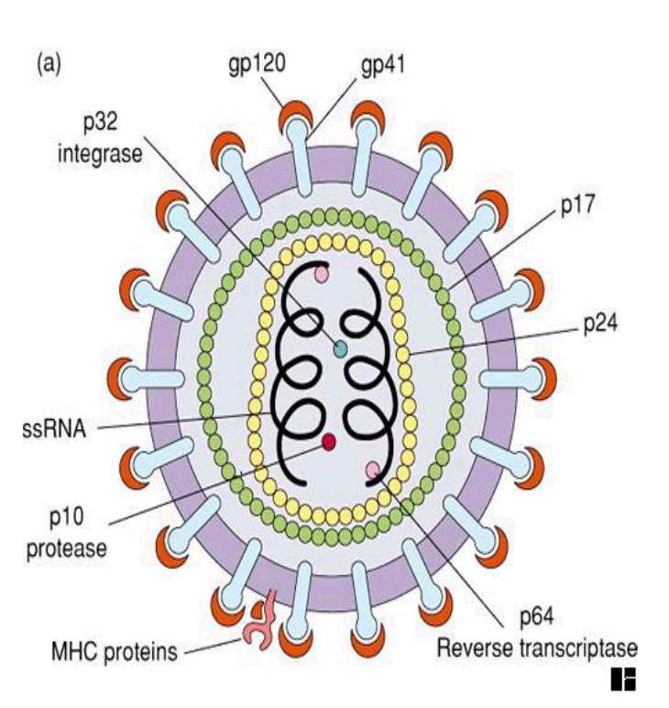
HIV
Dr Binda pipaliya
Associate Professor
Department of Microbiology

Slide 2
Learning objectives
At the end of the session, the students will be able to
Introduction & structure of HIV
Pathogenesis & replication of HIV
Transmission of HIV

Slide 3
Introduction & Morphology
Retroviruses - group of RNA viruses that possess a unique enzyme ‘reverse transcriptase’ that directs the synthesis of DNA from the viral RNA after infection into a host cell.
  Genus Lentivirus – contains Human Immunodeficiency Virus (HIV)- 1 & 2
  Genus Deltaretrovirus – contains Human T cell Lymphotropic Virus-1 (HTLV-1).
  Human Immunodeficiency Virus(HIV) is the etiologic agent of Acquired Immunodeficiency Syndrome(AIDS).

Slide 4
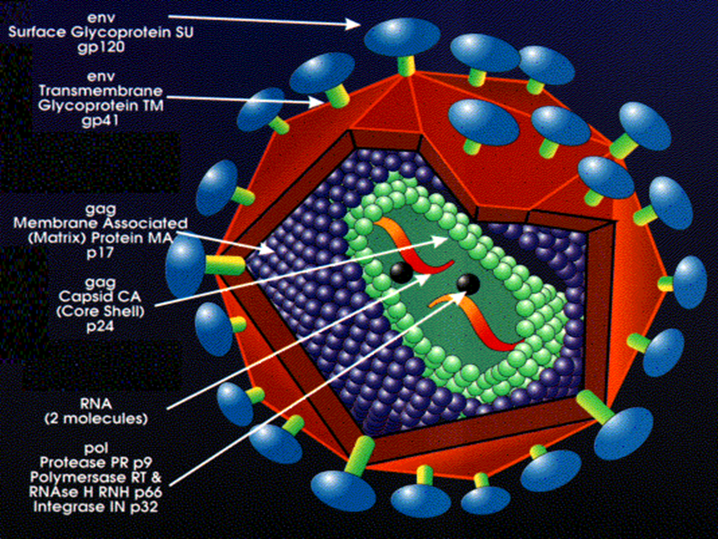
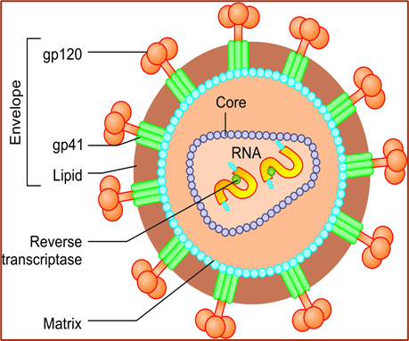
Structure of HIV
Spherical and 80–110 nm in size
Enveloped virus - envelope is made up of-
Lipid part is host cell membrane derived.
Protein part has two components –
  Glycoprotein-120(gp120)are projected as knoblike spikes on the surface.
  Glycoprotein- 41(gp41)- They form anchoring transmembrane pedicles.

Slide 5
Nucleocapsid- Capsid is icosahedral in symmetry, made up of core protein with dense cylindrical inner core which encloses :
  RNA- Two identical copies of single-stranded positive sense linear RNA.
  Viral enzymes such as reverse transcriptase, integrase and proteases that are closely associated with HIV RNA.

Slide 6
HIV Genes and Antigens
Three structural genes—gag, pol, and env
gag gene codes for the core and shell of the virus.
Expressed as a precursor protein, p55 which is cleaved into three proteins,
  p18 constitutes the matrix or shell antigen
  p24 and p15- constitute the core antigens
pol gene codes for viral enzymes such as reverse transcriptase, protease and integrase.
  Expressed as a precursor protein
  Cleaved into proteins p31, p51 and p66.

Slide 7
Non-structural Genes
env gene codes for the envelope glycoprotein (gp160), which is cleaved into two components:
  gp 120- main receptor of HIV that binds to CD4 molecules on host cell to initiate infection
  gp41-It is the fusion protein
Non-structural genes regulate viral replication - important in disease pathogenesis in vivo.
They can be grouped into:
  Essential regulatory genes: tat (transcriptional transactivator), nef (negative factor) and rev genes
  Accessory regulatory genes: vif (viral infectivity factor), vpr and vpu genes

Slide 8

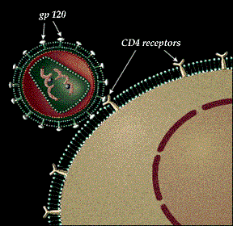

Attachment

Slide 9
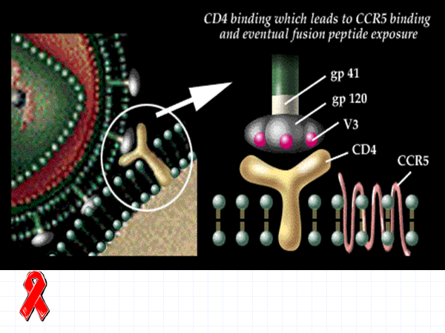

Slide 10
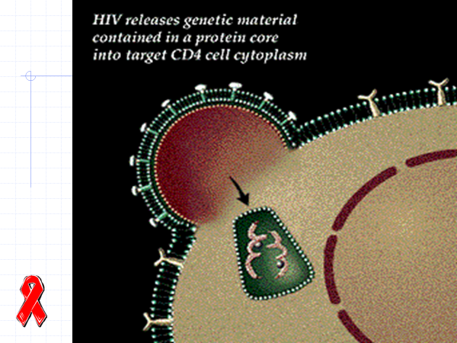

Slide 11
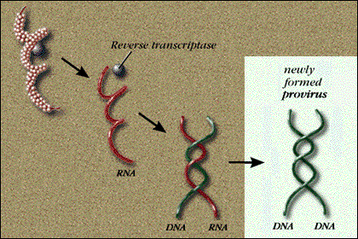

Slide 12
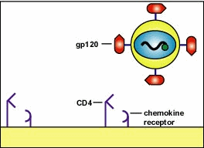
ATTACHEMENT

Slide 13
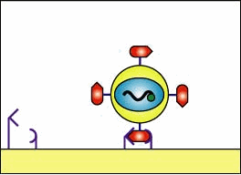
FUSION AND
PENETRATION

Slide 14
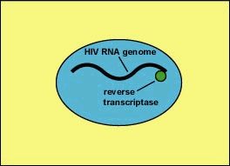
REVERSE TRANSCRIPTION

Slide 15
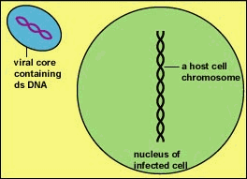

Slide 16
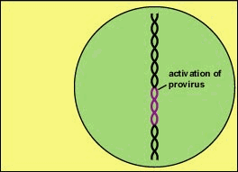
Activation of Provirus and Replication of HIV
Activation of the HIV proviral DNA enables it to be transcribed into HIV genomic RNA and HIV mRNA. The viral mRNA is translated into viral proteins at the host cell's ribosomes.
Doc Kaiser's Microbiology Home Page
Copyright © Gary E. Kaiser
All Rights Reserved
Updated: Sept. 30, 1999
Please send comments and inquiries to Dr. Gary Kaiser

Slide 17
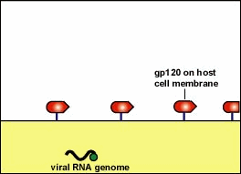

Slide 18
Antigenic Variation and Diversity
HIV shows extensive antigenic diversity
  High rates of mutation
  Due to the error-prone nature of reverse transcriptase enzyme.
Most notably - env gene.
Envelope proteins - major target against which antibodies are produced.
Hence mutations in env gene are the main reason which explains why-
  HIV evades the host’s immune response
  Vaccination against HIV is extremely difficult

Slide 19
HIV Serotyping
Based on env gene, HIV comprises of two serotypes -HIV- 1&2.
HIV-1- divided into three distinct groups (M, N, &O).
  ‘M’ is the dominant group worldwide (10 subtypes or "clades" A-J)
  Subtype C – MC form worldwide(47%).(dominant form in Southern and Eastern Africa, India, and China)
HIV-2 comprises of eight groups (A–H) (Group A – MC)

Slide 20
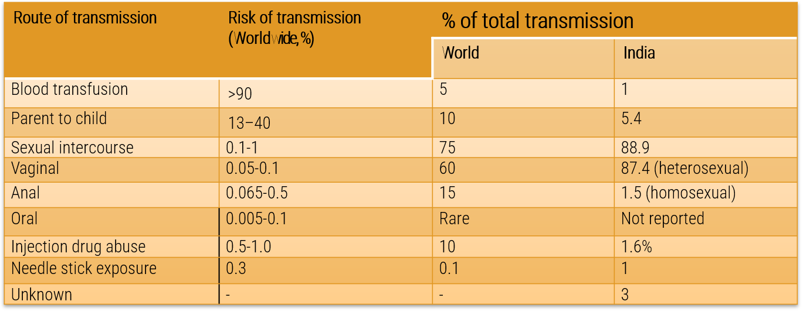
Transmission of HIV

Slide 21
Mode of Transmission
Transmission of HIV
Viral load is maximum in blood, genital secretions and CSF
Sexual mode is by far the most common mode of transmission, accounts for 75% of total cases in the world
Heterosexual route (male to female via vaginal coitus) is the commonest mode
However, the risk of transmission through sexual route is minimal (0.1–1% per coitus)
Anal intercourse (among homosexual males or even male to female) has higher risk of transmission than vaginal intercourse.

Slide 22
Mode of Transmission
Transmission of HIV
Blood transfusion is the least common mode of transmission (5%) but the risk of transmission is maximum (90–95%)
Percutaneous/mucosal transmission modes such as needle stick injury, injection drug abuse and sharing razors or tattooing or splashes of infected blood on eyes, etc. are among the less effective modes of transmission
Perinatal mode: In the absence of any intervention, the risk of transmission from mother to fetus is about 20–40%
Viral load is maximum in blood, genital secretions, and CSF; variable in breast milk and saliva; zero to minimal in other body fluids or urine

Slide 23
Routes of HIV Transmission
84.6
1.8
1.9
4.3
5.6
Sexual
IDUs
Blood and Blood Products
Perinatal
Unidentified

Slide 24
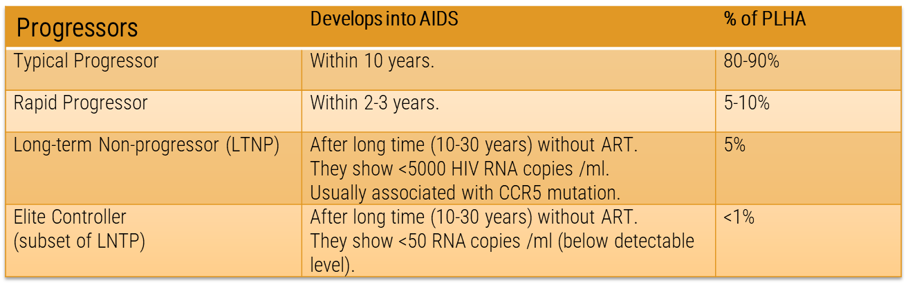
Disease Progression

Slide 25
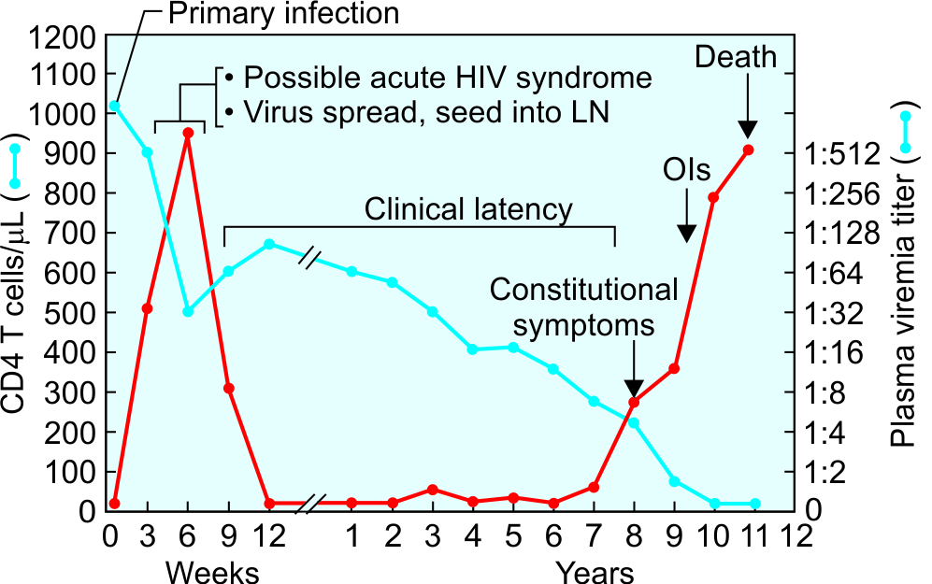

Natural Course (Typical Progressors)
About 80–90% of HIV, infected individuals are “typical progressors,” with a median survival time of approximately 10 years.

Slide 26
Acute HIV Disease /Acute Retroviral Syndrome
Following infection - HIV carried to the lymph nodes and other lymphoid tissues where further multiplication occurs in T cells.
Initially, HIV destroys the infected T cells and spills over into blood stream to cause primary viremia (or acute mononucleosis-like syndrome)
This coincides with an initial flu like illness that occurs in many patients (50-75%) 3-6 weeks after the primary infection.
There is a significant drop in numbers of circulating CD4 T cells at this stage.

Slide 27
Asymptomatic Stage (Clinical Latency)
Adequate immune response develops within 1-months in most of the patients. Both effective CMI response (HIV specific CD8 T cells) and humoral response (HIV specific neutralizing antibodies) comes into play.
Viremia drops down and CD4 T cell count becomes normal.
State of clinical latency, but not microbiological latency.
Immune response cannot clear the infection completely, HIV-infected cells persist in the LN, and there is a high level of ongoing viral replication . May last for 10 years but ranges from few months to 30 years.
Once the latency is broken, the disease progresses rapidly and death usually occurs within 2 years if left untreated.

Slide 28
Persistent Generalized Lymphadenopathy (PGL)
As a result of HIV replication in lymph nodes, 25-30% of infected people who are otherwise asymptomatic, develop lymphadenopathy.
PGL is defined as enlarged lymph nodes of >1cm size in two or more non-contiguous sites that persist for at least 3 months.
PGL must be distinguished from other causes of lymphadenopathies such as lymphoma.

Slide 29
Symptomatic HIV Infection (AIDS-related Complex)
After variable period of clinical latency, the CD4 T cell level starts falling.
Eventually patients develop constitutional symptoms such as:
  Unexplained diarrhea lasting for >1 month
  Weight loss >10% of body weight, fatigue malaise, and night sweat
  Mild opportunistic infections such as oral thrush

Slide 30
AIDS - advanced end stage
Rapid fall in CD4 T cell count (usually less than 200 cells/µl)
High virus load
Lymphoid tissue is totally destroyed and replaced by fibrous tissue.
Opportunistic infections set in secondary to profound immune suppression.
Development of neoplasia (e.g. CNS lymphoma)
Development of direct HIV induced manifestations such as HIV encephalopathy

Slide 31
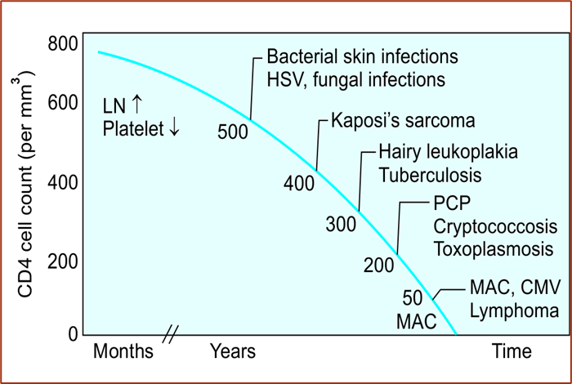
AIDS - advanced end stage
Opportunistic infections associated with HIV infection and correlation with CD4 T cell counts

Slide 32
Reservoir
Infected people (both symptomatic as well as asymptomatic) are the only reservoir host.
Once infected, they harbor the virus for life.

Slide 33
Extremely high-risk group:
  Female sex workers
  Men who have sex with men
  Hijra/transgenders
  IV drug abuser group
Moderately high-risk group:
  Health care workers (via needle pricks or splashes injury)
  Hemophiliacs and other recipients of blood products
  People with other STIs (sexually-transmitted infections).

Slide 34
Opportunistic Infections
Globally including India, tuberculosis is the most common OI that occurs in HIV infected people
  Common fungal infections are candidiasis (oral thrush) and Pneumocystis jirovecii
  Frequent viral infections are herpes simplex mucosal lesions and CMV retinitis
  Common parasitic infections are Cryptosporidium parvum diarrhoea and Toxoplasma encephalitis

Slide 35
AIDS Control Organizations
UNAIDS: The Joint United Nations Program on HIV and AIDS (UNAIDS)
NACO-National AIDS Control Organisation (NACO)
SACS-State AIDS Prevention and Control Societies (SACS)
National Strategic Plan for HIV/AIDS and STI (2017–2024)

Slide 36
KINETICS OF IMMUNE RESPONSE
Viremia - Viral entry into the body leads to a transient period of high level viremia and p24 antigenemia.
Humoral response is evidenced by formation of antibodies of different classes(IgM, IgA, IgG) against different:
  Structural proteins (gag - p15, p17, p24, p55; env - gp 41, gp 120, gp 160; and pol - p31, p51 and p66)
  Regulatory proteins (nef, rev, tat)
  Accessory proteins (vif,vpu and vpr).
Window period- 3 to 12 weeks.

Slide 37
Antibodies to gag protein (p24 and p55) usually appear first, though antibodies to env proteins and pol proteins may also be produced simultaneously.
As infection progresses to AIDS, antibody to p24 usually declines as p24 antigen levels rise concomitant with progression of disease to AIDS.
Antibodies to env proteins persist throughout the infection
Anti-HIV antibodies: Among the antibodies (IgA, IgM and IgG) that appear, only IgG response is consistent and long lasting.

Slide 38
LABORATORY DIAGNOSIS HIV INFECTION
Laboratory Diagnosis of HIV
3Cs while performing the test for HIV.
Consent in written format should be taken before the test is done.
Confidentiality of a positive test result is a must. Patient name or the word “HIV positive” should not be written on the report form
Counselling should be provided to motivate the individual to tell the spouse/family and induce behavioural change.

Slide 39
Antibody detection
Specific Tests for HIV Infection:
  Screening tests (antibody detection)
  Supplemental tests (antibody detection)
  Confirmatory tests
Non–specific Immunological Methods

Slide 40
Screening tests (antibody detection)
Take less time (2–3 hrs for ELISA; <30 minutes for rapid/simple tests)
High sensitivity and specificity
Should be confirmed: Results of a single screening test should never be used as the final interpretation of HIV status as false positive results or technical errors can occur.
HIV-1 specific (p24, gp 120, gp160, gp41)
HIV-2 specific gp36.

Slide 41
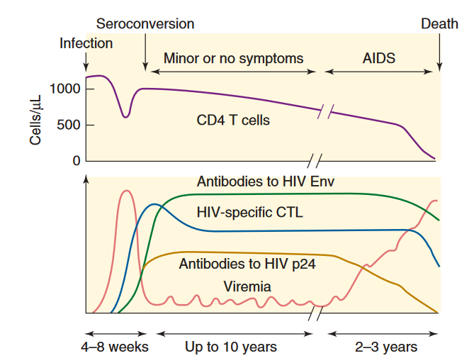
Antibody detection

Slide 42
ELISA
MC performed screening test at blood banks and tertiary care sites.
  It is easy to perform, adaptable to large number of samples.
  Sensitive, specific, and cost effective.
  4th generation ELISA - detects both HIV antibodies and p24 antigen by using combination of recombinant/synthetic peptides as well as monoclonal antibodies respectively- reduces the window period considerably.

Slide 43
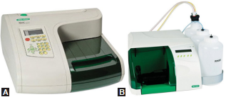
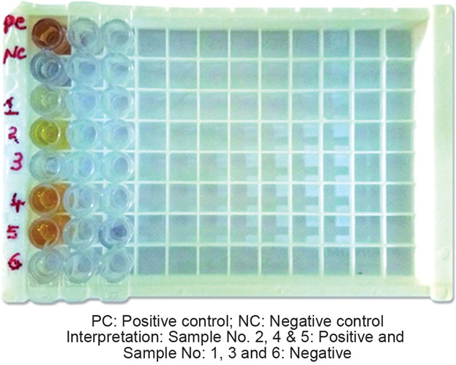
ELISA
Immunoassay that detects either antigen or antibodies in the specimen, by using enzyme–substrate– chromogen system for detection.
A. ELISA reader (Biorad); B. ELISA washer

Slide 44
Rapid/Simple Test
  Ease of performance & quick results (< 30 mins) and do not require special equipment.(Point of care test (POC)).
  Most commonly used tests in India and it works on various principles such as:
    Dot blot assays (or Immunoconcentration or flow through method, e.g. Tridot test)
    Immunochromatography (or ICT, lateral flow assay)
    Particle agglutination assays (using latex, gelatin, RBCs)
    Dip stick/Comb tests (Enzyme immune assay-based tests).

Slide 45
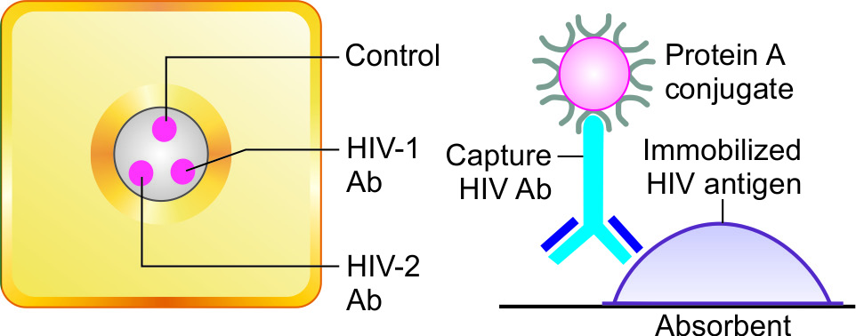
Flow-through Assay
The NCM is coated at three regions
Sample and buffer reagents are added sequentially from the top following which they pass through the membrane and excess fluid is absorbed into the underlying absorbent pad.
As the patient’s sample passes through the membrane, HIV antibodies, if present bind to the immobilized antigens.
Test dots- Protein-A conjugate (present in buffer) binds to the Fc portion of the HIV antibodies to give distinct pinkish purple DOT(s), separately for HIV-1 and 2 antibodies.
Control dot- Irrespective of whether the HIV antibodies are present or not, Protein-A can bind to any IgG present in serum and the IgG-protein A complex can further bind to the antihuman Ig at the control line to give a pinkish purple DOT

Slide 46
Immunochromatographic Test (Lateral Flow Assay)
Test band: At the test line, the Ag-labeled Ab complex is immobilized by binding to the monoclonal Ab in the test line to form a colored band.
Control band: The free colloidal gold labeled Ab can move further and binds to the anti-human Ig to form a color control band.
If the control band is not formed, then the test is considered invalid irrespective of whether the test band is formed or not.

Slide 47
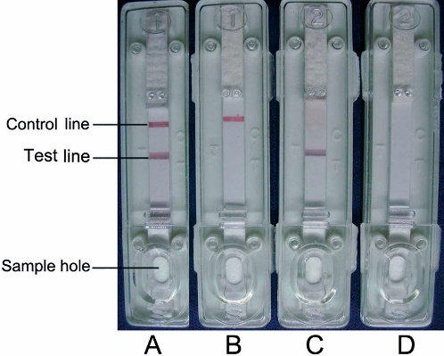
Write the Interpretation of the results of Sample A, B, C &D detected by immunochromatography strip.
A-
B-
C-
D-

Slide 48
Western Blot
Most commonly used supplemental test available and is also recommended by NACO.
Principle- immunoblot technique
It detects individual antibodies in serum separately against various antigenic fragments of HIV
WHO criteria: presence of at least two envelope bands (out of gp120, gp160 or gp41) with or without gag or pol bands
CDC criteria: presence of any two; out of p24, gp120, gp160 and gp41 bands.

Slide 49
Detection of p24 Core Antigen
p24 antigen becomes detectable after 12–26 days of infection and lasts for 3–4 weeks thereafter.
p24 Ag is detected by 4th generation ELISA
Less sensitive (~30%)
Uses of p24 antigen detection test:
  For confirmation of diagnosis of HIV/AIDS
  Diagnosis of HIV during the window period
  To diagnose the late stage of HIV/AIDS or CNS disease
  Diagnosis of HIV in infants (not reliable)
  Monitoring the progress of HIV infection

Slide 50
Viral RNA Detection
HIV RNA (best confirmatory method) - detected 10 -14 days after infection
  Reverse transcriptase PCR (RT-PCR)
  Branched DNA assay
  NASBA (nucleic acid sequence-based amplification)
  Real time RT-PCR for estimating viral load

Slide 51
Viral RNA detection ( Gold standard method)
Advantage:
Most sensitive & specific method: detect even few copies of viral RNA
Diagnosis of HIV during window period(early detection 10-14 days)
Viral load monitoring : Quantify the viral load – monitoring the response to antiretroviral therapy.
Typing: Differentiate between HIV-1 & HIV-2 infections
Detection of drug resistance genes.

Slide 52
HIV DNA detection
Useful for diagnosis of pediatric HIV
Differentiate latent HIV infection from active viral transcription.
Useful during the window period ,viral load estimation( real time PCR) & detection of genotypes.
HIV DNA PCR: Baby is tested for HIV DNA PCR at 6 weeks by DBS(Dry blood spot) Collection. If found positive then is reconfirmed by repeat HIV DNA PCR . It is reported as positive & baby is then initiated on lifelong ART.

Slide 53
HIV DNA detection
Useful for diagnosis of pediatric HIV
Differentiate latent HIV infection from active viral transcription.
Useful during the window period ,viral load estimation( real time PCR) & detection of genotypes.
HIV DNA PCR: Baby is tested for HIV DNA PCR at 6 weeks by DBS(Dry blood spot) Collection. If found positive then is reconfirmed by repeat HIV DNA PCR . It is reported as positive & baby is then initiated on lifelong ART.

Slide 54
Non- specific/Immunological test
CD4 T cell count: Flow cytometry methods
Assessing the risk of opportunistic infections.
Initiation of antiretroviral therapy- previously used. Current guideline says treatment should be started in all patients regardless of CD4 T cell count.
Monitoring the response to antiretroviral therapy.

Slide 55
NACO Strategy for HIV Diagnosis
NACO (National AIDS Control Organization, India) has formulated a strategic plan for HIV diagnosis.
Depending on the situation/condition, for which the test is done, the positive result of the first screening test should be either considered as such or confirmed by another one or two screening tests.
First screening test should be highly sensitive whereas the second and third screening tests should have high specificity.
Three screening tests should use different principles or different antigens. The same kit should not be used again.
Supplemental or confirmatory tests should be used only when the screening test(s) result equivocal/intermediate.

Slide 56
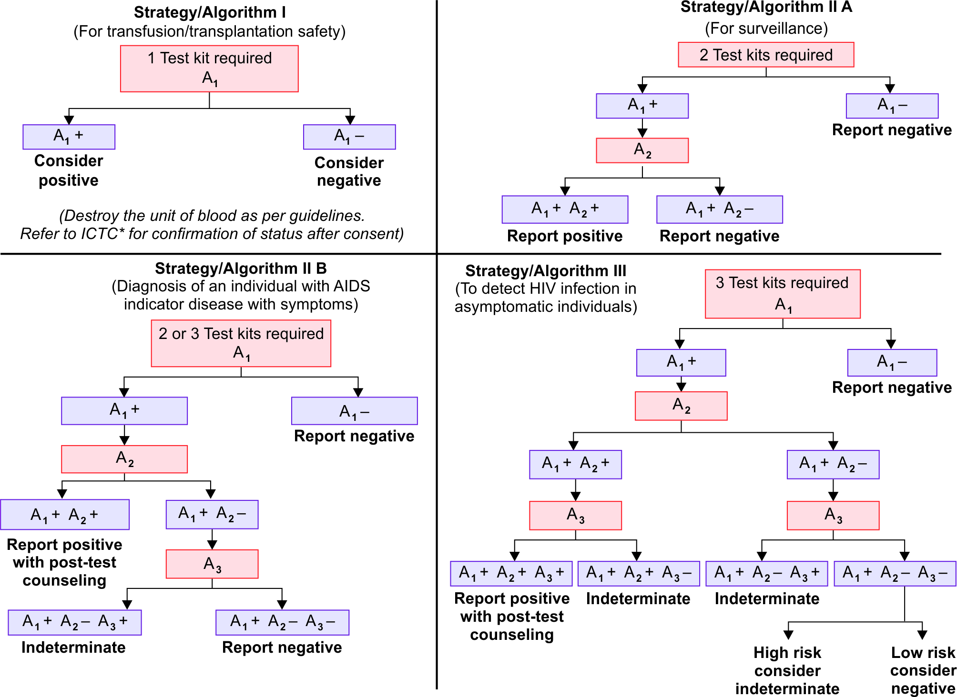
NACO Strategy for HIV Diagnosis
Screening of the blood donors & banks

Slide 57
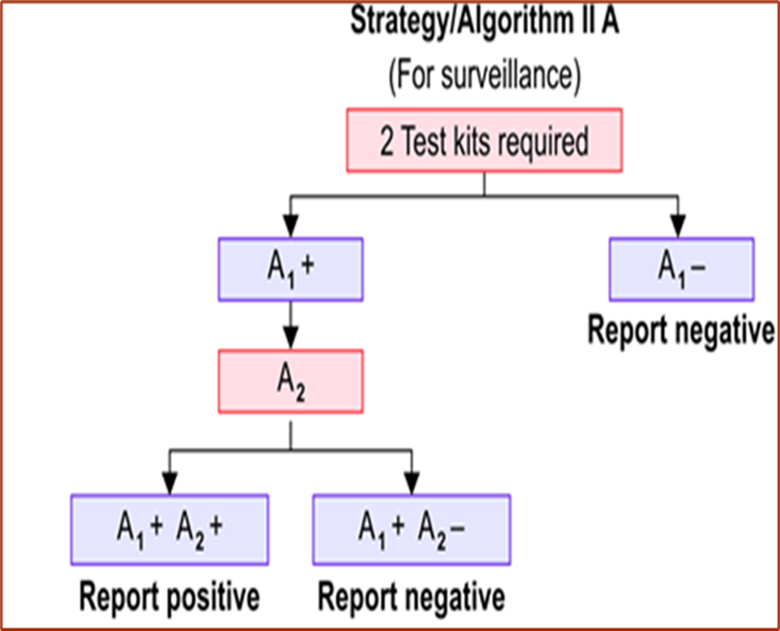
NACO Strategy for HIV Diagnosis
Sentinal surveillance: Unliked anonymous testing,sample are permanently decoded of personal identifiers.(without informed consent) ,Mainly to estimate prevalence of infection.

Slide 58
NACO Strategy for HIV Diagnosis

Slide 59
Strategy III :
Diagnosis of asymptomatic HIV patients
Antenatal screening
Screening of patients awaiting surgeries

Slide 60
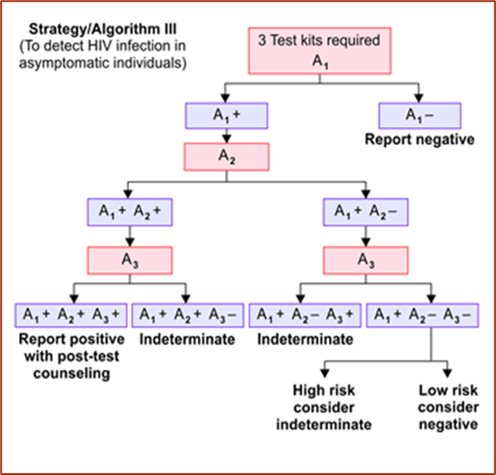
NACO Strategy for HIV Diagnosis

Slide 61


Slide 62
Q1
True regarding pathogenesis of HIV infection is
(i) P24 antigen is required for virus to bind to CD4 cells
(ii) Lysis of infected CD4 cells seen.
(iii) Dendritic cell does not support the replication.
(iv) Macrophage are infected
(a)Only i,ii and iii are correct
(b) Only i & iii are correct
(c) Only ii & iv are correct
(d) Only iv is correct
(e) All four are correct

Slide 63
Q2
Which of the following is the pathogen responsible for blindness in advanced HIV infection?
(a) Cytomegalovirus
(b) Epstein-barr virus
(c) Fugus
(d) Toxoplasma

Slide 64
Q3
Highest risk of transmission of HIV:
(a) Sexual
(b) Blood product
(c) Needle/ Syringe
(d) Mother to fetus

Slide 65
Q4
The gene coding for core of HIV is :
(a) gag
(b) env
(c) pol
(d) tat

Slide 66
Q5
Drug used against HIV virus fusion(gp41) protein as fusion inhibitor is:
(a) Maraviroc
(b) Enfuvirtide
(c) Zidovudine
(d) Nevirapine

