Slide 1
Function of brain lobes and its assessment
By
Department of Psychiatry
SBKS MI & RC

Slide 2
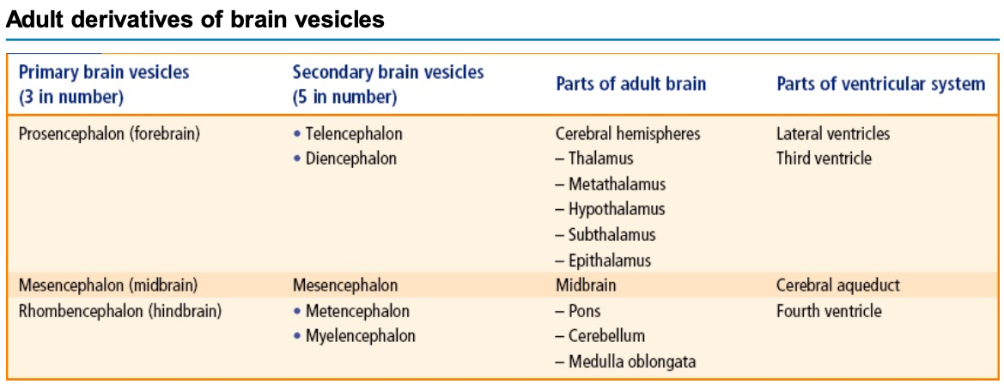
Textbook of Clinical Neuroanatomy, by Vishram Singh

Slide 3
Parts of Brain
3 main parts of the brain include: -
1) Forebrain: consists of the cerebrum, Diencephalon (principally the thalamus and hypothalamus)
2) Midbrain: consists of the tectum and tegmentum.
3) Hindbrain: consists of the cerebellum, pons and medulla.
(Brain Stem= Midbrain + Pons + Medulla)
Textbook of Clinical Neuroanatomy, by Vishram Singh

Slide 4
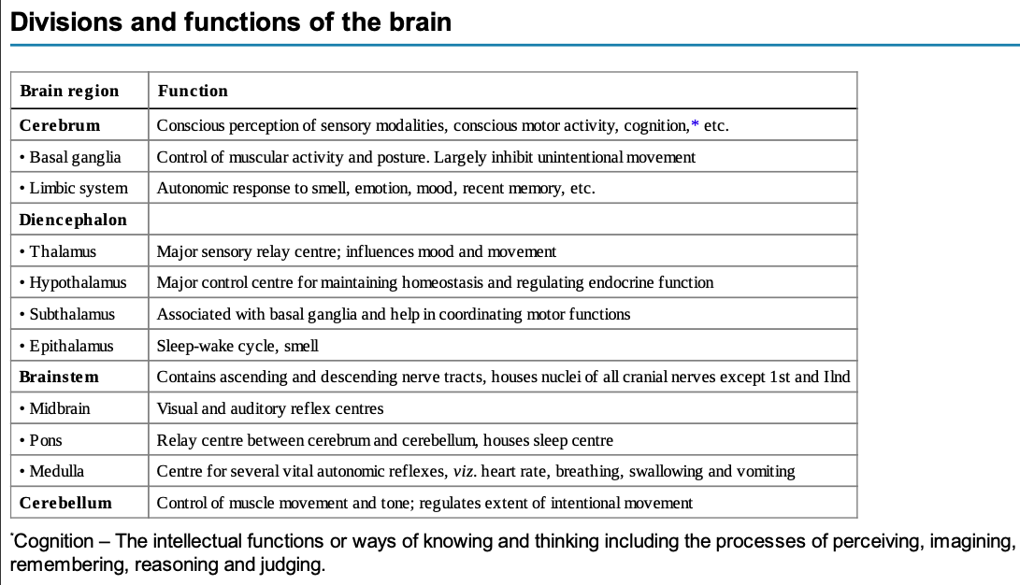
Notes:
mid brain corpora quadrigemina is aka Tectum . sup colliculi (visual), Inf colliculi (Auditory)… Transient ischemia can cause Auditory (also seen in lesions of tegmentum) and Visual hallucinations.
nuclei and tracts in front of Cerebral aqueduct = TEGMENTUM

Slide 5
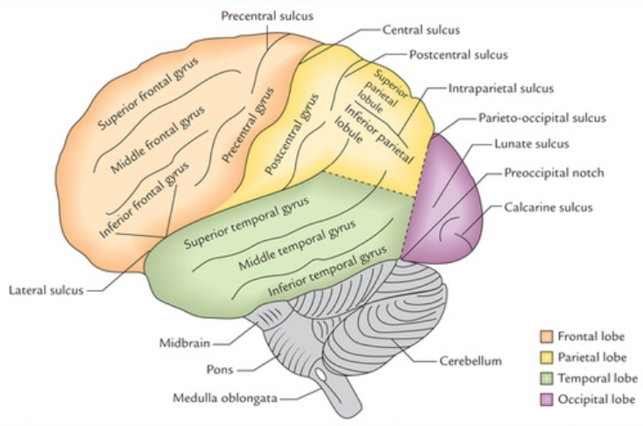
Lobes of the Brain
4 Main lobes of the Brain include:
Frontal lobe
Parietal lobe
Temporal lobe
Occipital lobe

Slide 6
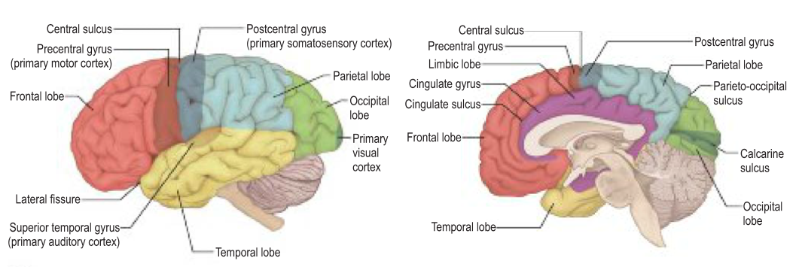

Slide 7
Frontal lobe is anterior to the central sulcus and above the lateral sulcus.
  The frontal lobe is important for voluntary motor functions, motivation, aggression, emotions, effect, drive and awareness of self.
Parietal lobe is posterior to the central sulcus and above the lateral sulcus.
  The parietal lobe is the major centre for reception and evaluation of all sensory informations except for smell, hearing, and vision.
Textbook of Clinical Neuroanatomy, by Vishram Singh

Slide 8
Occipital lobe is behind a line extending from parieto-occipital sulcus to the pre-occipital notch.
  The occipital lobe is responsible for reception and integration of visual input.
Temporal lobe is below the lateral sulcus and in front of parieto-occipital notch.
  The temporal lobe receives and evaluates input for smell and hearing and plays an important role in memory.
(Deep within the lateral sulcus lies a submerged portion of cerebral cortex, the insula which is often referred to as fifth lobe or central lobe)

Slide 9
Frontal Lobe
Largest lobe of the brain.
Located at the front of each hemisphere.
Separated from the parietal lobe by a groove between tissues called the central sulcus, and from the temporal lobe by a deeper groove called the lateral sulcus (Sylvian fissure).
most anterior rounded part of the frontal lobe is called the frontal pole
frontal lobe is covered by the frontal cortex.
  includes the premotor cortex, and the primary motor cortex – cortical parts of the motor cortex.

Slide 10
Four principal gyri in the frontal lobe.
  The precentral gyrus, is directly anterior to the central sulcus, running parallel to it and contains the primary motor cortex.
  Three horizontally arranged subsections of the frontal gyrus are
    the superior frontal gyrus,
    the middle frontal gyrus, and
    the inferior frontal gyrus.
  The inferior frontal gyrus is divided into three parts –
    the orbital part,
    the triangular part, and
    the opercular part.

Slide 11
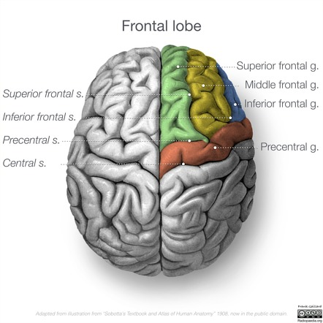

Slide 12
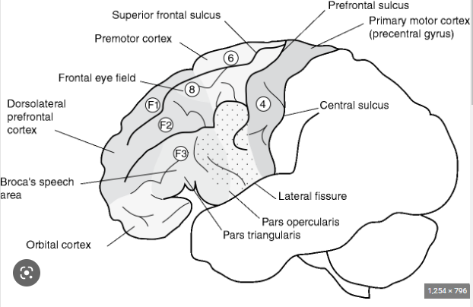
Functional areas in the frontal lobe
Primary Motor Cortex (Area 4)
Premotor Cortex (Area 6)
Supplementary Motor Area (Medial BA 6)
Frontal Eye Fields (Area 8)
Dorsolateral Pre Frontal Cortex (Area 9,10,46)
Orbitofrontal Cortex (Area 10,11)

Slide 13
Primary motor area (area 4 of Brodmann)
Located in the Precentral Gyrus.
Contains large pyramidal cells (of Betz).
Receives inputs from thalamus, basal ganglia, premotor area and sensory cortex
Send the output of motor fibres to the brainstem and the spinal cord
Stimulation of primary motor area produces contraction of muscles of opposite half of the body.
B/L control of the muscles of the upper part of the face, tongue (genio-glossus), mandible, larynx, pharynx and axial musculature.

Slide 14
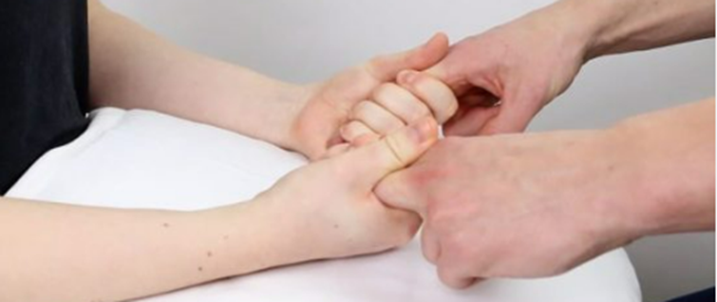
Lesions will include increased/decreased tone of the muscles, decreased power of the muscles and decreased fine motor sensation on the contralateral side.
Bedside tests –
Motor Strength of Hand Grip – Strength should be roughly equal with greater strength on the dominant side. It should be difficult for the examiner to free his/her fingers.
b) Motor Speed (Finger Tapping) – It is a useful test but does not discriminate from the premotor cortex.
Diagnostically, poor performances suggest local lesions such as vascular or neoplastic pathology or a generalized lesion such as a degenerative disease after ruling out peripheral nerve lesion.

Slide 15
Bedside Test –
Ask the patient to follow the movement of a finger from left to right and up and down.
Ask the patient to look from left to right, up and down (with no finger to follow).
Note for inability to move or any jerky movement.

Slide 16
Premotor Area (Brodmann area 6) :
It stores motor programmes and controls coarse postural movements.
It receives its inputs from Thalamus, Basal Ganglia, Sensory Cortex and suplementary motor cortex and gives output to the Primary motor area.
Lesion in this area will lead to weakness in proximal muscles on the C/L side.
Bedside tests –
Sensorimotor abilities are tested by asking the patient to touch each finger to the thumb in succession as rapidly as possible. Watch for speed and dexterity.
Apraxia can be tested by asking the patient to “blow a kiss” and to demonstrate the use of a shovel.
Notes:
Apraxia is the loss of ability to execute or carry out skilled movement and gestures, despite having the physical ability and desire to perform them.

Slide 17
Supplementary Motor Area (Medial Brodmann Area 6) :
It gets its inputs from cingulate gyrus, thalamus, sensory cortex and prefrontal cortex.
It sends output to the premotor cortex and primary motor cortex.
Its function is the intentional perception of movement and procedural memory.
Lesions will include Mutism and Akinesia.

Slide 18
Frontal eye field (area 8 of Brodmann)
Stimulation of this region causes deviation of both the eyes especially to the opposite side. (saccadic eye movements)
It receives inputs from the parietal and temporal cortex and gives outputs to caudate nucleus, superior colliculus and PPRF.
Lesions of the frontal eye field of one hemisphere cause the two eyes to deviate to the side of lesion if it’s a destructive lesion and towards the opposite side if its an irritating lesion and an inability to turn the eyes to the opposite side.
Notes:
PPRF – Paramedian Pontine Reticular Formation

Slide 19
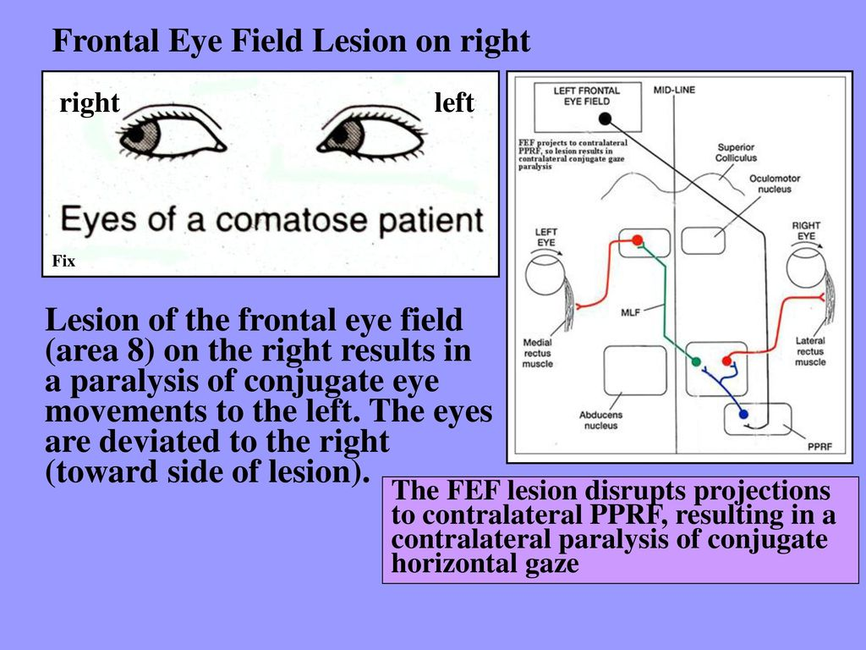

Slide 20
Motor speech area of Broca (areas 44 & 45 of Brodmann)
Located in the pars triangularis (area 45) and pars opercularis (area 44) of inferior frontal gyrus of frontal lobe of left hemisphere (dominant hemisphere) in most of the individuals, and the persons are right handed.
Broca's area is responsible for the production of expressive speech/vocalization. It brings the formation of words by its connections with the adjacent primary motor area, which in turn stimulate the muscles of the larynx, mouth, tongue, soft palate, and the respiratory muscles.
Lesions of motor speech area of Broca : loss of ability to produce speech k/a Expressive aphasia (also called motor aphasia).

Slide 21
Prefrontal area :
Concerned with the individual's personality.
Exerts its influence in determining the initiative and judgement of an individual.
concerned with depth of emotions, social, moral and ethical awareness, concentration, orientation, and foresightedness.
associating experiences that are necessary for the production of abstract ideas.
Clinical Correlation:
B/L destruction due to trauma or tumours results in profound change in personality, loss of concentration, initiative and judgement. The individual no longer conforms to the accepted mode of social behaviour and becomes careless about his dress and appearance (i.e. inappropriate social behaviour), e.g. use of obscene language, urinating in public.

Slide 22
DLPFC (Brodmann’s Area 9,10,46) :
DLPFC and subcortical elements are responsible for executive function which includes integration of sensory information, generation of range of responses alternatives to environmental challenges, selection of most appropriate response, maintenance of task set, sequential ordering of data, self –evaluation of performance and the selection of a replacement responses if the first applied response fails.
The executive functions determine the ability of the individual to cope with ever changing challenges of the environment.
It is believed by some that formal thought disorder arises from a lack of executive planning and editing.

Slide 23
Bedside Test :
Is the patient able to make an appointment and arrive on time?
Is the patient able to give a coherent account of current problems and the reason for the interview? Is there evidence of thought disorder?
Digit Span, days of the week or months of the year backwards.
Controlled oral word association test (COWAT) – The patient is asked to produce as many words as possible, in 1 minute, starting with F, then A, then S. Proper nouns and previously used words with a different suffix are prohibited.
Other categorical fluency tests include naming animals, fruits and vegetables.
A normal individual will be able to provide more than 10 items for each of these categories, while a patient with significant deficits will usually score less than eight.

Slide 24
e) Alternating Hand Sequences/Luria test – One hand is placed palm upwards and the other with palm downwards and the patient is asked to reverse these positions as rapidly as possible.
Patients with frontal lobe deficits usually perform poorly in these tests.
f) Wisconsin Card Sorting Test – This contains stimulus cards of different colour, form and number. These are presented to the patients to sort into groups according to a single principle (colour, ignoring form and number).
Persons with damage to the frontal lobes or to caudate lobe and some persons with schizophrenia give abnormal persons.
g) Trail Making Test – Connect the set of dots as quickly as possible.
It tests for mental flexibility, executive functioning and speed of processing.

Slide 25
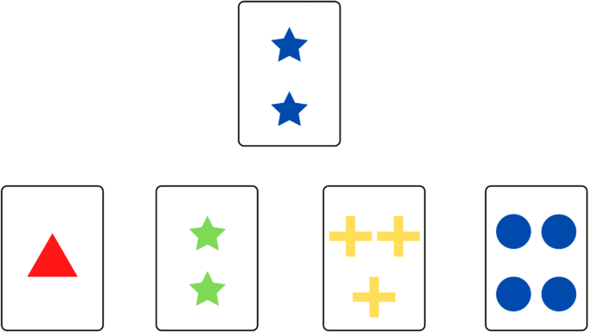
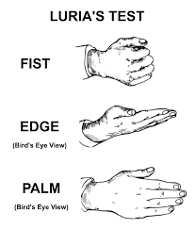
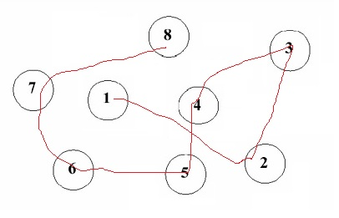
Wisconsin Card Sorting test
Trail Making Test

Slide 26
Orbitofrontal Cortex (Brodmann’s Area 10,11) :
This part mediates empathic, civil and socially appropriate behavior. Most of the personality change described in cases of frontal lobe injury is due to lesion in this area.
Patients may become irritable, labile, disinhibited and fail to respond to the conventions of acceptable social behaviour. Similar changes are also seen in Huntington’s disease.
Increased concern about social behaviour has been associated with increased OFC and caudate metabolism. It is also seen in lesions of the globus pallidus and in OCD.

Slide 27
Bedside Tests :
Does the patient dress or behave in a way which suggests lack of concern with the feelings of others or without concern to accepted social norms?
Sense of Smell – Coffee, cloves, etc
Go/no-go test – The patient is asked to make a response to one signal (Go signal) and not to respond to another signal (the no-go signal). The task may be made more demanding by reversing the customary meaning of signals.
Stroop Test – It examines the ability of the patient to inhibit responses. Patients are asked to state the colour in which words are printed rather than the word themselves. This task is made difficult by presenting the name of colors printed in different coloured ink.
Failure of inhibition is found in impulse control and antisocial personality disorder and it may complicate head injury, schizophrenia and destructive lesions(dementing processes).
OCD is associated with increased metabolism in the OFC area.

Slide 28
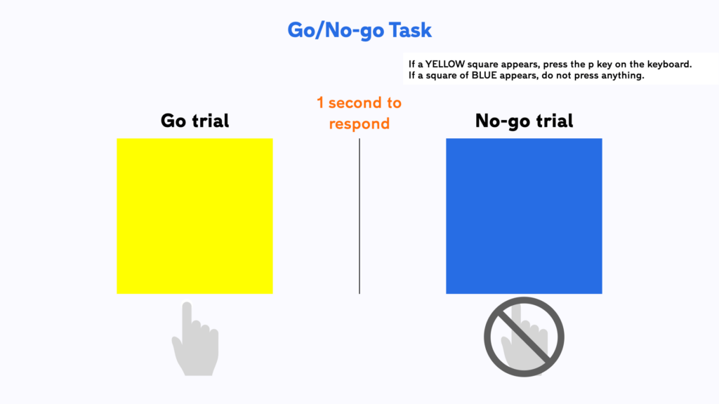
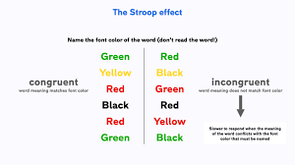

Slide 29
Other Tests
Attention :
Digit Span Test – Tell the patient to repeat some numbers that you give him/her. Start with three or four digit numbers and increase until the patient makes several mistakes at one number of digits. Then explain them to repeat the numbers backwards.
Normal – seven forwards, five backwards
Concentration :
Serial Sevens - Ask the patient to take 7 from a 100, then 7 from what remains
Doubling Threes – Done if serial sevens is too tough for the patient. Ask the patient what is 2*3? Twice that? Keep on doubling upon how high the patient goes and how long it takes ?
Further Tests – Ask the patient to perform increasingly difficult mental arithmetic like 7+12 ; 21-9 ; 4X7 ; 36/9

Slide 30
Alternating hand sequences
Perseveration
Soft signs and release reflexes
Apathy
Aprosody
Abstract reasoning
Judgement
Conceptual Series Completion
General Intelligence and Information

Slide 31
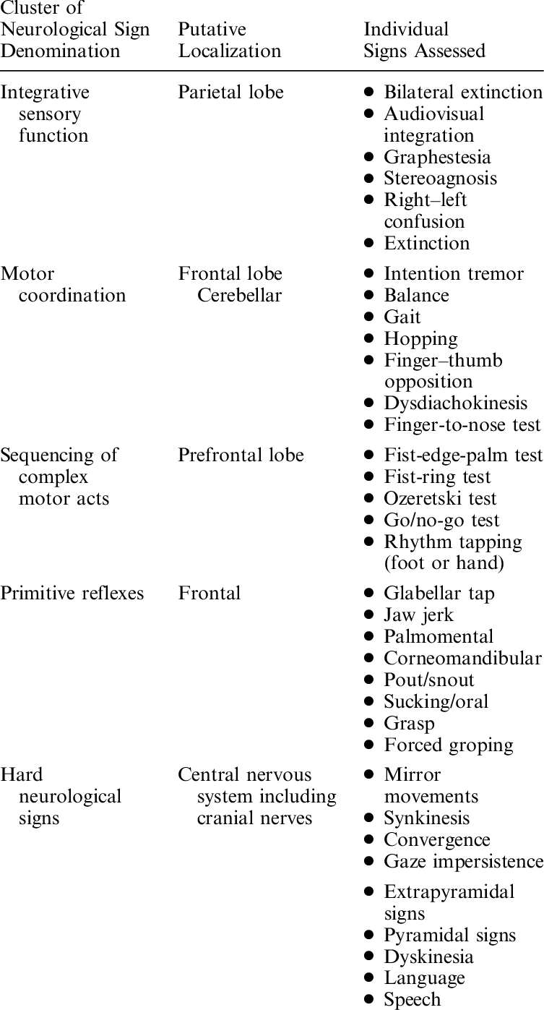

Slide 32
Specific implications
1. Orbitofrontal syndrome: -
Also known as pseudopsychopathic state.
It is associated with impulsiveness, distractibility, hyperkinesis, lack of empathy and lack of concern for the feelings of others.
The mood is typically irritable and labile, with insensitive humor (Witzelsucht).
2. Medial Frontal Lobe Syndrome (MFLS): -
Also known as pseudoapathetic state.
It is predominantly characterized by apathy.
The severity extends from akinetic mutism at one end to a mild lack of motivation(abulia) at the other end.
It is reported following bilateral anterior cerebral artery occlusion, trauma, hydrocephalus, bilateral thalamic infarction, etc.

Slide 33
3. Frontal Convexity Syndrome (FCS): -
It is called as the lateral frontal lobe syndrome
Also known as pseudodepressive state.
It is characterized predominantly by executive deficits (perseveration, impersistence, difficulty in planning and impaired serial order behavior). It also includes decreased attention to relevant stimuli, disinterest/indifference and lack of flexibility.
Schizophrenia is often considered to be a frontal convexity syndrome.
Another feature is the appearance of release reflexes and various soft neurological signs.

Slide 34
4. Frontotemporal Dementia :
The core features according to the Neary criteria include :
Early decline in social and personal conduct
Emotional Blunting
Loss of insight
There is relative sparing of memory and visuospatial functions in the early stages and executive function is more affected.
There are 2 variants :
Behavioural Variant : Behavioural disinhibition, apathy, loss of sympathy or empathy, perseveration/stereotypical or compulsive/ritualistic behaviour, hyperorality and dietary changes are seen.
Semantic Variant : Speech production, word finding, object naming, grammar and word comprehension are affected.

Slide 35
5. Frontal Lobe Epilepsy :
There maybe bizzare presentation with physical/emotional aura, tingling, numbness and tension.
Fear expressed on face, tonic posturing and clonic movements. It may be Simple or Complex partial epilepsy.
The presentation may vary based on the specific area involved.
It accounts for 20-30% cases of operative procedures for intractable epilepsy.
6. Broca’s Aphasia :
Lesions of Brodmann’s Area 44,45
It is the loss of ability to produce speech k/a Expressive aphasia (also called motor aphasia).
The patients retain the ability to think about the words they wish to say, they can write the words, and they can understand their meaning when they see or hear them, they can understand the language, But they cannot express in speech (difficulty in initiating speech, repetition, taking dictation and non-fluent and laboured speech) even though there is no paralysis of muscles of lips, tongue, and vocal cords.
These problems can increase the chance of MDD in such patients.

Slide 36
7. Schizophrenia :
Most symptoms are due to the involvement of the PFC.
Affective S/S due to VMPFC, Cognitive S/S due to DLPFC, Aggressive S/S due to OFC and Negative S/S due to involvement of Mesocortical areas and PFC.
DBS over Nucleus Accumbens and Ventral Striatum
8. Depression :
Reduced DA, NE and 5-HT in PFC leads to cognitive dulling.
Damage to the left side frontal lobe (due to stroke, any lesion etc.) can increase the chances of depression.
rTMS (high freq) over DLPFC is FDA approved for Rx resistant cases.
DBS over VMPFC
9. ADHD :
There are problems in executive functions of the frontal cortex.
Hyperactivity due to PFC, Selective attention deficit due to Dorsal Anterior Cingulate gyrus, sustained attention and problem solving deficits are due to DLPFC and impulsivity is due to the involvement of OFC.

Slide 37
10. OCD :
It is due to the abnormalities of the CSTC loops.
Mainly OFC is involved
Low levels of 5-HT in frontal lobe.
rTMS (low freq) over supplementary motor area and OFC can be given(not FDA approved).
11. Alcoholism :
PFC is linked to impulse control and therefore its damage leads to increased binge drinking.

Slide 38
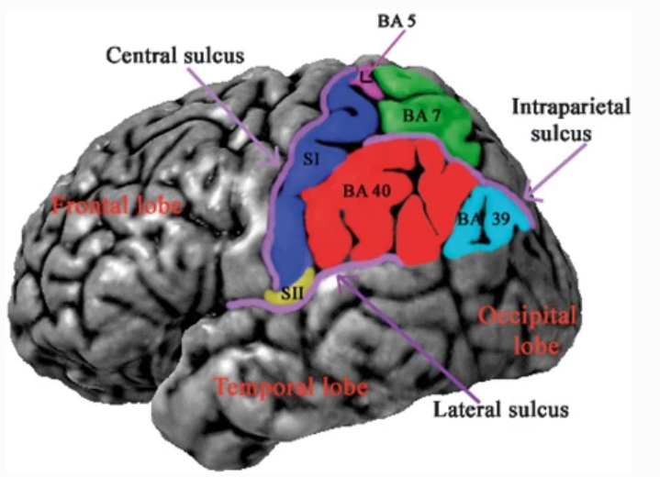
Parietal Lobe

Slide 39
Parietal Lobe
Functions:
1. Tactile localization and discrimination,
2. Fine touch, sensation,
3. Proprioception,
4. Kinaesthesia,
5. Stereognosis,
6. Gnosis: recognition of received tactile, visual or auditory input,
7. Praxis: storage of program or visuokinesthetic motor engrams necessary for motor sequences,
8.Body schema: postural model of body, body parts and their relation to the environment,
9. Language: comprehension of words, interpretation of tone, loudness and timing of words
Notes:
kinaesthesia

Slide 40
Parietal Lobe
Clinical Implications:
Disorders of tactile functions,
Visual or tactile agnosia,
Apraxias,
Constructional apraxia,
Disorders of language (such as alexia and agraphia),
Acalculia,
Contralateral neglect,
Disorders of visuospatial functions/spatial ability,
Body – schema disturbances,
Right – left confusion
Notes:
apraxia
constructional
alexia, agraphia, Acalculia
C/L neglect

Slide 41
Parietal lobe
It underlies the parietal bone of the skull.
Its anterior border on the lateral aspect is marked by the central sulcus and its posterior border by the parieto-occipital fissure.
1. Primary somatosensory cortex (Postcentral Gyrus) (BA 1, BA 2, and BA 3)
2. Somaesthetic Association Area
3. Superior parietal lobule (SPL; BA 5 and BA 7)
4. Inferior parietal lobule (IPL ; BA 39 and BA 40) Angular Gyrus and Supramarginal Gyrus

Slide 42
The anterior parietal lobe, made up of the postcentral gyrus (lateral aspect) and posterior paracentral lobule (medial aspect)
  somatosensory sensations – Touch, pain, temperature, and Proprioception
The posterior parietal lobe consisting of BA 7, BA 39, and BA 40
  Integrates somatosensory signals with signals from the visual, auditory, and vestibular systems (sensorimotor integration).

Slide 43
Primary somatosensory cortex : Somatosensory signals from both sides of face and
contralateral body.
Lesion results in temporary loss of sensation over
contralateral body
VPM and VPL nuclei of thalamus
Thalamocortical fibres to Primary Somatosensory Cortex. (Touch and proprioceptive signals project
predominantly to BA 1 and Pain signals project to BA 3)
Representation of leg and genitalia on the medial aspect of the cortex
Representation of remainder of the body and head on the lateral aspect.
Corticothalamic projections from the primary somatosensory cortex project back to the VPM and VPL
thalamic nuclei. Also efferent from Primary Somatosensory cortex goes to opposite Primary
Somatosensory Area, Secondary Somatosensory Area and Superior Parietal Lobule

Slide 44
Secondary somatosensory cortex and the parietal operculum :
Secondary Somatosensory cortex receives input from SI as well as from VPL and VPM of the thalamus.
It receives input from both sides of the body.
Four areas of the parietal operculum have been described: OP 1–4.
    OP 1, OP 3, and OP 4 appear to be a part of SII
    OP 2 lies deep inside the lateral fissure just posterior to the insula. OP 2 is recognized as the primary vestibular area.
  The anatomy of the parietal lobe varies from individual to individual, including that of the parietal operculum. An accessory postcentral gyrus accompanied by a parietal operculum of reduced length - This variation is related to impaired receptive language processing and dyslexia.

Slide 45
3. Superior parietal lobule :
Broadmann’s areas 5 and 7 on the lateral aspect make up the superior parietal lobule. BA 7 on the medial aspect is called as the precuneus.
It receives afferents from Primary and Secondary Somatosensory Area (It is the highest level of somaesthetic integration). Cortical association fibers connect it with adjacent cortex.
  SPL integrates the sensation of touch and proprioception with vision as well as with audition. It is especially important in planning and executing visually guided reaching.
  The parietal lobe is concerned with selecting and attending to a specific target located on the skin or in the nearby extrapersonal space.
  Provides the ability to appreciate the weight and texture of an object held in hand. Also in evaluating the shape and size of objects based on touch.
  It provides information about the location of the target including the direction and velocity of movement of that target. Optic ataxia : Following a lesion on either side involving the dorsal visual processing stream in the posterior superior parietal lobule.
  Patients are impaired in the ability to reach for and grasp objects in the contralesional visual field with either hand. Their efforts are inaccurate when using peripheral vision (dorsal visual stream), but accuracy is normal when using foveal vision (ventral visual stream).

Slide 46
Right (nondominant) SPL :
  It is critical in selecting one stimulus location among many.
    Spatial Neglect(Spatial Agnosia) : is more severe following right parietal damage as there is a map of the contralateral body and peripersonal space in the left IPL, but both an ipsilateral and contralateral map in the right IPL and norepinephrine input to the right parietal region is greater than to the left.
    Dressing Aprexia : Patients do not recognize the opposite side of their body and will not dress it.
    Constructional apraxia : Inability to correctly copy a simple drawn symmetrical figure
    Anosognosia : Patients are often unaware of the deficit. (due to loss of motor planning ability)

Slide 47
Left (dominant) SPL :
  Dysphasia and Agnosias
    Sensory Dysphasia : patient speaks slowly, makes many grammatical errors, and
    may be mistakenly labeled uncooperative or confused.
    Agnosia : Tactile Agnosia - A lesion bordering the postcentral gyrus can produce
    tactile agnosia, in which the patient cannot recall the
    name of an object by touch alone. With eyes closed a patient with
    Astereoagnosia – patient is unable to name a familiar object held in his
    or her hand based on the weight and three-
    dimensional characteristics of the object.
    Agraphesthesia - A number or letter written on the patient’s skin will not
    be recognized.

Slide 48
Precuneus(Formed by Broadmann’s area 7 on medial aspect) :
  It is rarely damaged due to strokes or trauma
  The neurons are not uniform in shape throughout the precuneus. The anterior portion is characterized by larger neurons and the posterior portion is characterized by smaller neurons.
  receives multimodal sensory input superior and inferior lobules as well as from the cortex within the intraparietal sulcus (IPS).
  It has strong reciprocal connections with frontal lobe, including the premotor and supplementary motor areas, as well as the dorsolateral and ventromedial prefrontal area.
  Four general functions of Precuneus:
  1. Consciousness 2. body movements in space 3. self-awareness 4. episodic memory retrieval.

Slide 49
    1. Consciousness : Precuneus is highly metabolically active during the resting state.”
    (consuming about 35% more glucose)
    Joint activation of the precuneus and prefrontal cortex may
    underlie a state of reflective self-awareness, and activity
    correlates with mind-wandering
    significant deactivation during states of altered consciousness.
    progressively deactivated as anesthetic-induced sedation
    progresses
    It is also one of the first areas to resume activity when
    consciousness is regained.
    Its activity is reduced in normal aging but more so in patients
    with dementia.

Slide 50
    2. Body movements in space : The precuneus is activated when preparing to
    make a movement or when executing a movement
    in space, especially movements involving pointing,
    reaching, and saccades.
    When imagining moving through an environment
    with obstacles the precuneus is activated
    bilaterally. Precuneus acts as the “mind’s eye” in
    these situations, assessing the environment and
    choosing a navigable route through it.
    3. Episodic memory retrieval : Memories of personally experienced events
    (episodic memory) are retrieved to the precuneus
    where they are relived and elaborated.

Slide 51
    4. Self-awareness : Self-awareness includes the recognition of self-ownership
    that “I am the initiator of the action and thus that I am
    causally involved in production of that action”.

Slide 52
Intraparietal sulcus :
  The IPS (or intraparietal fissure) lies on the lateral aspect, separates the superior from the inferior parietal lobule, and contains the intraparietal cortex. It extends from the postcentral sulcus to the occipital lobe
  Lateral intraparietal area (parietal saccade region) :
    -This area receives information regarding objects in the contralateral hemifield. Object location, direction, and velocity are registered.
    -It also monitors current eye position with respect to the head and head position and with respect to the body as well as the head’s orientation to gravity.
  Medial intraparietal area (parietal reach region) :
  -It operates in a manner similar to saccade programming but is responsible for
  planning and executing visually guided reaching movements of the upper limb.
  -Success of the movement is greater if the target is located on the fovea. If the
  target is in the periphery, a larger region of parieto-occipital cortex is activated
  including the precuneus.

Slide 53
  Anterior intraparietal area (parietal reach and grasp region) :
  -It contains neurons that are sensitive to size, shape, and orientation of
  objects to be grasped. The objects may be viewed or remembered and the
  area also monitors hand position and movement.
  -It projects to the ventral premotor cortex to provide signals for finger and
  arm movements involved in reaching and grasping.
  Ventral intraparietal area (navigation in space) :
  -Contain a crude somatotopic map with most of the map devoted to the head.
  -It plans motor responses to navigate through nearby space while avoiding
  obstacles.
  Posterior intraparietal area (three-dimensional analysis) :
  -It receives input from visual areas V3 and V4 and is involved in the analysis of
  the features of three-dimensional (3D) objects.
  -Binocular and monocular depth cues and other information from both the
  dorsal and ventral visual streams are integrated in this region.

Slide 54
4. Inferior Parietal Lobule :
Supramarginal gyrus (BA 40) and the Angular gyrus (BA39)
Divided into 5 areas 2 areas
  This is one of the last areas to mature so variability has been found between specimens based on experience and also left right differences.
    Total IPL volume is greater in males than females and the left IPL is larger in men than women (i.e., leftward asymmetry).
    Weaker leftward asymmetry has been reported for patients with borderline personality disorder, Psychotic symptoms and schizoid personality and correlates with deficits in social communication and interaction, and repetitive, stereotyped behavior in children with autism spectrum disorder.
  Like the SPL, the IPL has reciprocal connections with the pulvinar and the lateral thalamic nuclei.
  Short association fibers connect it with nearby occipital and temporal lobes, as well as the SPL and precuneus.
  Long association fibers link the IPL with the frontal cortex, including the frontal eye fields.

Slide 55
  The IPL plays an important role when the self takes the perspective of others (and may be part of a “concern mechanism”.
  The IPL and the supramarginal gyrus in particular are activated in skill learning (right side) and tool use (left side). It is hypothesized that the supramarginal gyrus stores information about limb and hand positions based on previous experience. Retrieval of a previously formed motor memory may be important in elaborating the skill and adapting it to a new situation.

Slide 56
Schizophrenia : Volume reductions were reported for the IPL in patients with
schizophrenia and in all parietal subregions.
: Delusions of passivity in individuals with schizophrenia are associated
with hyperactivity coupled with reductions in gray matter volume of
the inferior parietal lobule.
: These regions support language and may help explain the language
and thought disorders found in schizophrenia.
: During a verbal task subjects at high risk for schizophrenia showed
increased activation in the left IPL compared with controls. It was
suggested that the overactivation of the IPL is a compensatory action
related to attention to task and preparation of a suitable response.
: Reduced asymmetry has been reported for individuals with
schizophrenia, with smaller left and larger right IPLs than controls.
: The smaller size of left supramarginal gyrus correlates with the
severity of auditory hallucinations in patients with schizophrenia.

Slide 57
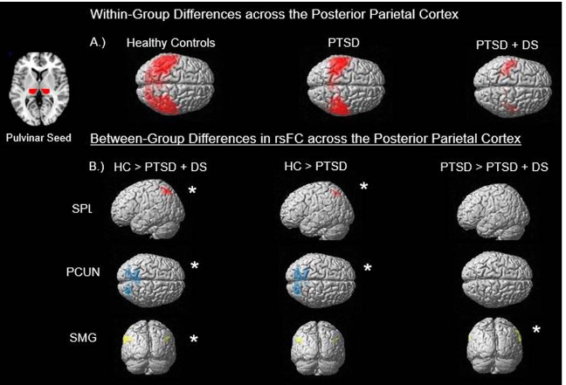
PTSD :

Slide 58
Left(Dominant IPL) :
  Apraxia : The inability to execute skilled, learned motor acts despite preservation of
  motor and sensory systems, comprehension, cooperation, and coordination.
  Ideomotor apraxia : Impaired performance in spite of preservation of sensory, motor, and language function. The patient cannot perform a meaningful movement of a limb when requested. It also includes inability to imitate gestures as part of ideomotor apraxia. Impaired ability to carry out the appropriate sequential actions of a multistep, complex task. The patient cannot form a plan to carry out movements in a proper sequence.
  Ideational apraxia : Lesions of the left parietal lobe alone or in combination with
  temporal and frontal lesions produces inability to carryout meaningful limb movements.
Gerstmann syndrome : Recognition of common gestures may be lost following
damage to the dominant IPL.
A lesion involving the angular gyrus (BA 39) may produce part or all of Gerstmann
syndrome• Left–right confusion • Finger agnosia –difficulty in naming fingers. •
Dysgraphia –difficulty with writing. • Dyscalculia –difficulty with numbers

Slide 59
Right(NonDominant) IPL :
  Aprosodia : A deficit in processing the nonsyntactic component of language.
  Patients fail to appreciate aspects of a verbal message that are conveyed
  by the tone, loudness, and timing of the words (i.e., emotional tone).

Slide 60
  B/L Damage to IPL :
    Balint syndrome : Bilateral damage to the posterior IPL, often including adjacent
  occipital cortex, may produce Balint syndrome:
  • Optic apraxia –eyes tend to remain fixed (stuck) on a visual target,
  although spontaneous eye movements are
  unaffected.
  • Optic ataxia –a deficit in using visual guidance to grasp an object.
  Simultanagnosia –seeing only the components of a visual object; unable to see the object as a whole.

Slide 61
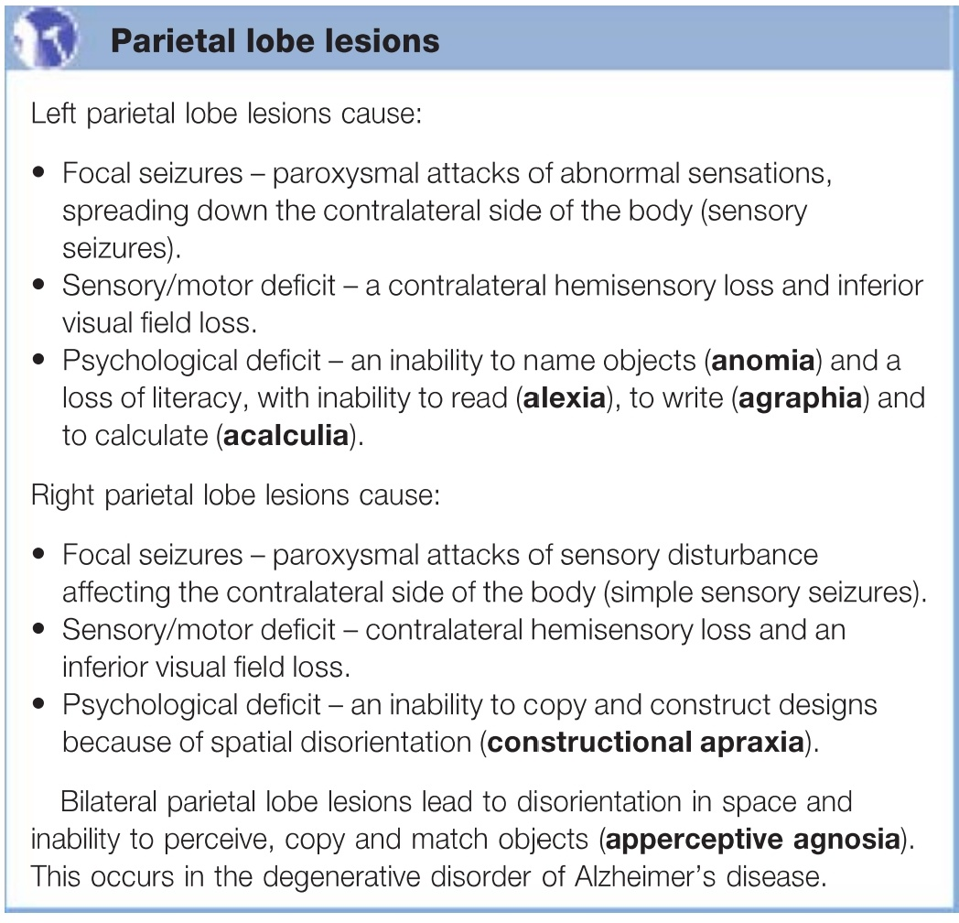

Slide 62
1. Loss of Proprioception
2. Tactile Agnosia (Tactile, Thermal and Noxious stimuli)
3. Agraphaesthesia
4. Astereognosis (Stereognosis)
5. Loss of 2 point discrimination (2 Point Discrimination Test)
6. Asomatoagnosia : Anosoagnosia (Dull, Apathetic, Inattentive)
Spatial neglect (Ask patient to copy models of clock)
Gerstmann Syndrome (B/L Asomatoagnosia) (Finger Agnosia, L R
confusion, Acalculia, Agraphia, Alexia) (L Inferior Parietal Lobe)
Calculations:
Tables
Recognition of signs + -
Basic Arithmetic
Verbal Complex eg
Parietal lobe Assessments
Right Left Confusion
Identification on self
Cross commands on self
Identification on examiner
Crossed commands on examiner
Finger Agnosia:
Nonverbal Finger Recognition
Verbal Identification Of Fingers
Identifing named fingers on examiner

Slide 63
7. Apraxia
8. Balint Syndrome : Optic Ataxia + Psychic Paralysis of Gaze + Simultagnosia
Apraxias
Give patient Hammer and Nail : and ask what to do with it
Conceptual Apraxia : Not able to identify tools
Ideational Apraxia : Not able to plan the movement to be performed
Ideomotor Apraxia : Not able to perform the movement asked / instructed
Limb Apraxia : Not able to use the limb
Constructional Apraxia : Not able to copy a diagram / Not able to put things into a meaningful whole.

Slide 64
Occipital Lobe
Visual processing centre,
Containing most of the anatomical region of the visual cortex.
Primary visual cortex is Brodmann area 17, commonly called V1 (visual one).
The full extent of V1 often continues onto the occipital pole.
Two occipital lobes are the smallest of four paired lobes.
Part of the posterior cerebrum.

Slide 65
Functions:
Visual reception,
Synthesis and integration of visual information,
Perception of visuospatial relationships,
Formation of visual memory traces,
Prepositional construction in language comprehension and speech,
Formation of visuokinesthetic motor engrams
Clinical Implications:
1. Impaired visual reception,
2. Disturbances of selection of visual input,
3. Impaired visuospatial organisation
Anton’s syndrome: Combination of cortical blindness, usually secondary to bilateral posterior cerebral artery occlusion and denial of any loss of vision by the patients.
Balint’s syndrome: Bilateral temporoparietal lesions cause ataxia of optically guided movements, inability to refix the eyes after fixation without first closing the eyes, and inability to see more than one object at a time.

Slide 66
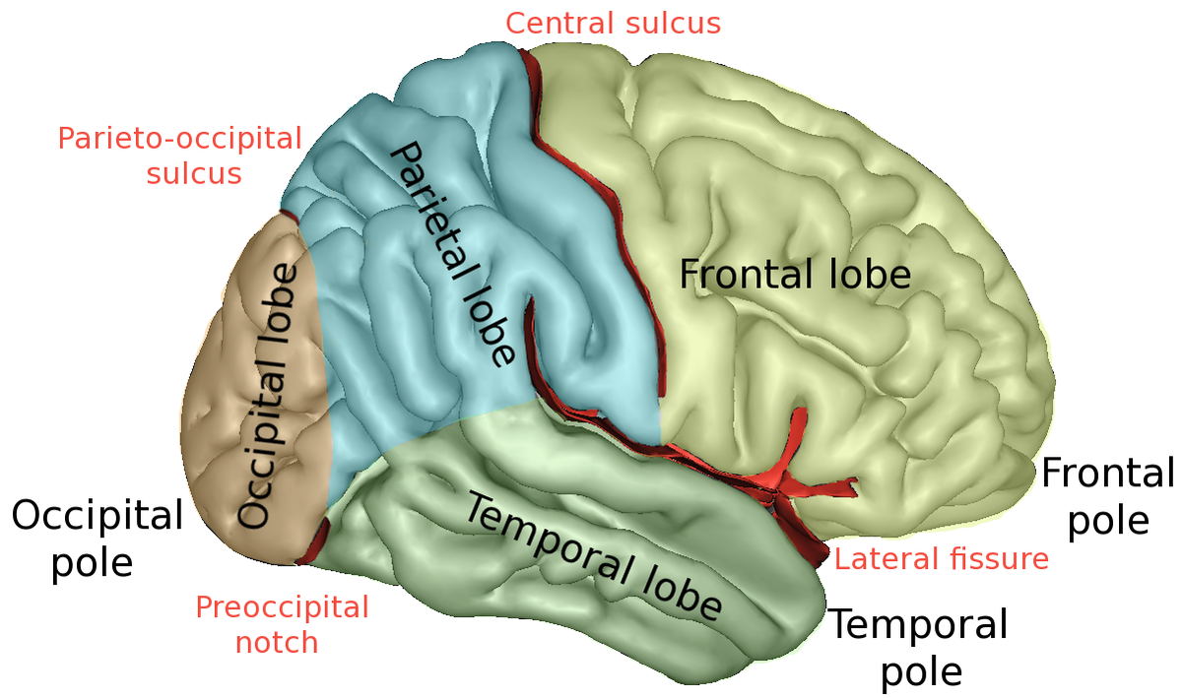
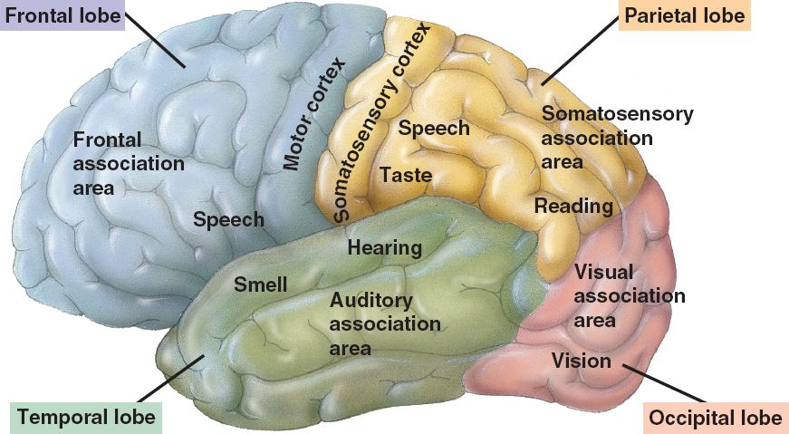

Slide 67
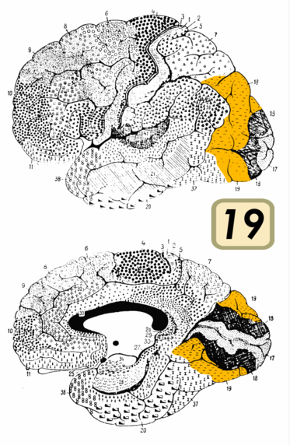
Occipital Lobe
L
M

Slide 68
Visual images are transduced into neural activity within the retina and are processed through a series of brain cells
Optic nerve - optic chiasma - optic tract - LGB - optic radiation - visual cortex(occipital) (BA 17,18,19).
The cells of the primary visual cortex(V1) project to the secondary visual cortex(V2, V3, V4), where cells respond specifically to particular movements of lines and to angles. In turn, these cells project to two association areas.
The inferior temporal lobe detects the shape, form, and color of the object (“What Pathway”)
The posterior parietal lobe tracks the location, motion, and distance.(“When Pathway”)

Slide 69
Visually Evoked Potentials (VEP) :
  Visual Evoked Potential/Response (VEP) measures the electrical signal generated at the visual cortex in response to visual stimulation. The visual cortex is primarily activated by the central visual field and there is a large representation of the macula in the occipital cortex.
  VEP amplitude decrease in optic neuritis indicated axonal atrophy or focal inflammation, or a combination of both.

Slide 70
Occipital Lobe
Demarcated from the parietal lobe on the medial surface by the parieto-occipital sulcus and the anterior limb of the calcarine fissure
The entire cortex is dedicated to vision
Brodmann’s areas 17, 18, and 19
  Brodmann’s area (BA) 17 : primary visual cortex (striate cortex). Much of the primary visual cortex lies within the calcarine fissure, which extends approximately 2.5 cm deep into the occipital lobe.
  Brodmann’s areas 18 and 19 : Secondary and tertiary visual areas, respectively, and represent the visual association areas.
Primary visual cortex :
  Nerve cell bodies in LGB of Thalamus Fibers project to the V1 (where they terminate and produce a retinal map.
  Macular areas of the retina - represented close to the occipital pole - occupy a relatively large area of the visual cortex.
  Peripheral vision - represented more anteriorly.

Slide 71
  Small spots of light are very effective in exciting the cells of the retina and the lateral geniculate body But cells of the primary visual cortex respond only to visual images that have linear properties (lines and edges).
  A lesion of V1 will produce an area of blindness (scotoma) in the contralateral visual field. Loss of an area as large as an entire quadrant of vision may go unnoticed by the patient. A lesion of the entire primary visual cortex on both sides results in cortical blindness.

Slide 72
Secondary and tertiary visual cortex (Extrastriate Visual Cortex):
  BA 18 (V2) receives binocular input and allows for the appreciation of three dimensions (stereopsis).
  BA 19 (V3) integrate visual with auditory and tactile signals. Area V3 is located dorsal and anterior to V2 on both the medial and lateral surfaces of the occipital lobe.
  Area V4 is represented by the cortex of lingual and fusiform gyri, located on the inferior surface of the brain, and is important in color perception.
  Area V5 is also important in stereopsis (like V2) and planning smooth persuit eye movements and direction of moving visual objects.

Slide 73
  Two parallel pathways from the retina :
    Magnocellular pathway arises from large retinal ganglion cells concentrated near the periphery of the retina and terminates on cells in the magnocellular layer of the lateral geniculate body. The magnocellular pathway carries signals related to object motion and location.
        Parvocellular (parvo) pathway arises from small retinal ganglion cells that serve mainly cones associated with the macula of the retina and terminates on cells in the parvocellular layer of the lateral geniculate body. The parvocellular pathway carries signals related to color and form.
        These two continue as separate parallel pathways to V1 of the occipital cortex.
        A third pathway arises from small cells in the lateral geniculate body that make up the koniocellular layer. The koniocellular layer receives color information from the retina.

Slide 74
        There is considerable mixing of all three pathways in V1.
        Two cortical visual streams arise from V1.
          Ventral Stream (What Pathway): V1 – V2 - Ventral V3 - V4
        Signals pass to the extrastriate body area
        located bilaterally in the inferior temporal
        lobe.
          Dorsal Stream (Where Pathway) : V1 - V2 – Dorsal V3 – V4
          Signals pass to posterior Parietal lobe.

Slide 75
        Face-responsive occipital region :A region of the striate cortex in the inferior occipital gyrus is sensitive to faces and is sensitive to physical differences between faces and between faces and objects, but it does not extract face identity

Slide 76
Schizophrenia :
  V1 (along with BA 9 in the frontal lobe) is decreased in thickness in the brains of patients with schizophrenia. and is accompanied by a 10% increase in neuronal density
  poor eye tracking
  A group of patients with schizophrenia exhibited visual defects when tested for contrast sensitivity and form discrimination.
  Patients with schizophrenia exhibiting reduced gray matter in the occipital lobe were found to have a poor outcome.
Hallucinations (MC following lesion on Right side of Occipital Cortex):
  Four categories of visual hallucinations
  Elementary 2. complex 3. illusions 4. distortions.
  1. Elementary hallucinations : include static or moving spots, line segments or simple shapes. Reflects activity in Primary Visual areas (even precortical structures) (Electrical Stimulation of V1)
  2. Complex hallucinations include objects, faces. Reflects activity in ventral visual stream (electrical Stimulation of V2 and V3)
  3. Illusions and distortions are alternations in perception of the external world, commonly alterations in shape, color, size, or movement). Objects may become disproportionately large (macropsia) or distorted in shape.

Slide 77
  Anton Syndrome : Denial of blindness resulting from complete bilateral lesion of all visual cortices resulting from occlusion of both posterior cerebral arteries.
  The Migraine visual aura : Positive and Negative Component.
  Bright, white, silver, or colored line segments, patterns or
  geometrical shapes that may flicker, pulsate, or move.
  More complex hallucinations, including faces, may be
  seen
  The aura begins in a restricted area of the occipital lobe
  representing the fovea then migrates as a form of
  spreading depression across the cortex representing the
  peripheral retina
  Infarction of the left posterior cerebral artery involving the medial occipital lobe produces a confusional state. Confusion and agitation may alternate with mutism.

Slide 78
Visual agnosia : lesions in the ventromedial occipital lobe
  The objects are seen but cannot be named, and the patient does not know what the object can be used for.
  Prosopagnosia : Loss of the ability to recognize the faces of known people may follow unilateral or bilateral lesions of the ventromedial occipital lobe that extend into the ventral temporal lobe and include the fusiform gyrus.
  Achromatopsia : Loss of colour vision, leaving shape detection relatively intact.

Slide 79
Blindsight : Loss of the V1 renders the patient blind. (Activity in V1 is required for visual stimuli to be perceived.) However, when confronted with forced choice testing some patients show residual capacity in the blind visual field. (Guess the location and motion (Dosal Visual Stream)). This residual capacity is called blindsight.
Due to
Direct ipsilateral connections from the lateral geniculate body of the thalamus to the
middle temporal area (MT/ V5).
  Affective Blindsight : Emotional valence of facial images can be detected even
  after loss of V1
  By way of a separate subcortical pathway involving the
  colliculus, pulvinar, and amygdala. This pathway does not
  pass through the occipital lobe and allows for the
  nonconscious recognition of fearful as well as happy
  expressions in sighted individuals.

Slide 80
Anxiety disorder : Increased blood flow has been reported in the occipital region (BA 18 and BA19) in patients with generalized anxiety disorder and with obsessive-compulsive, visually evoked anxiety. This is coupled with a decrease in blood flow to the prefrontal areas.
Charles Bonnet syndrome : Characterized by visual hallucinations following loss of vision, often due to cataracts, glaucoma, or age-related macular degeneration. The hallucinations may be simple or complex and are experienced as amusing or sometimes disturbing.

Slide 81
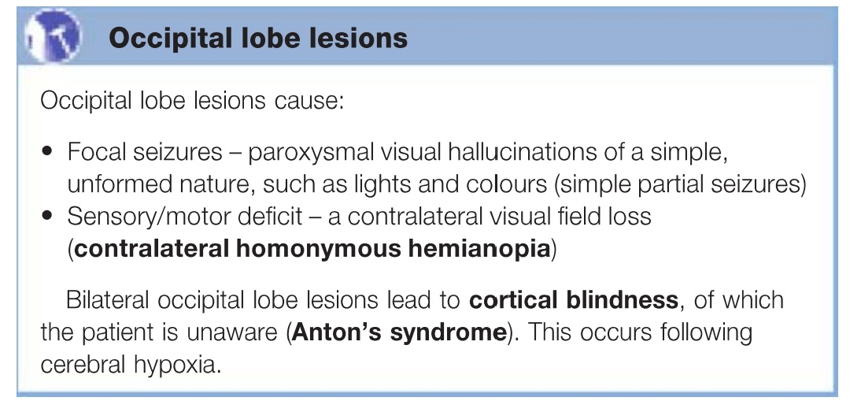

Slide 82
Occipital Lobe Assessments
Color anomia
Color agnosia
Prosopagnosia
Metamorphopsia
Allesthesia
Asthenopia (visual fatigue)
Visual illusion/ Visual hallucination
Anton’s syndrome
Balint’s syndrome ( simultanognosia, ocular apraxia, optic ataxia)
Visual agnosia

Slide 83
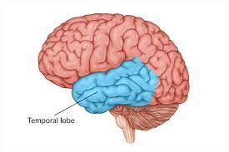
Temporal Lobe
It is located anterior to the occipital cortex and below the sylvian fissure.
Some important subcortical temporal lobe structures are –
Limbic System
Amygdala
Hippocampus

Slide 84
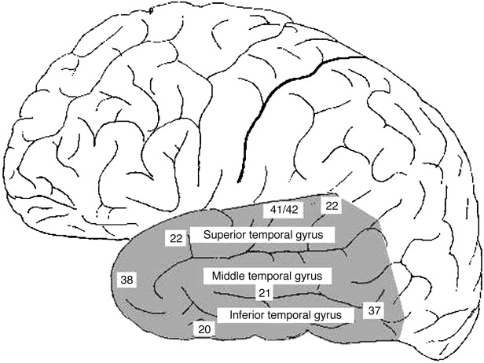
Lateral Aspect of Temporal Lobe
It consists of two sulci –
Superior temporal sulcus
Inferior temporal sulcus
3 gyri are present which terminate at the temporal pole (BA 38) -
Superior temporal gyrus (BA 41,42,22)
Middle temporal gyrus (BA 21)
Inferior temporal gyrus (BA 20)

Slide 85
Functional areas in the temporal lobe
Primary Auditory Cortex (Area 41, 42) :
Concerned with the reception of isolated impressions of loudness, quality and pitch of the sound.
Picks up the source and loudness of the sound.
Situated in the superior temporal gyrus
Also known as Transverse Temporal gyrus/ Heschl’s Gyrus
On the left hemisphere, its function is generation and understanding of individual words.
On the right hemisphere, its function is to differentiate between melody, pitch and sound intensity.

Slide 86
Secondary Auditory Area/Auditory association cortex (BA 22) :
It is responsible for auditory processing and language.
Language function is lateralized to the left side in most individuals.
The lesions of secondary auditory area result in an inability to interpret the meaning of the sounds heard, and the patient may experience word deafness (auditory verbal agnosia).
Ventral Visual Stream Areas (BA 20,21,37,38) :
It is responsible for higher levels of visual and recognition memory.

Slide 87
Wernicke’s Area (Posterior part of Area 22) :
It is located in the superior temporal gyrus in the dominant cerebral hemisphere (left hemisphere in 95% of right handed and 70% of left handed individuals).
It is involved in comprehension of written and spoken language.
It is an entry point for the conversion of auditory sequences into neural word representations leadig to meaning appropriate content words.
Damage to this area causes receptive fluent aphasia.

Slide 88
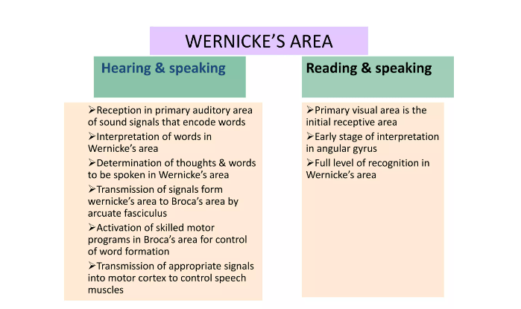

Slide 89
Medial Surface of Temporal Lobe
Fusiform Gyrus
Hippocampal Gyrus and surrounding cortex(subiculum, parahippocampal cortex, entorhinal cortex and perirhinal cortex)
Amygdala
Dentate Gyrus
Inferior Temporal Gyrus

Slide 90
Functions:
Auditory reception
Language comprehension and Naming
Sound modulation
Perception of music
Memory storage and long term potentiation
Learning of higher order visual tasks and auditory patterns
Emotion
Motivation
Personality (temporal lobe personality)

Slide 91
Principal symptoms of Temporal lobe damage
Disturbance of auditory sensation and perception
Disturbance of selective attention of auditory and visual input
Disorders of music perception
Disorders of visual perception
Impaired organization and categorization of verbal material
Disturbance of language comprehension
Impaired long term memory
Altered personality and affective behaviour
Altered Sexual behaviour

Slide 92
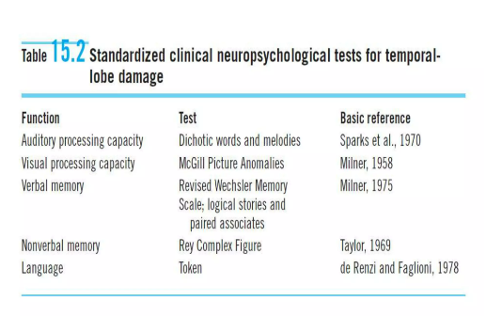
Assessment of Temporal Lobe

Slide 93
Assessment of the Temporal Lobe
McGill Picture Anomaly Test : It’s a non-verbal test and requires the subject to simply point out the aspect of the photo or drawing that is out of place.
Rey Complex Figure Test : In this, the examinees are asked to reproduce a complicated line drawing, first by copying it freehand (recognition) and then drawing from memory (recall).
Token Test : This is a test for verbal comprehension. It consists of tokens which differ in color, shape and sizes. The examinee has to follow verbal instructions which increase in complexity.

Slide 94
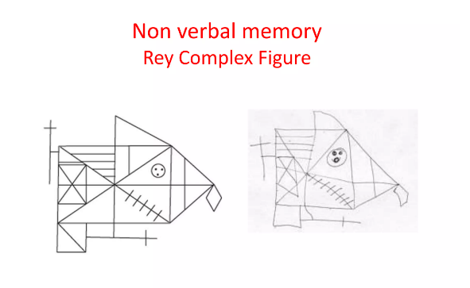
Rey Complex Figure Test

Slide 95
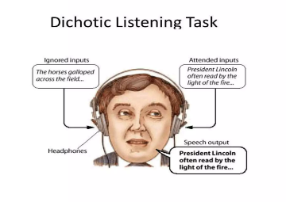
Dichotic Listening Task :

Slide 96
Revised Wechsler Memory Scale :
It consists of 7 subtests –
Spatial Addition
Symbol Span
Design Memory
General Cognitive Screener
Logical Memory (I & II)
Verbal Paired Associates (I & II)
Visual Reproduction (I & II)
A person’s performance is reported as five Index Scores – Auditory Memory, Visual Memory, Visual Working Memory, Immediate Memory and Delayed Memory.

Slide 97
Clinical Implications
Damage to Superior Temporal Gyrus will lead to -
Dominant Lobe Lesion:
Wernicke’s Aphasia
Memory dysfunction
Non-dominant Lobe Lesion :
Agnosia for sounds
Dysprosody – Disturbed emotional and affective components of language or body language
Damage to Inferior Temporal Gyrus will lead to –
a) Inability to recognize faces (Prosopagnosia)

Slide 98
Gestaut- Geschwind Syndrome/ Temporal Lobe Personality
Hypergraphia – personality that overemphasizes in writing their trivial and petty details of life
Hyper-religiosity
Pedantic Speech – an overly formal speaking style inappropriate to the converstional setting
Egocentricity – preoccupation with one’s own internal world
Perseveration and Circumstantiality
Altered Sexuality – hypo>hyper
Paranoia
Prone to Aggression -

Slide 99
Temporal Lobe Epilepsy
Seizure originates from the anteromedial aspect of temporal lobe
Begins in late childhood/early adulthood
Complex partial/psychomotor seizure which present as automations, illusions, hallucinations and pilomotor erections
Sometimes even Uncus is involved so also k/a Uncinate fits which involve olfactory hallucinations
Causes – Hippocampal sclerosis, cavernous angiomas, gliomas, head injury, alcohol withdrawal
C/f – A/s with most complex auras which can mimic s/s of psychiatric d/o, visual hallucination with image distortion, simple and complex seizures, starts as conspicuous motionless stare with relatively prolonged automations continuously for > 2 mins
Déjà vu, Jamais Vu, Deja Pansee/Deja Vacu, Experiential Hallucinations
Sequale – a) Post-ictal Psychosis – it has mixed affective and psychotic features with agitation but is self-limiting.
b) Inter-ictal Psychosis – it has features of depression, anxiety and suicide. In some rare cases, schizophrenia like psychosis and temporal lobe personality can occur.
Notes:
Déjà vu – Already seen
Jamais Vu – Something familiar is strange or new
Deja Pansee/Deja Vacu – somethingnew seeming strangely familiar
Experiential Hallucinations – based on remembered experiences

Slide 100
Kluver - Bucy Syndrome
It is due to B/L destruction of the amygdaloid body and inferior temporal cortex. In humans, it was first documented in patients with temporal lobectomy.
S/S – a) Visual Agnosia
b)Placidity (extreme calmness)
c) Hypermetamorphosis (Rapid and Sudden change of ideas)
d) Hyperorality
e) Hypersexuality
f) Amnesia (anterograde and retrograde)
g) Hypoemotionality
Causes – Cerebral trauma, Infections(encephalitis), Alzheimers and other dementias, Niemann-Pick disease, CVA.

Slide 101
Wernicke’s Aphasia
Mainly due to the damage of BA 22 i.e. in auditory processing
AKA Fluent/Repetitive/Sensory/Post-rolandic Aphasia
S/S –
a) Fluency intact (normal or increased word output k/a LOGORRHEA)
b) Meaningless Speech
c) Paraphasias, neologisms, paragrammatism (Jargon Aphasia)
d) Impaired Comprehension, Repetition, Reading, Naming, Writing, Insight about aphasia

Slide 102
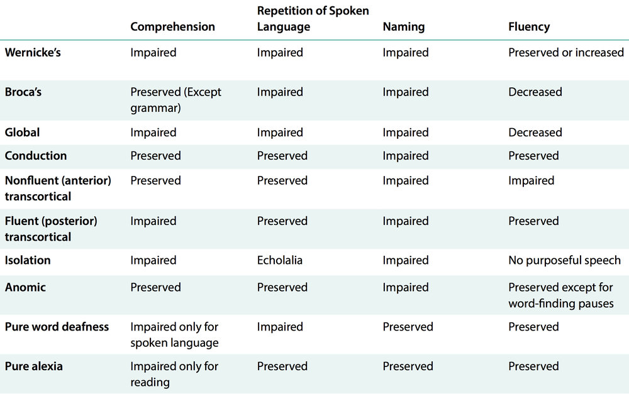

Slide 103
FrontoTemporal Dementia –
Personality and Behavioural Changes are earlier affected as compared to memory and other cognitive functions.
Can be associated with Kluver-Bucy Syndrome
Alzheimer’s Disease –
Atrophy in the posterior temporal cortex, parietal and frontal lobe is most prominent.
Temporal Lobe Tumors –
May have s/s of slowing, aspontaneity, Korsakoff psychosis, affective disturbances, auditory and visual hallucinations and personality changes
Memory Dysfunction –
Left sided – Verbal
Right sided – Non-verbal

Slide 104
Schizophrenia –
Localised reduction (decreased volume) of gray matter mainly of the left temporal lobe are correlated with disease severity.
Decrease in the volume of left posterior superior temporal gyrus is proportional to the severity of thought disorders.
rTMS (low freq) over temporo-parietal region can be helpful to reduce hallucinations (not FDA approved).
Antisocial Personality disorder –
Decreaase in the temporal lobe size especially that of amygdala is a/s with impulsive-aggressive acts seen in ASPD.

Slide 105
Temporal Lobe Syndromes
U/L diz of dominant lobe -
Homonymous upper quadrantanopia
Wernicke’s aphasia
Amusia
Anomia
Visual Agnosia
Impairment on tests of visually presented material
U/L diz of non-dominant lobe-
Homonymous upper quadrantanopia
Agnosia for sounds and some qualities of music
Impairment on tests of visually presented material

Slide 106
Either Lobe –
Auditory, Visual, Olfactory and Gustatory hallucinations
Dreamy states
Emotional and behavioural changes
Delirium
Disturbance of time Perception
B/L diz –
Korsakoff Amnesic defect
Apathy and Placidity
Kluver Bucy Syndrome

Slide 107
THANK YOU

