Slide 1
Fungal Infections of
Respiratory Tract
Dr.Nidhi Bhalodia
Associate Professor
Department of Microbiology
SBKSMI&RC
COMPETENCY MI 6.1,6.2,6.3

Slide 2
Learning objectives
At the end of the session, the students will be able to understand:
Examples of fungi that cause infections of respiratory tract.
Epidemiology, pathogenesis, clinical manifestations, lab diagnosis and treatment of Pneumocyctis pneumonia, Zygomycoses, Aspergillosis.

Slide 3
Fungi differ from bacteria & other eukaryotes
Eukaryotic and possess eukaryotic cell organelles
Possess a rigid cell wall, composed of chitin, β-glucans and other polysaccharides
Cell membrane contains ergosterol instead of cholesterol
May be unicellular or multicellular
Lack chlorophyll and divide by asexual and/or sexual means by producing spores

Slide 4
Classification of Fungi
1. Morphological classification
2. Taxonomical Classification
3. Systemic classification

Slide 5
Morphological classification

Slide 6
Morphological Classification of Fungi
1. Yeast: Round to oval cells that reproduce by budding
Cryptococcus neoformans (pathogenic)
Saccharomyces cerevisiae (non-pathogenic)
2. Yeast-like: Yeasts forming pseudohyphae (e.g. Candida)
- Differentiated from true hyphae as they have constrictions at septa
3. Molds: long branching filaments called hyphae
- Hyphae - septate or nonseptate

Slide 7
Morphological Classification of Fungi
4. Dimorphic fungi: exist as molds (hyphal form) in the environment at ambient temperature (25°C) and as yeasts in human tissues at body temperature (37°C)
Histoplasma capsulatum
Blastomyces dermatitidis
Coccidioides immitis
Paracoccidioides brasiliensis
Penicillium marneffei
Sporothrix schenckii.

Slide 8
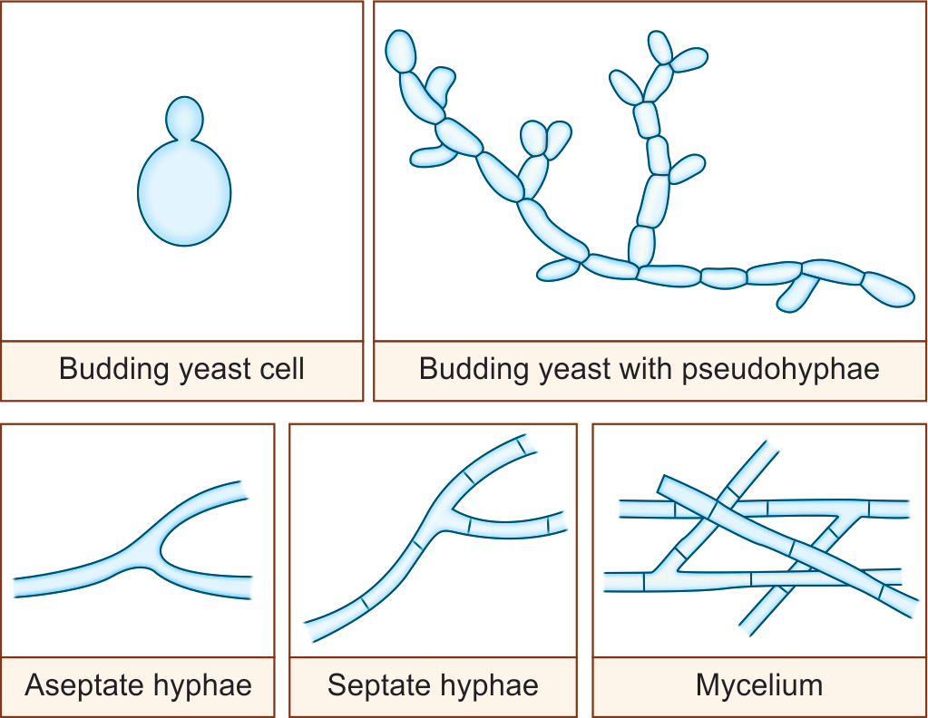
Morphological forms of fungi

Slide 9
Taxonomical Classification

Slide 10
Taxonomical Classification
Based on the production of sexual spores
1. Phylum zygomycota: sexual spores – zygospores, and possess aseptate hyphae, e.g. Rhizopus and Mucor.
2. Phylum ascomycota: Sexual spores - ascospores and possess septate hyphae, e.g. Aspergillus.
3. Phylum basidiomycota: Sexual spores - basidiospore e.g. Cryptococcus
4. Phylum deuteromycota (Fungi imperfecti): sexual state is either absent or unidentified yet

Slide 11
Types of fungal spores
A.Sexual spore
B.Asexual spore
Sexual Spore | Observed in-
Zygospores | Zygomycetes
Ascospores | Aspergillus
Basidiospores | Cryptococcus

Slide 12
Types of fungal spores
Aerial asexual spore
Conidiospore or conidia | Aspergillus
Sporangiospore | Zygomycetes
Microconidia | Dermatophytes
Macroconidia | Dermatophytes

Slide 13
SYSTEMIC CLASSIFICATION

Slide 14
SYSTEMIC CLASSIFICATION
Superficial mycoses | Agents
Tinea versicolor | Malassezia furfur
Tinea nigra | Hortaea werneckii
Piedra | Trichosporon beigelii, Piedraia hortae
Dermatophytosis | Trichophyton, Microsporum, Epidermophyton

Slide 15
SYSTEMIC CLASSIFICATION
Subcutaneous mycoses
Mycetoma | Madurella mycetomatis, Pseudallescheria boydii, etc
Sporotrichosis | Sporothrix schenckii
Chromoblastomycosis | Phialophora verrucosa Fonsecaea pedrosoi
Rhinosporidiosis | Rhinosporidium seeberi

Slide 16
CLASSIFICATION OF FUNGAL DISEASES
Systemic mycoses
Histoplasmosis | Histoplasma capsulatum
Blastomycosis | Blastomyces dermatitidis
Coccidioidomycosis | Coccidioides immitis
Paracoccidioidomycosis | Paracoccidioides brasiliensis

Slide 17
CLASSIFICATION OF FUNGAL DISEASES
Opportunistic mycoses
Candidiasis | Candida albicans, Other Candida species
Cryptococcosis | Cryptococcus neoformans
Zygomycosis | Rhizopus, Mucor, Absidia
Aspergillosis | Aspergillus flavus, Aspergillus fumigatus, Aspergillus niger
Penicilliosis | Penicillium marneffei, Other Penicillium species
pneumocystosis | Pneumocystis jirovecii

Slide 18
Microscopy
KOH preparation
Keratinized tissue specimens treated with 10% KOH → digests keratin → fungal hyphae clearly seen
2) lactophenol cotton blue (LPCB):
Phenol acts as disinfectant
Lactic acid preserves the morphology of fungi
Glycerol prevents drying
Cotton blue stains the fungal elements blue

Slide 19
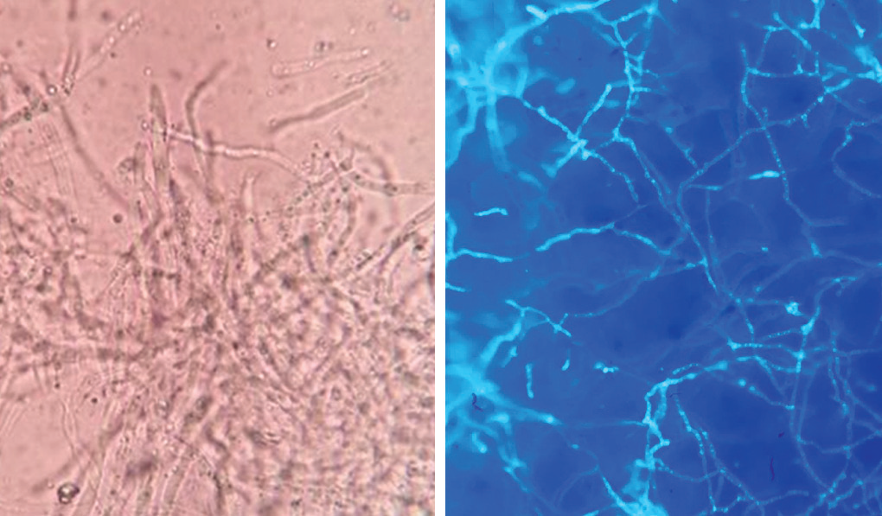
KOH MOUNT OF SAMPLE

Slide 20
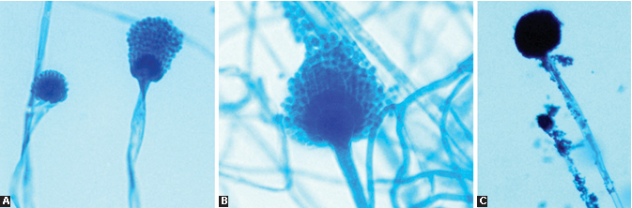
Aspergillus microscopic picture (LPCB mount)
A. Aspergillus fumigatus; B. Aspergillus flavus; C. Aspergillus niger

Slide 21
Culture Media
Sabouraud’s dextrose agar (SDA):
Most commonly used medium
Contains peptone (1%), dextrose (4%) and pH of 5.6
May not support some pathogenic fungi

Slide 22
FUNGAL INFECTIONS OF
RESPIRATORY TRACT

Slide 23
FUNGAL INFECTIONS OF RESPIRATORY TRACT
Opportunistic fungal agents: Major fungal agents cause respiratory infections
Pneumocystis jirovecii pneumonia
Zygomycoses
Aspergillosis
Penicillosis.

Slide 24
FUNGAL INFECTIONS OF RESPIRATORY TRACT (Cont..)
Fungi causing systemic mycoses:
Blastomyces dermatitidis
Histoplasma capsulatum
Paracoccidioides brasiliensis
Coccidioides immitis.
Yeast: Cryptococcus neoformans

Slide 25
PNEUMOCYSTIS PNEUMONIA

Slide 26
Taxonomy
Recently, the taxonomy of Pneumocystis has been changed (2002).
Once thought to be a protozoan, now under fungus based on nucleic acid sequence studies.
Taxonomists renamed the human species of Pneumocystis as Pneumocystis jirovecii.

Slide 27
Pathogenesis
Pneumocystis exists in cyst and trophozoite forms. The
Cysts - found in the environment, in human tissues both cysts an trophozoites (containing 4–8 sporozoites) are found.
Once inhaled, the cysts are carried to – lungs - transform into trophozoite
Trophozoites induce - inflammatory response – recruitment of plasma cells -frothy exudate - also called plasma cell pneumonia.

Slide 28
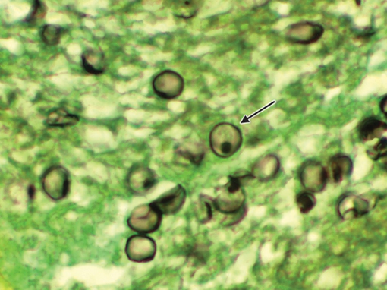
Laboratory Diagnosis
Histopathological examination of lung tissue - reveals cysts.
Gomori’s methenamine silver (GMS) staining method-demonstrate the cysts of P. jirovecii.
Cysts - black colored crushed ping-pong balls, against the green background

Slide 29
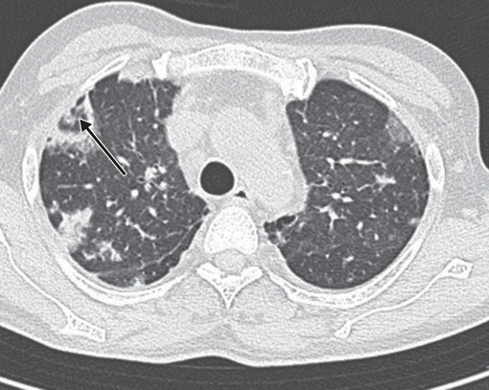
Laboratory Diagnosis (Cont..)
Radiology: Chest X-ray - classical finding of bilateral diffuse infiltrates.
CT of the lung - ground-glass opacities
at the early stage.
Atypical manifestations - nodular densities, cavitary lesions
CT scan of lungs suggestive of Pneumocystis pneumonia (soft tissue density nodule with reverse halo sign in the right upper lobe).

Slide 30
Laboratory Diagnosis (Cont..)
Pneumocystis is not cultivable - no serological test available
PCR - developed for detection of P. jirovecii specific genes
Detection of 1, 3 β-D-glucan in serum

Slide 31
Treatment of Pneumocystis pneumonia
Cotrimoxazole (trimethoprim/sulfamethoxazole) - drug of choice for Pneumocystis pneumonia.
Given for 14 days in non-HIV patients and 21 days in patients with HIV.
Also the recommended drug for primary and secondary prophylaxis in patients with HIV

Slide 32
ZYGOMYCOSIS

Slide 33
ZYGOMYCOSIS
Life-threatening infections caused by aseptate fungi belonging to the phylum Zygomycota
Order mucorales (causes mucormycosis)
  Rhizopus (R. arrhizus and R. microsporus)
  Mucor racemosus, Rhizomucor pusillus
  Lichtheimia corymbifera , Apophysomyces elegans.

Slide 34
Mucormycosis - Pathogenesis
Spores found ubiquitously in the environment
Transmission - inhalation, inoculation or rarely ingestion of spores
Spores - mycelial form which are angioinvasive - resulting in spread of infection

Slide 35
Mucormycosis – Pathogenesis (Cont..)
Predisposing factors:
Conditions with increased iron load
Diabetic ketoacidosis
End stage renal disease
Iron therapy or deferoxamine
Defects in phagocytic functions

Slide 36
Mucormycosis – Clinical Manifestations
1. Rhinocerebral mucormycosis: Most common form, Orbital cellulitis, proptosis and vision loss
2. Pulmonary mucormycosis - in patients with leukemia
3. Cutaneous mucormycosis

Slide 37
Mucormycosis – Clinical Manifestations
4. Gastrointestinal mucormycosis – necrotizing enterocolitis
5. Disseminated mucormycosis: Brain
6. Miscellaneous forms

Slide 38
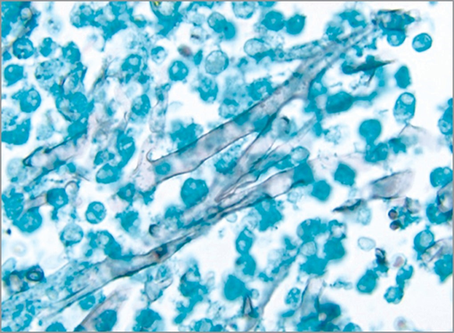
Mucormycosis – Laboratory Diagnosis
Histopathological staining or methenamine silver stain of tissue biopsies shows broad aseptate hyaline hyphae with wide angle branching
Zygomycosis—histopathology of tissue section shows aseptate broad hyphae (Methenamine silver stain).

Slide 39
Mucormycosis – Laboratory Diagnosis (Cont..)
Culture on SDA at 25°C: White cottony woolly colonies with tube filling growth (hence called lid lifters).
Rhizopus - colonies become brown black later, due to sporulation giving rise to salt and pepper appearance
A. Rhizopus colony on SDA shows white cottony woolly colonies with black spores (salt and pepper appearance);
B. Mucor on SDA—white cottony woolly colonies

Slide 40
Mucormycosis – Laboratory Diagnosis (Cont..)
Microscopic appearance: LPCB mount - broad aseptate hyaline hyphae, from which sporangiophore – sporangium – sporangiospores.
Rhizoid: Root like growth arising from hyphae
Rhizopus - nodal rhizoids
Lichtheimia - internodal rhizoids
Mucor - rhizoids absent.

Slide 41
Mucormycosis – Laboratory Diagnosis (Cont..)
C. LPCB mount of colonies of Rhizopus shows sporangium with rhizoid present;
D. LPCB mount of colonies of Mucor shows sporangium (absence of rhizoid).

Slide 42
Mucormycosis – Laboratory Diagnosis (Cont..)
A. Rhizopus; B. Lichtheimia; C. Mucor

Slide 43
Treatment of Zygomycosis
Amphotericin B deoxycholate - drug of choice for all forms of mucormycosis.
Posaconazole or isavuconazole - given alternatively.
For mild localized skin lesions in immunocompetent patients, which can be removed surgically.

Slide 44
ASPERGILLOSIS

Slide 45
ASPERGILLOSIS
Aspergillosis refers to the invasive and allergic diseases caused by a hyaline mold named Aspergillus.
There are nearly 35 pathogenic and allergenic species of Aspergillus, important ones being— A. fumigatus, A. flavus and A. niger

Slide 46
Pathogenesis
Widely distributed in nature - decaying plants
Transmission – inhalation of airborne conidia.

Slide 47
Pathogenesis (Cont..)
Risk factors for invasive aspergillosis are:
Glucocorticoid use (the most important risk factor)
Profound neutropenia
Neutrophil dysfunction
Underlying pneumonia, chronic obstructive pulmonary disease, tuberculosis or sarcoidosis
Anti-tumor necrosis factor therapy.

Slide 48
Clinical Manifestations
Incubation period - 2 to 90 days.
Pulmonary aspergillosis: Most common form
Allergic bronchopulmonary aspergillosis (ABPA)
Severe bronchial asthma
Aspergilloma (fungal ball)
Acute angioinvasive pulmonary aspergillosis
Chronic cavitary pulmonary aspergillosis

Slide 49
Clinical Manifestations (Cont..)
Invasive sinusitis
  Chronic granulomatous sinusitis
  Maxillary fungal ball
  Allergic fungal sinusitis
Cardiac aspergillosis: Endocarditis (native or prosthetic) and pericarditis
Cerebral aspergillosis: Brain abscess, hemorrhagic infarction, and meningitis

Slide 50
Clinical Manifestations (Cont..)
Ocular aspergillosis: Keratitis and endophthalmitis
Ear infection: Otitis externa
Cutaneous aspergillosis
Nail bed infection: Onychomycosis
Mycotoxicosis

Slide 51
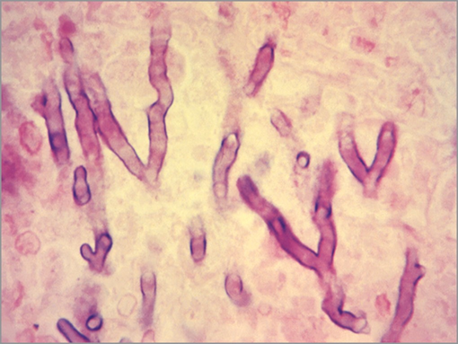
Laboratory Diagnosis - Direct Examination
Specimens - sputum and tissue biopsies
KOH (10%) mount or histopathological staining of specimens - narrow septate hyaline hyphae with acute angle branching

Slide 52
Laboratory Diagnosis - Culture
Culture: SDA and incubated at 25°C
Species identification - based on macroscopic and microscopic (LPCB mount) appearance of the colonies

Slide 53
Identification features of Aspergillus species
Aspergillus species | Macroscopic appearance of colony | Microscopic appearance of colony (LPCB mount)
A. fumigatus | Colonies—smoky green, velvety to powdery, reverse is white | Vesicle is conical-shaped Phialides are arranged in single row Conidia arise from upper third of vesicle Conidia are hyaline
A. flavus | Colonies—yellow green, velvety, reverse is white | Vesicle is globular-shaped Phialides in one or two rows Conidia arise from upper two-third to entire vesicle Conidia are hyaline
A. niger | Colonies—black, cottony type, reverse is white | Vesicle is globular-shaped Phialides in two rows Conidia arise from entire vesicle Conidia are black in color

Slide 54
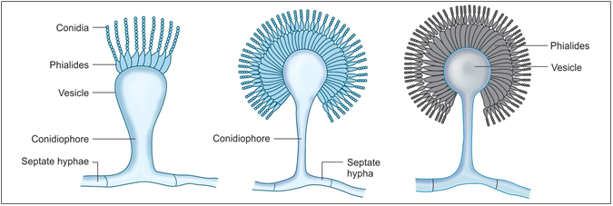
Conidiation of various Aspergillus species
A
B
C
A. A. fumigatus; B. A. flavus; C. A. niger

Slide 55
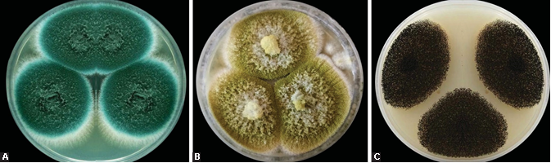
Aspergillus (colonies on SDA)
A. Aspergillus fumigatus; B. Aspergillus flavus; C. Aspergillus niger

Slide 56
Aspergillus microscopic picture (LPCB mount)
A. Aspergillus fumigatus; B. Aspergillus flavus; C. Aspergillus niger

Slide 57
Laboratory Diagnosis - Antigen Detection
β-d-Glucan antigen assay: Marker of invasive fungal infections
  Raised in most invasive fungal infection – invasive aspergillosis
Galactomannan antigen: Detected by ELISA in patient’s sera or urine.

Slide 58
Laboratory Diagnosis - Antibody Detection
Useful for chronic invasive aspergillosis and aspergilloma, where the culture is usually negative
In allergic syndromes such as ABPA and severe asthma, specific serum IgE levels are elevated.

Slide 59
Skin Test
Positive skin test to various antigen extracts of Aspergillus indicates hypersensitivity response and is usually positive for various allergic type of aspergillosis.

Slide 60
Treatment of Aspergillosis
For invasive aspergillosis—voriconazole is the drug of choice
For ABPA—itraconazole is the drug of choice
For single aspergilloma—surgery is indicated
For chronic pulmonary aspergillosis—itraconazole or voriconazole
For prophylaxis - posaconazole is indicated.

Slide 61
PULMONARY CRYPTOCOCCOSIS

Slide 62
PULMONARY CRYPTOCOCCOSIS
Cryptococcus neoformans - capsulated yeast causes meningitis in HIV-infected individuals.
Acquired by inhalational route
In immunocompetent individuals - lungs exhibit defense mechanisms.
People with low immunity, pulmonary infection occurs first, followed by dissemination through blood to distant sites such as CNS.

Slide 63
Q1. : Cryptococcus neoformans is?
Yeast
Yeast like fungus
Dimorphic
Mold

Slide 64
Questions:
Q2. Special stain used for demonstration of capsule of Cryptococcus neoformans is
Negative stain
Fullton stain
Giemsa stain
Leishman stain

Slide 65
Questions:
Q3. Special culture media used for cryptococcus neoformans
BHI agar
TCBS agar
Chrome agar
Bird seed agar

Slide 66
Q4. : Cryptococcus neoformans mode of transmission is
Inhalation
Ingestion
Vector borne
Contact

Slide 67
Q5. : Most important virulence factor of cryptococcus neoformans is
Capsule
Cell Wall
Cell membrane
Hyphae

