Slide 1
THALAMOCORTICAL SYSTEM
CEREBELLOTHALAMOCORTICAL SYSTEM
Dr. Naitik Patel
1st year Resident
SBKS MI &RC

Slide 2
Index
1) Overview
2) Neuroanatomy
3) Summary of Thalamic Nuclei’s
4) THALAMOCORTICAL Functional Circuitry
5) CEREBELLOTHALAMOCORTICAL SYSTEMS
6) Clinical Significance

Slide 3
FUNCTIONAL BRAIN SYSTEMS
1) Thalamocortical – connection between Thalamus and cortex
2) Basal ganglia, - collection of nuclei which regulate movement
and cognitive functions
3) limbic systems -Involved in process of memory
Relates telencephalic structures and their cognitive processes
with hypothalamus

Slide 4
Index
1) Overview
2) Neuroanatomy
3) Summary of Thalamic Nuclei’s
4) THALAMOCORTICAL Functional Circuitry
5) CEREBELLOTHALAMOCORTICAL SYSTEMS
6) Clinical Significance

Slide 5
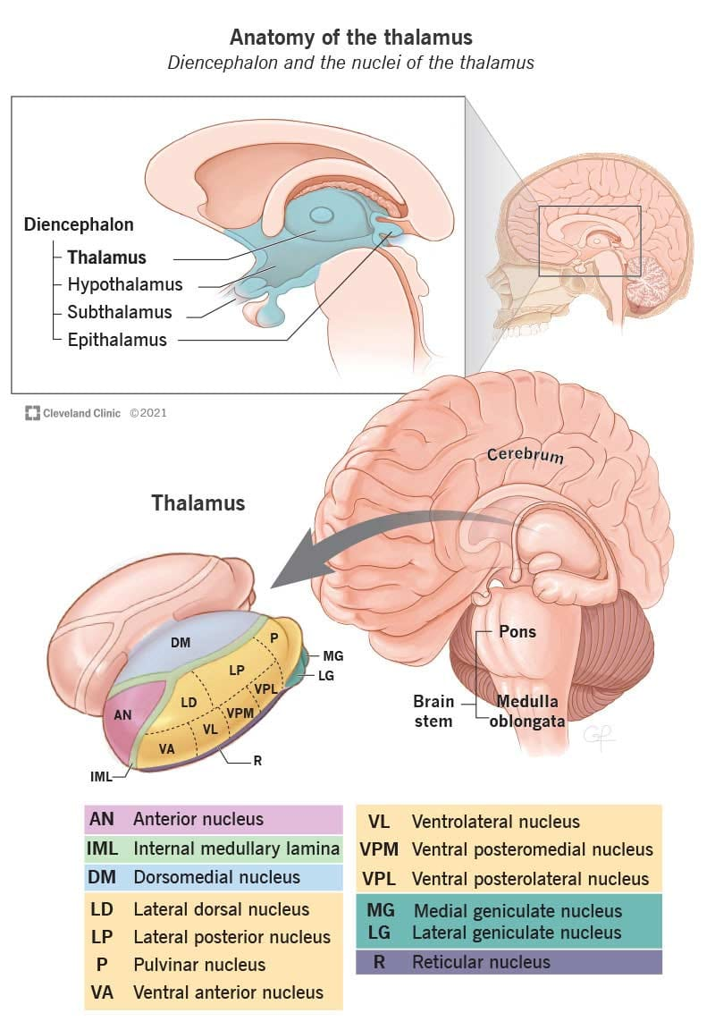
Neuroanatomy
The largest portion of the diencephalon is thalamus-
It is a group of nuclei located medial to the basal ganglia
It serves as the major synaptic relay station for information reaching from spinal cord to the cerebral cortex.
Thalamic Nuclei:
It is divided into six groups:
  anterior,
  Intralaminar,
  medial,
  lateral,
  midline nuclei,
  reticular

Slide 6
Index
1) Overview
2) Neuroanatomy
3) Summary of Thalamic Nuclei’s
4) THALAMOCORTICAL Functional Circuitry
5) CEREBELLOTHALAMOCORTICAL SYSTEMS
6) Clinical Significance

Slide 7
Thalamic Nuclei
Classification based on pattern and information of their connection
They project and receive input from specific regions of the cerebral cortex.
These reciprocal connections allow the cerebral cortex to modulate the thalamic input it receives.
Types:
Specific relay nuclei
  They process input either from a single sensory modality or from a distinct part of the motor system neurons of the thalamic relay nuclei and furnish topographically organized projections to specific regions of the cerebral cortex.
Association relay nuclei
  They receive highly processed input from more than one source and project to larger areas of the association cortex. Eg: medial dorsal thalamic nucleus
Diffuse projection nuclei
  They receive input from diverse sources and project to widespread areas of the cerebral cortex and to the thalamus.

Slide 8
Summary of Thalamic Nuclei’s
Nucleus | Functional class | input | output | function | lesion
Specific Relay Nuclei
i) Anterior | Relay | Hypothalamus- mammillary body | Cingulate gyrus | Learning , memory , emotion | Disorientation Reduced size seen in schizophrenia
ii)Lateral geniculate body | Relay | Retina | Primary visual cortex | Vision | Visual field deficits
iii)Medial geniculate body | relay | Inferior colliculus | Primary auditory cortex | hearing | hearing difficulties

Slide 9
Nucleus | Functional class | input | output | function | lesion
iv) Ventral Anterior | relay | Basal ganglia | Supplementary motor cortex, cingulate gyrus | Movement planning | Aphasia
v) Ventral Lateral | relay | cerebellum | Pfc and primary motor cortex | Movement planning and control | Mild transient hemiparesis and hemiataxia
vi) Ventral posterior lateral and medial | relay | Spinal cord, brainstem, ascending discriminative touch system | Parietal cortex | Touch , limb position sense | Sensory loss in contralateral side without major cognitive deficits, neuropathic pain , paraesthesia, pain contralateral neglect(deficit in attention to contralateral side of damage), lateral side- thalamic astasia (inability to stand)

Slide 10
Nucleus | Functional class | input | output | function | lesion
Association Relay Nuclei
i) Lateral Dorsal | Relay | hippocampus | Cingulate gyrus, parietal cortex
ii) Lateral Posterior | Relay | Sup. Colliculus, parietal, temporal, | Post parietal cortex | Sensory integration
iii) Pulvinar | Relay | Sup. Colliculus, parietal, temporal, | Parietal, temporal, occipital association cortex | Sensory integration, eye perception, movement control, language | Mediates pain pulvinotomy in past to control pain
iv) Mediodorsal | relay | Basal ganglia, amygdala, hypothalamus, nucleus accumbens, olfactory system | Pfc, cingulate gyrus, nucleus basalis | Emotion , cognition , learning , memory | b/l paramedian infarct-thalamic dementia- amnesia, speech disturbance, confusion apathy flattened affect, aspontaneity of motor acts. reduced size- schizophrenia

Slide 11
Nucleus | Functional class | input | output | function | lesion
Diffuse-Projection Nuclei
i)Midline | Diffuse -projecting | Reticular formation, hypothalamus | Cerebral cortex- cingulate gyrus amygdala | Regulation of forebrain excitability(it has dopamine receptors)
ii)Reticular | Diffuse projecting | Thalamus, cortex | thalamus | Regulation of thalamic activity
iii)intralaminar | Diffuse-projecting | Brainstem, spinal cord, basal ganglia | Cerebral cortex, basal ganglia | Regulation of cortical activity Selective attention, arousal, | Lesion – reduced aggression Infarct -Loss of consciousness

Slide 12
Index
1) Overview
2) Neuroanatomy
3) Summary of Thalamic Nuclei’s
4) THALAMOCORTICAL Functional Circuitry
5) CEREBELLOTHALAMOCORTICAL SYSTEMS
6) Clinical Significance

Slide 13
THALAMOCORTICAL Functional Circuitry
The connections between the thalamus, the cortex, and certain related brain structures constitute three types of thalamocortical systems, each with different patterns of functional circuitry.
These three systems—sensory, motor, and association systems

Slide 14
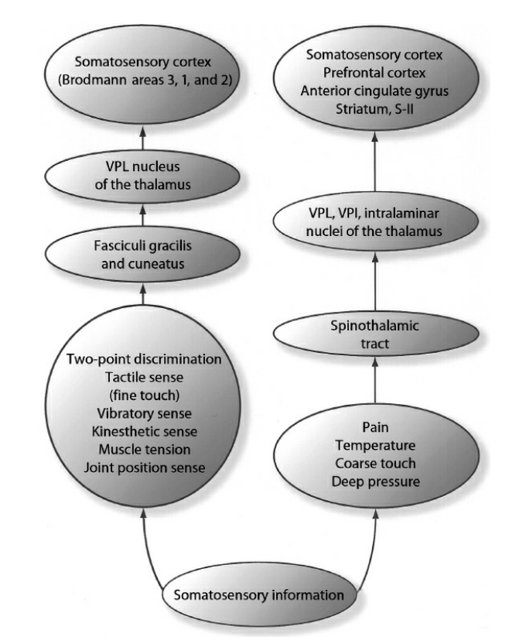
THALAMOCORTICAL SENSORY SYSTEMS
Sensory receptors transduce certain stimuli in the external environment to neural impulses.
Impulses ascend, often through intermediate nuclei in the spinal cord and the medulla, and ultimately synapse in specific relay nuclei of the thalamus.
Projections from peripheral sensory receptors to the thalamus and the cortex exhibit topography
For e.g. somatosensory system ,most fibers carrying tactile and proprioceptive information travel in the medial lemniscus, whereas fibers carrying pain and temperature information travel in the spinothalamic tract; both pathways terminate in the ventral posterior thalamic nuclei.

Slide 15
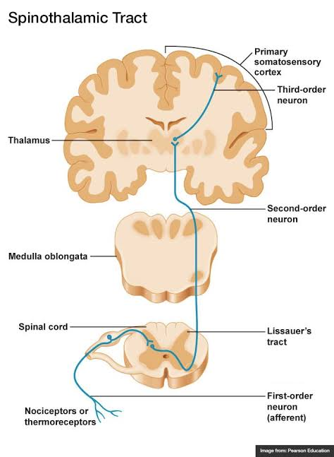
Sensory pathways exhibit convergence. That is, primary sensory areas process sensory information and project to unimodal association areas.
Then unimodal areas converge to multimodal associational area

Slide 16
Feed forward and feed backward:
Feedback
The reciprocal connection from
Higher Low
Projections from More advanced to simpler level
originate in layers III, V, and VI terminate outside cortical layer IV
Feedforward
The reciprocal connection from
Lower higher
simpler level to More advanced
originate in the superficial layers of cortex terminate in layer IV

Slide 17
THALAMOCORTICAL MOTOR SYSTEM
in contrast to sensory systems, which primarily ascend from sensory receptors to cortical association areas, motor systems descend from association and motor regions of the cortex to the brainstem and the spinal cord
motor systems exhibit strong topography at the thalamic and cortical levels.

Slide 18
Premotor cortex
Primary motor cortex
Higher Order Sensorymotor
& Visual Areas
ventral anterior thalamic nucleus
primary somatosensory cortex
ventral lateral nucleus
globus pallidus
Cerebellum

Slide 19
THALAMOCORTICAL ASSOCIATION SYSTEM
It is a Multimodal Association areas of the cortex
Which Receives a input from Following sources
  Association nuclei of the thalamus
  Unimodal association regions
Prefrontal Cortex receives afferents from
  Afferents from higher order sensory cortices of parietal and temporal lobes
  Contralateral PFC
  Cingulate cortex of the limbic system
  Medial dorsal thalamic nucleus which receives highly processed inputs from
    Amygdala
    Hippocampus
    hypothalamus
  amygdala

Slide 20
Index
1) Overview
2) Neuroanatomy
3) Nuclei Description
4) THALAMOCORTICAL Functional Circuitry
5) CEREBELLOTHALAMOCORTICAL SYSTEMS
6) Clinical Significance

Slide 21
CEREBELLOTHALAMOCORTICAL SYSTEMS
The cerebellum is considered to be involved with motor control, regulating posture, gait, and voluntary movements
Cerebellum also plays an important role in the mediation of certain cognitive abilities through inputs to portions of the thalamus that project to association regions of the cerebral cortex.
Cerebellar cortex processes the inputs to the cerebellum, and the deep nuclei process the outputs.

Slide 22
The cells of the dentate nucleus involved in these connections are distinct from the cells that influence the motor and premotor regions of the cerebral cortex
Functional imaging studies in individuals with schizophrenia have revealed abnormal patterns of activation in the cerebellum, thalamus, and prefrontal cortex, suggesting that dysfunction of this circuitry might be associated with the disturbances in cognitive processes exhibited by these individuals.

Slide 23
Index
1) Overview
2) Neuroanatomy
3) Nuclei Description
4) THALAMOCORTICAL Functional Circuitry
5) CEREBELLOTHALAMOCORTICAL SYSTEMS
6) Clinical Significance

Slide 24
Clinical Significance
1) Vegetative state -
  Disruption of Thalamocortical function and connectivity
  Impaired thalamocortical functional connectivity between the intralaminar nuclei and the prefrontal and anterior cingulate cortices

Slide 25
2) Epilepsy –
  Thalamocortical system is involved in the epileptic loss of consciousness.
  In absence seizures, the ability of thalamocortical-corticothalamic feedback loop to regulate the flow of information to the cortex suffers transient loss because large numbers of corticothalamic loops are engaged in strong, low-frequency oscillations of excitatory postsynaptic potentials (EPSP)/inhibitory post-synaptic potentials (IPSP).
  These EPSP/IPSP sequences generate specific electroencephalographic patterns called spike-and-wave discharges (SWDs).
  The increase in SWD activity within the thalamocortical network can disrupt normal sleep-wakefulness rhythms and ultimately cause absence seizures
  Dysfunction of frontal thalamocortical circuits involved in juvenile myoclonic epilepsy

Slide 26
3) Movement Disorders -
  Various movement disorders such as Parkinson disease result from the abnormalities of the basal ganglia thalamocortical circuit, due to the dysfunction disrupting downstream network activity in the brainstem, thalamus, and cortex
4) OCD
  Length of anterior thalamic radiations has been found to be negatively correlated with thalamic choline levels in patients with obsessive-compulsive disorder.

Slide 27
5) Anorexia nervosa –
  Anomalies in the posterior thalamic radiation and left mediodorsal thalamic nucleus may connect to patients with anorexia nervosa
6) Schizophrenia –
  Anterior thalamic radiation abnormalities may share links with the negative symptoms and cognitive abnormalities in schizophrenia

Slide 28
8) Autism spectrum disorder
  Anatomical and functional underconnectivity between the thalamus and the prefrontal, parieto-occipital, motor, and somatosensory cerebral cortices in patients with an autism spectrum disorder
9) Migraines.
  Volume reductions of several thalamic nuclei, including the central nuclear complex, anterior nucleus, and lateral dorsal nucleus
10) Dementia
  Abnormalities in ascending cholinergic projections within thalamic nuclei and visual areas in patients with dementia with Lewy bodies may elucidate the visual hallucinations associated with the disease

Slide 29
Thankyou

