Slide 1
Psychiatric comorbidities among disabled children

Slide 2
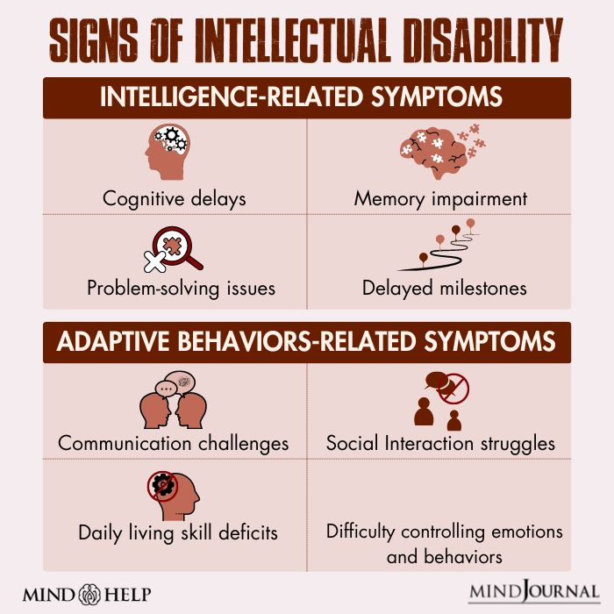
Intellectual Disability

Slide 3
Diagnosis: Standardized intellectual assessment + standardized measure of adaptive function (below the expected level in both areas)
The severity of the intellectual disability will be determined on the basis of the level of adaptive function.
2/3rd of children with ID have comorbid psychiatric manifestations.
Disruptive and Conduct disorders are more frequent in mild ID.
Autism spectrum disorder are more frequent in severe ID
2-3% of ID meet diagnostic criteria for schizophrenia. 50% of ID are found to meet criteria for mood disorder.
Treatment for aggressive behaviors in ID: Risperidone

Slide 4
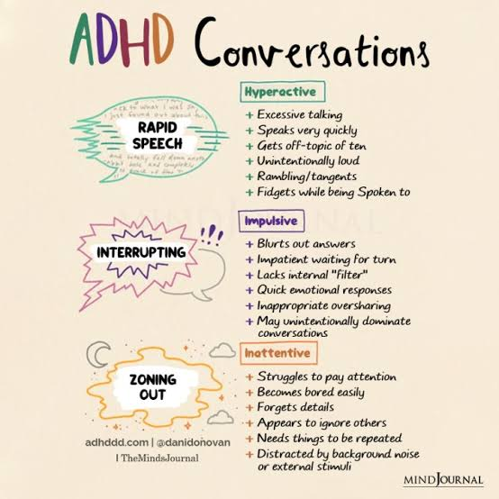
Attention Deficit Hyperactivity Disorder

Slide 5
Attention-deficit hyperactivity disorder (ADHD) is a neuropsychiatric condition affecting preschoolers, children, adolescents characterized by a pattern of diminished sustained attention, and increased impulsivity or hyperactivity.
Characteristics: Hyperactivity, attention deficit, impulsivity, memory and thinking deficits, specific learning disabilities, and speech and hearing deficits.
It is commonly associated with learning, mood and conduct disorder
Data suggests that inheritability of ADHD is 75%.
Treatment: First choice agents: Central nervous system stimulants like methylphenidate and dextroamphetamine

Slide 6
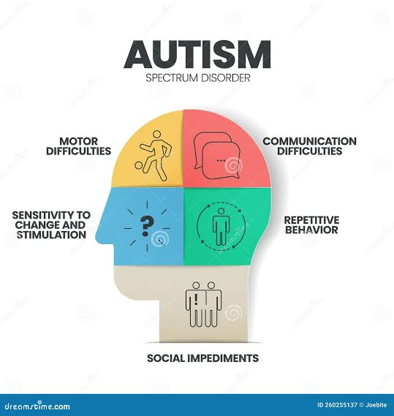
Autism Spectrum Disorder

Slide 7
Autistic disorder is characterized by impairments in three domains: social communication, restricted and repetitive behaviors, and aberrant language development and usage.
Irritability includes aggression, self-injurious behaviors, and severe temper tantrums.
Some individuals with autism spectrum disorder have precocious or splinter skills of great proficiency, such as prodigious rote memories or calculating abilities, usually beyond the capabilities of their normal peers.
Prevalence of ASD is 0.08% (8 cases per 10000 children}
Treatment: Psychosocial intervention- Improve social interactions, communication, broaden strategies to integrate into schools, develop meaningful peer relationships, and increase long-term skills in independent living. Interventions.

Slide 8
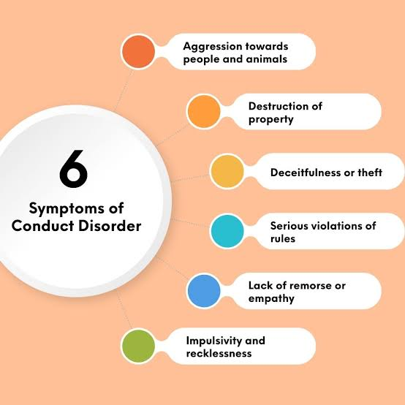
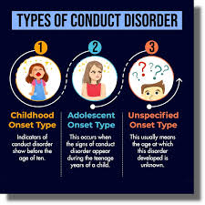
Conduct Disorder

Slide 9
Conduct disorder is set of behavior characterized by :physical aggression or threats of harm to people, destruction of their own property or that of others, theft or acts of deceit, and frequent violation of age-appropriate rules.
Aggression can be in the form of bullying, physical aggression, hostile, verbally abusive, and persistent lying, frequent truancy, and vandalism are common. Sexual behavior and regular use of psychoactive or other substances are present early for such children.
Associated with: ADHD, depression, and learning disorders.
Prevalence is more in males as compared to female 4:1. It is more common in children of parents with antisocial personality disorder and alcohol dependence.

Slide 10
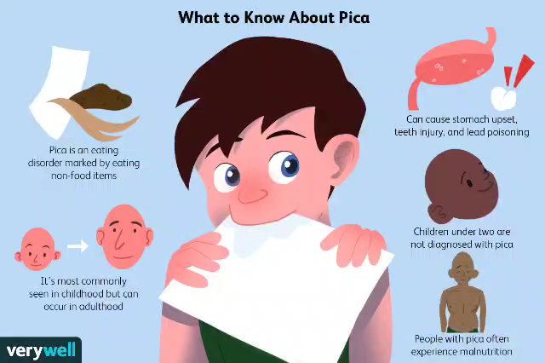
Pica

Slide 11
Pica is defined as persistent eating of nonnutritive substances.
Medical problems associated with pica: Intestinal obstruction, intestinal infections, or poisonings arise, such as lead poisoning due to ingestion of lead containing paint chips.
More frequent in the autism spectrum disorder or intellectual disability
It is more common in ID and ASD. 15% of severe ID patients has Pica.
Psychosocial, environmental, behavioral, and family guidance approaches. When lead is present in the surroundings, it must be eliminated or rendered inaccessible or the child must be moved to new surroundings.

Slide 12
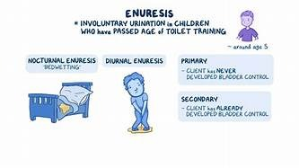
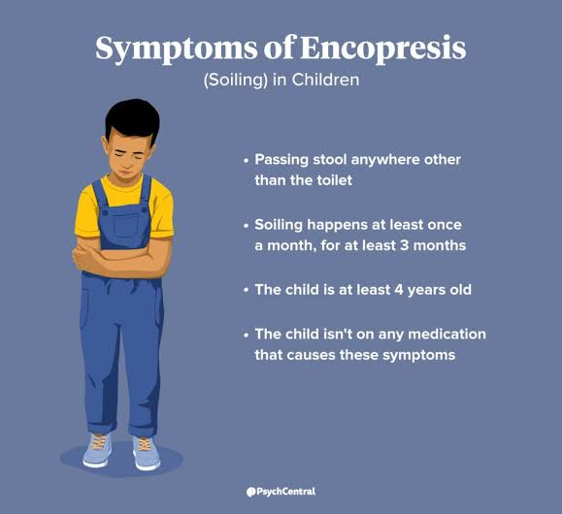
Enuresis and Encopresis
www.osmosis.org

Slide 13
Enuresis: defined as the repeated involuntary or intentional voiding of urine into bed or clothes, occurring at least twice a week for at least three consecutive months in a child who is at least five years old. This behavior must not be due to the direct physiological effects of a substance or a general medical condition.
Psychosocial stressors: the birth of a sibling, hospitalization between the ages of 2 and 4 years, the start of school, separation of a family due to divorce, or a move to a new environment.
Prevalence of enuresis decreases with increasing age. Most children with enuresis do not have comorbid psychiatric disorder but are at higher risk for developing psychiatric disorder.
Treatment: Review appropriate toilet training. Recordkeeping, restricting fluids before bed and alarm therapy. Desmopressin therapy.

Slide 14
Encopresis risk factors: sexual abuse, and other psychiatric disorders, parents insist that their children attempt to defecate before they are adequately treated may aggravate the condition.
Children with encopresis who are not promptly treated, however, frequently end up being socially rejected
Prevalence of encopresis ranges from 0.8 to 7.8%.
Treatment: Oral laxatives such as Poly Ethylene Glycol and cognitive-behavioral intervention to begin regular attempts to have bowel movements in the toilet, and to diminish anxiety related to bowel movement.

Slide 15
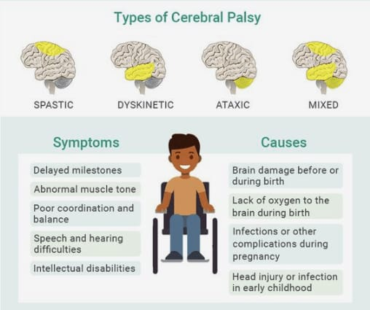
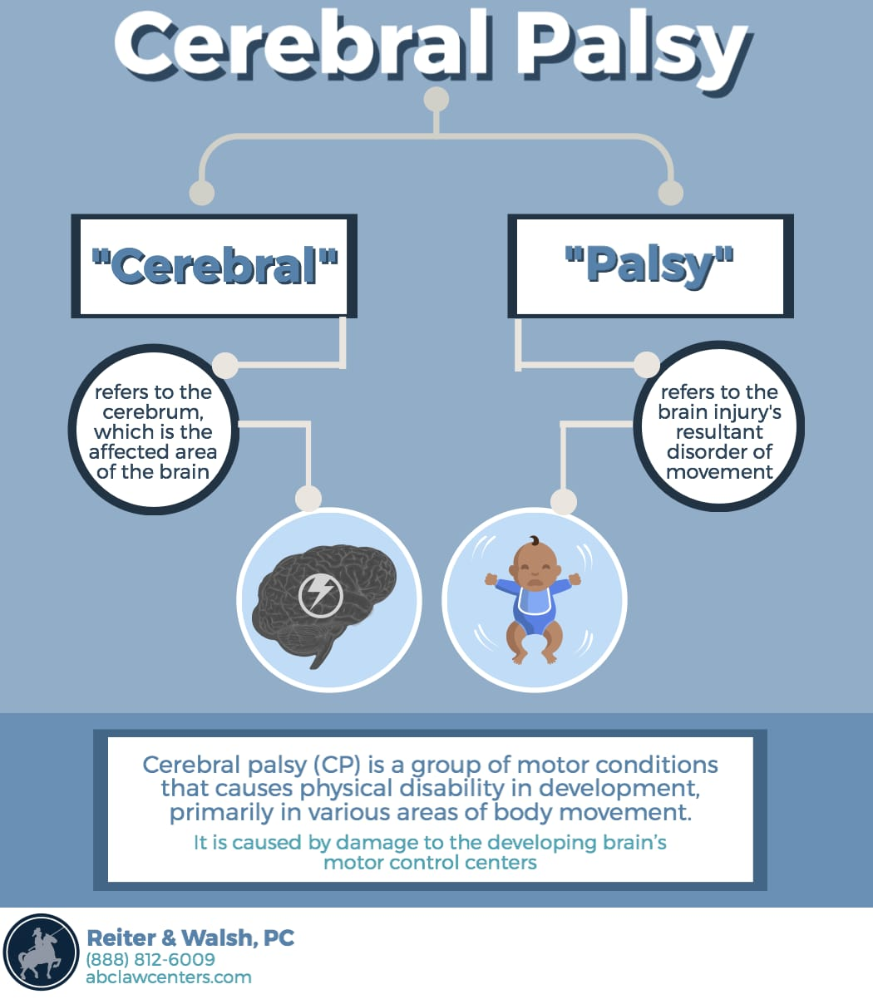
Cerebral Palsy

Slide 16
Cerebral palsy (CP) refers to a group of neurological disorders that appear in infancy or early childhood and permanently affect body movement and muscle coordination.
Etiology: Disruption in the brain's ability to control movement and maintain posture and balance.
Clinical Features:
Lack of muscle coordination when performing voluntary movements (ataxia)
Stiff or tight muscles and exaggerated reflexes (spasticity)
Walking on the toes, a crouched gait, or a scissored gait
Involuntary movements and difficulty with precise movements present.
Delayed motor milestones
Approximately 30–50 percent of individuals with CP have an intellectual disability.
People with CP are at greater risk of developing anxiety, depression, and social and emotional issues.
Treatment: Physical therapy, recreation therapy , occupational therapy, Speech and language therapy. Oral medications such as diazepam, baclofen, dantrolene sodium, and tizanidine are usually used as the first line of treatment to relax stiff, contracted, or overactive muscles.

Slide 17
Thank You

