Slide 1
IDENTIFICATION
Dactylography, Tattoo, Scar, Hair
Dr R G Datta

Slide 2
In this session
Dactylography
Tattoo
Scar
Hair

Slide 3
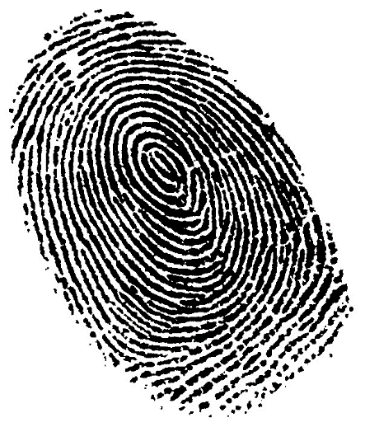
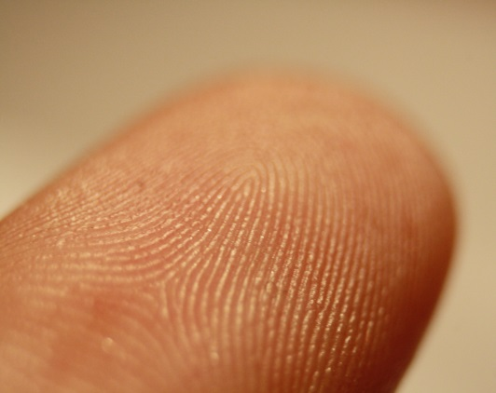
DACTYLOGRAPHY
‘Fingerprinting’, ‘Galton-Henry system’, ‘Dermatoglyphics’
Study of ridge pattern of skin
Fingerprints - impressions of patterns formed by papillary & epidermal ridges of fingers or palms. Sweat & sebaceous secretion.
Appear at 12-16wks IU
Permanent*
Identical
Possibilities of same FP – 1 in 64 billions
Also present in toes & sole of feet (podogram)

Slide 4
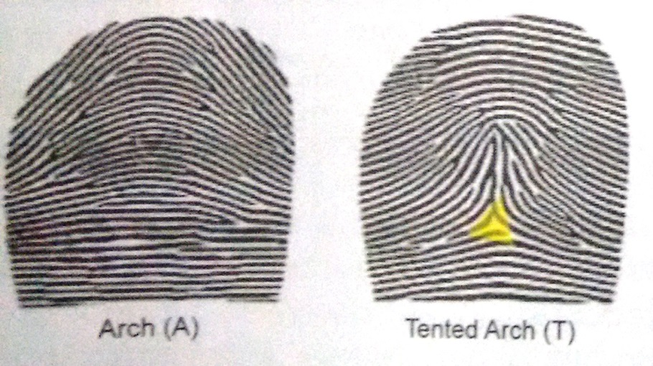
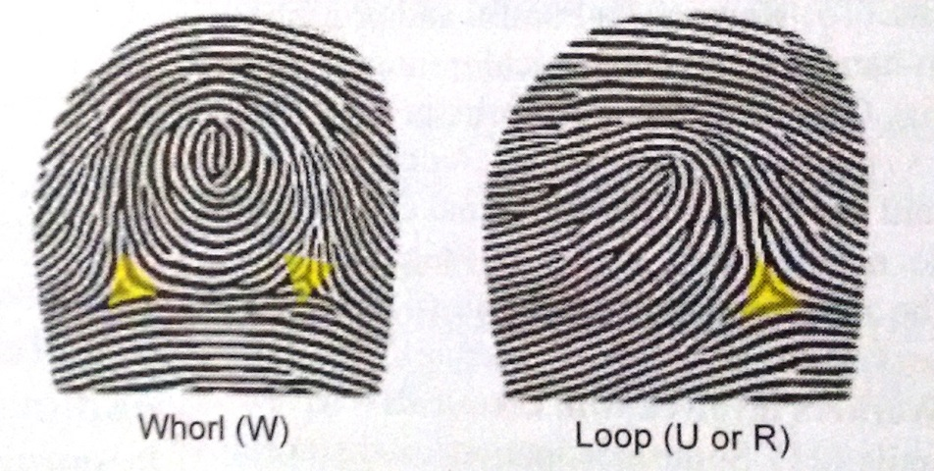
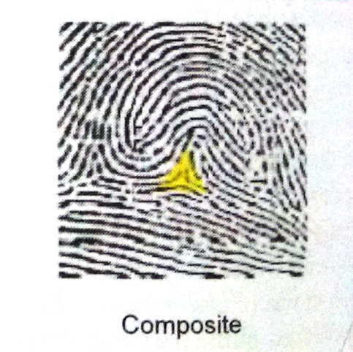
Classification:
  Loop (60-70%)
  Whorl (25-35%)
  Arch (6-7%)
  Composite (1-2%)
Characteristics
  Core
  Delta
  Ridge end
  Bifurcation
  Lake
  Island/ Dot
  Spur
  crossovers
10-12-20 characteristics matched

Slide 5
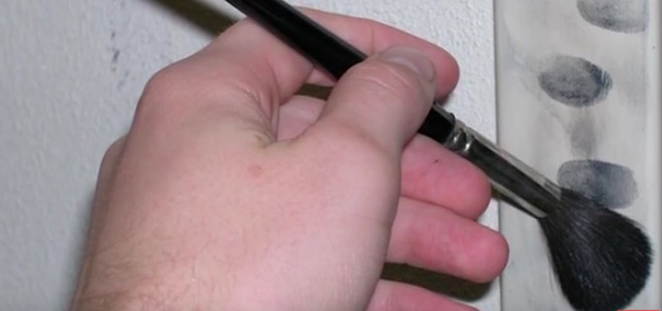
Techniques
1) In living persons
  Unglazed white paper, Printer’s ink
  Plain fingerprint
  Rolled fingerprint
2) In dead persons – fresh body, decomposed body
3) At crime scene
  Types
  Visible print – dusting & oblique photography, lifting
  Latent(chance) print – dusting/chemical process & lifting + photography
  Plastic print – dusting, scanning microscopy

Slide 6
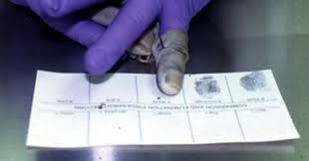

Slide 7
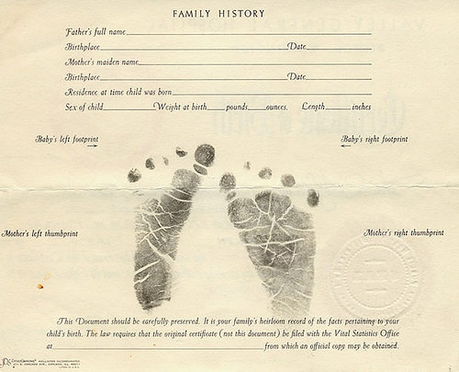

Slide 8
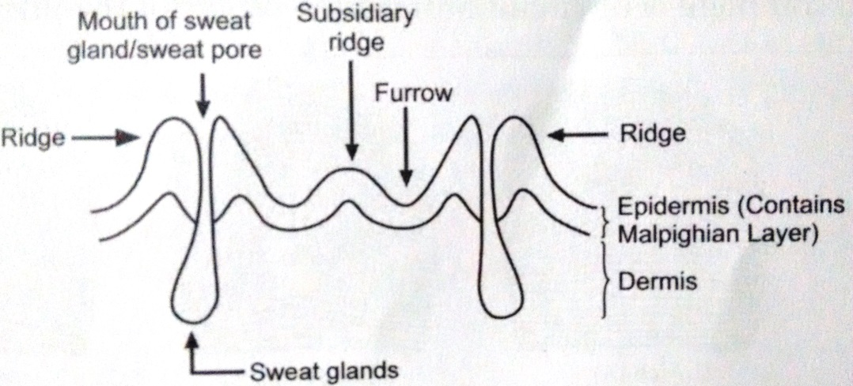
Alteration in fingerprint ridges
Change in ridge distance – Acromegaly, Rickets
Temporary loss/alt. – Burns, Coeliac Dz, Dermatitis
Permanent loss/alt. – Electrocution, Radiation, Leprosy, Eczema, Scleroderma
Occupational – cement, lime, sand, corrosives
Ridgeoscopy
Poroscopy
Edgeoscopy

Slide 9
Medicolegal importance
Identification – living & dead
Civil documents - cheques, contract aggrements, passport, driving liscence, ID cards
Consent
Correlation of crime scene & criminal
‘Baby swap cases’ – foot prints used
Biometric systems

Slide 10
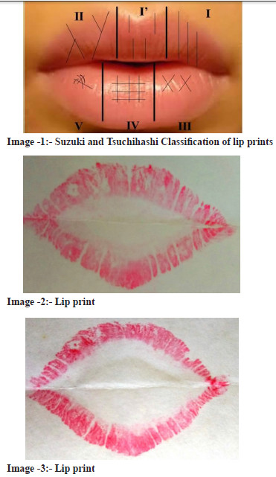
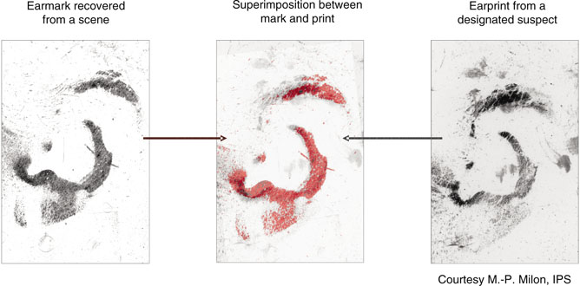
Cheiloscopy, Palatal prints, Ear print

Slide 11
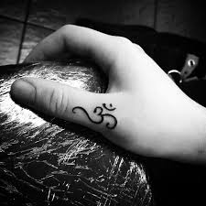
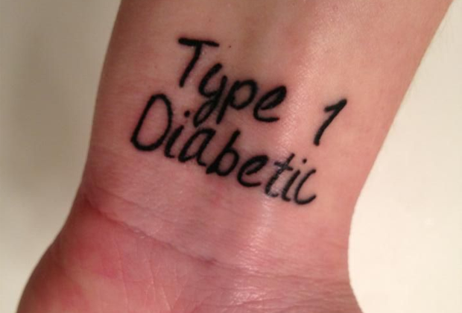
Tattoo
Def - Design made in the skin by multiple puncture wounds with needle dipped in color dyes.

Slide 12

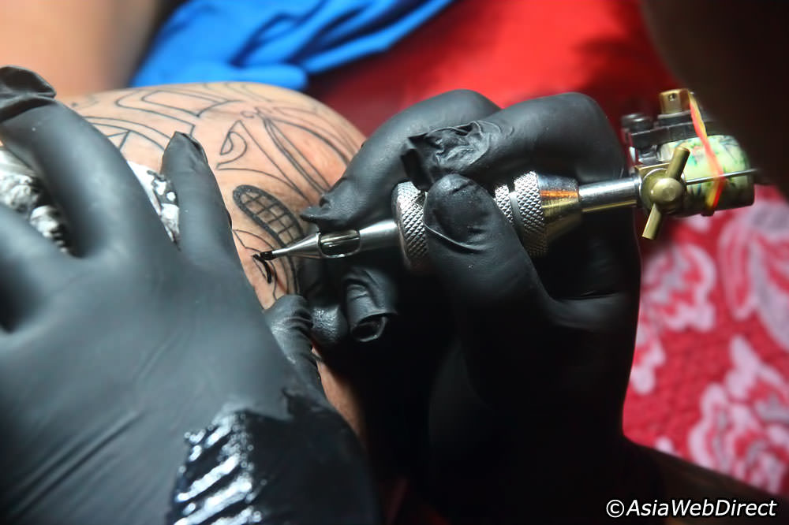

Slide 13
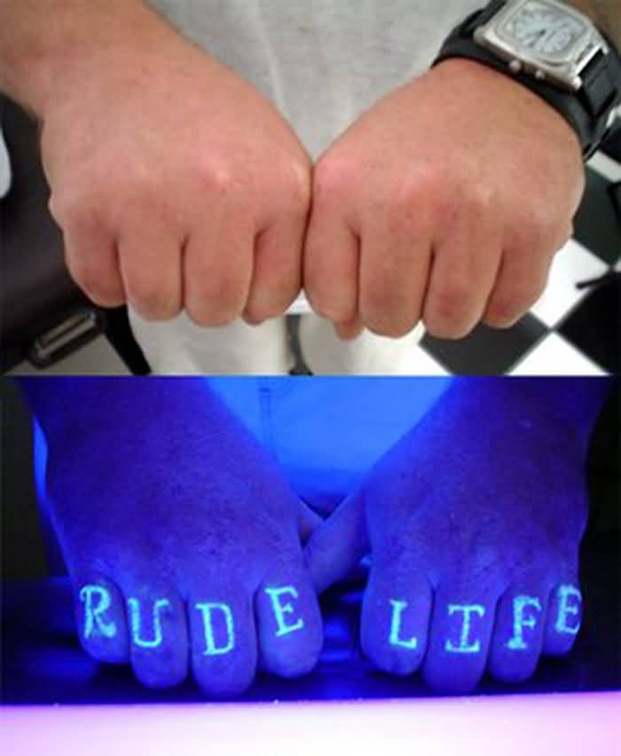
DYES :
  Indian ink
  Carbon black
  Cinnabar/vermilion
  Chromic acid green
  Indigo
  Prussian blue
  Ultramarine blue
  Cobalt salts
  UV florescent dyes
Disappearance – ink used, skin penetration, part of body
Old fade up tattoo – Infrared light

Slide 14
Erasure
  CO2 snow
  Laser
  Skin grafting
  Electrolysis
  Caustic chemicals
  Burns
  Chronic eczema, skin disorders

Slide 15
Medicolegal importance
  Identification – note size, site, color, shape(draw)
  Religion, Caste, Spiritual beliefs
  Race, ethnicity, culture, country, region
  Occupation, group/gang members
  Love mate, Sexual attitude
  Health problem, Drug addiction
  Personality, Mental perversions, psychosis

Slide 16
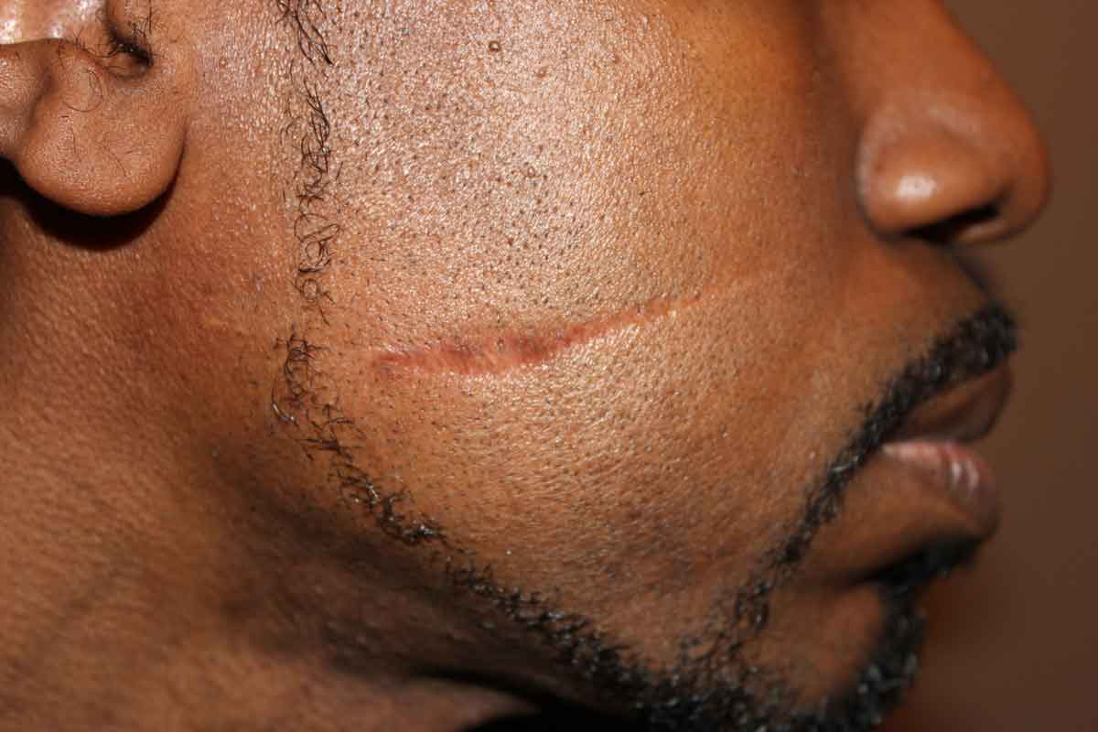
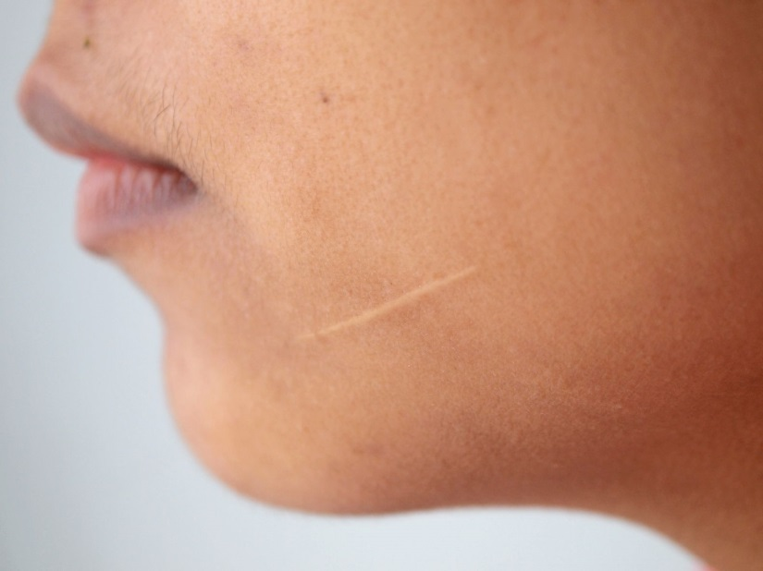
SCAR
Def - “Fibrous tissue covered by epithelium without hair follicles, sweat glands produced from healing of a wound”
Injuries to ‘dermis’ produce scars
Permanent
If primary healing – minor scar, secondary – larger

Slide 17
Medicolegal importance
  Identification
  Age of injury – recent, remote
  Type of injury – incise, stab, gun shot, laceration, abrasion, burns, splash, electrocution, radiation
  Nature of weapon
  Nature of injury – simple, grievous, ‘self inflicted’
  Medical history – surgery, pregnancy, vaccination skin disease

Slide 18
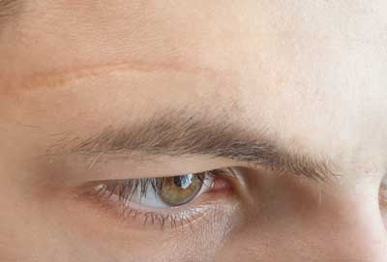
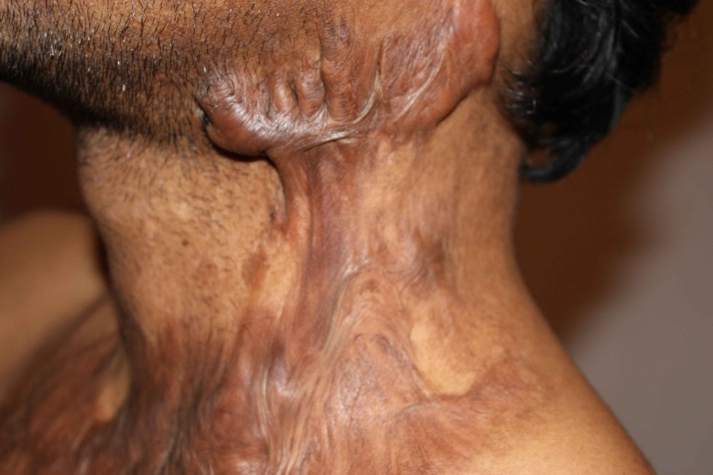
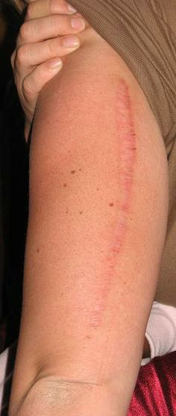
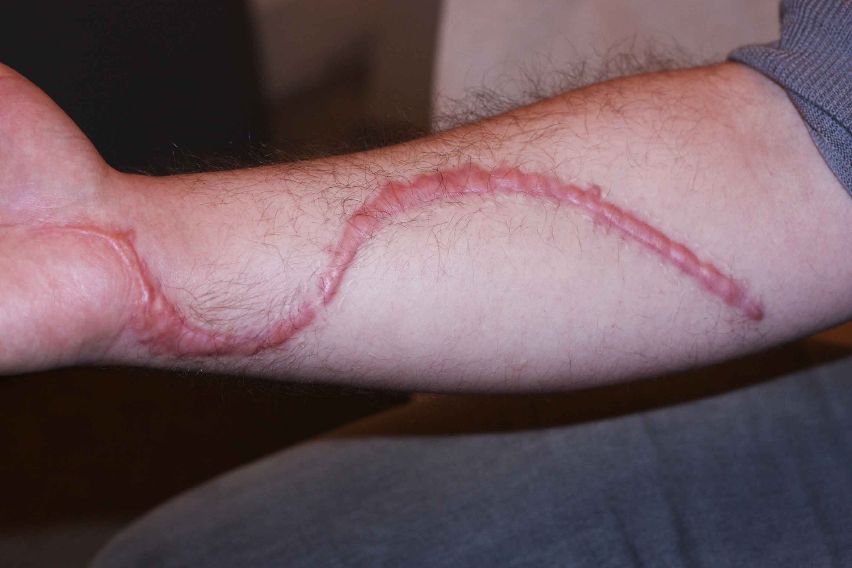

Slide 19
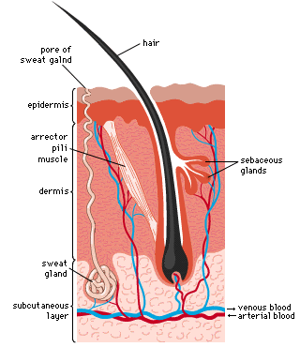
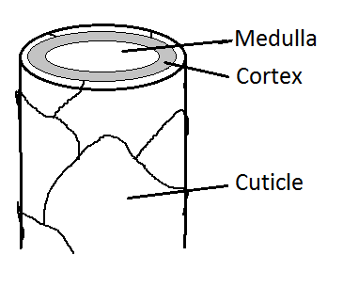
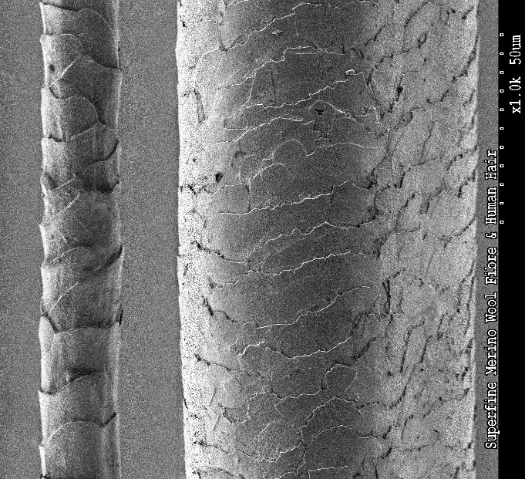
HAIR
Trichology
Morphology
  Root/ hair bulb
  Shaft

Slide 20
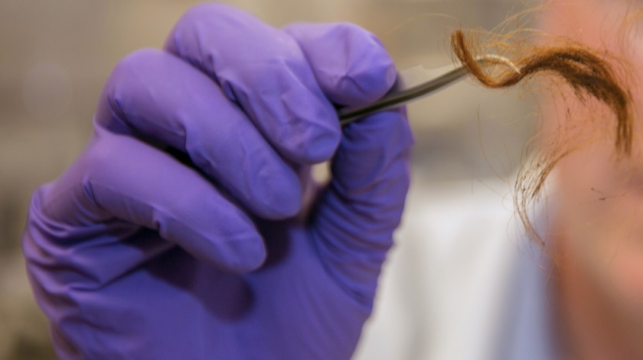
Medicolegal importance
  Hair or Fibre (cotton, silk, nylon, decron)
  Species – human/ animal
  Age of person
  Sex
  Occupation of person, drug addiction
  Blood grouping & DNA
  Cause of death, Time since death
  Sexual offences

Slide 21
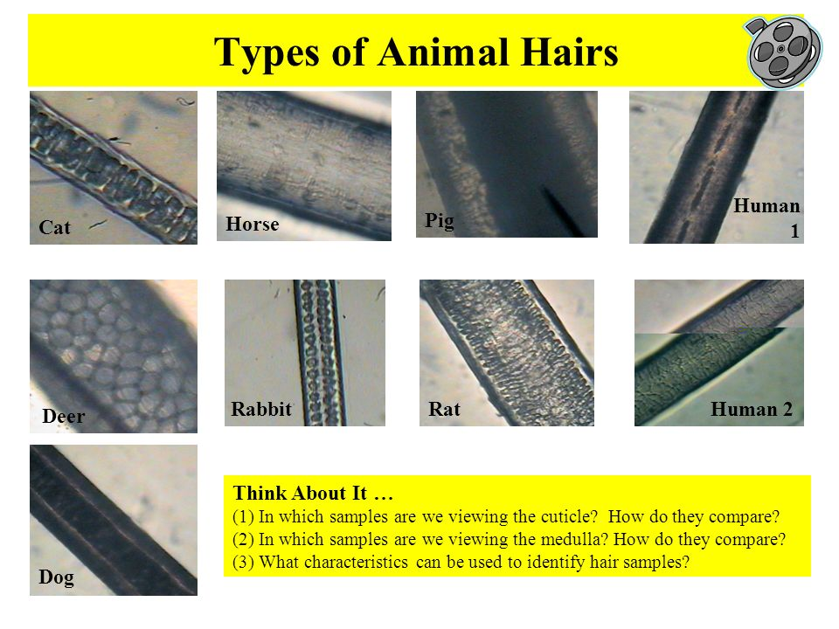

Slide 22
Human hair & animal hair
Traits | Human hair | Animal hair
Character | Thin, delicate | Thick, coarse
Cuticle | Scales are shorter, thinner, completely encircles shaft | Scales are larger, undulated projections but incompletely encircles shaft
Cortex | Forms max. thickness of shaft(4-6 times thicker than medulla) | Thinner, usually not more than than double of thickness of medulla
Medulla | Varies, narrow, absent/ fragmented/continuous | Always present, usually wider & continuous
Pigments | Mostly in cortex & little in medulla | In medulla usually
Precipitin Test | Specific for human being | Species specific for animals

Slide 23
Age
Lanugo hairs - 4 to 5 months IU
Pubic hair - 13 to 14 yrs in female, 14 to 15 yrs in male.
Axillary hairs - 14 to 15 yrs in female, 15 to 16 yrs in male.
Beard, moustache - 16 to 18 yrs in male.
Greying of hairs starts by 30 to 40 yrs.
Baldness in male - 40 to 50 yrs
In females - loss of axillary, pubic hairs - at menopause.

Slide 24
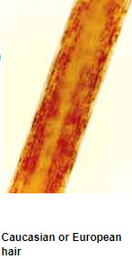
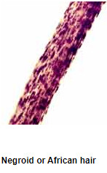
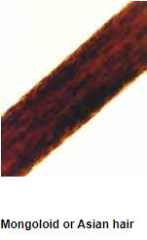
Race

Slide 25
Cause, nature & TSD of death
Poisoning – some poisons like arsenic etc. can be detected in hair by chemical analysis.
Mechanical Injury – crushing of root or sharp cut edge cut hairs depending upon hard, blunt or sharp cutting weapon.
Burns – hairs are burnt & singeined. Helps to differentiate scald from chemical burn.
If hairs of accused found grasped in victim’s cadaveric grip may point towards homicide.
TSD - Hair easily pluckable/ fall out – 3 to 5days after death

Slide 26
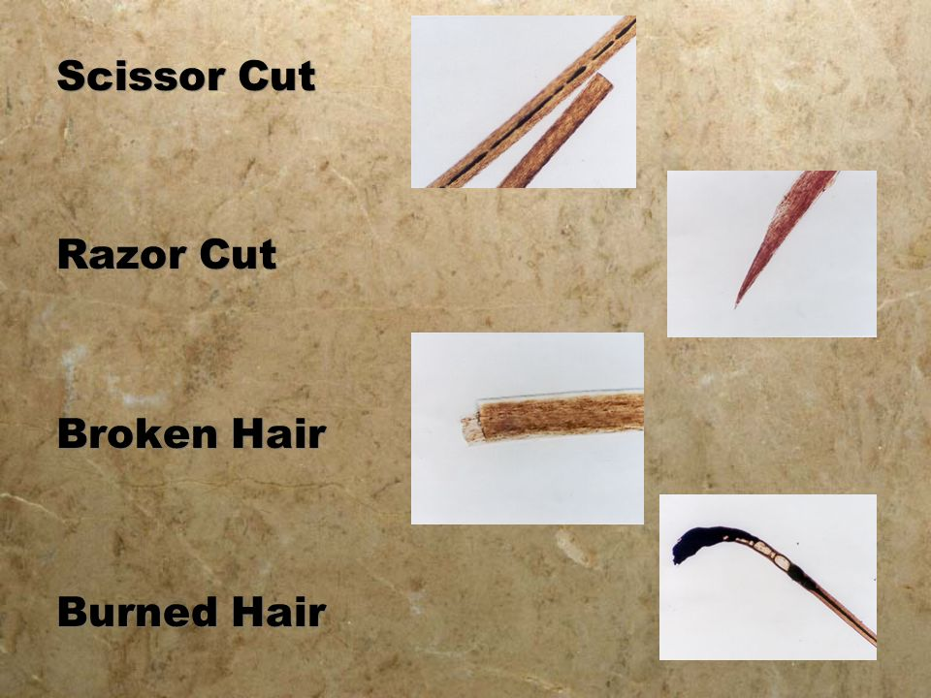

Slide 27
MCQs

Slide 28
MCQ 1
Which of following characteristic is not observed same type in Identical twins?
DNA typing
Fingerprint pattern
Blood group
HLA system

Slide 29
MCQ 2
‘Fragmented medulla in hair’ found in which human race?
Negroes
Mongols
Caucasians
Europians

Slide 30
MCQ 3
A criminal whose family or relatives were not known and no biological samples available with police, escaped from police custody. A deadbody resembling the criminal, found in nearby forest on next day. But due to mutilation of face, the identity could not be established on spot. Which of following method can be used for identification in this case?
Blood grouping
DNA profiling
HLA typing
Anthropomentry

Slide 31
MCQ 4
Cheiloscopy is the study of which of following?
Footprints
Lip prints
Palm prints
Palatal prints

Slide 32
MCQ 5
Which among following is most accurate method for identification of a person?
Dactylography
DNA fingerprinting
Anthropomentry
Superimposition

