Slide 1
IDENTIFICATION
- Dr Umang Patel

Slide 2
In this session
Anthropomentry
Age of fetus
Superimposition
DNA Fingerprinting
Forensic Odontology

Slide 3
ANTHROPOMETRY
‘Bertillon system’
Principle – after 21yrs skeleton dimension & other body parts remain unchanged
Descriptive data – hair color, eye, ear, nose, chin, complexion
Body marks – moles, scars, tattoo, birthmarks
Body measurements – Ht, arm span, Lt hand fingers, Lt forearm, Lt foot
Photographs – front & Rt profile

Slide 4
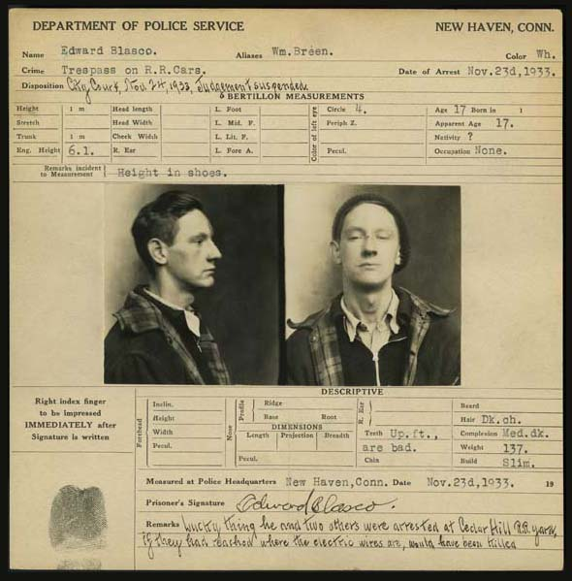

Slide 5
Age of foetus
Age in month IU | Features
1 | Lt – 1cm, Wt – 2.5gm, Eyespots, mouth cleft
2 | Lt – 4cm, Wt – 10gm, Hands & feets, anus spot center for clavicle(4-5wk), maxilla(6wk)
3 | Lt – 9cm, Wt – 30gm, Nails, neck
4 | Lt – 16cm, Wt – 120gm, Sex differentiation, lanugo hairs
5 | Lt – 25cm, Wt – 400gm, Scalp hairs, vernix caseosa, Center for Calcaneum, Sternum
6 | Lt – 30cm, Wt – 700gm, Eyebrows, eyelashes

Slide 6
Age of foetus
Age in month IU | Features
7 | Lt – 35cm, Wt – 1000gm, Testis at internal inguinal ring, center for Talus, Sternum
8 | Lt – 40cm, Wt – 1800gm, Testis in inguinal canal, Center for Lower Sacrum
9-10 | Lt – 45cm, Wt – 2.5-3kg Testis at external inguinal ring & scrotum, Center for lower end of Femur(IU) Center for upper end of Tibia(EU)
Rule of Haase : age (mth) = √length(cm)
Morisson’s Law : age (mth) = length(cm)/ 5

Slide 7
SUPERIMPOSITION
Scientific technique to determine weather the skull is of the person in image picture or not.
Recent face photograph of person
Photograph of skull at particular angle, dimension, distance
Both photographs ‘superimposed’ to each other and matched by certain biometric points –
  eyes with medial canthus
  nasion, nasal spine & nosetip
  lower border of upper jaw
  Teeth
  zygoma
  angle of jaw
  EOM & ears

Slide 8
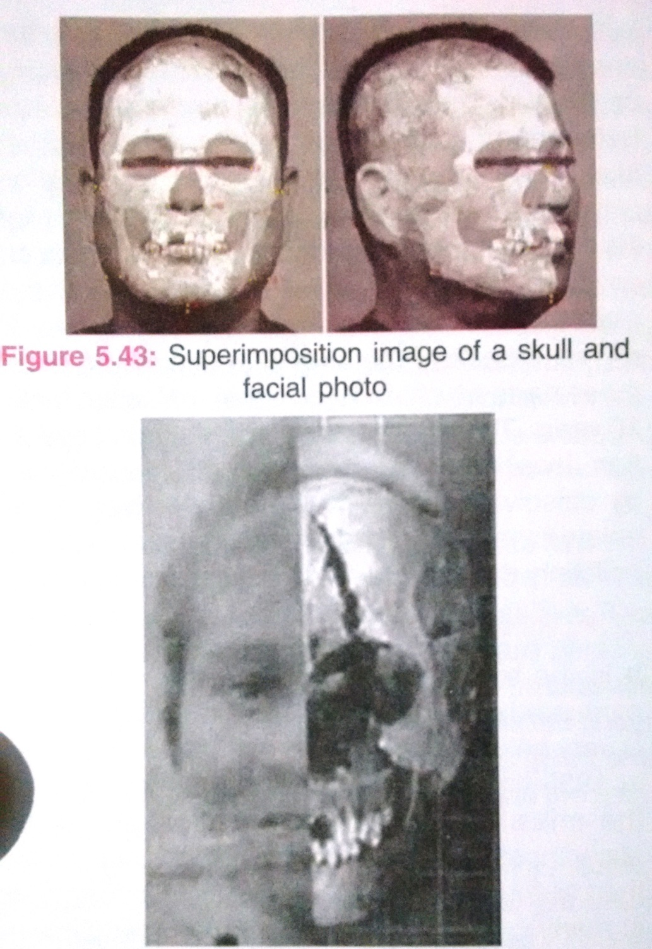

Slide 9
Medicolegal importance
  Skeletonized skull with other body parts
  Test is more negative value
Video superimposition
3D hologram superimposition

Slide 10
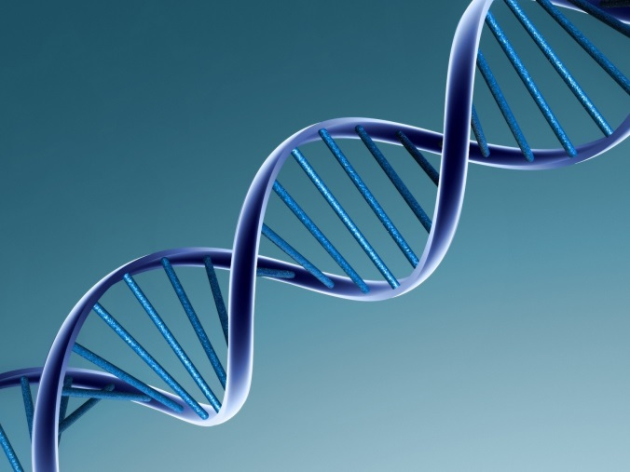
DNA FINGERPRINTING
Technique to study DNA characteristics.
Medicolegal Importance
  Identification – in living & dead
  Co-relation of accused to crime scene
  Sexual assault cases – rape, sodomy…
  Paternity disputes
  Maternity disputes

Slide 11
Samples for DNA analysis
In Living | In dead
Blood in EDTA bulb- venous, 5ml Swab – buccal swab, vaginal swab, penile swab Hairs – plucked 15-20 occipital Semen Fingernail scrapings/clipping | Blood Swabs Hairs Fingernail scrapings/clipping Bones with bone marrow Molar teeth Muscle tissue in NS – best Skin in NS Spleen-Liver tissue in NS

Slide 12
Mitochondrial DNA – derived from mother
Techniques
  Restriction Fragment Length Polymorphism(RFLP)
  Short Tandem Repeat analysis by PCR
Limitations
  Monozygotic twins
  Costly
  Difficult procedure
  Sabotage

Slide 13
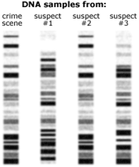
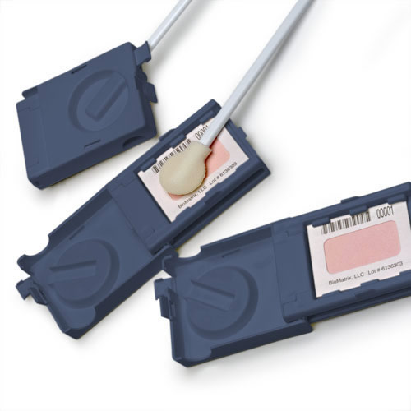

Slide 14
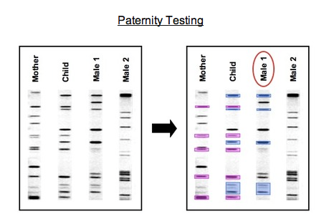
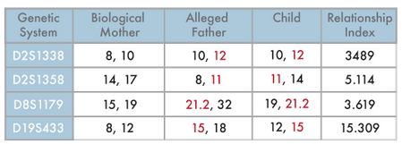

Slide 15
Forensic Odontology
Application of knowledge of dentistry into aid to the justice
Identification (Age, Sex, bite mark, implants...)
Bite mark injury analysis
DNA
Toxicological analysis
Cause of death, time of death

Slide 16
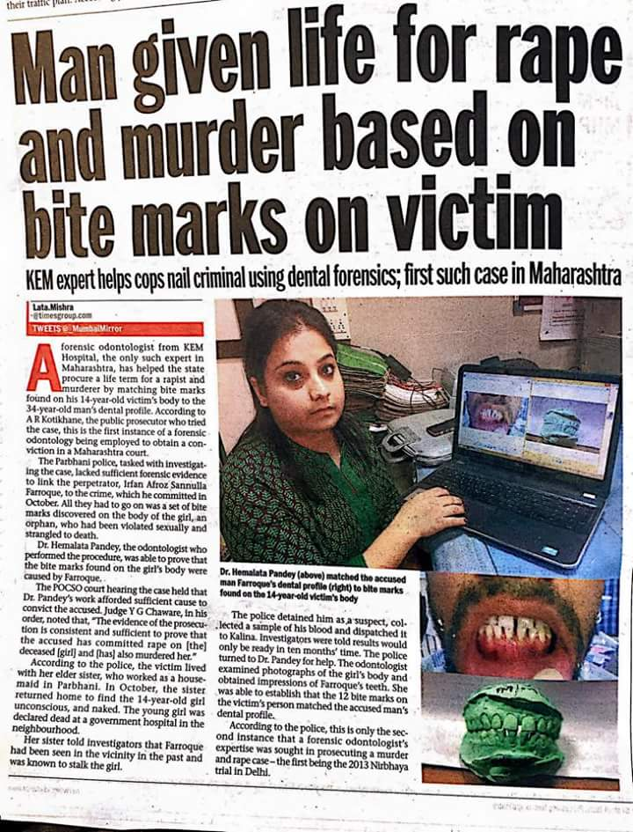

Slide 17
Bond, J. W. (2007), Value of DNA Evidence in Detecting Crime. Journal of Forensic Sciences, 52: 128–136. doi:10.1111/j.1556-4029.2006.00323.x
John W. Bond D.Phil. | Value of DNA Evidence in Detecting Crime | An analysis of DNA material recovered from the volume crime offences of residential burglary, commercial burglary, and theft of motor vehicle in Northamptonshire, U.K., in 2004 has enabled the DNA to be categorized into seven sources. | The results indicate that a number of predictors, other than timeliness, that greatly influence whether the DNA material recovered from a crime scene enables the crime to be detected.

Slide 18
MCQs

Slide 19
MCQ 1
Which of following characteristic is not observed same type in Identical twins?
DNA typing
Fingerprint pattern
Blood group
HLA system

Slide 20
MCQ 2
‘Fragmented medulla in hair’ found in which human race?
Negroes
Mongols
Caucasians
Europians

Slide 21
MCQ 3
A criminal whose family or relatives were not known and no biological samples available with police, escaped from police custody. A deadbody resembling the criminal, found in nearby forest on next day. But due to mutilation of face, the identity could not be established on spot. Which of following method can be used for identification in this case?
Blood grouping
DNA profiling
HLA typing
Anthropomentry

Slide 22
MCQ 4
Cheiloscopy is the study of which of following?
Footprints
Lip prints
Palm prints
Palatal prints

Slide 23
MCQ 5
Which among following is most accurate method for identification of a person?
Dactylography
DNA fingerprinting
Anthropomentry
Superimposition

