Slide 1
DEATH
- Dr KALPESH ZANZRUKIYA

Slide 2
In this session
No. | COMPETENCY | Domain (K/S/A/C) | Level (K/KH/S/SH/P) | Core (Y/N)
FM 2.1 | Define, describe and discuss death and its types including somatic/clinical/cellular, molecular and brain-death, Cortical death and Brainstem death | K | KH | Y
FM 2.4 | Describe salient features of the Organ Transplantation and The Human Organ Transplant (Amendment) Act 2011 and discuss ethical issues regarding organ donation | K | KH | Y

Slide 3
Specific Learning Objectives At the end of this session, the 2nd MBBS student.... | Integration
1. should be able to be familiar with Define, describe and discuss death and its types 2. should be able to describe and differentiate somatic/clinical/cellular, molecular and brain-death, Cortical death and Brainstem death | HI-Pathology
should able to familiar with features of the Organ Transplantation and The Human Organ Transplant (Amendment) Act 2011 should able to familiar with ethical issues regarding organ donation | HI-AETCOM

Slide 4
In this session
Introduction – ‘Death’
Process of Death
  Somatic Death
    How to diagnose?
  Molecular Death
Brain/Brainstem Death
Organ Transplantation Act

Slide 5
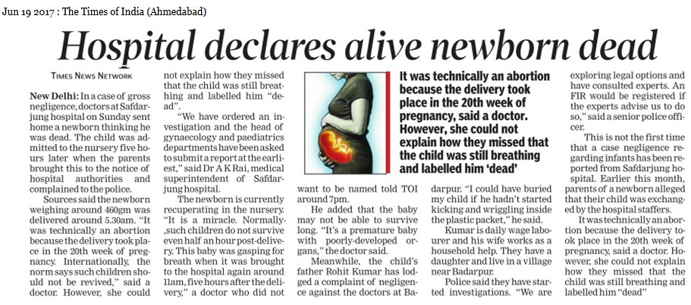

Slide 6
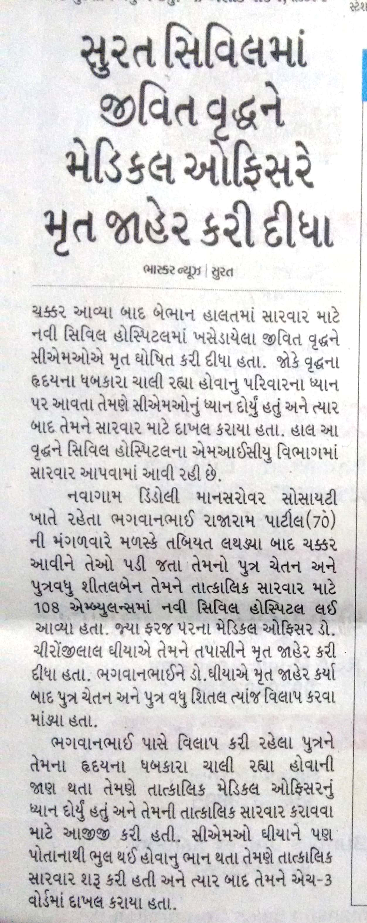
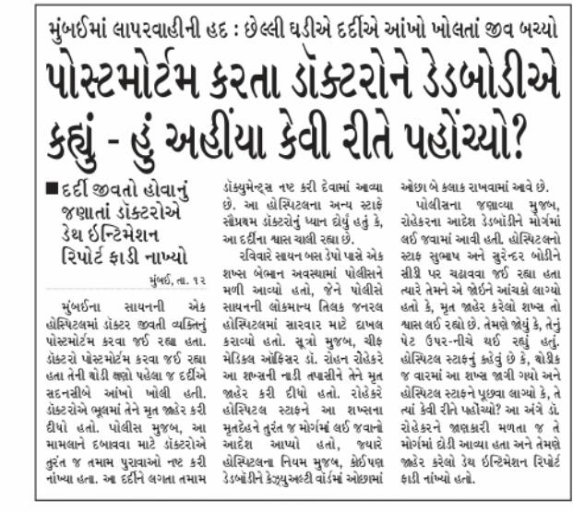

Slide 7
INTRODUCTION & DEFINITIONS
Thanatology : Branch of science that deals with death &
in all aspects.
DEATH:
Conventionally – complete & irreversible cessation of the
functions of nervous, circulatory and respiratory systems.
IPC S.46 – Death denotes death of a human being unless the contrary appears from the context.
Birth & Death Registraction Act – Permanent disappearance of all evidence of life at any time after livebirth has taken place.

Slide 8
Livebirth – child who showed any signs of life after completed or partial birth.
Signs of life in newborn– presence of one or more of below
  Cry
  Active respiration
  Pulse or heartbeat
  Active movement of limb or bodypart
Stillbirth

Slide 9
Process of DEATH
1
Clinical death/ Somatic death/ Systemic death
2
Brain death
3
Biological death/ cellular death/ molecular death

Slide 10
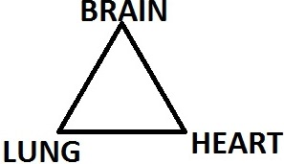
Somatic death
Systemic death, Clinical death
Def. : Complete & irreversible stoppage of the circulation, respiration and brain functions.
Bishop’s tripod of life:
(Bichat?!)

Slide 11
How to diagnose?
Out of hospital
No spontaneous movements
No respiratory efforts(10 min)
No heart sounds/palpable carotid pulse(10 min)
Pupils – dilated & fixed
No response to superficial & deep pain
Absent elicitable brainstem reflexes
  Light reflex
  Corneal reflex
  Conjunctival reflex
  Ciliospinal reflex

Slide 12
In hospital/medical setup
No spontaneous movements
No respiratory efforts/SPO2<60%(10 min)
Iso-electric ECG(10 min)
BP – not recordable(10 min)
Pupils – dilated & fixed
No response to superficial & deep pain
Absent brainstem reflexes
  Light reflex
  Corneal reflex
  Conjunctival reflex
  Ciliospinal reflex
  Pharyngeal/gag reflex
  Vestibulo-occular reflex

Slide 13
Medicolegal Imp
Declaration of ‘death’ of a person
Certification of death(MCCD)
‘Suspended animation’
Resuscitation & ‘DNR consent’
Body/organ donation
PM examination or funeral/cremation/other means for ‘final farewell’.
Legal hair disputes for property & other personal things, life insurance claims.

Slide 14
Molecular death
Biological death, Cellular death
Death of individual cells in various tissues
Various phenomenon during molecular death
  Zasko’s phenomenon – quadriceps muscle
  Lazarus phenomenon – hand movements
  Idiomuscular contraction/bulge
  Electrical excitability of facial muscles
Medicolegal Imp - ‘Brain death’ & Organ donation & transplantation(THO Act)

Slide 15
Time limit of organs procurement for Transplantation(after brainstem death)
  Eyes – 4 hrs
  Heart – 4-6 hrs
  Lung – 4-6 hrs
  Liver – 12-24 hrs
  Kidney – 48-72 hrs
  Intestine – 4-6 hrs
  Pancreas – 4-6 hrs

Slide 16
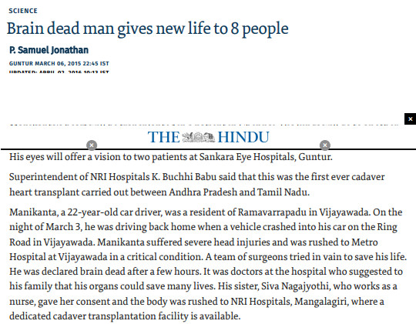
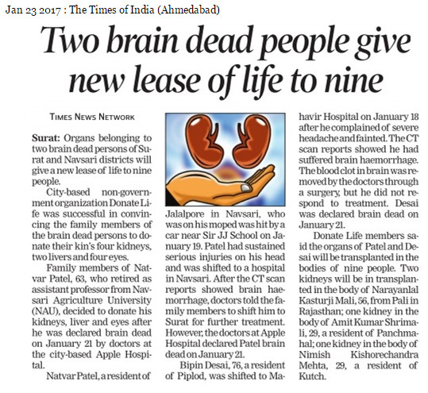

Slide 17
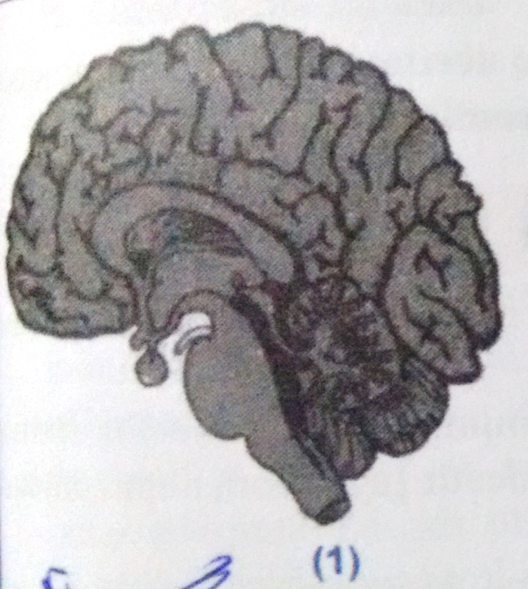

BRAIN DEATH
Whole brain death
  All part of brain dead
  Heart & lung failure
  Harvard criteria(1968)
  Philadelphia protocol(1969)

Slide 18
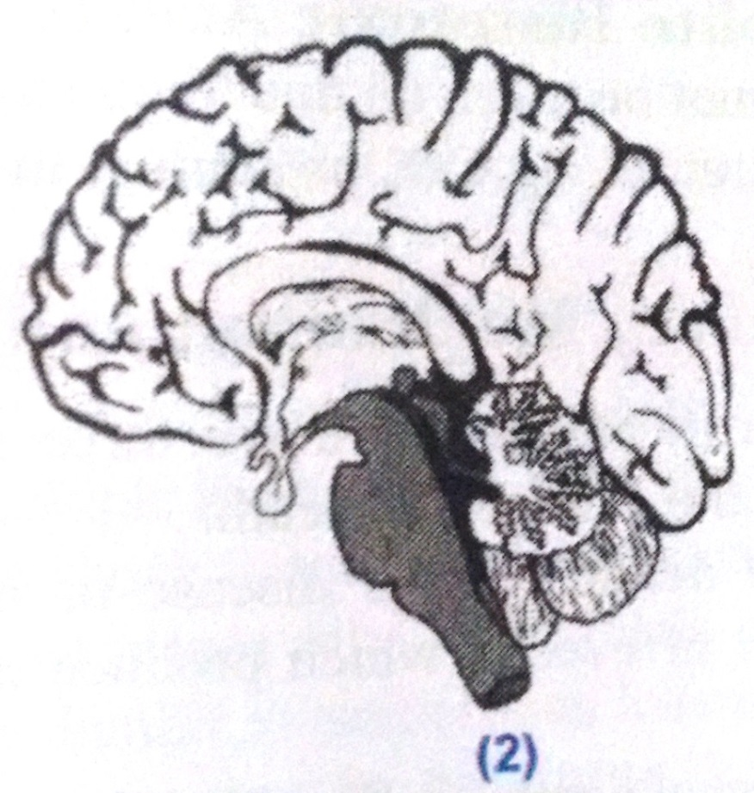
Brain stem death
  Only ‘brain-stem’ dead
  No spontaneous heart-lung function
  Minnesota criteria(1971)
  Adopted for THO Act in India

Slide 19
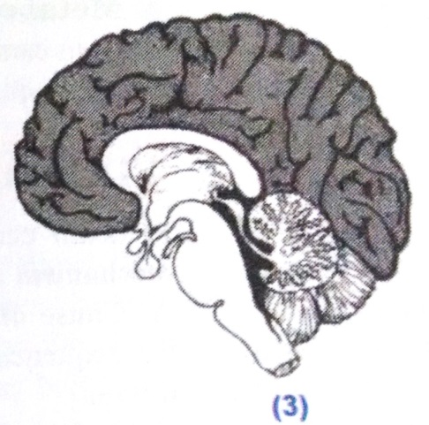
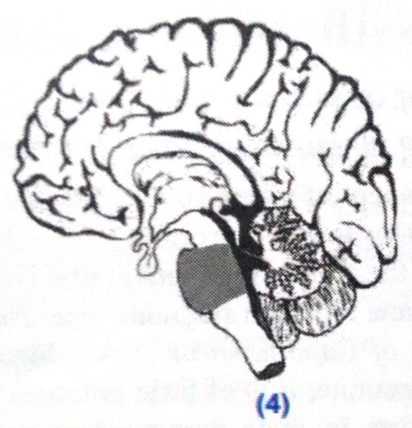
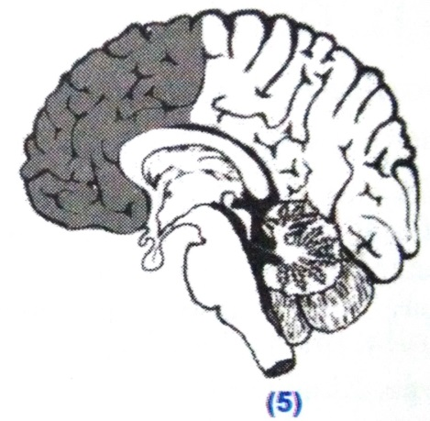
Cerebral/cortical death
  ‘Persistent vegetative state’
‘Locked in’ Sn
  Only ‘pons’ damage, ‘Jack in box’
Akinetic mutism
  Only Frontal cortex damage

Slide 20
Criteria for brain death
Philadelphia criteria(1969) – whole brain death
Harvard criteria(1968) – whole brain death
Minnesota criteria(1971) – Brainstem death
India – Transplantation of Human Organs & Tissues Act, 1994
USA – Uniform determination of death Act, 1981

Slide 21
THOT Act
Transplantation of Human Organs & Tissues Act, 1994
Aims
To regulate the removal, storage & transplantatn of human organs for therapeutic purposes.
Prevention of commercial dealings
All organs & tissues included except ‘Blood’.
Bone marrow included(2011 amendement)

Slide 22
Donor & recipient
Live donor – only for near relatives(father, mother, brother, sister, son, daughter, spouce)
  Consent
Cadaver/Brainstem dead donor – for any unrelated person
  Consent
Donor cannot determine the recipient person*
(Recipient should be decided by penal of experts)

Slide 23
Procedure
RMP declare death & certify
‘Beating heart donor’ - If body on Life support system, board of 4 med experts determine & certify ‘Brain-stem death’ acc to “internationally accepted criteria”(Minnesota).
Consent – near relative
Expert RMP/team will remove organs.
Expert RMP/team will transplant organs.

Slide 24
Brain stem death diagnosis
Preconditions
  Deep coma due to irreversible brainstem damage of known etiology
  On ventilator support
Exclusion
  Intoxication
  (CNS) Depressant drugs
  Muscle relaxants
  Hypovolemic shock
  Primary hypothermia
  Metabolic and endocrinal disorders

Slide 25
Tests for brain stem
Two different physician
Test twice- min 6 hrs apart
Coma
Cessation of spontaneous respiration
Absent brainstem reflexes
  Apnea test -
  Pupils – dilated & fixed
  Corneal reflex
  Doll’s eye reflex
  Gag reflex
  Cough reflex
  Vestibulo-cochlear reflex
  Motor reflex of cranial nerves

Slide 26
Punishments
Removal of organs/tissue without authority OR against THOT act guidelines – 10 yrs imprisonment + Rs. 20 lac fine (to all persons who involved in OT)
MCI – ‘penal erasure’
  1st offence – suspension for 3yrs
  2nd offence – permanently (professional death sentence)

Slide 27
Rithalia A, McDaid C, Suekarran S, Norman G, Myers L, Sowden A. A systematic review of presumed consent systems for deceased organ donation.
Health Technol Assess. 2009 May;13(26):iii, ix-xi, 1-95. doi: 10.3310/hta13260.
Rithalia A, McDaid C, Suekarran S, Norman G, Myers L, Sowden A | A systematic review of presumed consent systems for deceased organ donation | Eight electronic databases (MEDLINE, MEDLINE In-Process, EMBASE, CINAHL, PsycINFO, HMIC, PAIS International and OpenSIGLE) were searched with supplementary internet searches from inception to January 2008. A systematic review of studies comparing donation rates in a single country before and after the introduction of a presumed consent law or in countries with and without presumed consent systems. | Presumed consent alone is unlikely to explain the variation in organ donation rates between different countries. A combination of legislation, availability of donors, transplantation system organisation and infrastructure, wealth and investment in health care, as well as underlying public attitudes to and awareness of organ donation and transplantation, may all play a role.

Slide 28
MCQs

Slide 29
MCQ 1
As per Bichat’s tripod, existence of human life relies mainly on functions of all of following organs except
Heart
Lung
Liver
Brain

Slide 30
MCQ 2
In Transplantation of Human Organs Act of India, which of the following criteria is incorporated to declare a person ‘brainstem dead’?
Harvard criteria
Minnesota criteria
Philadelphia protocol
Bishop’s criteria

Slide 31
MCQ 3
After declaration of brain dead, what is maximum time limit to procure human ‘heart’ for good transplantation?
1 hour
2 hours
4 hours
12 hours

Slide 32
MCQ 4
Which of following does not indicate signs of ‘death’ ?
Absent spinal reflexes
Absent brainstem reflexes
Flat line ECG for 1 min
Apnea for 10 mins

Slide 33
MCQ 5
Which of the following is surest sign of death?
Absent brainstem reflexes
Rigor mortis
Flat line ECG for 10 seconds
Apnea for 5 mins

