Slide 1
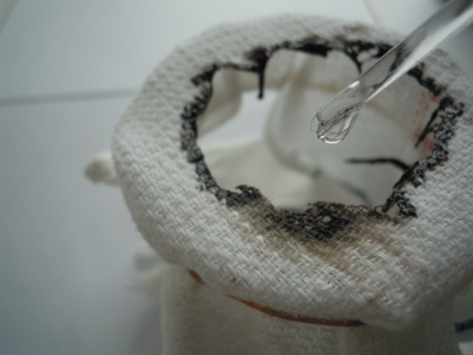
CORROSIVE POISONING
- Dr Shraddha Petiwale

Slide 2
In this session
Corrosive acids
  Sulphuric Acid
  Hydrochloric Acid
  Nitric Acid
  Phenol(Carbolic Acid)
  Oxalic Acid
Alkalies

Slide 3
In this session
No. | COMPETENCY | Domain (K/S/A/C) | Level (K/KH/S/SH/P) | Core (Y/N)
FM9.1 | Describe General Principles and basic methodologies in treatment of poisoning: decontamination, supportive therapy, antidote therapy, procedures of enhanced elimination with regard to: Caustics Inorganic – sulphuric, nitric, and hydrochloric acids; Organic- Carboloic Acid (phenol), Oxalic and acetylsalicylic acids. | K | KH | Y

Slide 4
SPECIFIC LEARNING OBJECTIVES At the end of this session, the 2nd MBBS student.... | Integration
1. should able to classify corrosive poisons with examples. 2. Should able to describe signs and symptoms caused by ingestion of corrosive poisons and skin contact of corrosive poisons including vitriolage. 3. Should describe general principles and basic methodologies in treatment of poisoning: decontamination, supportive therapy, antidote therapy, procedures of enhanced elimination with regard to: Caustics Inorganic – sulphuric, nitric, and hydrochloric acids; Organic- Carboloic Acid (phenol), Oxalic and acetylsalicylic acids. 4. Should able to describe fatal dose, fatal period and medicolegal importance of corrosive poisons. 5. Should able to describe post mortem examination findings in case of death due to corrosive poison ingestion. | VI Medicine IM21.3

Slide 5
Definition: CORROSIVES
These are the substances which
fixes, destroys & erodes the surface with which, it comes in contact
They act by extracting water from tissues and
coagulates cellular proteins and convert Hb -> haematin

Slide 6
CLASSIFICATION
CORROSIVES
ACIDS
ALKALI
INORGANIC
mineral
ORGANIC
SULPHURIC ACID
H2SO4
NITRIC ACID
HNO3
HYDROCHLORIC ACID
HCl
CORBOLIC ACID
C6H4OH
OXALIC ACID
C2H2O4
HYDROXIDE
SODIUM
POTASSIUM
CALCIUM
AMMONIUM HYDROXIDE
CARBONATE
SODIUM
CALCIUM
SODIUM HYPOCHLORIDE
Boric
acid
H₃BO₃
Phosphoric
Acid
H3PO4

Slide 7
Mechanism of action – mineral acids
Exothermic reaction
  Strong acid(H2SO4) contact with moist skin -> heat production & corrosion -> coagulative necrosis of cellular proteins -> crust formation -> prevents further penetration of acid
Sloughing, corrosion of mucosa of oesophagous, stomach, intestine - > charring, perforation
Systemic effects – haemolysis, systemic acidosis, circulatory shock, renal failure
Hydro fluoric acid – strong liquifactive necrosis

Slide 8
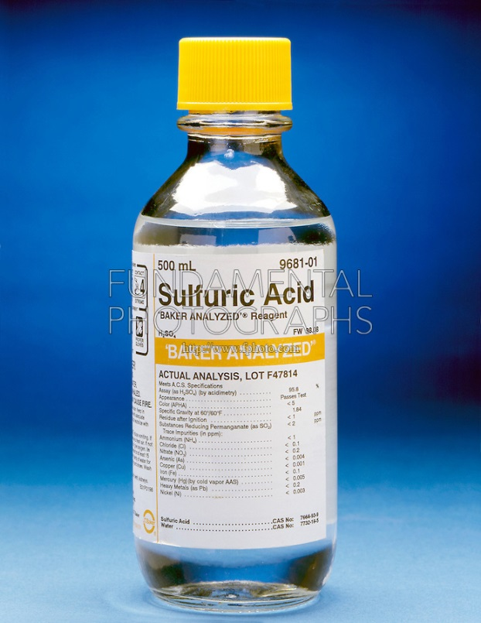
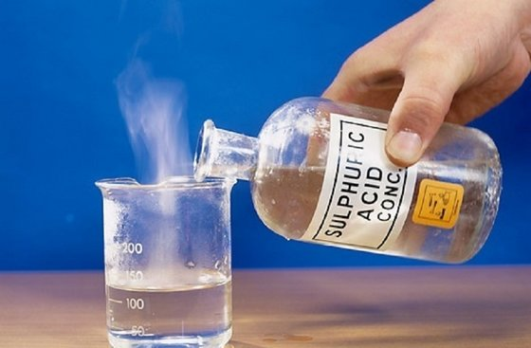
SULPHURIC ACID, H2SO4 :
Oil of Vitriol, Olium
It has tendency to carbonize the body tissue
Physical Features - heavy, colourless, odourless, oily liquid, hygroscopic
Commercial form – dark brown/yellow
USES: Indistrial chemicals, Batteries, Drain Cleaner
Fatal dose - 5 to 10ml
Fatal period- 12-24hr
Notes:
Fatal dose

Slide 9
SIGNS & SYMPTOMS
Corrosion
Burning pain-epigastrium-mouth, throat,chest, abdomen
Nausea, vomiting-brown bloody
Intense thirst, Dysphagia
Tongue-swollen, sodden black(mouse like), Teeth-chalky white
Esophagus, Stomach – blakened, fragile, charred wall, perforation-chemical peritonitis
Glottic edema, dysphonea/difficulty in speech
Eye – chemical burns & blindness
Face/skin – chemical burns, permanent scars, disfiguration

Slide 10
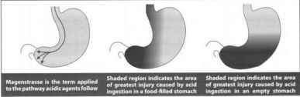
After recovery – Scar, fibrous contracture,
              Oesophageal stricture,
              Pyloric stenosis
Magenstrasse

Slide 11
  Cause Of Death
  - Circulatory shock
  - Laryngospasm/Oedema glottis
  - Stomach/intestinal perforation
  - Toxemia
    Delayed death
    – Pneumonia, Secondary infections
    -Renal failure
    -Starvation
DIAGNOSIS
History, Symptoms, Signs
Chemical Tests
  Litmus Paper-Blue – Pink
  On Stains: Sod Carbonate drops : Effervescence bubbles
  Ba nitrate or chloride sol -> white precipitate of Ba sulphate

Slide 12
Treatment
Gastric Lavage & Emetics are Contraindicated*.
Alkaline carbonate, Sod bicarbonate are contraindicated
Acid Dilution and neutralized by
-1/4 ltr water/milk/milk of magnesia, weak alkali
-Aluminum Hydroxide gel, Bismuth sub carbonate-2 gm
Demulcents -milk, starch water, melted butter
-olive oil, egg white, mineral oil
Prednisolone -60 mg/day-prevents esophageal stricture, shock

Slide 13
Correct circulatory shock, Acidosis
Respiratory Support – O2, Tracheotomy
Nil orally(NBM)-i.v. fluids & parental neutrients
-> fluid/soft food
-> regular diet
Skin burns - wash with water/NaHCO3(diluted)/apply paste MgO
Eye burns - wash with water/NaHCO3(diluted)

Slide 14
PM findings
External-lips/chin/angle-dribbling
Spurting, splashing pattern
teeth- chalky white
eyes- sunken and pupils dilated
Clothes- shows stains
Corrosion, charring, perforations of mucosa ,GIT
Stomach – soft, spongy, black, friable, perforated,
peritoneal bloody collection, chemical peritonitis
Test-
  strong acid chars-organic material
  Ba nitrate/chloride soln.- white ppt. of BaSO4

Slide 15
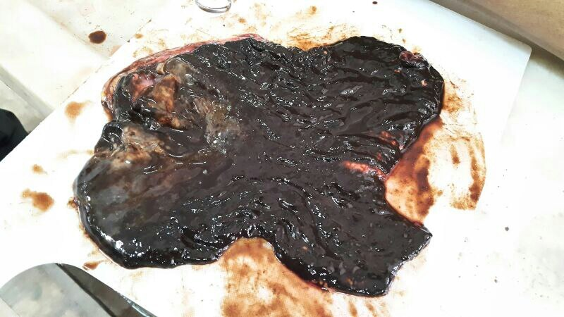

Slide 16
MedicoLegal Importance
Vitriolage
  Throwing of sulfuric or other corrosives on another individual
  Other substances used – HNO3, HCl, Carbolic acid, corrosive alkali, juice of marking nut/calotropis
  Jealousy, revenge, love failure
  Face/ upper part of body – splashing, dribbling pattern chemical burns
  Permant scar, disfiguration
  Treatment – wash with water/milk/milk of magnesia, MgO paste, plastic Sx
  Grievous hurt – IPC S.320, 326A, 326B; CrPC S.357C
suicidal-common
accidental- mistaken with glycerine, castor oil, water
inhalation in factory
abortificient

Slide 17
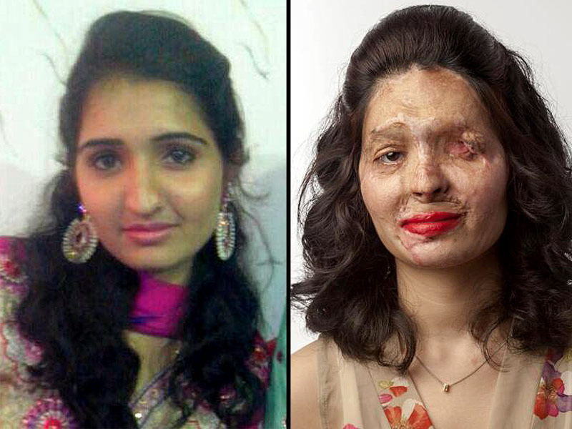

Slide 18
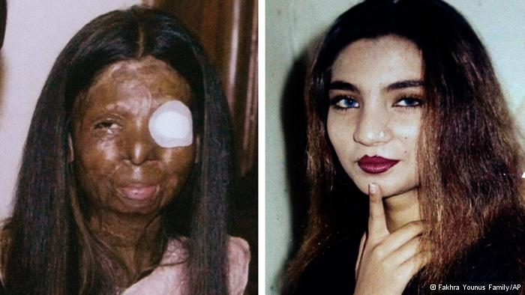

Slide 19
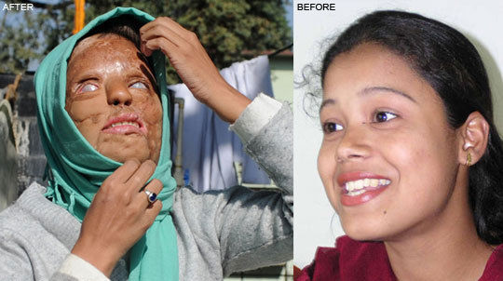

Slide 20
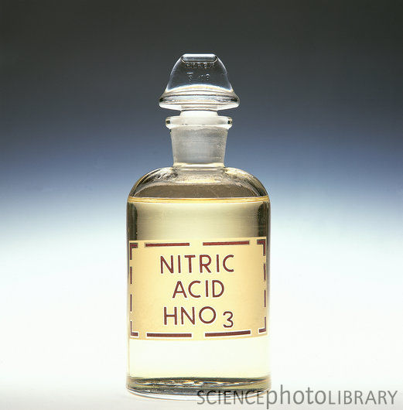
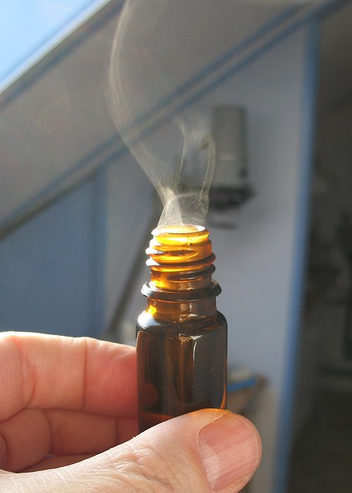
NITRIC ACID
‘Aqua fortis’, ‘red spirit of nitre’
Clear, colourless, Fuming, Heavy Fluid, Peculiar choking odour
Conc. Acid + organic matter-picric acid (yellow discolouration) -xenthoproteic reaction
Uses – Fertilizers making, Explosives(NG, TNT)
SIGNS/SYMPTOMS:
  - same
  - but more eructation & distention
  - & yellow discolouration
Treatment: same
Fatal dose :15-30 ml
Fatal period :12 to 24 hr

Slide 21
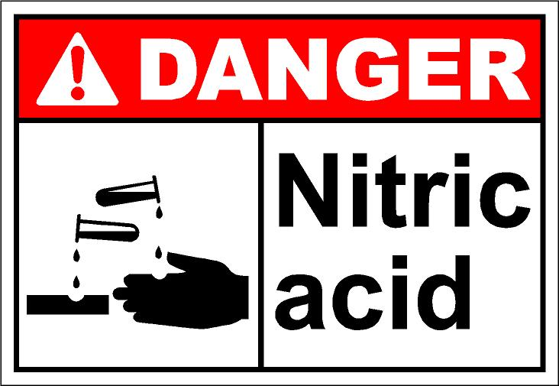
PM findings – same, yellow or brown/black patches.
    perforation less common
Tests
  solution+FeSO4+H2SO4-brown ring.
  solution + Ca--→pungent+ dark, brown heavy fumes
ML Imp - same

Slide 22
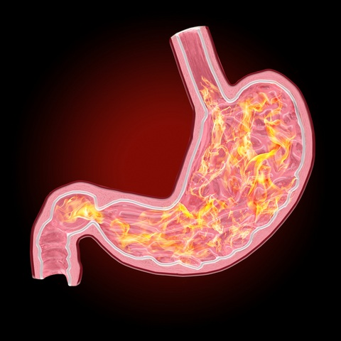
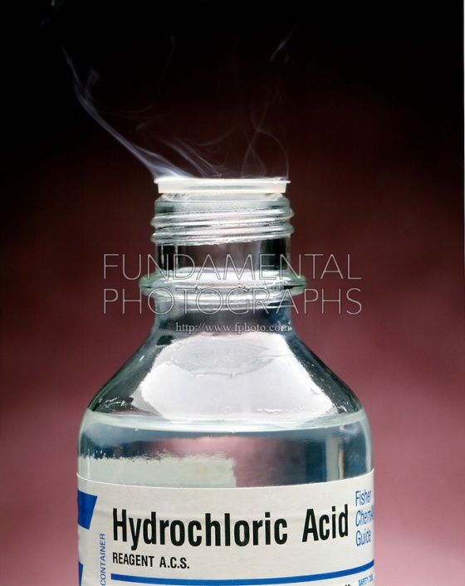
HYDROCHLORIC ACID,HCL
‘muriatic acid’ (natural constituent of Stomach)
Toilet cleaners - Harpic, Domex, …
Pungent odour, colourless, fuming liquid.
FUMES –intense irritation throat/Respi tract
Fatal Dose -15 to 20ml
Fatal Period -18 -36HRS
Treatment : Same
Postmortem Examination : Same
Test- with AgNO3 – heavy curdy white ppt of AgCl2 is formed

Slide 23
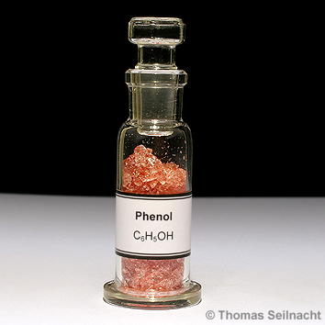
CARBOLIC ACID (Phenol)
‘Phenol’, C6H4OH
Colourless, prismatic niddle shaped crystal - turns pink when exposed to air
Burning sweetish taste
Typical Phenolic/carbolic smell
Slightly soluble in water but highly soluble in alcohol, ether, benzene, glycerine
Cresol = Methylphenol

Slide 24
Used as:
  Antiseptic,disinfectant
    Dettol: chlorinated phenol with terpinol
    Lysol, Domex : 50% cresol in saponified vegitable oil
    Phenyl(household): 5% phenol in water
  Preservative for organic tissues, museum specimens, embalming
Absorption - Through GIT, respi, rectum, vagina, wound, skin
Very mild corrosive but act as systemic toxicity
Fatal dose : 10-15ml
Fatal Period : 3-4 hr

Slide 25
Acute poisoning - CARBOLISM
    SKIN- Burning & Numbness
        White opaque eschar-later brown stain then falls
        Precipitate protein
    GIT- burning pain from mouth to stomach-then tingling &
    anaesthesia
        Painfull & difficult deglution & speech
        Corroded Lip, Mouth,Tongue-later white & hardened
        Nausea, vomiting
    RESPIRATORY: Pulmonary & Laryngeal Oedema
        Bronchitis & Bronchopneumonia

Slide 26
  SYSTEMIC:
  CNS DEPRESANT-
        Headache ,Giddiness, Unconsciousness, coma
        Respi Centre Depression
        Hypothermia
        Pupil constricted
        Startorious Breathing
        Pulse: rapid, thready, feble, irregular
        Convulsion, lock jaw
        Face : cold sweat, cyanosed
  URINE: (CARBOLUREA):
        Scanty urine with albumin & Hemoglobin
        Colourless/Green urine--air—Dark Green/Black
        Hydroquinone & pyrocatechol

Slide 27
  Treatment:
    Stomach wash* with luke warm water & activated charcoal
    30 gm of MgSO4 left in stomach
    Demulcents
    NS /NaHCO3 fluids
    Hemodialysis
    Methylene blue for methHbnemia
    Skin cleaned with water, MgO paste

Slide 28
  PM findings:
    Phenolic smell
    Brown coated tongue, corrosed mucosa & skin
    Brownish fluid in stomach & intestines with phenolic smell, brown leathery stomachwall
    Cyanosis, Pulmonary edema, congestion
    Other viscera congested
    Brownish dark urine(Carbolurea)
    Resist putrefaction for long time

Slide 29
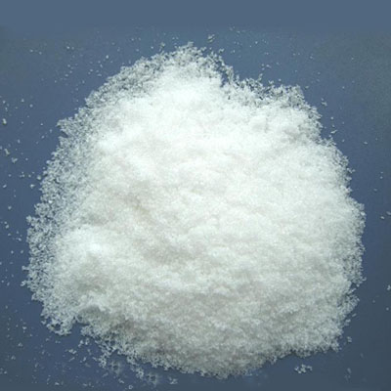
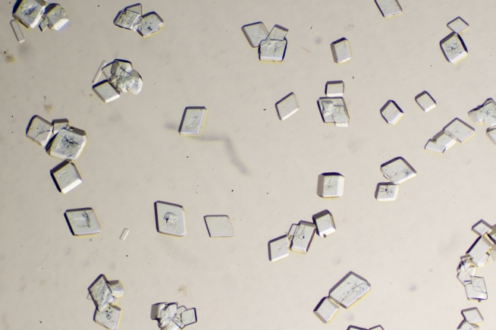
OXALIC ACID
Acid of sugar, salt of sorrel
colorless , odorless, prismatic crystal with sour & slightly bitter taste
USES:
  Bleaching & cleaning Agent
  Ink Removar/ Rust Removar
  Metal Polishing Industry, Ceramic, Leather, Metallurgic, Paper, Pharmacutical, Rubber Industry
FATAL DOSE: 15-30 gms
FATAL PERIOD : 1 to 2 hrs

Slide 30
MOA:
LOCAL: Corrosive on skin & mucus mm
SYSTEMIC:
  HYPOCALCEMIA - Combine with serum calcium to form Ca Oxalate Crystals ( insoluble) get deposited in the liver, kidney, heart, lung, blood & is excreted in urine(OXALURIA)

Slide 31
CLINICAL FEATURES
LOCAL:
  Corrosion: whitish/yellowish – skin/ mucus membrane later turns blackish due to acid hematin formation
SYSTEMIC:
  Vomiting (coffee coloured) & diarrhoea
  Tetany: Tonic muscle spasms, cramps
    Accoucher’s Hand : due to carpopedal spasm
    Trousaeau’s sign : spasm due to pressure on vessels
    Chovstic’s sign :spasm of facial muscle following a tap on facial nerve area
  Renal stones, tubular necrosis, renal failure

Slide 32
DIAGNOSIS:
  oxalate crystals in urine –Prism/needle/tent/envelop shaped
  Serum Calcium level, Serum Oxalate level
TREATMENT
  Stomach wash* with Lukewarm water/Ca Gluconate/Lactate Soln
  Ca Gluconate/chloride I.V
  Demulcents
  Hemo-Dialysis /Exchange Transfusion for renal failure
  Wash affected skin/eye with copious water
  Supportive Tt

Slide 33
AUTOPSY FEATURES
  EXTERNAL:
    Skin:Brown Eschar
    Mucosa: Whitish mucosa
  Scalded mucosa :of Stomach & GIT
  Brown/black colour due to acid hematin
  Crystals of Ca Oxalates on mucosa
  INTERNAL: Congested Organs-Brain, Liver, Kidney.
      KIDNEY: Cloudy swelling, Necrotic & Hyaline changes
  MLI: Accidental for epsom salt (cathartics)

Slide 34
ALKALI
Mostly as white powder/colorless soln
Ammonia gas is colorless, with pungent & choking odour
USES:
  Ammonia gas: smelling gas
  Ammo Hydroxide: paint remover
  Na Hydroxide : Drain cleaner (caustic soda)
  K Hydroxide : Drain cleaner (caustic potash)
  Na carbonate : Household washing detergent(washing soda)
  K carbonate : Household cleaners
  Na Hypochloride : Household bleach

Slide 35
FATAL DOSE: 10-15 gms
  15-20 ml for ammonia
Mech Of Action:
  Produce Liquifactive necrosis → extensive penetrating damage due to soponification of fat & solublisation of protein

Slide 36
CLINICAL FEATURES:
Corrosion of GIT with grayish pseudo-membrane
Oesophagus is more severely affected than stomach (contrast to acid poisoning) → vomiting, hematemasis, dysphagia
Abdominal pain, Diarrhoea, tenesmus
Skin : greyish, soapy ,necrosis, ulcer persists for several weeks
Eye : congestion, necrosis of conjunctiva, sclera, opacifiation
Ammonia Ingestion : respiratory symptoms

Slide 37
TREATMENT – same as acids
Respi support: Tracheostomy/ endotracheal tube, Oxygen
Demulsants: milk/water
Contraindicated – Neutralization with acid, Emesis, Gastric lavage, Activated charcoal, Catharsis
Withhold all oral feed
Assess fluid & electrolyte balance
Eye injury: wash with copious water/NS

Slide 38
AUTOPSY FEATURES
Characterstic odour.
Brown/greyish stain on skin.
Inflammatory oedema with corrosion & sliminess of tissue of oesophagus & stomach.
Respiratory tract inflammation & Pulmonary oedema. (Spe : Ammonia )
MEDICO-LEGAL IMPORTANCE :
Accidental Poisoning : mistaking as water, bear , lemonade.
Industrial ACCIDENTS :
Suicidal : Occasional
Homicidal : Rare
Robbery : Ammonia used.

Slide 39
Clinical Exercise
Household cleaning compounds in your stay place. - Observe & memorise – physical form & smell, tradenames, contents, method of use, first-aid steps in case of contact/poisoning.
Corrosive poisoning cases (Acid, Phenol, Alkali – household cleaners) in Casualty OR Surgery/Medicine wards - History, Symptoms-Signs, Examination findings, Lab investigations, Management, Prognosis

Slide 40
Kalayarasan R, Ananthakrishnan N, Kate V. Corrosive Ingestion. Indian J Crit Care Med. 2019 Dec;23(Suppl 4):S282-S286. doi: 10.5005/jp-journals-10071-23305. PMID: 32021005; PMCID: PMC6996660.
Kalayarasan R, Ananthakrishnan N, Kate V. | Corrosive Ingestion. | Corrosive ingestion remains a common problem in developing countries, such as India due to the lack of strict laws that regulate the sale of caustics. The aim of this review is to summarize the epidemiology and pathophysiology of corrosive ingestion, principles in the management of acute phase injury, long-term effects of caustic ingestion, and prevention of corrosive ingestion. | India, where acids are commonly used in the toilet cleaners compared to more expensive caustic soda, acids contribute to most of the corrosive injury.2,3 Corrosive ingestion could be accidental or suicidal. Accidental corrosive ingestion is frequent in children. Respiratory distress with tachycardia and drooling of saliva suggests severe injuries. The presence of abdominal tenderness and peritoneal signs is an ominous sign indicating gastric necrosis.

