Slide 1
BLOOD & OTHER STAINS
- Dr. Kalpesh Zanzrukiya

Slide 2
BLOOD stains
Circumstances where blood stain found ?
  Cloths of dead body in PM Examination
  Injury cases – cloths of victim, accused,
  Over weapons
  Sexual assault cases – inner cloths, tampoons/sanitary pads
  Over objects at crime scene
Method to collect blood stains
Liquid stains – by using gauge, cotton, filter paper
Dried stains – over cloths, over surfaces, over objects, over skin & intimal body parts – scrap by blade OR cut out stained part & preserve OR by using a swab stick with NS

Slide 3
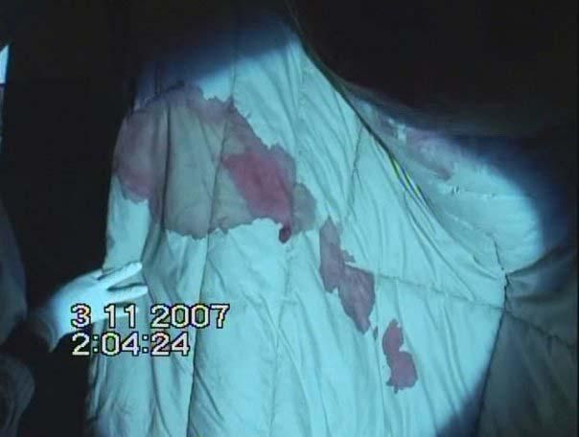
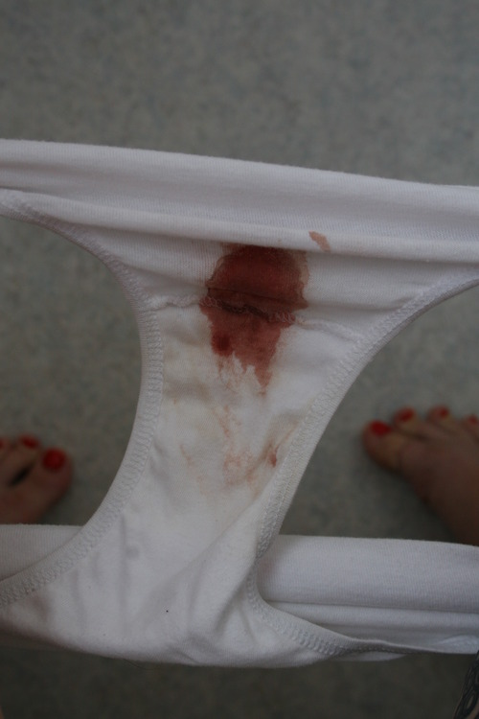
Blood stains

Slide 4
Substances resemble human blood stain
  Metals – red lead, iron oxides
  Rust stains
  Vegetable & fruits - tomato, beet, catechu(pan)…
  Nail polish, artificial colours
  Animal blood

Slide 5
Examination of suspected blood stain
[1] BLOOD OR NOT ?
Presumptive tests :
  Benzidine tests
  Phenolphthelin test
  O-Tolidine test
  Leucomalachite green(LMG) test
  Tetramethyle benzidine(TMB) test
  Luminol test – best test
  Flouroscence test

Slide 6
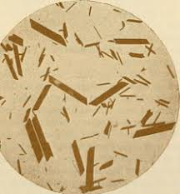
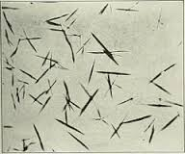
Confirmatory tests :
  Hemin crystal(Teichmann) test
  Hemochromogen(Takayama) test
  Microscopy – RBC, WBC, pletelets, …
  Spectroscopy – most reliable
  Electrophoresis, Chromatography

Slide 7
Examination of suspected blood stain
[2] If Blood, -> Human OR not ?
Precipitin Test:
  Ring assay
  Diffusion test
  Hemagglutination inhibition test
  Immunochromatography
Enzyme tests : Every enzymes is species specific
  LDH
  MDH
  Peroxidase
DNA analysis – human DNA

Slide 8
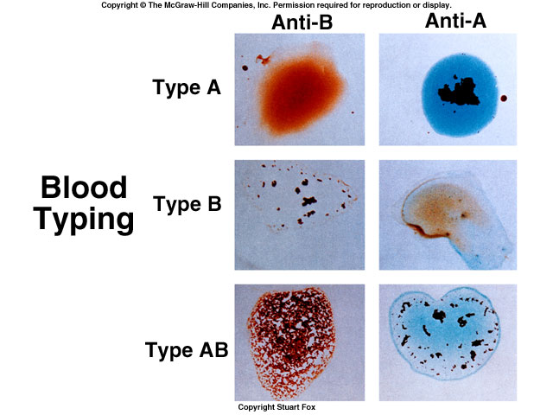
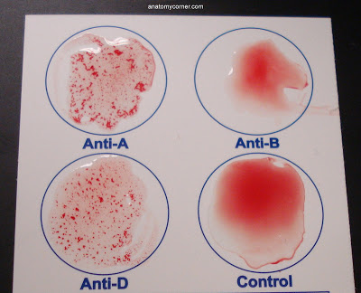
Examination of suspected blood stain
[3] If Human Blood, -> Blood group ?

Slide 9
ABO grouping
Rh grouping
Other systems – MNS, Hh, Duffy, Kell, Indian…(more than 50 types of blood grouping system discovered)
‘Lattes crust method’ – blood grouping from blood stains on objects
HLA grouping

Slide 10
ABO grouping
Founder - Karl Landsteiner
Antigen over RBC and ‘alloantibody’ in serum
Genes on Chromosome 9
Genes for ‘A’ and ‘B’ antigens are dominant
Blood Group (Phenotype) | Ag on RBC | Allo antibody in serum | Genotype
A | A | Anti B | AA or AO
B | B | Anti A | BB or BO
AB | A and B | --- | AB
O | ---- | Anti A and Anti B | OO

Slide 11
ABO Ag appear at 6th wk of intrauterine life, alloAntibody appear in serum at 1yr after birth
‘Secretors’ – person who secrets ABO antigens in body fluids e.g. saliva, sweat, semen etc. -> ABO blood grouping is possible from that fluid
Inheritance

Slide 12
ABO Blood grouping inheritance
PHENOTYPE of MOTHER | PHENOTYPE of FATHER | PHENOTYPE IN CHILD
 |  | POSSIBLE | NOT POSSIBLE*
A | A | O, A | B, AB
A | B | O, A, B, AB | ----
A | AB | A, B, AB | O
B | A | O, A, B, AB | ----
B | B | O, B | A, AB
B | AB | A, B, AB | O
O | A | O, A | B, AB
O | B | O, B | A, AB
O | AB | A, B | O, AB
O | O | O | A, B, AB
AB | AB | A, B, AB | O
* Not accurate for O blood group subtype – ‘Bombay blood group’

Slide 13
Rh grouping
Rhesus factor/ ‘D’ Antigen -> If present - Rh positive, if absent –> Rh negative
Gene on chromosome 1
Independent to ABO blood group system

Slide 14
HLA grouping
Human Leucocyte Ag – on WBC
Major Histocompatibility Complex(MHC) – a protein
Gene on chromosome 6
Important for Organ transplantation

Slide 15
Medicolegal importance of blood groupings:
  Identity
  Correlation to crime scene
  Blood transfusion
  Organ transplantation
  Paternity dispute – exclusionary value
  ‘Baby swap cases’ in OBGY & Pediatric hospitals

Slide 16
Blood Transfusion
Medicolegal points to remember
  Consent is must in advance (except emergency)
  Blood grouping- Cross Matching(BG-CM) before BT is must (even blood group of recipient is known)
  Proper check, monitoring & documentation – before, during and after the BT procedure
  If mismatched BT – case may be filed for Criminal negligence IPC 304A, 320, …
  If BT within 3 mths of DNA test -> results of DNA paternity test may be affected -> so, in paternity dispute cases if history of BT within 3 months is there -> DNA paternity test is to be done after 3 months

Slide 17
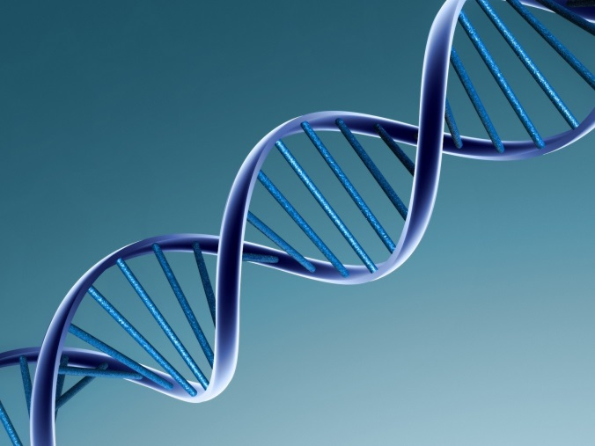
DNA FINGERPRINTING
Technique to study DNA characteristics & matching.
Medicolegal Importance
  Identification – in living & dead
  Co-relation of accused to crime scene
  Sexual assault cases – rape, sodomy…
  Paternity disputes
  Maternity disputes

Slide 18
Samples for DNA analysis
In Living persons | In Dead persons
Blood in EDTA bulb- venous, 5ml Swab – buccal swab, vaginal swab, penile swab Hairs – plucked 15-20 occipital Semen Fingernail scrapings/clipping | Blood Swabs Hairs Fingernail scrapings/clipping Bones with bone marrow Molar teeth Muscle tissue in NS – best Skin in NS Spleen-Liver tissue in NS

Slide 19
Techniques
  Restriction Fragment Length Polymorphism
  Short Tandem Repeat analysis by PCR
Limitations
  Monozygotic twins
  Costly & difficult procedure
  Sabotage

Slide 20
Semen examination
Semen = sperms from testicles(spermatozoa with CPK enzyme) + prostatic secretion(Acid phosphatase + spermine + Prostate Specific Antigen/P30) + seminal vesicle secretions(choline + Seminal Vesicle Specific Antigen)
Medicolegal indications for semen analysis
  Natural sexual offences
  Unnatural sexual offences
  Infertility cases
  Disputed paternity cases

Slide 21
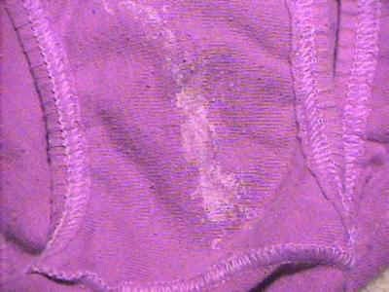
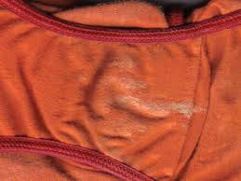
Seminal stains

Slide 22
Detection of semen in doubtful stains
UV light Test – blue-white fluorescence due to choline
Chemical tests
  Acid phosphatase test – prostatic secretion
    Positive in infertile male, vasectomized male
  Prostate Specific Ag/P30 test
  Barberio test – spermin picrate crystals
  Chromatography for choline
  Choline-iodide test
Microscopy for spermatozoa – confirmatory
DNA test for identity, paternity

Slide 23
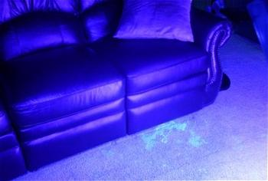
Suspected stains under UV light

Slide 24
Bond, J. W. (2007), Value of DNA Evidence in Detecting Crime. Journal of Forensic Sciences, 52: 128–136. doi:10.1111/j.1556-4029.2006.00323.x
John W. Bond D.Phil. | Value of DNA Evidence in Detecting Crime | An analysis of DNA material recovered from the volume crime offences of residential burglary, commercial burglary, and theft of motor vehicle in North amptonshire, U.K., in 2004 has enabled the DNA to be categorized into seven sources. | The results indicate that a number of predictors, other than timeline, that greatly influence whether the DNA material recovered from a crime scene enables the crime to be detected. They includes type of source tissue, components of tissue, technique of sampling & preservation etc.

Slide 25
Any Queries ??
MCQs

Slide 26
MCQ 1
Which of the following test can determine blood groups in a blood stain?
Luminol spray test
Haemin crystal test
Kastle-Meyer test
Lattes crust method test

Slide 27
MCQ 2
Which of the following test cannot determine disputed maternity case?
Blood grouping
HLA typing
Precipitin test
DNA fingerprinting

Slide 28
MCQ 3
A convict escaped from the jail. His family or relatives were not known and no biological sample was available with jail authorities. A dead body resembling the convict was found in nearby forest. but due to mutilation of face & fingers, identity could not be established. The positive identity that he is the same convict, who escaped from jail, can be established by which of following examination?
Blood Grouping
DNA Profile
Anthropometry
HLA typing

Slide 29
MCQ 4
Precipitin test may be used for which of following purpose?
Identify a bone fragment of human origin or not
Identify a blood stain of human origin or not
Identify a hair sample is of human origin or not
All of above

Slide 30
MCQ 5
In disputed paternity, ‘Blood group examination’ helps in which of the following?
Identification of a possible father and mother
Confirming that a certain person is the father
Confirming that a certain person is not the father
None of the above

