Slide 1
Anatomy of Male Genital Tract with Lymphatic Drainage
By- Dr KISHAN NINAMA
PROFESSOR
SBKS MI & RC

Slide 2
Introduction
Sexually transmitted diseases (STDs) mainly affect the genitalia, anorectal area and oral mucosa.
Majority of the signs and symptoms of sexually transmitted diseases are dependant on anatomy and the lymphatic drainage of the male and female genital tracts.

Slide 3
Male Genitalia
Male genitalia consists of :
1. Male Urethra
2. Penis
3. Scrotum
4. Glands- which include Prostate, Cowper’s glands, Littre’s glands &
Tyson’s glands.

Slide 4
Male Urethra
It is a membranous canal for external discharge of urine and seminal fluid .
It is 18-20cm long, which extends from the neck of urinary bladder tp external meatus .
It consists of 3 parts, which include: (i) prostatic urethra
(ii) membranous urethra
(iii) spongy / penile urethra

Slide 5
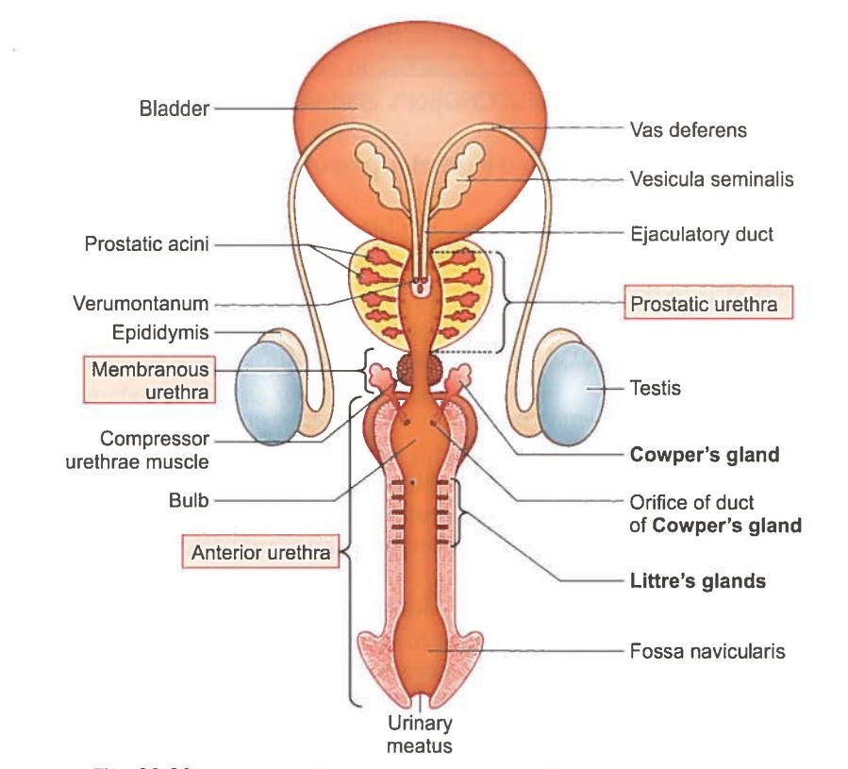
Caption

Slide 6
    The spongy/penile part is referred to as anterior urethra, which is 15cm in length .
    It is lined by pseudostratified columnar epithelium except the distal 10-12mm, which is lined by stratified squamous epithelium.
    This part of the urethra can be felt running deep within the corpora spongiosum along the medial raphe of the penis and ventrally.
    Therefore, palpating at this location gives a clue in detecting urethral strictures.

Slide 7
The membranous and prostatic part of urethra together constitute posterior urethra.
Prostatic part : 3cm long, lined by transitional epithelium
Membranous part: 1.5- 2cm long , lined by transitional epithelium.

Slide 8
Sphincter of the Urethra
There are two types :
(i) the internal urethral sphincter/sphincter vesicae :
It is involuntary in nature, which controls the neck of the bladder and the prostatic urethra.
(ii) the external urethral sphincter/sphincter urethrae :
It is voluntary in nature, which controls membranous urethra and is responsible for the voluntary holding of urine.
It is made of striated muscle fibres and is supplied by the perineal branch of pudendal nerve .

Slide 9
Lymphatics
The lymphatics from the prostatic and membranous parts of the urethra pass mostly to the internal iliac nodes and partly to the external iliac nodes.
The lymphatics from the spongy part of the urethra pass mostly to the deep inguinal nodes and some may end in superficial inguinal and external iliac nodes.

Slide 10
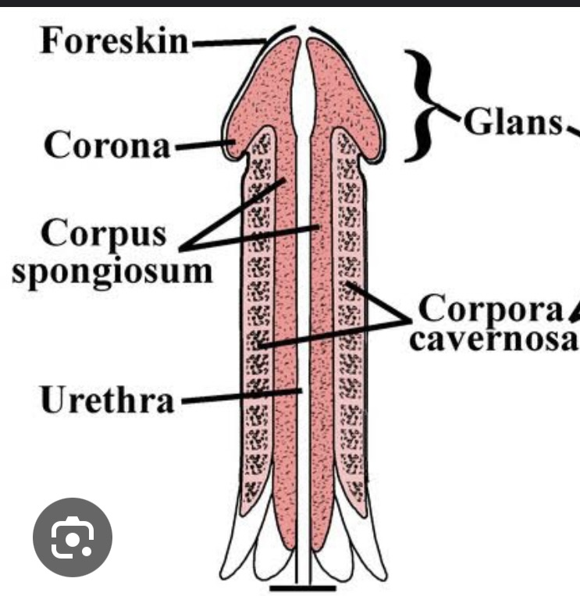
Penis
It is divided into :
(i) Shaft or body of the penis
(ii) Glans penis
(iii) Prepuce
Caption

Slide 11
(i) Shaft or body of the penis: It consists of erectile tissue which is constituted by corpora spongiosum penetrated by urethra throughout the length, ending up in bulb-like projection called glans penis.
(ii) Glans penis : It has a rim-like raised surface at its proximal end, termed as corona glandis.
A circular groove, coronal sulcus runs along the corona glandis which separates from the shaft of the penis.
Pearly penile papules are small , pin head-sized projections over the corona glandis arranged in 1 or 2 rows, which may be confused with condyloma accuminata.

Slide 12
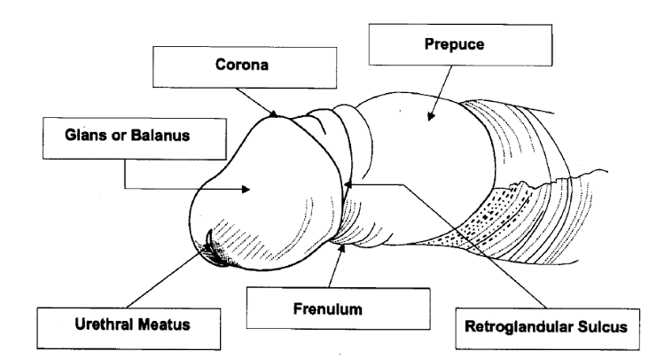
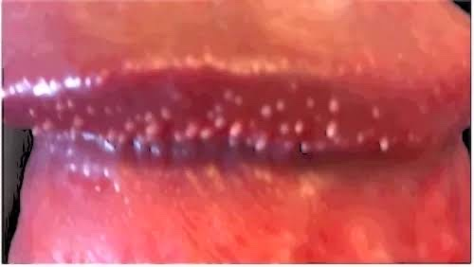
Caption
Pearly penile papule

Slide 13
(iii) Prepuce : It is a specialised fold of skin which marks the junction between cutaneous & mucocutaneous area of the penis.This fold of the skin covers the glans penis to form a potential space called preputial sac.
Since, this sac has a occlusive effect over glans and undersurface of prepuce, that makes this sac and glans penis vulnerable for inflammation, called as Balanoposthitis.

Slide 14
Scrotum
Scrotum is a loose sac of skin which contains - testes
- epididymis
- vas deferens
- loose areolar tissue
It is vulnerable to genital ulcer disease due to its close proximity with the penis.

Slide 15
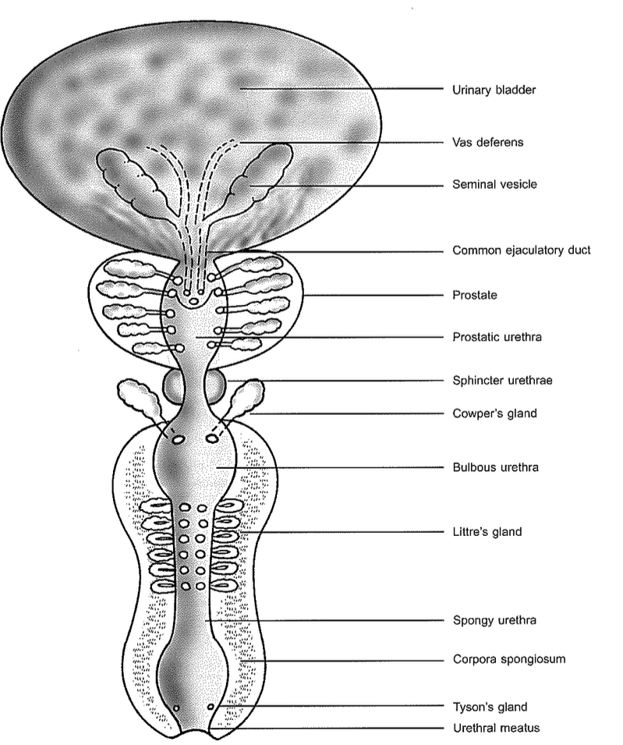
Glands
There are 4 types : - prostate
- Cowper’s glands
- Littre’s glands
- Tysons’s glands
Caption

Slide 16
Prostate gland: It is a branched glandular tissue with one middle and two lateral lobes which encircles the prostatic urethra .
  -This glandular tissue is lined by columnar epithelium and opens into prostatic urethra .
  -It is specially vulnerable for gonococcal and non gonococcal infections due to its branching character of glandular tissue + columnar epithelium.
  -This leads to chronicity with difficulty to eradicate the infection.

Slide 17
Cowper’s glands : also called as bulbourethral glands of Cowper
  -They are two in number, lying one on the either side of the membranous urethra, surrounded by sphincter urethrae muscle.
  -It is lined by columnar epithelium
  -On per rectal examination, it can be felt just below the prostate ,one on each side.

Slide 18
Lymphatic drainage of male genitalia
The superficial structures of genitalia drain mainly into the inguinal group of lymph nodes, which constitute the superficial and deep inguinal lymph nodes.

Slide 19
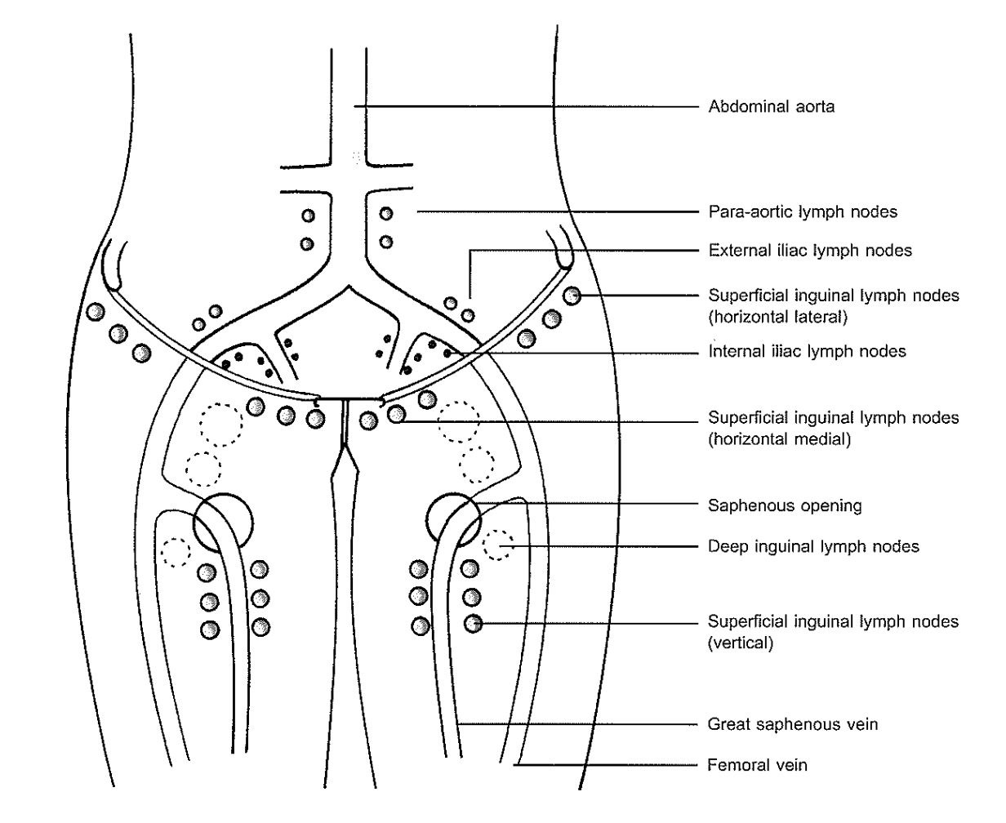
Caption

Slide 20
Superficial Inguinal lymph nodes
This set of lymph nodes lie superficial to the deep fascia of the thigh, and have two subgroups:
- horizontal subgroup
- vertical subgroup
The horizontal subgroup lies along the inguinal ligament and is further divided into medial and lateral chains.

Slide 21
The medial chains are 2-3 nodes in number.
They drain the external genitalia except the glans penis, clitoris, lower part of the vagina below hymen and anal canal above the pectinate line.
The lateral chain of the horizontal group drains the the lymphatics from the abdominal wall below umbilicus.
The vertical group have 4-5 nodes and they lie along the saphenous vein.
They drain lymphatics from thigh and leg.

Slide 22
Now, all the efferents from the superficial group of inguinal lymph nodes
Drain into deep inguinal lymph nodes and external iliac lymph nodes

Slide 23
Deep Inguinal lymph nodes
They are 1-3 in number with one among them lying within the femoral canal, which is called as node of cloquet into the deep fascia medial to the femoral vein.
The glans penis and clitoris drain directly into deep inguinal lymph nodes.
The efferents from the superficial inguinal lymph nodes and the deep lymphatics of the lower limb drain into deep inguinal lymph nodes.

Slide 24
Now , all the lymphatics from the inguinal lymph nodes
Common iliac nodes
Para- aortic lymph nodes
Internal & external iliac lymph nodes

Slide 25
Penis
  - The lymphatics from the skin of the penis drain into the medial chain of horizontal group of superficial inguinal lymph nodes.
  - The deep structures including the anterior urethra/ spongy or penile part urethra drain into deep inguinal lymph nodes.
  The posterior urethra drains into the deep iliac nodes.
  - The lymphatics from the glans penis drain directly into deep inguinal lymph nodes.

Slide 26
Scrotum
  - The lymphatics from the skin of the scrotum drain into the medial chain of the horizontal group of superficial inguinal lymph nodes.
  - The testes and the epididymis drain into the pre-aortic and para-aortic group of lymph nodes.

Slide 27
Prostate
  - The lymphatics from the prostate mainly drain into the internal iliac and sacral lymph nodes.
  - It also partly drain into the external iliac lymph nodes.

Slide 28
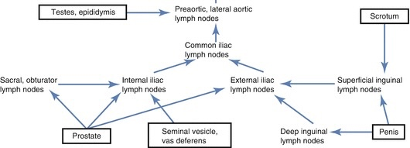
Caption

Slide 29
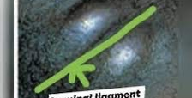
Enlargement of the regional lymph nodes is always observed in all sexually transmitted diseases , and gives a considerable clue and significance in the diagnosis of genital ulcer disease.
Groove sign of Greenbalt: When both inguinal and femoral lymph nodes are involved, they can be separated by the inguinal ligament(poupart’s ligament), Groove sign.
It is the characteristic of Lymphogranuloma venerum.
But, it can also be seen in other malignancies like lymphoma.
Caption

Slide 30
Consequences of lymphatic blockade
Inguinal lymph nodes are the most important lymph nodes when we talk about the sexually transmitted diseases.
Any insult to these lymph nodes by the process of infection, carcinoma, irradiation, etc. can lead to the blockage of lymphatic drainage of the external genitalia and the lower limb.
Due to this blockage , genital lymphoedema and elephantiasis are common, which are seen in LGV, donovanosis, filariasis, carcinoma, tuberculosis and irradiation.

Slide 31
THANK YOU.

