Slide 1
atypical mycobacteria
By- Dr Rashmi mahajan
hod & professor
sbks mi & rc

Slide 2
Classification
slow‐growing: M. avium and M. intracelulare.
rapidly growing: These mycobacteria capable of producing disease in humans are the M. fortuitum group (including M. margaritense), the M. abscessus group, M. chelonae and M. smegmatis

Slide 3
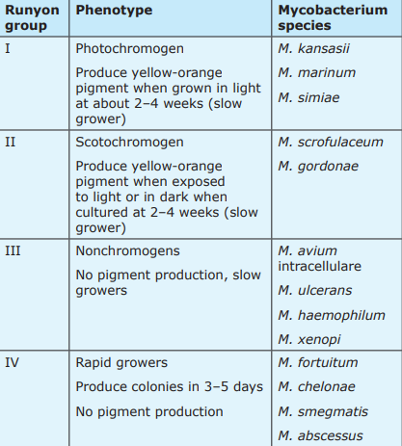

Slide 4
Mycobacterium marinum infection
Synonyms : Swimming pool granuloma ,Fish tank granuloma.
Mycobacterium marinum causes disease in many fish species and human infection follows contact with fishes or contaminated water.
Predisposing factors: Exposed professions include fish workers, fishmongers and cooks.
Pathology:Lesions may show non‐specific inflammation in the first few months, while older lesions show well‐formed tuberculoid granulomas with fibrinoid masses rather than caseation.
Epidermal changes including ulceration and pseudo epitheliomatous hyperplasia may occur in chronic lesions.

Slide 5
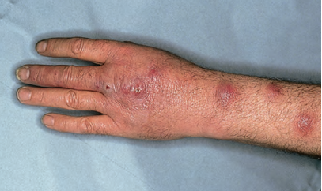
Mycobacterium marinum infection
Incubation period: 2–3 weeks.
Clinical features:Solitary nodule
pustule
ulcer or abscess
verrucous plaque.
Lesions are most common on the elbows, knees and feet of swimmers, and on the dominant hand and fingers.
Differential diagnosis:
leishmaniasis
sporotrichosis
atypical mycobacterial infections due ,M. kansasii, M. chelonae and M. gordonae, all of which may spread in a sporotrichoid manner

Slide 6
Mycobacterium marinum infection
Investigations: Culture can be done
PCR (PCR– reverse cross blot hybridization assay with species‐specific gene probes)
Management: clarithromycin, sulphonamides, trimethoprim/ sulfamethoxazole, rifampin, rifabutin and ethambutol, and variably susceptible to doxycycline, minocycline and streptomycin.

Slide 7
Mycobacterium kansasii infection
Mycobacterium kansasii is one of the most commonly reported species of non‐tuberculous bacteria isolated .
Cutaneous lesions are rare but are more common in patients with impaired immunity and in disseminated disease .
Primarily affects middle‐aged white men but it can affect adult patients of any sex, race or age.
Predisposing factors: Pulmonary disease is associated with chronic lung disease, including chronic obstructive pulmonary disease, bronchiectasis, pneumoconiosis and cystic fibrosis

Slide 8
Mycobacterium kansasii infection
Pathology: clinical picture, the histology can be very variable, but a granulomatous histology and a mixed inflammatory infiltrate with acid‐fast bacilli in the histiocytes is often noted.
Environmental factors:Chronic occupational exposure to dust, which can occur in miners, welders, sandblasters and painters.
Presentation: Papules
Pustules.
Verrucous or granulomatous plaques or nodules.
A sporotrichoid pattern , cellulitis , rhinophyma and single and multiple abscesses have all been reported

Slide 9
Mycobacterium kansasii infection
Differential diagnosis: Cutaneous tuberculosis
Actinomyces group, Wegener’s .
Investigations: Biopsy specimens with staining for acid‐fast bacilli should be done.
Management:
First line-Isoniazid, rifampacin, ethambutol, for 18 months.
Second line-streptomycin or amikacin for the first 3 months.
Third line- Rifampacin is the cornerstone of current therapy but acquired resistance to this and isoniazid can occur. In these cases, clarithromycin, levofloxacin, moxifoxacin.

Slide 10
Mycobacterium ulcerans infection
Synonyms
• Buruli ulcer
• Bairnsdale ulcer or Searls ulcer
• Kasongo

Slide 11
Mycobacterium ulcerans infection
Pathogenesis and pathology: After inoculation into the skin, M. ulcerans proliferates and produces the poly ketone toxin mycolactone.
Physiopathology of Buruli ulcer is closely associated with diffusion of the toxin from bacterial foci.
The temperature requirement of M ulcerans favours the development of lesions in cooler tissues, especially the skin and subcutaneous tissue.
Mycolactone destroys tissues by apoptosis and necrosis and suppresses host immune responses .
Environmental factors: The organism is prevalent in rural tropical wetlands.

Slide 12
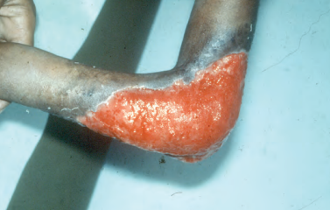
Mycobacterium ulcerans infection
Clinical features: Mycobacterium that infects the skin and subcutaneous tissue. This gives rise to a painless nodule, papule, plaque or oedema that evolves into a painless ulcer with undermined edges.
Differential diagnosis: Ulcerated tuberculosis lesions,
Blastomycosis
Cellulitis
Pyoderma gangrenosum,
Necrotizing faciitis
Investigations: . The four diagnostic laboratory tests for Buruli ulcer are:
(i) direct smear (with acid‐fast stains auramine ) (ii) culture at 32°C(iii) histopathology(iv) PCR

Slide 13
Mycobacterium ulcerans infection
Management:
First line- Oral rifampicin 10 mg/kg and intramuscular streptomycin 15 mg/ kg should be given for 8 weeks.
Second line- Rifampacin 10 mg/kg and amikacin 15 mg/kg should be given for 8 weeks.
Third line- Rifampicin and clarithromycin should be given for 8 weeks or rifapentine plus moxifloxacin for 8 weeks.

Slide 14
Mycobacterium avium complex (M. avium and M. intracellulare) infection
Predisposing factors- Immunesuppression is most commonly due to HIV infection. Patients without HIV infection emphasizes the frequent association with haematological malignancies.
Causative organisms:This complex comprises the closely related organisms M. avium and M. intracellulare, which can be differentiated using PCR‐aided DNA–DNA hybridization.
They are slow‐growing organisms with optimal growth at 37°C and are ubiquitous saprophytes, found in tap water, soil, dairy products, animals and house dust

Slide 15
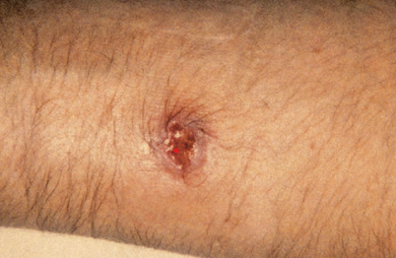
Mycobacterium avium complex (M. avium and M. intracellulare) infection
Clinical features: skin is uncommon, but can occur either following traumatic skin inoculation in cervical lymphadenitis, in which case sinus formation is indistinguishable from tuberculous scrofuloderma, or in immunocompromised hosts, in whom MAC may disseminate from primary visceral lesions.
Skin lesions are of variable appearance and include multiple ulcers , nodules, ulcerated nodules, abscesses , painless nodules and plaques resembling lepromatous leprosy or lupus vulgaris ,as well as lesions resembling prurigo nodularis.

Slide 16
Mycobacterium avium complex (M. avium and M. intracellulare) infection
Investigations: The diagnosis may be made by blood culture.
Culture of MAC from the bone marrow or a liver biopsy.
Management: Surgical excision of the affected nodes .
Surgical excision has also been used in some patients with localized skin lesions.
HIV‐associated MAC disease, a macrolide in combination with ethambutol is the minimum recommended treatment.

Slide 17
Mycobacterium haemophilum infection
Causative organism: The natural habitat and means of acquisition of M. haemophilum are unknown although water sources are strongly suspected.
Pathology : Histologically, suppurative granulomas containing acid‐fast bacilli are usually seen, but occasionally granulomas may be poorly formed and have varying amounts of necrosis.
Clinical features:Erythematous or violaceous papules
Nodules that enlarge to become painful abscesses or ulcers
Annular plaques.

Slide 18
Mycobacterium haemophilum infection
Differential diagnosis: M. marinum and MAC infections, other bacterial infections and Kaposi sarcoma.
Investigations: Cultured from the skin or other tissues or secretions.
Management:
First line- The antibiotic combination favoured is clarithromycin, ciprofloxacin and a rifamycine.

Slide 19
Mycobacterium scrofulaceum infection
Mycobacterium scrofulaceum has been primarily associated with cervical lymphadenitis in children.
Incidence and prevalence: Skin lesions due to M. scrofulaceum are extremely rare.
Pathology: Abscess formation is seen in the lymph nodes and can be difficult to differentiate from tuberculosis.
Acid‐fast bacilli are usually noted.
Skin lesions may show central necrosis with abscess formation surrounded by granulomatous inflammation with lymphocytes, epithelioid histiocytes and foamy macrophages and, occasionally, acid‐fast bacilli.

Slide 20
Mycobacterium scrofulaceum infection
Clinical features: Nodule
Abscess
plaque or ulcerative lesion .
A patient with sporotrichoid lesions has been reported and chronic ulcerative and nodular skin lesions associated with pulmonary infection.
Differential diagnosis:Scrofuloderma due to M. tuberculosis and MAC infection should be excluded.
Investigations: Biopsy specimens should be taken for culture and histology.
PCR

Slide 21
Infection with fast‐growing mycobacteria
These mycobacteria are very common in the environment and are fast growing in humans. They include the M. abscessus group, M. chelonae, M. fortuitum group and M. smegmatis infection.
Pathology: Abscess formation in the dermis and subcutis is the rule, but tuberculoid granulomas with or without necrosis may occur.
Causative organisms : These organisms are widely distributed in the environment in soil and water and may also be commensal organisms of human skin.
They are extremely hardy; members of the M. fortuitum group and M. smegmatis can grow.

Slide 22
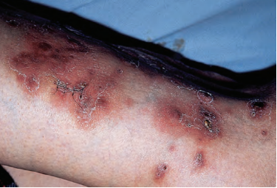
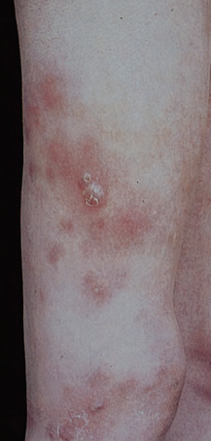
Infection with fast‐growing mycobacteria
Clinical features: Clinical cutaneous disease with these pathogens seems to follow two patterns.
In the immunocompetent host, a traumatic injury (including tattooing and surgical procedures) is followed by the development of localized abscess formation .
In the immunocompromised individual, there may be no history of trauma and patients may present with disseminated disease, with multiple subcutaneous nodular lesions.
Investigations: Usually made by the culture of biopsy material .

Slide 23
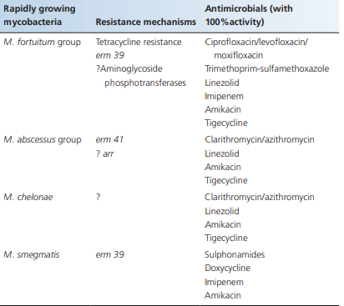
Infection with fast‐growing mycobacteria

Slide 24
Thank you

