Slide 1
BASICS OF LASER
By- Dr Neha Purohit
Assistant Professor
SBKS MI & RC

Slide 2
L Light
A Amplification
S Stimulated
E Emission
R Radiation
LASER IS AN ACRONYM FOR

Slide 3
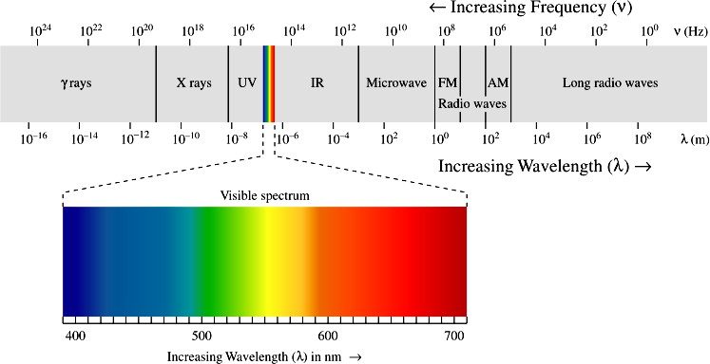
Laser light follows the basic properties of electromagnetic radiation.
Electromagnetic
spectrum
UVC 200-280, UVB 280-315, UVA2- 315-340, UVA1- 340-400nm
Visible- 400-700nm
Near IR-700-1400, short IR-1400-3000, Mid IR-3000-8000, long IR-8000- 15000nm, Far IR- >15000

Slide 4

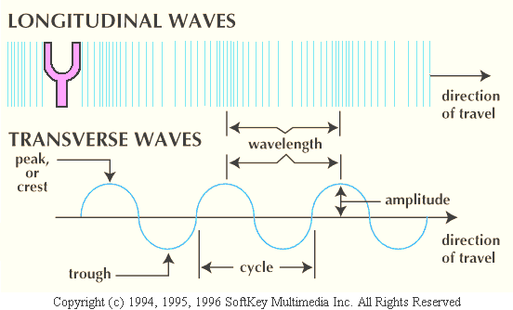
LIGHT
Light is composed of photons in the form of waves
Each electromagnetic wave has a “Wavelength”= distance between 2 peaks measured in “nm”
“Amplitude” is the height of one
peak
“Frequency” is the number of cycles per second measured in “hertz”
Wavelength and frequency are
inversely proportional to each other.

Slide 5
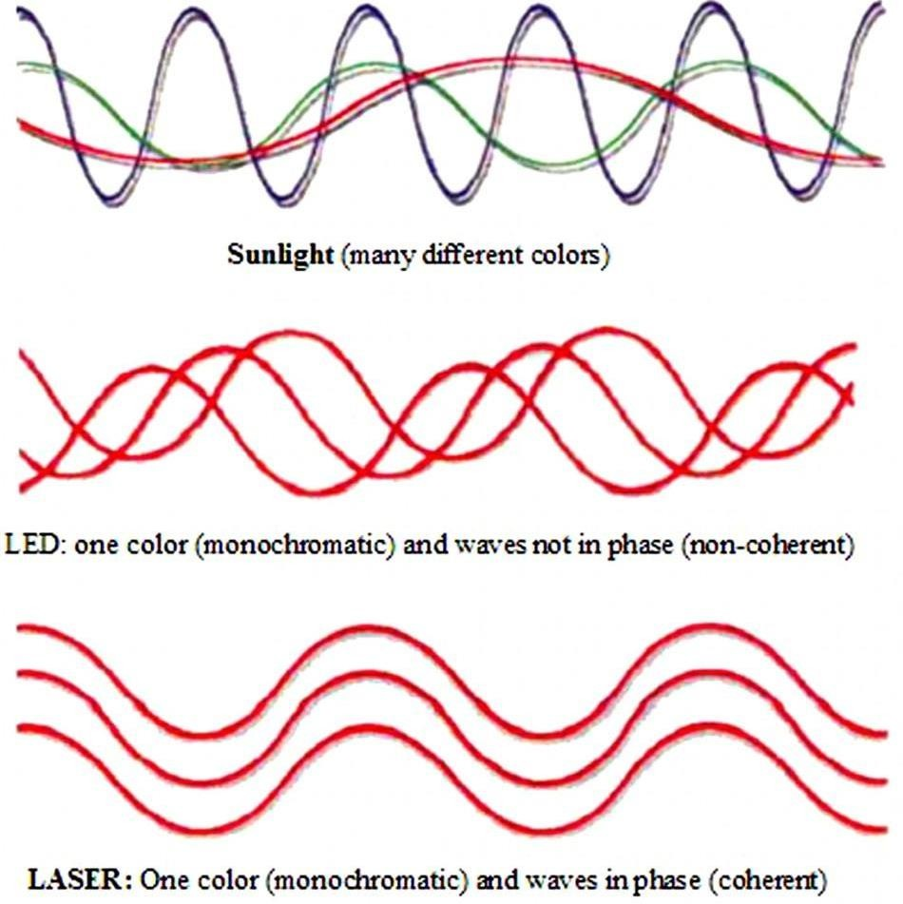
Characteristics of laser
light
Monochromatic: waves have the same color/ wavelength
Coherent: waves are in a definite phase with one another with respect to time and space.
Collimated: waves are parallel to each other without deviation

Slide 6
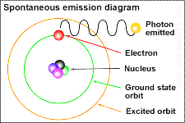
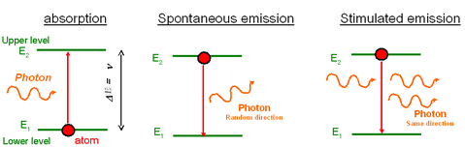
STIMULATED EMISSION
Spontaneous emission:
when electrons are close to nucleus, atom is in state of lowest energy. Unstable excited electron reverts back to its original stable position by releasing a photon of energy.
This emission is random and in all directions.
Sunlight and any light observed in nature are spontaneous emissions.
Stimulated emission:
Excited electron absorbs one more photon of same energy, reverts back to resting orbit (ground state) releasing 2 photons both having same energy, wavelength, phase and direction as of the absorbed photon.
Energy required for this process is provided to the laser by external power source.

Slide 7
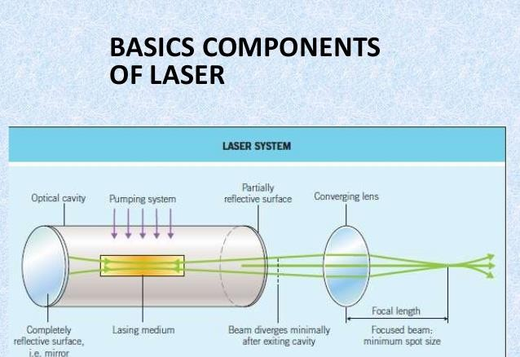
COMPONENTS OF A LASER
ACTIVE GAIN MEDIUM/ LASING MEDIUM (solid, liquid or gas)
This medium is composed of atoms, molecules, ions or electrons whose energy levels are used to increase the power of a light wave during its propagation. The physical principle involved is called stimulated emission.
PUMPING SYSTEM/ ENERGIZING SOURCE :
A system to excite the amplifying medium by supplying the
necessary energy. There are different kinds of pumping system:
  Optical (flash lamps, continuous arc lamps or tungsten-filament lamps)
  Electrical (gas discharge tubes, electric current in semi
conductors)
  Chemical
3. OPTICAL RESONATOR (OR CAVITY):
It contains the gain medium. Reflecting mirrors amplify the light source considerably by bouncing it back and forth within the cavity

Slide 8
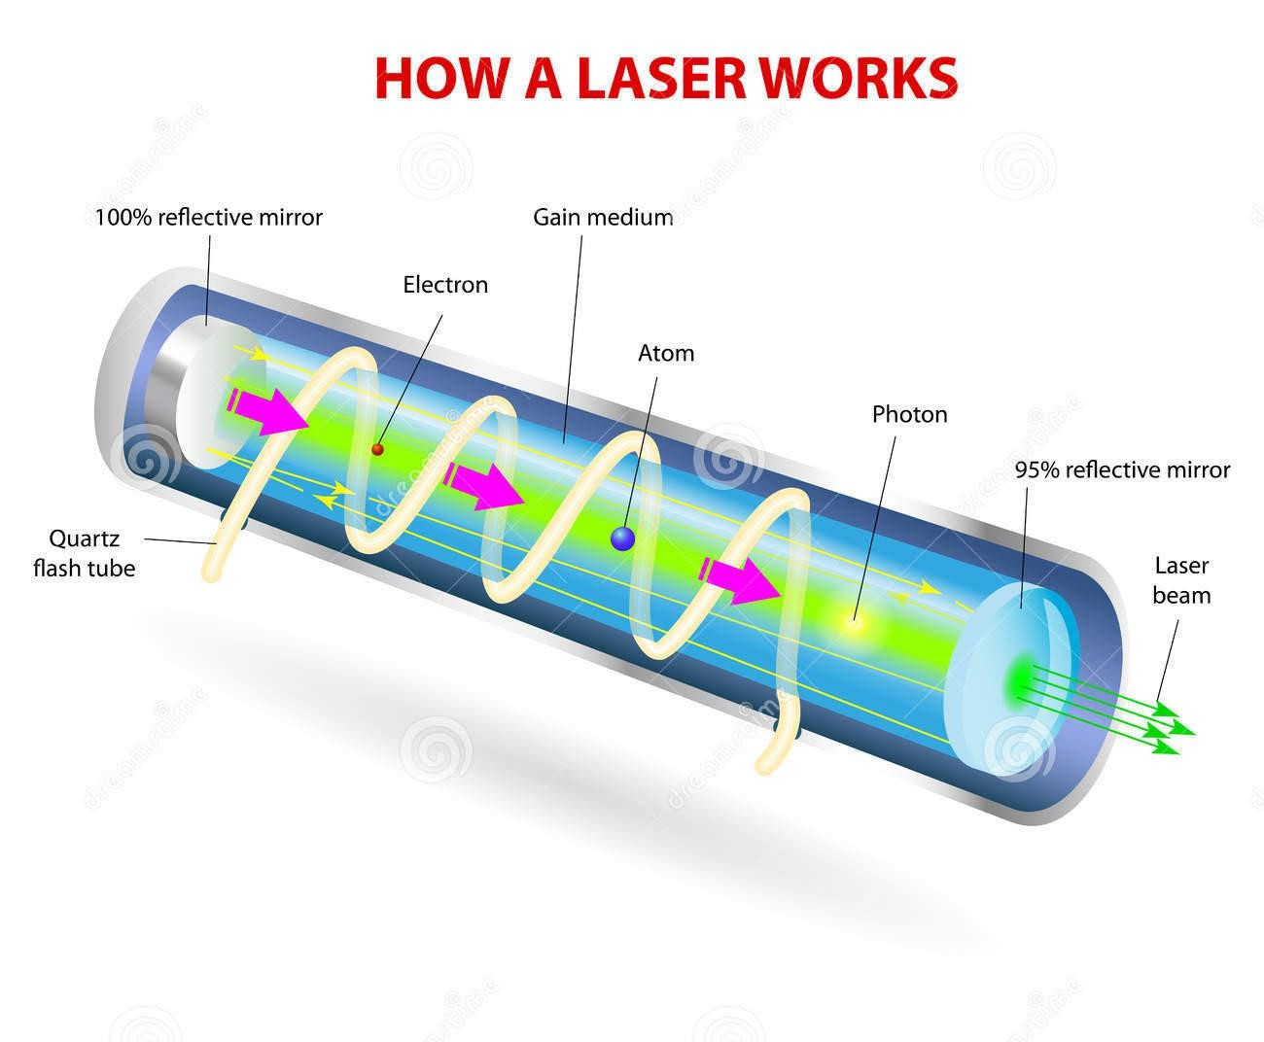
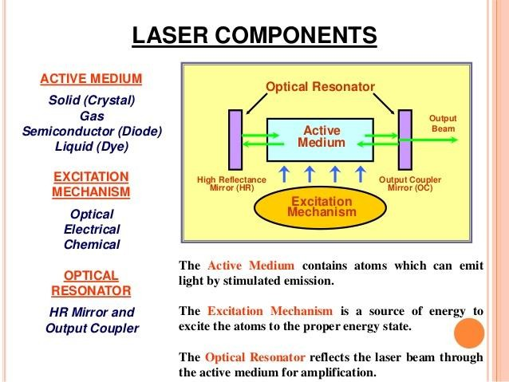

Slide 9
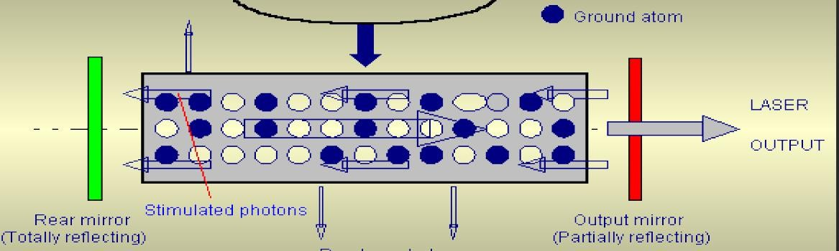
Photons reflect forwards and backwards due to mirrors.
one photon strikes an energized atom to release two photons and so on = amplification of stimulated emission.
Amplification

Slide 10
Energizing pump provides energy for absorption by active medium.
Atoms in gain medium reach an excited state and there is spontaneous emission. Some of these photons are reflected back-forth between two mirrors.
As photons collide with excited atoms in gain medium, energy inside the resonator builds and gets amplified by reflections between parallel mirrors.
At the output mirror a portion of light is allowed to escape, while rest remains inside
resonator to maintain the lasing process.
This continues as long as the pumping system is on.
Thus the energy that comes out is in the form of intense beam of monochromatic, collimated coherent light.

Slide 11
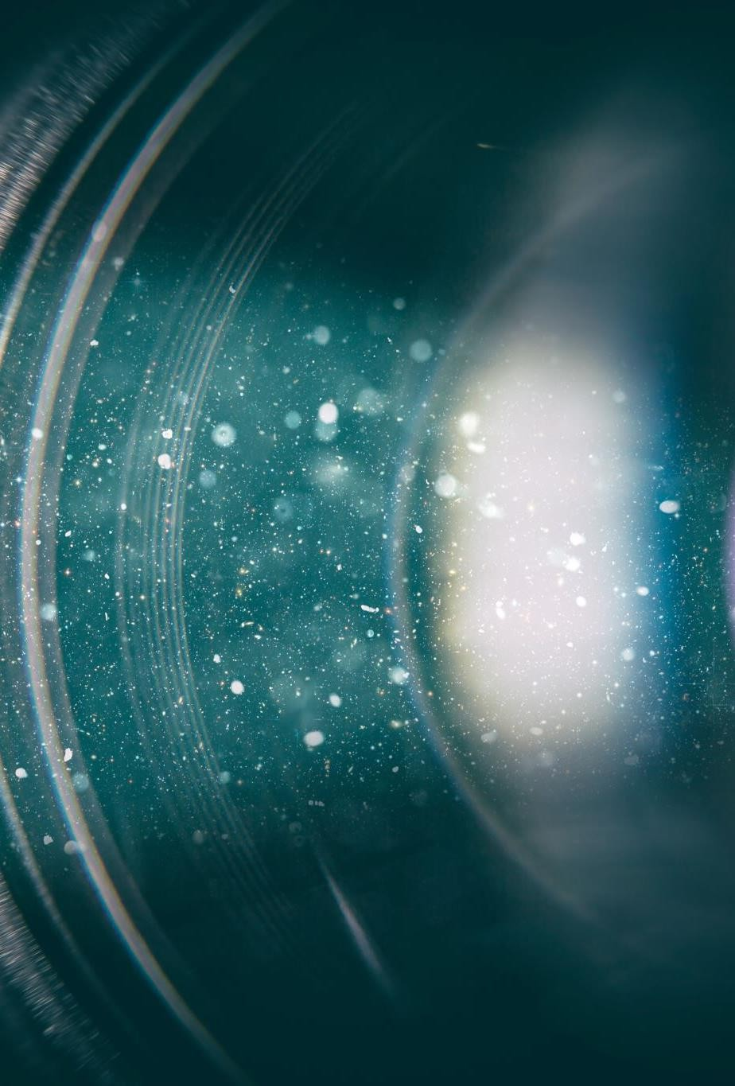
Laser delivery systems
Fibre optic cables:
Easy to use, lighter, may break or twisting occurs during
movement
Not robust to transmit emissions from Co2 lasers, Er:Yag,
Q-S lasers.
Articulated arms:
light is reflected by multiple mirrors.
Ends with a hand piece in which light can be focussed by a lens or transmitted as a beam.

Slide 12
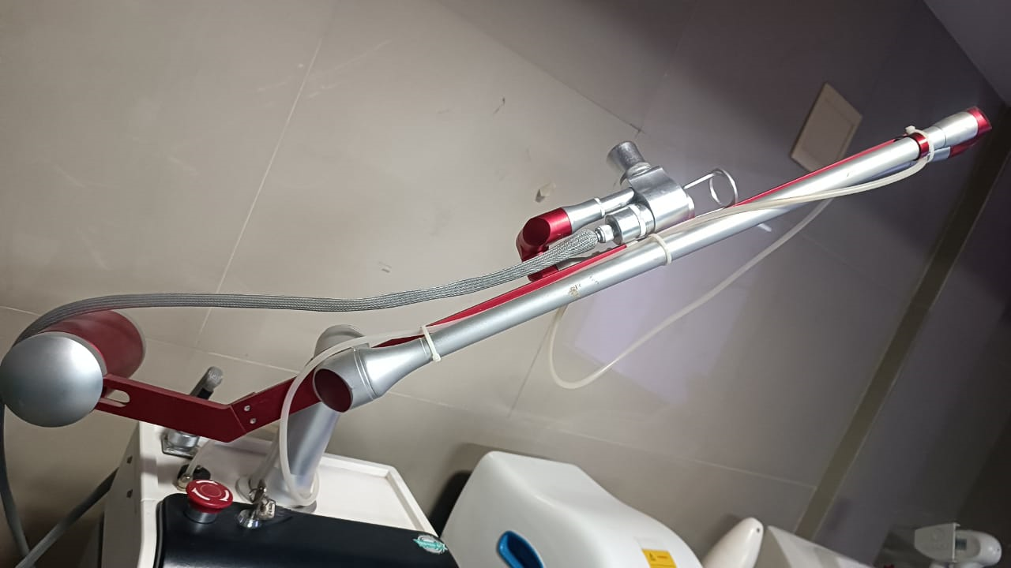
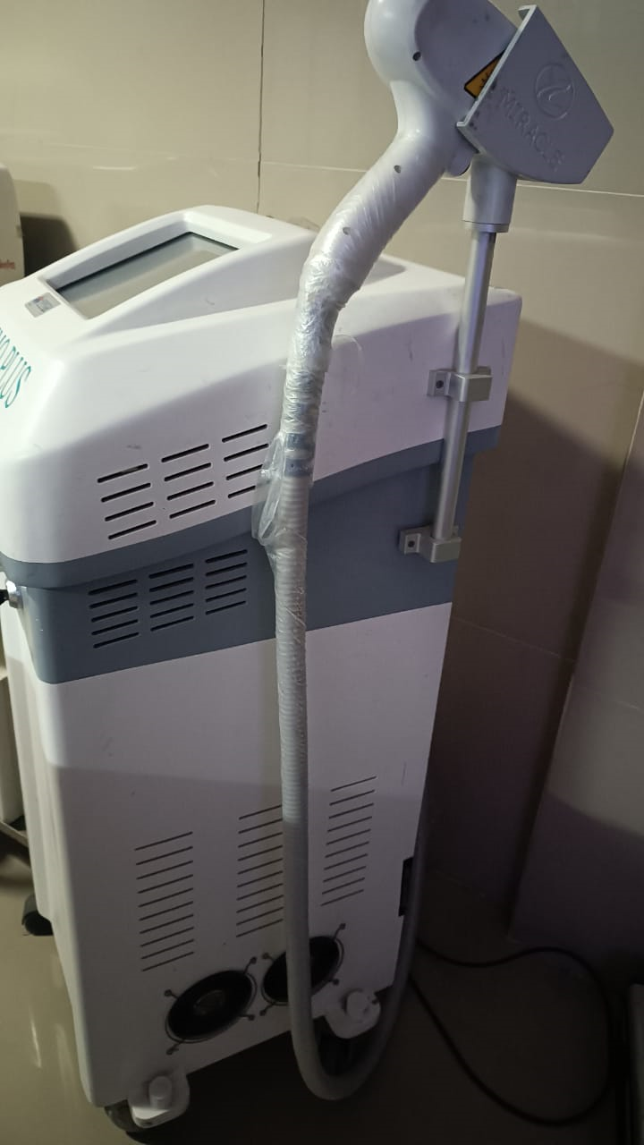
LASER DELIVERY SYSTEM

Slide 13
Laser beam types
 | Continuous Wave lasers | Quasi-continuous-mode (QSM) | Pulsed lasers
Mechanism of action | Continuous beam of light Pulse duration is appx 0.25s | Continuous – wavelength lasers that are mechanically shuttered to deliver pulses of light as short as 20 ms | Long pulse (millisecond) : 0.5 to 400 ms Short pulse (microsecond): modified to produce very short pulses with high peak power in a repetitive fashion; reduces thermal damage Q-switched (QS) nanosecond: 10-250ns: allows build up of extremely high energy in laser cavity before discharging in very short single pulses.
Characteristics | Little or no variation in power output over time (stable avg. beam power) | Not true pulsed lasers as the beam is physically chopped off to produce pulsed effect. Energy within the pulse is not constant but rather builds, peaks and tapers off within a very short time Peak power outputs are upto 100 time the max output of CW lasers
Complications | Non – selective tissue injuries as heat spreads from chromophore | Lower risk of thermal injury to surrounding non – targeted structures
examples | CO2 Laser Argon laser | KTP

Slide 14
Types of laser media
GAS | LIQUID | SOLID
argon carbon dioxide copper vapour helium-neon krypton xenon chloride | rhodamine dye dissolved in organic solvent | Crystal alexandrite erbium-doped yttrium aluminium garnet (YAG) holmium doped YAG neodymium doped YAG potassium titanyl phosphate Ruby Semiconductor diode- aluminium gallium arsenide

Slide 15
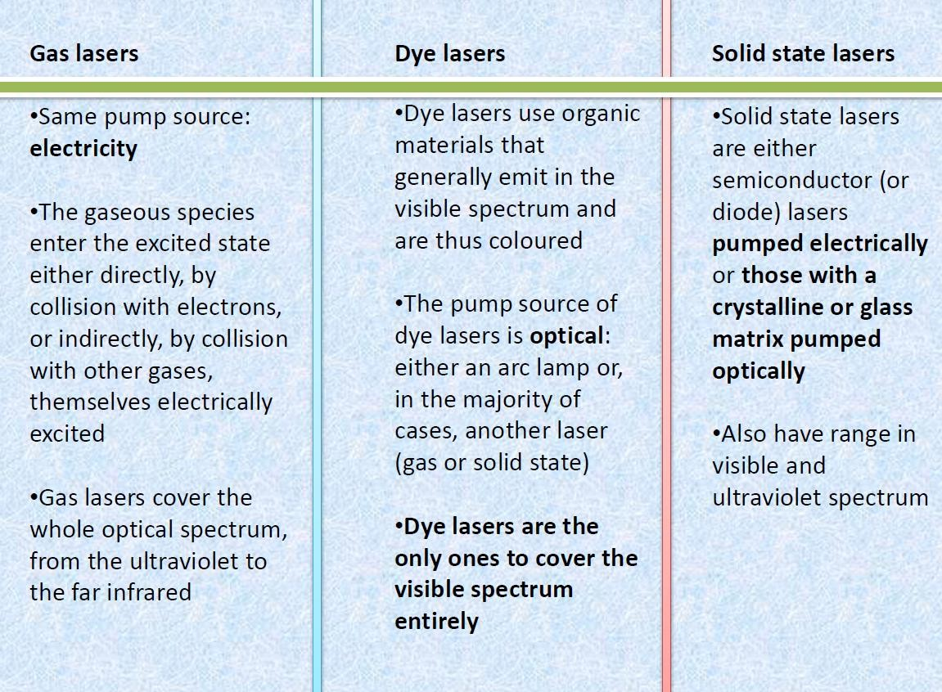

Slide 16
Laser parameters
Parameter | Definition | Unit
Energy | The number of photons delivered in a single pulse | Joules
Power | The amount of energy released per unit time | Watts (J/s)
Fluence (F) | It is a measure of the total density. Energy per unit area of incident tissue. | J/cm2 F= I x s
Power density/ Irradiance (I) | Power delivered per unit area of incident tissue It is a measure of intensity of laser beam. | W/cm2
Pulse duration/ pulse width | Time over which energy is delivered. | seconds
Wavelength | Distance between two peaks of the light waves | nm
Frequency/ pulse repetition rate | Rate at which single pulses are delivered | Hertz 1 Hz = 1 pulse per sec

Slide 17
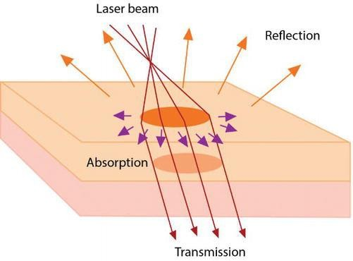

“Effect Of Laser On Skin Tissue”- Skin optics
When the skin is exposed to LASER, it could be:
Absorbed by the chromophores.
Reflected
Scattered
Transmitted

Slide 18


Grotthus-Draper photobiology law
In order to to have a biological effect in the tissue, light must be absorbed by the target tissue.
Light that is not absorbed but is scattered/ transmitted/ reflected has no true biological effect.

Slide 19
Chromophores (absorbing molecules)
Theses are specific Light absorbing target structures
Chromophores exhibit characteristic bands of absorption at certain wavelengths
When absorption occurs, the photon surrenders its energy to a chromophore.
Endogenous skin chromophores :
Melanin absorbs broadly across the visible and ultraviolet (UV) spectrum (400-1100nm)
Oxyhemoglobin and reduced hemoglobin in blood exhibit strong bands in the UV, blue, green and
yellow regions- (absorption spectrum 400-600nm)
Water has strong absorption in the near to far infrared (IR) region (2 peaks at 2490nm and
10,600nm)
Exogenous chromophore: Tattoo ink- depends on color of the ink

Slide 20
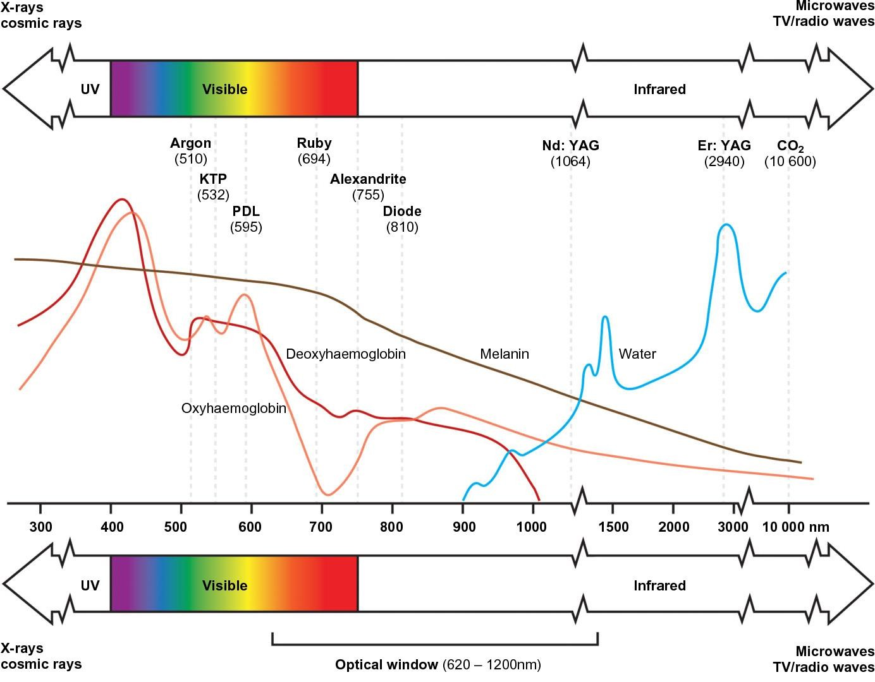

Slide 21
Penetration of laser depends upon:
Penetration of lasers
Absorption and scattering
Depth of penetration increases with wavelength
Spot size
In general, between 280 and 1300nm, the depth of penetration
increases with wavelength
Above 1300 nm, penetration decreases due to the absorption (trapping) of light in upper layers by water
The most deeply penetrating wavelengths are 650–1200 nm
the least penetrating wavelengths are within the far-UV and far-IR regions
Short wavelength will limit the penetration depth of the beam due to limitation by the strong scattering effect.
Longer wavelength, the scattering effect of the light is minimal deeper penetration of the light and it allows treatment of a deep dermal lesion.

Slide 22
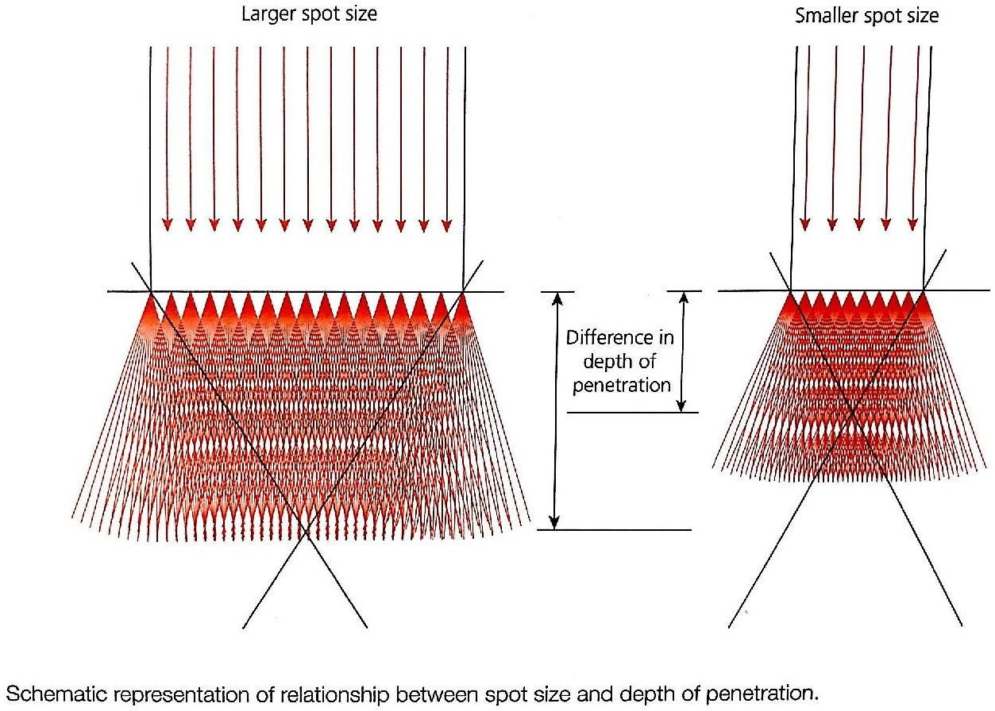

Slide 23
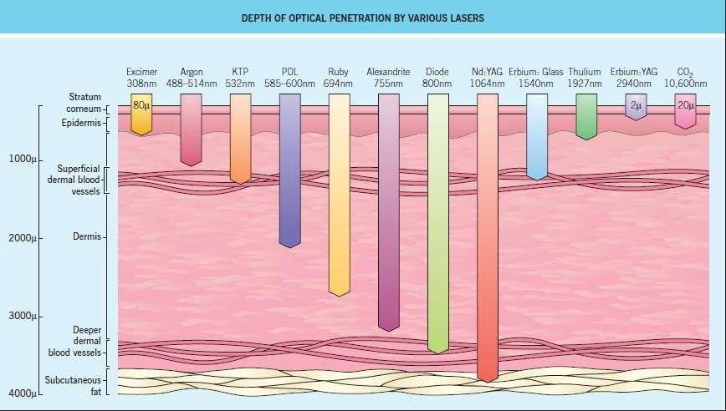

Slide 24
Photothermal effect:
Laser beam
Interaction with tissue Thermal energy/Heat Denaturation
Cell necrosis
Temperature | Molecular and tissue interactions
<50 | Hyperthermia leading to protein structural changes, hydrogen bond breaking, retraction
45-50 | More drastic conformational changes, enzyme inactivation, changes in membrane permeability, edema
>60 | Denaturation of proteins, DNA Coagulation of tissues
80-100 | Dehydration, dessication, blanching, shrinking of tissues
>100 | Vaporization, Tissue ablation

Slide 25
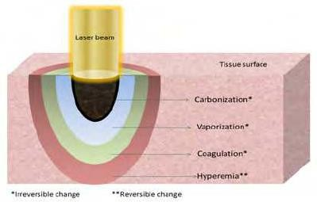
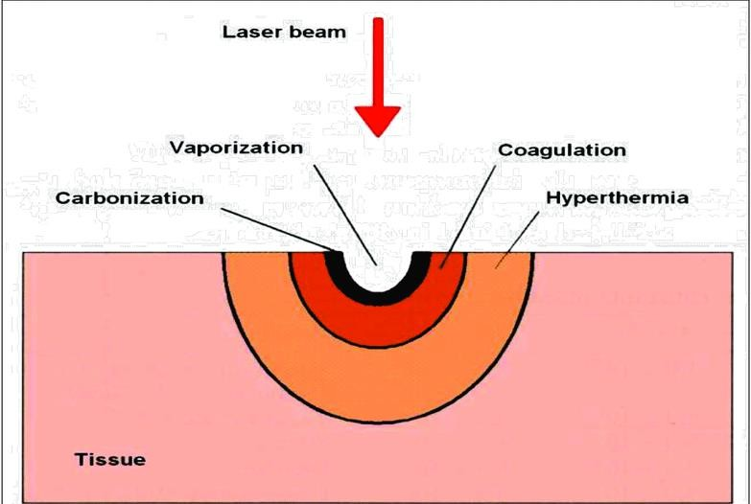
LASER tissue interaction

Slide 26
Thermal relaxation time (TRT)
Thermal relaxation time: It is the time required for a heated chromophore to dissipate 63% of its peak temperature.
If a chromophore is exposed to a laser for a time longer than its TRT it will result in collateral thermal damage and increased risk of complications.
Chromophore | Diameter | TRT
Erythrocyte | 1.5 microns | 2 micro sec
Melanosome | 0.5 microns | 0.25 micro sec
Hair follicle | 200 microns | 40 milli sec
Blood vessel | 0.1mm | 10 milli sec
 | 0.4mm | 80 milli sec

Slide 27
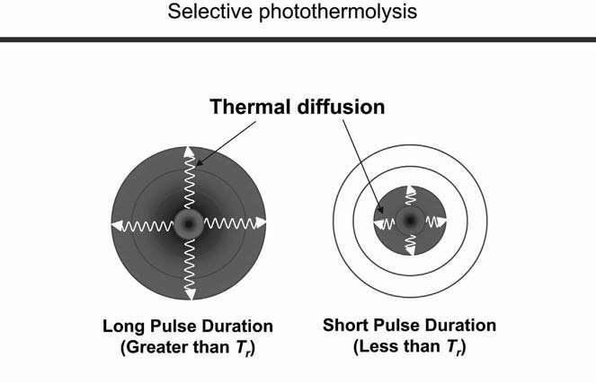
SELECTIVE PHOTO-THERMOLYSIS
Due to prolonged exposure to laser energy, there is collateral thermal damage to the surrounding tissue
Selectively destroying chromophore/target tissue without destroying surrounding
structures such as blood vessels, collagen etc by controlled destruction.
Factors governing Selective photothermolysis:
Wavelength
Pulse width/duration
Fluence/ energy density
Wavelength should be specific to absorption spectrum of the chromophore and penetrate deep enough to reach the target
Optimal pulse duration should be equal to or less that the TRT
Fluence should be high enough to destroy the
target within the pulse duration

Slide 28
SKIN COOLING
Epidermal melanin damage is the most undesirable side effect of LASER treatment.
If the target lesion is located in the dermis, laser has to pass through the epidermis which needs to be protected.
Three basic types of skin cooling
1. Pre-cooling
Pulsed dye and all Q-switched lasers (pulse durations shorter than ~5 milliseconds )
Cryogen spray
2. Parallel cooling
For pulses longer than ~5 milliseconds
Solid contact cooling with a cold sapphire window
pressed against the skin just before and during procedure
3. Post-cooling
– Bulk skin cooling before and after laser treatments (e.g. with ice or cold air) is useful for minimizing pain,
erythema and edema
All cooling methods extract heat at the skin surface via a cooling agent
Spray cooling/cold liquid - liquid fluorocarbon is sprayed on the skin
Solid contact cooling - cold sapphire window held against the skin, through which laser energy is delivered
Cold air or cold gels - passive skin cooling

Slide 29

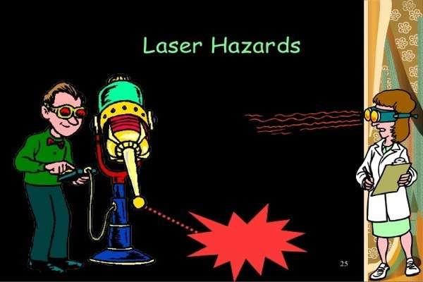
Laser hazards
Ocular hazards
Plume hazards
Electrical hazards
Fire hazard
Dye safety
Skin safety

Slide 30
Emergency management
Emergencies that may be seen during Laser procedure
Anaphylaxis | Commonly IV antibiotics, injectable lignocaine | Call for help Assess vitals Maintain ABC Oxygenation face mask Secure IV line Inj Adrenaline IV fluids in hypotension Transfer case to a hospital
Vasovagal Syncope | Usually related to anxiousness | Supine position or trendelenberg position helps in reveresing syncope Do not allow patient to get up suddenly Distraction by talking to patient helps

Slide 31
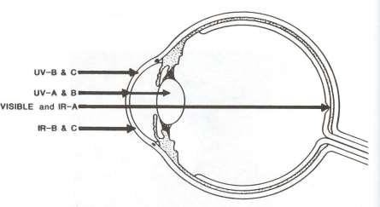
Hazards to the eye
The cornea and lens
Cornea is accessible to danger of UV and most of IR lasers. Far infra red 10600 nm Co2 laser is absorbed by water in cornea (78% aqueous composition)- causes corneal injury by thermal damage.
UV-A, UV-B (between 295nm and 320 nm) and
IR(between 1 to 2 mm) are dangerous for lens
Eg: 2490 Erbium : YAG laser can damage
cornea and lens
308-nm (UV-B) excimer XeCl laser is particular dangerous because of it can simultaneously damage the lens, the cornea and the retina.

Slide 32
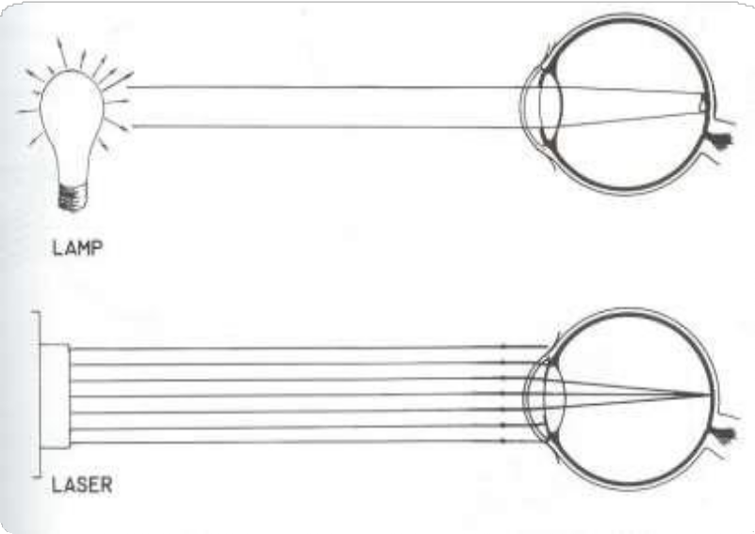
Hazards to eye
The retina
Retinal injury is related to absorption by melanin.
A collimated laser will be concentrated by a factor of 100,000 when passing from cornea to retina.
Visible or near IR lasers (400 -1400nm) are particularly dangerous to the retina.
Eg: 755 Alexandrite, 810 diode, 1064 Nd:YAG lasers can damage retina and lens.

Slide 33
GUIDELINES FOR EYE PROTECTION
The safety glasses must be specific to the wavelength of the laser being used
Protective eyewear should be labeled according to the optical density and wavelengths filtered
Eyewear and filters should be without defect. Frames should not be broken and separated from the lenses.
Side shields to protect against indirect exposure. Goggles should be adequately cleaned between treatments.
Corneal shields/ mini goggles- stainless steel, smooth polished concave surface but anodized convex surface.
Cover glass, mirrors, metal, polished surfaces in the room with opaque material.
Instruments should be anodized, roughened, ebonized with black fluropolymeric coating.
If an actual or suspected incident of eye exposure to laser happens, an eye examination should be carried out within 24 hours by an ophthalmologist

Slide 34
FIRE HAZARDS
Drapes, dry guaze, towels, dry hair, face masks and plastic materials can be ignited.
Greatest risk is with the CO2 and erbium: YAG lasers used for skin resurfacing and ablative fractional treatments
PREVENTION OF FIRES
Remember to place the laser in STANDBY mode when not actually treating the patient
Avoid inadvertently activating the laser foot-switch
Moisten any hair near the treatment field; remove mascara and eye makeup when working around Eyelids
Alcohol, acetone or other flammable skin-cleaning solutions must be allowed to completely dry before laser use
Reduce intraoperative oxygen concentration to <40%
A fire extinguisher and water should be readily available

Slide 35
“Plume” materials
INHALATION OF LASER GENERATED “PLUME MATERIALS
Particularly with resurfacing or vaporization of hair during its removal; latter can release irritating sulfur and other oxides.
Cytotoxic, mutagenic, disease transmission properties.
Chemical Contents detected: carbon monoxide, NH3, HCN, formaldehyde, benzene. They can produce upper respiratory irritation. Viral particles(HIV DNA, intact HPV DNA) have been detected in laser plumes of CO2 laser in treating warts/papillomatosis.
PREVENTION OF LASER “PLUME” BIOHAZARDS
Smoke evacuator , laser masks, good ventilation are most effective measures
Most Surgical masks filter upto 0.5um size , 77% Laser plumes are 1.1um or less in size.
Smoke evacuator should have specific attributes: suction unit or pump, filter, hose and inlet nozzle. The capture velocity should be about 30-50 cu feet per minute at the inlet nozzle. The filter should be high efficiency particulate air filter (HEPA).

Slide 36

Hyperpigmentation/ hypopigmentation
Blister formation, Milia, scarring
Wound infections/ delayed wound healing
Allergic Contact dermatitis
Postoperative erythema
Purpura
Cutaneous complications
Cutaneous burns
Can occur with essentially all dermatological laser, IPL, RF
or therapeutic ultrasound devices
Primarily due to improper device, dosimetry and/or treatment technique.
PREVENTION:
Appropriate cooling, proper technique, dosing

Slide 37
TIPS FOR SAFE LASER PRACTISE
Reflective jewellery worn by the operator and the patient should be removed before the treatment is commenced
Other dermatological procedures and activities must not take place in the laser theater while the laser is in use
When the laser is used, the number of persons in the room shall be kept to a minimum
The operator should be careful to avoid reflections of the beam from reflecting objects close to the beam and pay particular attention to the possibility of exposure of their own skin to the laser

Slide 38
TIPS FOR SAFE LASER PRACTISE
Whenever the laser is not under use, it must be switched off and the key withdrawn and placed in safe custody by the authorized operator
Lasers should be checked for proper operation and test fired prior to each procedure
The laser should be placed in the standby mode whenever it is not being fired, to prevent accidental firing into the field, prevent accidental fires, and preclude accidents that could occur if the laser and other foot pedals are confused and fired during a procedure
Only the operator and no other person should control the laser foot pedal or hand-switch
The laser foot pedal should be situated separately from other foot pedals such as electrosurgery.

Slide 39

TIPS FOR SAFE LASER PRACTISE
If oxygen is to be administered with in laser theater, in an emergency, minimum concentration of oxygen, preferably below 40%, should be used to oxygenate the patient with a laser resistant oxygen chamber
Before administering local anesthetic agents: Obtain history of xylocaine hypersensitivity
Never pass electrical cables over the patient
Avoid using spirit immediately before laser
Before laser surgery, wear surgical mask. The pore of the mask should be less than 1.0 micron. The mask should be covering the nose and mouth. Never put the used mask in apron’s pocket

Slide 40
Satish S Savant Textbook of dermatosurgery cosmetology
IADVL textbook of dermatology
Cosmetic dermatology Vol 2- Wiley
ACSI textbook on Cutaneous & aesthetic surgery
References

Slide 41
THANK YOU

