Slide 1

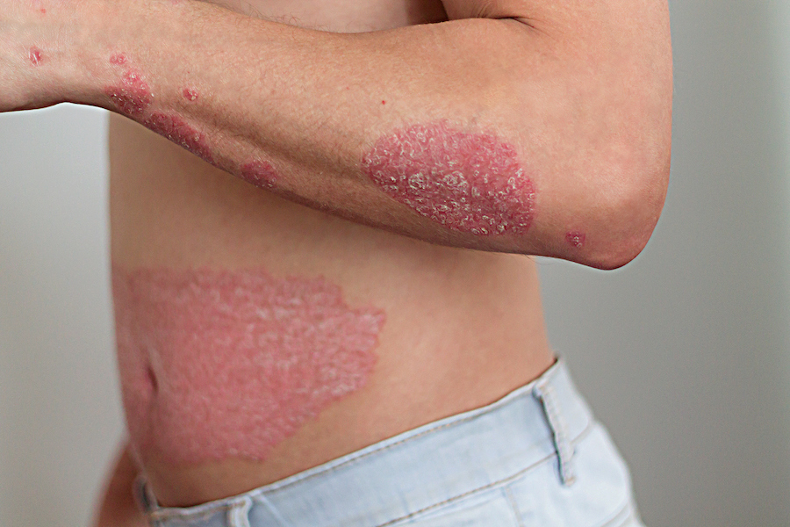
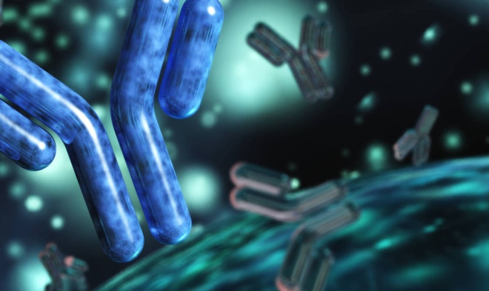
Biologics in psoriasis
-By Dr Yogesh Marfatia
Professor
SBKS MI & RC

Slide 2
BIOLOGICS
FDA definition- Biologicals include all substances derived from living material (human, plant, animal or micro-organism) and used for the prevention ,treatment or cure of disease in humans.
Large molecular-weight proteins that need to be injected
Biologics are generally divided into three major groups :
  Monoclonal antibodies
  Fusion antibody proteins
  Recombinant human cytokines and growth factors

Slide 3
Biologics in Psoriasis
Patients who are intolerant OR unresponsive to standard systemic therapy
Comorbidities which preclude the use of standard systemic agents.
Can be used as first-line therapy in patients having severe, unstable or life-threatening disease.
Category | Drugs
T cell activation inhibitors | Alefacept, Efalizumab
TNF-α antagonists | Infliximab, Adalimumab, Etanercept, Certolizumab
IL-17/IL-17R inhibitors | Secukinumab, Ixekizumab, Brodalumab
Anti IL 12/23 antibodies | Ustekinumab, Briakinumab
IL-23 inhibitors | Guselkumab, Tildrakizumab, Risankizumab
Anti CD6 antibody | Itolizumab

Slide 4
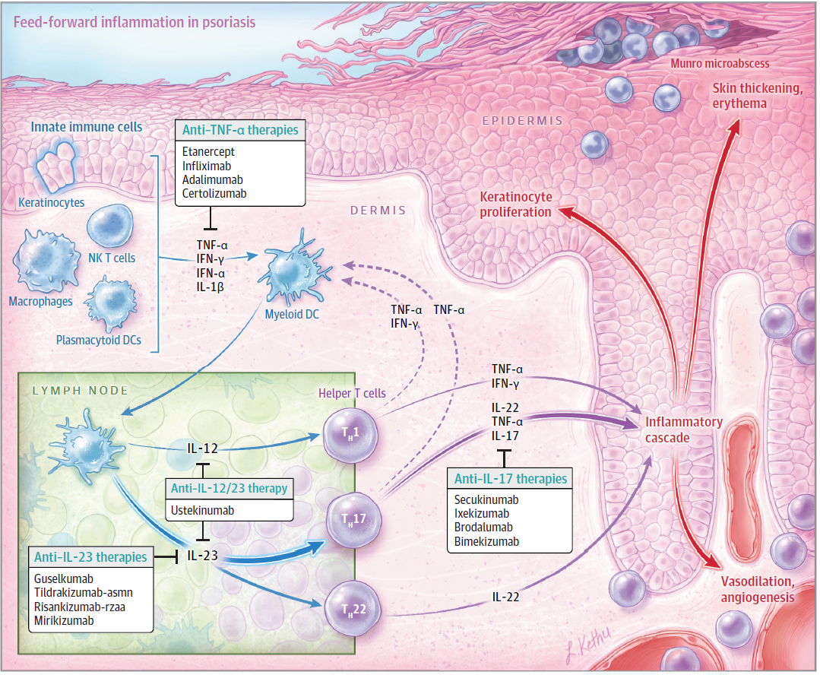
Biologics in Psoriasis
Pathophysiology, Clinical Presentation, and Treatment of Psoriasis
A Review
Armstrong, Read- JAMA 2020

Slide 5
T-Cell Targeted Biologics
Alefacept
Efalizumab
human lymphocyte function-associated antigen (LFA)-3/immunoglobulin (Ig) 1 fusion protein
binds to CD2 molecules on the surface
blocks co-stimulation of T-cells by APC
withdrawn – 2011 due to unjustifiable cost
monoclonal IgG1 antibody,
directed against CD11a, the -subunit of LFA-1.
blockade of the interaction betweenLFA-1 and ICAM-1
Withdrawn – 2009 due to risk of PML

Slide 6
TNF-α INHIBITORS
Cytokine representative of TH1 response
Soluble form in blood
Bound form on membranes of activated T cells
Effects-
  Recruits other inflammatory cells
  Production of IL-1, IL-6, IL-8
  Increases keratinocyte proliferation and decreased apoptosis
  Stimulation of VEGF production

Slide 7
Etanercept
Approved for treatment of psoriasis in 2004.
Recombinant human TNF-α receptor fusion protein.
Can bind two TNF -α molecules and act as a competitive inhibitor of endogenous TNF-α
ADA has been reported to occur in 0–18% of subjects receiving the drug
TNF-α receptor - 2 UNITS
Bind both soluble and membrane-boundTNF-
Human IgG (Fc portion)
Stabilizes the molecule

Slide 8
Etanercept
Dose- 50 mg given twice weekly for the first 12 weeks followed by 50 mg once weekly thereafter.
Route - Subcutaneous
PASI 50 was seen within 8 weeks and PASI 75 by 16 weeks
Efficacious in other forms of psoriasis such as pustular, erythrodermic, and palmoplantar.
*Parasramani SG, Pillai J. Biologics in psoriasis: Indian experience. Indian J Drugs Dermatol 2019;5:1-5
**Gordon K, Korman N, Frankel E, et al. Efficacy of etanercept in an integrated multistudy database of patients with psoriasis.
J Am Acad Dermatol. 2006;54(3 Suppl 2):S101-S111

Slide 9
Infliximab
Chimeric IgG1 monoclonal antibody
Neutralizes biological activity of TNF-α by binding soluble and membrane-bound TNF-α
Route : Intravenously
Dose : 5 mg/kg at weeks 0, 2, and 6 and thereafter every 8 weeks
Efficacious in the treatment of palmoplantar and nail psoriasis
Barker J, Hoffmann M, Wozel G, et al. Efficacy and safety of infliximab vs. methotrexate in patients with moderate-tosevere plaque psoriasis: results of an open-label, activecontrolled, randomized trial (RESTORE1). Br J Dermatol. 2011; 165(5):1109-1117.
*Sridhar J, Desylva P, Singh YD. Chimeric monoclonal antibody to tumor necrosis factor alpha (infliximab) in psoriasis. Indian J Dermatol Venereol Leprol 2006;72:133-5.

Slide 10
Adalimumab
Completely human IgG1 monoclonal antibody.
Binds to TNF-α, inhibiting its interaction with TNFα receptors
Route : subcutaneous injection
Dose: Adults: 80 mg week 0, 40 mg week 1, then 40 mg every other week
Effective in the treatment of palmoplantar, nail and scalp psoriasis
Used successfully in erythrodermic and generalized pustular psoriasis
PASI 50 was seen by week 1, PASI 75 by week 3, and PASI 90 by week 7 in an Indian study*
Parasramani SG, Pillai J. Biologics in psoriasis: Indian experience. Indian J Drugs Dermatol 2019;5:1-5

Slide 11
Certolizumab
Humanized antigen-binding fragment of a monoclonal antibody (50 kDa) conjugated with a 40-kDa polyethyleneglycol moiety
400 mg (given as 2 subcutaneous injections of 200 mg each) every other week.

Slide 12
Side effects of TNF inhibitors
Most commonly reported side effects include upper respiratory tract infections
Statistically significant increased risk of serious infections including sepsis and TB
1.08% developed TB despite of prophylactic screening before initiation of TNF - inhibitor.*
Neutropenia is common but usually mild and most patients do not require discontinuation
Risk of developing ADA
Serious infusion and delayed hypersensitivity reactions have been reported with infliximab
*Ergun, T.; Seckin, D.; Baskan Bulbul, E.; Onsun, N.; Ozgen, Z.; Unalan, P.; Alpsoy, E.; Karakurt, S. The risk of
tuberculosis in patients with psoriasis treated with anti-tumor necrosis factor agents. Int. J. Dermatol. 2015,
54, 594–599.

Slide 13
Side effects of TNF inhibitors
association with anti-TNF agents and demyelinating disease has been postulated
Postmarketing surveillance reports of severe hepatic reactions, hepatitis, cholestasis, and acute liver failure.
Sufficient evidence to substantiate a causal relationship with HF, demyelinating disease and hepatic disease unavailable

Slide 14
IL-12/IL-23 Inhibitor
Secreted by the myeloid dendritic cells upon activation
Induce the T-cell to differentiate into mature Th1-, Th17-, and Th22-cells
T-cell linages stimulate keratinocytes to proliferate and leads to an altered differentiation
Ustekinumab is a human IgG1 monoclonal antibody
Targets the shared protein subunit p40 of IL-12 and IL-23

Slide 15
Ustekinumab
Administered subcutaneously
Subcutaneous Adult Dosage Regimen:
  <100 kg, the recommended dose is 45 mg initially and 4 weeks later, followed by 45 mg every 12 weeks.
  >100 kg, the recommended dose is 90 mg initially and 4 weeks later ,followed by 90 mg every 12 weeks.
ADA occured in 4–6% of patients treated.
Efficacy was maintained over for at least 3 years.
Reich K, Pinter A, Lacour JP, et al. Comparison of ixekizumab
with ustekinumab in moderate-to-severe psoriasis: 24-week
results from IXORA-S, a phase III study. Br J Dermatol. 2017;
177(4):1014-1023.

Slide 16
Side Effects
Most frequent are nasopharyngitis, upper respiratory tract infection, headache, and fatigue.
TB has only been reported in one case report and one clinical trial
No increased risk of serious infections and malignancies compared with placebo

Slide 17
Side Effects
Review of data from phase II and III trials did not demonstrate an increased risk of Cardiac events.
Cumulative rates of serious adverse events leading to the discontinuation of the drug were comparable in 45 mg and 90 mg group
Rarely, reversible lymphomatoid drug eruption have occurred
Safer profile of ustekinumab compared with the TNF- inhibitors

Slide 18
IL-17 INHIBITORS
IL-17 cytokine family has six members IL-17 A-F
IL-17A and IL-17F mediate pro-inflammatory response
IL-17B, C and D biological function is largely unknown.
IL-17C in mucosal immunity and autoimmune responses
IL-17E regulates Th 2 response against parasites and allergic inflammation.
T-helper cells express proinflammatory IL-17
Cascade of cytokines and cellular mediators like IL-1, IL-6 and TNF-α

Slide 19
Resulting in
  Thickening of the epidermis with clustering of CD8 T cells and neutrophils
  Keratinocyte proliferation
  Markedly reduced granular layer
  Dilation of blood vessels in the papillary dermis

Slide 20
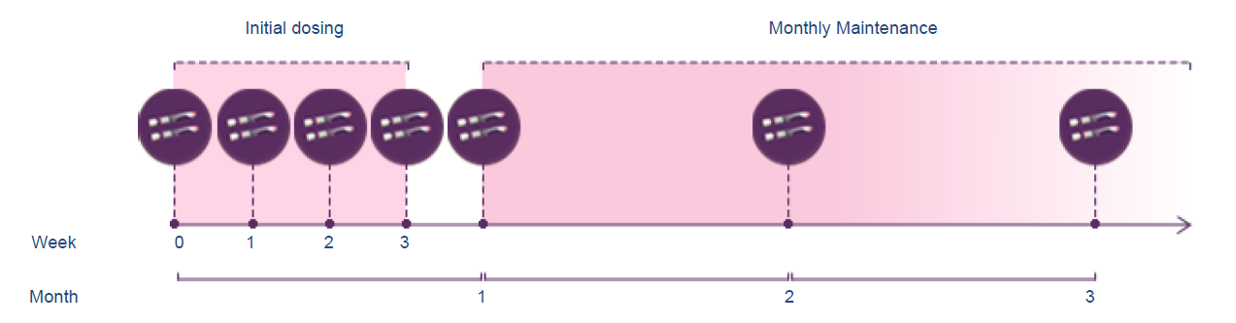

Secukinumab
Fully human monoclonal IgG1 antibody
Binds and neutralizes the proinflammatory cytokine IL-17A.
Route: Subcutaneous
The recommended dose is 300 mg
Langley RG, Elewski BE, Lebwohl M, et al. Secukinumab in
plaque psoriasis results of two phase 3 trials. N Engl J Med.
2014;371(4):326-338.

Slide 21
Secukinumab
Efficacy of secukinumab was maintained for at least 52 weeks .
0.4% of developed anti-drug antibodies with minimal effect on response to treament.
Favorable safety profile in patients with moderate to severe plaque psoriasis
Parasramani SG, Pillai J. Biologics in psoriasis: Indian experience. Indian J Drugs Dermatol 2019;5:1-5

Slide 22
Special populations
Renal impairment / hepatic impairment
  Has not been studied specifically in these patient populations.
Pediatric patients
  Safety and effectiveness in pediatric patients below the age of 18 years have not yet been established.
Geriatric patients
  No dose adjustment is required.

Slide 23
Ixekizumab
Humanized IgG4 monoclonal antibody that neutralizes IL-17A
Route: self-administered subcutaneous injection
Dose:
  initial dose of Ixekizumab is 160 mg
  followed by 80 mg on weeks 2, 4, 6, 8, 10, and 12
  followed by 80 mg every 4 weeks.
Highly effective for genital psoriasis regardless of the body surface area
Griffiths CE, Reich K, Lebwohl M, et al. Comparison of ixekizumab with etanercept or placebo in moderate-to severe psoriasis (UNCOVER-2 and UNCOVER-3): results from two phase 3 randomised trials. Lancet. 2015;386(9993):541-551.

Slide 24
Brodalumab
Human monoclonal antibody that binds to IL-17 receptor A
Blocks the biologic activities of IL-17A, IL-17F and IL-17E
Route : self-administered subcutaneous injection
Dose :
  210 mg by weeks 0, 1, and 2
  followed by 210 mg every 2 weeks
Antibodies has been demonstrated. However, no neutralizing antibodies were detected
de Carvalho AV, Duquia RP, Horta BL, Bonamigo RR. Efficacy
of immunobiologic and small molecule inhibitor drugs for
psoriasis: a systematic review and meta-analysis of randomized
clinical trials. Drugs R D. 2017;17(1):29-51.

Slide 25
Bimekizumab
Humanized monoclonal IgG1 antibody
Selectively neutralizes both IL-17A and IL-17F, functioning as a dual inhibitor
Spares IL-17E, unlike brodalumab

Slide 26
Side Effects
Most common adverse events include nasopharyngitis, URTI , injection-site reaction, and nausea.
Candidal infections occurred significantly more frequently
However, all Candida infections were mild or moderate in severity and easily treated.
No cases of reactivation of latent TB were reported

Slide 27
Side Effects
Greater frequency of Crohn’s disease and ulcerative colitis, including exacerbation of pre-existing IBD
Risk of adverse cardiovascular and cerebrovascular events did not differ with placebo
However, low serum levels of IL-17 have been linked to repeat myocardial infarctions.

Slide 28
Guselkumab
Monoclonal antibody that blocks the p19 subunit of IL-23.
Dose -100 mg at week 0, week 4, and every 8 weeks thereafter; SC
Neutralizing antibodies were generally not associated with decreased efficacy or development of injection-site reactions.
Reich K, Armstrong AW, Foley P, et al. Efficacy and safety of
guselkumab, an anti-interleukin-23 monoclonal antibody,
compared with adalimumab for the treatment of patients
with moderate to severe psoriasis with randomized withdrawal
and retreatment: results from the phase III, doubleblind,
placebo- and active comparator-controlled VOYAGE 2
trial. J Am Acad Dermatol. 2017;76(3):418-431.

Slide 29
Tildrakizumab
Route : self-administered subcutaneous injection
Dose : 100 mg at weeks 0 and 4 and then every 12 weeks thereafter.
Neutralizing antibodies leading to lower serum concentrations of tildrakizumab and reduced efficacy demonstrated
Reich K, Papp KA, Blauvelt A, et al. Tildrakizumab versus
placebo or etanercept for chronic plaque psoriasis
(reSURFACE 1 and reSURFACE 2): results from two
randomised controlled, phase 3 trials. Lancet. 2017;
390(10091):276-288

Slide 30
Risankizumab
Route : self-administered subcutaneous injection
Dose : 90-mg or 180-mg doses at weeks 0, 4, and 16
No data available on antidrug antibodies
Papp KA, Blauvelt A, Bukhalo M, et al. Risankizumab versus
ustekinumab for moderate-to-severe plaque psoriasis. N Engl
J Med. 2017;376(16):1551-1560.

Slide 31
Itolizumab
Anti CD6 antibody
Available in India as Alzumab
DCGI approval in 2013
Available in 25 mg/5 ml vials
Given by infusion, and the recommended dose is 1.6 mg/kg body weight.
Biweekly for 3 months and once a month for 3 months.
No treatment-related severe adverse effects necessitating discontinuation or reduction of drug dosage were noted.

Slide 32
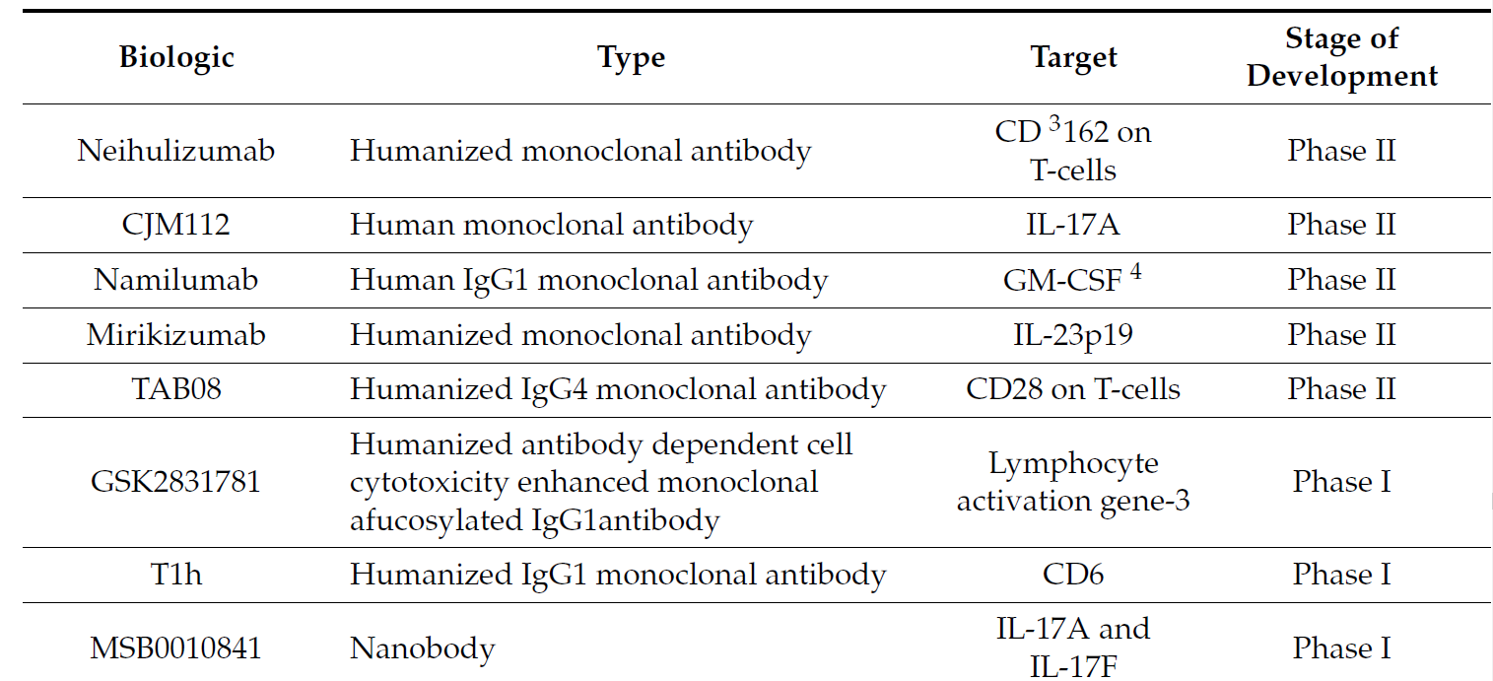
Biologics under development for psoriasis

Slide 33
Biologics under development for psoriasis
Drug | Target
Clazakizumab | IL-6
Tregalizumab | C2 type 1 domain of CD-4
ABT-122 | IL-17A and TNF inhibitor
Biologics under development for generalized pustular psoriasis
Drug | Target
Spesolimab | IL-36
ANB019 | IL-36
Generalized Pustular Psoriasis: Clinical Management and Update on Autoinflammatory Aspects
Takuya Takeichi & Masashi Akiyama
American Journal of Clinical Dermatology volume 21,227–236(2020)

Slide 34
IBD
  All except secukinumab (IL-17 Inhibitors) can be used
Risk of malignancy
  monotherapy in patients with moderate-to-severe psoriasis are not associated with a risk of solid tumor or lymphoreticular malignancy
  Biologics other than TNF inhibitors may be preferred.
History of solid tumor malignancy
  Pts who have failed other therapies such as phototherapy, methotrexate, and/or acitretin
  Can be given biologics

Slide 35
Biologics in tuberculosis
1.08% developed TB despite of prophylactic screening before initiation of TNF inhibitors.*
Reported in one case report and one clinical trial of Taiwanese patients receiving ustekinumab for psoriasis
No clinical studies indicate an association between IL-17 inhibitors and development of active TB
All candidates for biologics should be screened for TB and treated before initiation.
Rønholt K, Iversen L. Old and new biological therapies for psoriasis. Vol. 18, International Journal of Molecular Sciences. MDPI AG; 2017

Slide 36
Vaccination
Inactivated or ‘‘dead’’ vaccines may be given during treatment with all biologics.
Discontinuation of all biologic agents is recommended before administration of a live vaccine.
Discontinuation of biologics 2 to 3 half-lives before and after administration of live vaccines is advised.

Slide 37
BIOLOGICS AND SURGERY
All biologics can be continued through low-risk surgical procedures in patients with psoriasis.
Moderate- and high-risk surgical procedures require a case-by-case approach.
Biologic agent could be discontinued approximately 3 to 4 half-lives before and until 1 to 2 weeks after elective surgery

Slide 38
PEDIATRIC POPULATION
Limited evidence for the treatment of pediatric patients with biologic agents.
Etanercept is the only biologic approved for plaque psoriasis in children aged 4 to 17
Ustekinumab is approved for plaque psoriasis in adolescents aged 12 to 17.
Adalimumab is FDA-approved for children with CD≥ 6 years and JIA≥ 2 years but not FDA-approved for children with Psoriasis.
EMA has approved adalimumab in children 4 years or older with Psoriasis.

Slide 39
Pregnancy and Lactation
Anti-TNF-α antibody therapy is feasible throughout pregnancy(Grade of recommendation- B)
Only minimal concentrations of anti-TNF-α antibodies are detected in breast milk
Due to insufficient data, application of other biologics during pregnancy and lactation should be avoided.
Puchner A, Gröchenig HP, Sautner J, Helmy-Bader Y, Juch H, Reinisch S, et al. Immunosuppressives and biologics during pregnancy and lactation: A consensus report issued by the Austrian Societies of Gastroenterology and Hepatology and Rheumatology and Rehabilitation. Wien Klin Wochenschr [Internet]. 2019

Slide 40
Biologics and COVID-19
Patients on biologics were at higher risk of testing positive for COVID-19.
Risk of being hospitalized was higher.
TNFα, IL-17, IL-6, IL-8, and IL-1, play a pivotal role in driving the hyperinflammatory final stage of COVID-19
Inhibition of pro-inflammatory cytokines seems to be fundamentally beneficial in the hyperinflammatory phase
Biologics increase the risk of SARS‐CoV‐2 infection and hospitalization, but not ICU admission and death: Real‐life data from a large cohort during red‐zone declaration
Giovanni Damiani,Bragazzi,Malagoli;May 2020

Slide 41
Comparison of biologics-Cost in India
Drug | Cost(₹)/ Unit | Total cost(₹) for 52 weeks
Etanercept | 8700/ 25 mg | 11,13,600
Infliximab | 41000/ 100 mg | 9,84,000*
Adalimumab(Exemptia) | 25000/ 40 mg | 7,00,00 – 7,50,000
Ustekinumab | 140000/ 45 mg | 8,40,000*
Secukinumab | 15000- 20000/ 150 mg | 6,40,000
*in an individual weighing 60 Kg

Slide 42
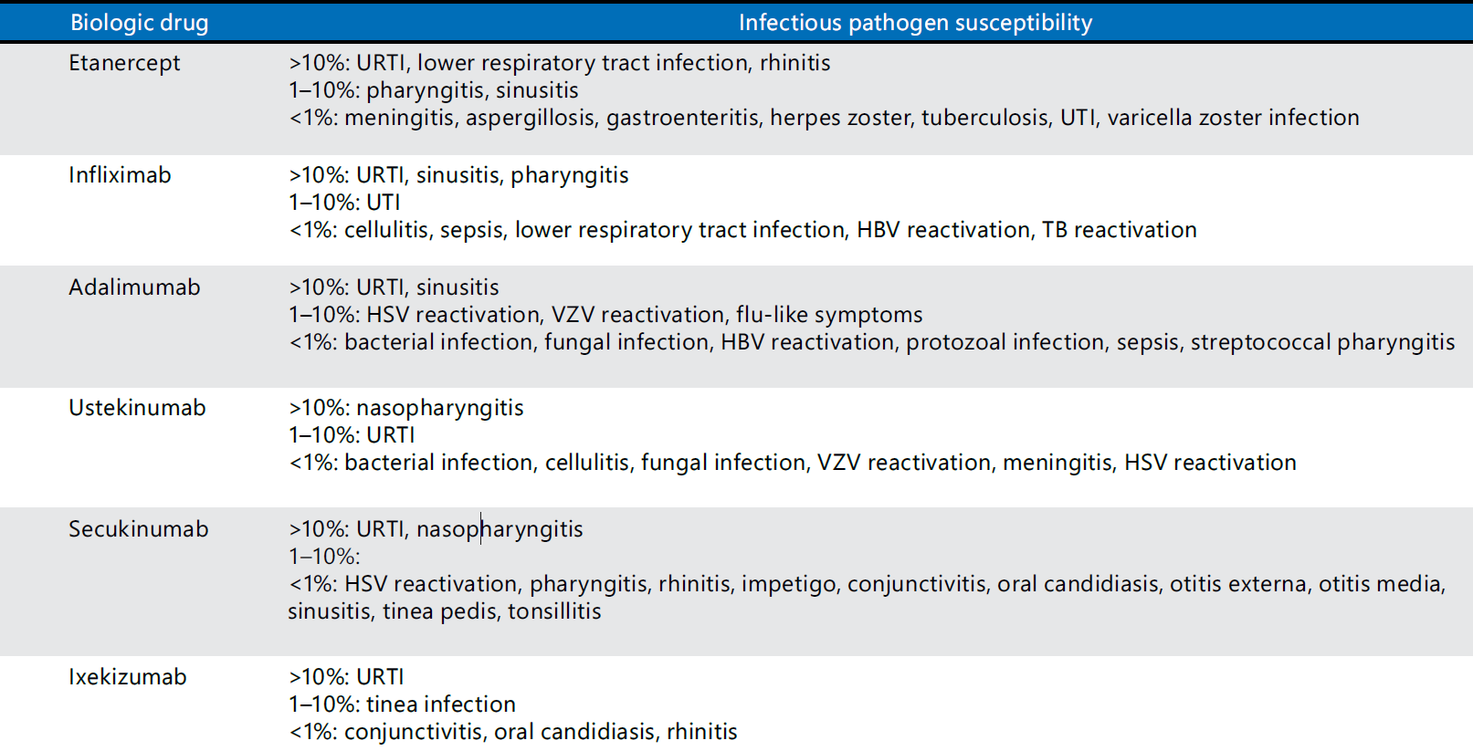
Comparison of biologics- Infections

Slide 43
Biologic Fatigue
The precise mechanism that causes clinical decline is not entirely understood
associated with an immune-mediated mechanism
antibodies are developed via a T-cell-dependent humoral response
  Form immune complexes that interrupt drug end target interaction
  Increase drug clearance

Slide 44
Clinical strategies to reduce the impact of biologic fatigue
Increasing the dose of the biologic medication to maintain therapeutic efficacy (i.e., “dose-creep”)
Counseling about the risk of biologic fatigue
Counseling about importance of consistent use
Concomitant immunosuppression with methotrexate, especially in patients on infliximab

Slide 45
Conclusion
High rates of complete clearance of psoriasis have been reported with biologics that target IL-17 or IL-23.
long-term maintenance of clinical response is observed with the newer biologics.
Brodalumab has the earliest onset of efficacy.
Newer biological agents have low risk of serious infections or malignancies.
Cost and availability are a major disadvantage.
Newer biological agents need further evaluation for more widespread use.

Slide 46
Thank you

