Slide 1
BOTULINUM TOXIN
By- Dr Pratiksha Rathwa
Asisstant Professor
SBKS MI & RC

Slide 2
BOTULINUM TOXIN
Botulinum toxin is produced by a gram-positive anaerobe, clostridium botulinum.
Seven toxin subtypes, A, B, C (c1, c2), D, E, F, and G.
A and B are available for use by clinicians.
The term Botulism is derived from the latin word “botulus” meaning sausage

Slide 3
Botulinum toxin is synthesized as a single chain neurotoxin (150 kd) that undergoes an endogenous proteolytic conversion to a di-chain molecule.
This conversion is essential for clinical activity.
Botulinum toxin works by temporary chemo denervation by inhibition of release of acetylcholine at the neuromuscular junction.
It works on cholinergic efferent motor and efferent autonomic pathways, through a multistep process—binding to nerve terminals, internalization, and inhibition of calcium-dependent neurotransmitter release.

Slide 4
Three steps to Botulinum toxin action
Binding
Translocation or internalization
Inhibition of transmitter release
Binding
Brought about by carboxy-terminal of the heavy chain.
Attach to receptors on presynaptic nerve terminals, cholinergic.
Specificity varies for different serotypes.

Slide 5
Translocation or internalization
Receptor-mediated endocytosis.
Energy-dependent process.
Nh2 terminal of heavy chain forms pore for entry of light chain.
Inhibition of transmitter release
Endocytotic ph dependent conformational change in toxin; disulfide bond broken and light chain released.
Serotype-specific light-chain cleavage of one or more snare proteins (involved in vesicle docking and fusion), requires intramolecular zinc.
Resultant inhibition of ach release at neuromuscular junction.

Slide 6
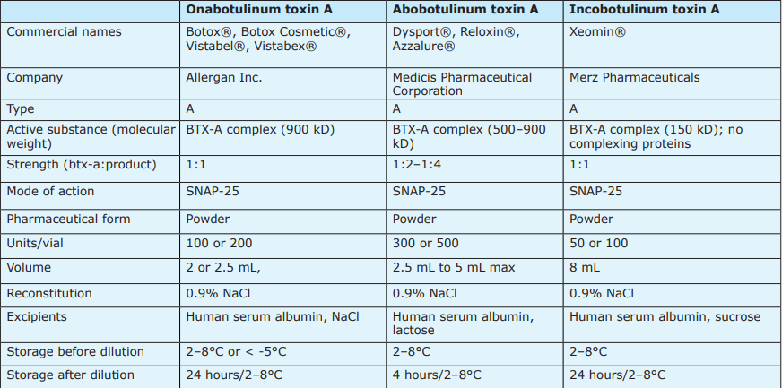

Slide 7
Onabotulinum toxin A: Botox, Botox cosmetic
Abobotulinum toxin A: Dysport
Incobotulinum toxin A: Xeomin
Botulinum toxin has a clinical onset of action approximately 12–72 hours after injection, with a peak effect at 1–3 weeks. Effects then plateau for 2–3 months, with patients often requiring reinjection approximately every 4–6 months.
Masseters, the maximal cosmetic benefit is seen around 6–8 weeks after injecting the botulinum toxin and the result lasts for 8–12 months.
A vial of 100 units of onabotulinum toxin and 100 units of incobotulinum toxin contains 100 U of neurotoxin, 0.9 mg of sodium chloride in a sterilized, vacuum-dried preservative-free form and 0.5 mg of human albumin.

Slide 8
Indications of Botulinum Toxin
Cosmetic indications for botulinum toxin
Forehead lines
Glabellar or frown lines
Crow’s feet
Eyebrow lift
Infra-orbital lines
Bunny’s lines or nasal scrunch lines
Nasal-tip elevation
Nasal flare
Gummy smile
Perioral rhytides
Marionette lines
Popply chin
Platysmal bands
Nefertiti Lift
Masseter hypertrophy
Calf muscles hypertrophy
Temporal hypertrophy
Breast elevation

Slide 9
Noncosmetic indications of botulinum toxin
Hyperhidrosis
Painful hypertrophic scars
Juvenile cerebral palsy
Skeletal muscle hyperactivity
Smooth muscle conditions
Adult spasticity
Postherpetic neuralgia
Migraine

Slide 10
Contraindications of botulinum toxin
Absolute
Infection at the injection site
Pregnancy and lactation
Hypersensitivity to any of the components of botulinum toxin (toxin itself, human albumin, sodium chloride, sodium succinate, lactose)
Relative
Neuromuscular disorders such as myasthenia gravis, Eaton lambert syndrome
Concomitant use of aminoglycosides, cholinesterase inhibitors, penicillamine, calcium channel blockers, quinidine
People with unrealistic expectations or body dysmorphic disorder

Slide 11
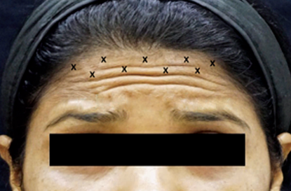
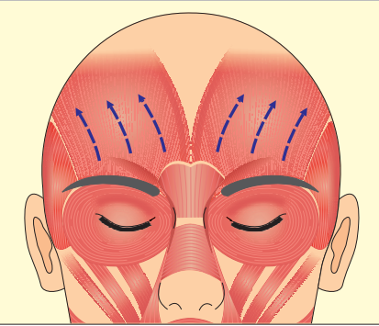
Injections in the Upper Face
These lines are seen running horizontally across the forehead, accentuated when the patient raises the eyebrows and looks up, varying from one single line high up to multiple lines of different lengths across the forehead.
The muscle responsible is the frontalis which is the only brow elevator of the face.
Injection technique: . Inject 1 U per injection site spaced 1–2 cm apart keeping the needle at a 60 degree angle and pointing upward.

Slide 12
DOSE:
5–7 units are sufficient for female patients.
7–12 units are required in male patients.
Always inject in the upper two-third of the frontalis, avoid the lower third, the area 2 cm above the upper eyebrow margin, or 2–3 cm above the actual bony orbital margin.
Never forget to inject the lateral fibers of the frontalis muscle
SIDE EFFECTS:
Brow ptosis: Injections in the frontalis close to the brow can cause diffusion into brow depressors.
Quizzical brow or Spock’s brow: This develops when only the central fibers of frontalis are injected and lateral fibers remain unopposed.
Eyelid ptosis: Downward diffusion of toxin into the levator palpebrae superioris muscle due to poor technique

Slide 13
Glabellar Lines
Frown or glabellar lines are seen as two lines between the brows and are usually associated with negative feelings such as worry, irritation, anger, or frustration.
The corrugators, depressor supercilii, procerus, medial fibers of orbicularis oculi, and lower fibers of frontalis are the muscles responsible for frown lines.
Injection technique:
The corrugator muscle is deep medially, but becomes superficial laterally, and inserts into the skin above the eyebrow.
This point can be appreciated as dimpling in the skin when the patient frowns.
The thumb of the nondominant hand is placed over the orbital rim and the base of the muscle is supported

Slide 14
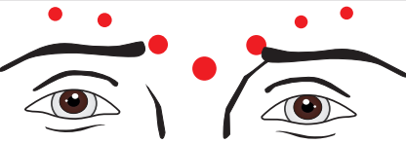
toxin is then slowly injected into the muscle.
A second injection point is more superficial, just medial to the point of insertion of the corrugators.
A third injection is given directly into the procerus muscle which lies between the two brows.
Dose: 10–12 units in females, 12–15 units in males
Side effects:
Lid ptosis: Large doses or improper technique can lead to diffusion along the orbital septum and cause paralysis of levator palpebrum superioris.
Asymmetrical eyebrows: A preexisting asymmetry that may have gone unnoticed before injections, get enhanced post-injections

Slide 15
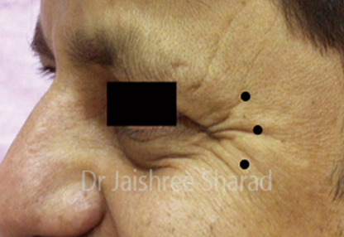
Crow’s Feet
These lines run diagonally from the lateral canthus to the temples
The lateral fibers of orbicularis oculi muscle are lateral brow depressors responsible for crow’s feet.
Injection technique: Ask the patient to squint
The recommended dose is 8–10 units per side in females and about 10–12 units per side in males.
Stay away from all visible blood vessels in order to prevent obvious bruising

Slide 16
Side effects:
Lip ptosis or asymmetrical smile occurs when the injection is placed below the zygomatic arch, or too much of botulinum toxin is injected into the orbicularis oculi muscles close to the zygomatic arch.
Cheek ptosis or drop: The inferomedial fibers of orbicularis oculi are cheek elevators, Injecting too medially into these fibers can cause cheek ptosis.
Fixed smile, loss of smiling eyes, or a Duchenne smile occur due to overcorrection or total paralysis.
Lagophthalmos:Due to loss of sphincteric action of orbicularis
Diplopia: Due to weakening of lateral rectus and inferior oblique if you inject medial to the orbital rim
Ectropion: Weakening of lateral sling of orbicularis

Slide 17
Infraorbital Wrinkles
Lower fibers of orbicularis oculi.
Injection technique: Inject 1–2 U of botulinum
toxin 2–3 mm below the lower lid margin in the midpupillary line raising a bleb
Avoid injecting medial to the midpupillary line.
Stay superficial, as the skin here is thin and muscle is superficial.
Avoid in older patients with a positive snap test.
Side effects:
Pseudoherniation or worsening of under-eye fat bags can occur in older individuals with lax, inelastic skin and an already weak muscle
Lagophthalmos, epiphora, and dry eye, if injections are given medial to the midpupillary line

Slide 18
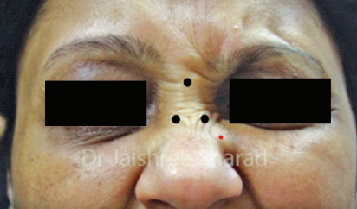
Nasal Lines, Bunny Lines, or Botox Sign
These are seen as diagonally radiating lines, on either side of the nasal bridge, from the medial canthus toward the nasal alae.
Muscle involved: Contraction of the transverse nasalis and partly due to the levator palpebrae superioris alaeque nasi.
Injection technique: The belly of the nasalis in the lateral walls of the nose is injected with 2–4 U on either side to raise a wheal.

Slide 19
Side effects:
Lip ptosis: Diffusion into fibers of the LLSAN or LLS fibers if injected too lateral.
Epiphora: Can occur if the injection is given higher and too medial causing diffusion into medial rectus.

Slide 20
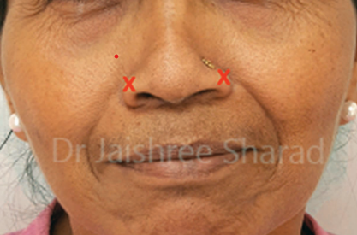
Nasal Flare
Contraction of the alar part of the nasalis causes nasal flare.
Inject 4–8 U into the center of the ala after asking the patient to flare their nares

Slide 21
Nasal-Tip Elevation
Droop of the nasal tip should be treated only in those cases where the nasal tip pulls the cutaneous part of the upper lip downward.
Depressor septi.
Injection technique: The patient is asked to pull the upper lip down and 2–4 U are injected into the columella, just above the columella and lip junction.
Side effects:
Elongation of the upper lip with a loss of definition of the philtrum, if the toxin diffuses into the upper lip levators when the injection site is lower

Slide 22
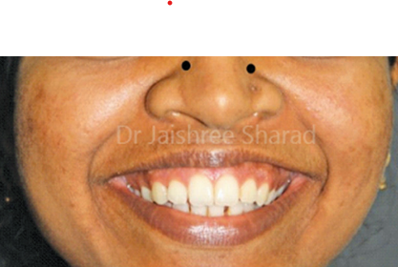
Gummy or Gingival Smile
Exposure of more than 2 mm of the upper gums while smiling is called the gummy smile. It can sometimes be esthetically unappealing.
Muscle involved: LLSAN.
Injection technique: Palpate the LLSAN muscle in the nasofacial groove while the patient is smiling and inject 1–2 U of BTX into this groove
Side effects:
Upper lip ptosis due to the diffusion of toxin into the upper-lip elevators
Oral incompetence due to diffusion into the fibers of orbicularis oris

Slide 23
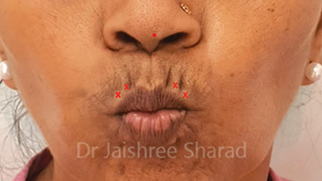
Perioral Rhytides or Smokers’ Lines
These lines are seen radiating outward from the vermilion of the lip.
Muscle involved: Orbicularis oris.
Injection technique: Inject 1–2 units over 2–4 points on the upper lip, 3–5 mm from the lip vermilion.
Side effects:
Flattening of the philtrum edges due to injections in the center of the philtrum/upper lip.
Difficulty in pouting, puckering, whistling, or sucking liquids through a straw due to larger doses.

Slide 24
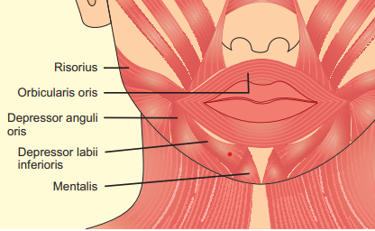
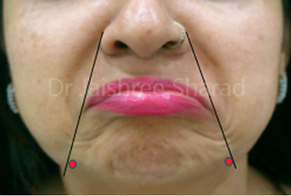
Mentolabial Folds or Marionette Lines
These folds are caused by the downward pull of the depressor anguli oris at the angle of the mouth giving a sad look to an individual.
Injection technique: 2–5 U of toxin is placed a the intersection of the vertical extension of the nasolabial line at the mandibular border.

Slide 25
Side effects:
Lower lip flattening due to diffusion into the depressor labii inferioris. This occurs due to deep injections, larger doses, or if DAO is injected in its mid- or upper-third.
. Asymmetric smile, drooling, and inability to pucker the mouth due to diffusion into the orbicularis oculi fibers resulting from high injections.

Slide 26
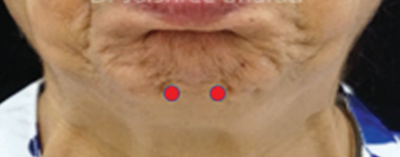
Cobblestone or Popply Chin
A hyperactive mentalis produces multiple dimpling called peau d’orange on the skin.
Muscle involved: Mentalis
Injection technique: Ask the patient to evert the lower lip and pull the chin up. Inject 2–3 U into each belly of the mentalis with needle at 90° to the skin surface.
Stay below the transverse mental crease

Slide 27
Side effects:
Asymmetry and lower lip incompetence if injections are placed too high or too far apart, laterally affecting the fibers of the depressor labii inferioris
Oral sphincter weakness or incompetence, if injection is higher into the fibers of the orbicularis oris.
Drooling and dribbling due to high doses

Slide 28
Masseter Hypertrophy
Botulinum toxin is injected into masseters in those having a square face or broad jaws.
Muscle involved: Masseter
Injection technique: A line is drawn from the lower tragus to the corner of the lips.
inject at three points rather than five. 15–30 U are injected into each side of the face with a 30 gauge, 1 inch long needle.
Do not inject patients who have a fat bulge, mandibular bone prominence, and sagging facial tissues

Slide 29
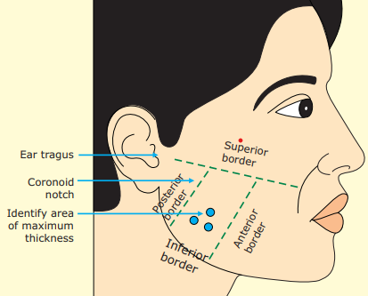
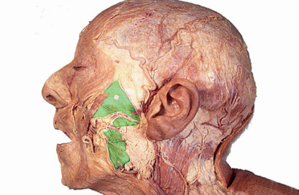

Slide 30
Side effect:
Asymmetrical smile, if the injections are given higher up due to diffusion into the zygomaticus major or minor muscles, or are given closer to the anterior border of the muscle where chances of diffusion into risorius muscle are high.
Difficulty opening the mouth due to diffusion into the pterygoids if injected very deep

Slide 31
Neck Bands
Neck bands are seen in older people or in people who exercise a lot.
Muscle involved: Platysma
Platysma is a superficial, sheet-like muscle extending upward from the lower neck and inserting into the upper neck and lower face.
Injection technique: Ask the patient to make the platysmal bands prominent by clenching his teeth and trying to pull the angle of the mouth out and downward.
Hold the band in between the index finger and thumb of the nondominant hand.
Inject 1–2 U all along the band at 1–1.5 cm interval , 10–30 U for females and 10–40 U for males

Slide 32
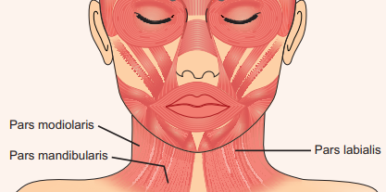
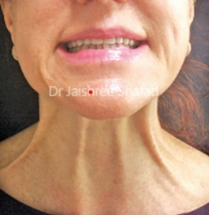

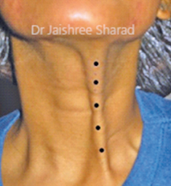

Slide 33
Side effects:
Difficulty in deglutition and phonation can occur if injections are given deep in the neck or if there is diffusion into laryngeal, strap, and cricothyroid muscles due to high doses into the platysma.
Inability to hold the head erect if botulinum toxin is injected into the sternocleidomastoid.

Slide 34
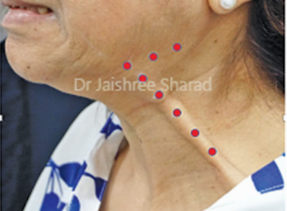
Nefertiti Lift
Nefertiti lift, described by Dr Philip Levy, helps to alter the dynamics of muscle pull of the ageing face that leads to loss of definition at the jawline.
Negating the effect of the downward pull of the platysma helps the normal activity of the other facial muscles to pull at the jawline in an upward vector, restoring the definition.
2–3 U of botulinum toxin are injected into the upper part of the posterior platysmal band, and along the mandible on each side, a little under the mandible.

Slide 35
Complications of Botulinum Toxin
Injection-related:
1. Erythema
2. Swelling
3. Bruising
4. Pain
5. Transient numbness and paresthesias
6. Itching
7. Infection
8. Urticarial reaction

Slide 36
Systemic Complications:
Temporary headache
Hypersensitivity/allergic reactions: In rare cases, generalized pruritis, rashes, granuloma, anaphylactic reactions
Treatment failure: If suboptimal doses are used or the wrong muscle targeted
Generalized reactions: Rarely reported in esthetic cases.
Fatal reactions: Fatal poisoning with botulinum toxin has been known after oral ingestion. Systemic absorption with injected BTX for esthetic indications is minimal.

Slide 37
Conclusion
Botulinum toxin has shown very good efficacy and safety record for esthetic indications.
Results can be rewarding and very satisfying in the hands of an adept injector.
The key is to know the muscle anatomy well, be able to assess the muscle mass, and decide the adequate doses.

Slide 38
Thank you

