Slide 1
CM-1.4 - Describe and Discuss Natural History of Diseases
Department of Community Medicine
SBKS MIRC, SVDU

Slide 2
Competencies of session (lecture)
Understand the stages of disease progression.
Discuss the phases in the natural history of disease.
Recognize the importance of early detection and prevention strategies.

Slide 3

Definition of Natural History of Disease
The natural history of disease refers to the progression of a disease process in an individual over time, in the absence of intervention.
It helps to understand how a disease develops and progresses from initial exposure to resolution or chronicity.

Slide 4
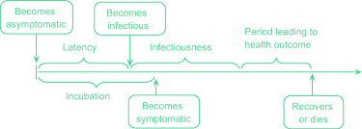
Stages and public health importance

Slide 5
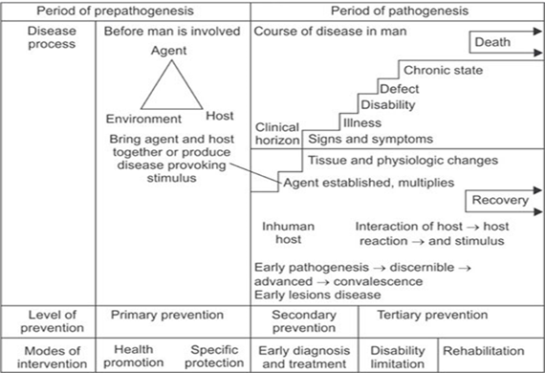
Stages and level of prevention

Slide 6
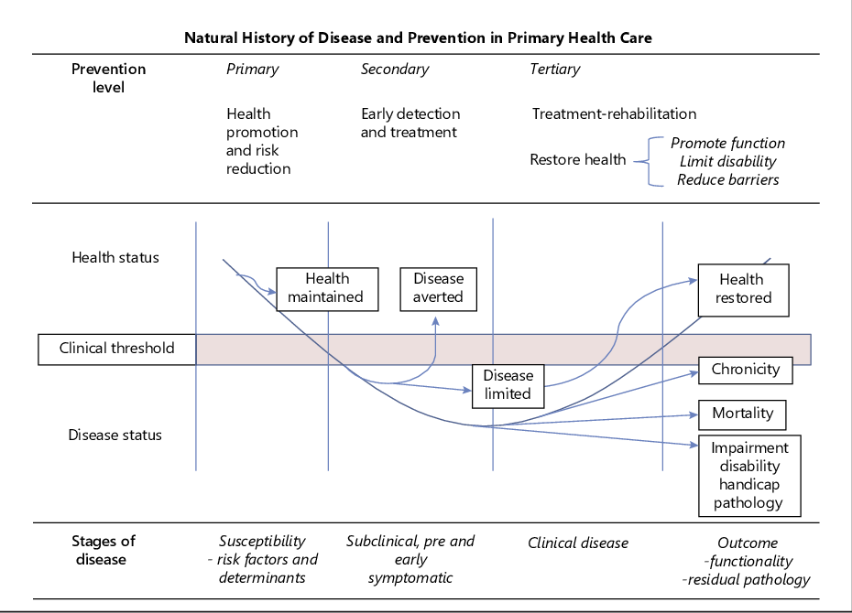
Concept of early detection

Slide 7
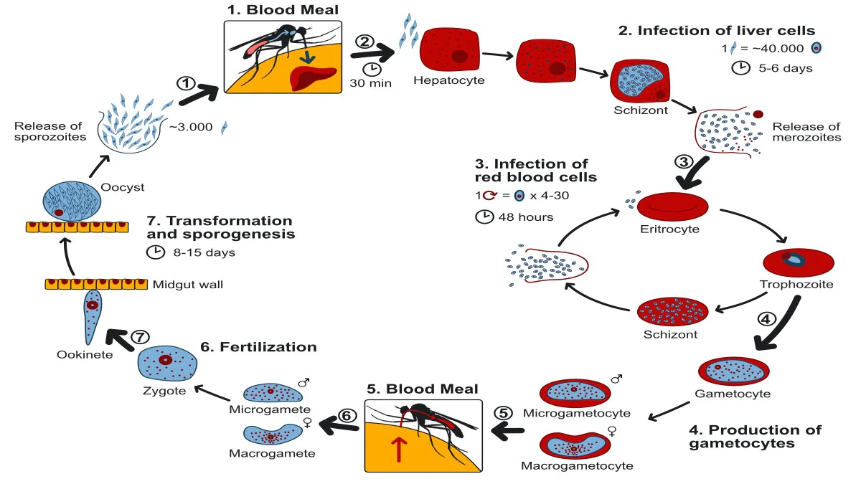
Malaria and Natural history of disease

Slide 8
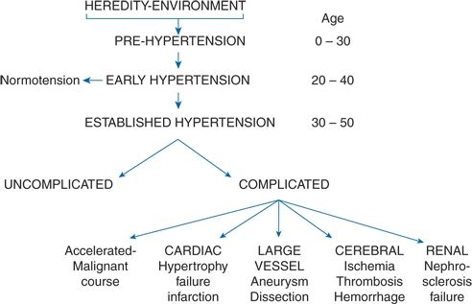
Hypertension and Natural history of disease

Slide 9

Thank you
Exam time

Slide 10
1. Which of the following is the correct sequence of stages in the natural history of disease?
A. Exposure → Pathogenesis → Pre-Pathogenesis → Outcome
B. Pre-Pathogenesis → Pathogenesis → Early Outcome → Late Outcome
C. Pre-Pathogenesis → Pathogenesis → Outcome
D. Outcome → Pathogenesis → Pre-Pathogenesis

Slide 11
2. Which of the following types of prevention is aimed at early detection and treatment of disease in the pathogenesis stage?
A. Primordial Prevention
B. Primary Prevention
C. Secondary Prevention
D. Tertiary Prevention

Slide 12
3. Which of the following is an example of primary prevention in the context of infectious diseases?
A. Screening for tuberculosis
B. Vaccination against measles
C. Physical therapy for stroke patients
D. Surgery for a malignant tumor

Slide 13
4. A 45-year-old male comes to your clinic for a routine check-up. He is asymptomatic but mentions that his father had a history of myocardial infarction at the age of 50. On examination, his blood pressure is slightly elevated at 140/90 mmHg. His BMI is 28 kg/m². He is a smoker and works in a stressful corporate job. You decide to conduct further tests, including cholesterol levels and blood glucose levels, to assess his cardiovascular risk. What stage of the natural history of disease is the patient currently in?
A. Pre-pathogenesis
B. Pathogenesis (Early)
C. Pathogenesis (Advanced)
D. Outcome Stage

Slide 14
5. Which of the following would be considered tertiary prevention for above patient if he develops ischemic heart disease?
A. Educating about a healthy diet
B. Administering thrombolytic therapy after a heart attack
C. Annual cholesterol screening
D. Advising regular physical activity to prevent hypertension

Slide 15
Thank you

