Slide 1
Hair Cycle and Stages of Hair growth
By- Dr sharookh khan
Senior Resident
Sbks mi & rc

Slide 2
INTRODUCTION
Hair is a miniature, autonomous organ with
a reservoir of pluripotent, self-regenerating
stem cells.
The source of the hair is the active germinal
epithelium lying over dermal papilla.

Slide 3
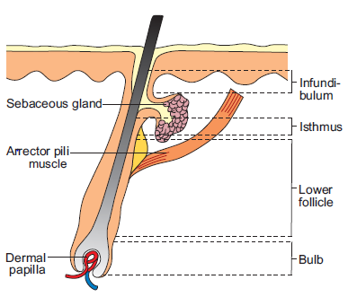
Hair follicle
The human hair follicle is a component of pilosebaceous
unit, which comprises of
  arrector pili muscle
  the sebaceous gland
  the Hair follicle
Hair follicle is a complex miniature organ, derived from neuroectodermal-mesodermal origin composed of more than 20 different cell populations in total.

Slide 4
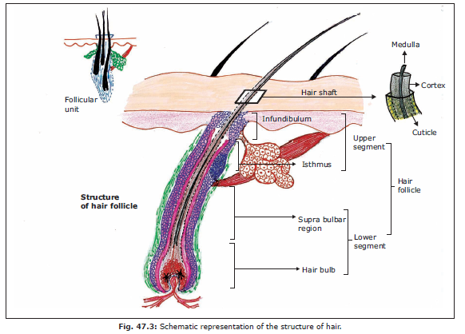
Structure of hair
Divided into
Hair shaft
Hair root

Slide 5
The hair root may be divided anatomically into four parts from below upward
1. The bulb comprising DP and matrix.
2. The suprabulbar area: From the matrix to the insertion of the arrector pili muscle.
3. The isthmus: From the insertion of the arrector pili muscle to the opening of sebaceous gland duct.
4. The infundibulum: Sebaceous duct opening to the follicular orifice.
The bulb and suprabulbar areas constitute an impermanent lower segment of HF, whereas isthmus and infundibulum form a permanent upper segment

Slide 6
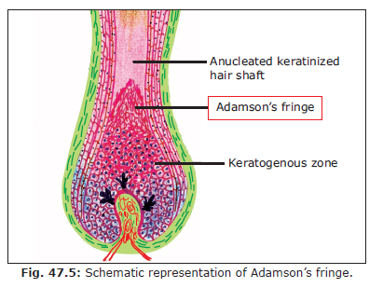
The follicular bulb extends from the base of a follicle
till the summit of the high arched keratogenous
zone that ends at the distinct border known as
Adamson’s fringe

Slide 7
The Hair Bulb
Bulb refers to the lowest part of a hair enclosing the DP, comprising of DP cells, nerve fibers,mucopolysaccharide-rich stroma, and single capillary loops, which invaginate its base.
Bulb can be divided into two zones
lower region of undifferentiated cells and
an upper region of differentiated cells.

Slide 8
From outside inside, the seven components of the bulb are as follows
1. Outer root sheath
2. Henle’s layer of the inner sheath
3. Huxley’s layer of the inner sheath
4. Cuticle of the inner sheath, one cell thick
5. Cuticle of the hair
6. Cortex of the hair.
7. The medulla of the hair

Slide 9
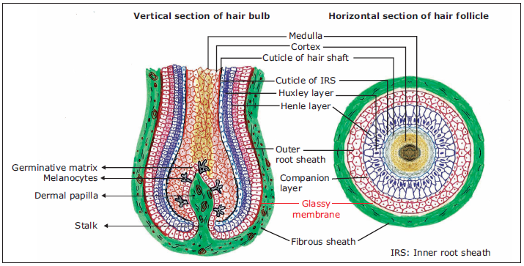

Slide 10
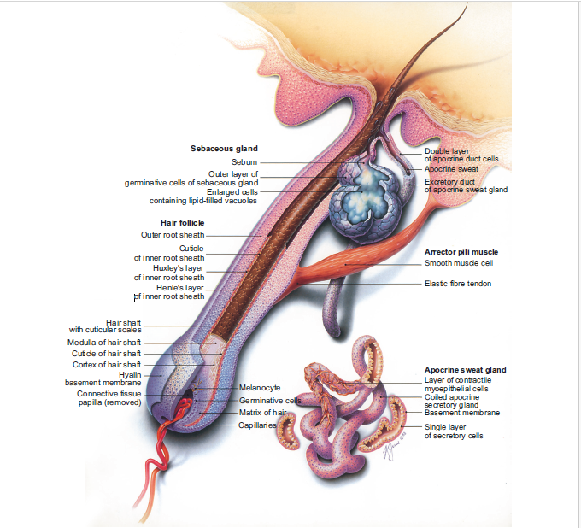

Slide 11
Follicular morphogenesis includes three processes:
Induction of HF: Here hair placode is formed.
Organogenesis of HF: Hair peg is created.
Cytodifferentiation of HF: Bulbous hair peg is formed.

Slide 12
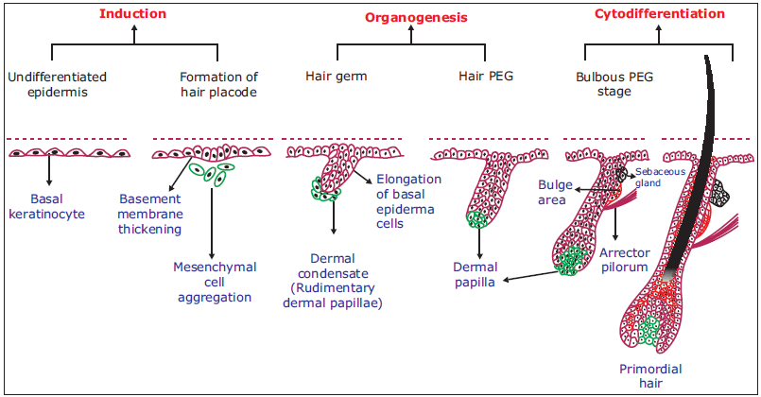

Slide 13

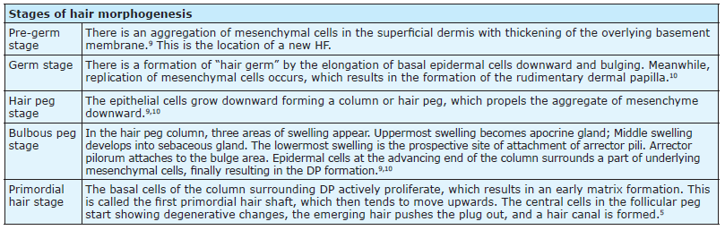

Slide 14
HAIR CYCLE
The Hair follicle represents a neuroectodermal-mesodermal derivative with pluripotent stem cell nidus at the bulge area.
Each follicle has the capacity to undergo cyclic phases of growing, resting, and replenishing itself with an independent biological clock.
It shows stages of
Anagen (Growth phase)
Catagen (Regression phase)
Telogen (Resting phase)
Exogen (Shedding phase)
Kenogen (Lag phase)

Slide 15
ANAGEN
Anagen refers to the period of active hair growth
Normally 80–90% of the HFs on the human
scalp are in the anagen phase at any given point
of time.
The duration of anagen phase determines
the final length of the hair and varies with age,
sex, and region.

Slide 16
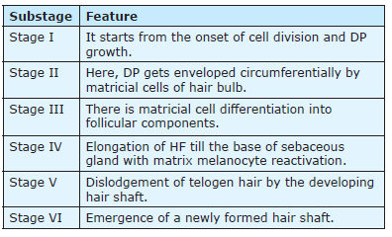
Anagen phase subclassified into six sub stages

Slide 17
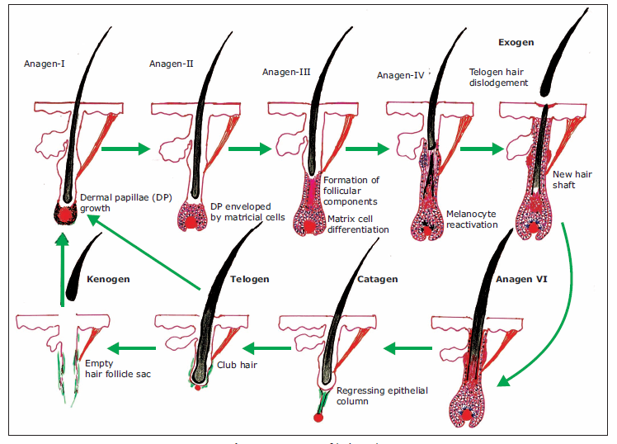

Slide 18
CATAGEN
It is the phase of involution
Here the mitotic activity declines and ceases.
The proximal end of the hair shaft keratinizes,and the lower part of the follicle involutes by apoptosis and forms a “glassy membrane”.

Slide 19
The Dermal papilla gets transformed into a cluster of quiescent cells lying adjacent to the regressing Hair follicle epithelium and moves from the subcutis to the dermis to maintain contact with the distal portion of the Hair follicle epithelium including the secondary hair germ and bulge.
The Hair follicle eventually shrinks in length by 70%.
In catagen phase there is decrease in growth-promoting agents, and an increase in inhibitory factors

Slide 20
Inhibitory factors are – TGF-β, tumor necrosis factor-α (TNF-α), and interleukin-1α (IL-1α)
The process of apoptosis is well evident during catagen.
It is regulated by the ectodysplasin-signaling pathway and apoptosis-associated proto-oncogenes such as c-myc, c-jun and c-myb

Slide 21
Endothelin-1, IGF-binding proteins-3/4/5, prolactin,vitaminD receptor,endocannabinoids or thrombospondin-1 has also been found to contribute in initiation of catagen
The hair bulb undergoes extensive premature apoptosis toward the end of the first anagen phase and epithelial column formation gets disrupted during catagen.

Slide 22
TELOGEN
The period between the completion of the follicular regression and the onset of next anagen is termed as Telogen
It lasts for about 3 months in humans

Slide 23
Dermal papillae produces growth factor BMP-4, which interacts with receptor BMPR-1A, expressed by keratinocytes in the secondary epithelial germ and causes suppression of follicular growth and differentiation during telogen.
The resultant telogen hair known as club hair lies within an epithelial sac attached by trichilemmal keratin.

Slide 24
EXOGEN
The shedding of the club hair through an active process is known as EXOGEN
KENOGEN
Kenogen is an interval in which the HF remains empty after the telogen loss and before the outbreak of a new anagen hair

Slide 25
Mechanism of Hair cycling
Bulge Activation Hypothesis
Explain the cyclic activity of the follicle
It proposes that the stem cells of the follicle reside not in the bulb matrix but in the bulge region at the insertion of the arrector pili muscle, this being the lowermost permanent part of the follicle
Cells divide at the end of telogen to give rise to the “transient amplifying cells” that multiply to form the matrix cells with a fixed life span

Slide 26
After this, the bulb disappears and the follicle returns to telogen only to restart the cycle
The dermal papilla, which moves upward during telogen, may interact with the bulge cells to start their activation.
Variation in the proliferative capacity of the transient amplifying cells may be responsible for the variation in the length of the anagen

Slide 27
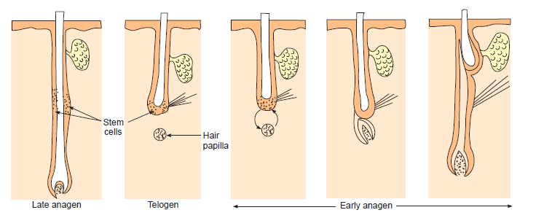
Bulge activation hypothesis

Slide 28
Factors Controlling Hair Growth
Hair cycle during neonatal period is synchronous but with advancing age it becomes asynchronous.
An intrafollicular “hair cycle biological clock” drives the Hair follicle cycle and brings about necessary changes in the intra- and perifollicular signaling

Slide 29
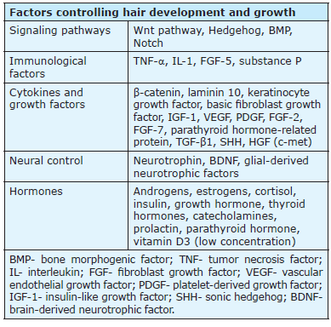

Slide 30
INTRINSIC CONTROL OF HAIR CYCLE
Hair follicle controls its own cycling phenomenon through an autocrine and intracrine mechanism.
Growth factors are secreted by the hair follicle itself, and intracellular proteins that stimulate cellular proliferation are synthesized
In humans, interactions between the epithelial stem cells in the outer root sheath and mesenchymal cells in dermal papilla and dermal sheath underlie the intrinsic control of the hair cycle

Slide 31
Molecular Control of Hair Cycling
The molecular signals include: developmental genes, transcription factors, nuclear receptors, intracellular signaling pathways, growth factors and their receptors, neurotrophins, and cytokines
During follicular morphogenesis: The first signal for Hair follicle induction is Wnt signaling pathways

Slide 32
In the induction stage Wnt signals arise from mesenchymal cells and cause thickening of the overlying epithelial cells, which results in the formation of a placode
Wnt/β-catenin signaling prenatally causes the initiation of placode formation and postnatally the initiation of anagen phase

Slide 33
Primary Wnts 3,4,6 are needed in Hair follicle initiation, but secondary Wnts 2,7b,10a and 10b are needed for Hair follicle development
Inhibitors for placode formation are Dickkopf related protein 4 (DKK4), upregulation of epidermal growth factor and keratinocyte growth factor

Slide 34
Bone morphogenetic protein signaling: BMP signal prenatally helps in the morphogenesis of Hair follicle and postnatally controls the hair cycle.
Sonic Hedgehog signaling: It acts as a mitogen and causes anagen regeneration
During the organogenesis stage: there is a formation of dermal condensate, which signals epithelial cells to grow downward into dermis. This dermal fibroblast condensation is mediated by fibroblast growth factor (FGF) ,EDA/EDAR and Wnt/β-catenin signals expressed in placodes

Slide 35
During the cytodifferentiation stage DP is formed and shaping of HF is done by the interplay of growth factors and morphogens.
Positioning and spacing of HF are mediated by EDA/EDAR/BMP signaling and β-catenin stabilization
During hair cycle regeneration, telogen to anagen transition is regulated by TGF-β2/Smad2/3 pathway
Anagen to catagen induction occurs owing to the increased expression of cytokines-promoting apoptosis, such as TGFβ 1, TNFα, IL-1α, IL-6, DKK1and decreased expression of IGF-1,basic fibroblast growth factor (bFGF) and VEGF

Slide 36
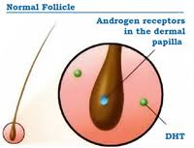
ANDROGENS AND HAIR GROWTH
Androgens exert paradoxical effects on human HF
through androgen receptors in DP cells depending
on regional distribution and differential gene
expression of these receptors
It causes hair growth stimulation on the face, axilla, pubis,and chest, with no effect on the eyelashes.
Its actions are supported by 5α-reductase type 2 enzyme present intracellularly which metabolises testosterone to its more potent metabolite 5α-dihydrotestosterone

Slide 37
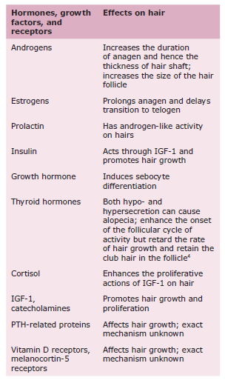

Slide 38
THANK YOU !

