Slide 1
Mechanism of Sweat Secretion
By- Dr Dhiral Shah
Senior Resident
SBKS MI & RC

Slide 2
Sweat evaporation from the skin surface plays a critical role in human thermoregulation and this is most apparent when the ability to sweat is compromised during periods of strenuous physical labor and/or exposure to hot environments
The purpose of this section is to compare and contrast the three main types of sweat glands:
Eccrine
Apocrine
Apoeccrine

Slide 3
Eccrine sweat glands
Eccrine glands were the first type of sweat gland discovered; as they were initially described in 1833 by Purkinje.
Eccrine glands are often referred to as the small gland variety.
The highest gland densities are on the palms and soles (~250–550 glands/cm2 )
It responds to emotional as well as thermal stimuli.
The density of eccrine glands on non-glabrous skin, such as the face, trunk, and limbs are ~2–5-fold lower than that of glabrous skin.

Slide 4
Apocrine sweat glands
The apocrine gland is a second type of sweat gland, which was first recognized by Krause in 1844.
Apocrine sweat glands are located primarily in the axilla, breasts, face, scalp, and the perineum.
These glands differ from eccrine glands in that they are larger and open into hair follicles instead of onto the skin surface.
Apocrine glands produce viscous, lipid-rich sweat, which is also comprised of proteins, sugars, and ammonia.

Slide 5
Apoeccrine sweat glands
A third type of sweat gland, only recently described by Sato et al. in 1987.
Apoeccrine glands develop from eccrine sweat glands between the ages of ~8 to 14 years and increase to as high as 45% of the total axillary glands by age 16–18.
They are intermediate in size, but as the name suggests, apoeccrine glands share properties with both eccrine and apocrine glands.
Apoeccrine glands are more similar to eccrine glands in that the distal duct connects to and empties sweat directly onto skin surface.

Slide 6
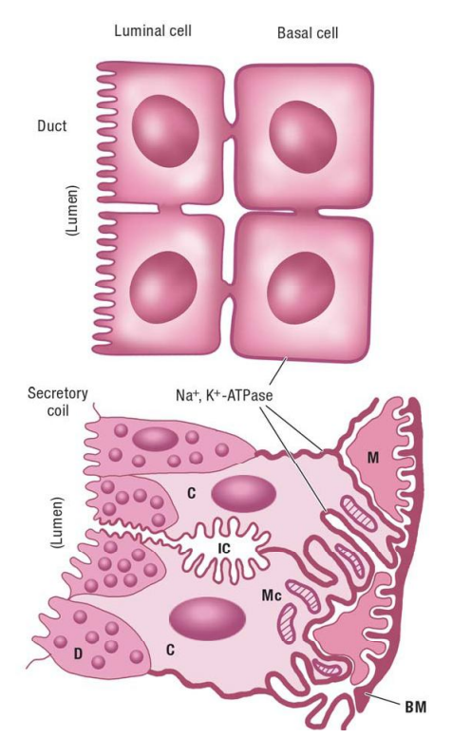
The basic mechanism by which secretion of primary sweat occurs in the clear cells, according to the Na-K-2Cl cotransport
First, binding of acetylcholine to muscarinic receptors on the basolateral membrane of the clear cell triggers a release of intracellular Ca stores and an influx of extracellular Ca into cytoplasm.
This is followed by an efflux of KCl through Cl channels in the apical membrane and K channels in the basolateral membrane.

Slide 7
This leads to cell shrinkage, which triggers an influx of Na, K, and Cl via Na-K-2Cl cotransporters on the basolateral membrane and subsequently Na and K efflux via Na-K-ATPase and K channels on basolateral membrane as well as Cl efflux via Cl channels on apical membrane
In turn, the net KCl efflux from the cell creates an osmotic gradient for water movement into the lumen via aquaporin-5 channels.

Slide 8
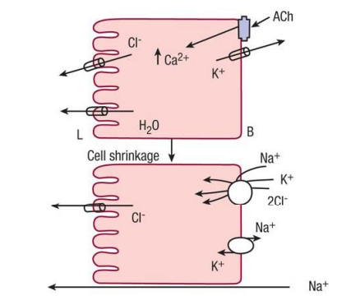

Slide 9
Ductal Reabsorption and Formation of Final Sweat
The principal functions of the eccrine sweat duct are to reabsorb Na2+, Cl–, and HCO3 – from the plasma-like primary sweat, to conserve these vital electrolytes for the body, and to produce a final secretion that is hypotonic.
Indirect evidence suggests that Na+/K+-ATPase (sodium pump) is actively involved in the ductal reabsorption of NaCl–. Na2+ passively enters the cell from the ductal lumen through the Na2+ channels on the luminal membrane and is then pumped out across the basal membrane by the sodium pump in exchange for K+.

Slide 10
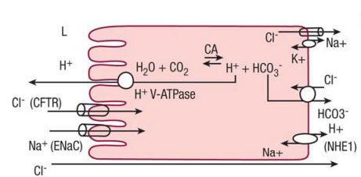

Slide 11
Eccrine sweat gland sweat secretion
The formation of sweat within the eccrine sweat gland is a two-step process
elaboration of a nearly isotonic, primary, or precursor sweat from the interstitial fluid by the secretory coil through active transportation of electrolytes
modification of the primary sweat through partial reabsorption of NaCl– by the sweat duct to produce the ultimate secretory product, the hypotonic eccrine sweat

Slide 12
The immediate consequence of cholinergic receptor stimulation by ACH is an increase in cytosolic calcium concentration
This results in activation of potassium (K+) and chloride (Cl–) channels on the cell membrane causing a net K+ and Cl– ions efflux from the cell; Cl– into the lumen and K into the interstitial fluid.
Decreased cytosolic K+ and Cl– concentrations favor the movement of ions through sodium potassium chloride cotransporters
The activated cotransporters on the cell (cAMP mediated) carry sodium (Na2+), K+, and Cl– in an electrically neutral manner without the expenditure of energy, and partially offset the cell shrinkage

Slide 13
Eccrine sweat glands primarily respond to thermal stimuli; particularly increased body core temperature , but skin temperature and associated increases in skin blood flow also play a role .
An increase in body temperature is sensed by skin thermoreceptors and this information is processed by the preoptic area of the hypothalamus to trigger the sudomotor response

Slide 14
Thermal sweating
Thermoregulatory sweating involves eccrine sweat glands that are distributed over almost the whole body surface.
Along with vasodilatation in the skin, thermoregulatory sweating serves as a system for temperature reduction under heat stress conditions.
Sweat gland activity is directly controlled by the central nervous system with the hypothalamus as the principal centre of thermoregulation.
Thermoregulatory sweating is affected by many other internal factors like gender, physical fitness, menstrual cycle and circadian rhythm as well as external factors like air humidity.

Slide 15
Emotional sweating
Emotional sweating is a physical reaction to emotive stimuli like stress, anxiety, fear and pain that can occur over the whole body surface, but is most evident on palms, soles and in the axillary region.
Emotional sweating in the axillary region, as well as axillary hyperhidrosis, does not occur before the onset of puberty.
This may lead to the assumption that apocrine and apoeccrine sweat glands play an essential role in emotional axillary sweating, as they are activated during this developmental stage.
Apoeccrine glands, which contribute notably to axillary secretion by emitting high amounts of watery fluid, show strong cholinergic sensitivity, but can also be activated by adrenergic stimulation.

Slide 16
Gustatory sweating
Under certain conditions, sweat secretion can be induced by ingestion, which can be explained by a direct or indirect thermal effect. First, ingestion causes an increase in metabolism, leading to elevated body temperature and thermal sweating.
Second, hot and spicy food is able to induce a mild form of gustatory sweating, which is confined to the face, the scalp and the neck.
gustatory sweating describes a pathological state, referred to as Frey's syndrome, which follows parotid surgery and affects the area of the cheek.

Slide 17
Composition of sweat
1)Sodium : low sweat rate: 10–20 mmol , high sweat rate: 100 mmol
2) Potassium : About 5–6 mmol
3) Chloride : Cl– concentration is generally considerably lower than that of Na2+
4) Bicarbonate : 14 mmol
5) Lactate : At low sweat rates: 30–40 mmol ,at higher sweat rates: 10–15 mmol
6) Urea : 15–25 mg/dL

Slide 18
Composition of sweat
7) Ammonia : 0.5–0.8 mmol
8) Proteins : 20 mg/dL
9) Glucose : 0.2–1.5 mg/dL
10) Pyruvate : 0.2–1.6 mmol

Slide 19
Sodium : In the primary fluid, the sweat Na2+ concentration is isotonic to that of plasma and is uninfluenced by the sweat rate ,formed sweat it is hypotonic. This is the result of ductal reabsorption of sodium and chloride in excess of water. The sweat rate has a significant effect on ductal sodium reabsorption so that at low sweat rates the sweat Na2+ concentration is low, but increases with increasing sweat rates to plateau at around 100 mmol
Potassium : The concentration of K+ in the primary sweat is also isotonic with that of plasma and is about 5–6 mmol

Slide 20
Chloride : The chloride concentration in the finally formed sweat also increases with the sweat rate
HCO3 – and pH : When measured under a constant CO2 pressure (5% pCO2), sweat pH is approximately 7.2–7.3 in the primary sweat with an HCO3 – concentration of 14 mmol. The pH of the final sweat, however, is about 5.0
Lactate : The sweat lactate concentration usually depends on the sweat rate and varies from 30 to 40 mmol at low sweat rates and from 10 to 15 mmol at higher sweat rates.
Urea : The sweat urea concentration is approximately the same as or slightly higher than that of plasma.

Slide 21
Ammonia : The total sweat ammonia concentration is 0.5–0.8 mmol, which is 20–50 times higher than that found in plasma.
Amino Acids : Free amino acids are present in human sweat and their mean concentrations are the same or slightly lower than those found in plasma.
Proteins : Human eccrine sweat contains a number of proteins including glycoproteins and mucopolysaccharides. In uncontaminated thermally induced sweat, their concentration is about 20 mg/dL

Slide 22
Drugs excreted in sweat
Clofazimine
Griseofulvin
Ketoconazole and other azoles
Sulfa drugs
Phenytoin
Phenobarbitone
Carbamazepine
Cytotoxic agents
Ethanol

Slide 23
Thank you

