Slide 1
CM 10.8 ARSH
Dr. Niraj Pandit
Professor & Head
Department of Community Medicine,
SBKSMIRC, Sumandeep Vidyapeeth DU, Piparia

Slide 2
CM10.8 Physiology, clinical management and principles of adolescent health including ARSH

Slide 3
1. What do we mean by the term
'adolescents ' ?

Slide 4
The term adolescence is derived from the Latin word “adolescere” meaning to grow, to mature.
• It is a time of physical and emotional change as the body matures and the mind becomes more questioning and independent.
• These are the formative years of life of an individual when major physical, psychological & behavioural changes takes place.
• Period of preparation for undertaking greater responsibilities including healthy responsible parenthood.
• Adolescents (10-19 years) constitute about one fourth of India's population and young people (10-24 years) about one third of the population

Slide 5
Adolescent represents a great 'demographic dividend' and offers a dependable potential to drive and sustain economic growth of India.
• They require information and skills, health services and counselling as well as a safe and supportive environment for development
• Adolescents are generally considered healthy by themselves, their families, even health care providers and society at large.
• They suffer significant morbidity caused by risk taking behaviour and inadequate access to health care. .

Slide 6
The second decade:
No longer children, not yet adults !
Adolescents 10 - 19 years
Youth 15-24 years
Young people 10-24 years
Source: A picture of health? A review and annotated bibliography of the health of young people in developing countries (WHO, UNICEF, 1995).
Notes:
In this slide, the terms that are commonly used in the literature: adolescents, youth and young people, are listed alongside age bands.
WHO defines adolescents as individuals who are going through a very special phase in their lives – adolescence. A phase during which enormous
physical and psychological changes occur, as do changes in social perceptions and expectations. A phase when an individual is no longer a child, but not yet an adult.
Although according to WHO's definition, adolescents are aged between 10-19, WHO is conscious that adolescence is a phase in an individual's life, rather than a fixed time period.

Slide 7
What is an adolescent?
Adolescent Age group: 10-19 years
Youth: 15-24 years
Early Adolescence: (10-14 years): Growth spurt, Secondary sexual characters
Middle Adolescence: (15-17 years): Striving for identity/ independence; Relationship with opposite gender; experimentation
Late Adolescence: (18-19 years): Almost an adult

Slide 8
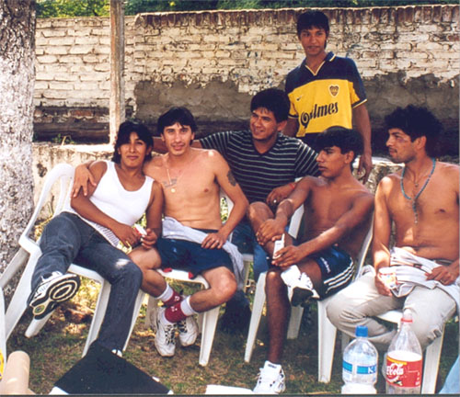
Adolescents are a diverse population group
Different needs
Changing needs
Notes:
Adolescents are a very diverse group.
A boy of 12 is very different from a young man of 19.
A boy of 12 is also very different - physically but also psychologically from a girl of the same age.
A boy of 12 who is part of a caring and financially secure family is growing up in very different circumstances from another of the same age who has run away from home to escape physical violence.
Two boys of 12 who are growing up in very similar conditions may develop in very different ways.
All these categories of adolescents have different needs; different but also changing needs.

Slide 9
What is special about adolescence ?
(What makes it different from childhood & adulthood ?)
A time of rapid physical and psychological (cognitive and emotional) growth and development.
A time in which new capacities are developed.
A time of changing social relationships, expectations, roles and responsibilities.
Notes:
Adolescence is a time of rapid physical and psychological growth and development, and one in which individuals develop new capacities. It is also a time of changing social relationships, expectations, roles and responsibilities.

Slide 10
Special Characteristics
Rapid physical growth & development
Onset of sexual activity: Secondary sexual characteristics
Beginning of menstruation in girls
Transition: Dependent to Independent; Establishing identity
Experimentation

Slide 11
A – Aggressive, Anaemic, Abortion
D – Dynamic, Developing, Depressed
O – Overconfident, Overindulging, Obese
L – Loud but lonely & Lack information
E – Enthusiastic, Explorative & Experimenting
S – Social, Sexual, & Spiritual
C – Courageous, Cheerful, & Concern
E – Emotional, Eager & Emulating
N – Nervous, Never say no to peers
T – Temperamental, Teenage pregnancy

Slide 12
Puberty
Sexual changes
Boys: Testosterone. Production of sperms & ejaculation
Girls: Estrogen. Menstruation & ovulation
Secondary Sexual Characters
Boys: Pubic hair, hair on face, deep voice
Girls: Development of breasts, pubic hair, rounding of hips

Slide 13
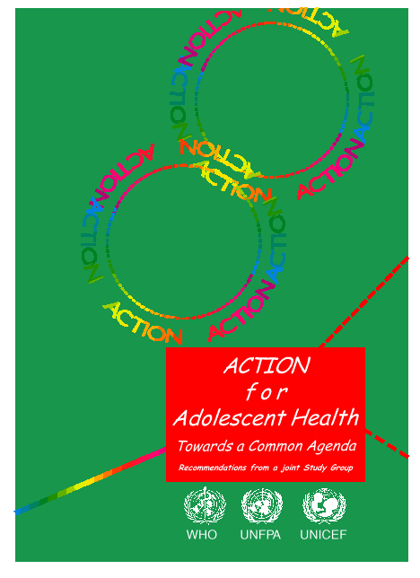
What adolescents need & why?
Information & skills
(they are still developing)
Safe & supportive environment
(they live in an adult world)
Health & counselling services
(they need a safety net)
Notes:
The Common Agenda for Adolescent Health and Development endorsed by UNFPA, UNICEF and WHO in 1995 lists what adolescents need to grow and develop in good health, and why they need these things.
A useful analogy is that of an 8 year old girl who needs to cross the road every day to get to school.
She needs information & skills: where to look, what to look for, when to walk across, when not to do so.
She needs a safe & supportive environment: a zebra crossing, traffic lights that work or a traffic warden in position, drivers who respect traffic rules or are punished if they do not do so.
She may also need health & counselling services, if she stumbles and falls, or is struck down by a vehicle.
One problem with this analogy is that it presents health services in a curative context alone. Health workers and health services have important roles to play in promotive and preventive health as well.

Slide 14
Health Needs of Adolescents
Correct & complete information on: Health, Menstruation, Hygiene, Sexuality
Adequate diet for growth & development
Healthy life styles
Education: Guidance/ counseling
Supportive environment

Slide 15
Adolescents: Major Health Problems
Knowledge & Information
Poor, incorrect knowledge especially about: Sexuality, reproduction
Half baked knowledge from peers
Anemia, Under-nutrition, Obesity
90% girls anemic
30-35 % boys/ girls: Chronic malnutrition
Obesity: Especially in Urban area (about 20%)
Short stature

Slide 16
Adolescents: Major Health Problems
HIV/ AIDS
40 % new infections in age 15-24
Unsafe sex, early initiation of sex, pre-marital sex
Sexual abuse: rape, trafficking for prostitution
Homosexuality
Early marriages
40 % girls married before 18 years
Too early, too quick , too many pregnancies
Teen age pregnancy = Low birth weight

Slide 17
Adolescents: Major Health Problems
Teen age Pregnancy
Account for 15-20 % of total
Leads to
High MMR
High morbidity
High fetal deaths
Unwanted Pregnancies
Pregnancies in un-married girls
Illegal abortions

Slide 18
Adolescents: Major Health Problems
School Drop-outs
Only 1/3 rd continue to matriculation
Accidents
Rate highest in adolescents
Careless, high speed, non-use of protection like helmets, seat belts

Slide 19
Adolescents: Major Health Problems
Drug abuse
Tendency to experiment
Peer pressure
Smoking, alcohol, drugs
STIs/ STDs
Early, unsafe sex
Pre-marital sex
poor acceptance of contraception
Poor knowledge of safe sex

Slide 20
Who needs to contribute to meeting these needs & fulfilling these rights ?

Slide 21
Politicians
Journalists
Bureaucrats
Relatives
Friends
Family friends
Teachers
Sports coaches
Healthcare providers
Religious leaders
Traditional leaders
Parents
Brothers/Sisters
Adolescents
Musicians
Film stars
Sports figures
Notes:
Who needs to contribute to the health and development of adolescents ?
To answer this question, it is useful to think of these players in concentric circles of contact & influence.
At the centre is the adolescent himself or herself. Parents, siblings and some other family members are in immediate contact with the adolescent & constitute the first circle.
The second circle includes people in regular contact with them such as their own friends, family friends, teachers, sports coaches, health workers and religious leaders.
The third circle includes musicians, film stars & sports figures who have a tremendous influence on them from afar.
Finally in the fourth circle, politicians, journalists and bureaucrats (within the government & private sectors) affect their lives in small & big ways, through their words and deeds.

Slide 22
Why should we invest in the health and development of adolescents ?

Slide 23
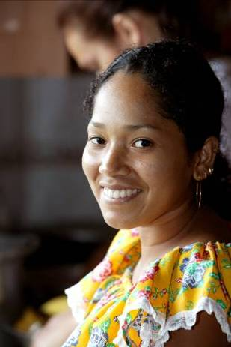
Demographic rationale
Public health rationale
Economic rationale
Human rights rationale
Notes:
There are sound demographic, public health, economic and human rights reasons for addressing the health of adolescents.

Slide 24
Public health rationale – 5/5 sound reasons for investment for this generation
Health problems / health-related behaviours during adolescence | Age when this has its major impact
 | Adolescence | Adulthood | Childhood (next generation)
Injuries and violence | +++ | +
Too-early pregnancy | ++ | + | ++
Human Papilloma Virus infection | + | +++
Tobacco use | + | +++ | +
HIV infection | + | +++ | ++
Notes:
One final point is that some health problems (illnesses and infections) and health-related behaviours acquired during adolescence have their impact during adolescence; others have their impact in adulthood; and still others have their impact in the next generation.

Slide 25
Frameworks for addressing the health and development of adolescents
Notes:
A framework is a structure.
Conceptual and operational frameworks provide a structure to think about and to do things.
The World Bank, WHO and UNFPA have all developed frameworks on adolescent health and development.
The World Bank's framework is the broadest one. It addresses health and development in a broad sense.
WHO's framework is one that addresses the role of the health sector in improving the health and development of adolescents.
UNFPA's framework addresses sexual and reproductive health.

Slide 26

World Bank framework: Youth transitions seen through three lenses
  First lens: Broadening opportunities for young people to develop skills and use them productively.
  Second lens: Helping them acquire the capabilities to make good decisions in pursuing those opportunities
  Third lens: Offering them second chances to recover from bad decisions, either by them or by others.
Source: World Bank. World Development Report 2007. Development and the next generation. World Bank. Washington, USA. 2007.
Notes:
This slides lists the three lenses that the World Bank urges policymakers and programme managers to apply in understanding and responding to the needs of young people as they grow and develop.

Slide 27
S
Strategic
information
WHO: Delineating & strengthening
the contribution of the health sector
S
Supportive
evidence-informed
policies
S
Services &
commodities
S
Strengthening &
supporting
other sectors
WHO. Strengthening the health sector response to adolescent health & development. WHO. Geneva. 2009.
Notes:
This slides lists the four elements of WHO's 4-S framework to strengthen the health sector's response to adolescent health and development.

Slide 28
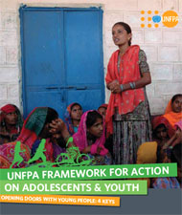
UNFPA framework for action on adolescents & youth
Supportive policy making that applies the lens of population structure & poverty dynamics analyses
Gender & life-skills based sexual & reproductive health education
Sexual & reproductive health services
Young people's leadership and participation
Source: UNFPA framework for action on adolescents and youth. Opening doors with 4 keys. UNFPA. New York, USA. Undated.
Notes:
This slide lists the four key areas in which UNFPA has decided to strategically position its work.

Slide 29
PROTECTION-LEGAL ASPECTS
Age of consent to sexual activity -16 years
Reduces the incidence of
STI
teenage pregnancy
sexual abuse exploitation
Convention on the Rights of the Child in 1989
(children defined as under 18)-against unchecked
child labour, child prostitution and pornography.

Slide 30
PROTECTION OF ADOLESCENTS
STI HIV prevention and pregnancy prevention information
Encouraging health care providers to make their
services youth friendly
ADOLESCENT FRIENDLY HEALTH SERVICES (AFHS)

Slide 31
ADOLESCENT FRIENDLY HEALTH SERVICES
WHO consultation 2001- AFHS
piloting under Adolescent District Health Project
Target population- young people
Key elements
  Confidentiality
  Flexibility
  Well staffed
  Information
  Partnershipapproach

Slide 32
ADOLESCENT PSYCHOLOGY
Role of family and environment pivotal in
Character and personality building
Cognitive emotional and attitudinal changes
Seek Individuality Attention and Independence
Peer groups more influential
Peer pressure- addictions
antisocial activities

Slide 33
MENTAL DISORDERS
Conduct and behavioural disorders
Learning disorders
Anxiety disorders
Teen depression
Juvenile delinquency
Adjustment problems

Slide 34
DELINQUENCY PREVENTION
Broad term for all efforts aimed at preventing
youth from becoming involved in criminal, or
other antisocial, activity.
CHILD GUIDANCE CLINIC
Prevention services include activities -
  substance abuse education and treatment,
  family counseling, youth mentoring,
  parenting education, educational support, and
  youth sheltering.

Slide 35
ADOLESCENT COUNSELING
School Avoidance
Separation Anxiety
Coping With Chronic Illness
Building Social Competence
Managing Powerful Peer Personalities
Minimizing Family Conflict
Working Through Divorce Separation
Avoiding Drug Alcohol Use
Transitioning - High School to College
Accepting Imperfection
Building Friendships

Slide 36
National Programs for Adolescents
Departments Involved
Ministry of Youth Affairs & Sports: Nodal Ministry
Ministry of Health & Family Welfare
Ministry of Women & Child Affairs
Ministry of Human Resource Development

Slide 37
National Programs for Adolescents
Ministry of Youth Affairs & Sports
Modular Training of teachers through NSS
Core life skills: Effective communication, dealing with stress, problem solving, inter-personal relations
Need based information

Slide 38
Adolescent health programmes in India
Kishori Shakti Yojana, Balika Samridhi Yojana,
Rajiv Gandhi Scheme for Empowerment of Adolescent Girls, “SABLA”,
Rashtriya Kishor Swasthya Karyakram, and Adolescent
Reproductive Sexual Health Programme (ARSH)

Slide 39
National Programs for Adolescents
Adolescent Reproductive & Sexual Health (ARSH)
NRHM initiative
Training of MOs, ANMs on adolescent health
Stress on themes like anemia, malnutrition, menstrual hygiene

Slide 40
National Programs for Adolescents
ARSH Clinics
Service availability on fixed days: ARSH clinic at PHC, Sub-center, CHCs
Advice on contraception, menstrual disorders, management of STIs, HIV/ AIDS
Counseling for sexual problems
Supply of sanitary napkins at subsidized rates

Slide 41
ARSH (Adolescent Reproductive & Sexual Health)
The National Adolescent Reproductive and Sexual Health strategy provides a framework for a range of sexual and reproductive health services to be provided to the adolescents.
The strategy incorporates a core package of services including preventive, promotive, curative and counseling services.
Effective implementation of policies and programmes has progressed from the past few years and has lead to strengthening of Adolescent Friendly clinics and subsequently the outreach programmes.

Slide 42
Adolescent clinics
  Focuses on reorganizing the existing public health system in order to meet the service needs of adolescents.
  Under this programme counseling services, routine check-ups at primary, secondary and tertiary levels of care is provided on fixed days and fixed time to adolescents, married and unmarried, girls and boys during the clinic sessions.
  To make the clinics adolescent friendly, states have branded the clinics in the name of "Maitry in Maharashtra, UDDAN in Uttrakhand, Sneha in Karnatka and so on. The objective of it being addressing the stigma behind accessing the adolescent services.

Slide 43
ARSH training:
All the health functionaries are made sensitive towards the health needs of the adolescents through a systematic training of 5 days for ANM/SN and 3 days for MO through State Institute of Health and Family Welfare.
Outreach programmes:
Periodic health check-ups at the village health and nutrition days are conducted to provide services to adolescent girls who cannot access the clinic based services.
Convergence:
To support the adolescent health issues across the country, partnerships with various other departments like WCD has been initiated with the ongoing SABLA programme

Slide 44
National Programs for Adolescents
School Health Program
Major NH Program
Periodic Health Checkup
Immunization: TT, HBV,
IFA tablets
16 hours devoted in curriculum (IX, X,XI) on HIV/AIDS & STIs

Slide 45
National Programs for Adolescents
National HIV/ AIDS Control Program
University talk AIDS
Through NSS
Manual in 7 languages for students on HIV/ AIDS
Favorable attitudes for: Voluntary blood donation

Slide 46
National Programs for Adolescents
Kishori Shakti Yojana
Part of ICDS, in 2000
Improvement of nutritional & health status of girls 11-18 years
Literacy & numeracy skills through non-formal education
Improvement in home based vocational skills
Promote awareness on health, hygiene, family welfare, child welfare

Slide 47
National Programs for Adolescents
Adolescent Girl Scheme
Scheme-1: Girl-To-Girl Scheme
Scheme-2: balika Mandal

Slide 48
National Programs for Adolescents
Girl-To-Girl Scheme
Age 11-15, family income below 6400/- per year
3 School drop-outs per Angan wadi
Implementation: Through Angan wadi, for 6 months
Supplementary nutrition (= pregnant mother) for 6 days / week
Education on : Hygiene, nutrition, family health
These girls act as resource persons

Slide 49
National Programs for Adolescents
Balika Mandal
All eligible girls 11-18 years (no income restriction)
10 % of Anganwadis selected to serve as Balika Mandals
20 girls (11-18 years) identified, enrolled for 6 months
So, 40 girls/ year

Slide 50
National Programs for Adolescents
Balika Mandal: Interventions
Supplementary nutrition: 600 Kcal, 18-20 gm proteins
Health Education: Personal hygiene, nutrition, home nursing, first aid, vaccination, family life
Participation in creative activities
Training in vocational skills

Slide 51
National Programs for Adolescents
SABLA
Pilot project in 200 districts,
Districts chosen on the basis of high drop-out rates
Merger of KSY and Nutritional Program For Adolescent Girls

Slide 52
National Programs for Adolescents
SABLA
Formation of Kishori Samooh (KS): 15-25 Age from village/ Anganwadi area
3 girls from each KS will be selected as “Sakhi” (one girl), Saheli (2 Girls)
Sakhi & Saheli to have terms of 4 months by rotation
KS to be provided training in areas of Health, Nutrition, ARSH

Slide 53
National Programs for Adolescents
SABLA
Planned health activities: 2 hours a day x 3 days per week
Take Home ration or Hot cooked meal
IFA supplementation
Health Check up & Referral
Vocational Training
Counseling & guidance

Slide 54
RASHTRIYA KISHOR SWASTHYA KARYAKRAM
The Ministry of Health and Family Welfare launched
Rashtriya Kishor Swasthya Karyakram on January 7, 2014 for adolescents (10–19 years)
Objective:
to focus more on continuum of care for adolescent health and developmental needs.
The main strategies are community‑based interventions, facility‑based interventions, and social and behavior change communication with focus on interpersonal communication.

Slide 55
Title of the study | Methodology | Results | Conclusion
Evaluation of the effectiveness of an educational intervention for general practitioners in adolescent health care: randomised controlled trial L A Sanci, fellow in adolescent health,ª C M M Coffey, epidemiologist,ª F C M Veit, adolescent physician,ª M Carr-Gregg, director of training and education,ª G C Patton, director,ª N Day, principal research fellow,^{b} and G Bowes, professorial fellowª | Design: Randomised controlled trial with baseline testing and follow up at seven and 13 months. Setting: Local communities in metropolitan Melbourne, Australia. Participants: 108 self selected general practitioners. Intervention: A multifaceted educational programme for 2.5 hours a week over six weeks on the principles of adolescent health care followed six weeks later by a two hour session of case discussion and debriefing. Outcome measures: Objective ratings of consultations with standardised adolescent patients recorded on videotape. Questionnaires completed by the general practitioners were used to measure their knowledge, skill, and self perceived competency, satisfaction with the programme, and self reported change in practice. | 103 of 108 (95%) doctors completed all phases of the intervention and evaluation protocol. The intervention group showed significantly greater improvements in all outcomes than the control group at the seven month follow up except for the rapport and satisfaction rating by the standardised patients. 104 (96%) participants found the programme appropriate and relevant. At the 13 month follow up most improvements were sustained, the confidentiality rating by the standardised patients decreased slightly, and the objective assessment of competence further improved. 106 (98%) participants reported a change in practice attributable to the intervention. | General practitioners were willing to complete continuing medical education in adolescent health care and its evaluation. The design of the intervention using evidence based educational strategies proved an effective and quick way to achieve sustainable and large improvements in knowledge, skill, and self perceived competency.

Slide 56
MCQ
ARSH IS
Acute Reproductive & Sexual Health
Adolescent Research and Statistics in health
Adolescent Reproductive & Sexual Health
None of the above

Slide 57
Early adolescent is
5 to 9 yrs
10 to 14 yrs
10 to 17 yrs
10 to 19 yrs

Slide 58
All of the following are adolescent health programmes except
ARSH
NLEP
NACP
RMNCH+ A

Slide 59
Who needs to contribute to meeting the needs & fulfilling these right Adolescence ?
Parents
Politicians
Friends
All of the above

Slide 60
Departments Involved in National Health programmes for Adolescent are except
Ministry of Youth Affairs & Sports
Ministry of Health & Family Welfare
Ministry of Human Resource Development
Ministry of disaster management

