Slide 1



National Programme for Prevention & Control of
Non-Communicable Diseases (NP-NCD)
District NCD Cell
Jilla Panchayat, Gandhinagar

Slide 2
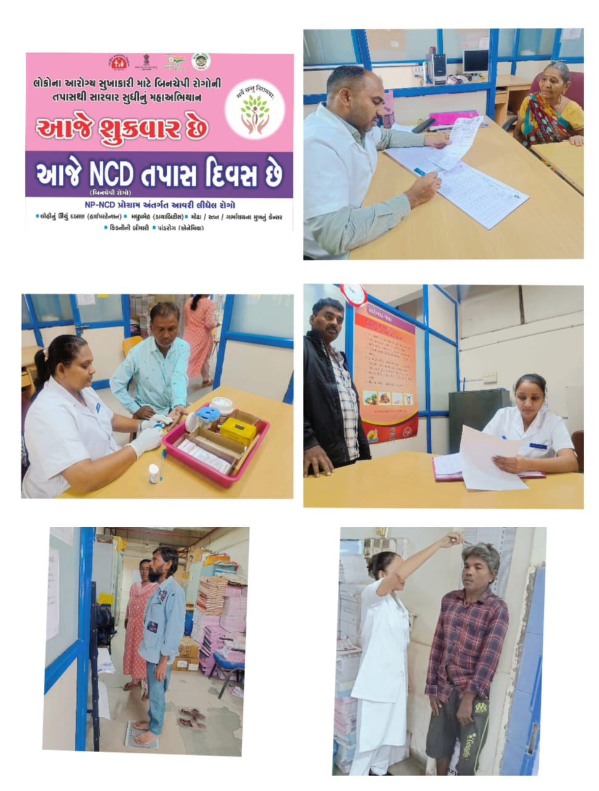
NCD GUJARAT - OBJECTIVES
To reduce risk factors of NCDs among all people of Gujarat through promotive health measures
To provide screening to treatment facility to around 3 crore falling in the age of 30 or above
Diseases covered :
  Hypertension
  Diabetes
  Cardiovascular disease
  Stroke
  Oral/Breast/ Cervical Cancer
  CKD
  COPD
  NAFLD

Slide 3
Activities
Place
Village Level
Sub center/
PHC level-Day
CHC Level-Clinic
SDH/DH/
Medical College
Service
Provider
ASHA
CHOs / FHW / MPHW / ASHA / GSS Members
Medical Officer, Ayush, Dental Surgeon, Resident
Gynaecologist, Physician, Surgeon, Dental Surgeon
District Expert Team
Primary assessment(CBAC)
Counselling on Healthy lifestyle
Health Card, Screening, Diagnosis and Treatment
ABHA ID, NCD card and PMJAY-MA Card, measurement of Blood sugar, Blood pressure Primary assessment for Oral, Breast and Cervical cancer,Diagnosis and treatment of diabetes and BP by medical officer , digital machines
Diagnosis and treatment of severe diabetes and BP, ECG, X-ray, Kidney function test, lipid profile test, Pep smear/VIA test, MA Card kiosk
Treatment of severe diabetes and BP, Stroke, heart disease, cancer treatment, PAP Smear/VIA , USG , Biopsy & FNAC, MRI , CT Scan, Mammography, Radiotherapy, Chemotherapy ,ICU
Service
Benefi-ciary
Home visit by ASHA for collection of Data of people of age 30 or above (430 in a population of 1000)
ABHA ID, NCD card and PMJAY-MAY CARD
Screening of approximately 2100 people on a population of 5000, Medical examination, diagnosis and treatment of at-risk individuals (approximately 450).
Referred patients who need specialist treatment
Advanced medical care for critically ill referred patients
Screening to Treatment

Slide 4
NP-NCD Programme : Goal, Objective & Targets
Goal: Development of an integrated approach that targets all major common risk factors of cardiovascular diseases, hypertension, diabetes mellitus, stroke and cancer by strengthening of Infrastructure, human resource development, health promotion, early diagnosis, treatment and referral.
Objective:
Prevent and control common NCDs through behaviour and lifestyle changes.
Provide early diagnosis and management of common NCDs.
Build capacity at various levels of health care for promotion, prevention, diagnosis and treatment of common NCDs.
Train human resource within the public health setup viz. Doctors, paramedics and nursing staff to cope up with the increasing burden of NCDs.
Establish and develop capacity for palliative & rehabilitative care.
Notes:
National Program for prevention and control of cancer, diabetes, cardiovascular disease and stroke

Slide 5
NP-NCD Programme : Goal, Objective & Targets
Target:
To be established in all 41 districts/corporations for proper implementation of program.
NCD Day camp to be held on every Friday.
Population based screening of NCDs –8.3% per month target to be achieved.

Slide 6
NPHCE Programme : Goal, Objective & Targets
Goal: To provide accessible, affordable comprehensive & dedicated care services to 60+ age group population, To promote the concept of Active and Healthy Ageing; Convergence with NHM, AYUSH and other line departments like Ministry of Social Justice and Empowerment.
Objective:
To provide an easy access to promotional, preventive, curative and rehabilitative services to the elderly through community based primary health care approach
To identify health problems in the elderly & provide appropriate health interventions in community with a strong referral backup support.
To build capacity of the medical and paramedical professionals as well as the care-takers within the family for providing health care to the elderly
To provide referral services to the elderly patients through district hospitals, regional medical institutions.

Slide 7
NPHCE Programme : Goal, Objective & Targets
Target:
To be established in all 41 districts/ corporations
Easy access to health services to all elderly population
Separate geriatric ward, geriatric queue and pharmacy in all Health care facilities

Slide 8
NPPCD Programme : Goal, Objective & Targets
Goal: Early identification, diagnosis and treatment of ear problems responsible for hearing loss and deafness
Objective:
To prevent avoidable hearing loss on account of disease or injury.
Early identification, diagnosis and treatment of ear problems responsible for hearing loss and deafness.
To medically rehabilitate persons of all age groups, suffering with deafness.
To strengthen the existing inter-sectoral linkages for continuity of the rehabilitation programme, for persons with deafness.
To develop institutional capacity for ear care services by providing support for equipment, material and training personnel.

Slide 9
NPPCD Programme : Goal, Objective & Targets
Target:
To be established in all 41 districts/corporations. At present in 26 districts.
All students (schools & colleges) to be screened and Teachers to be trained.

Slide 10
NPPC Programme : Goal, Objective & Targets
Goal: Availability and accessibility of rational, quality pain relief and palliative care to the needy, as an integral part of Health Care at all levels, in alignment with the community requirements.
Objective:
To provide basic palliative care services at district level and its integration into district healthcare delivery system.
To build capacity for delivery of palliative care services in terms of infrastructure, equipment and human resource.
To promote community awareness and participation in the delivery of palliative care services.
To broad-base palliative care into other related programs.

Slide 11
NPPC Programme : Goal, Objective & Targets
Target:
To be established in all 41 districts/corportions. At present in 14 districts.
Home visit to be started for bedridden patients for palliative care
Day care Chemotherapy centre.

Slide 12
NCD Implementation in Gujarat State:
Enrollment, Screening & Early Detection for NCDs:
CBAC form filled by ASHA during home visit.
Primary Screening & Early detection of 30+ population by Field worker (CHO/MPHW/FHW) for various NCDs – DM, HTN & 3 type of Cancer (Oral/breast/cervical)
DM, HTN using glucometer and digital BP instrument
Early detection of 3 type of cancer: Counselling on Self examination of Breast by ASHA for Breast cancer, VIA & PAP Smear test for Cervical cancer, Oral cavity examination using oral kit for Oral cancer
Examination & diagnosis – After screening medical examination and treatment by Medical officer or specialist consultation via Telemedicine.
Referral and management of severe cases of NCD at higher center.
Treatment – After screening medical examination and treatment by Medical officer or specialist consultation via Telemedicine
Health ID card generation of 1.5 crore people and provision of NCD Health Card

Slide 13
NCD Implementation in Gujarat State:
Promoting awareness and lifestyle in the community -
Health day celebration and competitions with the help of school colleges and voluntary organizations.
Promotions for a healthier lifestyle using ppamphlets, flipcharts, banners and boards
Promotion through various mass media
Services through HWC for NCD:
Availability of all antihypertensive and anti diabetic drugs as per EDL
Availability of essential equipment such as Glucometer, Weighing Scale, Sphygmomanometer, Stediometer, Oral Kit, VIA kit etc.

Slide 14
NCD Implementation in Gujarat State:
IHCI – Indian Hypertension Control Initiative (IHCI)Indian Hypertension Control Initiative (IHCI)- in all 41 districts & corporations
Care of Geriatric Patient –
Reservation of beds for elderly patient at all PHIs.
Separate queue for elderly at case window, pharmacy, laboratory, physiotherapy etc. for prioritizing them and reducing their waiting time
Palliative care: Awareness creation on palliative by field workers.
Teleconsultation: The services of specialist’s consultation are made available via telemedicine.

Slide 15
NCD Implementation in Gujarat State:
Day Care Chemotherapy Centers: 35 Day care Chemotherapy centers have been made across 33 districts of Gujarat
Opportunistic screening: Screening of all patients (30+) coming at all PHIs for common NCDs such DM, HTN, Cancers (oral/breast/cervical)
Patient Tracking and monitoring: using GOI CPHC- NCD portal
Reduction in Out of pocket expenditure: Confirmed Patients of NCDs are benefitted under Ayushman Bharat’s PMJAY Scheme who are referred to higher centers.
Deafness: Early identification, diagnosis and treatment of ear problems responsible for hearing loss and deafness. Medically rehabilitation of persons of all age groups, suffering with deafness. Provision of hearing aid to those requiring it at District Hospital level.

Slide 16

Thank You
Thank You

