Slide 1
Physiological skin changes in newborn
By- Dr Kishan Ninama
Professor
SBKS MI &RC

Slide 2
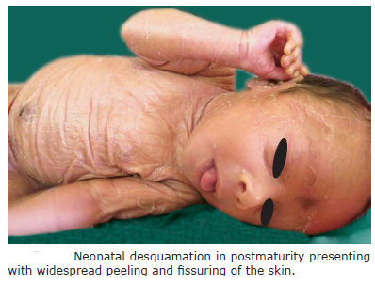
Neonatal Desquamation-
Physiological desquamation is commonly seen in newborns
healthy full-term infants have fine desquamation at birth or within 24–48 hours of age and are localized to hands, ankles, and feet.
Postmature infants and sometimes dysmaturity lead to widespread desquamation with cracking and peeling at birth
D/D- Collodion baby-presents with parchment-like
membrane at birth covering the entire body surface,
congenital ichthyosis
X-linked hypohidrotic dysplasia

Slide 3
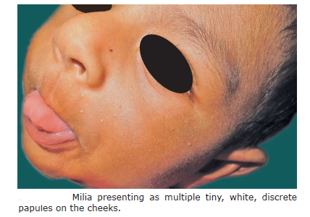
Milia
Milia are small retention cysts in epidermis
They are present at birth or in infancy
Pathogenesis- benign, derived from the pilosebaceous unit of vellus hair, and contain concentric layers of keratin.
Classification- into primary and secondary milia.
Primary milia are associated with the pilosebaceous
unit
secondary milia occur after trauma and
originate from various epithelial structures
such as hair follicles, sweat ducts sebaceous ducts,
or epidermis

Slide 4
Clinical Features -yellow to white superficial, tiny, smooth-surfaced, discrete papules measuring around 1–2 mm in size
Sites affected-nose, cheeks, chin, nasolabial folds and forehead, and periocular region
D/D-sebaceous hyperplasia, miliaria rubra, and molluscum contagiosum
Treatment-resolves spontaneously by 3–4 weeks
If lesions are persistent, they can be incised
Clinical Significance-Widespread or persistent milia can be associated with
Epidermolysis bullosa (present in healing erosions),
type 1 oral-facial-digital syndrome (congenital oral malformations, distinct facial features, and brachydactyly), pachyonychia congenita, and Marie Unna hereditary hypotrichosis

Slide 5
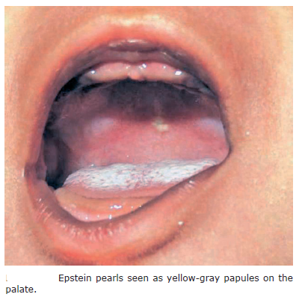
Oral Mucosal Cysts (Epstein’s Pearl/Bohn’s
Nodule)
Epstein’s pearls (palatal cysts) and Bohn’s nodules are milia lesions located in the mouth
Present on the palate, described as “Epstein’s pearls”
present on alveolar ridges, termed “Bohn’s nodules”
Both these occur in mucous membranes that are
keratinized and in correlation with embryonal fusion planes.
clinically seen as tiny, 1–2 mm, smooth,
yellow to gray papules
They are self-limiting
D/D-gingival cysts, dental lamina cysts, lymphangiomas, congenital epulis (granular
cell tumor), mucoceles, and ranulas.

Slide 6
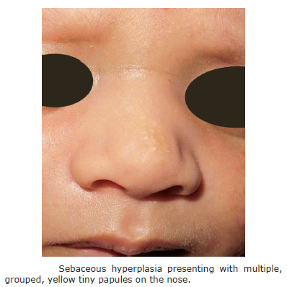
Sebaceous Hyperplasia
occurs in newborn secondary to the influence of maternal androgens
Present as multiple, tiny, monomorphous, yellow- to
fleshcolored papules located on the nose,
upper lips, malar region, and chin
Sebaceous hyperplasia resolves within a few weeks of
life

Slide 7
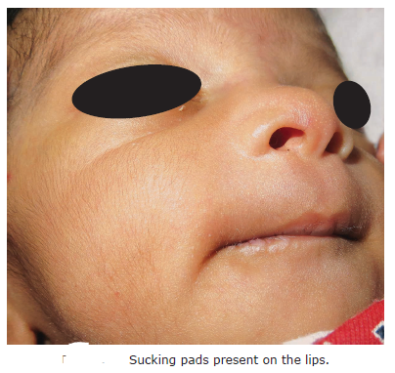
Sucking Blisters/Calluses
present at birth, later on hands, forearms and can be solitary or multiple
Sucking blisters at birth are presumed to be induced
in utero due to repetitive vigorous sucking of the affected part
clinically present as 0.5–2 cm oval-shaped bullae or
erosions on the dorsal aspect of fingers, thumbs,
wrists, and radial aspect of forearm and lips.
If the sucking is vigorous and chronic, result in a callus
present on lips or fingers in infants
Sucking blisters resolve without any treatment.
Sucking pads on lips desquamate by 3–6 months
D/D-epidermolysis bullosa, bullous impetigo, and
herpes neonatorum

Slide 8
Miliaria
describing transient eccrine disorder due to occlusion of sweat duct at various
levels.
Etiopathogenesis-there is obstruction of sweat glands within the stratum corneum or deeper in the epidermis, keratinous plugging of eccrine ducts and thus escape of sweat into the skin below the level of obstruction
Pathology-characterized by intracorneal or subcorneal vesicles in communication with sweat ducts.
The sweat duct plug is periodic acid-Schiff (PAS) positive

Slide 9
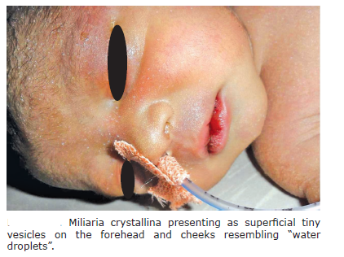
Clinical Features
There are four types of miliaria depends on level of obstruction
1. Miliaria crystallina (Sudamina)
is the most common type
seen in newborns, especially those nursed in incubators.
level of obstruction is intracorneal or subcorneal
are asymptomatic.
It is seen as clear, superficial, pinpoint vesicles without
any inflammatory component resembling water droplets on the skin
occur on face, mainly forehead, scalp, and trunk,
resolves within few days by desquamation.

Slide 10
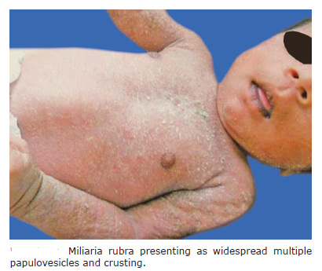
2. Miliaria rubra (prickly heat)-also called “heat rash” or “prickly
heat” is seen more commonly in febrile newborns.
is an obstruction in the deeper level of sweat glands
Characterized by multiple, grouped to discrete,
erythematous, nonfollicular papules and papulovesicles
measuring from 1 to 4 mm in diameter
Present over the scalp, face, neck, flexures, trunk,
and at the sites of occlusion
subsides within 2–3 days, but recurrences are
common. Commonly, secondary infections can occur

Slide 11
3. Miliaria pustulosa-consists of papulovesicular lesions becoming pustular. The obstruction is lower than miliaria crystallina, but intraepidermal.
They are sterile pustules and not due to secondary infection.
4. Miliaria profunda It is rarely seen in a newborn period and occurs
in the deeper level of sweat duct obstruction, below the dermoepidermal junction It presents as firm, pale papules on trunk and extremities
D/D-neonatal acne, candidiasis, staphylococcal infections, and herpes simplex infections
Treatment -avoidance of excessive heat and humidity, wearing cotton clothes, and air conditioning. Soothing agents such as topical calamine lotion are useful. Systemic antibiotics are given if a secondary infection is present.

Slide 12
Mongolian Spot
It is the most common type of congenital dermal melanocytosis noted in 90% of Asians.
There is an arrest of melanocytes in the deep dermis as they fail to migrate from neural crest to dermoepidermal junction during embryogenesis.
seen as grayish-blue macules of variable sizes present more commonly on the lumbosacral region and less on buttocks, shoulders, and flanks
The bluish tinge is mainly due to Tyndall effect.
fade within 2–3 years of life (14% at preschool age and none by 6 years of age).
Histopathology shows bundles of spindle-shaped melanocytes containing fine melanin granules dispersed within collagen fibers

Slide 13
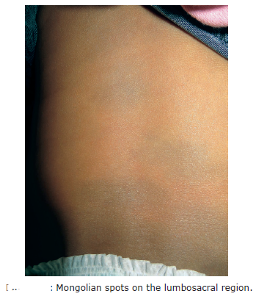
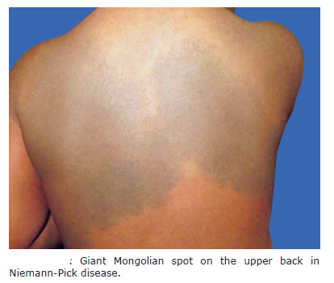
Mongolian spots present on atypical sites tends to persist and do not disappear. Persistent and giant Mongolian spots are seen in inborn errors of metabolism such as Hurler’s disease, Niemann-Pick disease, Hunter’s disease, and type 1 gangliosidosis

Slide 14
Harlequin Color Change
Harlequin color change is a rare physiological phenomenon seen more commonly in preterm, low birth weight, sick infants, and with a severe intracranial injury.
can affect 10% full-term neonates.
This color change occurs when the child is lying on one side; the dependent side becomes strikingly red with contralateral blanching on the upper half of the body with a sharp line of demarcation. The mucosa and genitalia are spared.
episodes may persist for few seconds to minutes (30 seconds–20 minutes).
The color change is rapidly reversible with a change in position, crying, and increased muscular activity.
onset of this phenomenon is seen at 2–5 days of age and may last up to 3 weeks
Repeated can be present in 50% of the affected neonates.
probably related to immaturity of the hypothalamic centers and autonomic control of vascular tone leading to capillary bed dysregulation

Slide 15
Cutis Marmorata
Cutis marmorata is a benign, cutaneous vascular phenomenon seen in both full-term and preterm neonates
Clinically, it presents as reticulate, mottled bluish discoloration of the skin lasting for few minutes to few hours.
presents on the trunk and extremities
vascular pattern disappears when the baby is rewarmed
Persistent cutis marmorata has been associated with trisomy 18, Down syndrome, congenital hypothyroidism, and Cornelia de Lange syndrome
Physiological cutis marmorata at birth is differentiated from a persistent vascular phenomenon called cutis marmorata telangiectatica congenita (CMTC)
CMTC. It presents as dark red to purple, reticulated pattern with telangiectasia. Atrophy, ulceration, and hyperkeratotic lesions can be present in the involved area

Slide 16
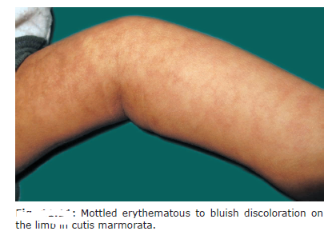
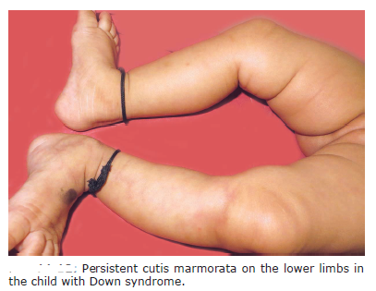

Slide 17
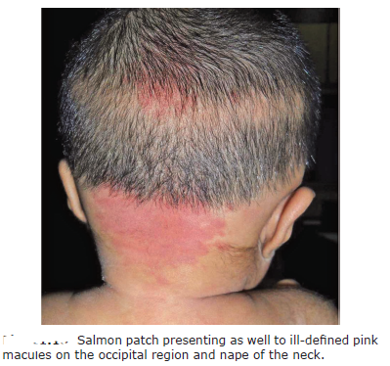
Salmon Patch
(Syn. Nevus Flammeus Simplex)
also called “stork marks” or “Angel kiss” according to the location on the nape of the neck or forehead
They are ectatic dermal capillaries.
They present as pale pink in color that are blanchable and become prominent on vigorous activity, crying, straining with defecation,
breathholding, or changes in ambient temperature.
They commonly involve the eyelids, glabella, or
nape of the neck
resolve by the first year of life or rarely in
early childhood

Slide 18
Cradle Cap
part of the infantile seborrheic dermatitis, is a common, self-limiting, chronic inflammatory scaling condition of the scalp
Presents between the third week to the first 3 months of life.
Etiology-there could be secondary influence by maternal circulating hormones, resulting in over activity of the sebaceous glands
Malassezia yeast has been implicated as the cause of cradle cap.
It breaks down the sebum-consuming saturated fatty acids, leaving behind unsaturated fatty acids.
Clinical Features-Cradle cap presents as asymptomatic, erythematous, greasy, scaly, noninflammatory plaques on the scalp mainly affecting the vertex and frontal region,forehead, eyebrows, and ears.

Slide 19
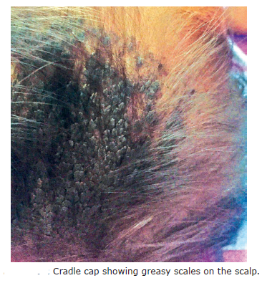
Clinical Features-presents as asymptomatic, erythematous, greasy,
scaly, noninflammatory plaques on the scalp mainly affecting the
vertex and frontal region,forehead, eyebrows, and ears

Slide 20
Extensive cradle cap or persistence beyond 3–4 months is suggestive of atopic dermatitis
Treatment-Cradle cap is usually a self-limiting condition. An oil or emollient should be applied on scalp and left for few hours to soften the scales and later gentle shampooing should be considered.
cradle cap is not improved with conservative treatment, 2% ketoconazole or 1%
hydrocortisone cream can be used
Applications containing salicylic acid should not be used due to the risk of percutaneous absorption
Counseling parents about the chronicity and self-limiting nature is important.

Slide 21
Erythema Toxicum Neonatorum
(Syn. Toxic Erythema of Newborn
also called toxic erythema of newborn, is a benign, idiopathic self-limiting transient eruption
Less commonly seen in preterm and low-birth-weight babies.
It is a misnomer as there is no toxic component.
Etiology-
The etiology of ETN is exactly not known. Studies have shown that predisposing factors such as seasonality, health of the child at birth, gestational age, and birth weight can influence the onset of ETN
Immunohistochemical studies in the lesional skin have shown many inflammatory mediators such as interleukin (IL)-1α, IL-1β, aquaporins 1 and 3, IL-8, psoriasin, nitric oxide synthetases 1, 2, and 3, and high mobility group box 1 protein (HMGB-1), suggesting immune system maturity in the pathogenesis of ETN

Slide 22
Pathology-There are subcorneal or intraepidermal pustules with eosinophils in the intrafollicular region
Macular lesions show edema of the upper dermis with a perivascular infiltrate of eosinophils.
Clinical Features-ETN can occur within the first 3–4 days of life but can be delayed up to three weeks of life.
ETN presents as two types of variants: erythematous papular (70%) or pustular variant (30%).
clinically present as firm, erythematous papules or papules surmounted by a white or pale yellow pustule.
described as “flea-bitten appearance” or papules surrounded by sea of erythema.
ETN starts as blotchy macular erythema on the first day and later develops into papules and pustules measuring 1–3 mm in size
ETN starts on the cheeks and spreads rapidly involving the forehead, face, chest, trunk, and extremities.
no systemic involvement in ETN.

Slide 23
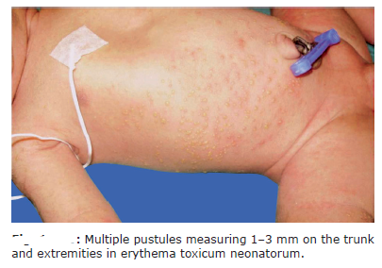
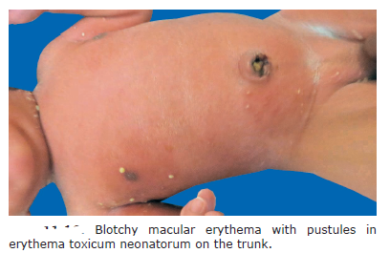
Diagnosis- mainly clinical. Peripheral eosinophilia is seen in 20% of cases.
Stained smears with Wright’s/Giemsa stain show eosinophils.
Cultures are sterile with no organisms.
Treatment- No treatment is required for ETN as it resolves spontaneously by 10–14 days.

Slide 24
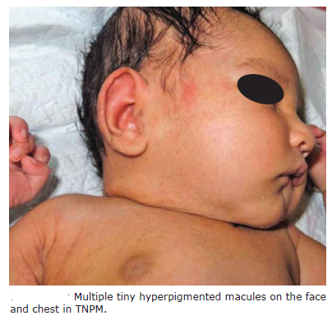
Transient Neonatal Pustular Melanosis
It is a transient, benign, self-limiting, neonatal disorder characterized by superficial pustules at birth and resolves with hyperpigmented macules
Clinical Features-Lesions are present at birth as superficial, sterile pustules, without inflammatory components.
pustules are extremely fragile, remain for
24–48 hours,and rupture to form a collarette
of fine scales surrounding a hyperpigmented macule
Diagnosis-is mainly clinical
Giemsa/ Wright’s stain of the smear shows
neutrophils.
Treatment- self-limiting and required no treatment

Slide 25
Infantile Acropustulosis
Definition-Infantile acropustulosis, also called acropustulosis of infancy,
is an idiopathic pustular disorder
characterized by recurrent crops of pruritic vesiculopustular lesions predominantly on the palms and soles.
Etiology-is exactly not known.
possible association with preceding scabies infestation has been implicated
Recently, the
cause has been attributed to the deficiency of IL-1, IL-6, and IL-8 receptor antagonists resulting in systemic inflammation.

Slide 26
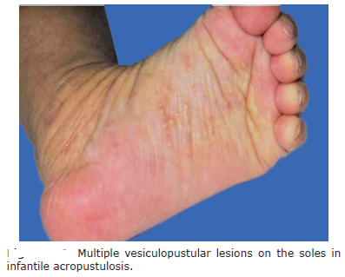
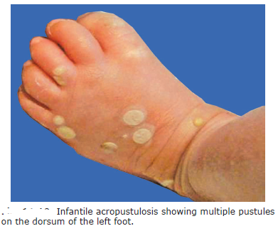
Clinical Features-Lesions start from birth to 2 years. It
presents as recurrent, pruritic,
crops of vesiculopustular
lesions measuring 1–4 mm on the palms,
soles, and sides of feet
Lesions start as pinpoint erythematous papules
evolve into pustules, and last for 1–2 weeks.
The complete resolution takes 2–3 years.
D/D-scabies, dyshidrotic eczema, ETN, TNPM,
pustular psoriasis, impetigo, and
subcorneal pustular melanosis

Slide 27
Investigations-Histopathology shows subcorneal or intraepidermal aggregation of neutrophils with a sparse lymphohistiocytic infiltrate in papillary dermis.
Treatment-Moderate-to-high topical corticosteroids are useful
Systemic antihistamines relieve pruritus.
Dapsone (2 mg/kg body weight in two divided doses) is the treatment Of choice in severe infantile acropustulosis
use of topical maxacalcitol, which not only improves the symptoms but also reduces the relapses between the intervals

Slide 28
Eosinophilic Pustular Folliculitis of Infancy
Introduction-characterized by the presence of recurrent, itchy, sterile pustules
Etiology- is not known
Histopathology shows eosinophilic spongiosis with an occasional subcorneal pustule and dense dermal infiltrate of eosinophils, lymphocytes, and histiocytes and involves follicular, perifollicular, and periadnexal region.
Clinical Features-presents with crops of papules and pustules on the scalp, measuring 1–3 mm in size and generally crust within 2–3 days of onset.
Lesions are distributed on the face, trunk,and extremities
D/D-ETN, scalp folliculitis, acropustulosis of infancy, TNPM, candidiasis, bacterial and fungal folliculitis, and Langerhans cell histiocytosis.
Treatment- disappears spontaneously without treatment.

Slide 29
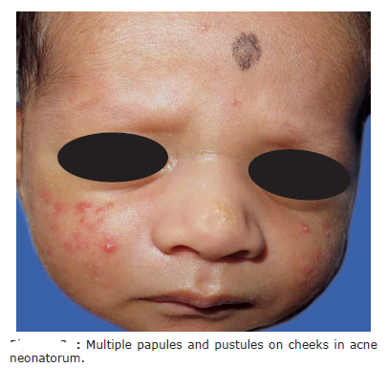
Acne Neonatorum
Pathogenesis -The exact pathogenesis of neonatal acne is not clear. It is attributed to increased production of dehydroepiandrosterone by fetal adrenal glands or due to transplacental stimulation of sebaceous glands by androgens and production by neonatal testicles.
also an increased level of luteinizing hormone and
testosterone from birth to 6–12 months.
Clinical Features-presents as
mild erythematous papules, pustules,
and occasionally with comedones.
seen on the face, cheeks, forehead, chest and back

Slide 30
D/D-infections (bacterial, candidal, or viral), ETN, milia, miliaria, sebaceous gland hyperplasia, and eosinophilic folliculitis
Treatment- neonatal acne benign, transient and self-limiting. It resolves within 4 weeks to 3 months but may persist up to 1 year.
therapies like 2.5% benzoyl peroxide can be tried

Slide 31
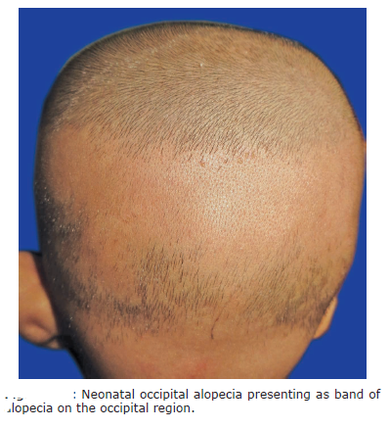
Neonatal Occipital Alopecia
is a physiological phenomenon seen in newborns as nonscarring, patchy hair loss on the occipital region.
seen at 2–3 months of age.
clinically presents with a band-like alopecia or
oval alopecic patch on the occipital region.
Lower margin of the scalp has a band of hair extending
to the nape of the neck and the upper margin hair
is merged with the vertex

Slide 32
Thank you

