Slide 1
Skin at Different Ages
By- Dr Yogesh Marfatia
Professor
SBKS MI & RC

Slide 2
INTRODUCTION
Skin serves as a barrier for our body against the external environment right from the earliest stages of human life
Our skin is also responsible for thermoregulation, hormone synthesis, and sensory perception
Skin is one of the first organs in the body to show signs of visible aging.

Slide 3
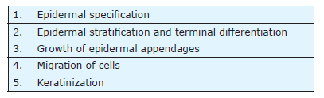
SKIN IN EMBRYO
Epidermal development in embryo is a multistep process, including

Slide 4
Primitive ectoderm is established by the first week of gestation.
Ectoderm gives rise to both skin epithelium and nervous system.
Wnt signaling, bone morphogenetic protein expression, and
restricted ectodermic response to fibroblast growth factors
inhibit neural induction
At around 5 weeks, skin consists of epidermis, dermoepidermal junction (DEJ), dermis, and subcutaneous connective tissue.

Slide 5
Epidermal Specification- Keratin K5/K14 induction in multipotent cells marks the beginning of epidermal commitment of the cells.
Epidermal Stratification and Terminal Differentiation- Multipotent epidermal layer becomes embryonic basal layer, which give rise to all structures of the future epidermis.
layer of closely adhered cells forms over the ectoderm at 4–8 WEEKS, called periderm possibly protects the developing epidermis

Slide 6
By the end of 8 weeks, basal layer forms an “intermediate layer”
which proliferates into spinous cells.
These layers express keratin K1 under notch signaling.
“Notch signaling” induces spinous cells to differentiate and
migrate towards the surface to form granular layer and cornified
layer
In the postnatal epidermis,spinous cells develop from basal cells
instead of the intermediate cells (as in fetal epidermis).
Notch signaling in the postnatal epidermis it inhibits basal cell
proliferation and initiates terminal differentiation.

Slide 7
Growth of epidermal appendages - During development, basal layer cells form buds, which invaginate into dermis to form appendages.
Hair follicle development is a multistep process, including hair placode formation, follicle organogenesis, and cytodifferentiation

Slide 8
Migrant Cells - Neural crest-derived cells migrate into fetal epidermis by 12 weeks and form “melanocytes”. present in high density (∼1000 cells/mm2) with a regular pattern of distribution
At 6 week , antigen-presenting cells of the immune system appear in fetal skin and demonstrate functional activity as “Langerhans cells” by 12–14 weeks
At 7 weeks, the density of Langerhans cells is nearly 50 cells/mm2
By 8 week, it has a density of 130 cells/mm2
They are derived from either within the epidermis or by migration of neural crest cells, which complete by 18 weeks of gestation.
Keratin markers for Merkel cells are K8, K18, K10, and K20.
only keratin found exclusively in Merkel cells is K20

Slide 9


Slide 10
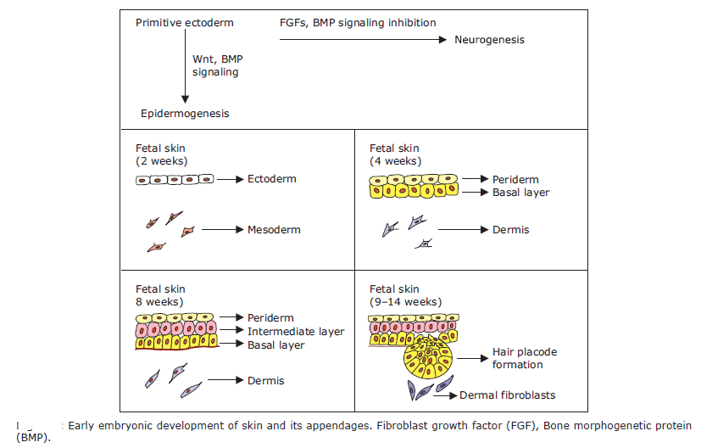

Slide 11
Skin in Neonate and Infants
Definations
Infant: from birth to 1 year of age
Neonatal period : first month of life
Premature baby: born before 37th week of gestation
Structure of the skin in a neonate is almost complete with a fully
developed epidermis, skin appendages, and DEJ
Infant skin has higher keratinocyte turnover rates and thinner epidermal
layers as compared to adult

Slide 12
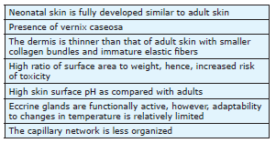
Important features of neonatal skin

Slide 13
Characteristics of Neonatal Skin
Thickness of Infant skin is about 40-60% of adult skin thickness.
Skin Surface pH
Acid mantle of stratum corneum decided by -
Secretion of sebum (fatty acids),
sweat (lactic acid),
urocanic acid
pyrrolidone carboxylic acid from keratinization

Slide 14
2. Acid mantle of stratum granulosum decided by-
Amino acids
Membrane-based proton pump exocytosis from lamellar bodies (odland bodies)
mean surface pH of neonatal skin varies from 6.2 to 7.5 (higher as compared to adults)
This predisposes neonates to inflammatory dermatoses
e.g. diaper dermatitis
Higher pH enhances the action of serine proteases, results in blockage of lamellar body secretion and activation of T-cell mediated inflammatory process
High pH also enhances the colonization with Staphylococcus aureus and Candida albicans.

Slide 15
Skin pH in the neonate also varies according to the anatomical site:
lowest pH on the forehead and highest pH on the inner aspect of the forearm.
Post first week, pH on the forehead becomes further acidic while pH on abdomen, forearm, and upper leg reaches that of adults
Intertriginous areas such as diaper area continue to have a slightly higher pH.
Hydration, Transepidermal Water Loss, and Percutaneous Absorption of Skin
Stratum corneum in an infant is better hydrated but has a higher rate of TEWL at rest than adult stratum corneum
Stratum corneum in infant skin absorbs more water and looses excess water faster than adult skin.
Long-term over usage of moisturizers in normal skin increases skin susceptibility to irritants.

Slide 16
Sebum Secretion -In the first week of neonatal period, sebum secretion gradually increases and finally matches the excretion rate in adults.
After few weeks, as the effect of transplacental maternal hormones on the sebaceous glands wears off, sebum secretion decreases.
Sweating - sweat glands are immature in neonates, emotional sweating is present.
Heat loss by sweat evaporation makes heat loss easier in infants and young children (<3 years) due to the high surface to weight ratio

Slide 17
Thermoregulatory Mechanisms - functionally active in neonates and children but can get easily exhausted.
hypothermia and hyperthermia can easily develop due to rapid decrease/increase in ambient temperatures as response to a change in temperature
On exposure to cold in infants, heat production occurs from brown fat.

Slide 18
Cutaneous Vasculature -In the neonate, blood vessels in the skin form a horizontal dense plexus with an unorganized capillary network and the absence of capillary loops in all regions except nail beds, palms, and soles.
Capillary loops start becoming evident at the second week and are well formed at 14–17 weeks
Microbiota -In infants, the normal flora is not well established.
The umbilicus and nose are often colonized by Staphylococcus aureus or Streptococcus pyogenes.
Nails -In full-term neonates, fingernails are oval or flat ,
toenails are triangular or round
absence of lunula and hypertrophy of nail folds is common

Slide 19
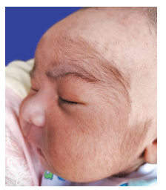
Hairs -Fine, soft, unpigmented hairs present in fetuses and newborns are
called lanugo hair.
Lanugo hair plays an important role in binding the vernix caseosa to the skin of
fetuses.
shed at about 33–36 weeks of gestation and replaced by vellus or terminal hairs.

Slide 20
Skin in Preterm Infants
Skin in preterm infants is thin, translucent with prominently visible
cutaneous vasculature.
The weight of a preterm infant skin is nearly 13% of the body weight, compared
with 3% for an adult.
Characteristics of Preterm Infant Skin
Thickness of Skin- Preterm infants have a thinner epidermis and a thinner
stratum corneum than full-term infants
Surface Skin pH-
Skin surface pH in preterm infants is mostly similar to the acid mantle of
full-term neonates.

Slide 21
Barrier Function of the Skin- especially in low-birth weight babies, the skin barrier is not well developed, it takes around 2–4 weeks for maturation.
Hydration- Infants born at less than 30 weeks of gestational age have statistically
significant greater hydration, than infants born after 30 weeks of gestational age
Transepidermal Water Loss in a newborn of 25 weeks of gestational age is 15
times greater than that of a term infant
Due to the immature barrier function and thinner epidermal layers, relatively
increased blood flow to skin, and a high surface area to volume ratio
Due to this increased water loss through the skin, low birth weight infants
sometimes succumb to hypernatremic dehydration without noticeable water
losses
in preterm infants such as emollient application, skin-to-skin contact/kangaroo
mother care, and plastic heat shields to minimize TEWL

Slide 22
Percutaneous Absorption -Preterm infants (less than 34 weeks) have more percutaneous permeability than full-term infants advantage of such permeability include attainable therapeutic systemic concentrations of drugs such as theophylline and caffeine for neonates with transdermal therapy.
Easy cutaneous absorption can be hazardous as toxicity has been reported with topical agents such as aniline dyes, hexachlorophene, isopropanol, iodine and boric acid
Thermoregulatory Function -in preterm babies, thermal and emotional sweating are absent/very weak.
Two weeks after birth, preterm babies develop thermal sweating but emotional sweating develops at 36 weeks of gestational age.
Microbiota- Staphylococcus, Streptococcus, Enterococcus, and enteric gram-negative bacteria including Escherichia and Enterobacter dominate the skin microbiota in pre term infants

Slide 23
Skin in Adolescent/Skin at Puberty
Characteristics of Skin at Puberty
There is a gradual increase in thickness of dermis more in males than in females.
At puberty, females start developing a thick layer of subcutaneous fat, while males do not
The adult epidermis is on an average 50 to 100 μm thick and the adult stratum corneum is 10 to 20 μm thick
Surface pH of Skin - similar to that of adults: between 4 and 5.9.
Sebum Production-Sebaceous glands begin to develop at an age of
7–8 years due to adrenarche.

Slide 24
Sebum production is slightly more in males.
Sebum production correlates with testosterone levels in both sexes, and with dehydroepiandrosterone in males and etiocholanolone in females
Most effective androgens are 17β-hydroxy group
(i.e. testosterone, 5α-dihydrotestosterone, and
5αandrostane-3β-17β-diol)
Dehydroepiandrosterone sulfate levels rise earlier in females than males
The maximum level is present at about 24 years of age in women and at about 30 years of age in men

Slide 25
Hairs- At puberty, androgens cause vellus hair to transform into terminal hair, giving rise to secondary hair growth in armpits and pubic regions; and in beard, moustache, abdomen, and chest regions in men.
Genital Region- Hormonal influence causes the genital skin to be highly darkened.
The skin of the anogenital region is rich in eccrine and apocrine glands. The skin of the perineal area has a higher surface pH than other areas.
Pearly penile papules may be seen around the corona and rarely on the glans.The equivalent condition in females is vestibular papillomatosis.

Slide 26
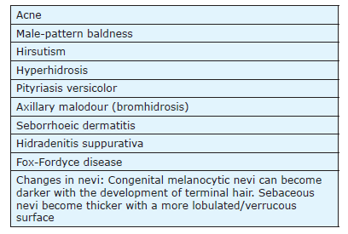
Hormonal changes at puberty can mark the start of several cutaneous and hair-related conditions

Slide 27
Skin in Elderly
Aging is a continuous process in every organ system, skin conveys this process to the external world by its appearance
The aging process is driven by both genetic/intrinsic and environmental/extrinsic factors.
Aging of the skin is of two types: intrinsic aging and extrinsic aging, both of which run together

Slide 28
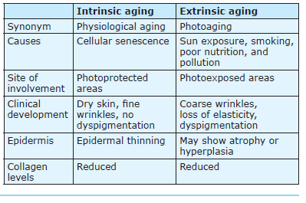
Intrinsic aging versus extrinsic aging

Slide 29
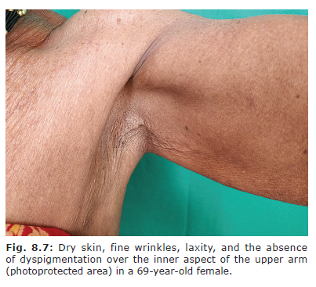
Intrinsic Aging

Slide 30
Epidermal and dermal changes in intrinsic aging
Reduced proliferative capacity of keratinocytes, fibroblasts, and
melanocytes results in a thinned-out epidermis
Degeneration of fibrous extracellular matrix components: elastin,
fibrillin, collagen, and oligosaccharides.
Reduced number of mast cells and fibroblasts.
Downregulation of transforming growth factor β (TGF-β)/Smad signaling
process results in reduced collagen expression
Results in reduced capacity of the dermis to hold water, resulting in loss
of suppleness of the skin.
Reduced collagen results in wrinkling.

Slide 31
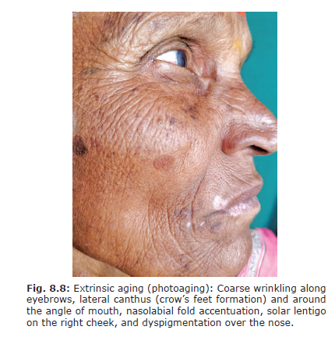
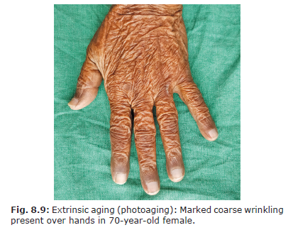
Extrinsic Aging
Typical changes of extrinsic aging are seen on the face, V area of the neck, and dorsum of hands

Slide 32
Extrinsic aging has two clinical variants: atrophic and hypertrophic variants
Atrophic variant is commonly seen in skin types I and II
characterized by extensive fine wrinkling, atrophy, telangiectasia, focal dyspigmentation, and skin malignancies. Also known as “proliferative exhaustion”
Hypertrophic variant is commonly seen in skin types III/IV
characterized by coarse wrinkling, uniform tanning, and relatively lesser risk of skin malignancies. Also know as “protective hyperplasia”
single patient will have a combination of features of intrinsic aging and both variants of extrinsic aging.

Slide 33
Epidermal and dermal changes in extrinsic aging
against intrinsic aging, there is thickening of the epidermis in sun-exposed skin.
Desmosomes do not disintegrate leading to retention of corneocytes and
thickening of stratum corneum
Indicated by the decreased expression of β1-integrin (epidermal stem cell marker) Decreased type VII collagen (anchoring fibrils) leads to an impaired dermal-epidermal connection,thus contributing to the formation of wrinkles
increased expression of differentiation marker involucrin in the stratum corneum
MMPs, serine proteases, and elastases degrade the collagen and elastin in the dermis.

Slide 34
Pathogenesis/Molecular Mechanisms of Skin
Aging
Oxidative stress (ROS)
On exposure to UV radiation, ROS inhibit the receptor protein tyrosine phosphatases and activate the downstream signaling pathways, mitogen-activated protein kinase, nuclear factor-κB (NF-κB), and transcription factor activator protein-1 (AP-1)
NF-κB and AP-1 upregulate MMP gene transcription
AP-1 downregulate the expression of TGF-β type II receptor, resulting in reduced collagen production

Slide 35
UV exposure causes DNA damage and mutations resulting in skin aging and carcinogenesis
Telomere Shortening-
repetitive nucleotide sequences, telomeres, protect the tips of the chromosomes from degradation.
shorten after each cell division resulting in ultimate cellular death/cellular senescence.
iii. ROS cause telomere mutations and finally cell death
MicroRNA Dysregulation-
Dysregulation in miRNAs results in cellular senescence.
The increase in miR-23a-3p expression causes reduction in the hyaluronic synthase mediated production of hyaluronic acid.
miR-126 in endothelial cells is downregulated, consistent with the findings of a decrease in number and function of skin capillaries.

Slide 36
Concept of Epigenetics and Aging
Epigenetic processes control the expression of genes and thus have a complex connection with cellular differentiation and tissue specification.
Epigenetic mechanisms include DNA methylation and covalent histone modifications.
The epigenetic hallmarks of senescence and aging are as follows:
i) Covalent histone modification/loss by methylation/acetylation
ii) Altered DNA methylation
iii) Breakdown of nuclear lamina
iv) Chromatin remodeling

Slide 37
Characteristics of Elderly Skin
Thickness of Skin-Keratinocytes become shorter and fatter while corneocytes become bigger as a result of decreased turnover of epidermis in aged skin
Dermal thickness decreases with age.
Elastin has a higher degree of calcification and collagen bundles are disorganized
Surface pH, Barrier Function, and Hydration- elevated pH of skin surface in elderly is attributable to a decrease in epidermal expression of Na/H+ exchange 1 (NHE1)
Increased skin pH activates serine proteases, which leads to premature breakdown of corneodesmosomes and thus impaired integrity of stratum corneum

Slide 38
increased pH of the skin affects the processing of lipids forming the skin barrier
In aged skin, there is reduction in ceramides and aquaporin expression.
Ceramides are important for the skin barrier function, while aquaporin 3 controls the movement of water and glycerol to maintain skin hydration
Reduction in natural moisturizers is responsible for reduced hydration of the skin in elderly. Hydration plays an important role in regulating epidermal proliferation, differentiation, or inflammation
Thus, moisturizers are required in this age.
The skin barrier function is impaired leading to dry skin called asteatotic eczema.

Slide 39
Sebum Production- sebum production is reduced, sebaceous glands are enlarged in size due to impaired turnover of cells.
Sweat Production- number of eccrine sweat glands and their functional ability decrease in elderly skin
This is microscopically evident as disarray and shrinkage of secretory cells and the lumen.

Slide 40
Thermoregulatory Function in Elderly- fluctuations in temperature are more pronounced than in younger individuals as short-term adaptation to temperature change is reduced due to decline in thermosensory function in old age
causes for these are age-related sensory neuropathy, impaired nerve
regeneration,nerve conduction velocity, decrease in thermoreceptors,
and superficial skin blood flow.
Due to a decline in the number of sweat glands and sweat production, the response to dry heat is reduced in elderly, which makes them prone for heat stress and heat intolerance
Elderly can develop hypothermia too as skin vasoconstriction and norepinephrine production are impaired.

Slide 41
Skin Microbiota - Streptococci are more prominent in elderly skin
Cutaneous Vasculature- There is curtailed angiogenesis, abnormal expression of adhesion molecules, and abnormality in vasodilatation.
Hair Follicles- Follicles decrease in size, shaft diameter reduces, and pigment is gradually reduced.
Aging of the follicular unit, resulting from decreased and inactive melanocytes, causes the appearance of gray hair.

Slide 42
Nail Changes -the toenails especially depict the chronic cumulative effects of mechanical trauma, diminished tissue repair, and circulatory impairment.
Chemical Content of the Nail- in elderly have low lipid content (0.1–5%) and low water content in addition to low concentrations of calcium and iron but high levels of magnesium. This leads to easy damage and splitting of nails.

Slide 43
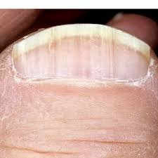
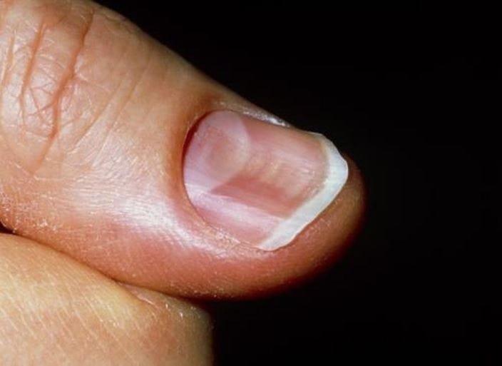
Clinical Appearance of nails
The normal double curvature (longitudinal and transverse) is not maintained
Platonychia and koilonychia are seen.
toenails are thickened (onychauxis) and distorted in shape with increased susceptibility to fungal infections.
Nails also lose their lustre and appear dull, opaque, or can have yellowish discoloration

Slide 44
Physiological Cutaneous Changes in Old Age
Idiopathic guttate hypomelanosis- Hypo to depigmented macules with fine scalloped borders predominantly on extensor aspects of both upper and lower limbs.
Senile Purpura: Ecchymotic patches of various sizes can be seen almost exclusively on photoexposed areas. Classic manifestation of combined extrinsic and intrinsic aging.
Solar lentigo: (Synonym: Senile freckle, Old age spot) These present as brown colored macules with irregular edges and are a result of excessive sun exposure

Slide 45
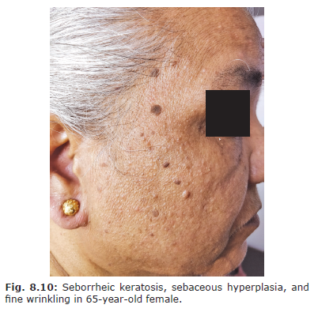
Sebaceous hyperplasia: is benign hypertrophy of the sebaceous glands characterized by yellowish papules (with occasional umbilication) on the forehead, cheeks
Seborrheic keratosis: It is a benign tumor of keratinocytes occurring most commonly in elderly. They are pigmented, acanthotic sometimes with a cerebriform surface with plugged follicular orifices

Slide 46
Dermatoporosis: Chronic impairment of skin integrity in old age due to aging and chronic UV exposure.
Stage I: Senile purpura/ecchymoses, marked thinning of skin (atrophy), and stellate-shaped pseudoscars.
StageII: Erosions secondary to dermoepidermal cleavage.
Stage III: Extensive erosions with impairment and delay of wound healing.
Stage IV: Severe skin damage with dissecting hematomas.
Immunity and Skin in Elderly-
Aging is associated with gradual deterioration in immunity. This process is called
“immunosenescence”
Adaptive immunity deteriorates more than innate immunity

Slide 47
Factors responsible for the same are
i) Defective toll-like receptor signaling (TLR) with decreased production of proinflammatory cytokines such as tumor necrosis factor-α (TNF-α),interleukin (IL)-6, and IL-12
ii) Cutaneous dendritic cells: Impairment of migration, stimulation of T-cells, and phagocytosis.
iii) Plasmacytoid dendritic cells: Decrease in number and impaired interferon-α production.
iv) Macrophages: Reduced TLR expression, impairment of phagocytic capacity, and reduced secretion of cytokines TNF-α.
v) Langerhans cells: Decrease in number and impaired migration.
Reduced function of the cutaneous dendritic cells
impairs the antitumor immunity.

Slide 48
THANK YOU

